Slide 1
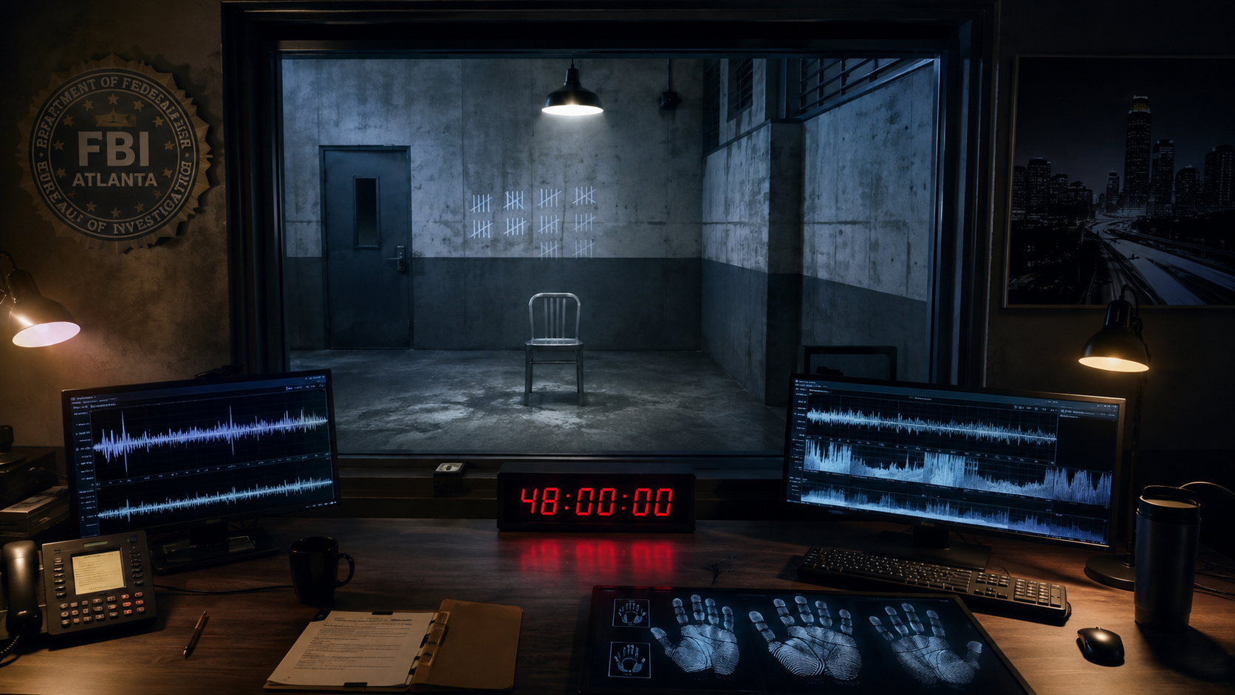
LIMITED SERIES • 8 EPISODES
THE EXTRACTION
PRESTIGE PSYCHOLOGICAL THRILLER
Forty-eight hours to save the one life she was never trained to reach.
Created by Kelly R. Tenney

Slide 2
THE PROMISE
A clean hook with a built-in clock
A legendary hostage negotiator must save her kidnapped daughter from the terminally ill bomber she imprisoned fifteen years ago, a man who has studied and defeated every technique she knows.
The negotiator cannot negotiate. She wins only when she stops performing expertise and hears what her captor cannot hide.
THE EXTRACTION
02

Slide 3
THE WORLD
The setting creates pressure, not decoration
WORLD
WHY NOW
Atlanta crisis infrastructure under pressure: FBI command rooms, surveillance networks, civic systems and a captivity mapped in eight-counts.
The systems built to protect Nina contain the leak. Her expertise is celebrated, studied and finally weaponized against her.
THE EXTRACTION
03

Slide 4
THE LEAD
NINA CADE
Precise, composed and haunted by the life she lost. The kidnapping forces her back into the fire for the one life that matters most.
The role is built for transformation, authority and a sustained close-up.
THE EXTRACTION
04

Slide 5
THE CONSTELLATION
Every ally carries a competing version of the truth
ZOE CADE
A sixteen-year-old dancer who maps her cage in eight-counts.
VICTOR STONE
Terminally ill, patient and terrified of dying unfinished.
FELIX OKONKWO
The FBI mentor who kept Nina alive with a lie.
DIANA REEVES
The warmest agent in the building and the long con at its center.
THE EXTRACTION
05

Slide 6
THE ENGINE
Pressure escalates because every answer changes the trap
01
02
03
04
05
Zoe is taken and Victor calls.
He names and defuses Nina’s methods.
The demanded confession exposes a rigged conviction.
Mother and daughter solve the same cage separately.
Nina turns Victor’s surveillance into the extraction line.
THE EXTRACTION
06

Slide 7
TONE & POSITIONING
THE SILENCE OF THE LAMBS × THE NIGHT OF × YOUR HONOR
PRESTIGE
Eight escalating hours built around a 48-hour clock, a contained two-hander engine and an Atlanta-based federal conspiracy.
WITH PULSE
Commercial propulsion is carried by morally complex characters, a specific cultural world and a visual motif that can power the campaign.
THE EXTRACTION
07

Slide 8
THE THEMATIC PROMISE
The thriller delivers a reckoning, not a lecture
01
Control versus listening
02
Expertise used as a weapon
03
Institutional rot
04
Mother and daughter as doubles
THE EXTRACTION
08

Slide 9
NETFLIX TARGET • GLOBAL AUDIENCE
THE EXTRACTION
The negotiator cannot negotiate. She wins only when she stops performing expertise and hears what her captor cannot hide.
Eight escalating hours built around a 48-hour clock, a contained two-hander engine and an Atlanta-based federal conspiracy.
Created by Kelly R. Tenney

