Slide 1
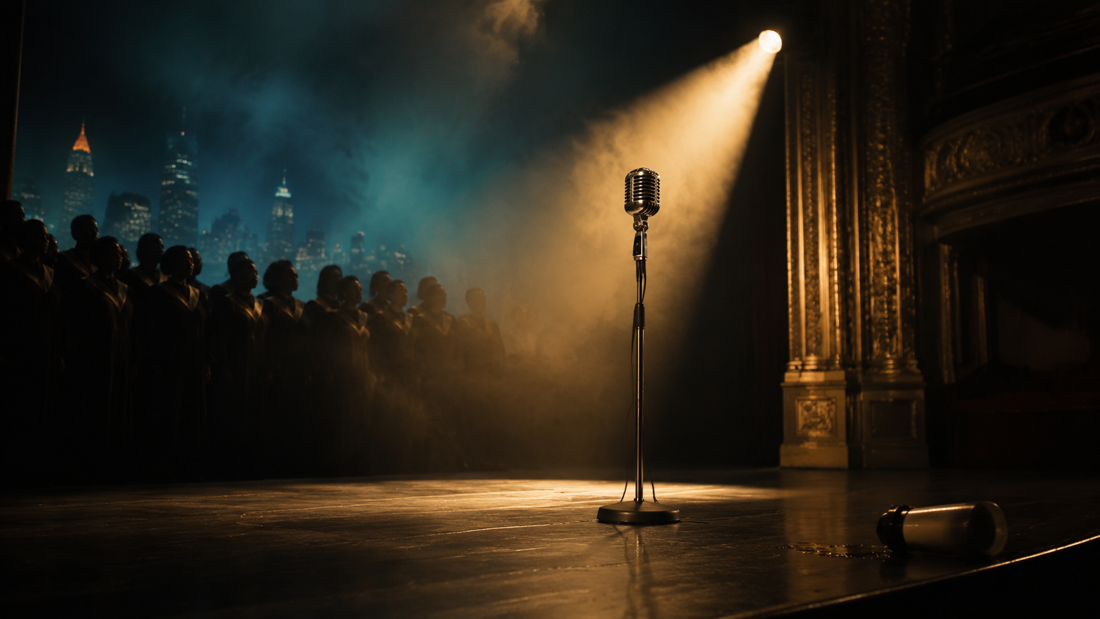
FEATURE FILM / MOVIE OF THE WEEK
THE UNDERSTUDY
GOSPEL NOIR THRILLER
God forgives. But somebody has to remember out loud.
Original by Kelly R. Tenney

Slide 2
THE PROMISE
A clean hook with a built-in clock
When gospel superstar Tamar Reese collapses mid-concert, her invisible assistant inherits the spotlight, then discovers the star was slowly poisoned and her own hands delivered every dose.
The evidence is a song. The murder weapon is a smoothie. The only safe place to confess is live television.
THE UNDERSTUDY
02

Slide 3
THE WORLD
The setting creates pressure, not decoration
WORLD
WHY NOW
Atlanta gospel royalty, backstage labor, church credibility and the business machinery that decides whose voice becomes history.
Ghost credits and ownership have moved from industry whisper to public reckoning. The thriller turns that debate into a ten-day clock.
THE UNDERSTUDY
03

Slide 4
THE LEAD
DEJA MOORE
A gifted singer and ghostwriter who has spent a decade making another woman legendary. Fame gives her visibility. Truth demands authorship.
The role is built for transformation, authority and a sustained close-up.
THE UNDERSTUDY
04

Slide 5
THE CONSTELLATION
Every ally carries a competing version of the truth
TAMAR REESE
Fallen gospel royalty, victim and thief.
MARCUS VANE
A velvet menace who converts truth into product.
DR. ELOISE GRANT
The physician willing to name the poison.
DEACON WILLIS
Buried knowledge and the film’s musical conscience.
THE UNDERSTUDY
05

Slide 6
THE ENGINE
Pressure escalates because every answer changes the trap
01
02
03
04
05
Tamar collapses at the Fox Theatre.
Deja is crowned as her replacement.
Thallium points back to Deja’s daily routine.
Marcus stays three moves ahead.
At the awards broadcast, Deja returns two stolen truths.
THE UNDERSTUDY
06

Slide 7
TONE & POSITIONING
GREENLEAF × GONE GIRL × THE CLARK SISTERS
PRESTIGE
Contained, Atlanta-forward: theater, hospital, church and one arena-scale live finale. Original music drives story and marketing.
WITH PULSE
Commercial propulsion is carried by morally complex characters, a specific cultural world and a visual motif that can power the campaign.
THE UNDERSTUDY
07

Slide 8
THE THEMATIC PROMISE
The thriller delivers a reckoning, not a lecture
01
Authorship and erasure
02
The price of the spotlight
03
Complicity and testimony
04
Faith as reckoning
THE UNDERSTUDY
08

Slide 9
LIFETIME • OWN • BET+ • NETFLIX
THE UNDERSTUDY
The evidence is a song. The murder weapon is a smoothie. The only safe place to confess is live television.
Contained, Atlanta-forward: theater, hospital, church and one arena-scale live finale. Original music drives story and marketing.
Original by Kelly R. Tenney

