Slide 1
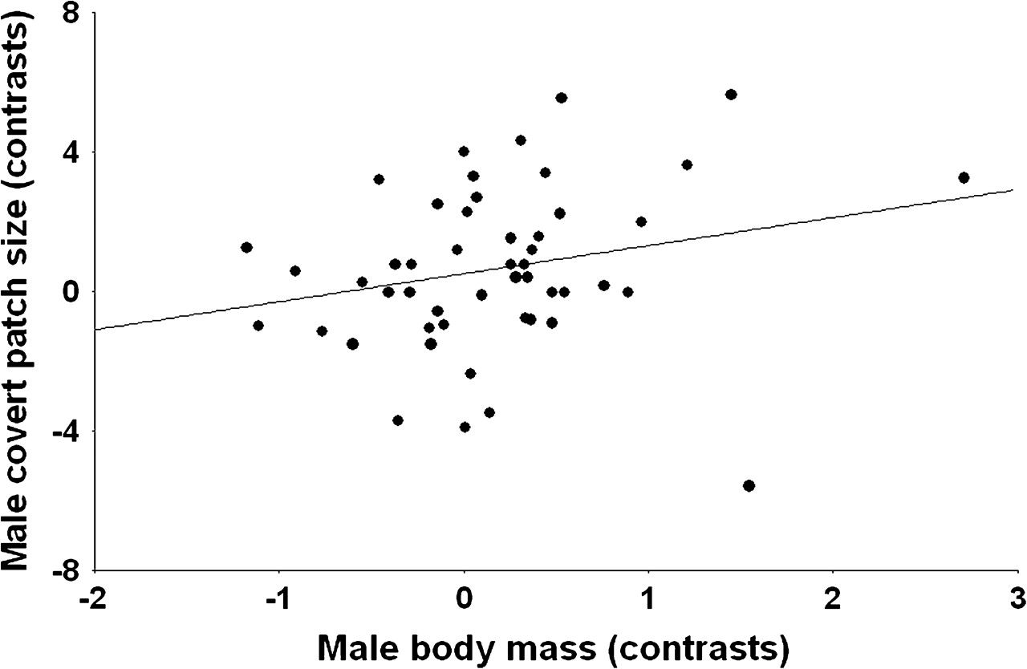

Figure 2 The size of white covert patches in male ducks in relation to their body mass: independent contrasts. Zero ...
Notes:
Figure 2 The size of white covert patches in male ducks in relation to their body mass: independent contrasts. Zero contrasts are not shown.
Unless provided in the caption above, the following copyright applies to the content of this slide: © The Author 2008. Published by Oxford University Press on behalf of the International Society for Behavioral Ecology. All rights reserved. For permissions, please e-mail: journals.permissions@oxfordjournals.org

