Slide 1
Bash (.sh)
Kelompok studi linux itb stikom bali

Slide 2
Types of linux shell
Shell translate your command and send it to the system.
Sh shell
Bash shell
Ksh shell
Csh and tcsh

Slide 3
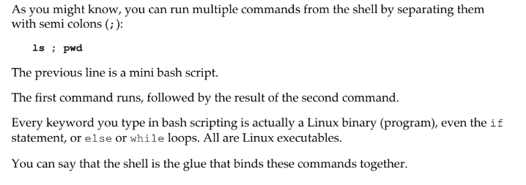
What is bash scripting?
Basic idea of bash scripting is execute multiple command to automate specific job.

Slide 4
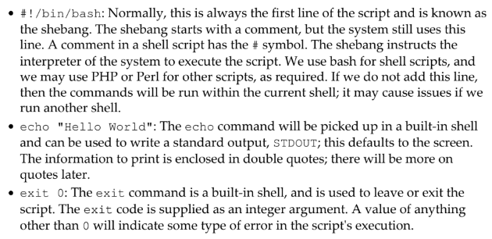




Hello world!

Slide 5
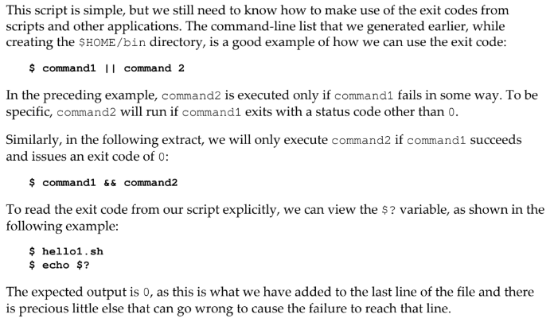
Error status handling

Slide 6
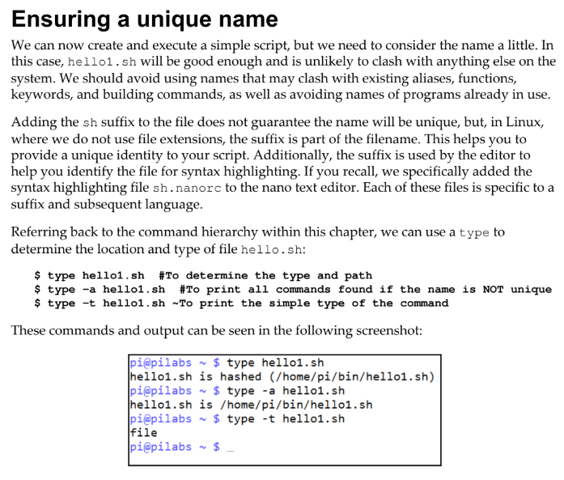
Unique Name

Slide 7
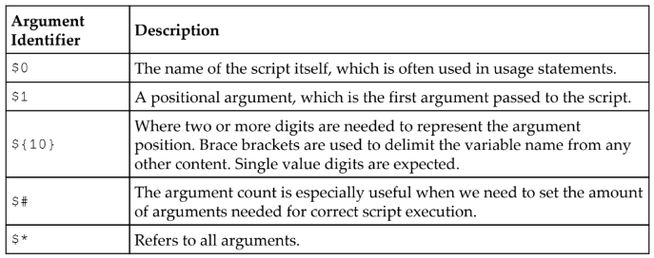
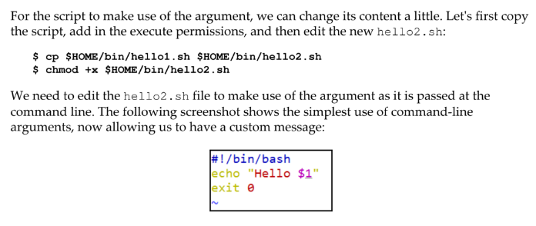
Arguments

Slide 8
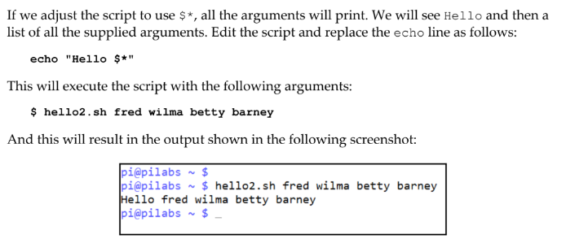

Slide 9
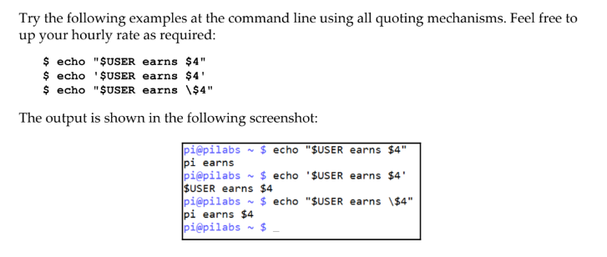
Quotes

Slide 10
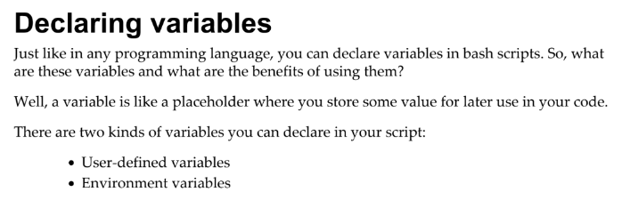
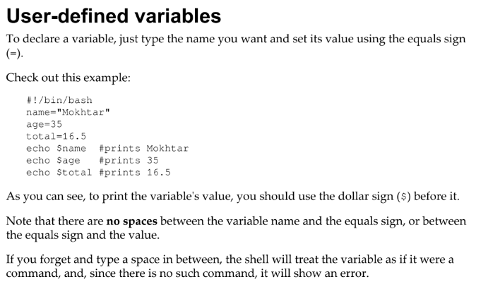
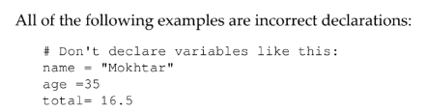
variables

Slide 11
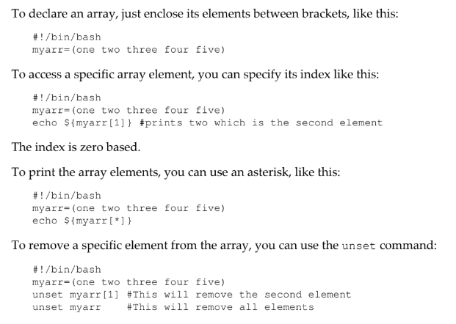

Slide 12
reference
Mokhtar Ebrahim, A. M., 2018. Mastering Linux Shell Scripting: A practical guide to Linux command-line.
2nd ed. birmingham: Packt Publisching Ltd.

