Slide 1
GROUP 5 · DATA MINING · KDD PHASES 1–5
Where the Bank Quietly
Loses Its Customers
Knowledge discovery in a 10,000-customer retail-banking book
Bank Customer Churn · France · Germany · Spain
Notes:
(0:00–0:30, Insight Communicator) Good morning. One in five customers of this bank closes their account. That number is printed in the raw data — but it is not knowledge. For fourteen weeks, our group treated this file as a discovery problem, not a prediction contest. Today we show you four things hidden under that 20% — each one invisible in a column average, and each one actionable. [ADVANCE]

Slide 2
THE BRIEF
One number sits on the surface. The knowledge is underneath.
10,000
20.4%
14
customers across France,
Germany and Spain
closed their account —
the only obvious fact
attributes per customer:
behaviour, money, geography
“What did we discover that was not already obvious from the raw data?” The assignment is graded on discovery and interpretation — not model accuracy.
02
Notes:
(0:30–1:15, Insight Communicator) The dataset: ten thousand customers, three markets, fourteen attributes each — balances, products, activity, demographics — and a label saying who left. The brief was explicit: this is knowledge discovery, not a churn-prediction benchmark. So our question for every result was not "how accurate," but "is this something the bank did not already know, and can someone act on it Monday morning?"

Slide 3
METHOD
One connected KDD pipeline, five phases
1
2
3
4
5
Prepare
Segment
Mine rules
Audit anomalies
Present
Clean, scale, translate
numbers into named
business bands
Three clustering
algorithms find natural
customer groups
Apriori finds attribute
combinations that travel
with churn
Four detectors flag and
classify every unusual
customer
Dashboard, this talk,
and a plain-language
report
Churn is never a training target — it is the lens we hold up to every pattern afterwards.
03
Notes:
(1:15–2:00, Data Engineer) Quickly, the method. We cleaned and scaled the data, and — important for everything that follows — translated continuous values into named bands a banker would recognise: "age 46 to 60", "balance 50 to 125 thousand". Then three independent clustering algorithms, association-rule mining with Apriori, and an anomaly audit using four detectors that cross-check each other. Churn was never a target to optimise — it was the lens for interpreting what the unsupervised methods found.

Slide 4
SEGMENTATION
Three customers, not one
C0 — The Engaged Loyalists
C1 — The Wealthy Watchlist
C2 — The Passive Holders
3,735 (37%)
3,161 (32%)
3,104 (31%)
15.7%
23.6%
22.8%
churn
churn
churn
£6,214 avg balance
1.88 products held · 2% German
£115,296 avg balance
1.32 products held · 38% German
£121,520 avg balance
1.33 products held · 40% German
France/Spain; little money,
deep relationship — they stay
Newest relationships (2.3 yrs);
big money, one product
Long tenure (7.5 yrs) but least
active group — money parked
04
Notes:
(2:00–3:00, Segmentation Specialist) All three clustering algorithms converged on the same three-segment story. C0, a third of the book: modest balances, nearly two products each, mostly France and Spain — our most loyal group. C1 and C2 are where the money is: hundred-thousand-pound average balances, but barely more than one product, heavily German, churning above baseline. C2 has been with the bank seven and a half years yet is the least active segment. Two-thirds of the deposits sit in the two least anchored groups. Honest caveat: these are working personas, statistically soft at the edges — we validated them across K-Means, hierarchical and DBSCAN before trusting them.

Slide 5
DISCOVERY 1
The mid-life churn cliff
77.3%
churn among inactive, single-product
customers aged 46–60 (lift 3.8×)
Age alone is not the story — over-60s are fine. It is the interaction of mid-life age, inactivity and shallow product holdings that makes leaving almost certain. No single column shows this.
05
Notes:
(3:00–4:00, Pattern Analyst) Discovery one. Customers aged 46 to 60 churn at fifty-one percent — everyone else at fourteen. And the rule mining sharpens it: when that age band is also inactive and holds a single product, churn reaches seventy-seven percent — nearly four times baseline, on a segment of four hundred customers. This is the consolidation window: people simplifying their finances before retirement, deciding which bank keeps the money. The over-60s, interestingly, are not a risk group. A dashboard average of churn-by-age would never show you this interaction.

Slide 6
DISCOVERY 2
Germany is a structural problem, not a customer problem
2×
the churn rate of France and Spain — across every segment, age band and product count we sliced
67.3%
churn among German customers aged 46–60, with no other condition attached (lift 3.3×)
46.3%
of all high-balance churners are German — half the most expensive losses from a quarter of the book
06
Notes:
(4:00–4:50, Pattern Analyst) Discovery two: Germany. Thirty-two percent churn — double the other two markets — and the effect survives every control. German mid-lifers churn at sixty-seven percent with no other condition. Nearly half of the high-balance losses are German accounts. When one market misbehaves across all segments simultaneously, the customers are not the problem — the offer is. Something about pricing, service or product fit in the German operation is pushing people out, and that is a strategic finding no per-customer model would surface.

Slide 7
DISCOVERY 3
Engagement, not balance, is what anchors a customer
The loyalists
The passive rich
£6,214
£121,520
average balance
1.88 products each
15.7% churn
average balance
1.33 products each
22.8% churn
A second product is not extra revenue — it is a retention anchor. Balance measures parked money; products measure how much of a financial life has moved in.
07
Notes:
(4:50–5:40, Segmentation Specialist) Discovery three flips the bank's instinct. Rank customers by deposits and the loyal ones come last: six thousand pounds average, but nearly two products, sixteen percent churn. The wealthy passive segment: hundred-twenty thousand pounds, one-point-three products, twenty-three percent churn. The mechanism is product depth — one-product customers churn at twenty-eight percent, two-product customers at eight. If management dashboards rank customers by balance, they are ranking by exactly the wrong loyalty signal.

Slide 8
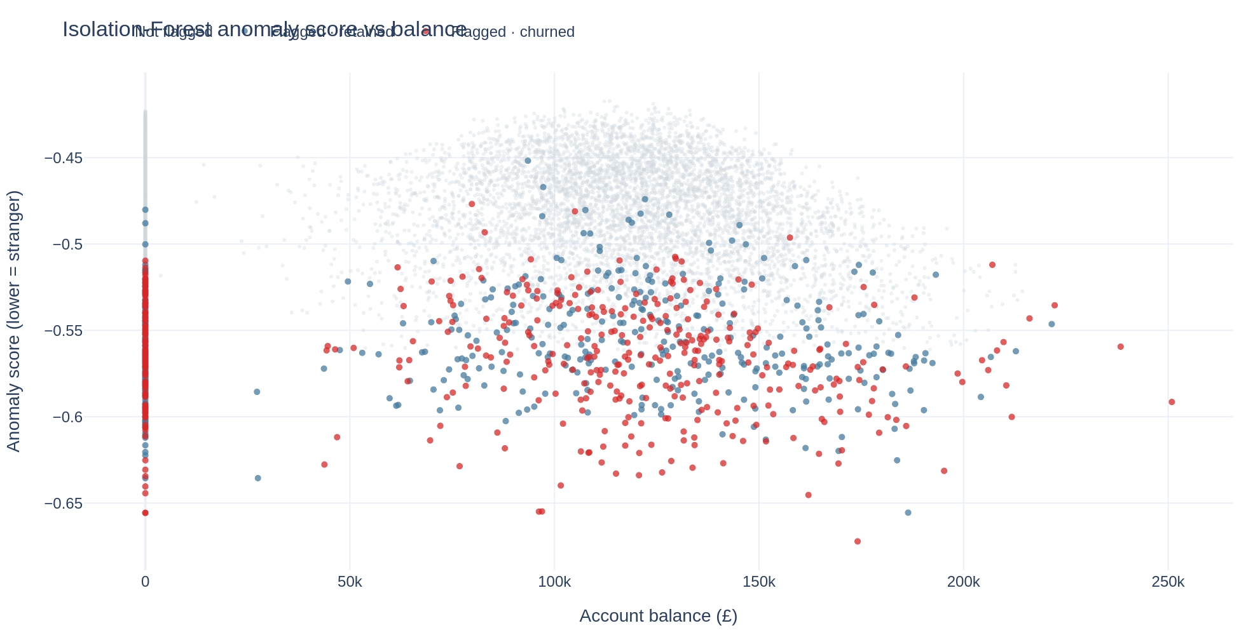
DISCOVERY 4
High-value money leaves quietly
592
high-balance churners found in the anomaly audit
£149,755
average balance walking out per account
49–52%
churn among structural outliers — 2.5× baseline, confirmed by two independent detectors
Isolation-Forest anomaly score vs balance: flagged churners (red) cluster among high balances with unusual profiles.
08
Notes:
(5:40–6:30, Data Engineer) Discovery four comes from the anomaly audit. Two detectors built on completely different logic — Isolation Forest isolates odd attribute combinations, DBSCAN finds customers far from every segment — flagged overlapping groups, and both groups churn at roughly two and a half times baseline. Strangeness in this book is churn-shaped. Inside that population: five hundred ninety-two churned accounts above the seventy-fifth balance percentile, averaging a hundred and fifty thousand pounds each. The data is a snapshot, so we cannot watch balances fall — but these closed, unusually-shaped, high-balance accounts are the footprint such departures leave. Every flagged record was classified: two data errors, five hundred eighty-three rare-but-legitimate, four hundred sixty-nine risk signals.

Slide 9
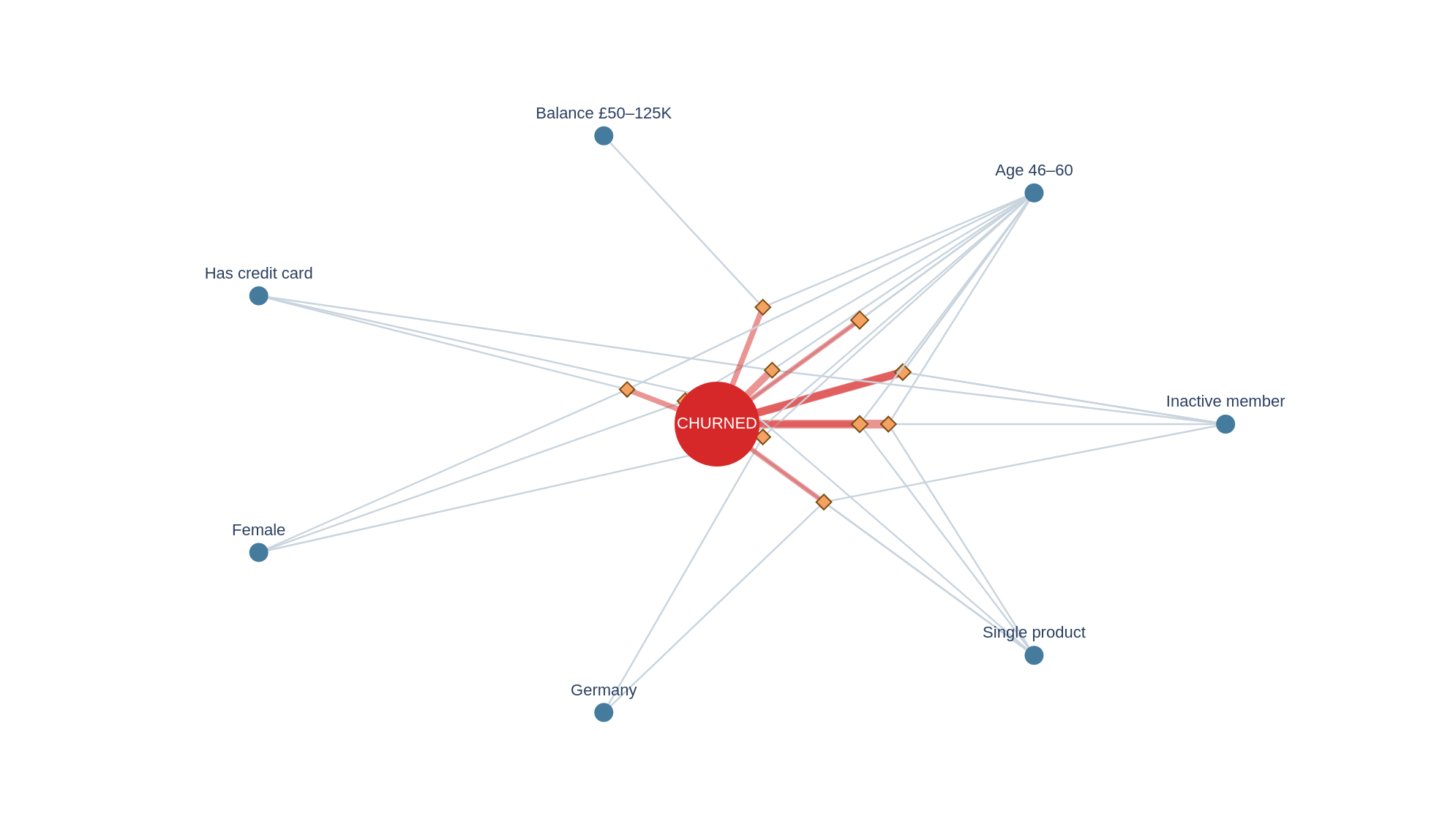
ASSOCIATION RULES
A rulebook the branch can read
The headline rules
Inactive + 46–60 + single product
77%
lift 3.8×
46–60 + Germany
67%
lift 3.3×
46–60 + single product
61%
lift 3.0×
13 rules at ≥1.5× lift — every line ends at “churned”. Diamond size = customers covered; line width = lift.
09
Notes:
(6:30–7:15, Pattern Analyst) The rule network reads left to right: customer traits on the rim, every line ending at "churned". Thirteen rules cleared our thresholds; the full ranked table with support, confidence and lift for each is in the written report. Notice what repeats: age forty-six to sixty appears in nearly every strong rule, compounding with inactivity, single products, Germany, or the mid-balance band. One surprise worth naming: holding a credit card does not protect a shallow relationship — card-holding mid-lifers with one product still churn at sixty percent.

Slide 10
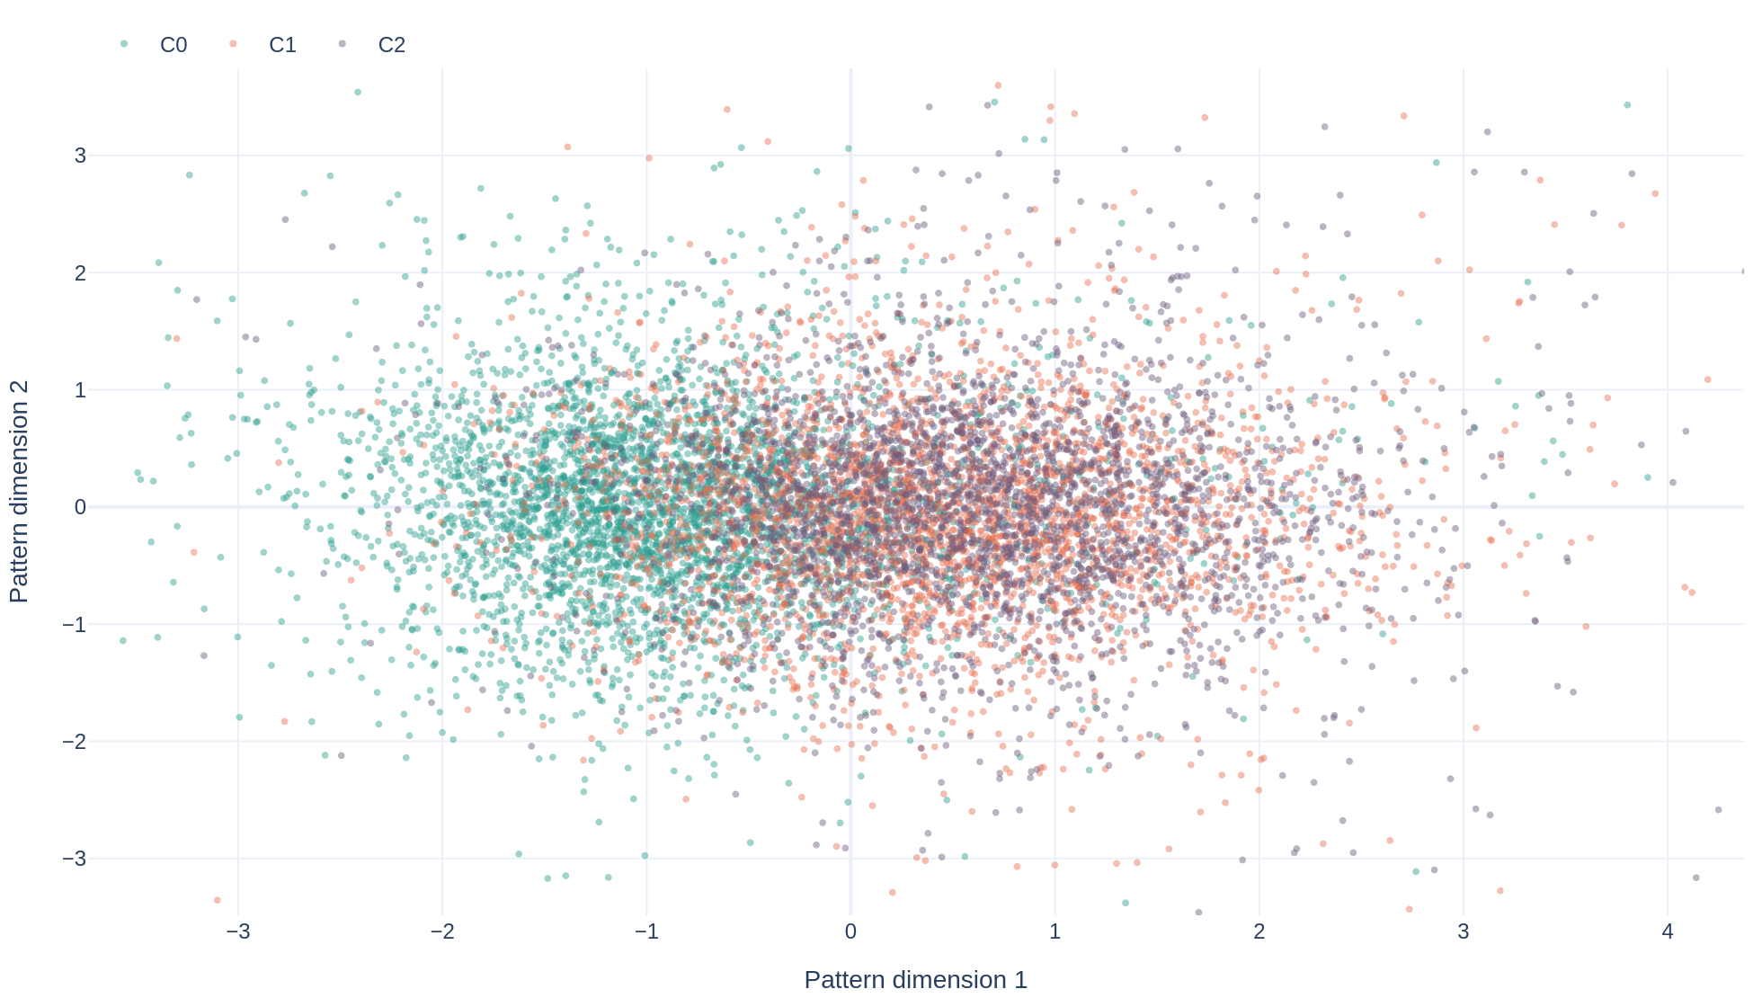
PHASE 5 DELIVERABLE
Explore it yourself — the live dashboard
Built with Python Dash
Five linked views: discovery cards, cluster maps, the rule network, outlier plots, and market distributions.
<100 ms
every interaction — all views are precomputed, memoized and pre-warmed
python prepare_data.py → python app.py
FAMD cluster map — one of five interactive views (segments, rules, anomalies, distributions, discovery).
10
Notes:
(7:15–8:00, Insight Communicator — switch to live demo if time allows) Everything we have shown is explorable in the dashboard. Five tabs: the discovery answer, the cluster map you see here, the rule network with a lift slider, the anomaly views with method toggles, and per-market distributions. Every figure is precomputed and cached, so each click responds in well under a hundred milliseconds — the rubric bar. Two commands start it on any machine with Python.

Slide 11
SO WHAT
Five things to do Monday morning
1
Call the cliff Retention call when a 46–60, single-product customer goes inactive one quarter — 4× the hit rate of random outreach.
2
Review Germany Benchmark German fees, rates and service — treat 32% churn as a market problem, protecting half the high-value losses.
3
Cross-sell to anchor Second-product offers for single-product holders: the 27.7% → 7.6% churn gap is the biggest controllable lever.
4
Wire anomaly alerts High-balance account + structural-anomaly flag → relationship-manager review. Past losses here: £149,755 each.
5
Fix the loyalty KPI Report relationship depth (products, activity) beside balance — balance flatters the segments most likely to leave.
11
Notes:
(8:00–8:50, Insight Communicator) The point of discovery is action, so here is Monday morning. One: pre-emptive calls into the mid-life cliff — that profile churns at seventy-seven percent, so outreach there has four times the hit rate. Two: a German market review — benchmark the offer, not the customers. Three: cross-sell as a retention tool, not a revenue tool. Four: wire the anomaly flags to relationship managers for high-balance accounts. Five: change the loyalty KPI — balance flatters exactly the wrong customers. Each action traces to one discovery and one number you have seen.

Slide 12
“What did we discover that was not
already obvious from the raw data?”
1
Churn concentrates in a mid-life window (46–60) and multiplies with shallow engagement — up to 77%.
2
Germany churns at double rate across every segment at once: a market problem, not a customer problem.
3
Product depth, not balance, anchors customers — the poorest segment is the most loyal.
4
The costliest churn hides among structurally unusual high-balance accounts two detectors can flag early.
None of this is visible in a column average. That is the difference between data and knowledge.
Notes:
(8:50–10:00, whole group on stage) So, the central question. [Read the four answers.] None of these is visible in a column average — that is the difference between data and knowledge. Thank you — questions. EXPO Q&A PREP — Q1 Most surprising rule: Senior+Germany→churn, 67% with no other condition (also: credit cards do not anchor). Q2 Most interpretable clustering: K-Means at K=3 — silhouette peaks at K=2 but K=2 collapses business meaning; Ward agreed (ARI 0.37), DBSCAN contributed the outlier lens. Q3 Anomalies: 1,054 flagged, classified 2 data errors / 583 rare-valid / 469 risk signals; headline: 592 high-balance churners at £149.8K average, 46% German. Q4 Cross-group contrast: fraud groups (3/8) hunt transaction-level point anomalies; our churn signals are relationship-level interactions (age × products × activity) — same banking data, different granularity of knowledge.

