Slide 1
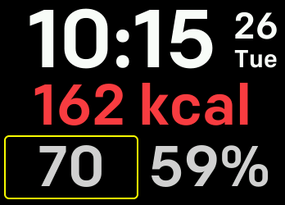
Time
Day of month and week
Activity tracker (touch to toggle)
Heart rate monitor
(touch to change zone)
Battery status

