Slide 1
Impaired OX prevents mice from partaking in stable social interactions
Corentin Nelias
27.05.2025

Slide 2
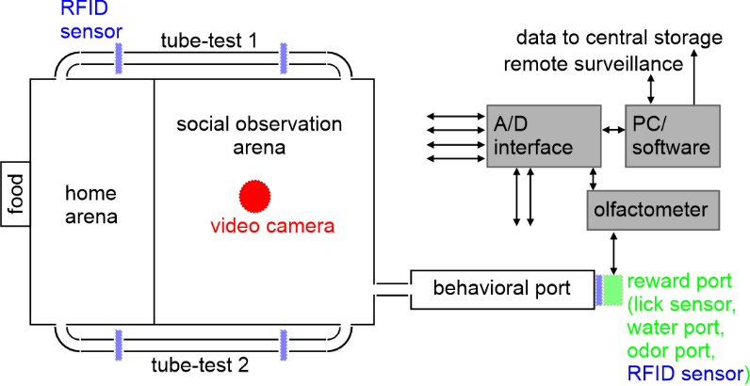
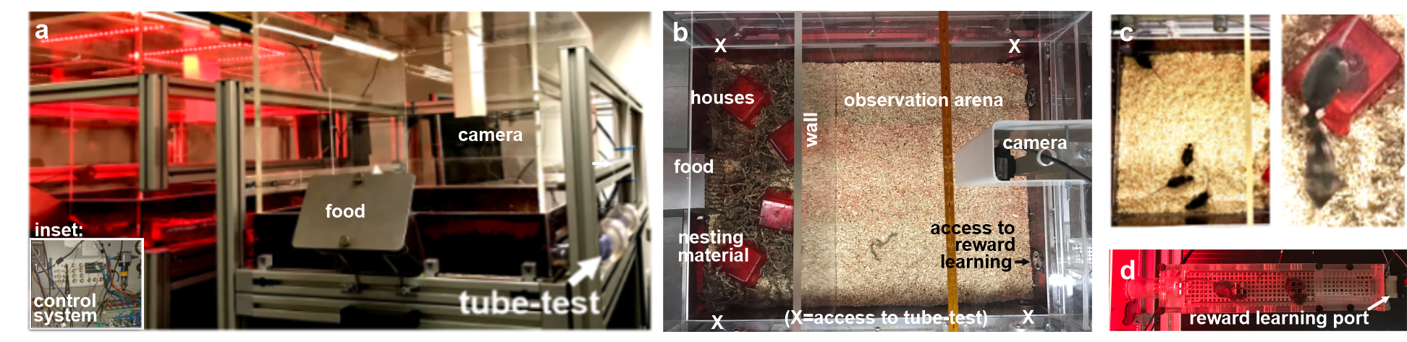
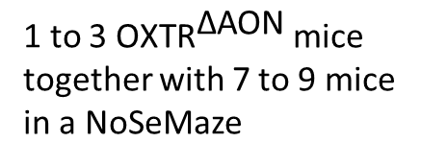
Data acquisition: NoSeMaze
- non-invasive sensor-rich maze
3 sources of data
1 to 3 ${\text{OXTR}}^{\text{∆}\text{AON}}$ mice together with 7 to 9 mice
in a NoSeMaze
B
A
C
B
A
B
C

Slide 3
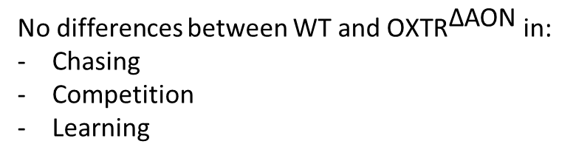
Data acquisition: NoSeMaze
- non-invasive sensor-rich maze
1 to 3 ${\text{OXTR}}^{\text{∆}\text{AON}}$ mice together with 7 to 9 mice
in a NoSeMaze
B
A
C
B
No differences between WT and ${\text{OXTR}}^{\text{∆}\text{AON}}$ in:
Chasing
Competition
Learning
A
B
C

Slide 4
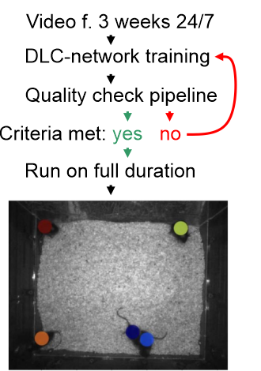
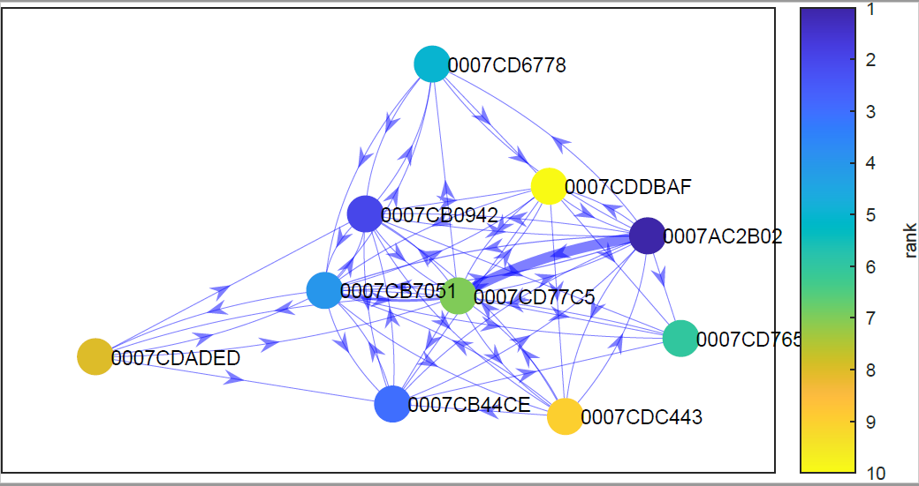
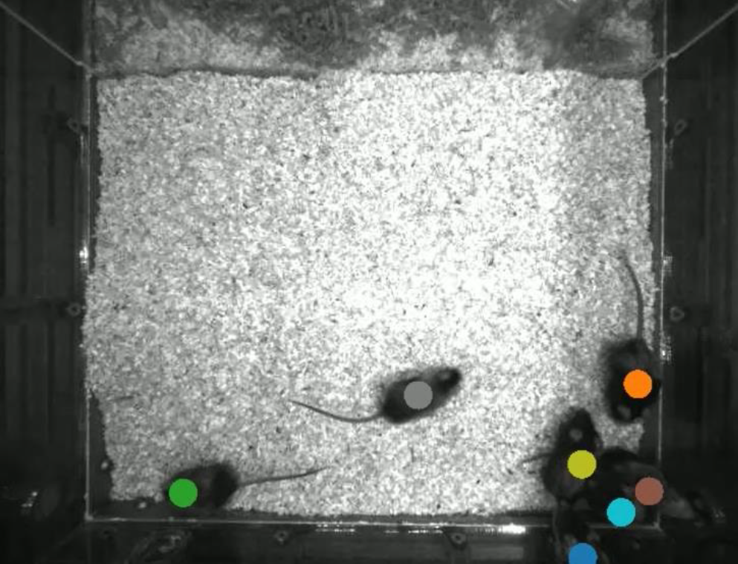
Video data processing
dyadic interaction:
1-10 cm, >1 second
approaches:
calculated using the (smoothed) distance travelled in the 3-4 seconds before the interaction
distance travelled of mouse A must be at least 1.5x the distance travelled of mouse B
 | B02 | 7C5 | 765
B02 |  | 10 | 1
7C5 | 3 |  | 0
765 | 0 | 1
automated video tracking

Slide 5
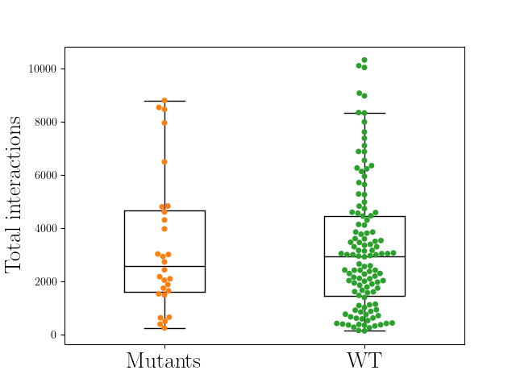
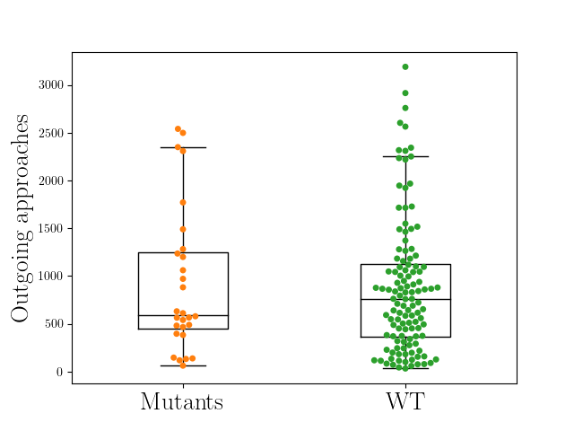
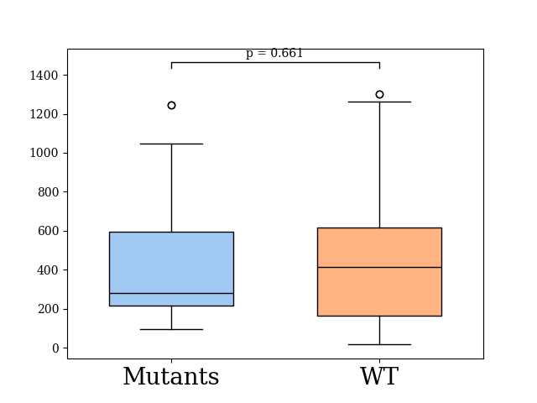
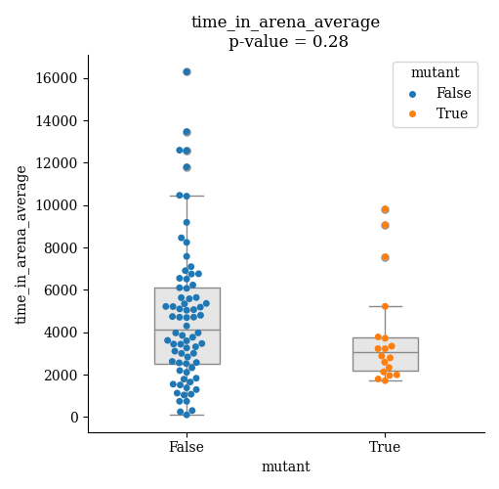
Statistics of the events

Slide 6
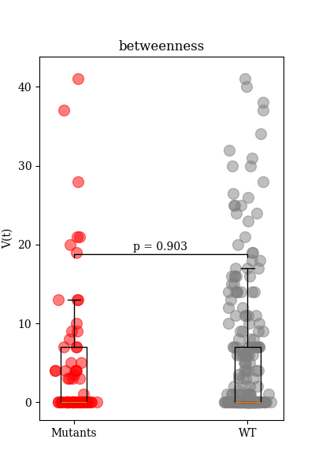
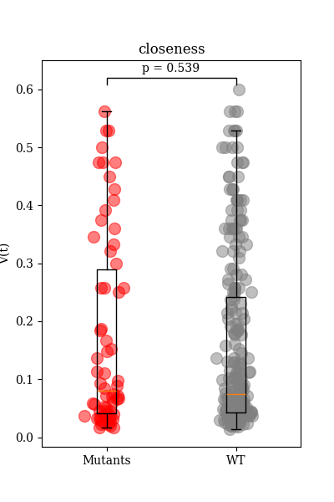
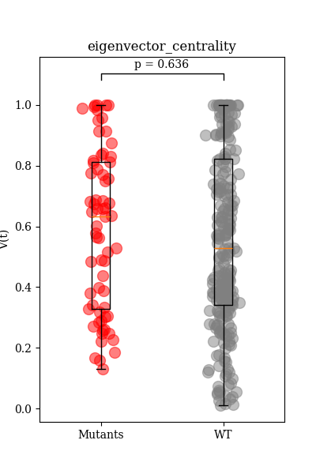
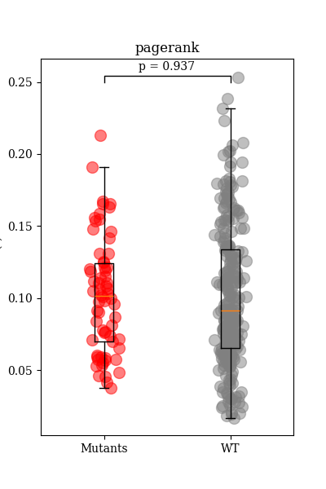
Graph theoritical metrics
Averaged value

Slide 7
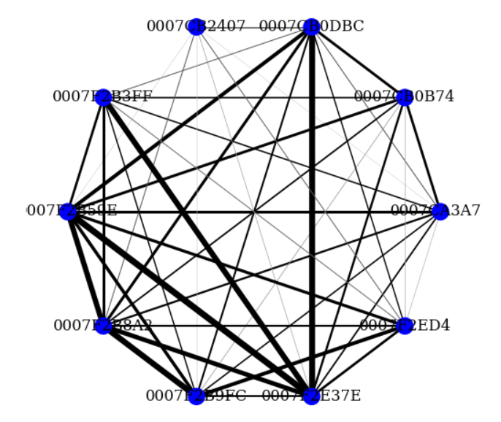
How about unweighted metrics (structure)?
For that we need to prune the interaction graphs

Slide 8
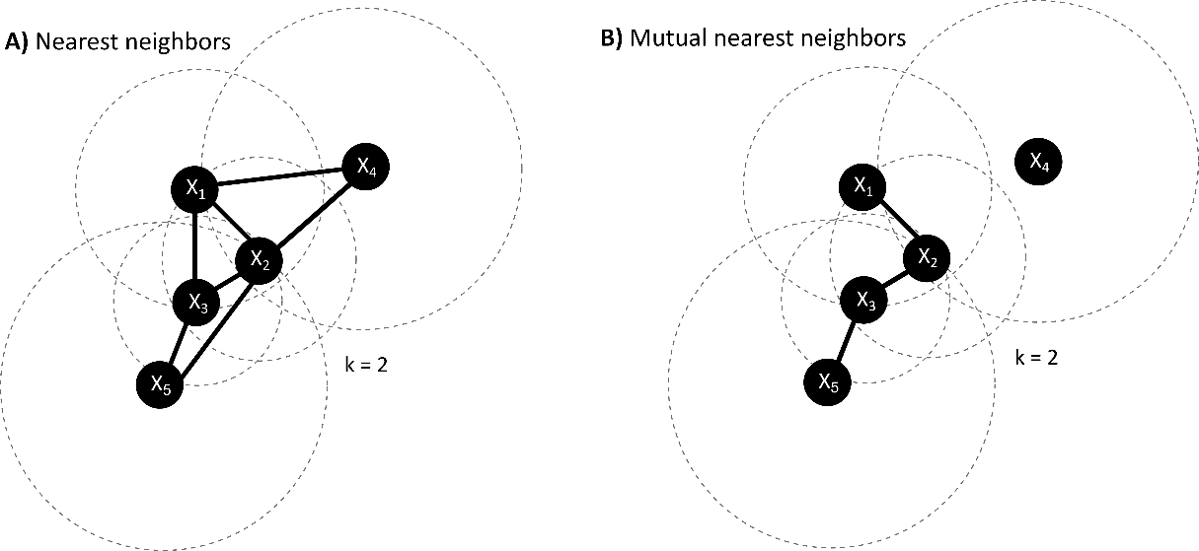
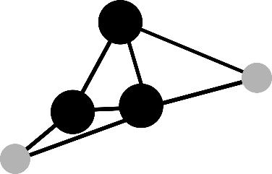
rich clubs
rich club
What is a “rich club”?
nodes with high connectivity that tend to form tightly interconnected groups or clusters among themselves
hierarchical organization in networks, where a small subset of highly connected nodes form a significant core

Slide 9
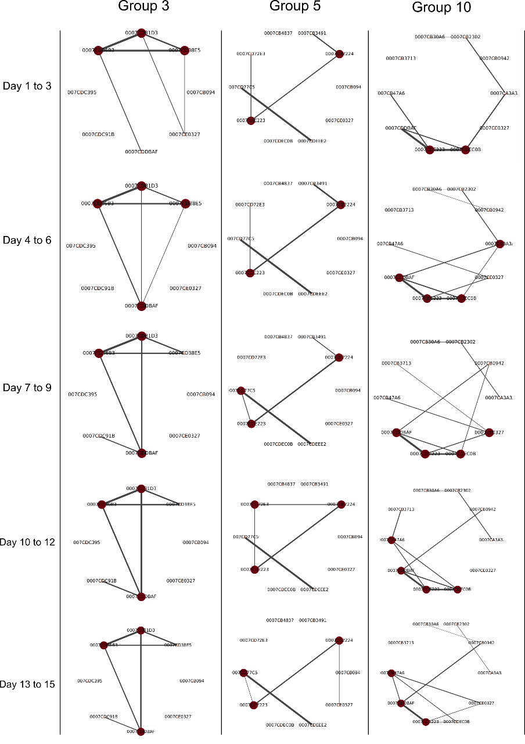
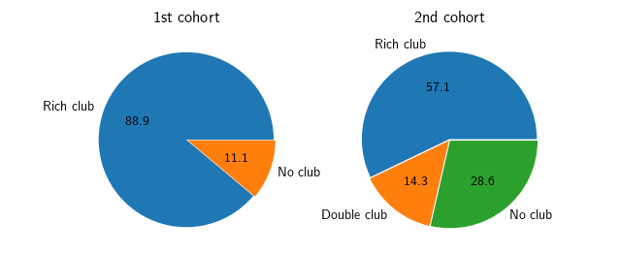
rich clubs
rich clubs are relatively stable over time
stable rich clubs are more consistently found in cohort 1
Proportions of observed stable rich clubs within the different groups.

Slide 10
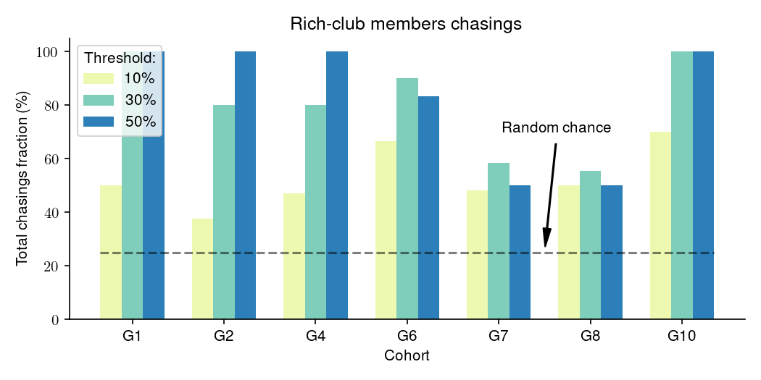
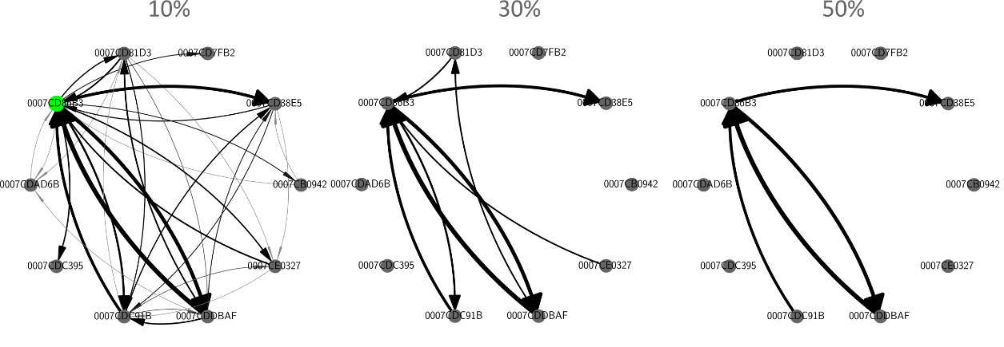
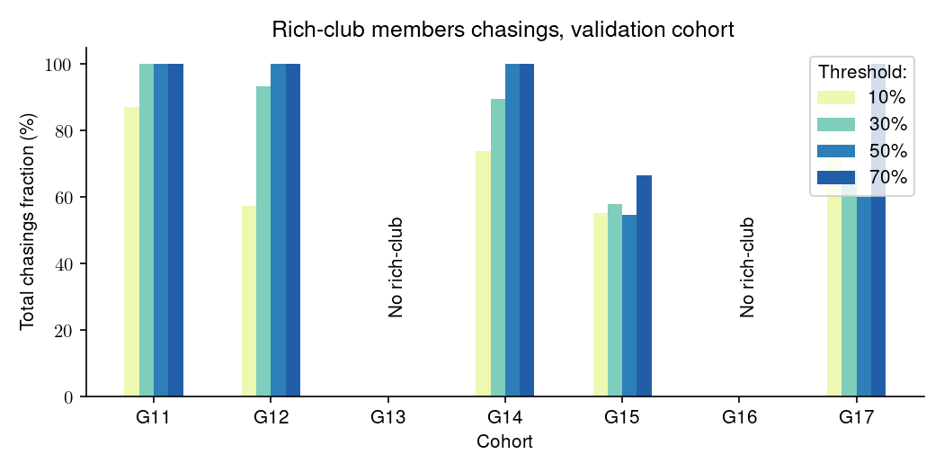
rich clubs and chasing
Examples of different thresholding on the chasing network
→ members of the rich club participate more in chasings
Is it combining „chasing“ and „being chased“

Slide 11
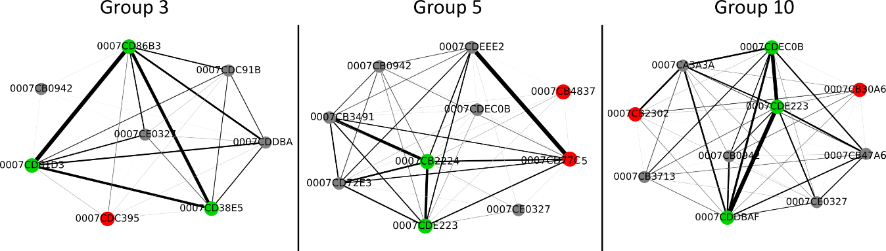
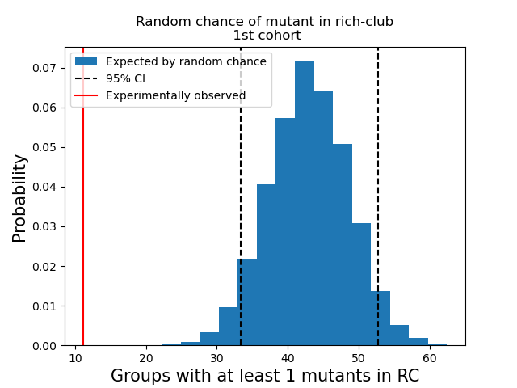
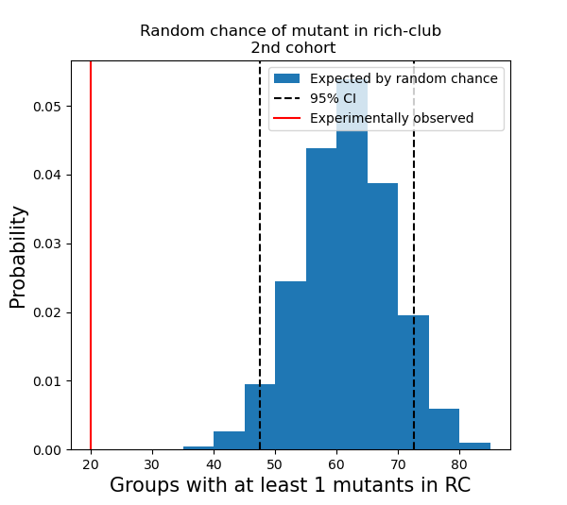
OXTR^{ΔAON} vs control animals: rich club
OXTR^{ΔAON} are excluded from the rich club

Slide 12
