Slide 1
Asymmetry: percentage of animals that chased another one more when they are higher in the rank variable.
Variable:
Tube rank | Chasing rank | Chasing order | Approach Rank
50% | 80% | 53% | 35%
Asymmetry:
No predictability
No predictability
Animal higher in chasing rank, tend to chase their lower counterparts more (to be expected)
Animal higher in approach rank, tend to chase their lower counterparts less

Slide 2
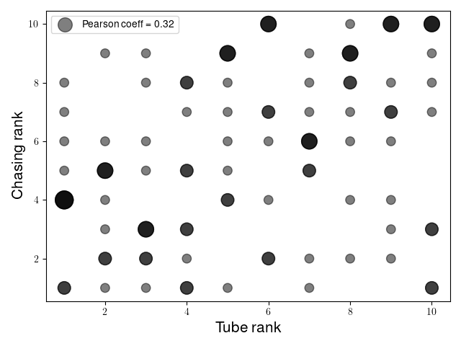
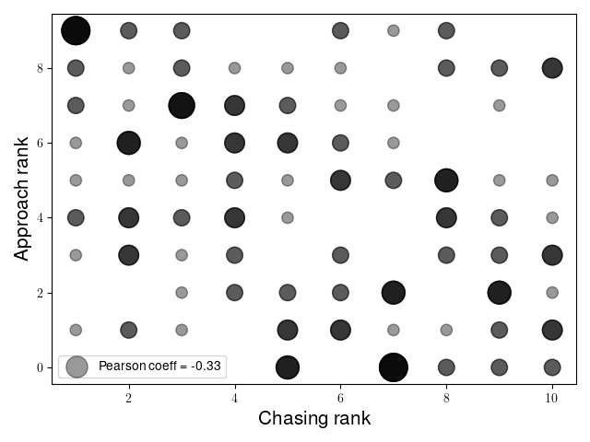
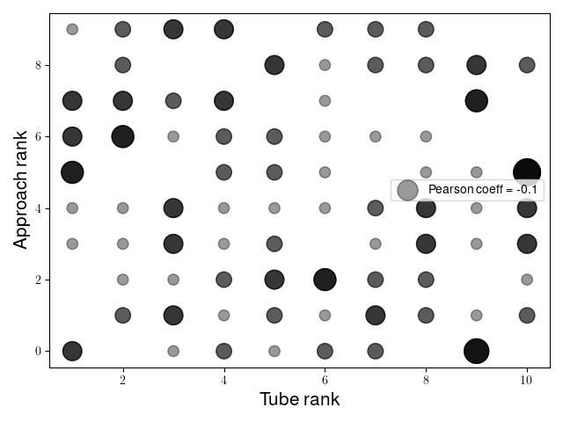
Preserved (corr. Coeff. ~0.55)
Chasing rank
Moderate corr. (0.3)
Moderate anticorr. (-0.33)
Tube rank
Approach rank
Weak anticorr. (-0.1)
Preserved (corr. Coeff. ~0.6)
Moderately preserved* (corr. Coeff 0.38)
*only true for first cohort, somehow.

Slide 3
Preserved (corr. Coeff. ~0.55)
An animal that initiates a lot of chasing is not necessarily dominant in hierarchy.
An animal that initiates a lot of chasing will tend to approach less or get approached more.
Chasing rank
Moderate corr. (0.3)
Moderate anticorr. (-0.33)
Tube rank
Approach rank
Weak anticorr. (-0.1)
Preserved (corr. Coeff. ~0.6)
Moderately preserved* (corr. Coeff 0.38)
Approaches are not very relevant for social hierarchy.
*only true for first cohort, somehow.

Slide 4
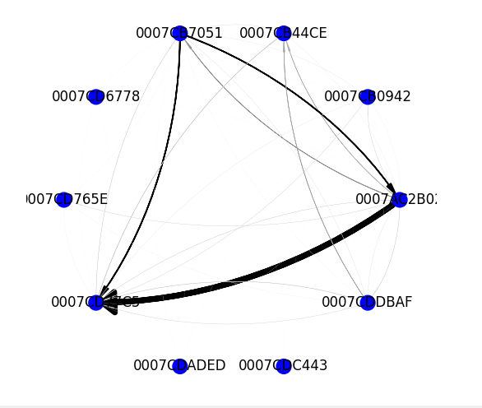
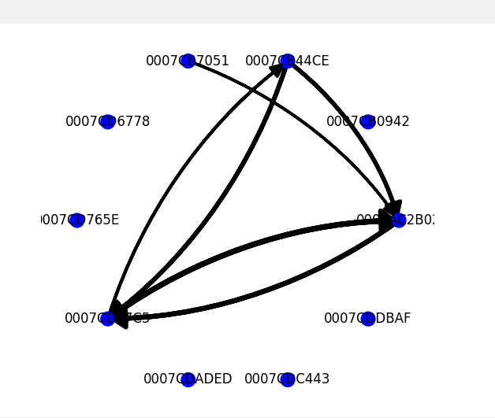
G1
50% thresholded
Chased a lot
Got chased a lot
Chasing
Approaches

Slide 5
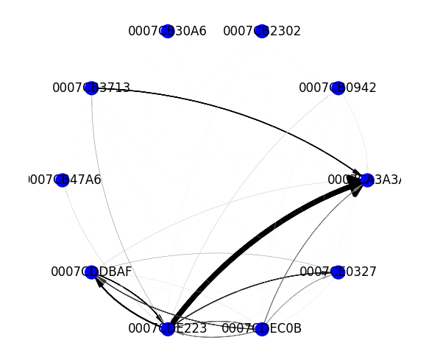
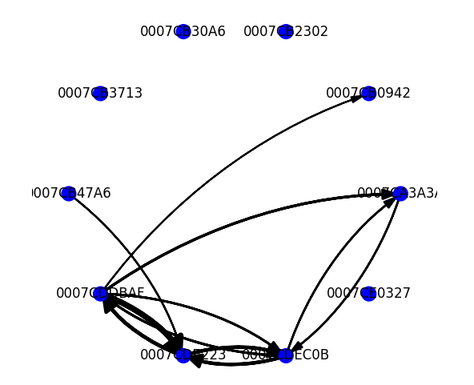
G10
Thresholded 30%
Chased many, but not much
Approached many, a lot
Chasing
Approaches

Slide 6
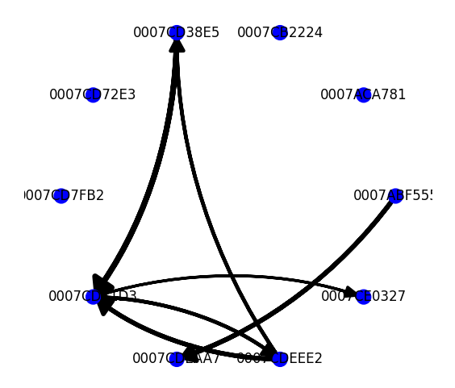
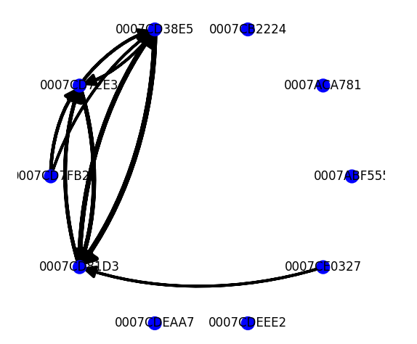
Not a 1 to 1 correlation: G7
Thresholded 50%
Chasing
Approaches

