Slide 1
Analysis of principle components
NoSeMaze data, 05.2023

Slide 2
Dimensionality reduction of feature space using PCA
To reduce the number of predictors and to minimize redundancy between similar features, we performed dimensionality reduction using principle components analysis on the original feature space.
We grouped similar features together (e.g., all features describing the lick-frequency response to the CS+).
For every group of features separately:
Skewed distributions were log-transformed. If features contained 0-values, min(data)/2 was added to every value before log-transformation.
The values were zscored within feature.
PCA of the matrix with dimensions: observations x features

Slide 3
Analysis of principle components
To understand the biological meaning/interpretation of principle components for different behavioral domains/components:
PC coefficients were inspected. For every PC, the original features with the strongest contribution was noted.
Scatter plots of scores of PC1 and PC2 were complemented with illustrative plots of the underlying behavior to provide visual/intuitive understanding of the meaning of the PC.

Slide 4
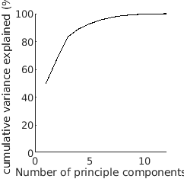
Chasing through tube networks
PC1 (top weights)
PC2
PC3
0.39: log10(chasing_outstrength)
0.39: chasing_outdegree
0.36: chasing_incloseness_weighted
0.49: chasing_indegree
0.48: log10(chasing_instrength)
0.47: chasing_hubs
0.61: chasing_incloseness
0.44: log10(chasing_betweenness)
0.35: chasing_instrength

Slide 5
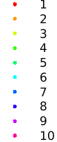
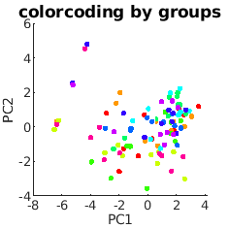
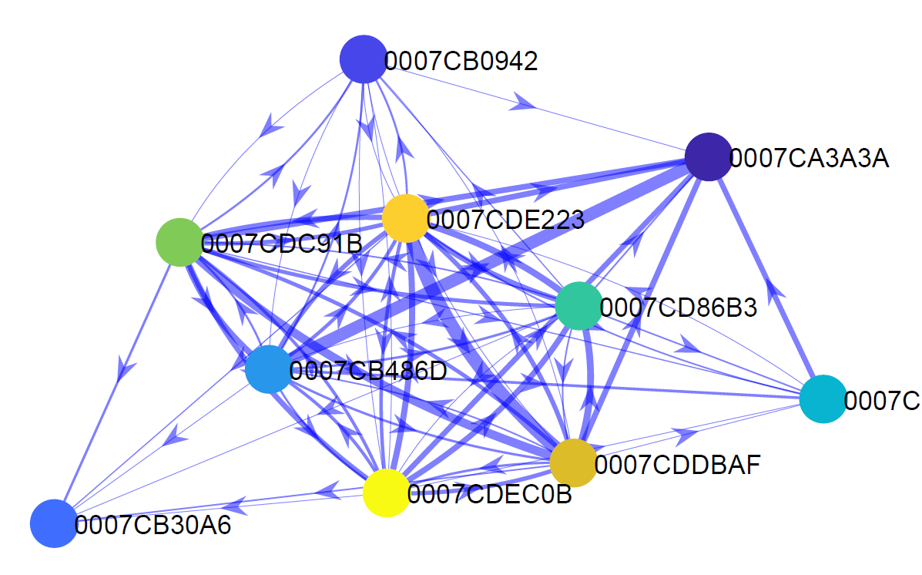
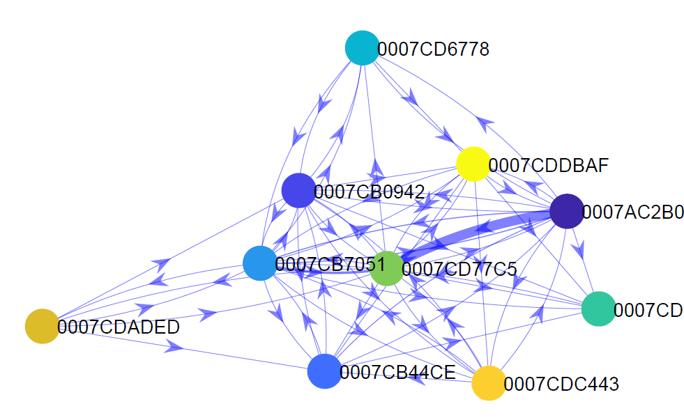
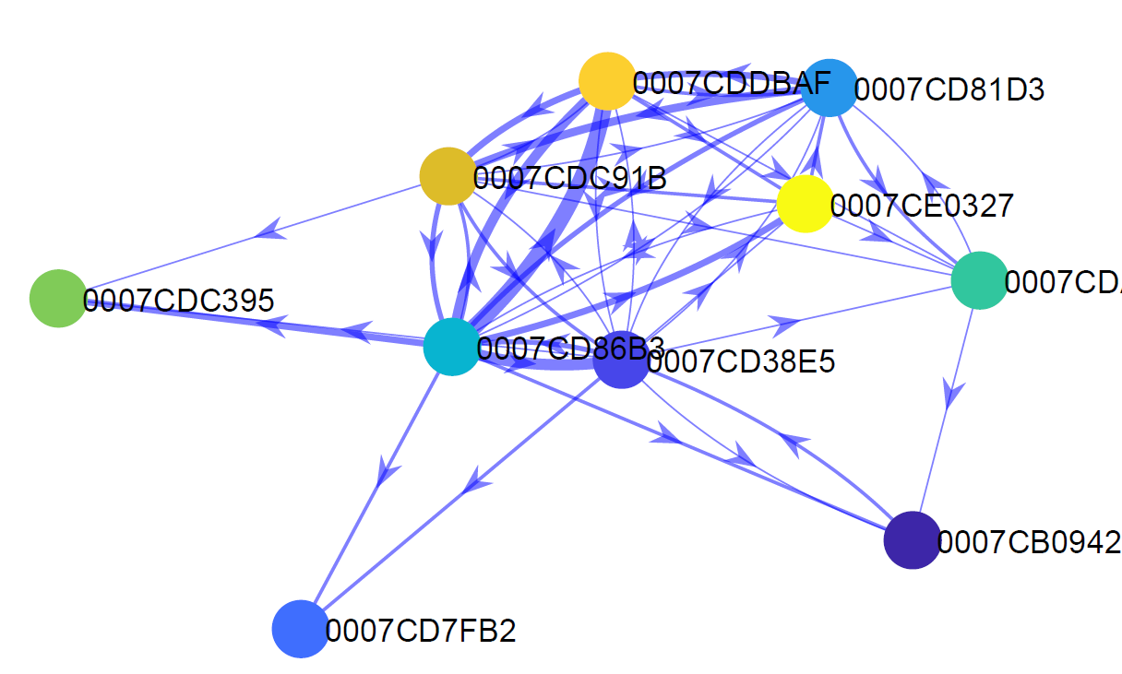
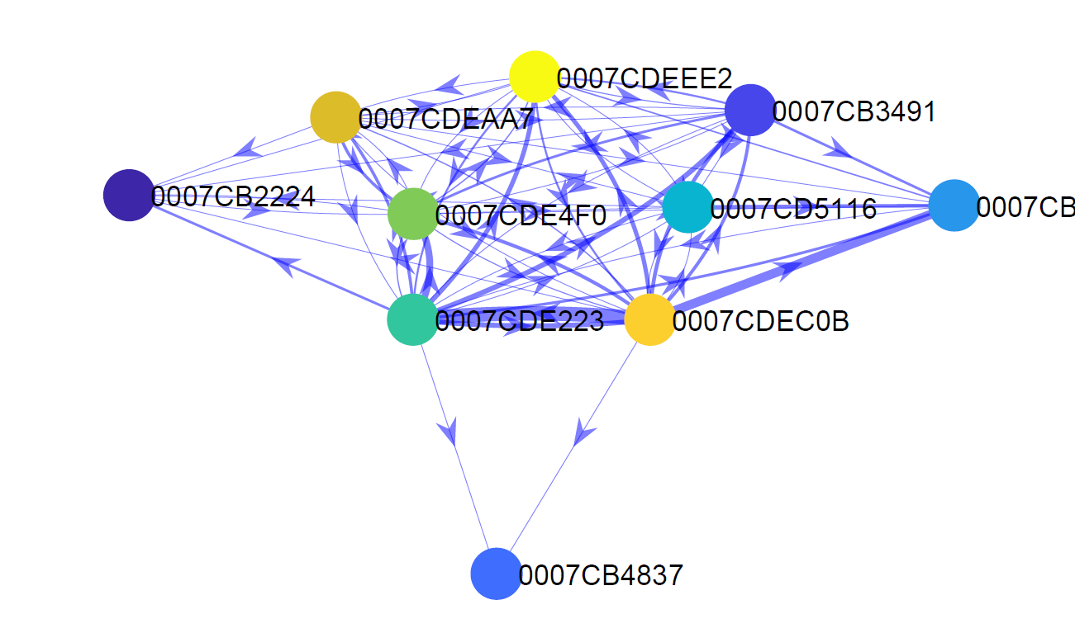
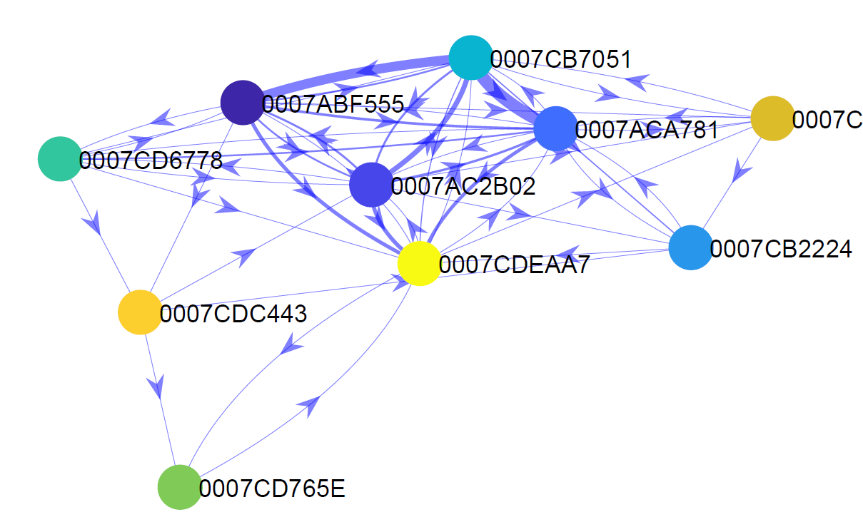
Chasing through tube networks

Slide 6
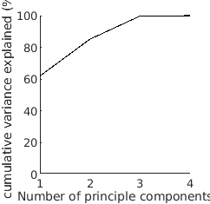
CS+ processing
PC1 (top weights)
→ CS+ modulation to baseline
PC2
→ CS+ ramping
0.62: log10(cs_plus_modulation_peak_to_base)
0.60: log10(cs_plus_modulation_averaged)
-0.44: log10(cs_plus_modulation_min_to_base)
0.9: log10(cs_plus_ramping)
0.41: log10(cs_plus_modulation_min_to_base)

Slide 7
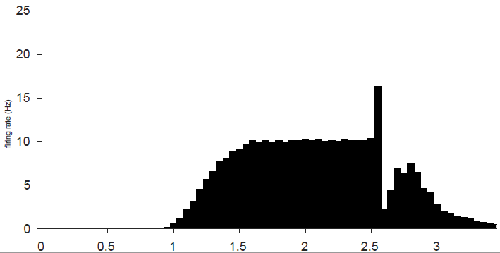
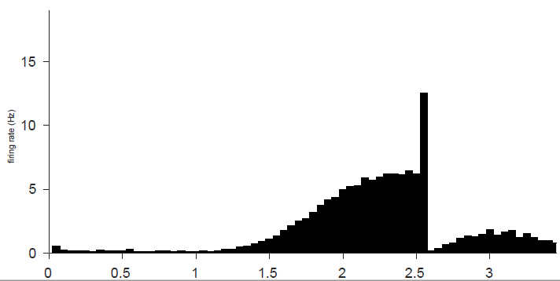
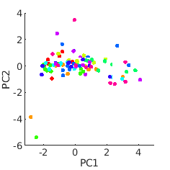
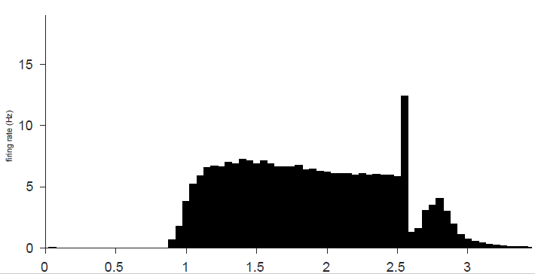
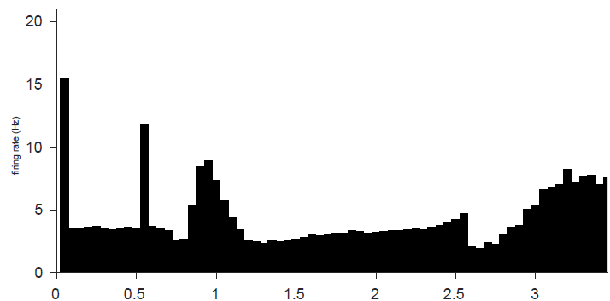
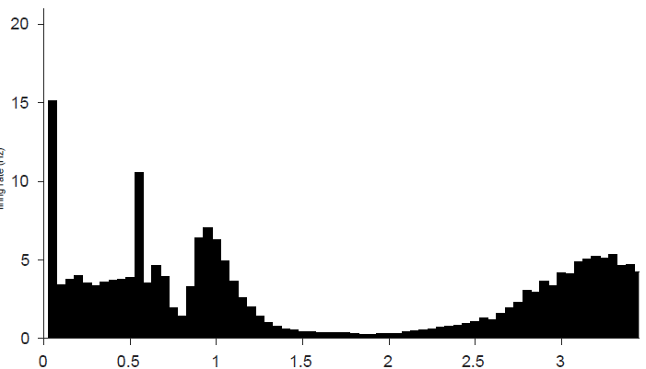
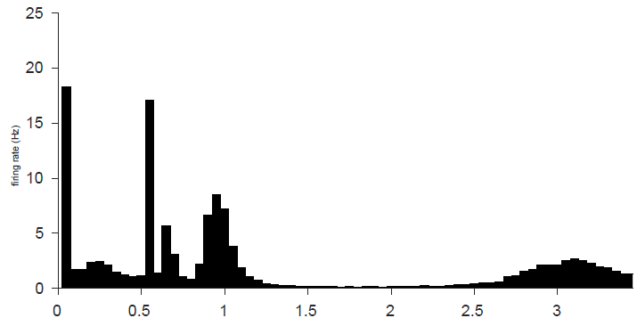
CS+ processing
Same animals
Same animals

Slide 8
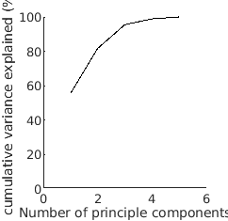
CS- processing
PC1 (top weights)
→ CS- peak
PC2
→ CS- modulation to base
0.59: log10(cs_minus_modulation_peak_to_base)
0.57: delay_avoidance_learner
0.55: log10(cs_minus_modulation_min_to_base)
0.7: log10(cs_minus_modulation_full_window_averaged)
-0.69: log10(cs_minus_modulation_averaged)

Slide 9
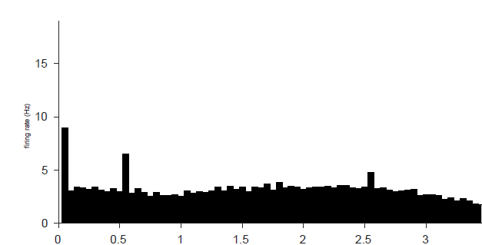
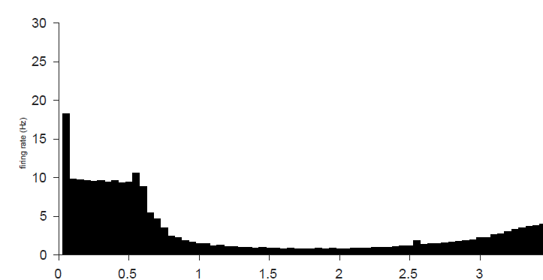
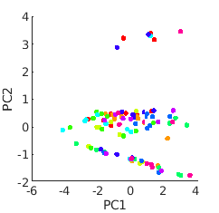
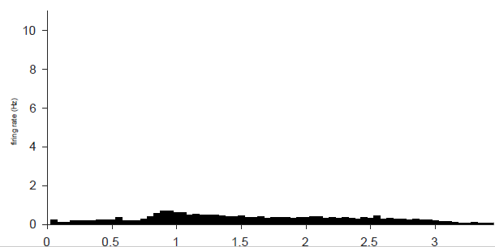
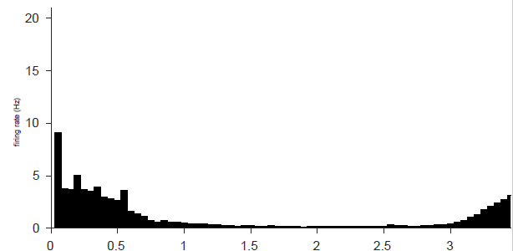
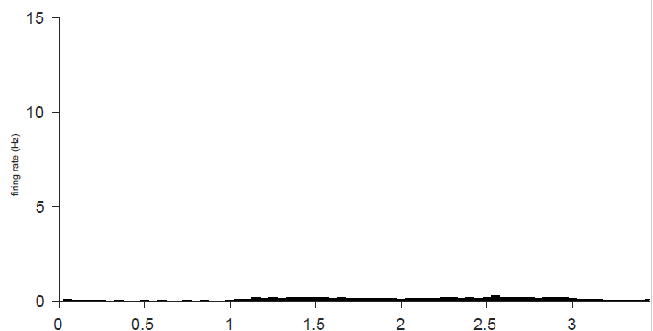
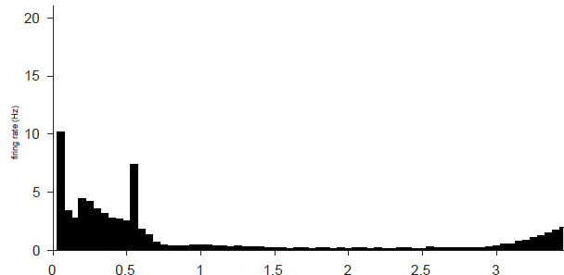
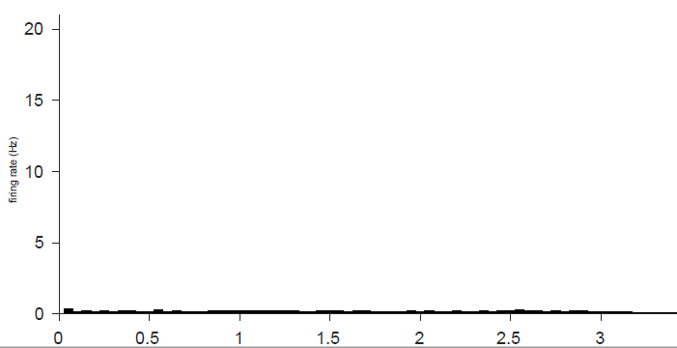
CS- processing

Slide 10
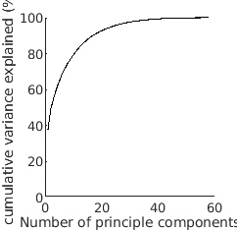
Switching flexibility
PC1 (top weights)
→ CS+ switch latency
PC2
→ CS- switch latency
0.19: log10(cs_plus_switch_latency_at_cs_mean)
0.19: log10(cs_plus_switch_latency_at_cs_mean)
0.33: log10(cs_minus_switch_latency_at_cs_mean)
0.33: log10(cs_minus_switch_latency_at_cs_mean)

Slide 11
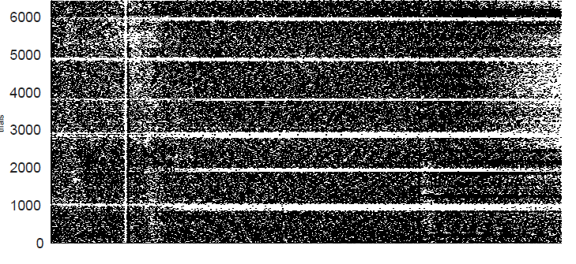
Switching flexibility (continued)
PC3
→ Giving up late
PC4
→ Pause duration
0.38: giving_up_at_US_rev6
0.37: giving_up_at_CS_rev6
6 components for 70%
10 components for 80%

Slide 12
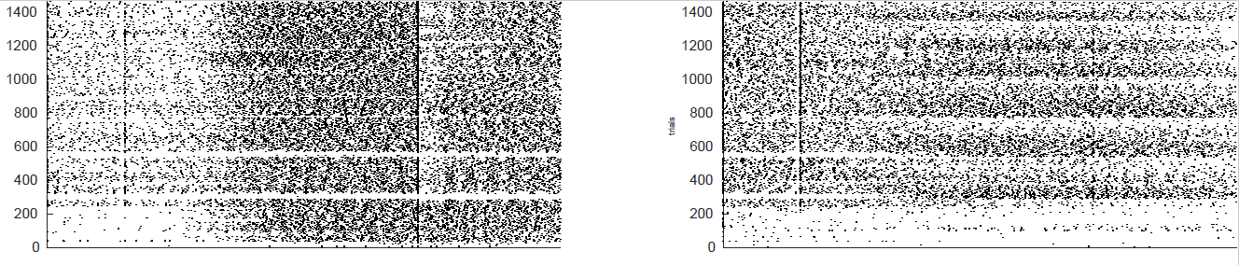
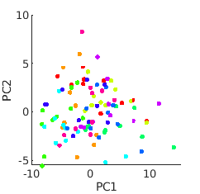
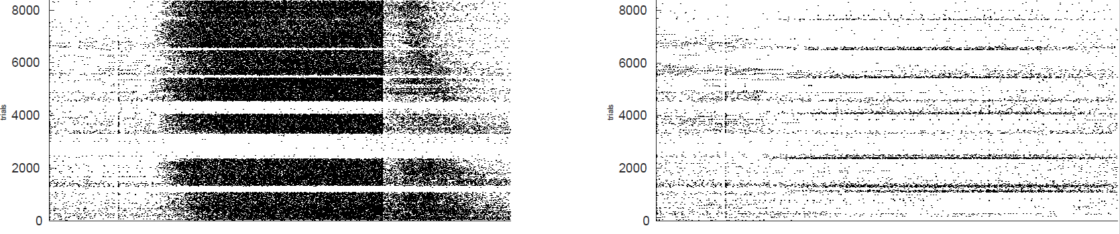
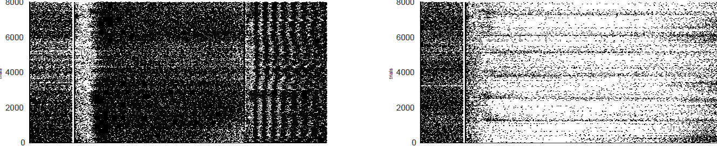
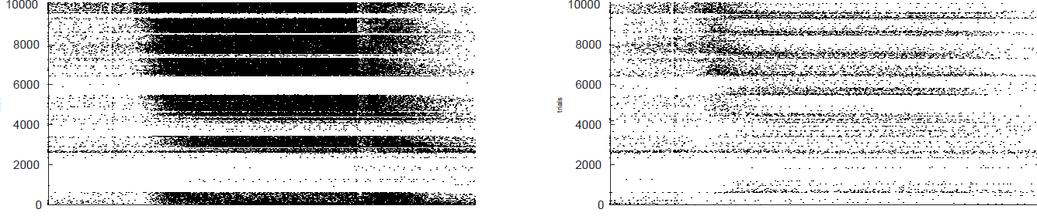
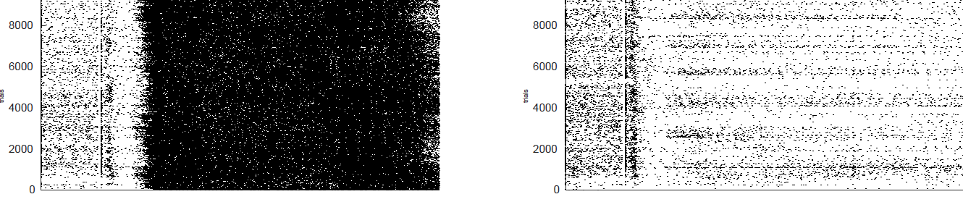
Switching flexibility

Slide 13
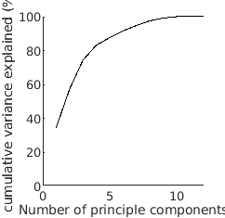
Cross-reversal shaping
PC1 (top weights)
→ Grand shaping CS+ switch latency
PC2
→ Early shaping CS+ switch latency
PC3
→ CS- switch latency shaping
0.46: log10(pause_duration_at_CS_shaping_rev_2to456)
0.45: log10(pause_duration_at_US_shaping_rev_2to456)
0.57: log10(pause_duration_at_CS_shaping_rev_1to2)
0.57: log10(pause_duration_at_US_shaping_rev_1to2)
0.57: log10(cs_minus_relearning_progression_at_us)
0.57: delay_avoidance_shaping
3 components for > 70%

Slide 14
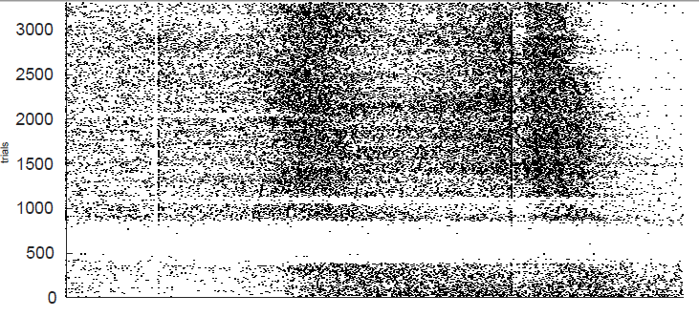
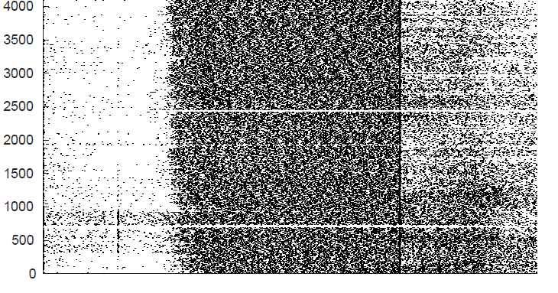
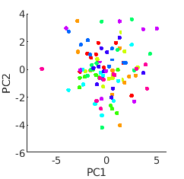
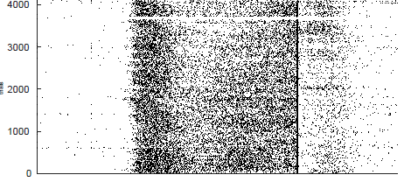
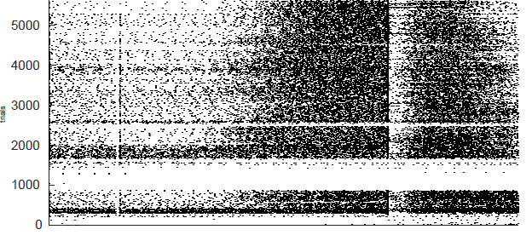
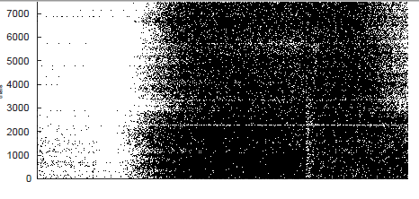
Cross-reversal shaping

Slide 15
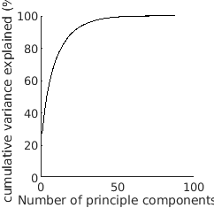
Social interactions
PC1
→ sociability
PC2
→ Approach behavior
PC3
→ Distance
~30 features contributing rougly equally
strength_summed_time_Res7_1_normalized
eigenvector_summed_time_Res7_1
strength_int_count_Res7_1_normalized
eigenvector_int_count_Res7_1
0.25: pagerank_abs_approach_Res7_1
Several 0.2 with approach
eigenvector_mean_distances_Res7_1
strength_mean_distances_Res7_1_normalized
eigenvector_mean_distances_Res7_2
- closeness_mean_distances_Res7_2_normalized
9 components for > 70%

Slide 16
Social interactions
PC4
→ ?
PC5
→?
PC6
→?
closeness_mean_time_Res7_1_normalized
out_closeness_approach_props_Res7_1
out_closeness_approach_props_Res7_1_normalized
eigenvector_mean_time_Res7_2
out_closeness_abs_approach_Res7_1
- out_closeness_approach_props_Res7_1_normalized
- out_closeness_approach_props_Res7_2
eigenvector_HWI_time_corr_Res7_1
betweenness_summed_time_Res7_2
closeness_mean_time_Res7_2_normalized

Slide 17
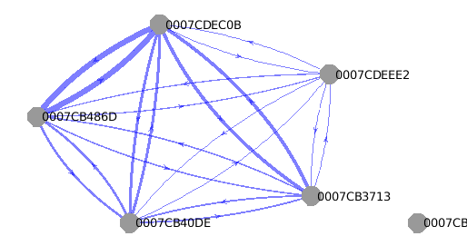
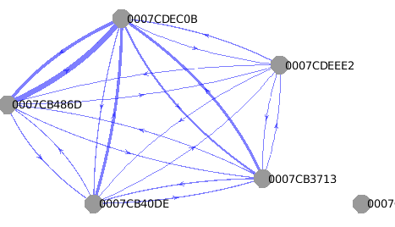
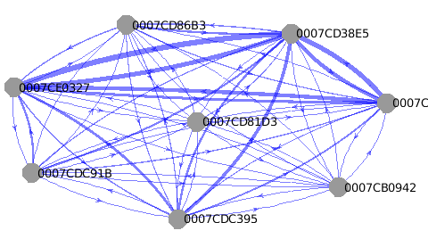
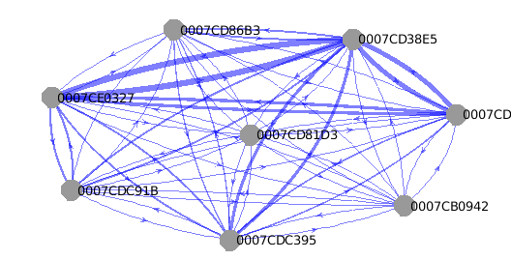
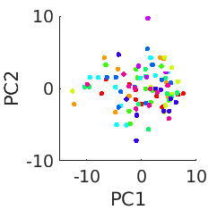
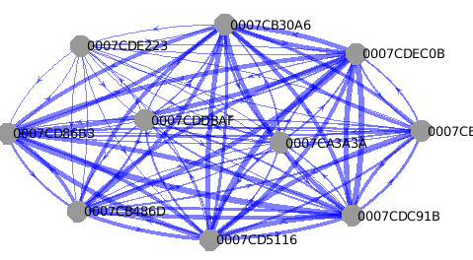
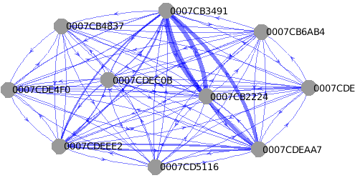
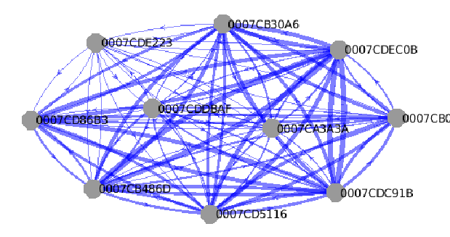
Social interactions
T_summed
Abs_approach

