Slide 1
BookStore DataBase
By: Kelsea Figaro
CMP241 Final Project

Slide 2
What is in this database?
This database is a fictional online bookstore. The tables include Title, Author, Genre, Orders, Customer, and a bridge table called AuthorTitle. The bridge table was added because you can’t have a many to many relationship between tables, in this case Author and Title. I chose this database because I am a reader myself and have read some of the books included in this database.

Slide 3
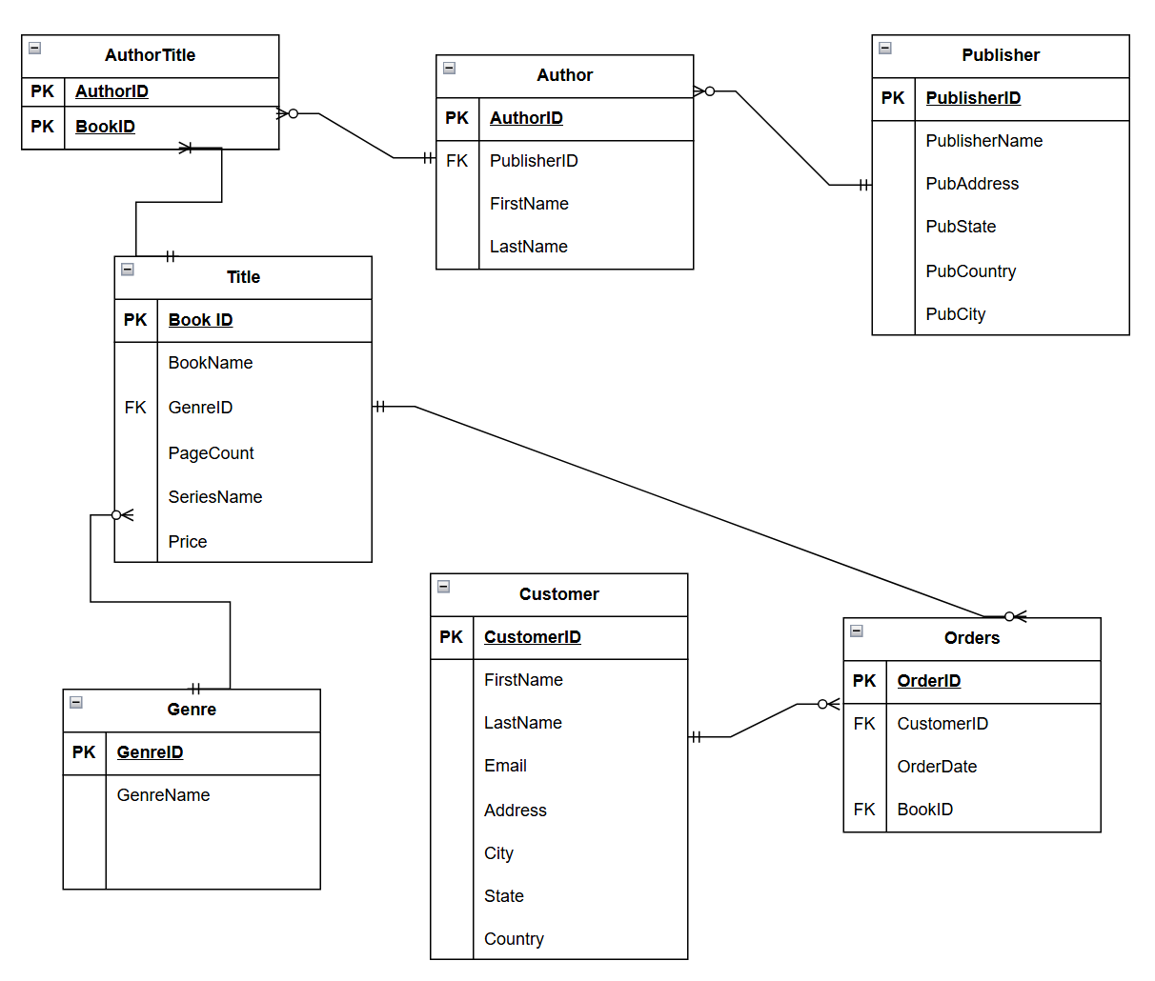
Entity Relationship Diagram

Slide 4

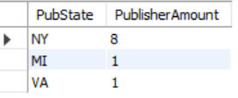
How many publishers are in each state?

Slide 5
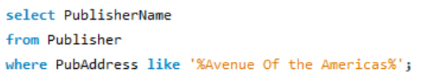

Which Publishers are located on the Avenue of the Americas street in NYC?

Slide 6


How much would it cost a customer to buy every book in the database?

Slide 7
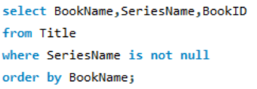
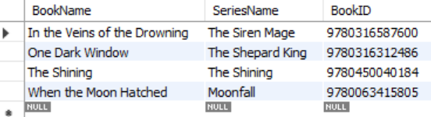
What books are part of a series?

Slide 8

Which customers are Canadian?

Slide 9
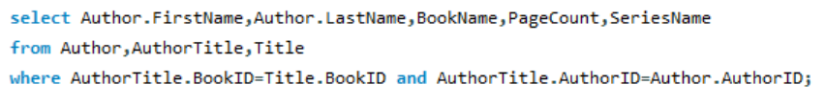
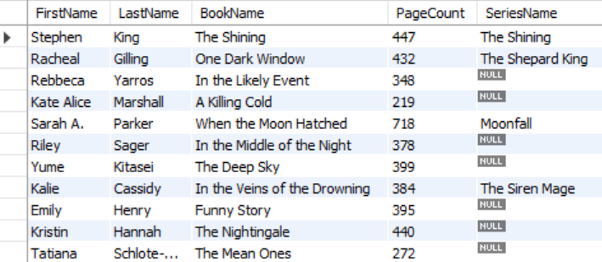
Which authors wrote what books?

Slide 10
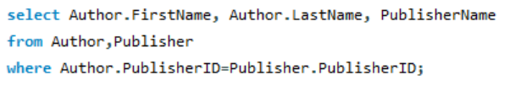
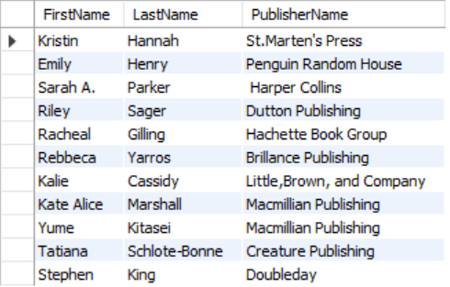
Which publishers do authors belong to?

Slide 11
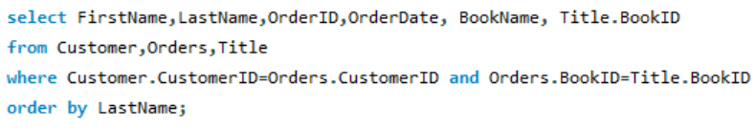
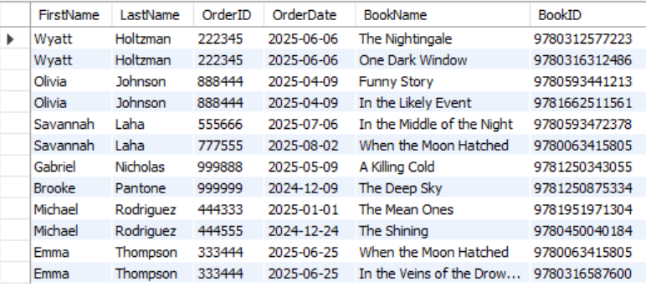
What books are customers ordering?

Slide 12
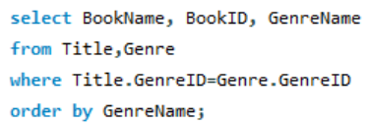
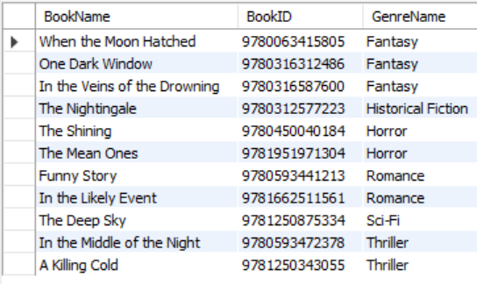
What genres are the books?

Slide 13
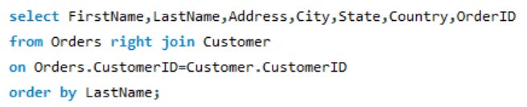
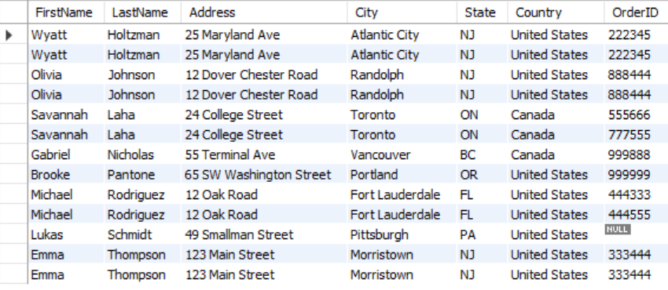
Show all customers with their orders

