Slide 1
Descriptive analysis of variables in a publicly available hepatitis dataset
Kelsey Butler
Colubri Lab
February 2021
http://archive.ics.uci.edu/ml/datasets/Hepatitis

Slide 2
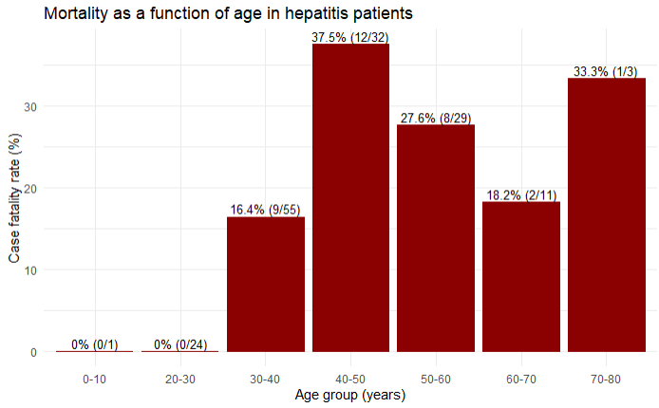

Slide 3
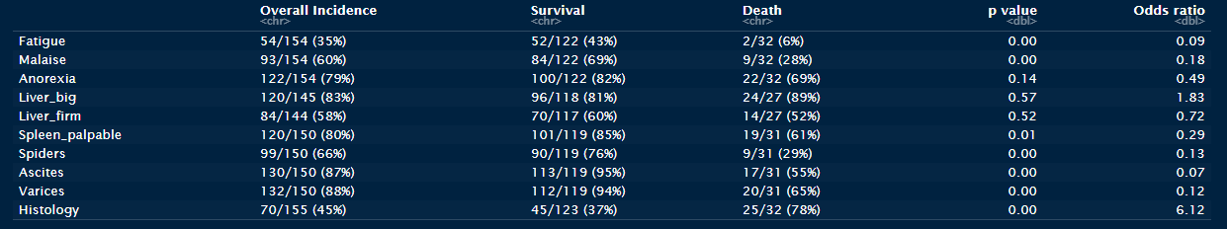

Summary of binary variables
$$Overall incidence=\frac{total \# of yes}{total \# who answered}$$
$$Survival/Death=\frac{total \# of yes with outcome live/die}{total \# with outcome live/die}$$

Slide 4




Calculating survival and death for fatigue
Fatigue
NA = 1
Live = 122
Die = 32
$$Survival=\frac{52}{122}$$
$$Death=\frac{2}{32}$$
1 = no
2 = yes
Andres: Are the rows in the right order?

Slide 5
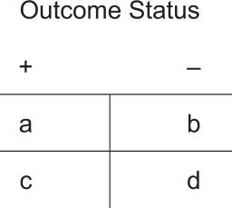
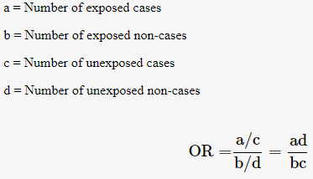

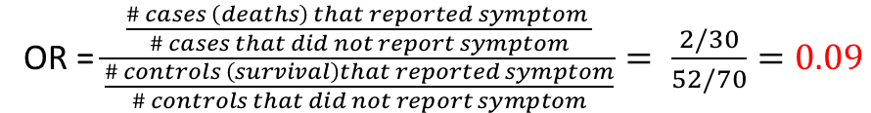
Calculating odds ratios
Example from PMID: 20842279
Case study - fatigue
1 = no
2 = yes
OR = $\frac{\frac{\# cases \left(deaths\right) that reported symptom }{\# cases that did not report symptom}}{\frac{\# controls \left(survival\right)that reported symptom}{\# controls that did not report symptom}}= \frac{2/30}{52/70}=0.09$
The odds of fatigue is lower in patients who died compared to those who survived.

Slide 6






Calculating mean and 95% CI for continuous variables
Example from http://www.stat.ucla.edu/~rgould/110as02/bsci
Case study - bilirubin
$$95\% CI=1.15 ±1.96(\frac{0.72}{\sqrt{119}})$$
$$\left(1−α\right)100\% CI=\overline{x} ±z(α/2)(\frac{σ}{\sqrt{n}})$$
$$95\% CI=1.15 ±0.129$$
For a 95% CI, $α$ = 0.05
$$1.15 (1.02−1.28)$$

Slide 7
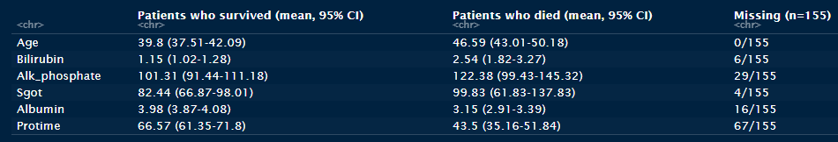
Summary of continuous variables

