Slide 1

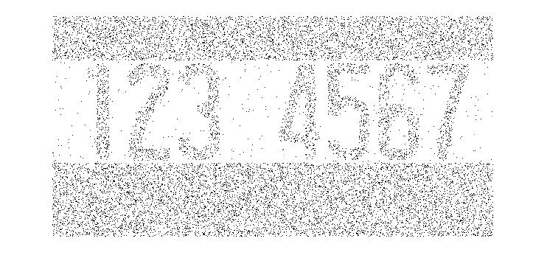
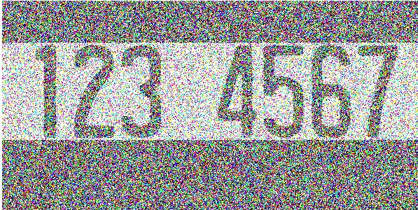
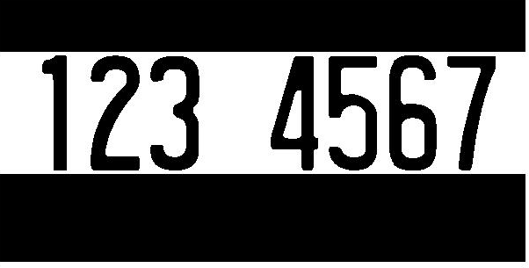
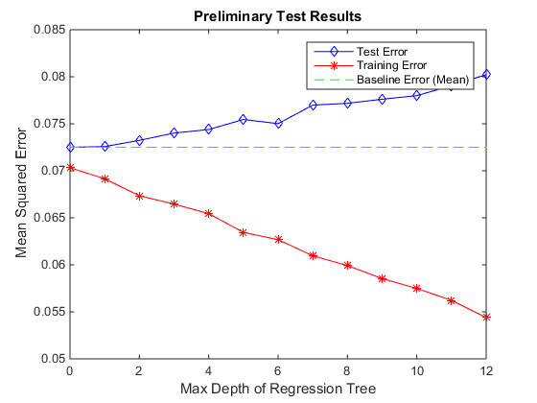


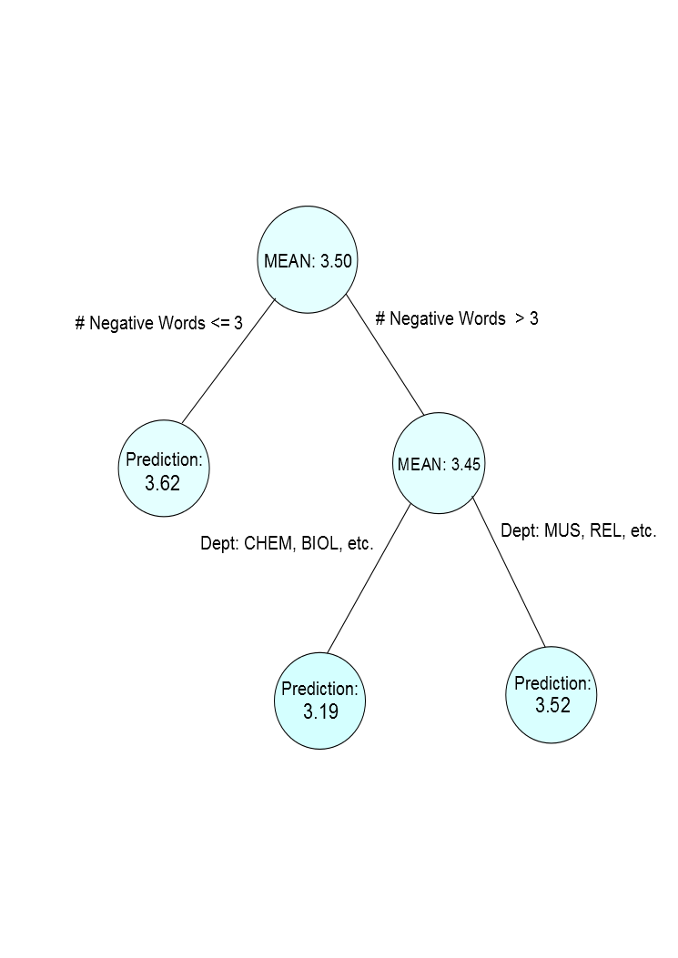
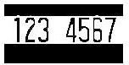
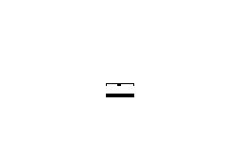


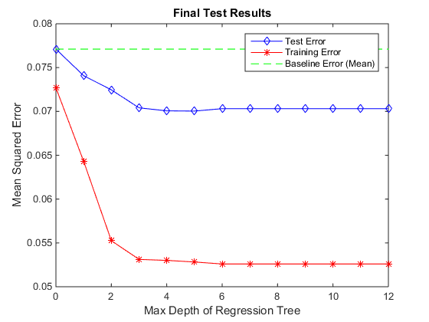

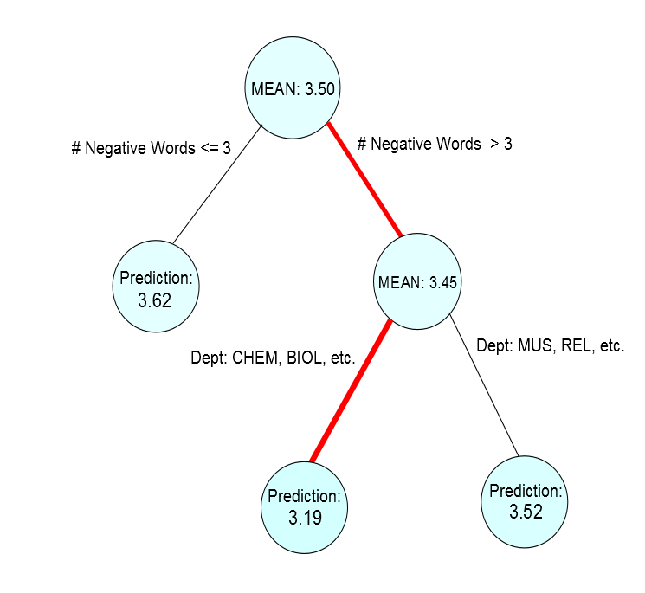

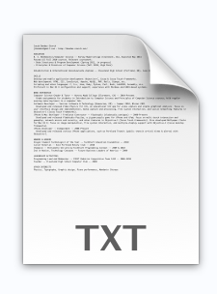

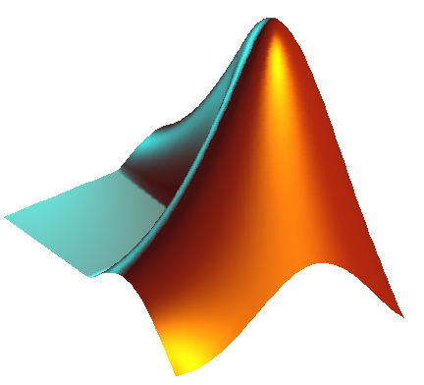
Course Median Prediction via Syllabi Analysis
Graeson McMahon, Kelsey Justis, Coralie Phanord
Dartmouth College, Department of Computer Science
Purpose
Model Used
Results
C4.5 Decision Tree Algorithm
255
0
Getting Started
Collect
Prediction
Format
Key Contribution
We identified recursive feature partitioning as a means of studying the correlation between the text in a course’s syllabi and the course’s median grade. We see that, with an appropriate feature set, syllabi text indeed somewhat correlates to course grade distributions. This shed’s light on how interesting a large scale study could be.
ACKNOWLEDGMENTS
We would like to thank all who contributed syllabi to our project.

