Slide 1

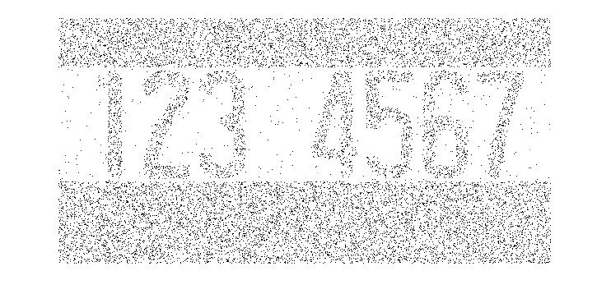
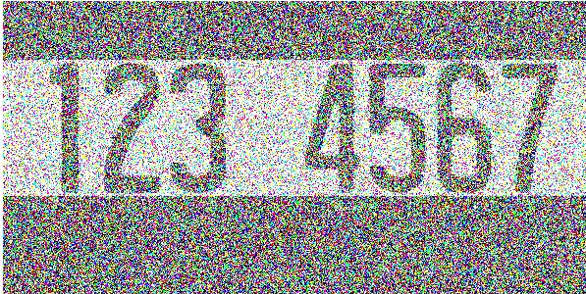
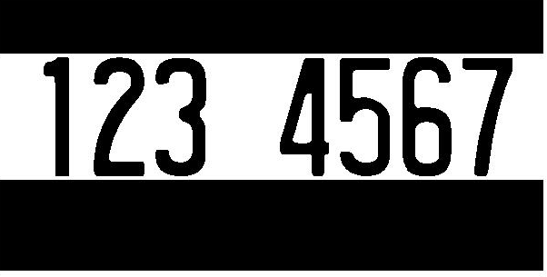
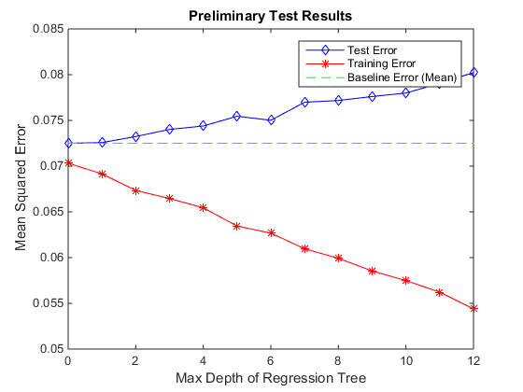


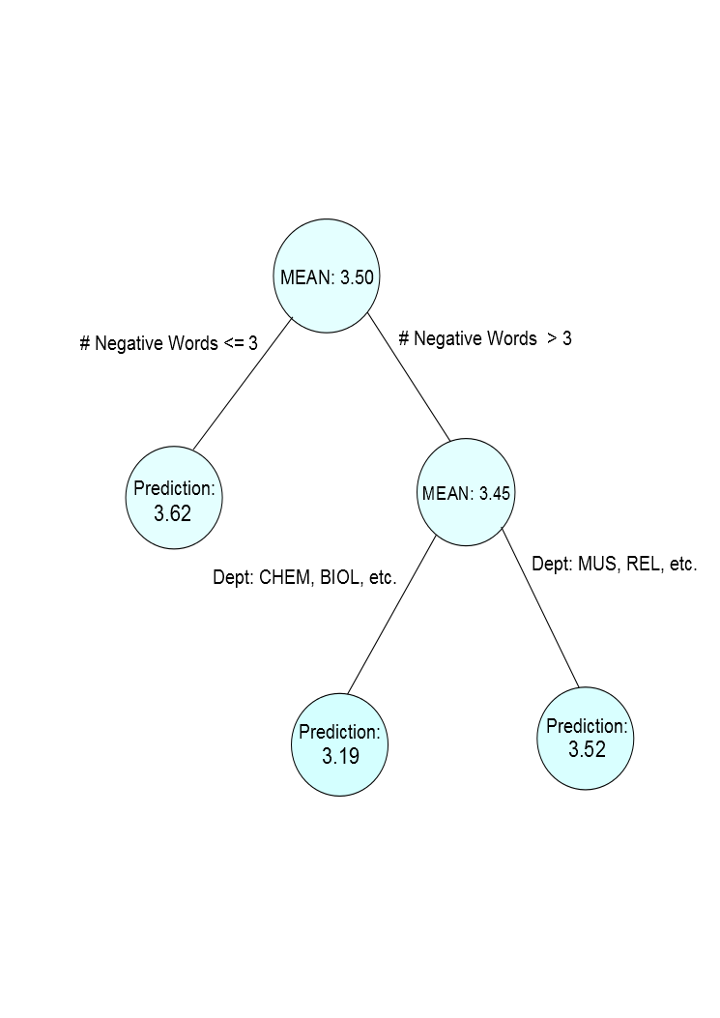
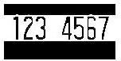
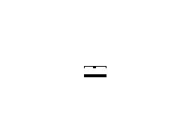


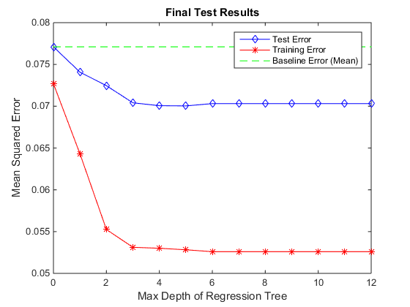

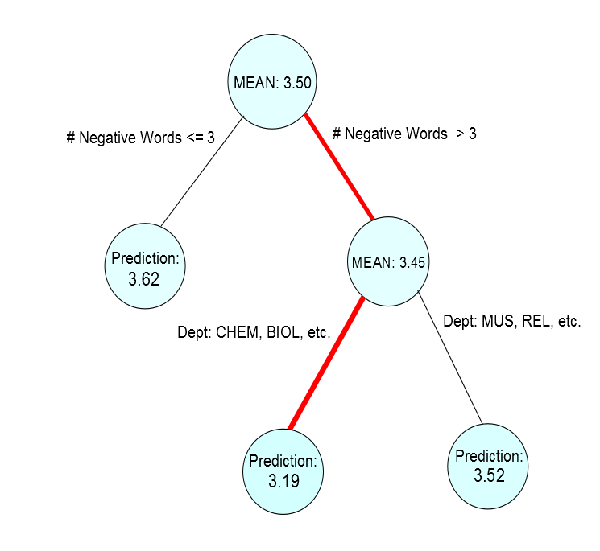

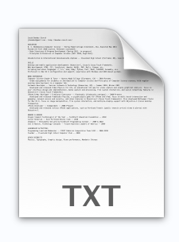

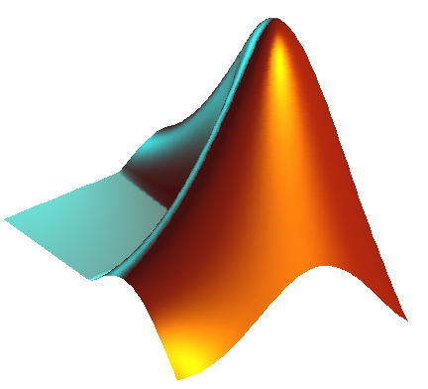
Course Median Prediction via Syllabi Analysis
Graeson McMahon, Kelsey Justis, Coralie Phanord
Dartmouth College, Department of Computer Science
Purpose
Model Used
Results
C4.5 Decision Tree Algorithm
255
0
Getting Started
Collect
Prediction
Format
Future
Or contributions in our case
Key Contribution
ACKNOWLEDGMENTS
We would like to thank all who contributed syllabi to our project.

