Slide 1

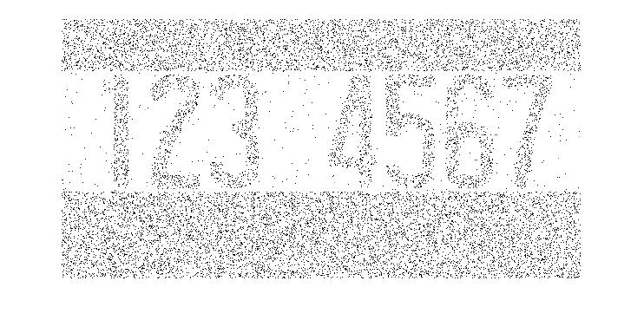
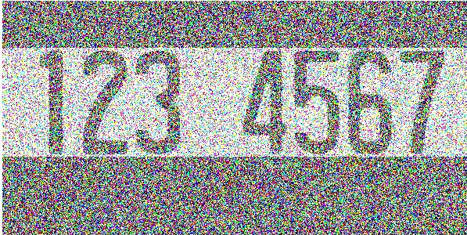
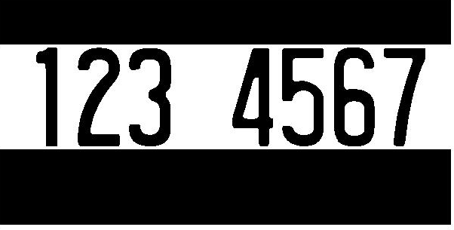


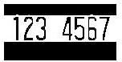
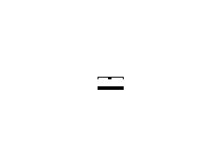
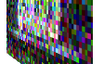
Course Median Prediction via Syllabi Analysis
Graeson McMahon, Kelsey Justis, Coralie Phanord
Dartmouth College, Department of Computer Science
Purpose
Model Used
Results
255
PICTURE of tree visualization
PICTURE
Of Median Grade Prediction
0
Getting Started
PICTURE of
syllabi docs
going to
computer
Pic of
medians going
to computer
Decision tree algorithms recursively split data.
PICTURE
Of Median Grade Prediction
PIC of
pdf syllabi
converted
to text
PICTURE of tree choosing a grade
Given a syllabi
Just make path red or whatever
Reality
PIC of
Text file
Becoming
Matlab
features
Future
Or contributions in our case
Key Contribution
ACKNOWLEDGMENTS
We would like to thank all who contributed syllabi to our project.

