Slide 1

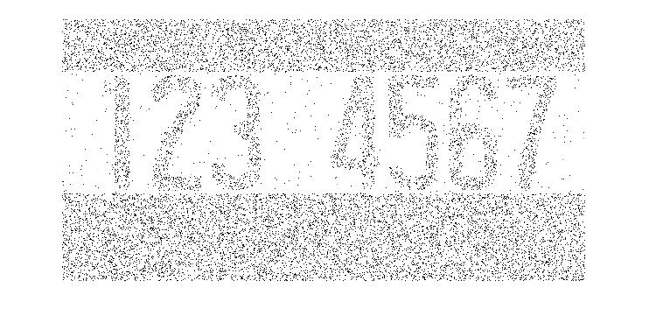
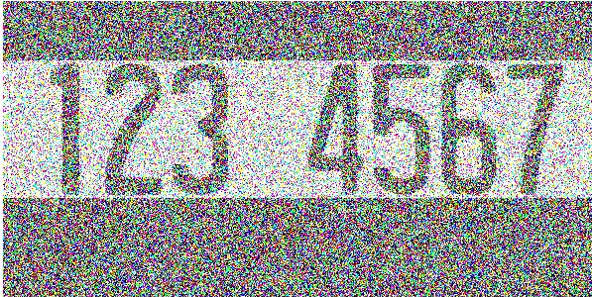
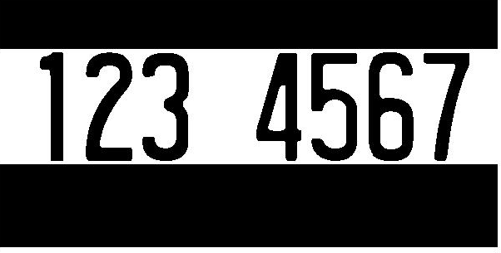


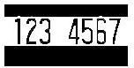
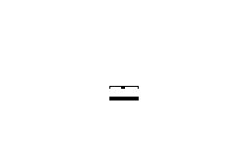




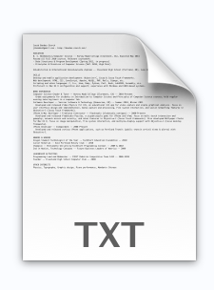

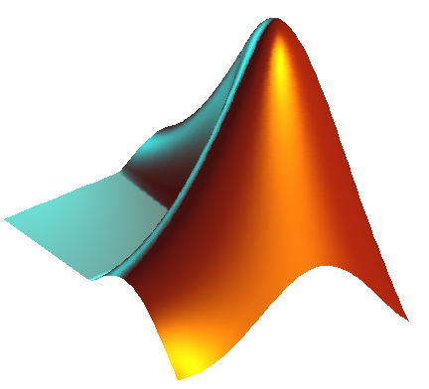
Course Median Prediction via Syllabi Analysis
Graeson McMahon, Kelsey Justis, Coralie Phanord
Dartmouth College, Department of Computer Science
Purpose
Model Used
Results
255
PICTURE of tree visualization
PICTURE
Of Median Grade Prediction
0
Getting Started
Decision tree algorithms recursively split data.
PICTURE
Of Median Grade Prediction
Collect
PICTURE of tree choosing a grade
Given a syllabi
Just make path red or whatever
Format
Future
Or contributions in our case
Key Contribution
ACKNOWLEDGMENTS
We would like to thank all who contributed syllabi to our project.

