Slide 1

PROPERTY PRICE PREDICTION (REGRESSION MODELS) MODELS)
GROUP VII
This Photo by Unknown Author is licensed under CC BY-SA

Slide 2


Slide 3
OUTLINE
Project Overview
Business Problem
Data Understanding
Data Cleaning and preparation
Data Analysis
Conclusion
Recommendation

Slide 4
PROJECT OVERVIEW
The project aims to support our stakeholder: The National Association of Realtors (NAR) with appropriate and comprehensive insights and information they can utilize to advice their clients: proprietors and homeowners about how different factors affect home sale prices in the county.

Slide 5
BUSINESS PROBLEM
1. To determine Property Valuation by considering the impact of various property attributes
2. To identify the most influential features in determining property prices.
3. To evaluate potential real estate investment opportunities thus assessing profitability and potential ROI

Slide 6
DATA UNDERSTANDING
12 columns/ features
17607
records
Data time frame:
1900 - 2015
3 data types
This project uses the north western county dataset.
It includes the below features:
price
bedrooms
bathrooms
sqft_living
zipcode
yr_built
3 categorical features
This Photo by Unknown Author is licensed under CC BY-SA

Slide 7

DATA CLEANING & PREPARATION
Check and drop duplicates in the 'id' column
Identify and handle missing values
Check for place holders in 'price‘ column
Convert data date types if necessary
Identify outliers
Feature Engineering by creating new columns i.e 'is_renovated'
Dropping irrelevant columns
This Photo by Unknown Author is licensed under CC BY-SA

Slide 8

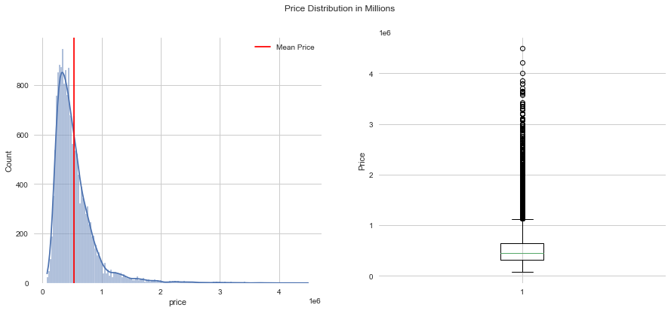

PRICE DISTRIBUTION

Slide 9
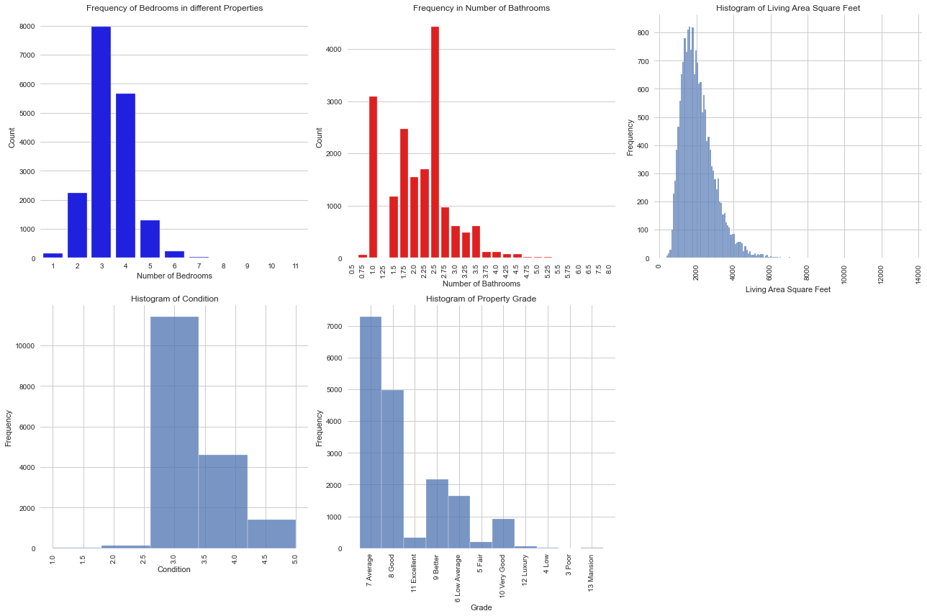
UNIVARIATE ANALYSIS
3 categorical features
This Photo by Unknown Author is licensed under CC BY-SA

Slide 10
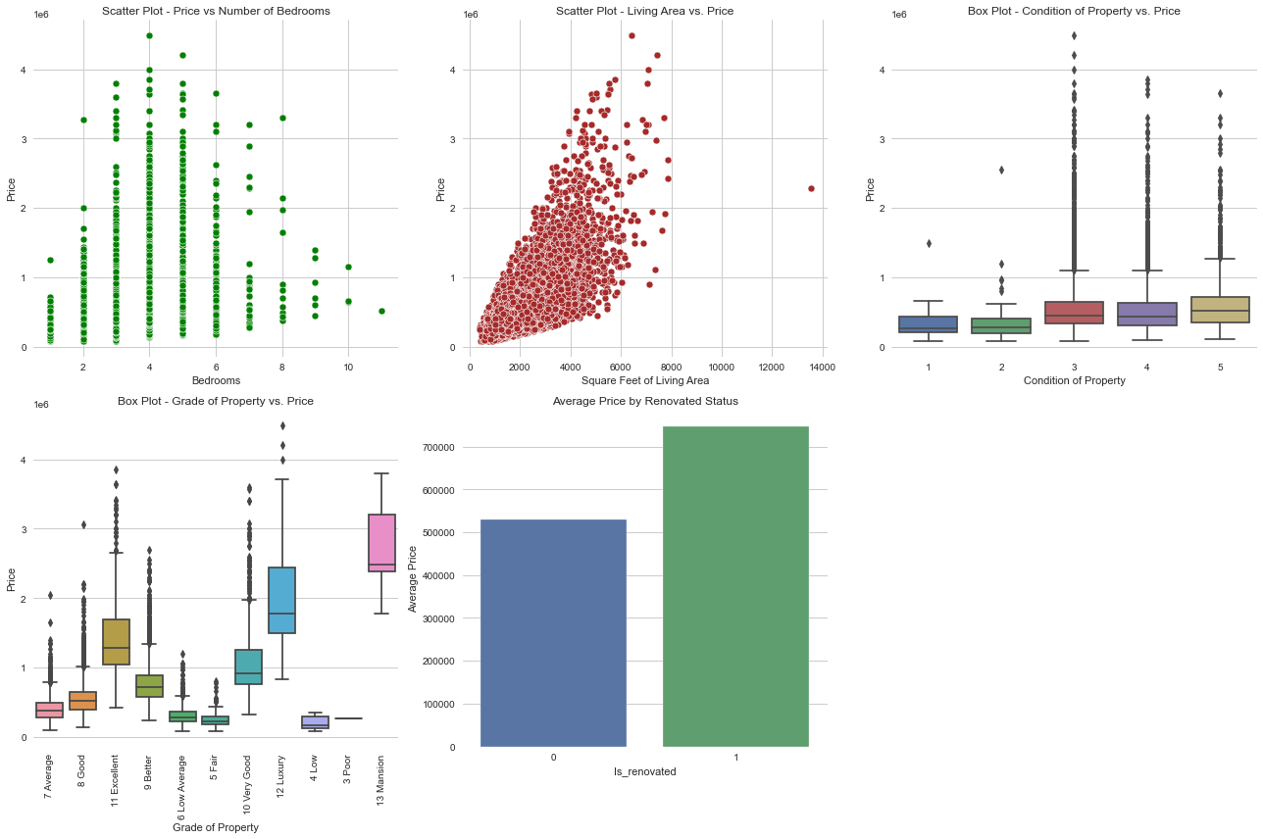
BIVARIATE ANALYSIS
3 categorical features
This Photo by Unknown Author is licensed under CC BY-SA

Slide 11
PROPERTY EVALUATION MODEL
The Model built illustrates price as below:
PRICE = 4,208,000 -57,350 bedrooms + 272.46 squarefootliving + 20,350 condition - 2180.09 yEAr_built + 94,430 is_renovated +94.58 sqftliving15
The model is statistically significant with an F-statistic p-value well below 0.05 and explains approximately 55% of the variability in the dependent variable (price)

Slide 12
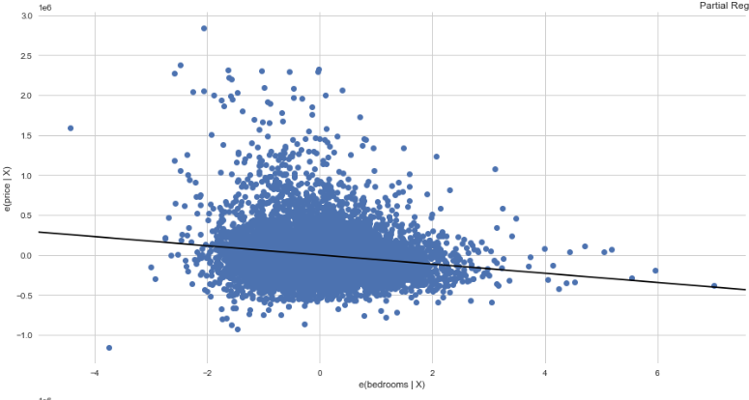
BEDROOM FEATURE
On average, each additional bedroom is associated with a decrease of approximately USD 57,350 in the price.
The model coefficient for bedrooms is statistically significant, with t-statistic p-value well below 0.05.
3 categorical features
This Photo by Unknown Author is licensed under CC BY-SA

Slide 13
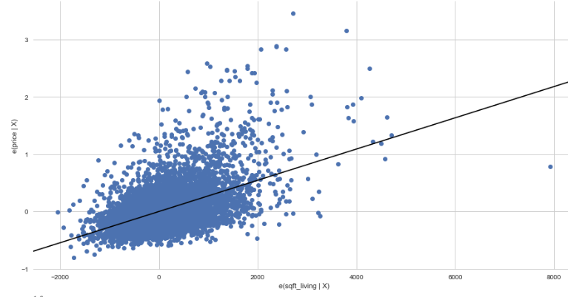
SQUARE FOOT LIVING FEATURE
The model coefficient sqft_living is statistically significant, with t-statistic p-value well below 0.05.
For each additional square foot of living area is associated with an increase of approximately USD272.46 in the price.
3 categorical features
This Photo by Unknown Author is licensed under CC BY-SA

Slide 14
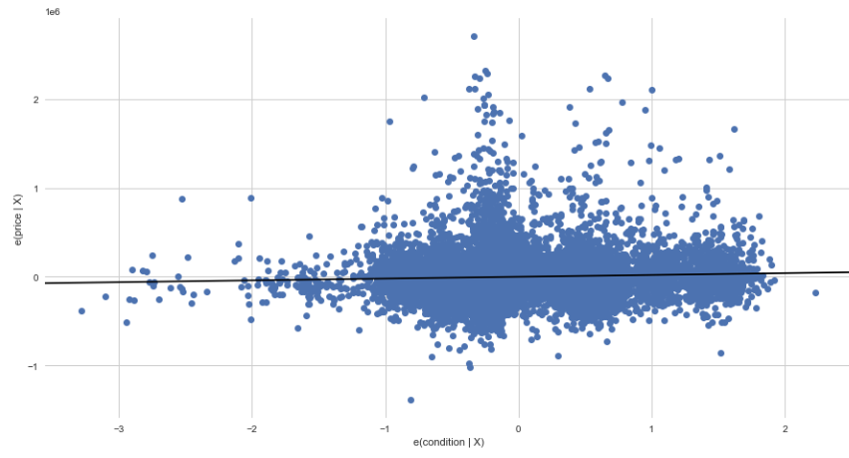
CONDITION FEATURE
The model coefficient condition is statistically significant, with t-statistic p-value well below 0.05.
On average, each unit increase in condition is associated with an increase of approximately USD20,350 in the price.
3 categorical features
This Photo by Unknown Author is licensed under CC BY-SA

Slide 15
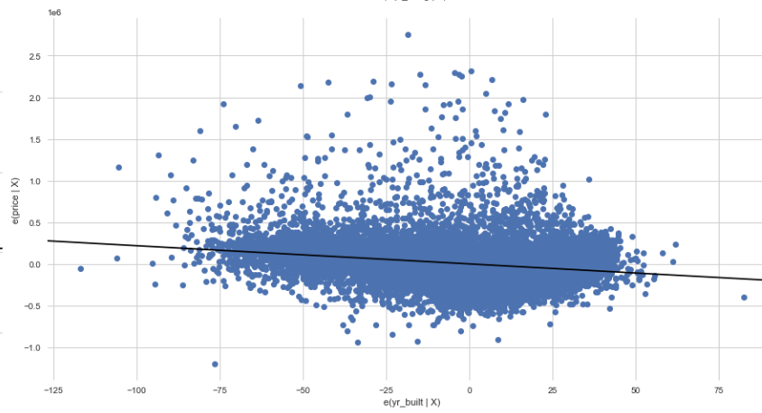
YEAR BUILT FEATURE
The model coefficient yr_built is statistically significant, with t-statistic p-value well below 0.05.
The yr_built on the other hand has an associated decrease in price the older the house is by approximately USD 2184
.
3 categorical features
This Photo by Unknown Author is licensed under CC BY-SA

Slide 16
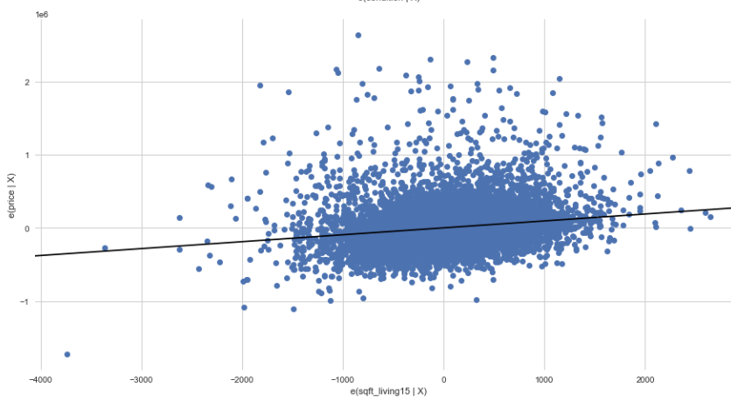
SQUARE FOOT LIVING FOR THE NEAREST 15 NEIGHBOURS FEATURE
The model coefficient sqft_living15 is statistically significant, with t-statistic p-value well below 0.05.
On average, each additional square foot of the neighboring properties' living area is associated with an increase of approximately USD 94.59 in the price.
3 categorical features
This Photo by Unknown Author is licensed under CC BY-SA

Slide 17
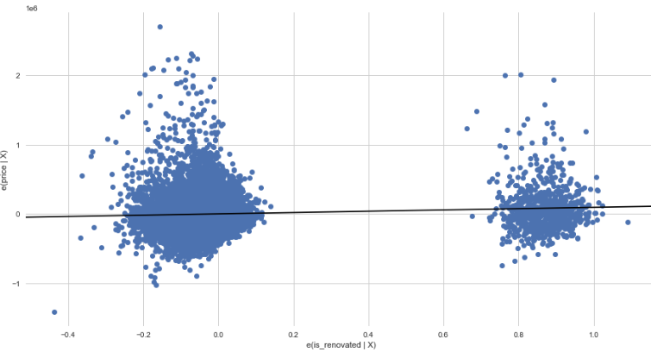
RENOVATION STATUS FEATURE
3 categorical features
The model coefficient is_renovated is statistically significant, with t-statistic p-value well below 0.05.A renovated property increases the price by USD 94,300
This Photo by Unknown Author is licensed under CC BY-SA

Slide 18
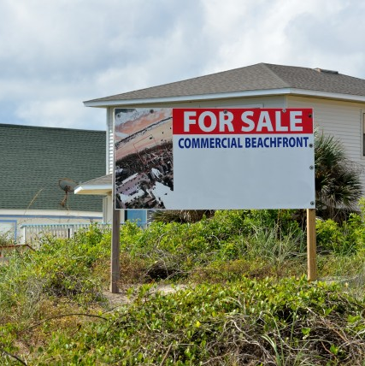
CONCLUSION
1. The model shows a moderate level of predictive power . The model can explain approximately 55% of the variability in home prices.
2. Significant predictors of price as per the model are ;
the number of bedrooms
square footage of living area
condition of house
year built
whether the property has been renovated
the square footage of neighboring properties
3. Normality assumption: The Q-Q plots of the model's residuals suggest that they approximately follow a normal distribution.

Slide 19

RECOMMENDATIONS TO HOMEOWNERS
Consider the number of bedrooms
Focus on the square footage
Maintain the condition of the property
Pay attention to the year built
Renovations can add value
Consider the influence of neighboring properties

Slide 20

RECOMMENDATIONS TO MEMBERS NAR
Educate clients on the impact of features
Provide renovation recommendations
Stay updated on market trends
Conduct thorough market analyses
Collaborate with appraisers
Stay informed about regulations and policies

Slide 21

Any Questions….
This Photo by Unknown Author is licensed under CC BY-NC

Slide 22

Thank you!

