Slide 1
Predicting Financial Exclusion with Explainable AI
[Your Name]
Student Number: [Your Student Number]

Slide 2
Problem Statement
Financial exclusion affects millions in Kenya.
Traditional methods are slow and costly.
Hard to design targeted interventions without data.

Slide 3
Project Objectives
Build predictive ML model
Compare scenarios (unweighted, weighted, SMOTE)
Provide explainable results (LIME)
Deploy app for stakeholders

Slide 4
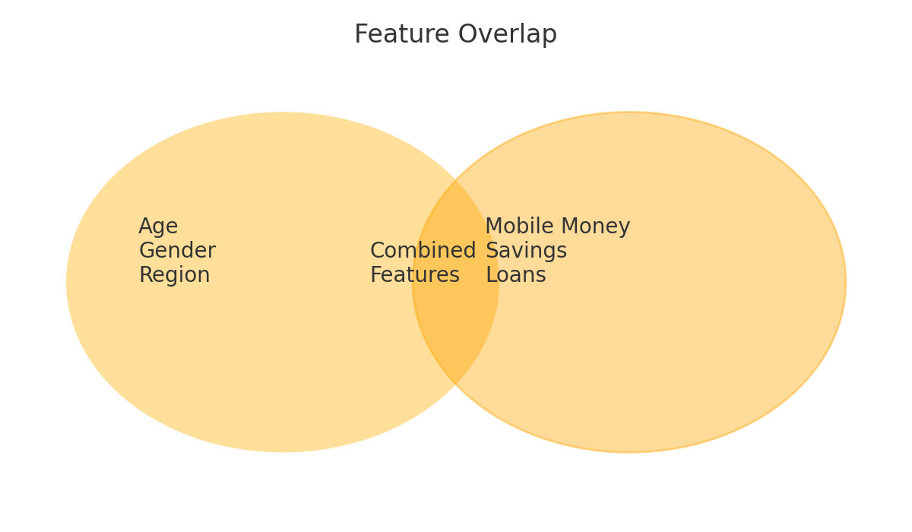
Features: Demographic vs Behavioral

Slide 5
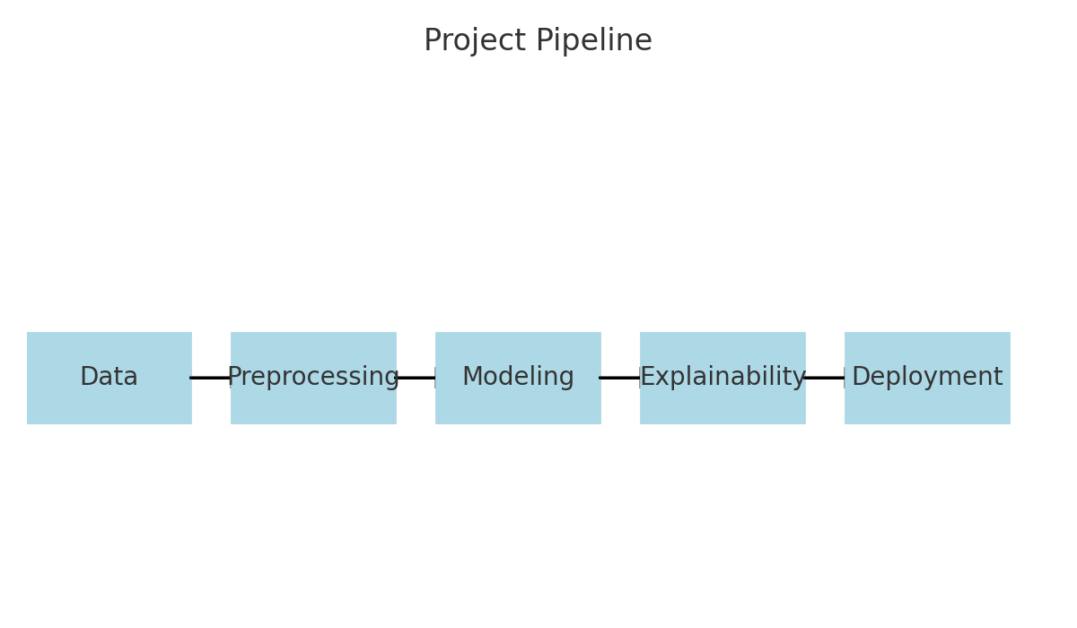
Project Pipeline

Slide 6
Explainability with LIME
LIME = Local Interpretable Model-agnostic Explanations
Provides transparency
Visualizes key features per instance

Slide 7
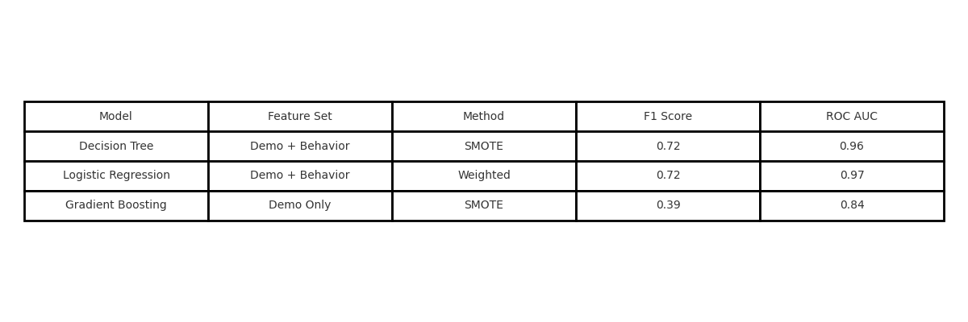
Results: Model Performance

Slide 8
Insights & Findings
Best performance: SMOTE + Decision Tree (F1 = 0.72)
Mobile money & banking = top predictors
Education & residence matter
LIME explains predictions clearly

Slide 9
Interactive App Overview
Predict exclusion risk from inputs
Get LIME-based explanations
Compare model outputs
Visualize key features

