Slide 1
Draw And Guess
Kaiqi Yu
Zichu Chen

Slide 2
Google Quickdraw dataset
The dataset contains around 50 million drawings of 345 classes.

Slide 3
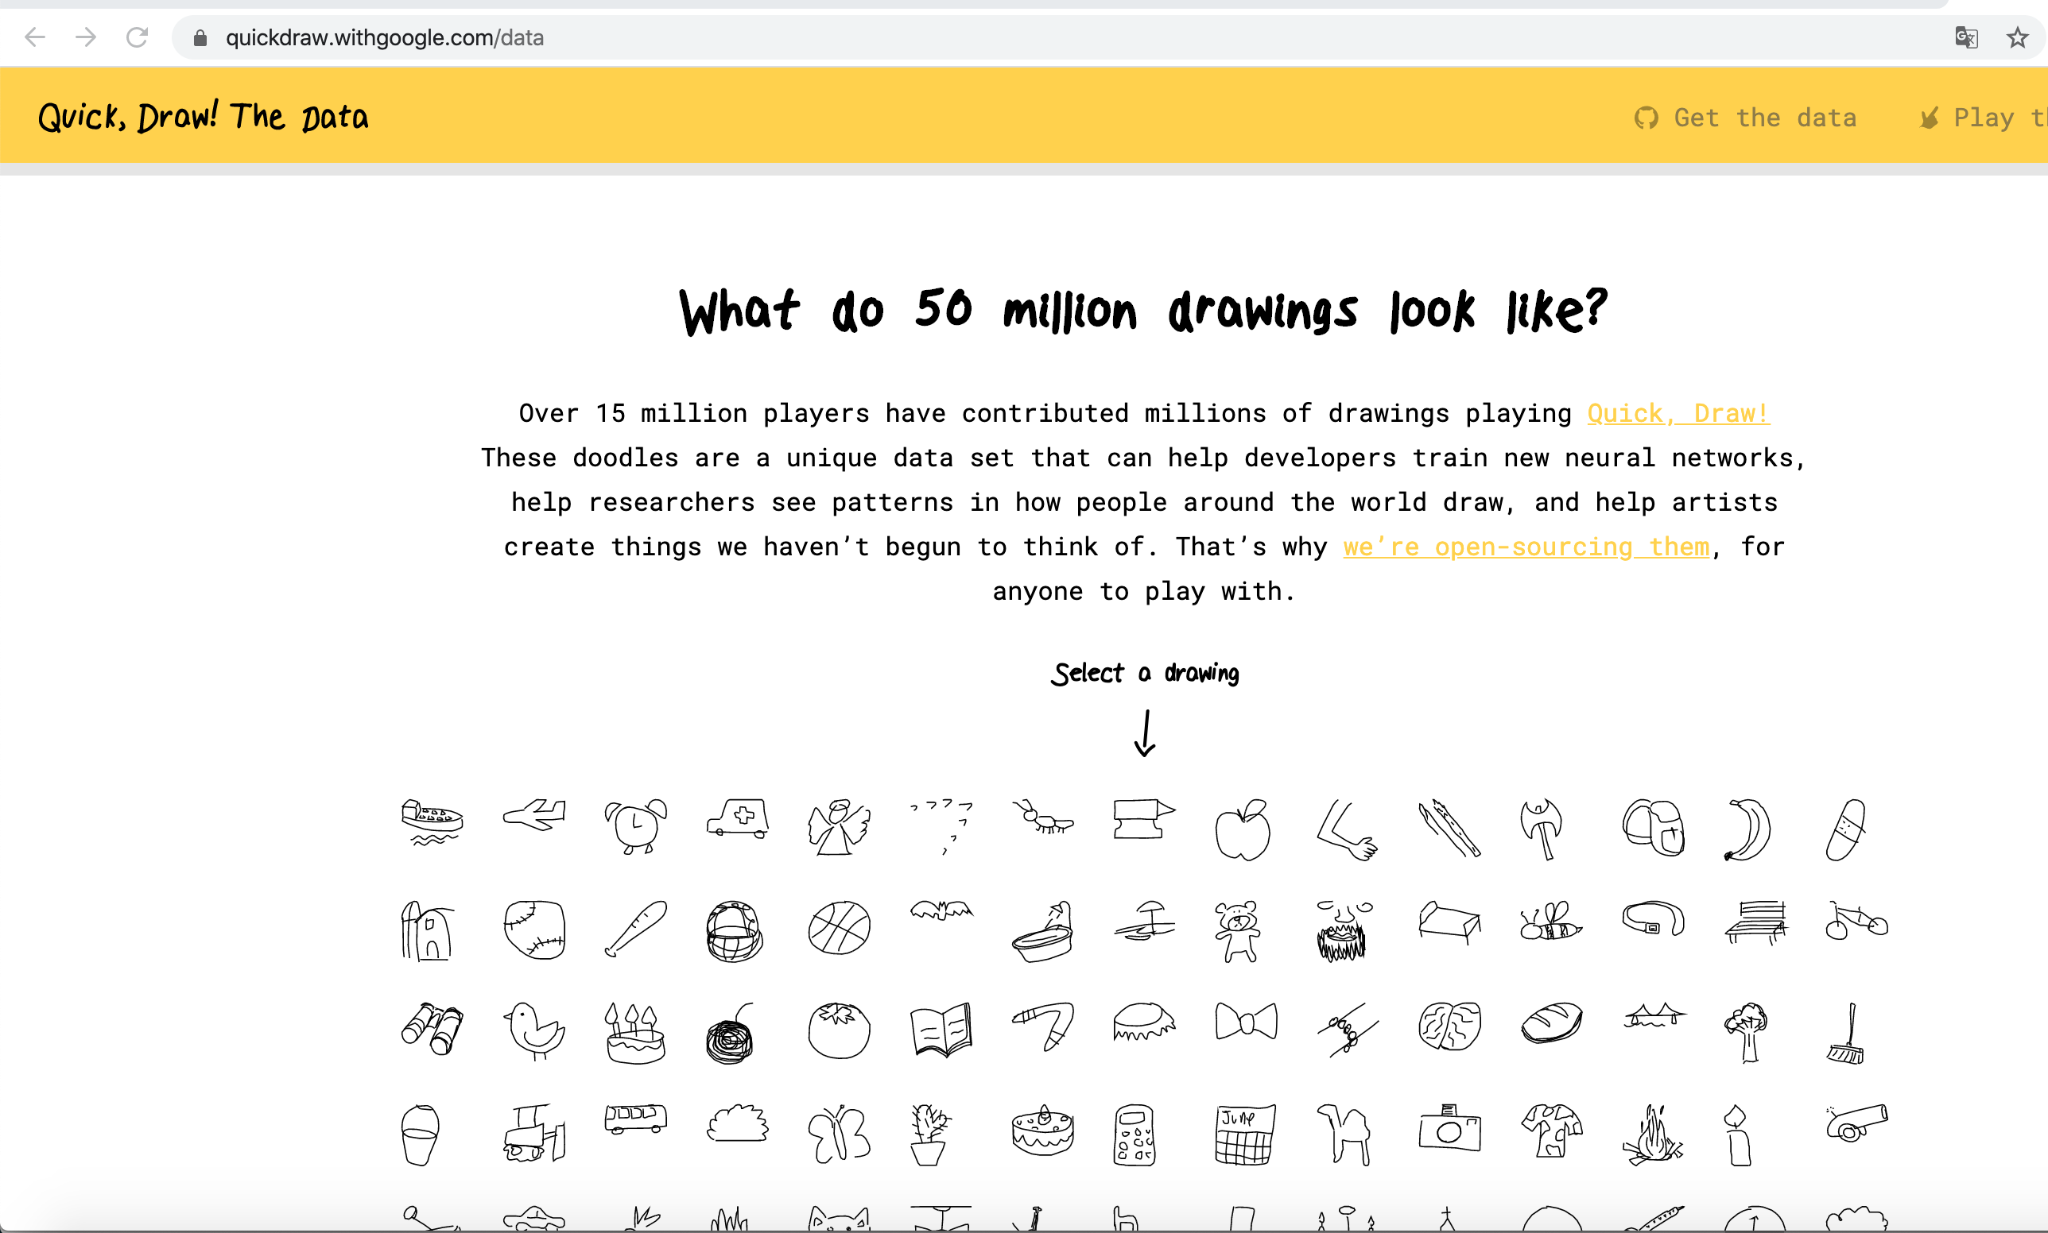
Project definition

Slide 4
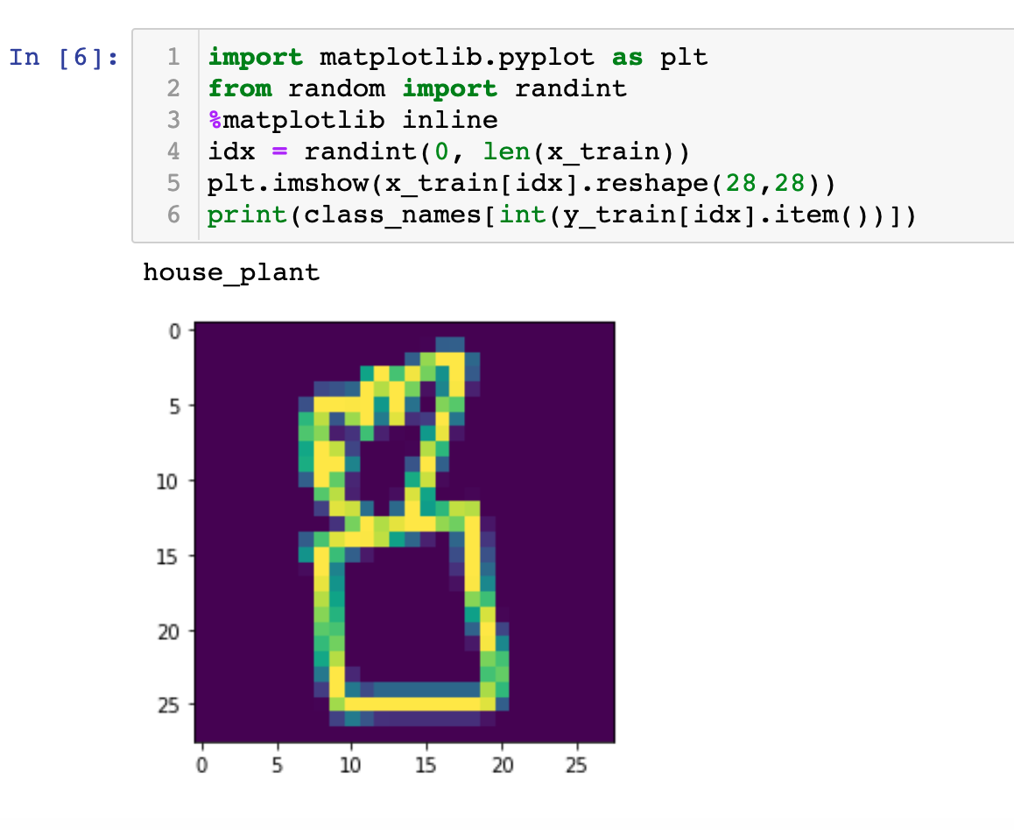
Preprocess
Import data from S3 bucket
Choose 4000 image matrix from each categories
28*28 grey matrix for each image
Normalize each matrix into a range from 0 to 255
80% as training set, 20% as testing set

Slide 5
Model
Layers | Output shape | Number of parameters
Convolutional Layer 1 | 28*28*32 | 320
Max Pooling Layer 1 | 14*14*32 | 0
Convolutional Layer 2 | 14*14*64 | 8256
Max Pooling Layer 2 | 7*7*64 | 0
Convolutional Layer 3 | 7*7*128 | 32896
Max Pooling Layer3 | 3*3*128 | 0
Flatten Layer | 1152 | 0
Dense Layer1 | 512 | 590336
Dense Layer2 | 345 | 176895
Total parameters: 808793

Slide 6
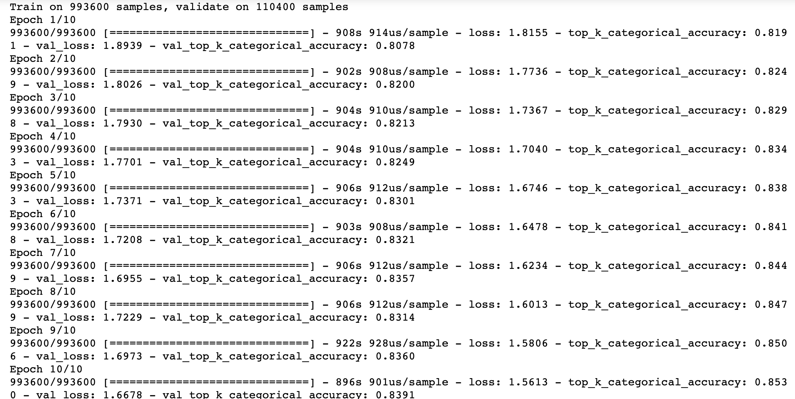
Training the model

Slide 7
Fit the model
Epoch: 20
Accuracy: 85.3%
Loss: 1.5613

Slide 8






Logic Architecture
AWS Cloud
VPC
Availability Zone 1
Availability Zone 2
S3
NAT gateway
NAT gateway
Instance
Instance
Amazon SageMaker

Slide 9
Build the Web—back-end
Flask + Apache2
Model

Slide 10
Build the Web—front-end
CSS
JavaScript
HTML
Tensorflow.js

Slide 11

Demo

Slide 12
Thank you for listening --Hope you like it

