Slide 1
WELCOME ALL

Slide 2
CREDIT CARD FRAUD DETECTION
According to an article written by Debra.E.Ross;
Credit Card Fraud, act committed by any person who, with intern to defraud, uses a Credit Card. That has been revoked, cancelled, reported lost, or stolen to obtain anything of value.

Slide 3
Fraud can be termed as an unlawful action, which is intentional in nature for personal gain.
A fraud done by someone without the knowledge of the card holder is termed as
“First-Party Fraud” .
A Common belief is that a fraud is mostly carried out by third-party not the first party, but this is not true. As per experience statistics the ration of first and third party frauds are nearly equal.
Overall world Statistics about Fraud detection
Organizations across the globe have adopted e-transactions in order to increase their productivity and to expand their business and provide 24/7 sercives
But the Fraud rate also have raised tremendously with the ration3:100. Due to this Monitory loss has reported in billions for the organizations like 50 billion dollars in card related frauds.

Slide 4


History:
To get into history until 1980’s frauds were manually checked in papers by domain experts.
From 1990’s financial institutions started investing millions of dollars in building rule-based engines or export systems.
Introduction to the Credit Card System:
CUSTOMER:
Gets the card from bank and uses the account to make payments for bills and services
MERCHANT:
Any Business personal, who accepts Credit and Debit cards

Slide 5

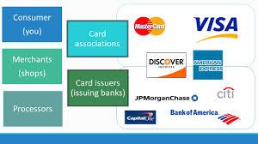
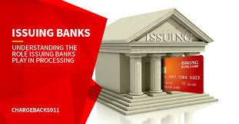
MERCHANT BANK:
Creates and maintains Merchant account .People who accepts the payments of Cardholders
PAYMENT PROCESSORS:
is a gateway like VISA, MASTER CARD transmission of data from who using it and who has issued it
ISSUING BANKS:
Banks and other financial institutions who issues debit and credit cards
Every single cashless, and digital transactions has to go through all these 5 processes

Slide 6
Overview of the Transaction cycles:
Credit Card processing works in Three cycles:
from financial institution point of view transaction has to go through all the 3 cycles:
The Settlement Cycle
Authorization cycle
Clearing
Cycle

Slide 7
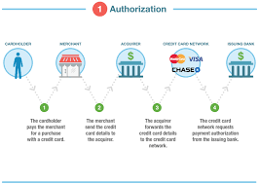

Slide 8
AUTHORIZATION CYCLE:
This is the first cycle; it starts when customer goes to a shop and buys something and uses the card
The merchant sends the customer card information to bank which customer has an account, through the device.
[POS] Point of Sale device
When the bank receives the request and they validates it. After validation, the request goes to payment networks (VISA,MASTERCARD)
The Payment schemes validate the data, then sends the request to the Bank(customer)
After checking thoroughly in the database; bank will send a code and other details of customer to the merchant to accept or declaim the card

Slide 9
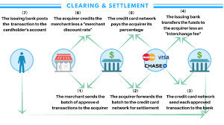

Slide 10
CLEARING AND SETTELMENT CYCLE:
In Clearing cycle a batch of transactions related information is sent from acquirer to issuer through the payment Gateway.
In the Settlement cycle the actual money movement happens in this cycle. Actual money dealings happens here.
SOURCES OF DATA
Financial transactions can be generated from;
ATM
POINT OF SERVICE DEVICE[POS]
CARD NOT PRESENT [CNP] CHANNELS

Slide 11
Each of these transactions have unique codes; so they are equally different from each other.
POS occurs when the customer makes a purchase.
POS and ATM card transactions are Card present scenarios, where as e-commerce, mail, and telephone transactions are CNP scenarios.
Here in CNP scenarios card may not present but both Card and Customer details are given/shared to the merchant
Here with CNP scenarios the existence of different proportions of Fraud takes place

Slide 12
FRAUD PROTECTION SYSTEM:
To get caught of Frauds, financial institutions have developed Fraud Protection System; containing of two layers
The Prevention layer ; makes sure the fraud doesn’t happen and alerts in advance
When the prevention layer is bypassed, then Fraud detection system comes into picture.
Fraud detection system comes into functionality when the fraud prevention fails and is counterfeit by the fraudsters
Fraud prevention is the first layer of the fraud protection system; like firewall protection, external network id detection, mapping of physical address with device and data encryption through the network
One of the main concern in the financial industry is that for every falsification , the organization has to bear a cost.

Slide 13
Credit card fraud detection techniques are two types:
Misuse detection(Fraud analysis)
Anomaly detection(user behavior analysis)
Misuse detection system:
A misuse system is similar to expert system; given by domain experts or SME (Small and Medium Enterprises)coded.
This is a rule-based system, consisting of if-else conditions or market standard technique like inventory optimization.

Slide 14
A rule-based system for fraud detection consists of 3 modules:
DETECTION RULE ENGINE:
Most Trusted detection system for e-tail, till date.
WEIGHT CONFIGURATION SYSTEM:
Typical expert based system, where each attribute us assigned a weight and specific set of simple calculations are done.
VELOCITY RULE ENGINE:
Relies on the concept of dynamic sliding window where the data is assigned in buckets, with fixed time frame length or fixed number of data stream bytes captured by the system.

Slide 15
ANOMALY DETECTION SYSTEM:
Anomaly Detection System, consists of Machine learning algorithms or Data mining techniques.
Many articles published a clear view of how data mining techniques like association, clustering, and classification can be used for behavior analysis of customer and customer profiling.
Machine Learning algorithms are used for solving different types of Fraud detection system, the usage of algorithm is based on the financial industry use cases and cost.
Every Card transaction coming into live anomaly system is to be processed with a few hundred mille seconds or else a penalty cost is to be paid by the serving bank

Slide 16
RAISING A FRAUD FLAG-ISSUER:
Customer details are verified from database and run time metrics, called SCREENING.
Screening is the first step of Fraud detection, this checks customer, OTB(over the bank), transaction country, the currencies checked. This request then sent to the Fraud Detection System[FDS] to check the fraud .
After the Screening the request is sent to Heuristic System which decides whether to raise a flag or not
If it is a fraud then issuer bank alerts the customer by either sending a message, e-mail, etc…

Slide 17
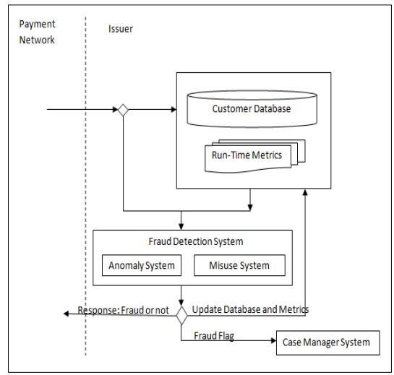

Slide 18
THE CHALLENGE OF THE CASE:
KPMG, India had designed an Anomaly Detection System for authorization cycle, which is capable of handling and processing approximately >100 transactions per second.
Considering the time limit on each transaction process is 300milli sec.
This product had to be deployed in the FDS of the issuer bank and had to run in parallel with rule based system.
M.L cannot stand alone for a such a sensitive use-case, we require data pre-processing and data security as they were heavy penalty for the institutions if they goes wrong, because they are highly confidential.
Earlier all the e-transactions coming from POS,ATM, or e-commerce were in the xml or json format(Market standards).

Slide 19
The data has to be extracted in structure format, so feature extraction and feature engineering can be done, so that data is sent to M.L model to test and result. So that they could achieve their goal of completing the 300milli.sec. per transaction.
For this there was need for Big data which is powerful and fast to achieve the target. Tools like Amazon Kinesis, Apache Kafka, Apache Storm etc.. Used for ingestion of the transaction data.
WHO ARE DESIGNING AND DEVELOPING THE PROJECT:
A team with different skillset is needed for the project like:
POC(Proof of Concept)
Prototype
Pilot
And
Production

Slide 20
KPMG has designed a fully functional POC with :
A Misuse Engine
An Anomaly Engine
Case Manager Module
A UI
A team with 7 to 10 required to build fully functional POC, which includes lead, manager, and developers. They perform multiple roles to improve the efficiency.

Slide 21
Technical Manager
Task Manager/lead/scrum Master
Has past development experience & knowledge of M.L
Dividing the project into modules
Planning the tasks
Track the timeline and meeting the clients
Gathering the domain knowledge
Role is critical and decides the proper flow of the project
Assigning the tasks to team
Checks the progress and challenges
Co-ordinates with SME and understand the client’s vision
If SME is not found the company looks for the consultants as an alternative
The Manager, Scrum Master, and SME comes together and brainstorm the requirements of clients

Slide 22
KPI[Key Performance Indicators]
This team is very important to the project.
These people will interact with clients.
Research and perform activities like documentations and requirement gathering etc…
A Key Performance Indicator is a measurable value that demonstrates how effectively a company is achieving key business objectives.
Organizations use KPIs at multiple levels to evaluate their success at reaching targets.

Slide 23
DEVELOPER
It has to done by a team not an individual task; but support and backup is mandatory.
Building blocks of the project
For development of Misuse Engine- a rule building done with SME
For Anomaly system experienced ML/DS developer is required with 5 to 10 years of exp.
For an analyst 2 years of exp. and knowledge of ML/DS as they perform activities like storing the data extraction of data etc…
For Fraud Detection Project: we need
A Big Data Developer
An UI/UX Developer
Prototype or POC
Having a different skill set and different expertise comes together and build a final project. Hence the expectation from a data scientist is high and important.

Slide 24
PROJECT PLAN:
Any DS project requires a strong planne, which describes/ illustrates many requirements, outlines, structure of data etc..
It’s a vital document of the project. It involves methods and purpose of the project by the experts.
ML is a new technology for many and hard to manage the project.
Data revenue analyzed nearly 30 M.L project and designed a checklists to avoid missing of important points during project planning. Like

Slide 25
Project motivation and problem definition
What is the problem we are trying to solve?
What strategic goal is it linked to?
What output is expected?
What is the description of input data (num.of.fields,entries)
Are there any geo spatial data? (information about a specific location on the Earth's surface.)
How the data being captured?
What might the relevant factors which might affect the output
Performance Measurements/timeline/contacts:
On the basis of what KPI will the performance be checked
Is there any documentation required?
What will be the KPI
What will the output do?
Are there reference solution(Research articles)
What is the over all deadline of entire project?
What is the timeline for each module?
By when the first solution be provided?
Who is responsible for the project?
Who is to be contacted for getting the data (server)
Who will help providing the background knowledge?
Who is the SME for the project

Slide 26
Collaboration:
Set weekly/daily updates b/w business people and developers
Who is to involve? What should they learn?
Define where the cases are stored and how to access them
DATA COLLECTION AND UNAVAILABILITY:
The biggest challenge at the initial stages were “Data Availability” as financial data is very sensitive and a real data is very hard to find.
Without the real dataset designing a system becomes very difficult as real Fraud Scenarios are hard to get & understand.
Most of the online datasets won’t give us proper explanation/description.
We don’t know the nature of data like which cycle it belongs to so domain experts could gather and understand the data and what are the use cases.

Slide 27
For Example:
More than 2 cash withdrawal from an ATM using credit card with in 15 mins is considered as suspicious transaction in India.
A small amount of transaction then sudden large amount of transaction raises suspicion most parts of the globe.
A transaction coming b/w 12:00 to 4:00 A.M is considered high-risk and leads to suspicion.
After gathering and understanding the use cases we got specific idea of what data & created the scripts for generating the training and test data
KPMG has created 2 sample datasets for model development:
The datasets were created in such a way that the transactions with high risk are the same in both the samples; but the number of transactions or data records are differ in size.

Slide 28
The sample 1 was the smaller sample dataset with around 70k records
The sample2 dataset had more than 50lakh records.
The idea behind 2 sample datasets is that until the servers are fully ready for large scale development the data scientist/engineers will work on the smaller datasets.
Credit Card data is highly imbalanced or skewed i.e the total number of Fraud scenarios are very less as compared to the legitimate transactions.
M.L aims to improve the accuracy without the knowledge of the class distribution. Using M.L algorithms without balancing, the class distributions will result in higher error rates and unsatisfied accuracy.
This unbalanced distribution can be handled using data re-sampling techniques.

Slide 29
The data Re-Sampling techniques can be classified into two types:
Over Sampling
Under Sampling Techniques
Under Sampling aims at reducting the number of major class distribution
In this case-study under sampling will eliminate the total number of non-fraud transactions in order to balance the fraudulent & legate transactions
Under Sampling is not widely used in data re-sampling as it reduces the training data size
It may lose important scenarios usecases which were initially required & reduces the accuracy and performance.
Over Sampling aims at balancing the class distribution by replicating the instances of the minority class distribution
It can be sub categorized as
Random Over Sampling
Cluster Based and
Informed Over Sampling

Slide 30
RANDOM OVER SAMPLING:
The instances of the monitory class distributions are selected at random & replicated
CLUSTER BASED OVER SAMPLING:
INFORMED OVER SAMPLING:
Cluster based samplings aims at creating equal size cluster for both the majority and minority class distributions.
This re-sampling technique is based on K-Means algorithms.
It is based on the idea that both clusters(major, minor) having multiple small clusters.
Each of these clusters then oversampling to pre-determined number n
By replicating the instances of each sub-cluster results in the problem of overfitting to the training data , this can be solved by using information over sampling
In Informed Over Sampling like synthetic minority oversampling approach/SMOTE approach is the most widely used informed oversampling.
The subset of the minority class distribution is taken using KNN.
This technique helps tackle the imbalance class distribution without overfitting the model by creating small synthetic instances in the neighborhood of the minority class

Slide 31
DATA REDUCTION/DIMENTION REDUCTION:
Card Transactions for VISA/MASTERCARD/AMEX follow ISO-8583 format[3],which means there are more than 127 fields, with sensitive customer details, which were encrypted in “Alpha-Numeric” codes.
To reduce the high dimensionality data such that the number of fields for processing get reduced but still retain it’s accuracy
We can use LDA/PCA to reduce the data for pre-processing. Data reduction can be defined as reducing the data into smaller subset without losing value.
Data cube aggregation, attribute sub-selection, dimensionality reduction, numerosity, reduction, discretization and concept hierarchy generation methods.
Attribute subset selection method consists of smaller subset of variables to train the model; it has been sub categorized as “step forward selection”, “step backward elimination”, and “hybrid selection elimination” decision tree induction

Slide 32
In step forward selection, the best chosen attributes are added to the reduced subset.
Backward elimination considers all the attributes of the initial dataset & starts eliminating the least important attribute in each iteration.
Hybrid takes a two way approach where the best attribute is selected and least imp attribute is eliminated in each iteration.
Attribute subset selection method is aggressively used in our use-case in order to save time during pre-processing of data & raising a flag.
Eliminating variables is very risky, not only for use case but for any real world problem, we can either go with SME, or with PCA concepts.

Slide 33
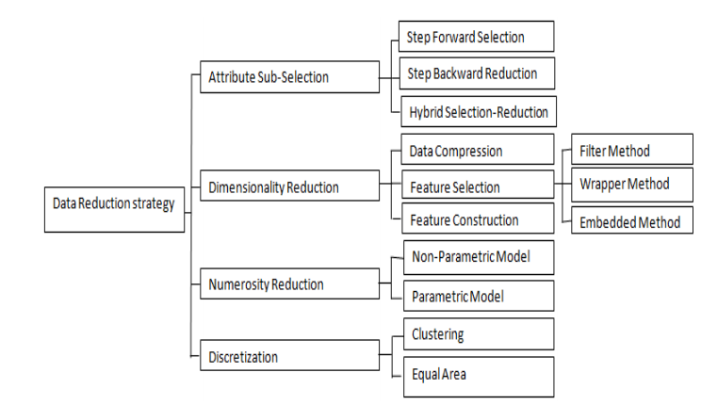

Slide 34
SOLUTION : ML MODEL DEVELOPMENT
KPMG used both black box and white box M.L models in the quest for finding the best fit.
BLACK BOX: are the ML techniques or algorithms in which the results reasoning cannot be back traced.
WHITE BOX: are the ML models/ methods and algorithms can be back traced.
With the help of ANN(Artificial Neural Network) the backward propagation would have in general reduced the error Proving more accuracy.
Find out the reason of a transaction being fraud we can’t back track the result.
In the case of DECISION TREE we can find the reason for which transaction was termed fraud but with stacked decision tree structure like random forest it becomes very difficult.
Decision tree, white box and random forest is black box techniques.

Slide 35
Model selection and evalution:
Many ML models like Regression, Decision Tree, ANN, super stacked model structure, random forest, XGboost etc. and evaluated them.
Regression models have been known to be widely used in the finance industry for solving most of the problems; so we can’t use Regression for Credit Card Fraud as we are dealing with logistic regression.
Model tuning & result observations were done multiple times by different times by different samples for testing.
During the evaluation Random Forest and ANN model provided a higher MCC value and a Mean square error, making them more suitable for Credit Card Fraud scenario.
Usually ML model’s performance is evaluated using accuracy, precision, recall, etc…

Slide 36
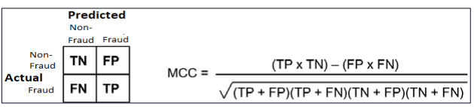
when you have an unbalanced binary classification problem, where the accuracy metric can't estimate well if the predictor is accurate. It is a contingency matrix method of calculating the Pearson product-moment
Mcc(Mathew’s Correlation Co-efficient score)/Confusion Matrix
We can also use LOG-LOSS or Logarithmic loss in order to understand cross entropy for a binary classifier or the divergence of our model from being the perfect model.
real-world machine learning is different, even with the evaluation of model. Companies will buy your product believing that it will save cost, ultimate goal is profit & business.

Slide 37
In a cost sensitive scenario like Credit Card Fraud model evaluated based on:
Business loss = False Positive (Non fraud flagged suspicious) = sum of all transaction amount.
Financial loss = False Negative (Fraud flagged non-fraud) = sum of all transaction amount.
Admin charges = sum of all transactions predicted fraud (TP, FP).
Operational charges =0.2% of all transactions predicted non-fraud.
There is a way of evaluating results; Initially we have to see how much loss the organization is facing without using an anomaly system; then we can use the model check how much is getting less after the model building.
In cost sensitive problem it’s about the loss you can avoid rather than the profit you gain.

Slide 38
whenever a case is created the customer service representative sends a warning and sometimes calls the customer.
In such cases, the customer service representative should be able to state the reason for the decline transaction which is not possible with these black-box models.
So Linear regression, logistic regression, decision tree models if used can provide backtracking easily, but their performance is typically not what we want for our system; therefore we look into complex black box models.
With Blackbox models like Adaboost, Random Forest, Artificial Neural Network we get high performance, but we need a reason for every flag raised in order to calculate the admin charges.
Finding a way to at least provide a reason becomes our next task. After brainstorming and research when we couldn’t find a method to backtrack the reason, we tried looking for interpretability concepts.
Interpretability concepts is similar to variable importance which is quite similar to what we do during EDA.

Slide 39
The concept relies on using local linear approximations for our complex ML models to derive explanations is also known as “local interpretable model agnostic explanations (LIME).
There is an another popular technique called (LOCO)- Leave One Covariate-Out to get the accuracy.
Like LOCO, and LIME, both have shortcomings with respect to accuracy, consistency, or speed.
LOCO works by analyzing individual feature at a time making the number of features slower and more expensive to run as compared to LIME. Both only work with the inputs and outputs of the model.
For Admin charges LIME fits out.
This project success was a sum up of a team work, experience, expertise and patience.

Slide 40
This project make anybody realize how big the scope of data science in the real world.
With the implementation of such system there is always an added advantage, the power of transparent view , which every top level organizations wants.
Because at the end of the day it’s the business and everybody wants to save time and money.
Hence ML/DS plays a vital role in all the industries. With lots of opportunities.

Slide 41
THANK YOU ALL

