Slide 1


Data Wrangling Presentation
Lim Wee Liang Kelven
S10221788K

Slide 2
Content
Findings

Slide 3
Findings

Slide 4
Finding 1
OneHot Encoding severely impacts processing speed
OHE creates a new column for each unique variable.
This increases processing time when fitting transformations or making visualisations.
Ordinal encoding only replaces the values with numbers and does not create new columns

Slide 5
Finding 2
Replacing categorical columns with ordinal numbers after splitting creates an error when building the regression model
If replacing the columns was done after splitting, X_train and X_test would purely contain numerical values while y_train and y_test would contain a mix of strings and numbers.
This creates an error when building the model.

Slide 6
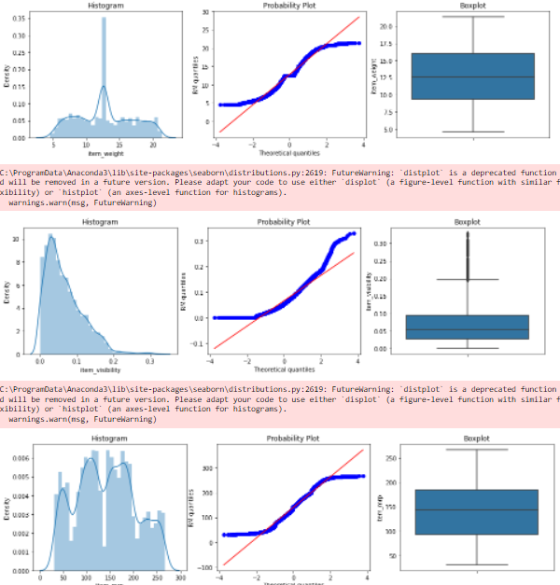
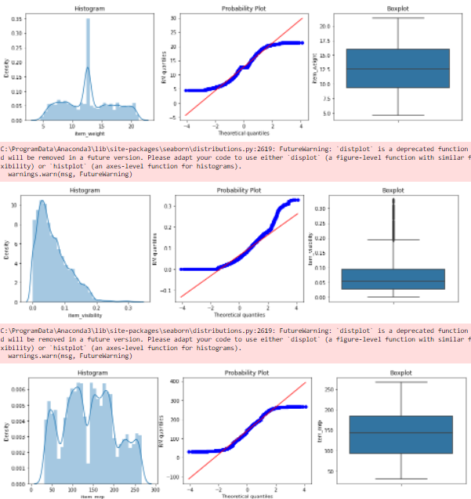
Finding 3
Removing outliers had minimal impact on the data
Before
After

Slide 7
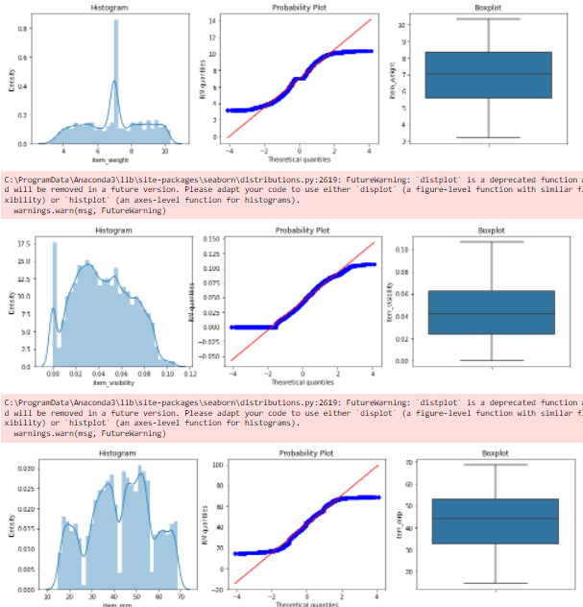
Finding 3
Transforming had a bigger impact on the second variable
Before
After

Slide 8
Finding 4
Not all transformations learnt can be used
Some transformations (like Box-Cox and Logarithm) cannot be used as there were computational errors.
These errors include the presence of a negative number or a zero.

Slide 9
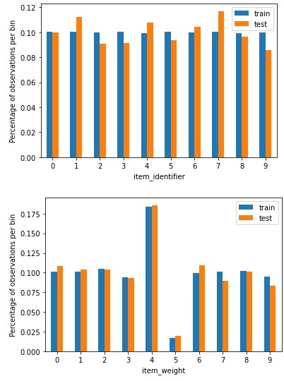
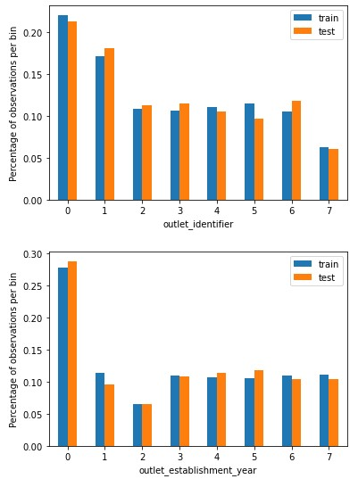
Finding 4
All columns had similar distributions of data

Slide 10
Finding 5
Some factors had a noticeable and minimal impact on the final mean square error
Replacing the null values in item_weight with the minimal/maximum/mean values had minimal impact on the final MSE.
Different scalers give different MSE values. (ie mean normalisation gives a lower MSE than Stadardisation and Min-Max scaling)

