Slide 1
DDP ASG2 Presentation
Lim Wee Liang Kelven
S10221788K
Notes:
Presentation link: https://youtu.be/GHqLbdw472Y

Slide 2
Table of contents
01
02
Problem Statement
03
04
Data Preparation
API Call
Data Display

Slide 3
Table of contents
05
06
Frontend Display
07
08
Demo
Summary
Reflection

Slide 4
01
Problem Statement

Slide 5
Problem Statement
As Singapore strives towards being a car-lite society, more commuters will use public transport like buses to travel.
A pipeline needs to be built to provide real-time bus arrival times for a given bus stop.
By not knowing when buses arrive, commuters may have to wait under hot or wet weather for a long time, miss buses, or be unable to plan their travel time effectively.

Slide 6
Problem Statement
This problem can be seen across Singapore across all ages from students to workers.
This problem also affects the government as they want to incentivise the use of public transport.

Slide 7
02
Data Preparation

Slide 8
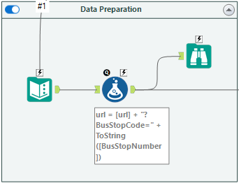

Slide 9




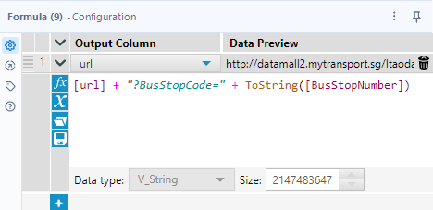
Data Preparation
Text Input
Enter the bus stop number, URL, User-Agent
Formula
Append bus stop number to the URL

Slide 10
03
API Call

Slide 11
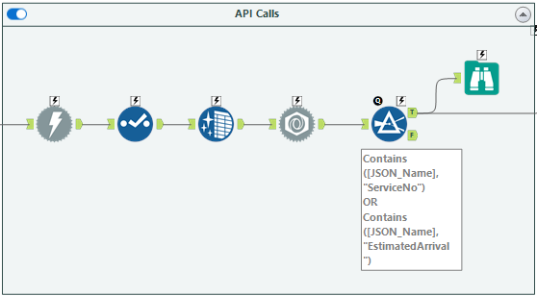

Slide 12


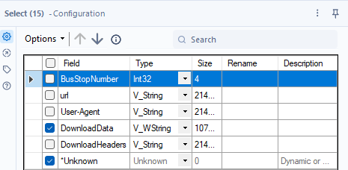
API Call
Download
Download website information
Select
Filter out redundant columns

Slide 13


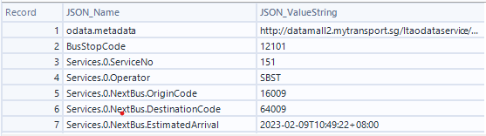
API Call
Data Cleansing
Remove null values and whitespaces
JSON Parse
Removes curly brackets, splits the data into rows, and separates the key-value pairs of each row

Slide 14

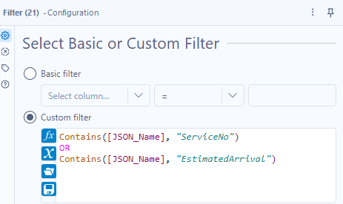
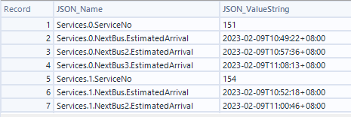
API Call
Filter
Filter out redundant columns

Slide 15
Data Display
04

Slide 16
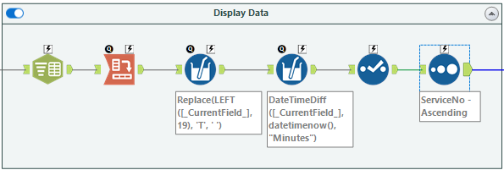

Slide 17


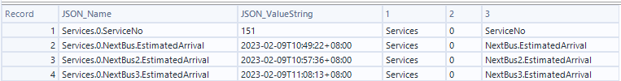

Data Display
Text to Columns
Split JSON_Name by delimiter
Cross Tab
Pivot table to create new columns and values

Slide 18



Data Display
Multi-Field Formula
Format values into proper DateTime format
Calculate arrival times in minutes

Slide 19



Data Display
Select
Filter out redundant columns and rename columns
Sort
Sort results by bus number

Slide 20
Frontend Display
05

Slide 21
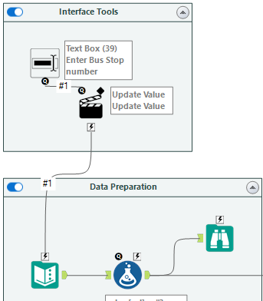
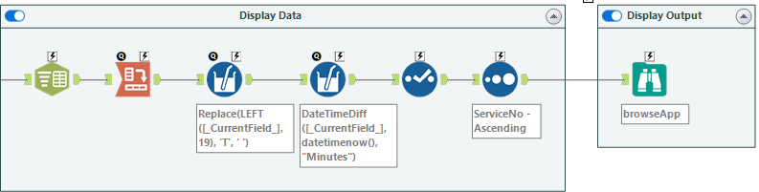

Slide 22


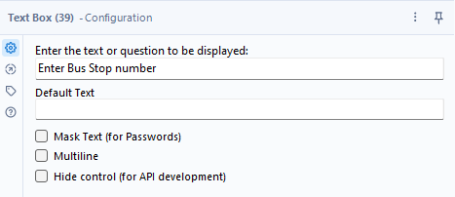
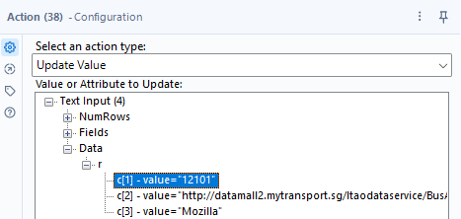
Frontend Display
Text Box
Enable user input
Action
Updates BusStopNumber

Slide 23

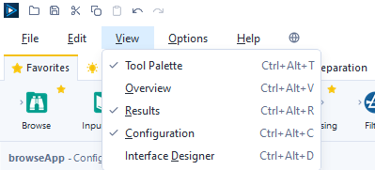
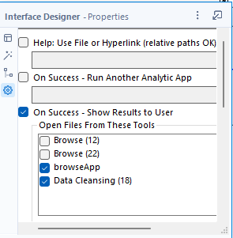
Frontend Display
Browse
Shows results when using the app

Slide 24
06
Demo

Slide 25
07
Summary

Slide 26
When parsing the data, it was observed that there were many redundant rows like Operator, Latitude, Longitude, VisitNumber, etc. To filter the important rows (ServiceNo, EstimatedArrival), a Filter tool was used.
When calculating the number of minutes for the next bus, it was found that the Multi-Field Formula tool is more effective than the standard Formula tool. The Multi-Field Formula tool could change 3 columns at once while the Formula tool could only change one column at a time.

Slide 27
To create an app, Interface tools were needed. The Text Box tool was used to get the user input, and the Action tool was used to update the data before downloading from the website.
Issues were encountered when attempting to display the results. After posting a question on Alteryx’s Community page, I found out that a Browse tool was needed, and changed some configurations.

Slide 28
08
Reflection

Slide 29
Through this assignment, I learnt how to use tools such as the Text Box, Action, and Multi-Field Formula which were neither taught in class nor the Getting Started Learning Path. I learnt how to create an app and perform calculations on multiple columns at once.
A skill I have learnt through this assignment was building a data pipeline using Alteryx. In another module, I learnt to create pipelines using Airbyte. Thus, learning a new pipelining method was educational and beneficial.
My understanding of Alteryx Designer tools has deepened. Through Alteryx’s community, I have asked questions and reviewed questions by others to better understand my mistakes. This cleared up many misunderstandings.

Slide 30
Thanks!
Do you have any questions?
youremail@freepik.com
+34 654 321 432
yourwebsite.com
Please keep this slide for attribution

