Slide 1

DW ASG2
Lim Wee liang kelven, s10221788k

Slide 2
Content
Problem Statement
Chosen Tables
Data cleansing & transformation
Machine Learning Models
Further Improvements
Summary

Slide 3
Problem Statement
What affects driver standings position?
Points?
Number of wins?
Race position?
Lap time?
Number of pit stops?
Pit stop duration?

Slide 4
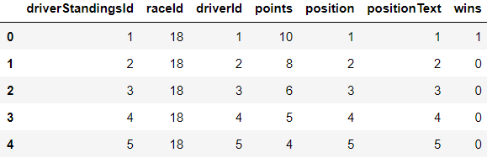
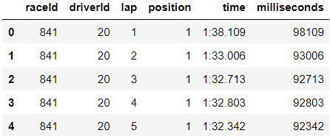
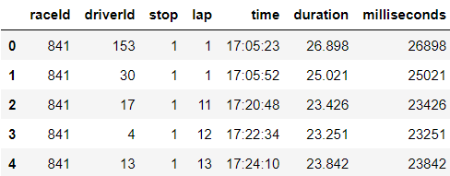
Chosen tables
Imported 3 tables: driver_standings, lap_times, pit_stops
Can merge tables on raceId and driverId

Slide 5
Chosen tables (driver_standings)
driverStandingsId is an auto-increment primary key that ranks each driver by points in each race
The columns “points” and “wins” can be used to predict driver standings position

Slide 6
Chosen tables (lap_times)
Shows the lap number, race positions, and lap times of the driver in each race
The columns “time” and “position” can be used to predict driver standings position

Slide 7
Chosen tables (pit_stops)
Shows the number of pit stops made, lap number, and pit stop duration of all drivers in each race
How often a driver stops, and the pit stop duration can be used to calculate race completion time, which can be used to predict race completion time

Slide 8
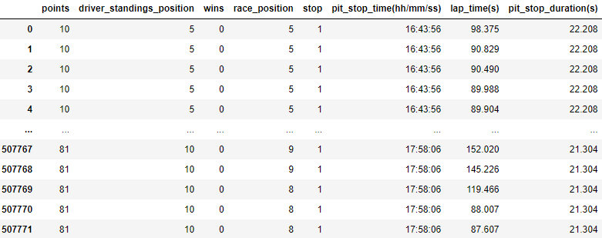
Merging tables
Merged based on raceId and driverId
Removed unnecessary columns
positionText, time_x, duration, lap_x, lap_y, time_y
Removed categorical columns
driverStandingsId, raceId, driverId
Renamed columns

Slide 9
Data cleansing & transformation
Missing Value Imputation
Outliers
Numerical Transformation
Categorical Encoding
Binning
Feature Engineering

Slide 10
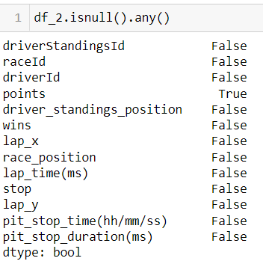
Missing Value Imputation
Only “points” had missing values

Slide 11
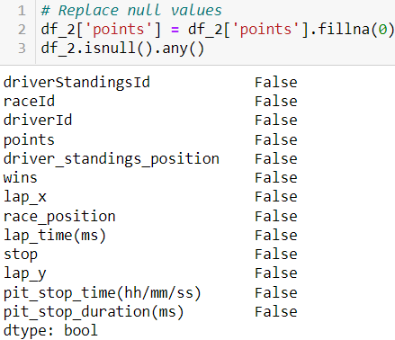
Missing Value Imputation
Replaced missing values with 0’s

Slide 12
Missing Value Imputation
Changed data type of “points” from object to float
Encountered an issue where there were O’s instead of zeroes.
Had to convert O’s into zeroes before changing the column data type

Slide 13
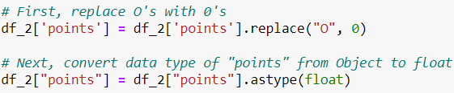
Missing Value Imputation

Slide 14
Outliers
No outlier removals were done
2 removal methods were experimented
Trimming
Winsorisation

Slide 15
Outliers
Trimming
Gave better naïve baseline model (NBM) scores but worser linear regression model (LRM) scores
Winsorisation
No difference in both scores

Slide 16
Numerical Transformation
5 transformers were experimented
ReciprocalTransformer (RT)
LogarithmTransformer (LT)
BoxCoxTransformer (BCT)
YeoJohnsonTransformer (YJT)
PowerTransformer (PT)

Slide 17
Numerical Transformation
PT with square root was used because it gave the best scores
RT, LT, and BCT gave errors due to 0’s or negative values
YJT gave the same NBM scores, a better LRM train score, but worser LRM test score
PT with cube root gave the same NBM scores, a better LRM train score, but worser LRM test score

Slide 18
Categorical Encoding
Since no categorical columns were used, one-hot encoding, ordinal encoding, target mean encoding, or rare grouping encoding were not used.

Slide 19
Binning
2 discretisers were experimented
EqualFrequencyDiscretiser (EFD)
EqualWidthDiscretiser (EWD)

Slide 20
Binning
EFD was used because it gave a better score
EWD gave the same NBM scores but worser LRM scores

Slide 21
Feature Engineering
5 scalers were explored
Mean normalisation
Stadardisation
Maximum absolute scaling
MinMax scaling
Robust scaling

Slide 22
Feature Engineering
Mean normalisation was used because it gave the best scores
All other scalers gave the same NBM and LRM scores

Slide 23
Machine Learning Models
Principle Components Analysis (PCA)
Naïve baseline model (NBM)
Linear regression model (LRM)

Slide 24
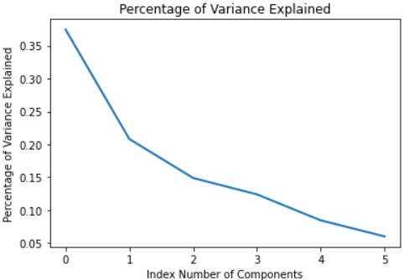
PCA
The PCA shows the number of columns and the variance in each column
The line chart shows that as the number of components / columns increases, the percentage of variance observed decreases.

Slide 25
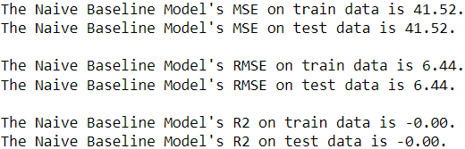
Naïve Baseline Model
final_X_train
355440 rows × 6 columns
final_X_test
152332 rows × 6 columns

Slide 26
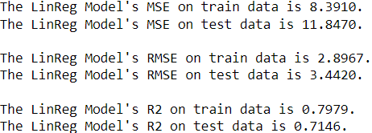
Linear Regression Model
final_X_train
355440 rows × 6 columns
final_X_test
152332 rows × 6 columns

Slide 27
Further Improvements
It was observed that using different target columns gave different machine learning model scores.
It can be theorised that using different target columns can yield different scores. However, this has not been explored.

Slide 28
Summary
Some transformations were effective, while some were not. And some changed the machine learning model scores while some did not.
Outlier removal did not provide better scores
EqualWidthDiscretiser gave the same naive baseline model scores but gave worser linear regression model scores
Different scalers did not provide better scores

Slide 29
Thank You
Lim Wee liang kelven, s10221788k

