Slide 1
DP A SSIGNMENT 2
By Kelven Lim, S10221788K

Slide 2

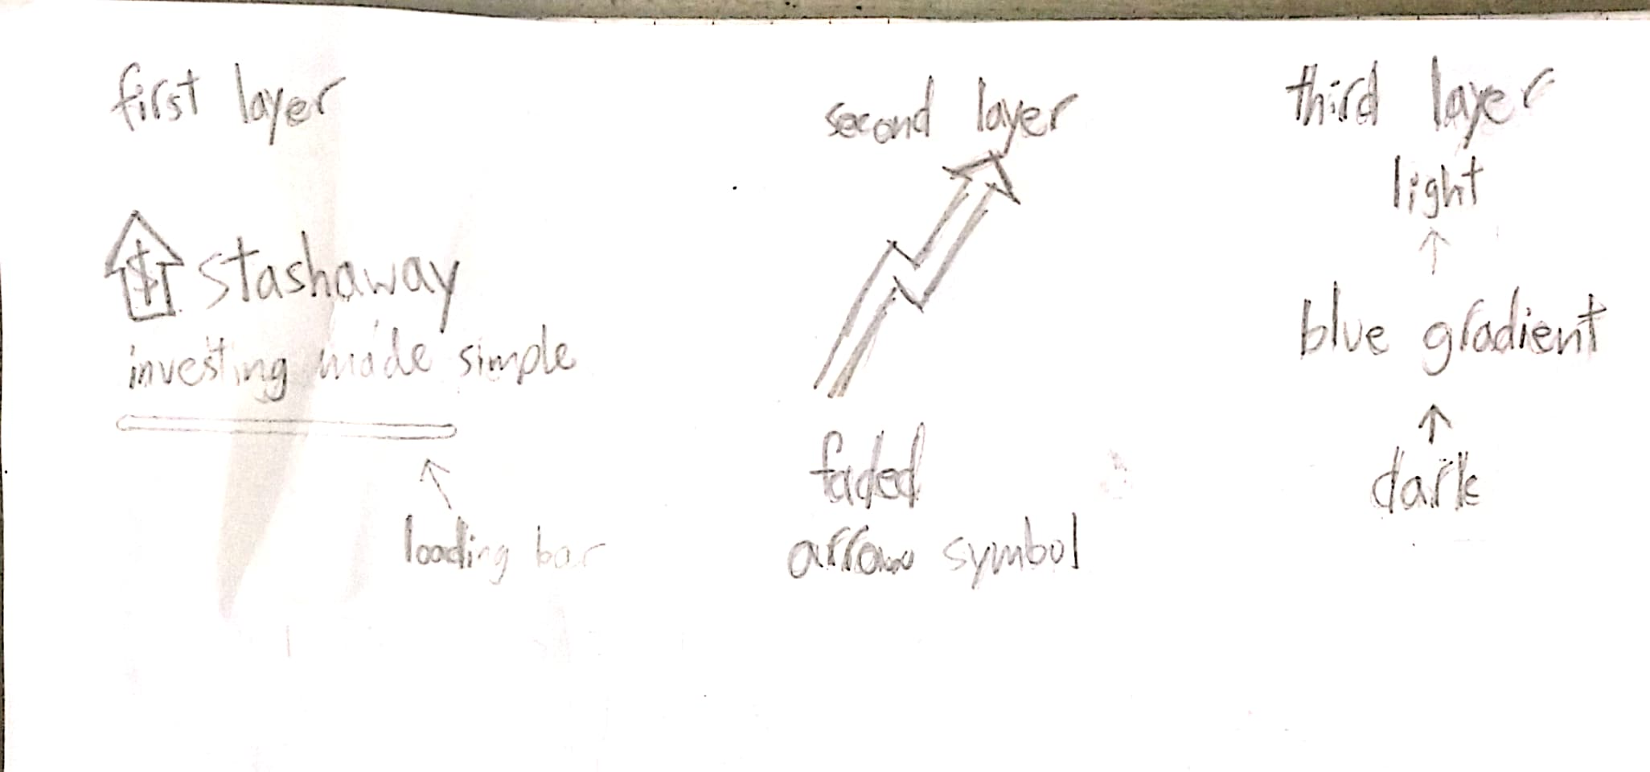
IDEATION FOR MOCK 1

Slide 3
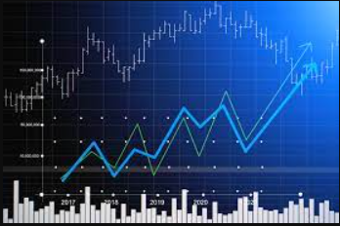
IDEATION FOR MOCK 1
For the first layer, I wanted to include the main icon of my app design
Added a quote saying, “Investing made simple”
Added a loading bar
For the second layer, I added a faded image of a stock market graph
Further add to feeling of investing
For the last layer, I chose to use the same blue tone as my icon design for the background
Added a tonal gradient

Slide 4
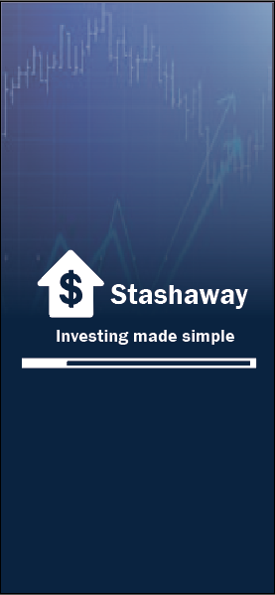
MOCK 1

Slide 5
COMMENTS FOR MOCK 1
Slogan may not be necessary (i.e. Investing made simple)
Loading bar makes it feel slow to load
Icon could be smaller

Slide 6
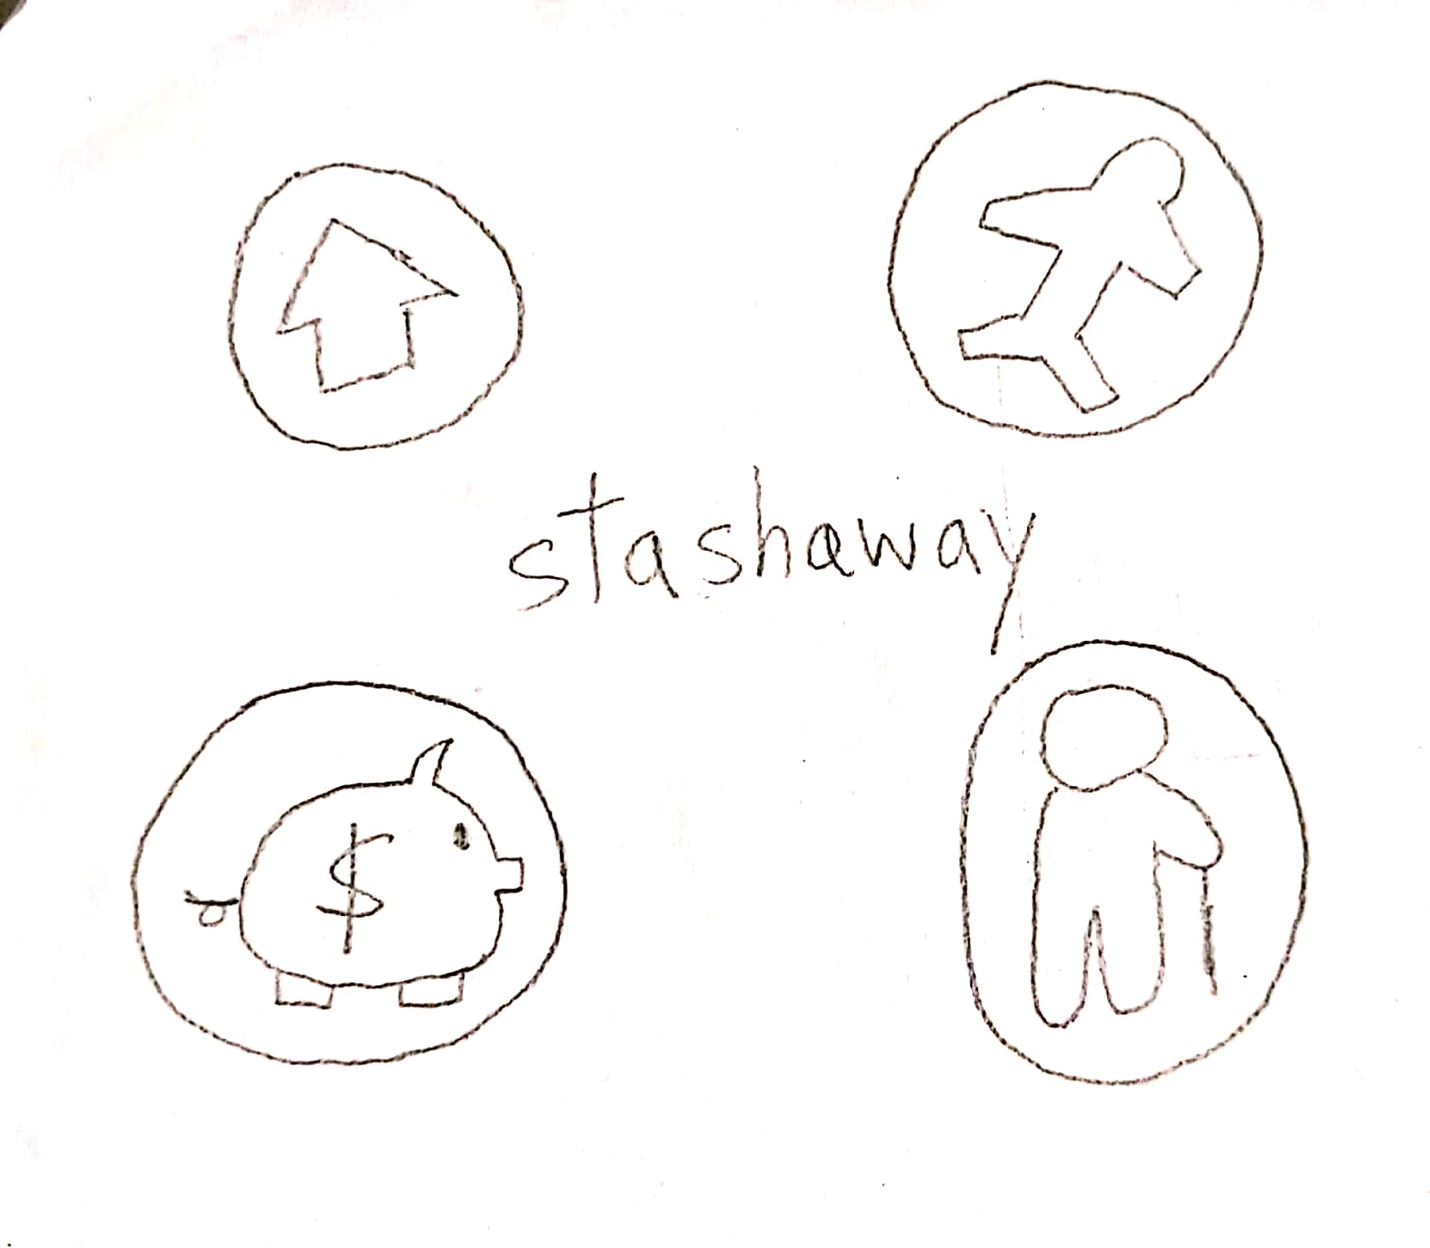
SKETCH FOR MOCK 2
The icons can let users know what they can invest / save up their money for (i.e., housing, holiday, general savings, retirement)

Slide 7

MOCK 2

Slide 8
COMMENTS FOR MOCK 2
Too many icons
White colour stands out too much
Try removing the circles on the icons

Slide 9
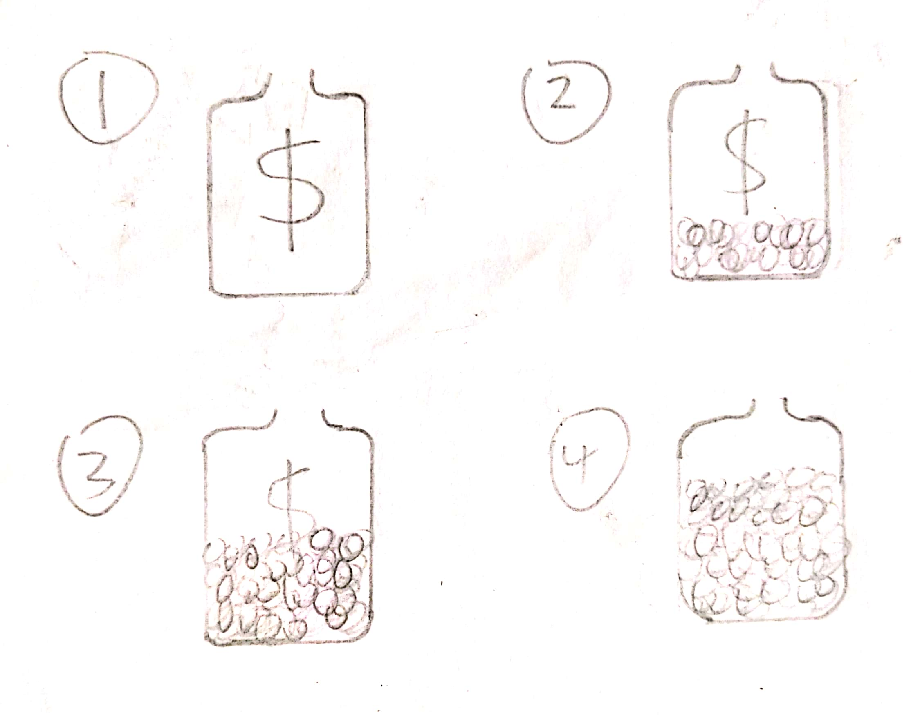
IDEATION FOR MOCK 3
Wanted to delve into animation
The jar would fill up with coins over time.
Represents the money-making effect of investing
Serves as a loading bar

Slide 10
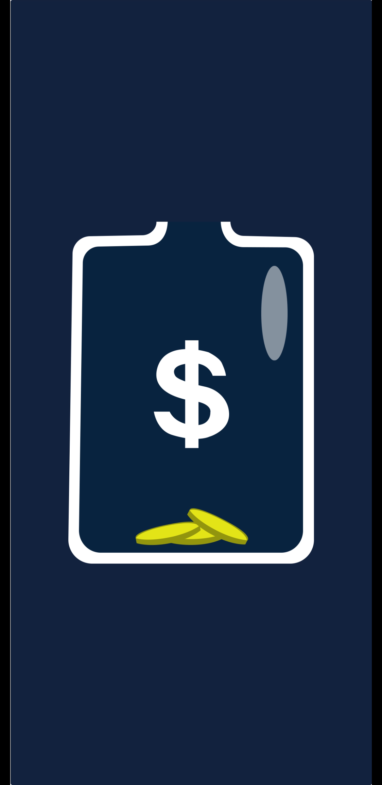
MOCK 3

Slide 11
REFERENCES
https://fortune.com/2019/10/29/stock-market-rally-2019-christmas-eoy/
https://www.shutterstock.com/image-vector/travel-vacation-simple-icons-set-web-788474662
https://www.dreamstime.com/illustration/icons-retirement.html#dt
https://www.dummies.com/personal-finance/investing/investing-for-dummies-cheat-sheet/
https://pixabay.com/illustrations/system-web-network-connection-3699542/

Slide 12
REFERENCES
https://thenounproject.com/term/jar/20208/

