Slide 1

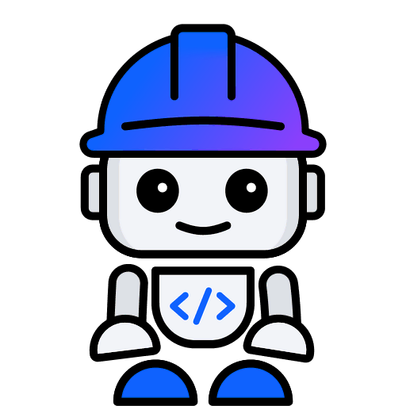
IBM BOB HACKATHON · THEME 1: EXPLORE, FIX, AND BUILD
smartDesktop
explored, fixed and built by IBM Bob
An offline voice assistant that turns speech into shell commands, and had never been audited.
→ smartdesktop-playground.onrender.com
github.com/Kelvin-Belmonte/smartDesktop
Team Kelvin-Belmonte
Notes:
smartDesktop is an offline voice assistant: say 'Jarvis, start dev' and it opens a terminal and runs your dev server. That also means it turns speech into shell commands, and nobody had ever audited it. We gave it to IBM Bob.

Slide 2



Speech goes straight to the shell
“Jarvis”
Porcupine wake word
Faster-Whisper
speech → text
CommandParser
substring match
Handlers
apps, windows, macros
subprocess
shell=True
Anyone near the mic
Config and transcripts reach the shell
No safety net
Any voice can trigger a command, and a misheard phrase can still match a macro by substring (S-08).
Unescaped AppleScript and cmd strings: two critical injections, S-01 and S-02.
45 tests, one of which could never fail. One Ubuntu CI job. The README claims more OS support than the code has.
Notes:
The pipeline goes from wake word to Whisper to a substring parser to subprocess calls. Config values and transcripts flowed into shell=True and AppleScript strings. There was no confirmation, a test that could never fail, and one CI job.

Slide 3
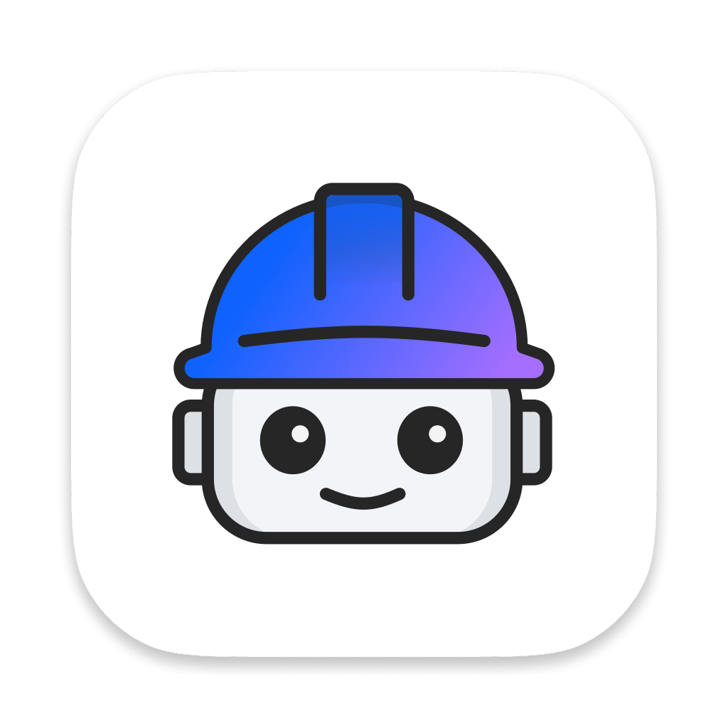




A playbook for Bob, not a single prompt
T1 · T9
T2
T3 · T8
T4 – T7
SD Analyst
SD Auditor
SD Tester
SD Developer
Documents the code: architecture, command catalog, OS matrix, after-report.
Audits injection, unsafe defaults and logging; runs bandit and pip-audit.
Proves each bug with a failing xfail(strict) test, then builds the CI matrix.
Fixes the bugs; builds dry-run, text mode, playground and the safety layer.
edits only
docs/baseline/overview.md
docs/after/, README.md
edits only
docs/baseline/
security-audit.md
edits only
tests/**
.github/workflows/ci.yml
edits only
voice-assistant/**
playground/**
BOB_TASKS.md prompt
mode + fileRegex
Bob works
accept check passes
human reviews + commits
12 prompts · 436 Bob tool calls · ~11,000 lines of transcript in docs/bob-sessions/
Notes:
We didn't just say 'fix it'. We wrote a playbook of nine tasks. Each runs in a custom Bob mode that can edit only its own files and has to pass a check before it's done. The analyst documents, the auditor audits, the tester proves bugs, and the developer fixes them.

Slide 4

What Bob found, and proved before fixing
7 functional bugs
9 security findings
B-01
Macro steps sent to the shell as literal text
2
3
4
B-02
Window commands hit an arbitrary window
B-03
Linux terminal ignores installed emulators
Critical
High
Medium
B-04
macOS apps with arguments fail to launch
S-01
AppleScript injection: unescaped string in do script "…" (terminal.py:51)
B-05
CPU fallback keeps the GPU float16 type
B-06
Wake-word thread dies on any error
S-02
cmd injection: shell=True with config and transcript values (terminal.py:44)
B-07
Config silently overrides built-in commands
Each bug got a test marked xfail(strict=True) that failed until the fix landed.
bandit: 5 High, 12 Low · pip-audit: 0 CVEs, but nothing pinned
Notes:
First Bob explored the code and audited it: nine findings, two critical, where a misheard phrase or a config value could inject AppleScript or cmd commands. Before fixing anything, Bob proved seven bugs with tests that fail. Only then did the developer mode fix them, removing each xfail without touching a single assertion.

Slide 5
Before → after
Tests
CI jobs
bandit High
Open findings
45 → 163
1 → 8
5 → 0
16 → 0
121 voice-assistant
+ 42 playground
Ubuntu · macOS · Windows
× Python 3.10 / 3.12
no shell=True
anywhere
7 bugs + 9 security,
each traced to a test
--text / --dry-run
confirm_destructive
PORCUPINE_ACCESS_KEY
runs without a microphone
asks before closing or running
keeps the key out of config.yaml
Notes:
The tests went from 45 to 163, and CI from one job to eight, across three operating systems. The two critical injections are gone, along with every high-severity bandit finding.

Slide 6



What Bob built: try it without a microphone
Dry-run plans
CommandParser.plan() returns what would happen on Windows, macOS or Linux, without touching the machine.
$ printf 'start dev\n' |
python main.py --text --dry-run
{"command": "start dev",
"action": "macro"
"platform": "macos",
"steps": [
{"action": "launch",
"target": "Terminal"
{"action": "terminal",
"target": "npm run dev"
]}
Web playground
FastAPI and the Web Speech API, always dry-run. A test proves no process is ever spawned.
Safety layer
Confirmation for destructive commands, no shell=True, AppleScript via argv, redacted logs.
→ smartdesktop-playground.onrender.com
Notes:
Bob then built what the project was missing: a text mode and a dry-run mode that return a structured plan instead of acting. That powers the playground, which shows exactly what each phrase would do on Windows, macOS and Linux. It's always dry-run, and a test proves no process is ever started.

Slide 7


An honest record, and what's next
Where Bob was corrected
Next
1
Logged planned actions instead of returning them.
A follow-up added CommandParser.plan().
Window snapping on macOS and Linux (Windows-only today)
Record and transcribe off the wake-word thread
Confidence-scored matching instead of substring (S-08)
Voice confirmation driven by the structured plan
2
Rebuilt the playground and dropped 29 of 30 tests.
The guardrails caught it. Bob restored all 30 and added 12.
3
Missed an import that Python 3.14 hid.
CI on 3.10 / 3.12 caught it. Bob fixed it and ran pyflakes.
→ smartdesktop-playground.onrender.com
Every Bob transcript: docs/bob-sessions/
Notes:
Bob wasn't perfect, and that's on the record too. Once it rebuilt the playground and dropped tests. The guardrails caught it and Bob restored them. CI caught an import that only broke on older Python. Every transcript is in the repo. smartDesktop, explored, fixed and built with IBM Bob.

