Slide 1


Spatial Space $S$
Are there enough neighbouring depth data for feature extraction?
Yes
No
Perform Feature Extraction
Bathymetry Prediction Model: Gaussian Process Regression
Feature Space $F$
Environment Prediction Model:
Gaussian Process Classification
Environment Prediction and Entropy

Slide 2
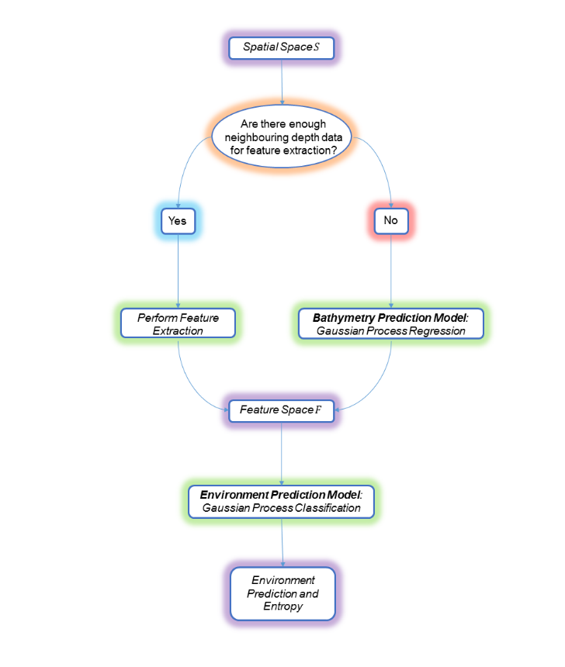

Slide 3
Learn initial GP model from past track data
Find optimal path of fixed horizon from current location through maximising acquisition function under GP model
Take one step into optimal path and take observation
Basic Receding Horizon Approach
Re-learn GP model with new data

