Slide 1


Spatial Space $S$
Are there enough neighbouring depth data for feature extraction?
Yes
No
Perform Feature Extraction
Bathymetry Prediction Model: Gaussian Process Regression
Feature Space $F$
Environment Prediction Model:
Gaussian Process Classification
Environment Prediction and Entropy

Slide 2



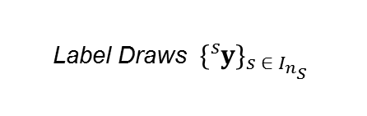
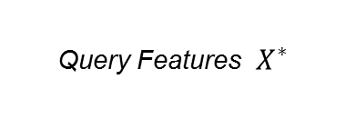




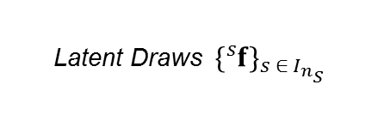

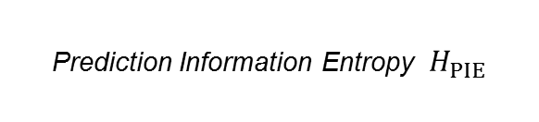
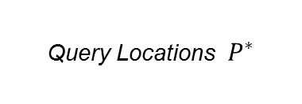

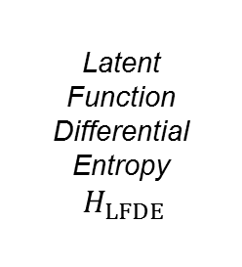
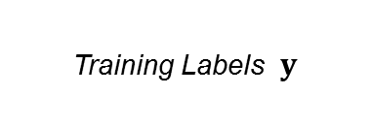

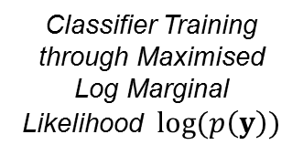


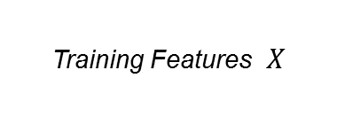



Query Locations $P^{∗}$
Training Locations $P$
Training Labels $y$
Query Feature Extraction & Whitening
Whiten Parameters $w$
Training Feature Extraction & Whitening
Classifier Training through Maximised Log Marginal Likelihood $log⁡(p\left(y\right))$
Query Features $X^{∗}$
Training Features $X$
Predictor Cache
Learner Cache
Query Features $X^{∗}$
Hyperparameters $θ$
Inference Kernel $K^{∗}$
Cholesky Decomposition $L$
Log Likelihood Gradient $\frac{∂}{∂f}log⁡(p\left(y \right| f))$
Log Likelihood Hessian $\frac{∂^{2}}{{∂f}^{2}}log⁡(p\left(y \right| f))$
Latent Expectance $𝔼{[f}^{∗}]$
Latent Covariance $𝕍{[f}^{∗}]$
Latent Variance ${\{𝕍\left[f_{i}^{∗}\right]\}}_{i ∈ I_{n^{∗}}}$
Latent Draws ${\{{}_{ }^{s}f\}}_{s ∈ I_{n_{S}} }$
Prediction Probabilities ${\{π_{i}\}}_{i ∈ I_{n^{∗}}}$
Latent Function Differential Entropy$H_{LFDE}$
Linearised Model Differential Entropy $H_{LMDE}$
Label Draws ${\{{}_{ }^{s}y\}}_{s ∈ I_{n_{S}} }$
Monte Carlo Prediction Information Entropy $H_{MCPIE}$
Prediction Information Entropy $H_{PIE}$
Predicted Query Labels ${\{{𝔼[y}_{i}]\}}_{i ∈ I_{n^{∗}}}$

