Slide 1

Informative Seafloor Exploration for Benthic Habitat Mapping
Kelvin Hsu

Slide 2

How much of the ocean seafloor have we mapped?
Notes:
I want to start of by asking: How much of the ocean do you think we have mapped?

Slide 3
How much of the ocean seafloor have we mapped?
“95% of the ocean remains unexplored”
Notes:
There is this general consensus that we have only explored 5% of the seafloor, leaving 95% of the ocean a mystery.

Slide 4
How much of the ocean seafloor have we mapped?
“95% of the ocean remains unexplored”
100% mapped at resolution of 5 km
Notes:
But actually, we do have a map of the entire ocean floor through satellite observations, just at a very crude resolution of 5 km.

Slide 5
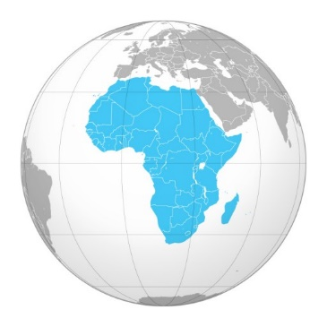
How much of the ocean seafloor have we mapped?
“95% of the ocean remains unexplored”
100% mapped at resolution of 5 km
10% to 15% mapped at resolution of 100 m
Notes:
If we want maps at higher resolutions, we still have around 10% to 15% covered, which is about the size of Africa. But that’s just the structural features of the seafloor, which we call Bathymetric features.

Slide 6
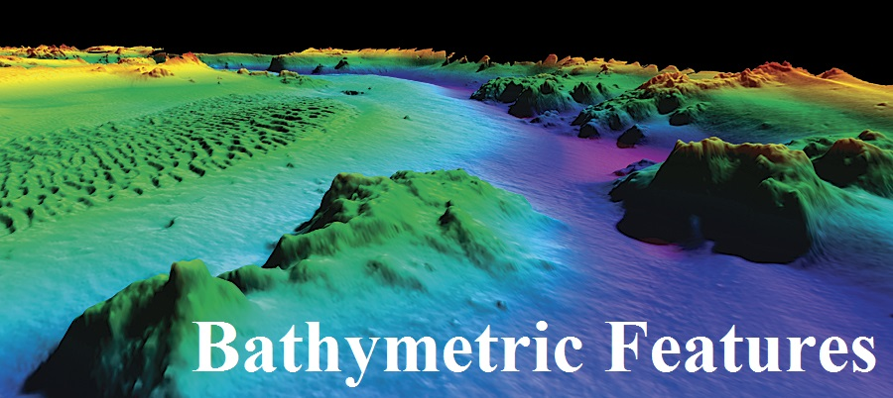
How much of the ocean seafloor have we mapped?
“95% of the ocean remains unexplored”
100% mapped at resolution of 5 km
10% to 15% mapped at resolution of 100 m
Notes:
But that’s not really THAT cool. What we really want to know about are the exotic creatures and funny looking fishies and the environmental habitats they live in. We call these Benthic Habitats.

Slide 7

How much of the ocean seafloor have we mapped?
“95% of the ocean remains unexplored”
100% mapped at resolution of 5 km
10% to 15% mapped at resolution of 100 m
Notes:
So how much of those habitat areas have we actually visited?

Slide 8
How much of the ocean seafloor have we mapped?
“95% of the ocean remains unexplored”
100% mapped at resolution of 5 km
10% to 15% mapped at resolution of 100 m
Less than 0.05% actually visited!
Notes:
And the answer is, only 0.05%! Clearly

Slide 9
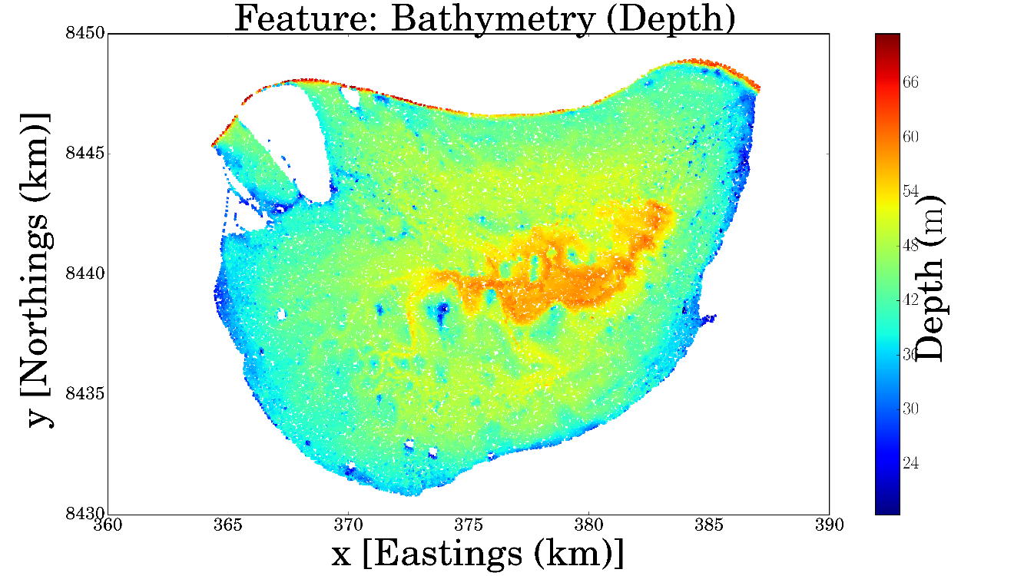
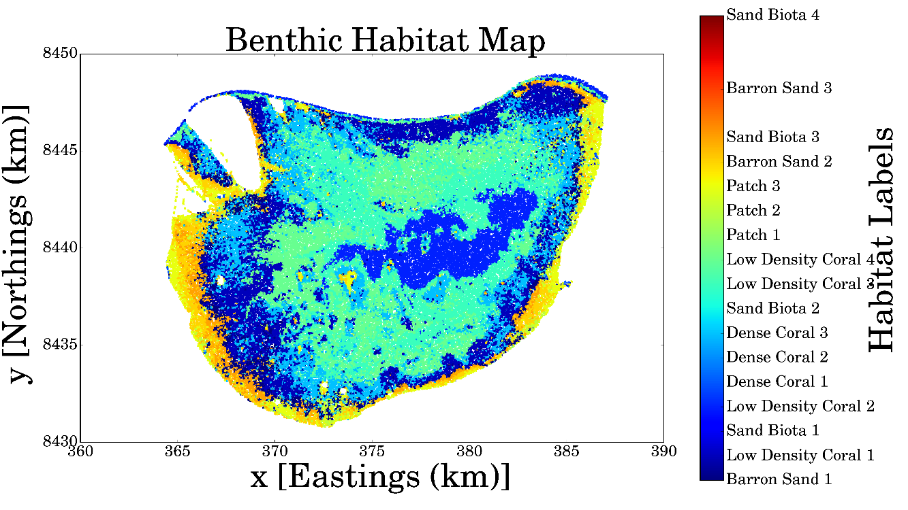
Benthic Habitat Mapping

Slide 10

Slide Title
Make Effective Presentations
Using Awesome Backgrounds
Engage your Audience
Capture Audience Attention

Slide 11
Slide Title
Product A
Product B
Feature 1
Feature 2
Feature 3
Feature 1
Feature 2
Feature 3

