Slide 1

Ending slide
PROMOTION PERIOD REPORT
Notes:
This slide contains the editable pieces that were used to build infographic sample
Icons – Eye, PC

Slide 2
The Eastern region contributed to 79% of the total sales, while the Western region accounted for 21%.
Product performance per region
Region Performance
Eastern Region
Western Region
2

Slide 3
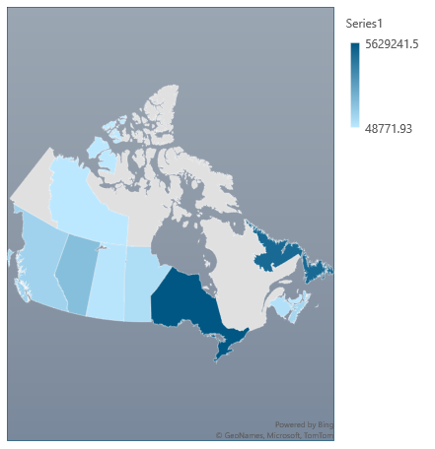

The province of Ontario generated the highest revenue during the period, while the Northwest Territories accounted for the least revenue.
Revenue heatmap by province
Performance by Province
Province | Revenue
Ontario | 5629241.5
Newfoundland and Labrador | 4924267.5
Alberta | 1641225
British Columbia | 877517.81
Nova Scotia | 759666.11
Manitoba | 456808.49
New Brunswick | 349980.96
Saskatchewan | 178614.92
Prince Edward Island | 87077.9
Northwest Territories | 48771.93

Slide 4
Total sales over time for every product increased significantly across all the promotion periods under consideration.
Key Highlights
Throughout the three years under analysis, the "Team Feast" product emerged as the most valuable, commanding a significantly higher amount of net sales compared to the "Feast for One" product. Additionally, "Team Feast" witnessed the most substantial surge in sales over the three-year period.
2021
2022
2023

Slide 5
The "Takeout" order type demonstrated the highest performance, accounting for 61% of all orders, followed by "Drive Thru" at 17%.
Order type Percentage share
Performance per order type
Order Type | Sum of Net Sale
Take Out | 9171134.22
Drive Thru | 2496426.46
MB App | 1456775.93
Eat In | 1065850.35
Pick Up | 482770.63
Smooth Delivery | 145123.25
Delivery | 120373.5
Dine In | 5940.4
Door Dash | 3289.8
Skip The Dishes | 3174.77
Uber Eats | 1253.19
Curbside Service | 969.64
Catering | 89.97
5

Slide 6
Franchise ownership type accounted for a significant portion, comprising up to 83% of the total net sales over the entire period.
Ownership percentage share
6

Slide 7
The Eastern region contributed to 78% of the total sales in 2021, while the Western region accounted for 21%.
Product performance per region
Region Performance in 2021
East
West
7

Slide 8
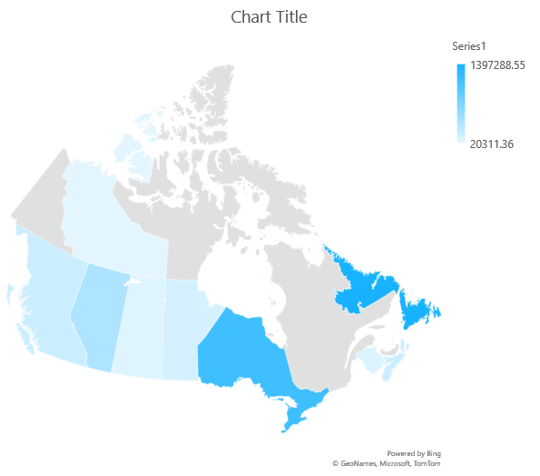
The province of Newfoundland and Labrador generated the highest revenue in 2021 with 39.37% , while the Northwest Territories accounted for the least revenue.
Revenue heatmap by province 2021
Performance by Province in 2021
Province | Revenue Percentage
Newfoundland and Labrador | 39.37%
Ontario | 31.68%
Alberta | 10.73%
Nova Scotia | 5.29%
British Columbia | 5.11%
Manitoba | 3.32%
New Brunswick | 2.43%
Saskatchewan | 1.49%
Northwest Territories | 0.57%

Slide 9
December witnessed the highest net sales across all products, followed by November.

Slide 10
The "Takeout" order type demonstrated the highest performance in 2021, accounting for 64% of all orders, followed by "Drive Thru" at 20%.
Order type share
Performance per order type
Order Type | Net sale Percentage
Take Out | 64.04%
Drive Thru | 20.83%
Eat In | 5.50%
MB App | 4.37%
Pick Up | 4.05%
DELIVERY | 1.07%
Dine In | 0.11%
Curbside Service | 0.02%
Skip The Dishes | 0.01%
DoorDash | 0.00%
10

Slide 11
Franchise ownership type accounted for a significant portion in 2021, comprising up to 80% of the total net sales.
Ownership percentage share in 2021
Corporate
franchised
11

Slide 12
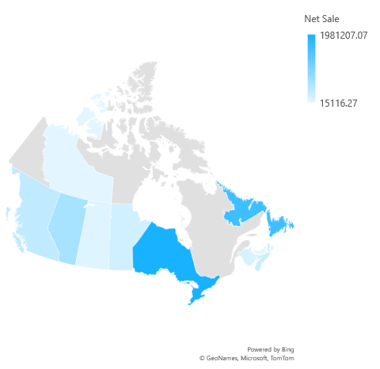
The province of Ontario generated the highest revenue in 2022 with 37.61% , while the Northwest Territories accounted for the least revenue.
Revenue heatmap by province 2022
Performance by Province in 2022
Province | Percentage share
Ontario | 37.61%
Newfoundland and Labrador | 30.67%
Alberta | 11.38%
British Columbia | 6.85%
Nova Scotia | 5.24%
Manitoba | 3.53%
New Brunswick | 2.46%
Saskatchewan | 1.25%
Prince Edward Island | 0.72%
Northwest Territories | 0.29%

Slide 13
Total sales in 2022 period picked in the month of December. for every product increased significantly across all the promotion periods under consideration.
November, 2022
December, 2022

Slide 14
The "Takeout" order type demonstrated the highest performance in 2022, accounting for 63% of all orders, followed by "Drive Thru" at 15%.
Order type share
Performance per order type
Order type | net sale percentage
Take Out | 63.08%
Drive Thru | 15.31%
MB App | 9.78%
Eat In | 6.60%
Pick Up | 3.26%
Smooth Delivery | 1.16%
DELIVERY | 0.76%
Dine In | 0.03%
DoorDash | 0.01%
Curbside Service | 0.01%
Uber Eats | 0.00%
Skip The Dishes | 0.00%
14

Slide 15
Franchise ownership type accounted for a significant portion in 2022, comprising up to 85% of the total net sales.
Corporate
Ownership percentage share in 2022
franchised
15

Slide 16
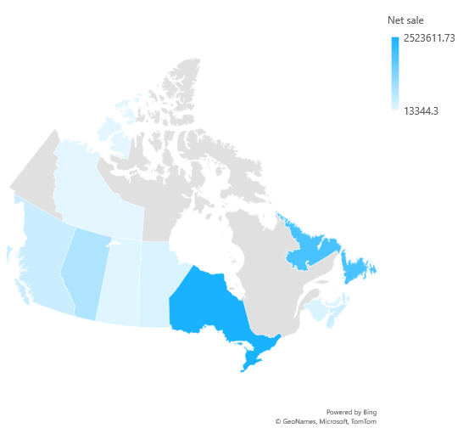
The province of Ontario generated the highest revenue in 2023 with 41% , while the Northwest Territories accounted for the least revenue.
Revenue heatmap by province 2023
Performance by Province in 2023
Province | Net sale Percentage
Ontario | 41.12%
Newfoundland and Labrador | 31.15%
Alberta | 10.77%
British Columbia | 5.46%
Nova Scotia | 4.82%
Manitoba | 2.50%
New Brunswick | 2.18%
Saskatchewan | 0.97%
Prince Edward Island | 0.80%
Northwest Territories | 0.22%

Slide 17
The "Takeout" order type demonstrated the highest performance in 2023, accounting for 58% of all orders, followed by "Drive Thru" at 15%.
Order type share
Performance per order type
Order Type | Net Sale percentage
Take Out | 58.26%
Drive Thru | 15.49%
MB App | 12.82%
Eat In | 8.52%
Pick Up | 2.73%
Smooth Delivery | 1.37%
DELIVERY | 0.70%
Door Dash | 0.05%
Skip The Dishes | 0.04%
Uber Eats | 0.02%
Dine In | 0.01%
Catering | 0.00%
Curbside Service | 0.00%
17

Slide 18
Franchise ownership type accounted for a significant portion in 2023, comprising up to 82% of the total net sales.
Ownership percentage share in 2023
Corporate
franchised
18

