Slide 1

1.4如何校准外生技术冲击的参数

Slide 2
Outline
The Model or Formula used to calibrate persistence and volatility of technology shock
The Data
The Code

Slide 3
The Problem
The technology shock: AR(1)
We need calibrate persistence parameter rho_a and volatility parameter sigma_a?

Slide 4
The Formula
We use the production technology
Taking logs and the first difference produce
Agents for output: GDP
Agents for capital stock: There are no observables for capital stock;

Slide 5
Capital stock growth rate?
What should we do for capital growth rate?
We use investment growth rates replace for capital stock growth rates for approximation before better measurement can be found.
See the next page for details.
This could have errors/bias in final estimation if capital stock is not that larger than investment.

Slide 6
Investment growth rate?
From the capital accumulation equation
If capital stock is far far greater than investment, this means that capital growth does varies too much, then above formula means the two growth rate approximately equal to each other.
Notes:
G_k = (1-delta)G_k + delta*G_I

Slide 7
The data
Annually data

Slide 8
The code
We use Eviews 6
The first period value for technology shock which we assume at steady state. No matter what the value for the 1st period, this will not effect the calibration of persistence and volatility since the 1st period value only have level effect and no slope effect.

Slide 9
Eviews command
genr loggdpgrowth=log(gdp) -log(gdp(-1))
genr loginvgrowth = log(investment) - log(investment(-1))
genr loglabgrowth=log(labor)- log(labor(-1))
scalar alpha=0.4
genr dproductivity = loggdpgrowth - alpha*loginvgrowth - (1-alpha)*loglabgrowth
genr productivity = dproductivity
smpl 1994 2012
//level of productivity
productivity = productivity + productivity(-1)
//Not demeaned, least square with constant
equation level_eq.ls productivity c productivity(-1)

Slide 10
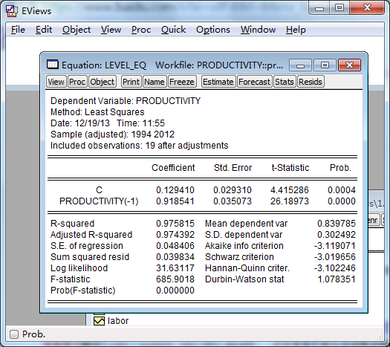

Slide 11
Regression with demeaned vars
//demean of the level
genr productivity_detrend = productivity - productivity_mean
show productivity productivity_detrend
smpl 1992 2012
//AR(1) regression, the coefficient will be the persistence of the technology shock and S.E. of regression will be the standard deviation of error term of the AR(1), demeaned and ls without constant
equation eq.ls productivity_detrend productivity_detrend(-1)

Slide 12
Summary
I. How can we find the growth rate of capital stock? And why we use investment growth rate?
II. The level effect and slope effect of the first period of technology shock
III. How we should do regression in Eviews?

Slide 13
Thanks！

