Slide 1

3.4模型均衡条件输入方法

Slide 2
Outline
Methods
log-linearized (linear)
Level (nonlinear)
Log-level (nonlinear)
Why we do not often log-linearize the model in practice?
Why we recommend that variables in log-level?

Slide 3
Method 1: log-linearized
You first log-linearize your focs of your model manually with pencil and paper;
Then write these log-linearized equations into the model block;
model(linear);
…
end;

Slide 4
Method 2: level
You do not need do anything.
You just input focs into the model block
You tell Dynare do the log-linearization for you by using option order=1 in stoch_simul command.
This will greatly save your time since you do not manually log-linearize your every focs.
You are save from possible errors and boring work when log-linearize manually which is time-consuming and energy-consuming.

Slide 5
Method 3: log-level
What is log-level?
In Mod file, we just Replace X with exp(X). The two X are not the same thing. The second X in exp(.) function is just log(X). We just want to save notations.
So if level equation is X+Y=Z, then log-level equation will be
exp(X)+ exp(Y) = exp(Z)

Slide 6
Why we recommend that writing mod block variables in log-level?
It has all the advantages as in method 2.
But it has additional one: the results presented by Dynare will be the percentage deviation form of original variables in final results, like IRF. Why?
Dynare uses y_t – y_ss instead of y_t in reporting for original variables y_t, where y_ss is steady state values of y_t. Hence if y_t in log-level, then the results will be in percentage deviation form.

Slide 7
IRF of level variables

Slide 8
IRF of log-level variables

Slide 9
Why we recommend write mod in log-level?
If you use level variable, the final reporting results y_t – y_ss is not percentage deviation. You need divide by y_ss, i.e.,(y_t – y_ss )/y_ss to get percentage deviation.
If you use log-level variable,i.e., y_t already in log-level, then y_t – y_ss is percentage deviation form.
Why we need percentage deviation, especially in IRF?

Slide 10
An Example
You have a resource constraint equation:
Log-linearized:
Level:
Log-level:

Slide 11
Further issues
Taking a log-linear approximation of a model is equivalent to take a linear approximation of a model w.r.t the logarithm of the variables.
In practice, it is sufficient to replace all occurrences of variable X with exp(LX) where LX = log X.
It is possible to make the substitution for some variables and not another. You wouldn't want to take a log approximation of a variable whose steady state value is negative . . .
There is no evidence that log-linearization is more accurate than simple linearization. In a growth model, it is often more natural to do a log-linearization.

Slide 12
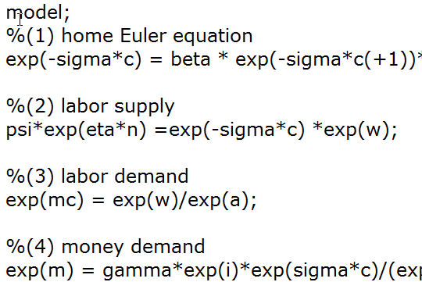
Good habits
Number and label each equation.
Leave a blank line between two equations to improve readability;

Slide 13
Summary
You should be able to understand why we want write model in log-level instead of level or log-linearized version
You should be able to translate a level equation into log-level equation now.

Slide 14
Thanks!

