Slide 1



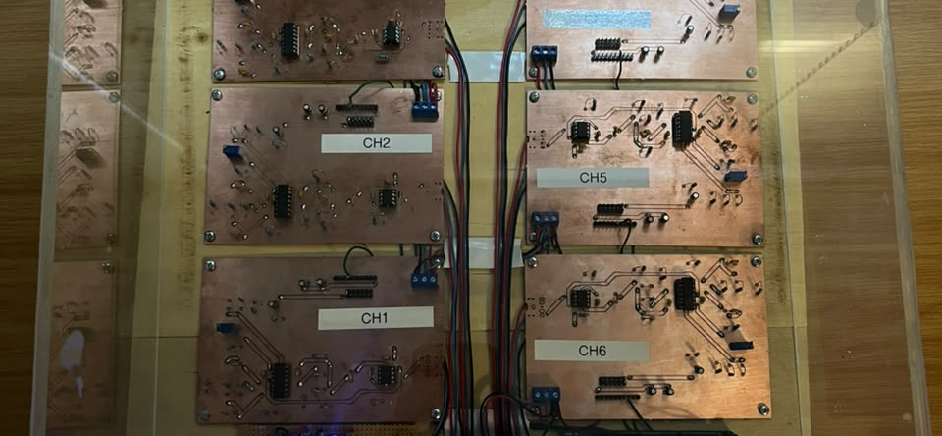
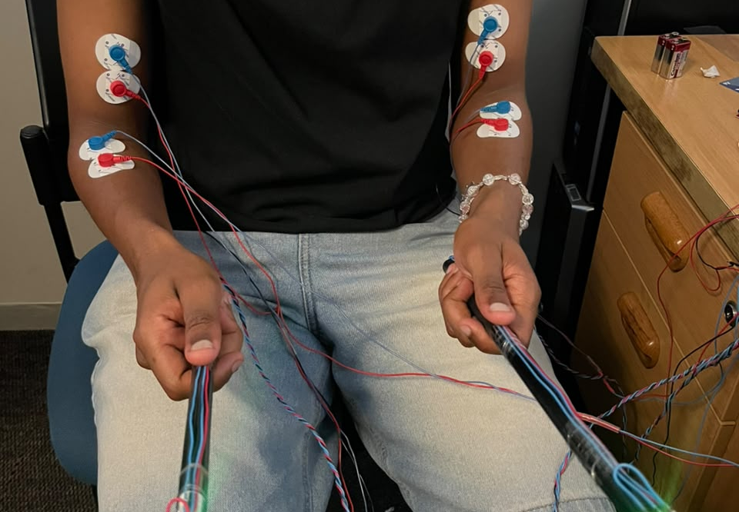
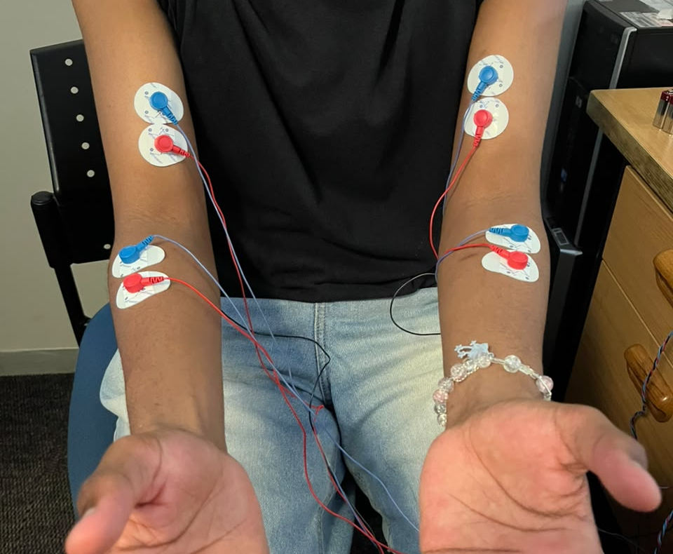
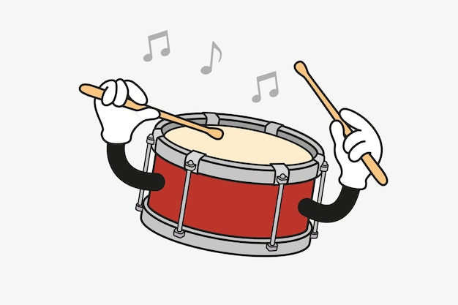
MYODRUM
A muscle-controlled virtual instrument using EMG and IMU sensing
[Author full name 1] | [Author full name 2] | Project 26P02
Why MyoDrum?
How MyoDrum works
Built hardware
Can muscle activity and arm motion identify intentional air-drumming strikes and choose a virtual drum quickly enough for interactive play?
EMG
muscle activity
6 EMG BOARDS
Goal: an affordable wearable instrument that turns natural drumming gestures into sound.
SYNCHRONIZED
SENSOR WINDOW
CHOOSE A
CLASSIFIER
PLAY
SOUND
IMU
stick movement
WORKING TWO-STICK PROTOTYPE
The IMU describes what the stick did. EMG helps decide whether the movement was intentional.
KICK • SNARE • CRASH
Rule-based classifier - working now
Bagged-tree classifier - next stage
Signal conditioning, power and Arduino Mega 2560
1
IMU proposes
One labelled
sensor window
Motion + muscle
features
Many decision
trees
Machine-learning data status
A fast movement, reversal and acceleration change create a strike candidate.
3
72
1,080
2
EMG confirms
Each tree votes: NO HIT | KICK | SNARE | CRASH
The active arm must cross its own calibrated muscle threshold.
MAJORITY VOTE = FINAL PREDICTION
sessions
labelled blocks
requested hits
Two MPU6050 sensors + four active EMG channels
3
Safeguard
A group of trees should be less sensitive to one noisy electrode or one unusual swing than a single tree.
NEXT: TRAIN → TEST ON AN UNSEEN SESSION
Cooldown and return travel suppress double or triple sounds.
FOUR EMG CHANNELS
Virtual drum zones
WHAT STILL NEEDS TESTING
A0
Left forearm
A2
Left triceps
SNARE
left pose
KICK
centre / down
CRASH
raised / right
• held-out accuracy
• false-trigger rate
• sound latency
• orientation drift
• 6-channel benefit
A3
Right forearm
A4
Right triceps
Six-channel expansion follows the four-channel comparison.
Zones are defined relative to a calibrated neutral pose, not by double-integrated position.
Accepted versus rejected strike: synchronized IMU and EMG
Performance metrics by operating mode
ACCEPTED: IMU + EMG align
REJECTED: EMG stays below threshold
0% = not measured 50% = partial evidence 100% = measured result
Real right-hand events from session_20261012_165912. The accepted decision occurs at 0.00 s; the EMG-timeout rejection follows 0.51 s later.
Current result: rule-based median decision delay = 0 ms (95th percentile = 125 ms).
Accuracy = correct drum selections ÷ intended strikes × 100%. A 0% evidence bar means unmeasured, not zero system accuracy.
CONCLUSION
MyoDrum already combines synchronized motion and muscle sensing for three virtual drums. The next step is to train the bagged-tree model and compare it fairly with IMU-only, EMG-only and rule-based fusion.
References: TDK InvenSense, MPU-6050 Product Specification; SENIAM, Sensor Locations; MyoDrum recorded sessions. *Classifier delay excludes speaker/Bluetooth audio latency.
Notes:
Poster evidence sources:
Project repository: C:\Users\ndlov\OneDrive\Desktop\FinalMyodrum
Synchronized strike plot: data/raw/session_20261012_165912/imuEmgStream.mat.
Rule-based thresholds: common/myoDrumConfig.m and classifiers/ruleBased/*.m.
ML collection summary: sessions 20261013_182950, 20261014_103705 and 20261014_110441.
Institutional layout reference: C:\Users\ndlov\Downloads\In_Person_Poster_Guidelines.pptx
Background artwork generated for this poster with OpenAI image generation; drum illustration supplied by the user.
External references shown on poster: TDK InvenSense MPU-6050 product specification; SENIAM sensor location guidance.

