Slide 1

Introducing GrateBox
Team 8

Slide 2

Who is Grate?
Jin Liu
Code Ninja
Kelvin Lin
Team Lead
Eric Chaput
Technical Evangelist

Slide 3



What Do Grate People Do?

Slide 4
Well… What is a Genetic Algorithm?
Generate
Simulate
Rank
Select
Mutate

Slide 5
What is GrateBox?
Grate reimplemented Genetic Cars by Rednhut.org
Genetic Cars is a car simulation designed to show the effects of a Genetic Algorithm over time.
Cars are generated and they are made to run through a track.
The cars that get the furthest are selected to produce the next generation of cars.
Text on the bottom shows the results of each generation.

Slide 6
Let’s Play!
http://ugweb.cas.mcmaster.ca/~linkk4/

Slide 7
Why Is Grate So Great?

Slide 8



Three Pillars of Grateness
Portability
Simplicity
Reusability

Slide 9





Meet Portability
GrateBox supports all major operating systems and platforms.

Slide 10





Meet Portability
As an web application, GrateBox runs on all major web browsers.

Slide 11
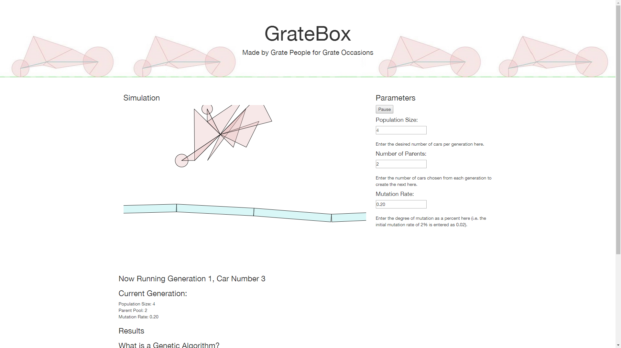
Simplicity is Bliss
All of the features are directly accessible on one page

Slide 12
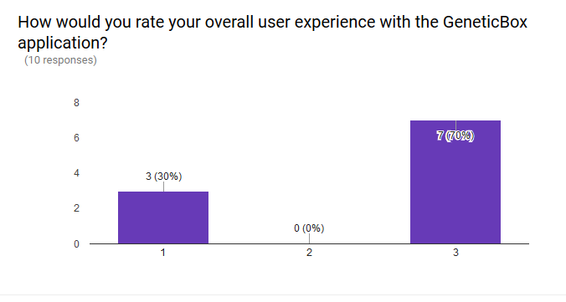
Users Think It’s Grate!
70% of respondents in a usability survey gave GrateBox 3/3 for overall user experience.

Slide 13

Something for the Developers Too!
Interested in getting into Genetic Algorithms as a developer?
GrateBox is meticulously documented so anyone can contribute to the ever-growing body of code.
Our open source license allows anyone to modify, redistribute, and share the code.

Slide 14

Want to Play Again?
Everyday is a new adventure with GrateBox!
The random nature of Genetic Algorithms allow for new cars to be generated with each generation.
Every time you run the program, you’re bound to see new cars on with new designs!

Slide 15
And so…
… Any Questions?

