Slide 1

Introducing GrateBox

Slide 2
Who is Grate?
Eric Chaput,
Technical Evangelist
Kelvin Lin,
Team Lead
Jin Liu,
Code Ninja

Slide 3



What Do Grate People Do?

Slide 4
So…
Grate reimplemented Genetic Cars by Rednhut.org
Genetic Cars is a cars generation simulation designed to show the effects of a Genetic Algorithm over time.
Cars are generated and they are made to run through a track.
The cars that got the furthest are selected to produce the next generation of cars.
Text on the bottom shows the results of each generation.

Slide 5
Well… What is a Genetic Algorithm?
Generate
Mutate
Simulate
Rank
Select

Slide 6
Proof or It Ain’t Real
“Shit’s Lit” – Anonymous Survey Respondent

Slide 7
Why Is Grate So Great?
“Don’t Be An Ass” – Eric Chaput, 2016

Slide 8



Three Pillars of Grateness
Portability
Simplicity
Reusability

Slide 9





Meet Portability
GrateBox supports all major operating systems and platforms.

Slide 10





Meet Portability
As an web application, GrateBox runs on all major web browsers.

Slide 11
Machine Learning Made Simple
All of the features are directly accessible on one page

Slide 12
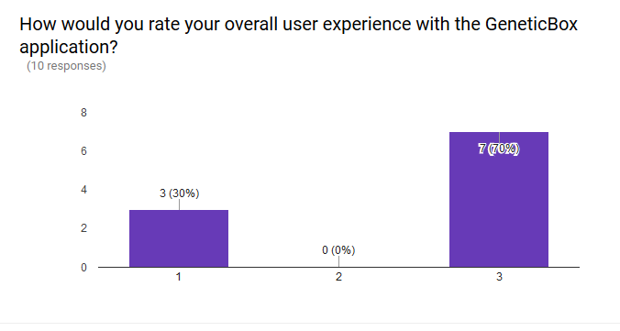
Machine Learning Made Simple
70% of respondents in a usability survey gave GrateBox 3/3 for overall user experience.

Slide 13
Something for the Developers Too!
Interested in getting into Genetic Algorithms as a developer?
GrateBox is meticulously documented so anyone can contribute to the ever-growing body of code.
Our open source license allows anyone to modify, redistribute, and share the code.

Slide 14
Want to Play Again?
Everyday is a new adventure with GrateBox!
The random nature of Genetic Algorithm allows for new cars to be generated with each generation.
Every time you run the program, you’re bound to see new cars with new designs!

Slide 15
So, Let’s Play…
… Any Questions?

