Slide 1
Team 1: The Weather System
McMaster Engineering Competition, 2016

Slide 2
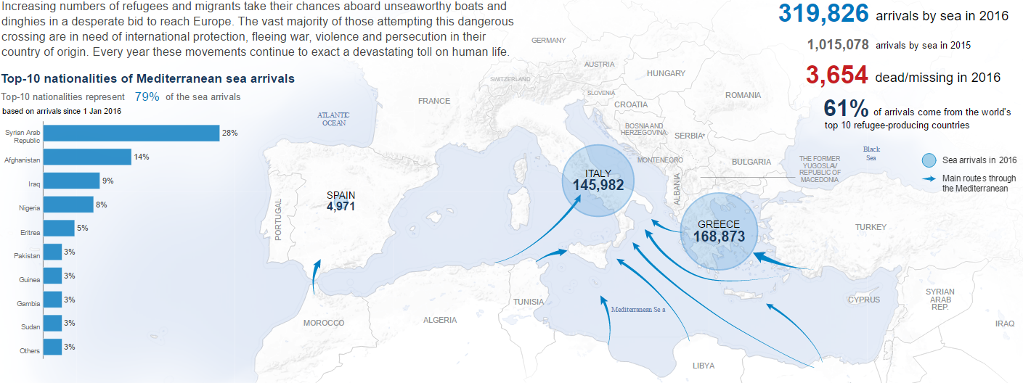
Context
In 2016, 319,829 refugees traveled to foreign countries by sea.
However, 3654 refugees died or went missing while at sea.
There HAS to be a safer way for refugees to navigate the dangers of the open ocean.

Slide 3
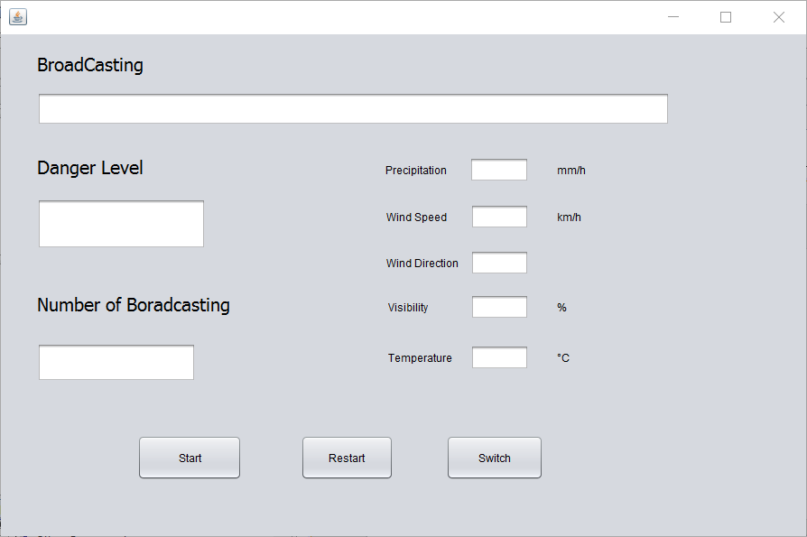
Introducing The Weather System

Slide 4
What Does It Do?
Broadcasting System
Precipitation
Visibility
Wind
Temperature

Slide 5
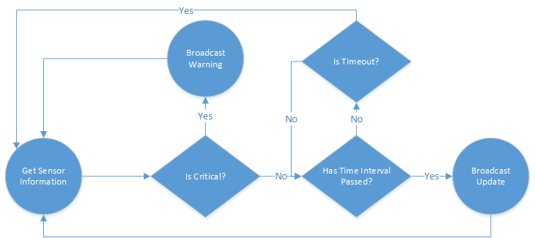
What Does It Do (Part 2)?

Slide 6
How Was It Done?
Sensors: Receive information from external environment
Internal Communication Network: Mediates communication between internal components
Buoy: Determines criticality and broadcasts messages

Slide 7

Testing the System
Combination of black box and white box testing.
JUnit tests ensured full code coverage.
Thorough integration testing at boundary conditions.

Slide 8
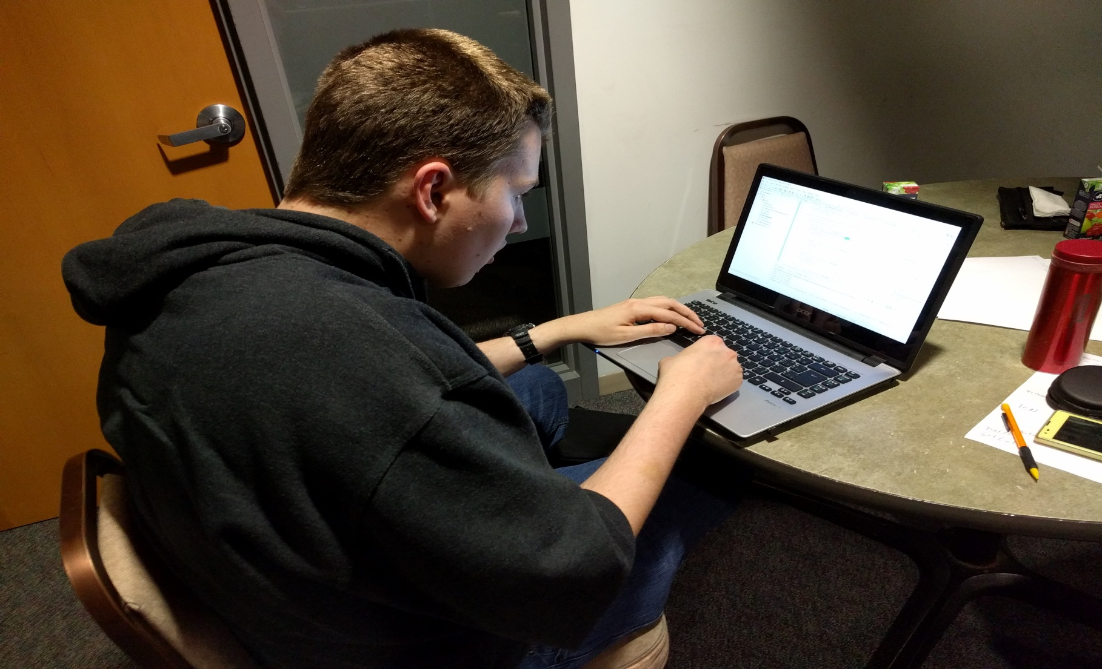
Let’s See a Demo!

Slide 9

References
http://data.unhcr.org/mediterranean/regional.php

Slide 10
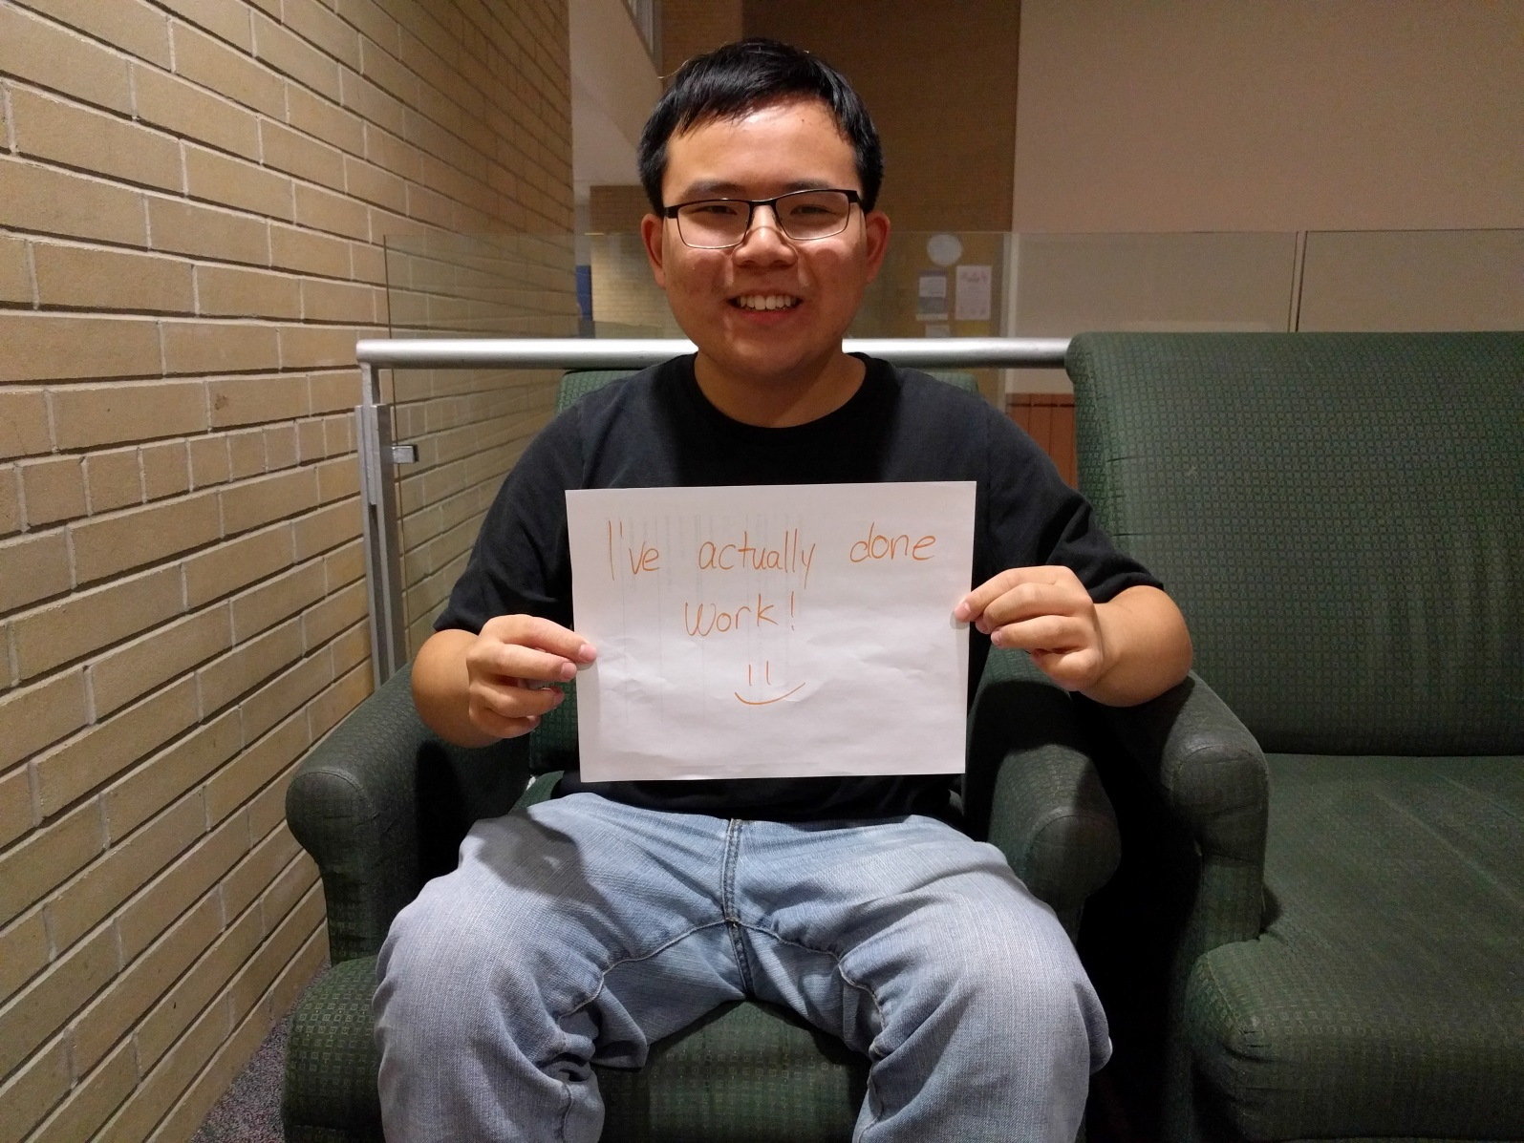
Thank You For Your Time!

