Slide 1

Algorithmic Trading Challenge
Wanting Cheng, Jiongjiong Li, Kai Li,
Chunzi Wang, Pak Kin Lai
Group 3
30/4/2018

Slide 2
Agenda
01 Background Introduction
02 Data and EDA
03 Feature Selection Methods
04 Prediction Models
05 Model Performance Evaluation

Slide 3

Background Introduction
It’s a forecasting project that aims to develop new models to predict the stock market's short-term response following large trades.
Develop empirical models to predict the behavior of bid and ask prices following such "liquidity shocks"

Slide 4
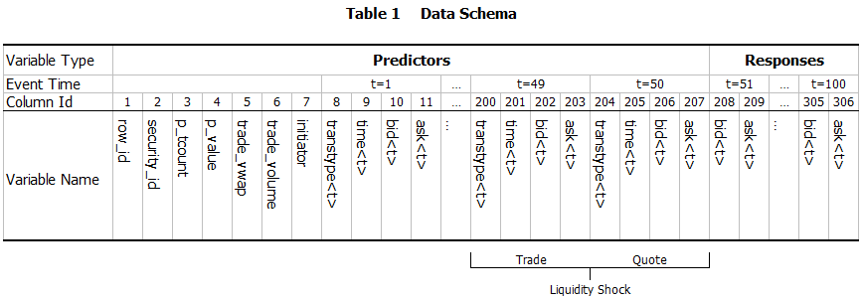
A glimpse of the data
Trade and quote data from the London Stock Exchange
The preprocessed dataset comprises observations of the limit order book before and after a liquidity shock
Data acquired from a Kaggle competition from the following URL: https://www.kaggle.com/c/AlgorithmicTradingChallenge

Slide 5
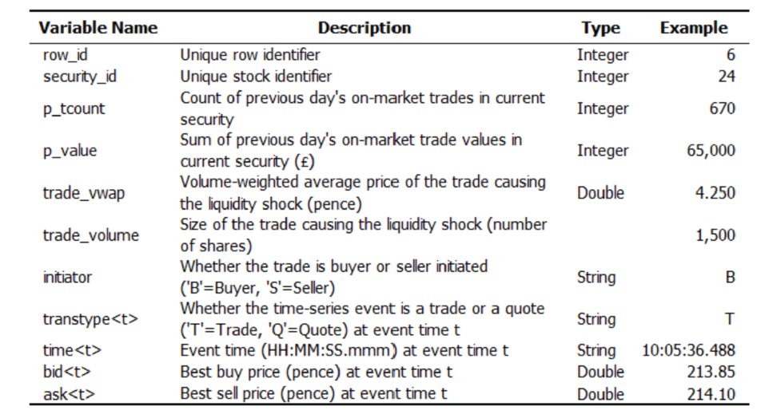
Variable Description

Slide 6
Data Sampling and Pre-Processing
Stratified Sampling
test.csv only contains the first 50 time periods of prices and do not disclose the actual prices of the prices of t51-100.
We believe security_id is an important factor in the prediction.
We used stratified sampling to get equal proportion of security_id's.
Data Pre-Processing for Time Series Modeling
There're 101 securities in total.
In training set, every security has 371 rows. In test set, 124 rows.
Every row has 100 bid prices and 100 ask prices. For time series modeling, we created a time series matrix by combining all the bid and ask price of rows belong to the same security into a long column, bid and ask separately. So the dimension of training matrix is 371*100 rows and 101*2 columns and the test matrix is 124*100 rows and 101*2 columns.

Slide 7
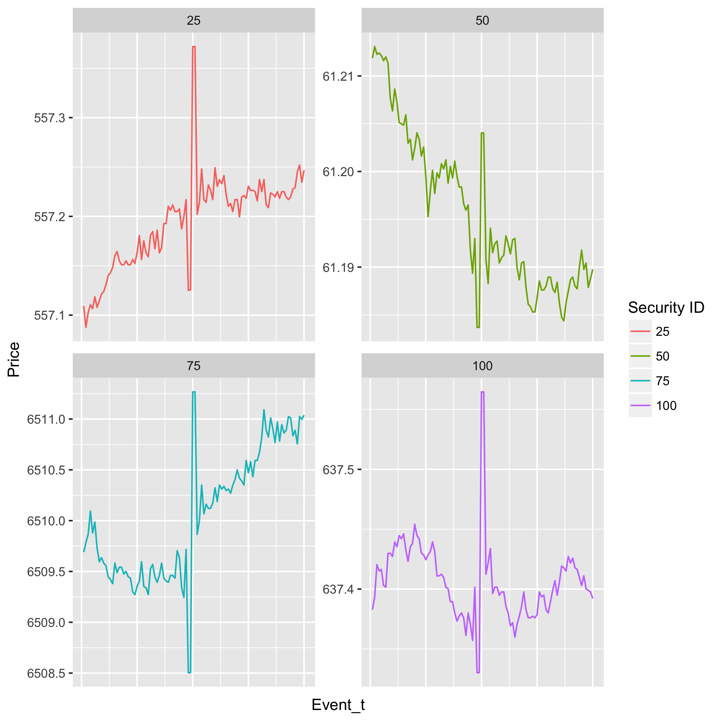
Bid and Ask price of sample security
Bid
Ask

Slide 8
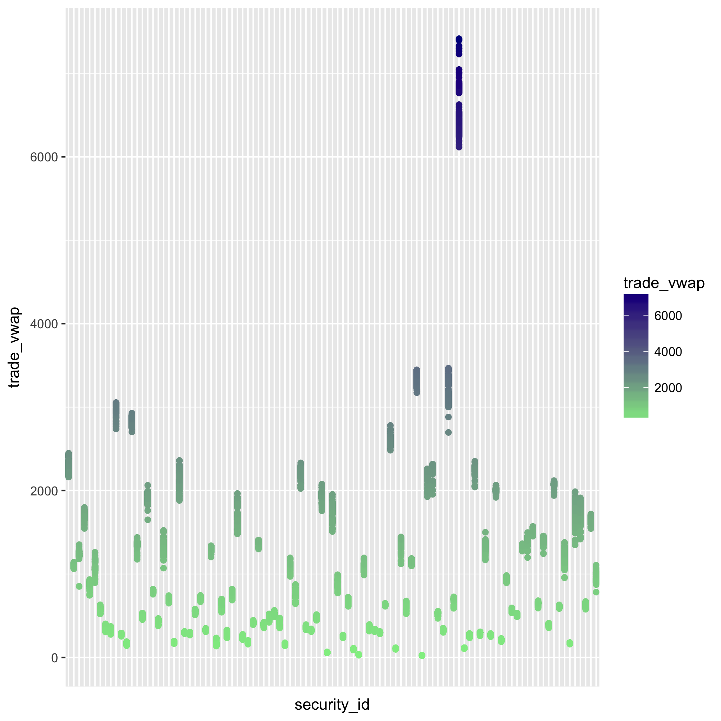
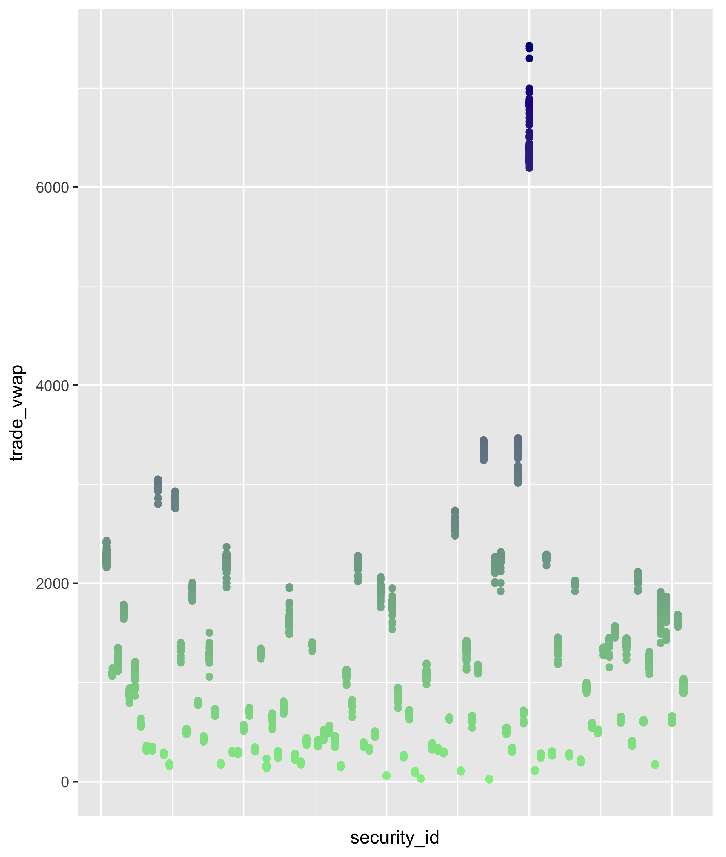
Volume Weighted Average Price for all securities
Train
Test

Slide 9
Feature Extraction
We want to extract semantically meaningful features from the original data
The features can be divided into 4 categories:
Price (information about the bid/ask normalized price time series)
Liquidity book (information about the depth of the liquidity book)
Spread (information about the bid/ask spread)
Rate (information about the arrival rate of orders and/or quotes)

Slide 10
Feature Extraction: Semantically meaningful features
The features can be divided into 4 categories:
Price
Exponential moving average (distribute different weights to different days)
Number of price increments during the past 5 days
Liquidity book
Bid and ask price increase between two consecutive quotes
Spread
Bid/ask price spread on Day50
Rate
Number of quotes over number of trades during the last n events

Slide 11
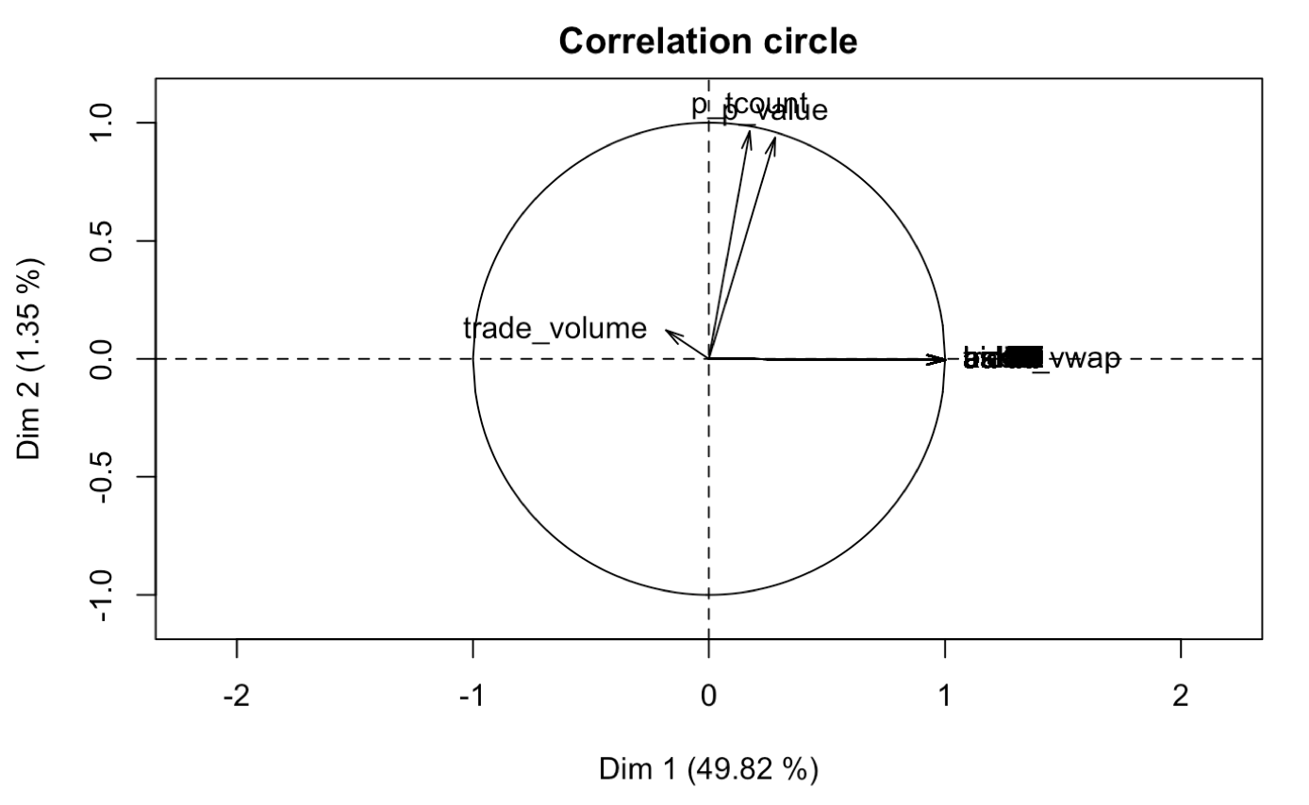
Principal Component Analysis
Note that PCA normally deals with all numerical data whereas in our case we have categorical data (e.g security_id) and binary data (e.g initiator). This requires us to perform a slightly different way of decomposing the dimensions.

Slide 12
Models
Models used:
Linear Regression
Random Forest
ARIMA Time Series
Lasso Regression
GBM
SVM
For each model, a security will have 100 prediction numbers as outputs, 50 for buy prices from t=51 to t=100, and the other 50 for sell prices from t=51 to t=100.
Model Underlying hypothesis:
Future events will depend on post-liquidity shock events to be predicted. In this way, the prediction error will tend to increase with the distance from the liquidity shock.

Slide 13
Linear Regression
Inspired by the 6th Place Competitor of the Competition
Separate data into Buyer Initiated and Seller Initiated subsets
Use Trade Volume Weighted Average Price, Bid 41, Bid 50, Ask 50 as Predictor Variables
Total of 200 Models are used to calculate the buy and ask price from t=51 to t=100
(50 x 2 x 2) → (Time x Buyer/Seller Initiated x Bid/Ask)

Slide 14
Random Forest
Same predictor chosen as Linear Regression
Trade Volume Weighted Average Price, Bid 41, Bid 50, Ask 50 as Predictor Variables
Result
Models
Total of 200 Models are used to calculate the buy and ask price from t=51 to t=100 (50 x 2 x 2) → (Time x Buyer/Seller Initiated x Bid/Ask)
Advantages
Reduction in overfitting
Less in variance
Disadvantages
High Computation cost

Slide 15
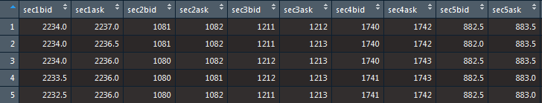
ARIMA Time Series
First Attempt:
Making each row two time series, one for bid and one for ask.
Non-stationary, non-seasonal, and extremely skewed.
Prediction result around RMSE = 2
Second Attempt:
Since each row only have 100 data points, that’s too limited to produce meaningful forecasting results, so we combined every row of each security together to train arima model using the whole training data and input the new test data predictors to predict the response and compare with the original response. It returns better prediction results than the original attempt.

Slide 16
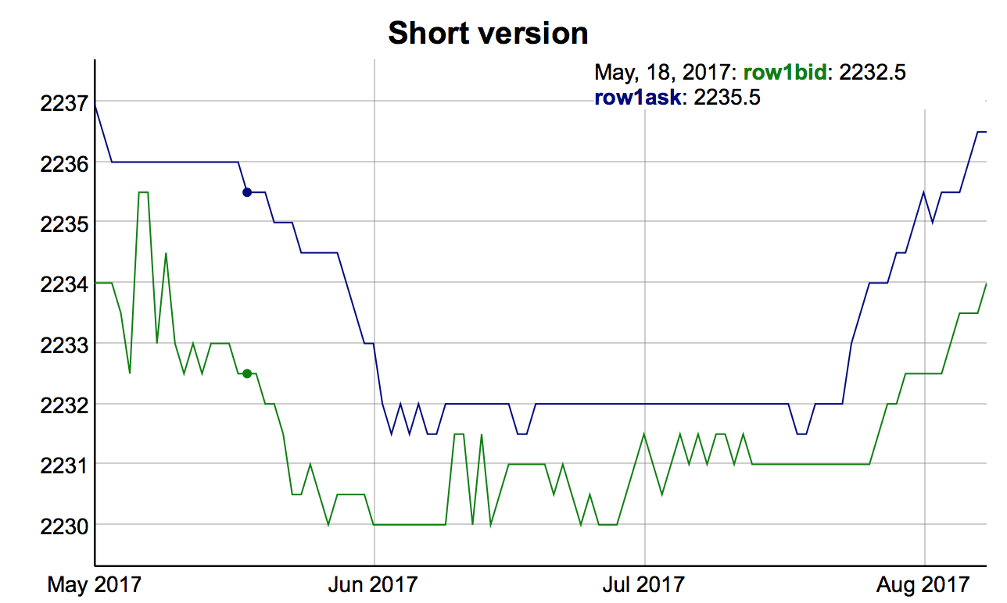
ARIMA Time Series

Slide 17
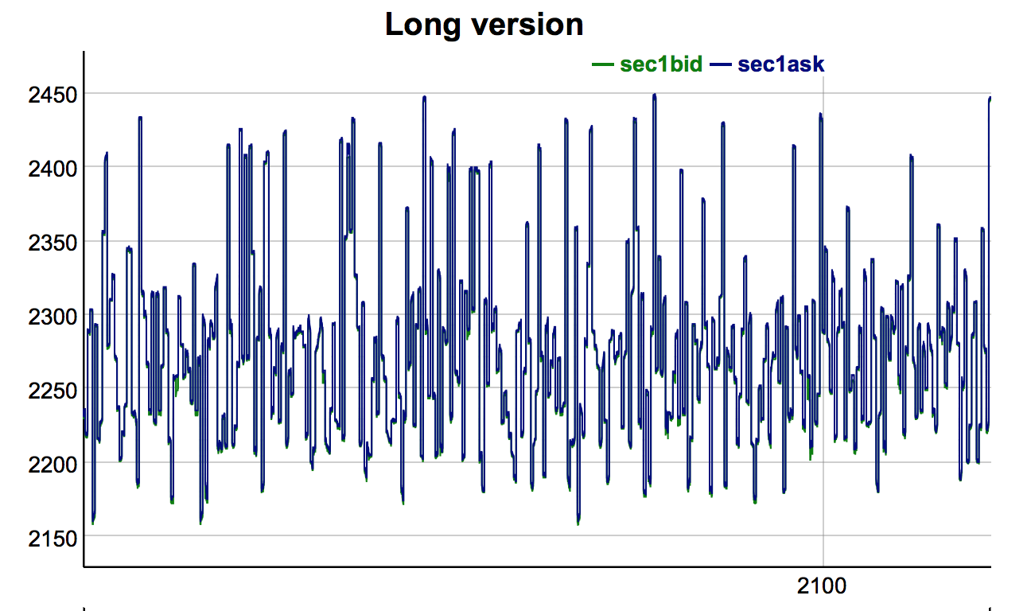
ARIMA Time Series

Slide 18
Lasso Regression
Benefits of Lasso:
Shrink unimportant variables to 0 so we could see which variables are important.
E.g. for security 1, 96 predictor coefficients are 0 (104 predictors in total). Trade_vwap, bid1, bid5, bid34, bid50 are important variables.
Limitations of Lasso:
Imputed data must be matrix.
So we only use p_tcount, p_value, trade_vwap, trade_volume, 50 bid and ask prices as predictors, and this arrangement will lose information on initiator and transtype of per bid and ask. That's the trade-off.
Modeling:
For each security, we trained a lasso model based on predictors and responses and used cross validation to choose the best lambda. Then we used this model to predict the responses on test data given the predictors and compare it with original responses.

Slide 19
GBM and SVM
Same predictor chosen as Linear Regression
Trade Volume Weighted Average Price, Bid 41, Bid 50, Ask 50 as Predictor Variables
Result
Models
Total of 200 Models are used to calculate the buy and ask price from t=51 to t=100 (50 x 2 x 2) → (Time x Buyer/Seller Initiated x Bid/Ask)
Advantages
GBM models are expressive
SVM is very efficient
Disadvantages
The error is high compared with other models

Slide 20

Model Performance Evaluation
Performance evaluation will be conducted using root mean square error.
For each prediction, RMSE will be separately calculated for the bid and ask at each time step following a liquidity shock.
The lower, the better.

Slide 21
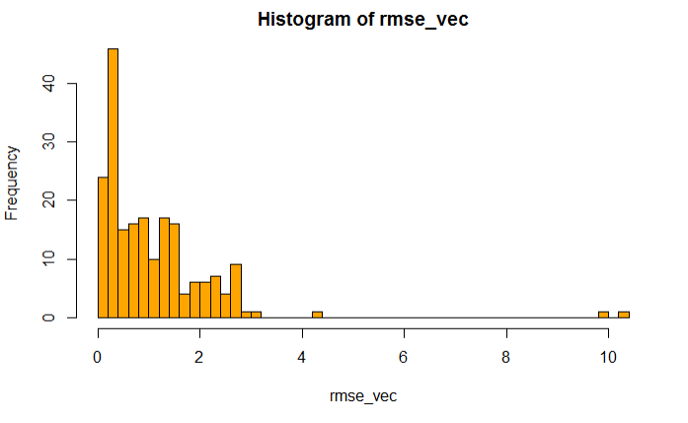
TS RMSE distribution by security + bid/ask
Mean: 0.96

Slide 22
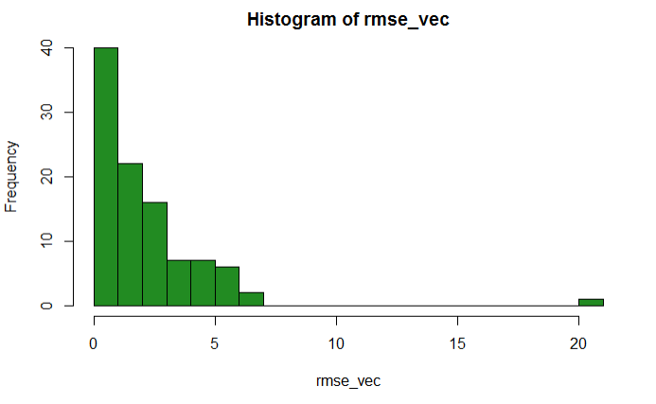
Lasso RMSE distribution by security
Mean: 1.94

Slide 23
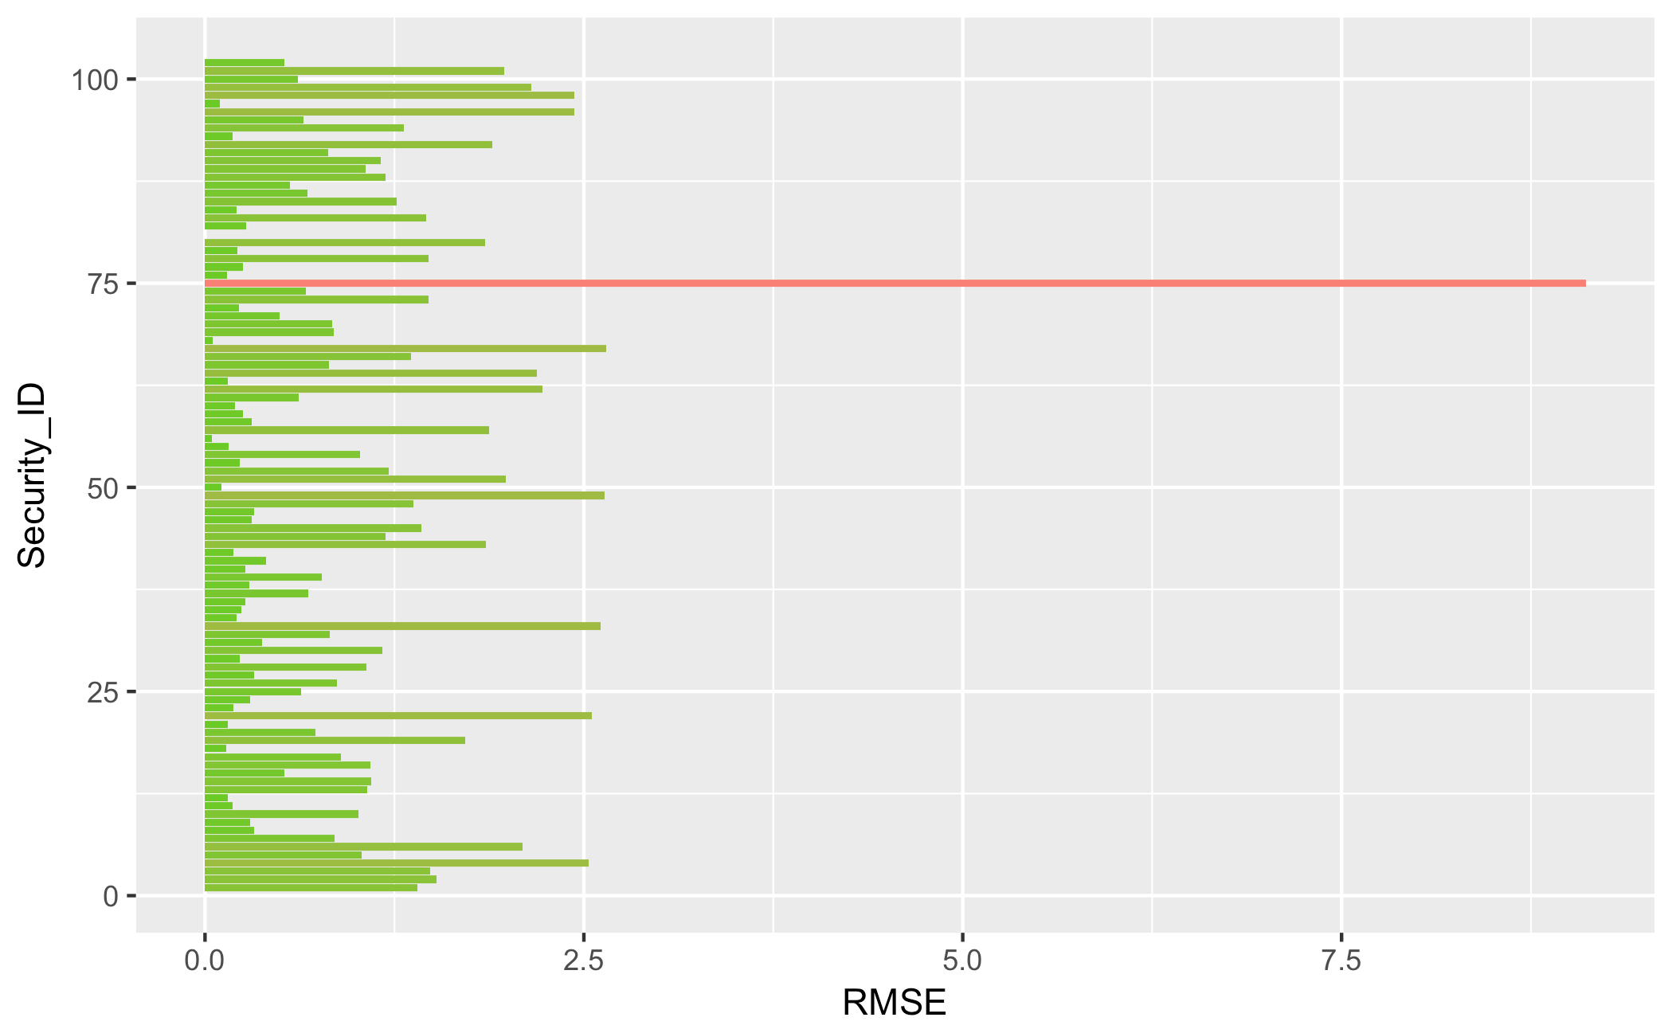
LR RMSE by security

Slide 24
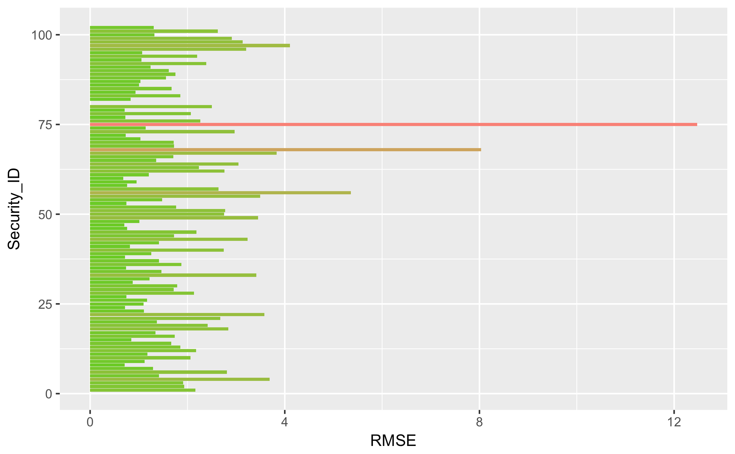
LR_PCA RMSE by security

Slide 25
Thank you

