Slide 1
Ethereum Price Predictor
Kelvin Le
Thomas Burns
Aaron Rogers

Slide 2
Ethereum
This tool runs future price predictions of Ethereum through multiple machine-learning model types and time periods. The intent of this tool is to help the user predict up trends and downtrends in the market or to DCA (Dollar Cost Averaging). It's also a guide to help predict maximum returns for 2022.

Slide 3
Machine Learning Models
AutoTS - Automated Time Series Forecasting
Kats - Kits to Analyze Time Series
Tsfresh - Automated feature extraction and selection library for time series data
Prophet - Forecasting procedure

Slide 4
Source of Data
Yahoo Finance API - All data was pulled from yahoo finance api. (https://www.yahoofinanceapi.com/)
We also downloaded Ethereum prices from 2017 to Current time from yahoo finance api. ETH-USD.CSV was used in KATS_Ethereum_Predictor and TSFRESH_Ethereum_predictor.

Slide 5
Project File
Long_or_Short_Ethereum: this program was used for indicator to short or go long on Ethereum. -1 was to short and 1 was to go long. Result was to go long on Ethereum
[Ethereum Current Trend Analysis Chart](Images/Ethereum_LongorShort.png)
KATS_Ethereum_Predictor: this ML model predicted Ethereum prices on the first of every month in the near future.
Ethereum_Price_Prediction: this is the main file to predict 5 days into the future for Ethereum.
TSFRESH_Ethereum_predictor: We gathered data from this ML model. The data at the end was all over the place. The data that go spit out we believe is 5 days into the near future.

Slide 6
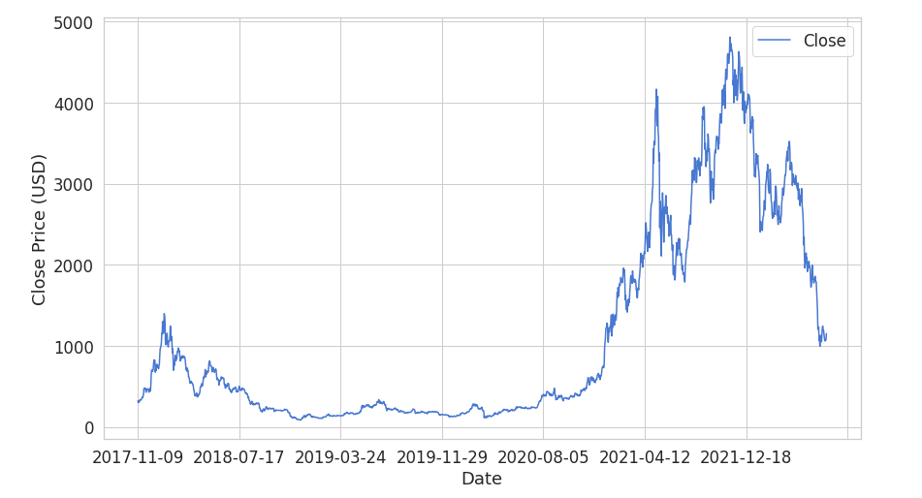
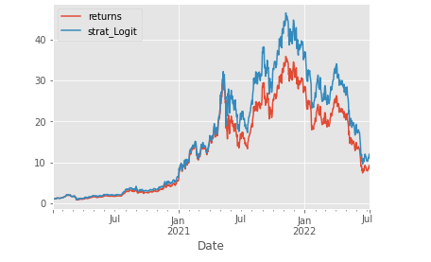
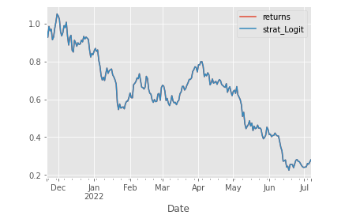
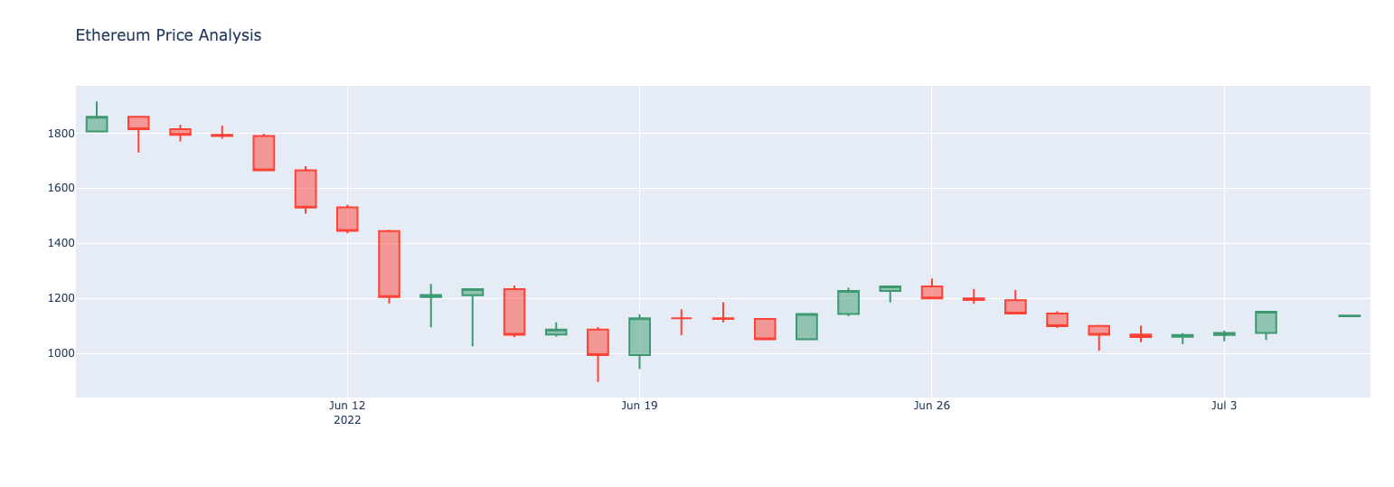
Charts

Slide 7
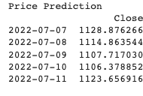
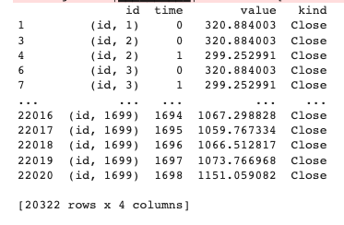
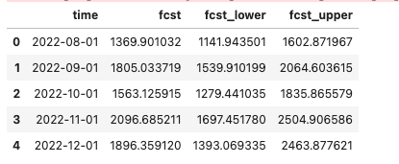
Results
- AutoTs results : - TSFresh :
→ 2022-07-07 12,53.13 According to CoinMarketCap
- KATS

Slide 8
Conclusion
Looks like we already bottomed out from the market and market has been positive the past 4 days. We could be heading toward a small recovery and from KATS data we could be seeing a mini bull in November 2022. Possiblilty to go long on Ethereum or DCA and sell during November for maximum profit. And then short it in December.

