Slide 1

CSCI E-96 Data Mining, Exploration and Discovery Introduction to Clustering Models Part 1
Steve Elston
Copyright 2020,2021, 2022, 2023, 2024, 2025, Stephen F Elston. All rights reserved.

Slide 2
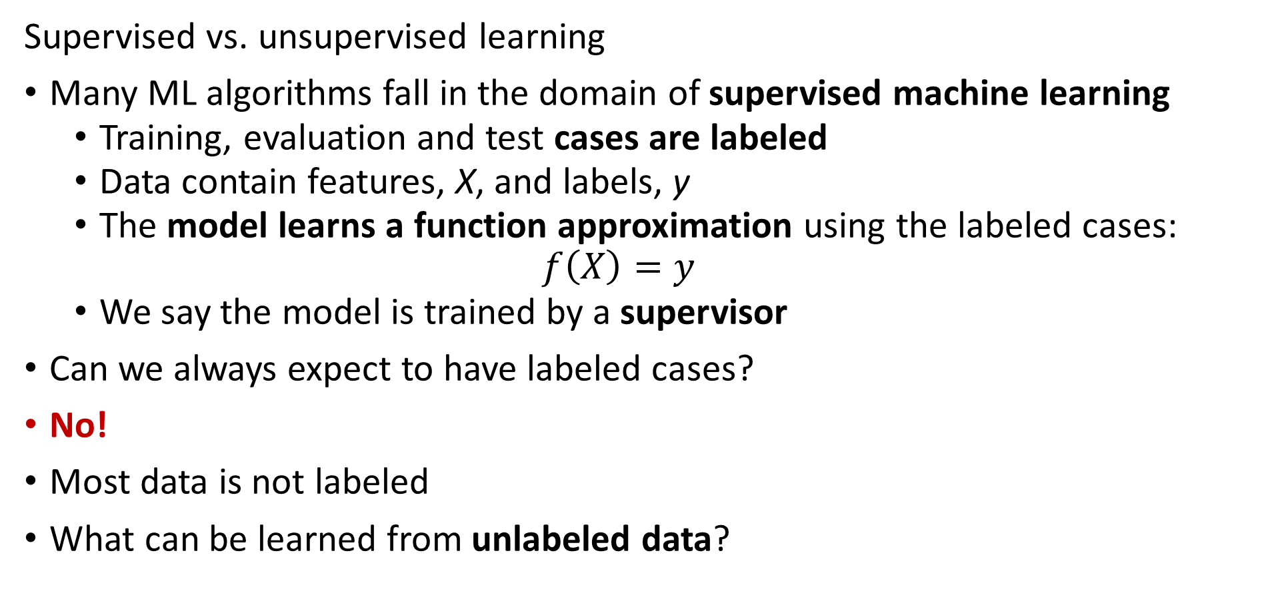
Overview, Unsupervised Learning
Supervised vs. unsupervised learning
Many ML algorithms fall in the domain of supervised machine learning
Training, evaluation and test cases are labeled
Data contain features, X, and labels, y
The model learns a function approximation using the labeled cases:
$$f\left(X\right)=y$$
We say the model is trained by a supervisor
Can we always expect to have labeled cases?
No!
Most data is not labeled
What can be learned from unlabeled data?

Slide 3
Overview, Unsupervised Learning
Why should we care about unsupervised learning?
Most data is not labeled
Learning relationships in data is useful in many data mining solutions:
Find groups of similar purchases
Discover unusual or outlier events
Similar genes in microassay data
Find groups of people with similar behaviors – e.g. voting, purchases,…
Find patients with related symptoms
Data compression algorithms
And many more...

Slide 4
Overview, Unsupervised Learning
Many types of unsupervised learning algorithms
Clustering models – today’s topic
Embedding models – PCA, manifold embedding,… - future lesson
Search algorithms – PageRank, HITS,…
Similarity search - Recommender models, document search, image search, …
Social network models
Association models – e.g. market basket analysis – future lesson
And many more…………
All methods depend on measures of distance or similarity

Slide 5
Overview, Unsupervised Learning
Without labeled data, what can a model learn?
Cluster models are a form of similarity search
Clustering algorithms are core data mining methods
Data mining seeks to find interesting relationships in data
Wish to find related or similar groups or associations that help us understand complex relationships in data
Cluster models create embeddings
Embed a high-dimensional feature space in a low dimensional space
Cluster assignments are a low-dimensional embedding
Embeddings can greatly enhance understanding of relationships in data

Slide 6
Common Properties of Cluster Models

Slide 7
Properties of Cluster Models
Without labeled data, what can a model learn?
Can learn relationships or structure between variables
Structure is learned by determining association between cases
Association based on measures of similarity
Or, distance or dissimilarity

Slide 8
Properties of Cluster Models
Properties of unsupervised learning models
Cluster models are a form of similarity search
Algorithms can use different similarity or dissimilarity metrics
Different distance metrics can discover different relationships
Different algorithms use different metrics
Non-Euclidian metrics often required
What are the ideal properties of clusters?
Compactness: minimum distance between members of a cluster, a closeness property
Separation: maximum distance between clusters, a confidence property

Slide 9
Properties of Cluster Models
There are a wide variety of unsupervised learning models
Different similarity (dissimilarity) metrics will give different results
Similarity metrics often matter more than model choice
But which one should we use?
Evaluation is a significant problem for unsupervised learning
There are no labels for objective evaluation
Evaluation is often subjective
Do we have to pick one best model?
No!
Different models can show different useful relationships
In practice, try lots of models, keep the few useful ones

Slide 10
Properties of Cluster Models
There is no one best clustering model!
Many classes of models
Models seeking compactness
Models seeking affinity between points
Models seeking high density regions

Slide 11
Distance and Similarity Measures for Cluster Models

Slide 12
Measuring distance or dissimilarity
Relationships in data is based on dissimilarity measured by some distance metric
Multiple variables with multiple observations or measurements
Distance measures are inherently multivariate
Distance is a scalar
Distance metrics can be computed for three types of variables
Numeric distance for numeric variables
Rank difference or binary distance for ordinal variables
Coded difference, usually binary, for unordered categorical variables

Slide 13
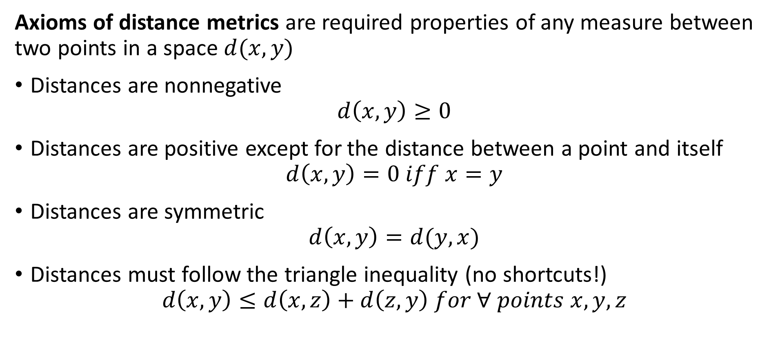
Measuring distance or dissimilarity
Axioms of distance metrics are required properties of any measure between two points in a space $d(x,y)$
Distances are nonnegative
$$d\left(x,y\right)≥0$$
Distances are positive except for the distance between a point and itself
$$d\left(x,y\right)=0 iff x=y$$
Distances are symmetric
$$d\left(x,y\right)=d(y,x)$$
Distances must follow the triangle inequality (no shortcuts!)
$$d\left(x,y\right)≤d\left(x,z\right)+d\left(z,y\right) for ∀ points x,y,z$$

Slide 14
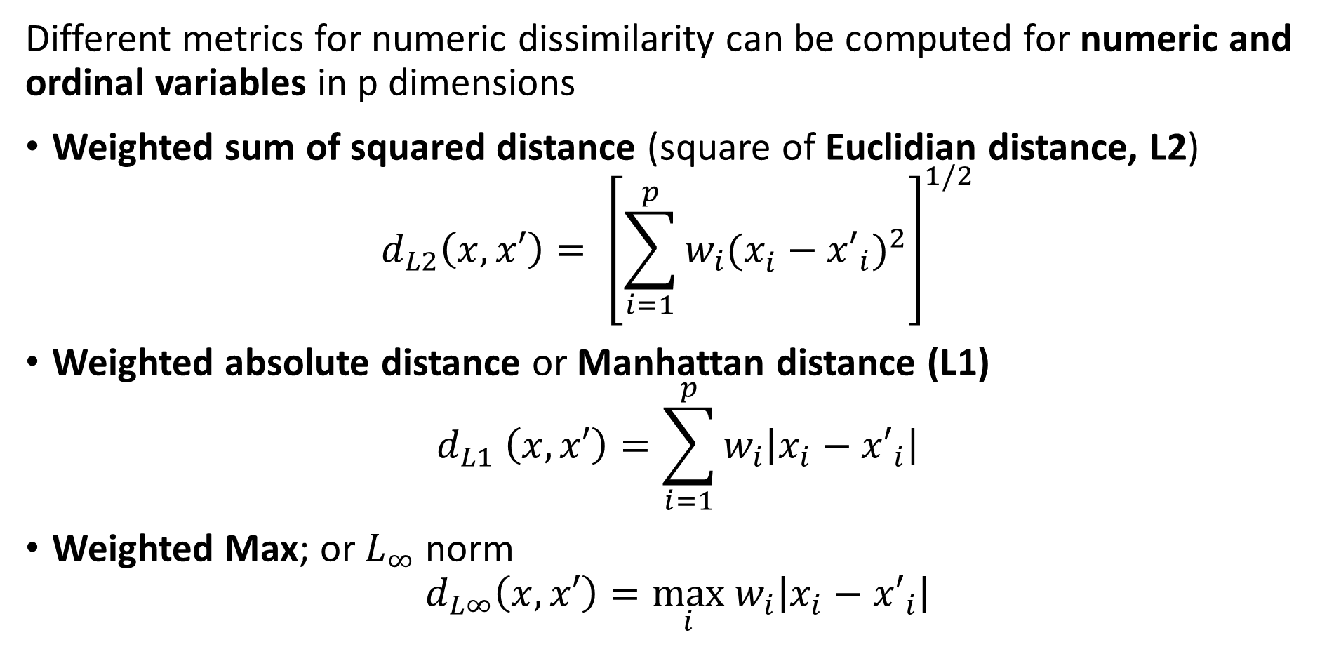
Measuring distance or dissimilarity
Different metrics for numeric dissimilarity can be computed for numeric and ordinal variables in p dimensions
Weighted sum of squared distance (square of Euclidian distance, L2)
$$d_{L2}\left(x,x′\right)= {\left[\sum_{i=1}^{p}{w_{i}(x_{i}^{ }−{x′}_{i})^{2}}\right]}^{1/2}$$
Weighted absolute distance or Manhattan distance (L1)
$$d_{L1} \left(x,x′\right)=\sum_{i=1}^{p}{w_{i}\left|x_{i}−{x′}_{i}\right|}$$
Weighted Max; or $L_{∞}$ norm
$$d_{L∞}\left(x,x′\right)=\max_{i} w_{i}\left|x_{i}−{x′}_{i}\right|$$

Slide 15
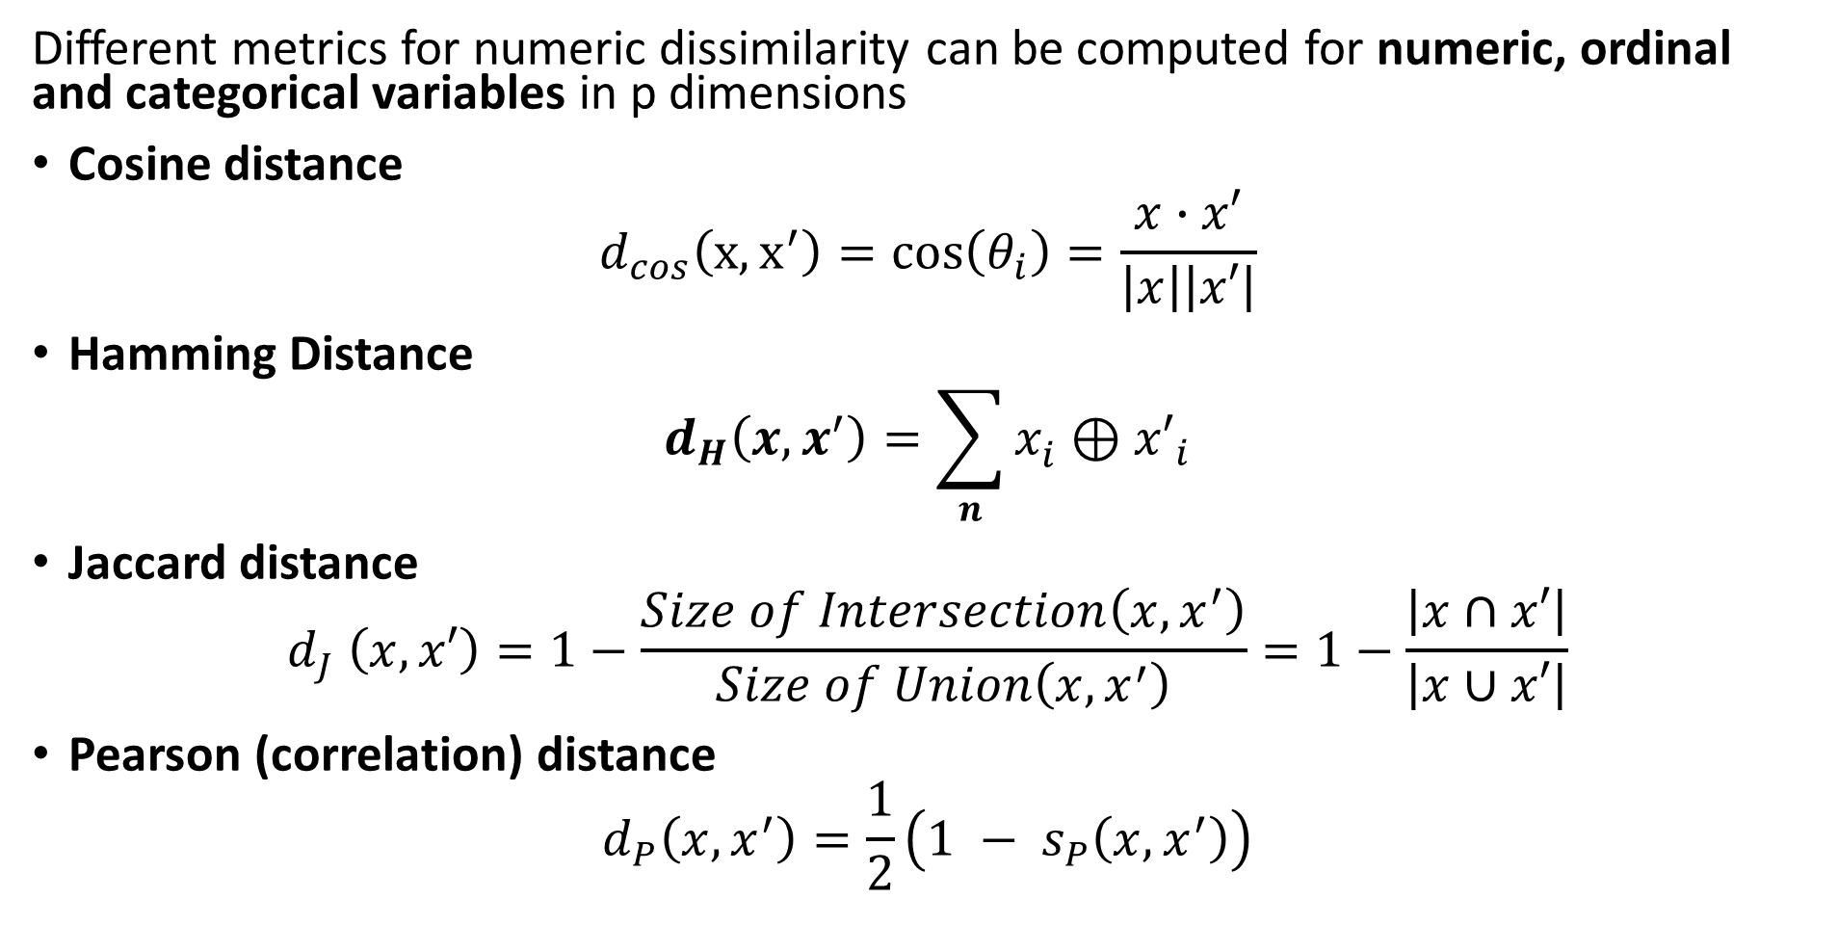
Measuring distance or dissimilarity
Different metrics for numeric dissimilarity can be computed for numeric, ordinal and categorical variables in p dimensions
Cosine distance
$$d_{cos}\left(x,x^{′}\right)=cos\left(θ_{i}\right)=\frac{x∙x′}{\left|x\right|\left|x′\right|}$$
Hamming Distance
$$d_{H}\left(x,x^{′}\right)=\sum_{n}{x_{i}^{ }{⊕x′}_{i}}$$
Jaccard distance
$$d_{J} \left(x,x′\right)=1−\frac{Size of Intersection\left(x,x^{′}\right)}{Size of Union\left(x,x^{′}\right)}=1−\frac{\left|x∩x′\right|}{\left|x∪x′\right|}$$
Pearson (correlation) distance
$$d_{P}\left(x,x^{′}\right)=\frac{1}{2}\left(1 − s_{P}\left(x,x^{′}\right)\right)$$

Slide 16
Measuring distance or dissimilarity
With so many choices, how can we pick a distance metric for clustering?
Carefully consider the problem and the variable types in the data
Example, Euclidean distance optimal for Normally distributed numeric variables
Example, ordinal variables often best with rank difference, cosine, and Jacard
Example, binary variables can use Hamming distance or Pearson distance
Example, categorical variables can use Hamming, cosine and Pearson
Ultimately this question can only be resolved emperically, one needs to try many distance metrics and use the ones that give reasonable results
For real-world mixed variable type problems considerable exploration may be required
Analytics packages like Scikit-Learn Metrics support a large number of distance metrics

Slide 17
K-Means Clustering Models

Slide 18
K-Means Clustering
The K-means clustering algorithm is arguably the most widely used method
Long history
One of the earliest data mining algorithms
First proposed as a coding method by Stuart Lloyd in 1957 – not published until 1982
Term ‘k-means’ coined by Jason MacQueen in 1967
The goal of the k-means algorithm is to find the best k clusters
Most compact is considered best
K is a chosen hyperparameter

Slide 19
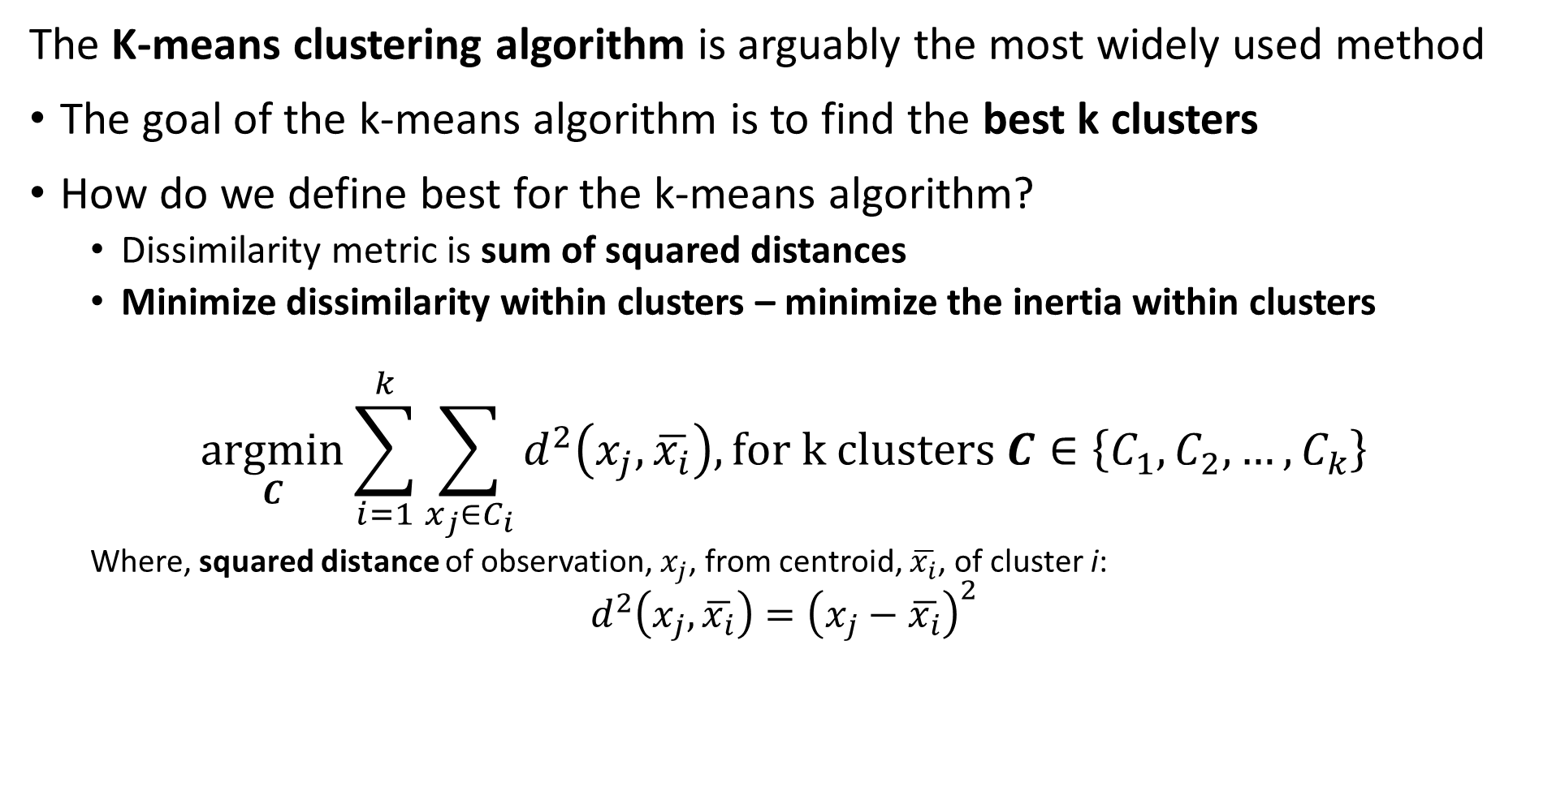
K-Means Clustering
The K-means clustering algorithm is arguably the most widely used method
The goal of the k-means algorithm is to find the best k clusters
How do we define best for the k-means algorithm?
Dissimilarity metric is sum of squared distances
Minimize dissimilarity within clusters – minimize the inertia within clusters
$$\underset{C}{argmin}{\sum_{i=1}^{k}{\sum_{x_{j}∈C_{i}}^{ }{d^{2}\left(x_{j},\overline{x_{i}}\right), for k clusters C∈\left\{C_{1},C_{2},…,C_{k}\right\}}}}$$
Where, squared distance of observation, $x_{j}$, from centroid, $\overline{x_{i}}$, of cluster i:
$$d^{2}\left(x_{j},\overline{x_{i}}\right)={\left(x_{j}−\overline{x_{i}}\right)}^{2}$$

Slide 20
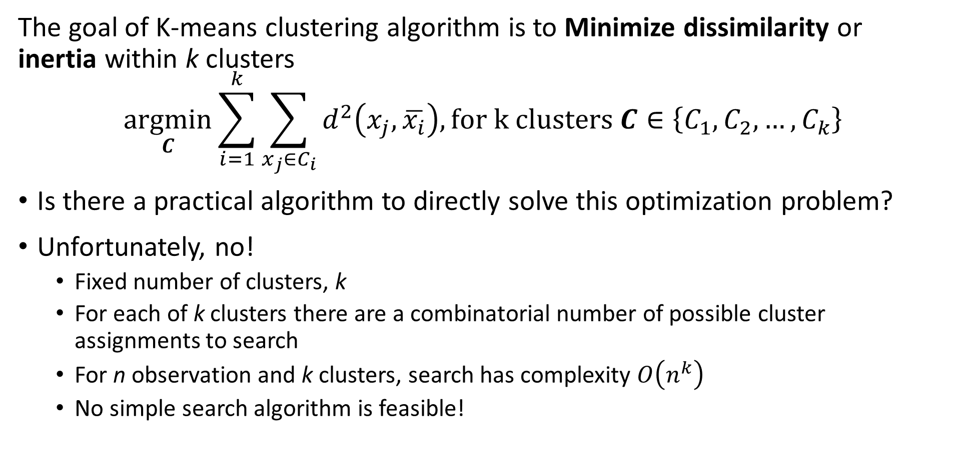
K-Means Clustering
The goal of K-means clustering algorithm is to Minimize dissimilarity or inertia within k clusters
$$\underset{C}{argmin}{\sum_{i=1}^{k}{\sum_{x_{j}∈C_{i}}^{ }{d^{2}\left(x_{j},\overline{x_{i}}\right), for k clusters C∈\left\{C_{1},C_{2},…,C_{k}\right\}}}}$$
Is there a practical algorithm to directly solve this optimization problem?
Unfortunately, no!
Fixed number of clusters, k
For each of k clusters there are a combinatorial number of possible cluster assignments to search
For n observation and k clusters, search has complexity $O\left(n^{k}\right)$
No simple search algorithm is feasible!

Slide 21
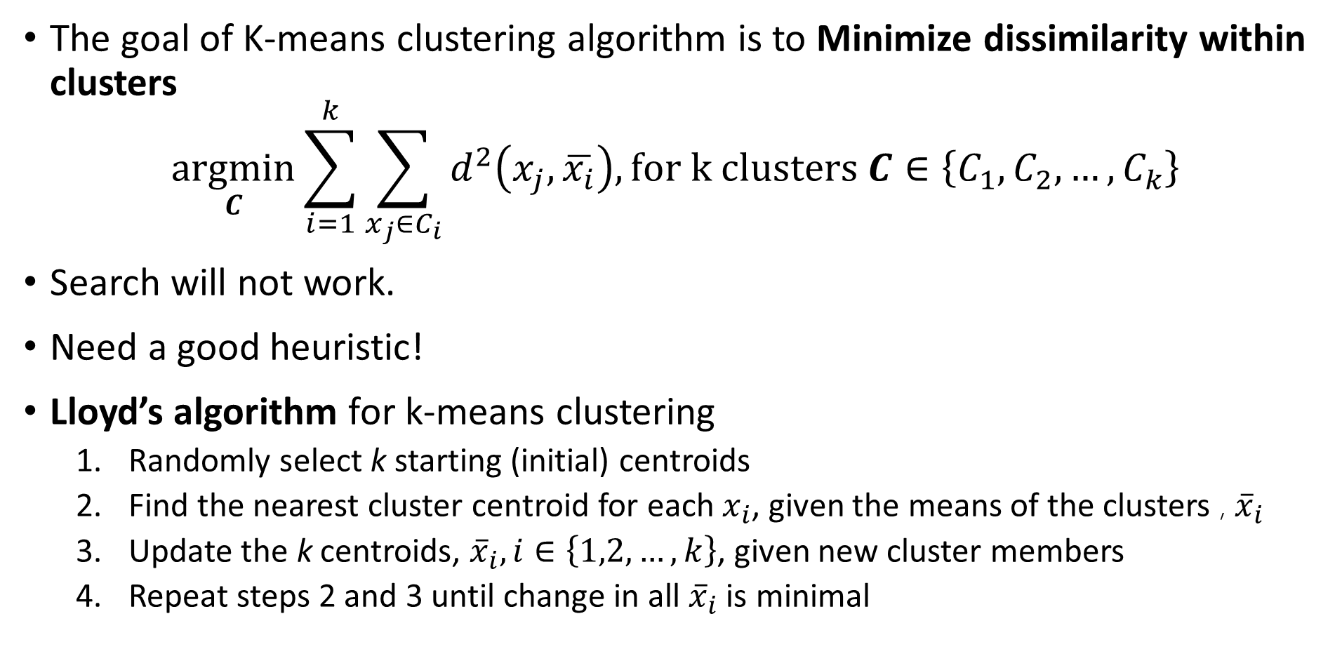
K-Means Clustering
The goal of K-means clustering algorithm is to Minimize dissimilarity within clusters
$$\underset{C}{argmin}{\sum_{i=1}^{k}{\sum_{x_{j}∈C_{i}}^{ }{d^{2}\left(x_{j},\overline{x_{i}}\right), for k clusters C∈\left\{C_{1},C_{2},…,C_{k}\right\}}}}$$
Search will not work.
Need a good heuristic!
Lloyd’s algorithm for k-means clustering
Randomly select k starting (initial) centroids
Find the nearest cluster centroid for each $x_{i}$, given the means of the clusters , ${\overline{x}}_{i}$
Update the k centroids, ${\overline{x}}_{i}, i∈\left\{1,2,…,k\right\}$, given new cluster members
Repeat steps 2 and 3 until change in all ${\overline{x}}_{i}$ is minimal

Slide 22
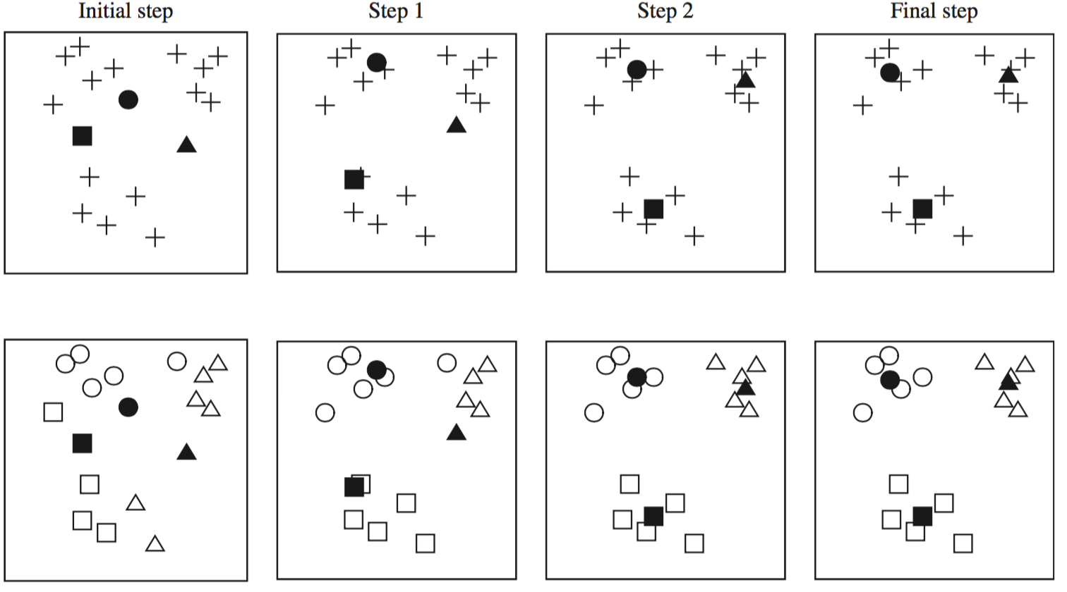
K-Means Clustering
Lloyd’s algorithm for k-means clustering, initializes with random start and iterates over several steps
Credit: Data Mining, Practical Machine Learning Tools and Techniques, Whitten et. al., fourth edition, 2016

Slide 23
K-Means Clustering
Lloyd’s algorithm for k-means clustering, initializes with random start and iterates over several steps
X
X
X
X
X
X
X
X
X
X
X
X
X
X
Start with data points
Initial cluster assignments
Update cluster centers and assignments
Iterate cluster centers and assignments until convergence
Assign Random cluster centers

Slide 24
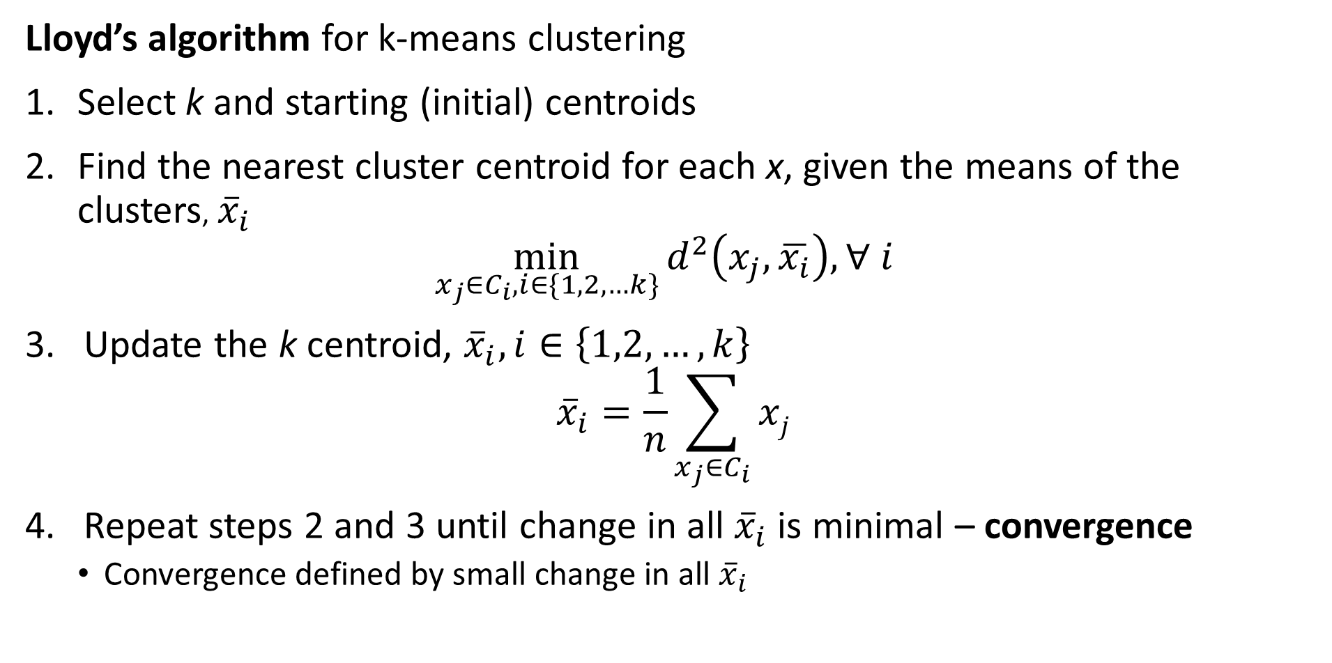
K-Means Clustering
Lloyd’s algorithm for k-means clustering
Select k and starting (initial) centroids
Find the nearest cluster centroid for each x, given the means of the clusters, ${\overline{x}}_{i}$
$$\min_{x_{j}∈C_{i},i∈\{1,2,…k\}}{d^{2}\left(x_{j},\overline{x_{i}}\right), ∀ i }$$
Update the k centroid, ${\overline{x}}_{i}, i∈\left\{1,2,…,k\right\}$
$${\overline{x}}_{i}=\frac{1}{n}\sum_{x_{j}∈C_{i}}{xj}$$
Repeat steps 2 and 3 until change in all ${\overline{x}}_{i}$ is minimal – convergence
Convergence defined by small change in all ${\overline{x}}_{i}$

Slide 25
K-Means Clustering
There are several difficulties with using the k-means algorithm
What is the value of k, the number of clusters?
The number of clusters should reflect fundamental relationships in the data
Is there any way to know k in advance for high dimensional problems?
No, k is found empirically, and the selection is often a bit subjective
How to find good starting values of the centroids?
At convergence the resulting clusters depend on the starting values
Is there any algorithm for finding good starting values?
No!
So, multiple random starts are often used
Copyright 2020, Stephen F Elston. All rights reserved.

Slide 26
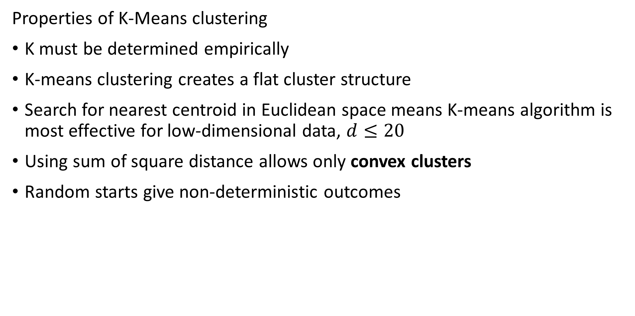
K-Means Clustering
Properties of K-Means clustering
K must be determined empirically
K-means clustering creates a flat cluster structure
Search for nearest centroid in Euclidean space means K-means algorithm is most effective for low-dimensional data, $d≤20$
Using sum of square distance allows only convex clusters
Random starts give non-deterministic outcomes
Copyright 2020, Stephen F Elston. All rights reserved.

Slide 27
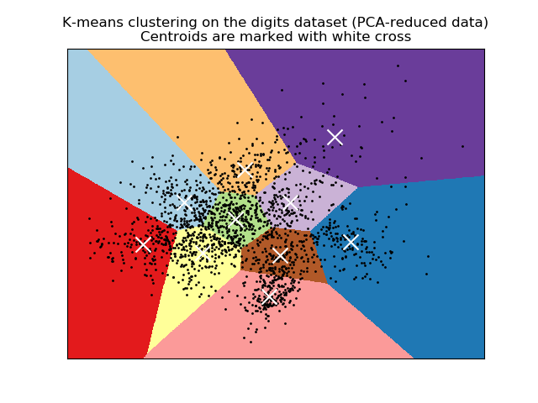
K-Means Clustering
K-means clustering produces convex clusters
Clusters are linearly separated
Clusters are within Voronoi regions
Analogous to k-NN algorithm of supervised learning
Credit: Scikit-Learn development team; Pedregosa et al., JMLR 12, pp. 2825-2830, 2011

Slide 28
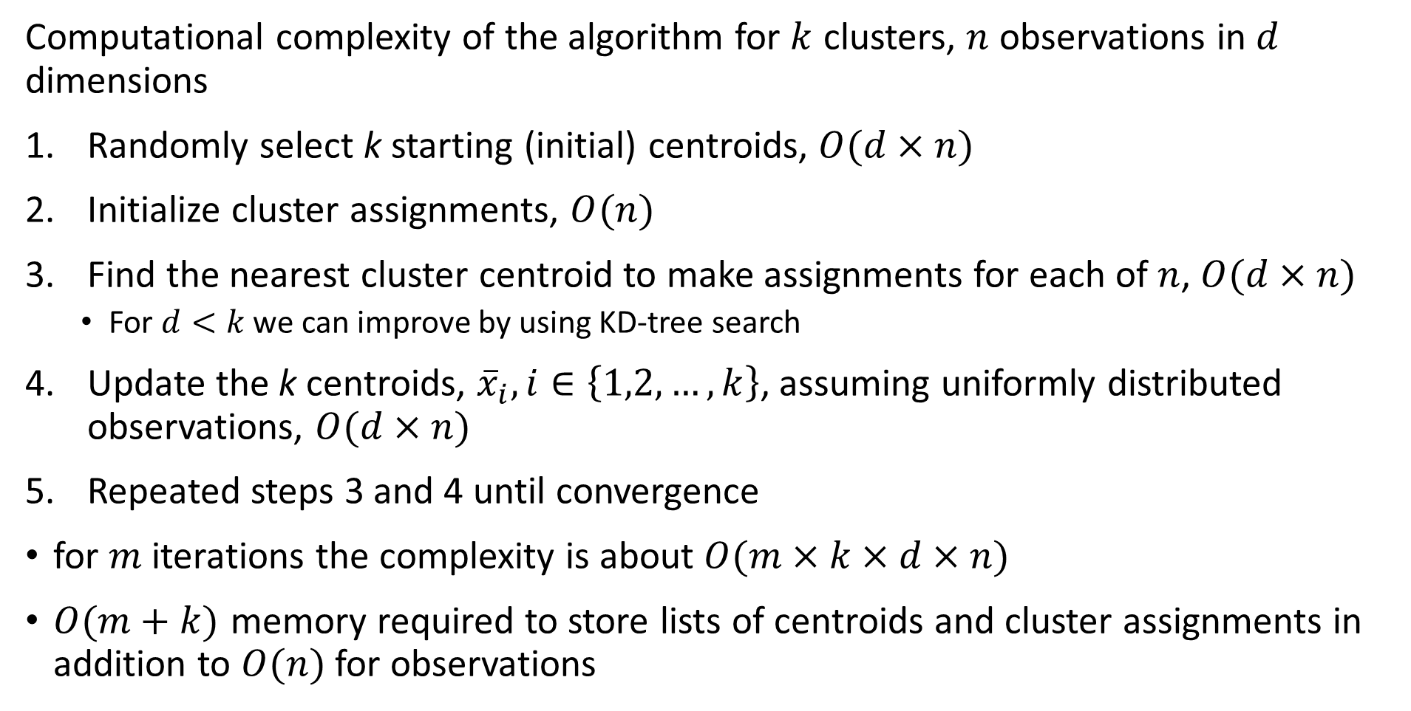
K-Means Clustering
Computational complexity of the algorithm for $k$ clusters, $n$ observations in $d$ dimensions
Randomly select k starting (initial) centroids, $O(d×n)$
Initialize cluster assignments, $O(n)$
Find the nearest cluster centroid to make assignments for each of $n$, $O(d×n)$
For $d<k$ we can improve by using KD-tree search
Update the k centroids, ${\overline{x}}_{i}, i∈\left\{1,2,…,k\right\}$, assuming uniformly distributed observations, $O(d×n)$
Repeated steps 3 and 4 until convergence
for $m$ iterations the complexity is about $O(m×k×d×n)$
$O(m+k)$ memory required to store lists of centroids and cluster assignments in addition to $O(n)$ for observations

Slide 29
Evaluating Clustering Models

Slide 30
Evaluating Clustering Models
How do we evaluate clustering models?
No direct measure as with supervised machine learning
Can we use cross validation?
Not directly, we have no labels
Use metrics that measure the properties of the clusters
Compactness of clusters
Separation between clusters
For k-means clustering the distance metric is quadratic
Use sum of square metrics

Slide 31
Evaluating Clustering Models
How do we evaluate clustering models?
Within and between cluster sum of squares
Can compare cluster models
Determine k
Only useful for Euclidean space!
Other methods
Silhouette coefficients – Does not depend on Euclidian space
Calinski-Harabasz index – Only for Euclidean space!
Many others…….
Notice that all of these methods assume clusters are Normally distributed in a Euclidean space!

Slide 32
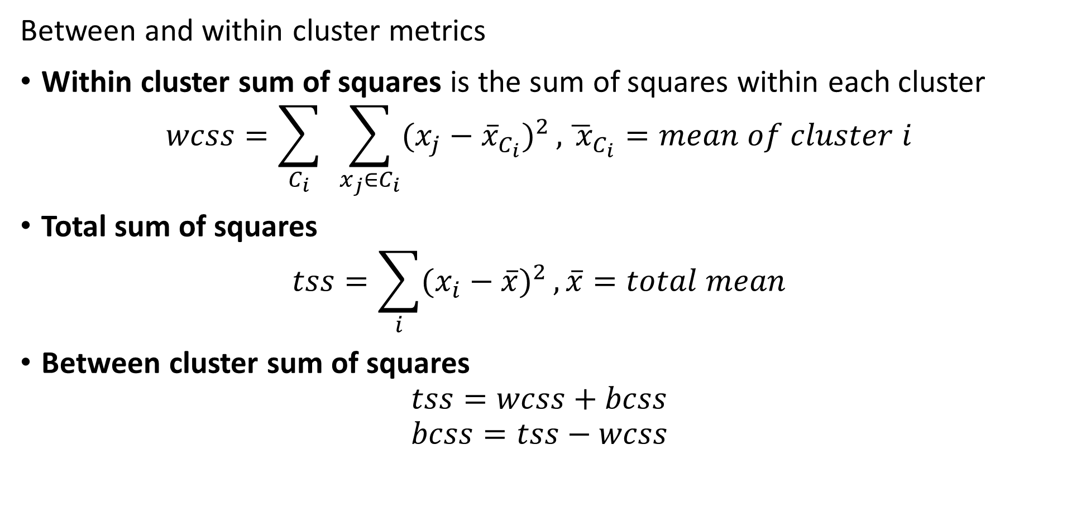
Evaluating Clustering Models
Between and within cluster metrics
Within cluster sum of squares is the sum of squares within each cluster
$$wcss=\sum_{C_{i}}^{ }{ }\sum_{x_{j}∈C_{i}}{(x_{j}−{\overline{x}}_{C_{i}})^{2}},{\overline{ x}}_{C_{i}}=mean of cluster i$$
Total sum of squares
$$tss=\sum_{i}{(x_{i}−\overline{x})^{2}},\overline{x}=total mean$$
Between cluster sum of squares
$$tss=wcss+bcss$$
$$bcss=tss−wcss$$

Slide 33
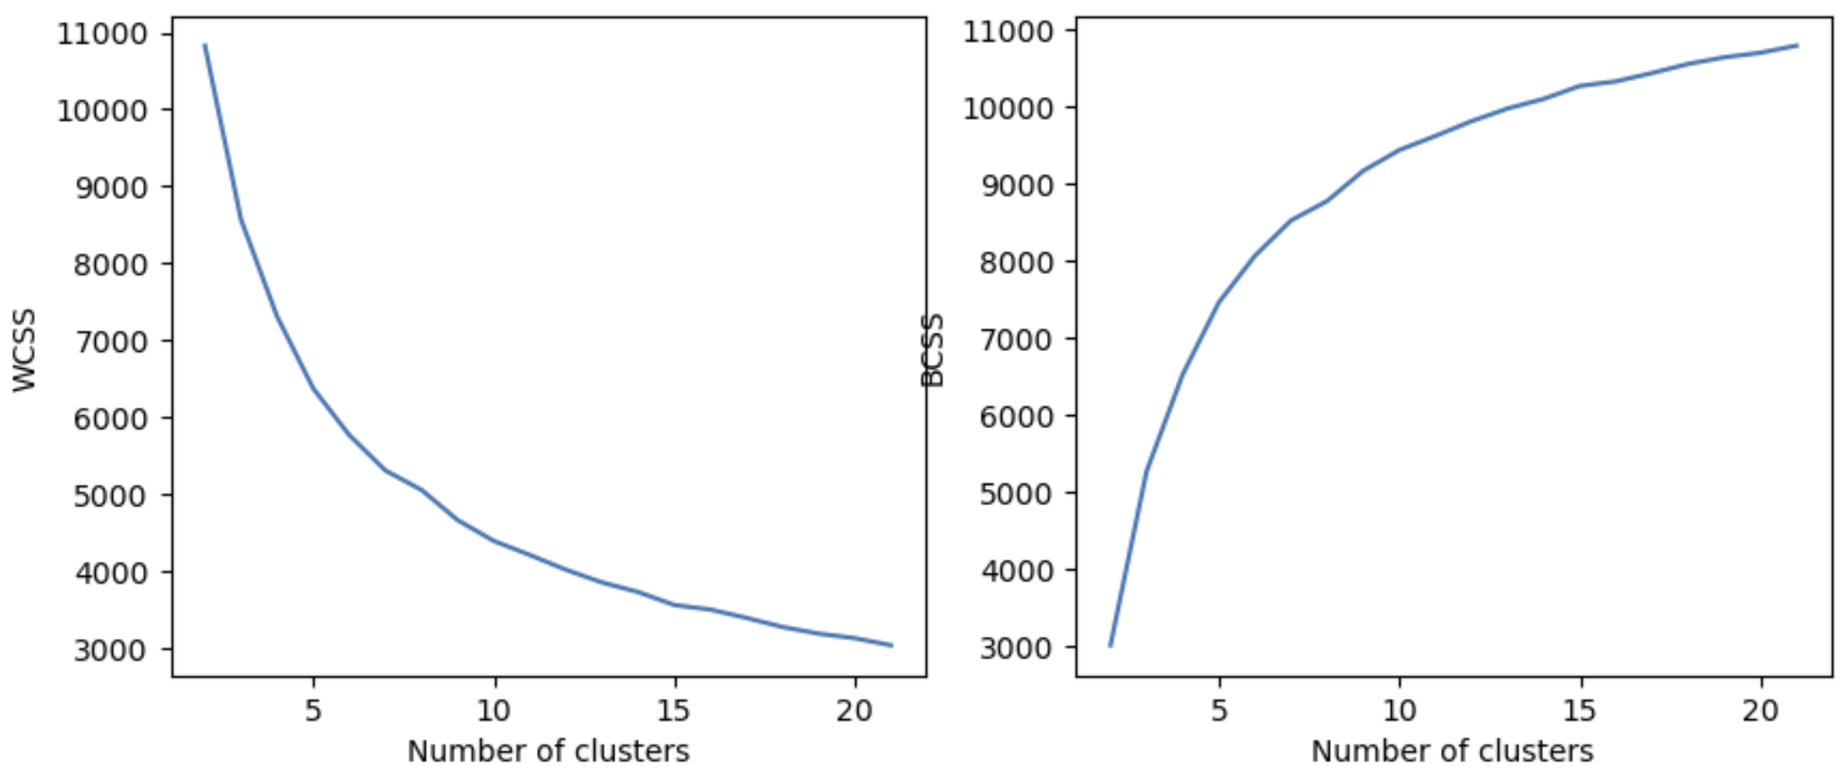
Evaluating Clustering Models
Use WCSS and BCSS to compare clustering models
Limit number of clusters where WCSS and BCSS have marginal changes

Slide 34
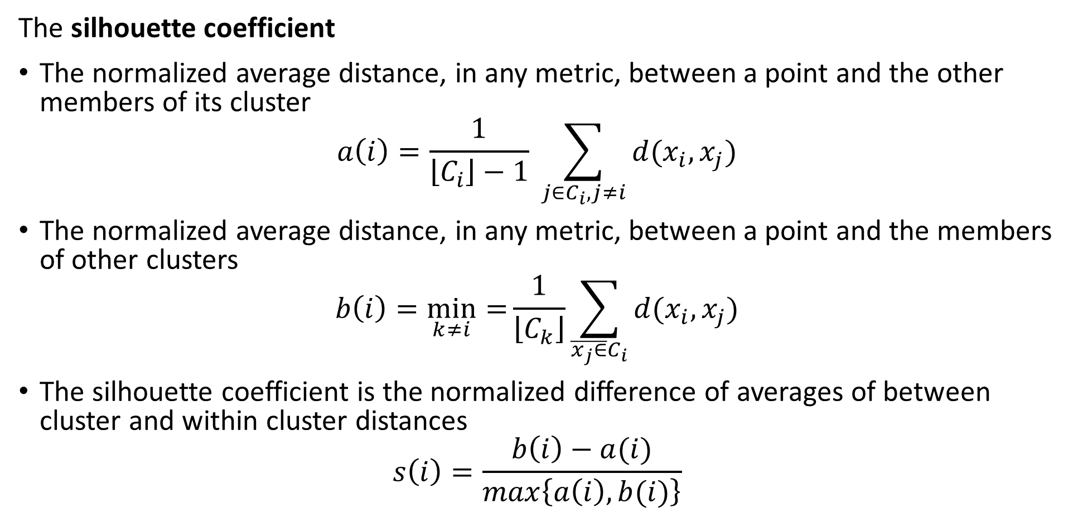
Evaluating Clustering Models
The silhouette coefficient
The normalized average distance, in any metric, between a point and the other members of its cluster
$$a\left(i\right)=\frac{1}{\left\lfloor C_{i}\right\rfloor −1} \sum_{j∈C_{i},j≠i}^{ }{d(x_{i},x_{j})}$$
The normalized average distance, in any metric, between a point and the members of other clusters
$$b\left(i\right)=\min_{k≠i}{=}\frac{1}{\left\lfloor C_{k}\right\rfloor }\sum_{\overline{x_{j}∈}C_{i}}^{ }{d(x_{i},x_{j})}$$
The silhouette coefficient is the normalized difference of averages of between cluster and within cluster distances
$$s\left(i\right)=\frac{b\left(i\right)−a(i)}{max\left\{a\left(i\right),b(i)\right\}}$$

Slide 35
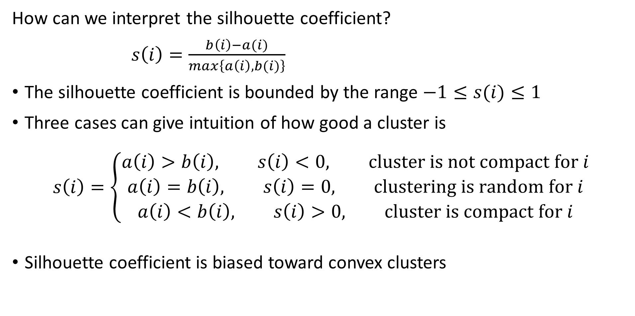
Evaluating Clustering Models
How can we interpret the silhouette coefficient?
$s\left(i\right)=\frac{b\left(i\right)−a(i)}{max\left\{a\left(i\right),b(i)\right\}}$
The silhouette coefficient is bounded by the range $−1≤s(i)≤1$
Three cases can give intuition of how good a cluster is
$$s\left(i\right)=\left\{\begin{aligned}a\left(i\right)>b\left(i\right), s\left(i\right)<0, cluster is not compact for i \\ a\left(i\right)=b\left(i\right), s\left(i\right)=0, clustering is random for i \\ a\left(i\right)<b\left(i\right), s\left(i\right)>0, cluster is compact for i\end{aligned}\right.$$
Silhouette coefficient is biased toward convex clusters

Slide 36
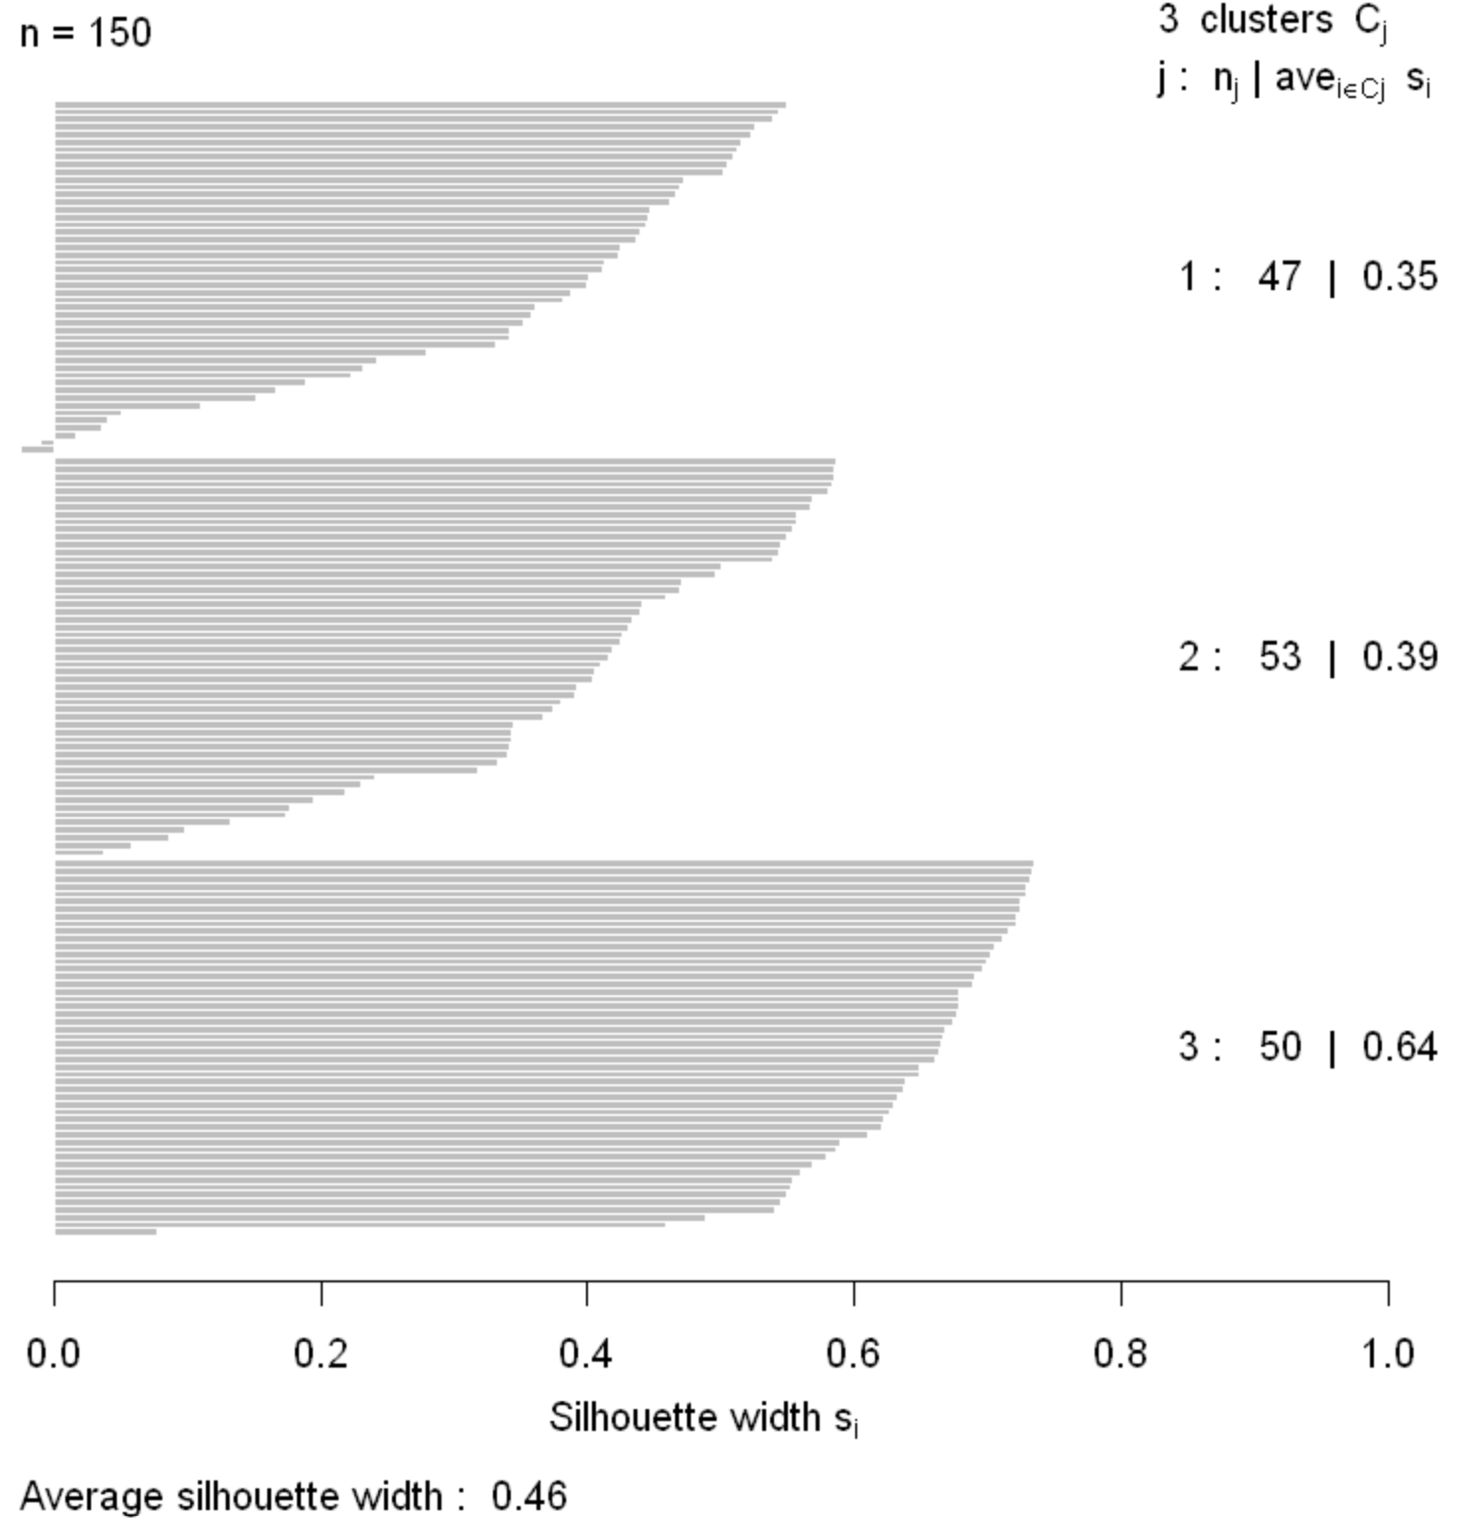
Evaluating Clustering Models
Silhouette coefficients can be graphed for small number of samples
Plot shows how compact and well separated the clusters are
Negative silhouette coefficients indicate sample incorrectly clustered

Slide 37
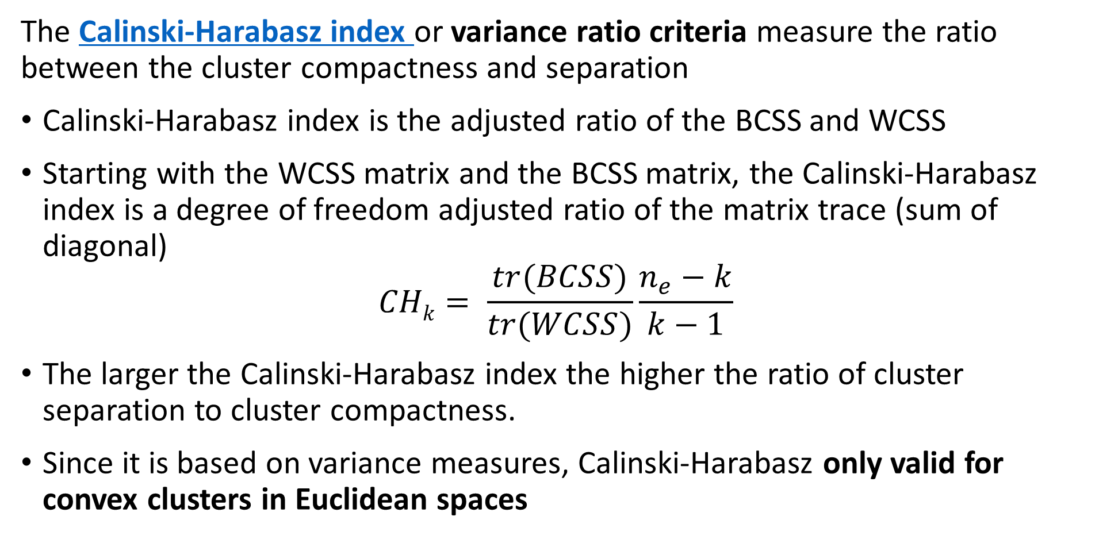
Evaluating Clustering Models
The Calinski-Harabasz index or variance ratio criteria measure the ratio between the cluster compactness and separation
Calinski-Harabasz index is the adjusted ratio of the BCSS and WCSS
Starting with the WCSS matrix and the BCSS matrix, the Calinski-Harabasz index is a degree of freedom adjusted ratio of the matrix trace (sum of diagonal)
$$CHk= \frac{tr(BCSS)}{tr(WCSS)}\frac{n_{e}−k}{k−1}$$
The larger the Calinski-Harabasz index the higher the ratio of cluster separation to cluster compactness.
Since it is based on variance measures, Calinski-Harabasz only valid for convex clusters in Euclidean spaces

Slide 38
Evaluating Clustering Models
Use multiple metrics to find best number of clusters
Knee in WCSS and BCSS – not very reliable!
Max of silhouette coefficient
Max of Calinski-Harabasz index
There is stochastic variation
Metrics may not agree
May need to try several models
Prefer simpler models – Occam’s razor!
Too many clusters is an over-fit model

Slide 39
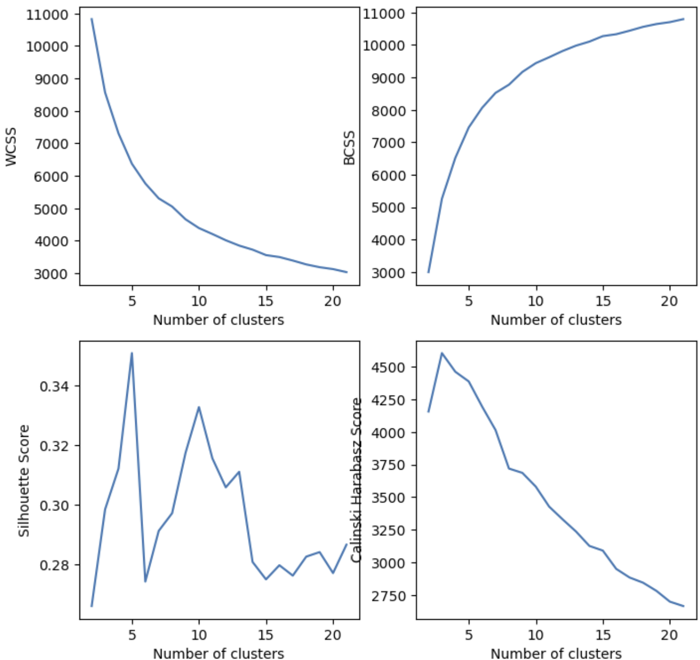
Evaluating Clustering Models
Use multiple metrics to find best number of clusters
Example: pick k=5

Slide 40
Visualizing Cluster Model Results

Slide 41
Visualizing Clustering Model Results
How can we visualize the results of a cluster model?
Visualization of any kind is difficult with high-dimensional data
Many methods possible
Look for domain specific methods
Scatter plot matrices between key variables
Useful for low-dimensional data
Impossible to see and understand for high-dimensional data
Compare distributions of clusters of key variables for clusters
Display a low-dimensional manifold projection of the high-dimensional cluster assignments

Slide 42
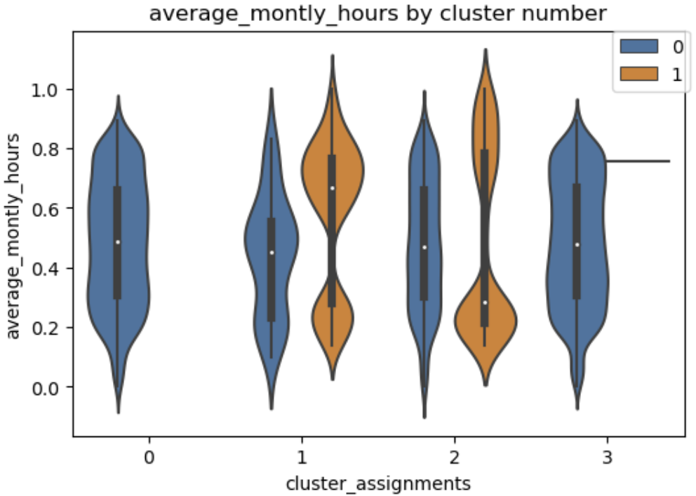
Visualizing Clustering Model Results
How can we visualize the results of a cluster model?
Compare distributions of clusters of key variables for clusters
Side by side violin plots are an excellent tool for this purpose
Compare kernel density estimates (KDE) of variables by cluster assignment
Includes box plot
Mirrored KDE with normalized areas
Box plot showing median and quartiles

Slide 43
Visualizing Clustering Model Results
How can we visualize the results of a cluster model?
Display a low-dimensional manifold projection of the high-dimensional cluster assignments
A manifold is a low-dimensional surface in a high-dimensional space
Principle Component Analysis (PCA) is only useful for Eucidean spaces
Uniform Manifold Approximation and Projection (UMAP) is a state of the art manifold projection algorithm
Finds the best low-dimensional projection of a high-dimensional space
Attempts to preserve distances
Attempts to preserve marginal probability distributions
Defined for most distance measures
We will explore manifold learning further in a subsequent lesson

Slide 44
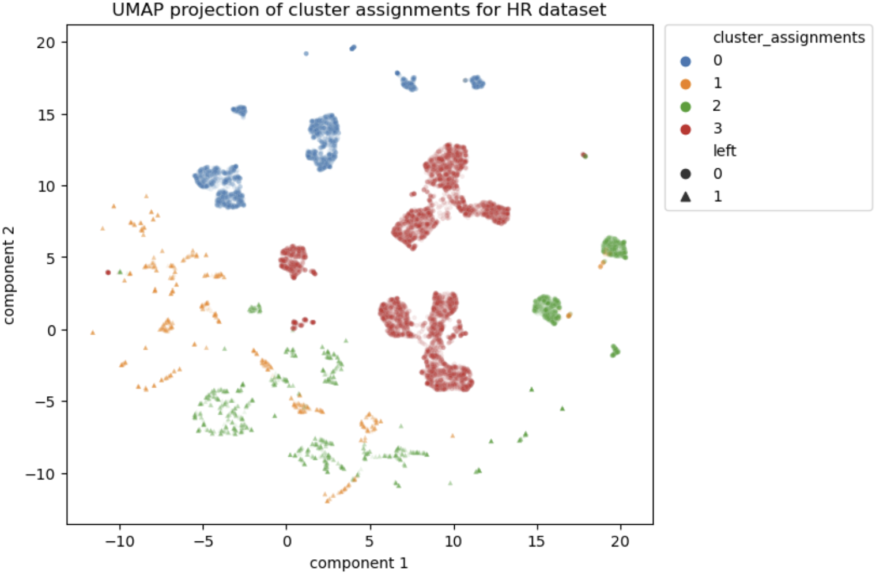
Visualizing Clustering Model Results
How can we visualize the results of a cluster model?
Uniform Manifold Approximation and Projection (UMAP) is a state of the art manifold projection algorithm
UMAP can project cluster assignments on a 2-dimensional space
Aids in visualization of cluster relationships
2-dimensional projection of cluster assignments

Slide 45
Mini-batch k-means

Slide 46
Mini-Batch K-Means
Mini-batch K-means improves scaling of the algorithm
The basic K-means algorithm requires that all data be held in main memory at once
Limits scalability for massive data sets
The mini-batch K-means algorithm is an alternative
Follows same steps as standard K-means algorithm
Updates based on repeated mini-batch (small) samples of massive data set
Incrementally update cluster centers and membership on each mini-batch
Using small mini-batch samples makes updates stochastic in nature
Convergence to result of batch (standard) algorithm on average
Can be small differences (stochastic error) compared to batch algorithm

Slide 47
Mini-Batch K-Means
Mini-batch K-means improves scaling of the algorithm
Mini-batch k-means algorithm
Randomly Bernoulli sort the samples – use a hash at scale
Round-robin, take a mini-batch sub-sample – typically round binary number
Update the cluster centers
Update cluster membership
Repeat 2-4 above until stopping criteria is reached
Notice the chance of repeating the mini-batch samples
In practice this does not create much bias
For large samples this generally hardly matters

Slide 48
Hierarchical Clustering Models

Slide 49
Hierarchical Clustering Algorithms
Are there other ways to create compact well-separated clusters?
K-means algorithms form clusters with maximum compactness
Clusters have minimum variance or inertia
Hierarchical clustering algorithms create compact and well-separated clusters
Algorithm sequentially considers groups of points
Cluster assignments made using linkage function
Can use any distance metric
Create hierarchy of possible clusters
One cluster at top with all samples
Single sample clusters at the bottom – singletons
Hierarchical clustering method work for most any distance metric!

Slide 50
Hierarchical Clustering Algorithms
Are there other ways to create compact clusters?
Hierarchy is a form of graph: a tree
Tree graph has no cycles
Tree graph has binary splits on nodes
Edge length (weight) is distance between nodes

Slide 51
Hierarchical Clustering Algorithms
Two possible approaches to hierarchical clustering
Divisive clustering – top down
Start will all samples in one large cluster
Recursively split into compact clusters
Stop when only single samples at leaves – singletons
Not discussed further here
Agglomerative clustering – bottom up
Start with each sample in an individual cluster - singletons
Build maximumly compact clusters, until all samples in one cluster
Forms a tree with singletons at the leaves and all samples at the root

Slide 52
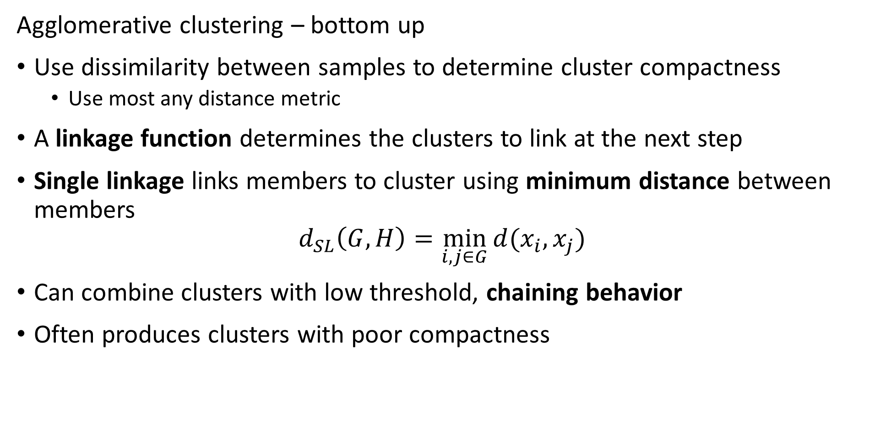
Hierarchical Clustering Algorithms
Agglomerative clustering – bottom up
Use dissimilarity between samples to determine cluster compactness
Use most any distance metric
A linkage function determines the clusters to link at the next step
Single linkage links members to cluster using minimum distance between members
$$d_{SL}\left(G,H\right)=\min_{i,j∈G}{d(x_{i},x_{j})}$$
Can combine clusters with low threshold, chaining behavior
Often produces clusters with poor compactness

Slide 53
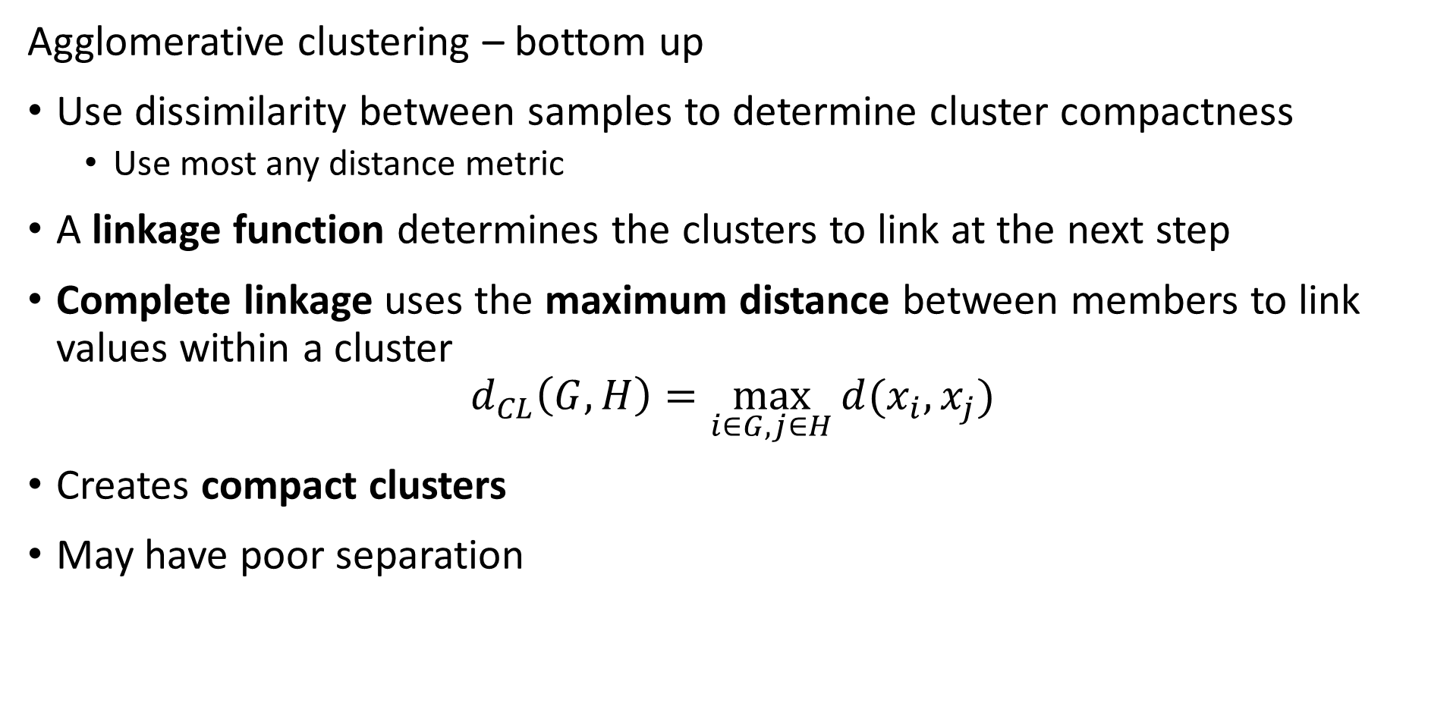
Hierarchical Clustering Algorithms
Agglomerative clustering – bottom up
Use dissimilarity between samples to determine cluster compactness
Use most any distance metric
A linkage function determines the clusters to link at the next step
Complete linkage uses the maximum distance between members to link values within a cluster
$$d_{CL}\left(G,H\right)=\max_{i∈G,j∈H}{d(x_{i},x_{j})}$$
Creates compact clusters
May have poor separation

Slide 54
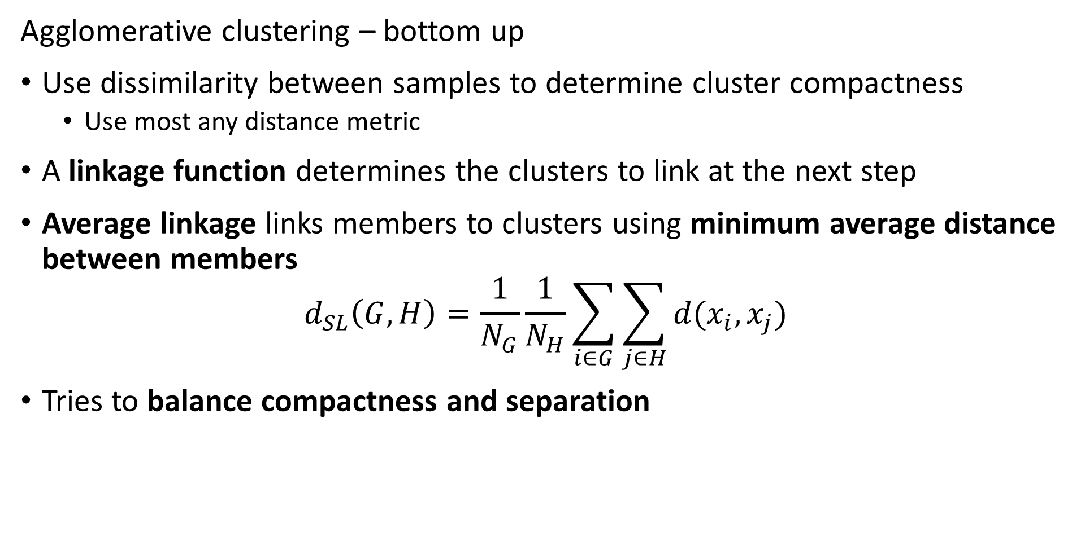
Hierarchical Clustering Algorithms
Agglomerative clustering – bottom up
Use dissimilarity between samples to determine cluster compactness
Use most any distance metric
A linkage function determines the clusters to link at the next step
Average linkage links members to clusters using minimum average distance between members
$$d_{SL}\left(G,H\right)=\frac{1}{N_{G}}\frac{1}{N_{H}}\sum_{i∈G}^{ }{\sum_{j∈H}^{ }{d(x_{i},x_{j})}}$$
Tries to balance compactness and separation

Slide 55
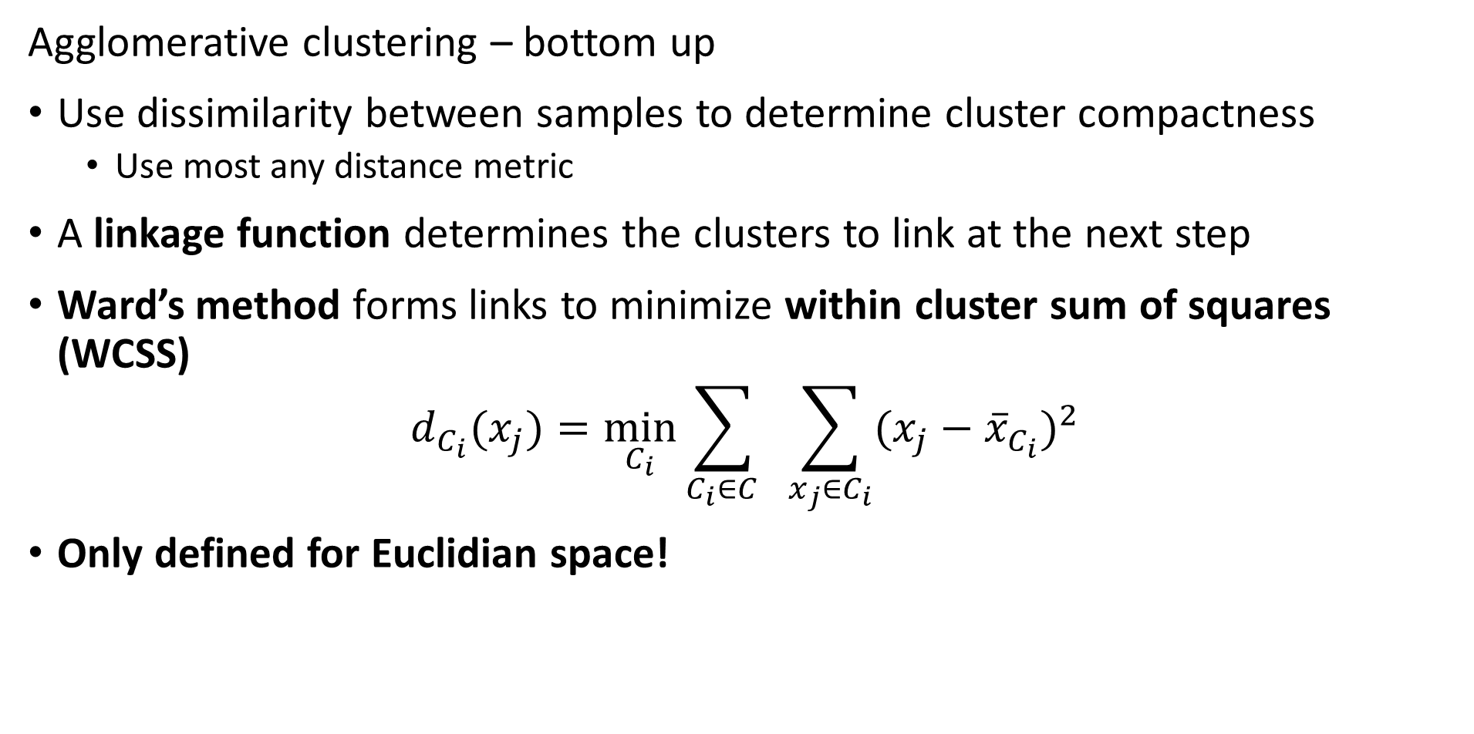
Hierarchical Clustering Algorithms
Agglomerative clustering – bottom up
Use dissimilarity between samples to determine cluster compactness
Use most any distance metric
A linkage function determines the clusters to link at the next step
Ward’s method forms links to minimize within cluster sum of squares (WCSS)
$$d_{C_{i}}(x_{j})=\min_{C_{i}}{\sum_{C_{i}∈C_{ }}^{ }{ }\sum_{x_{j}∈C_{i}}{(x_{j}−{\overline{x}}_{C_{i}})^{2}}}$$
Only defined for Euclidian space!

Slide 56
Agglomerative Clustering Example
Start with data points in a 2-dimensional Euclidian space
Use Euclidean distance and average linkage to find the first points to link –the leaves of the hierarchy
Continue to link points into clusters
At termination of algorithm all points are linked at root of hierarchy
5
3
2
6
4
1

Slide 57
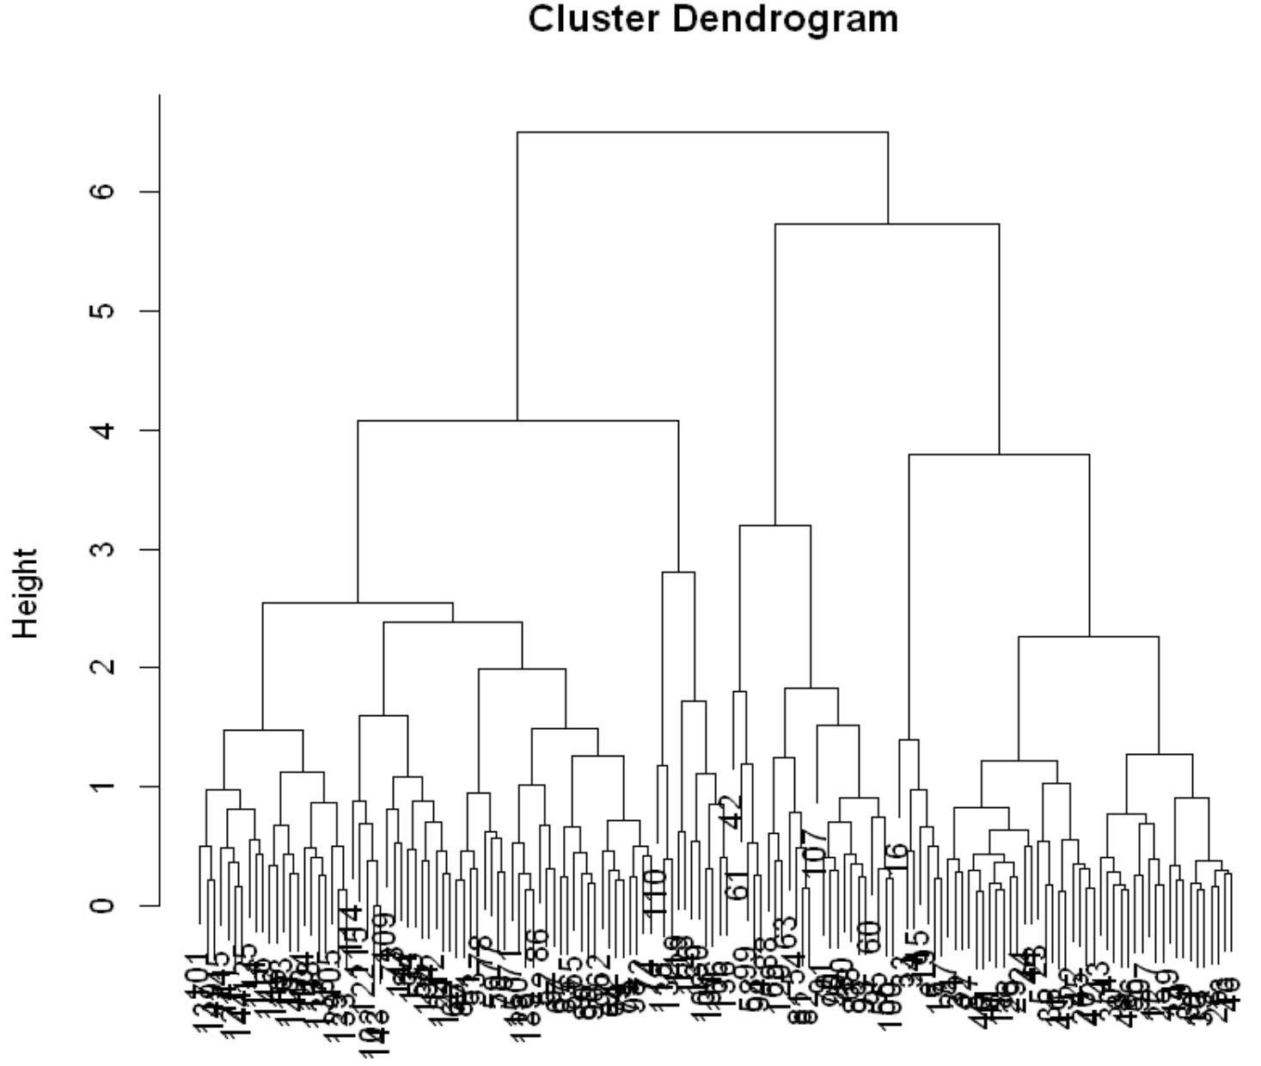
Hierarchical Clustering
Hierarchical cluster creates dendrogram
Number of clusters determined by depth of cut point
For example the cut-point shown results in 6 clusters
Or maybe 3 clusters?
Need some domain knowledge to determine which is useful

Slide 58
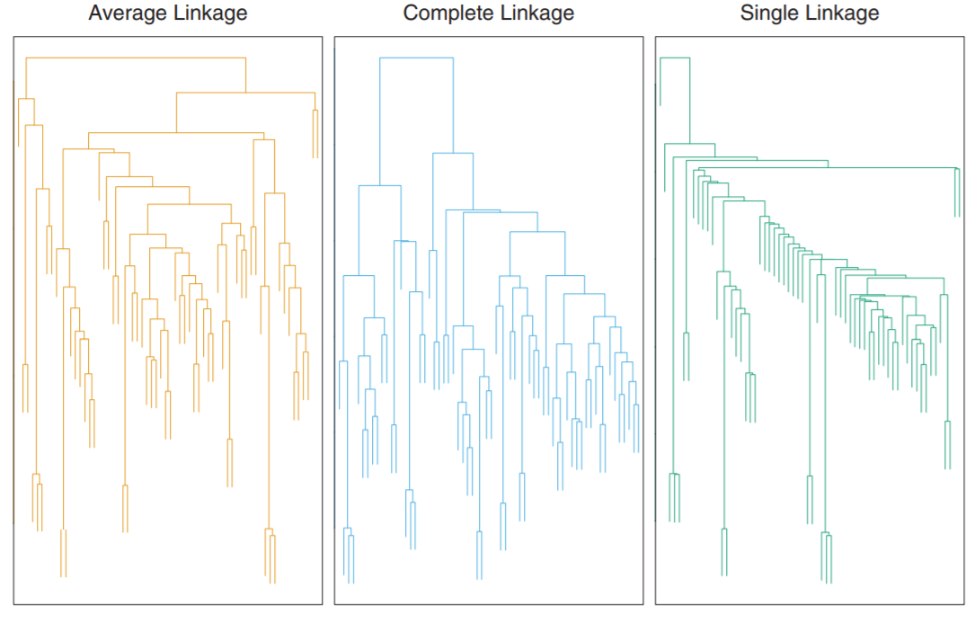
Hierarchical Clustering
Example of microasay of human tumors
The dendrograms are quite different
Choice of linkage function creates different hierarchy
Credit: Hastie, Tibsheirani and Friedeman, 2009

Slide 59
Evaluating Non-Euclidean Cluster Models

Slide 60
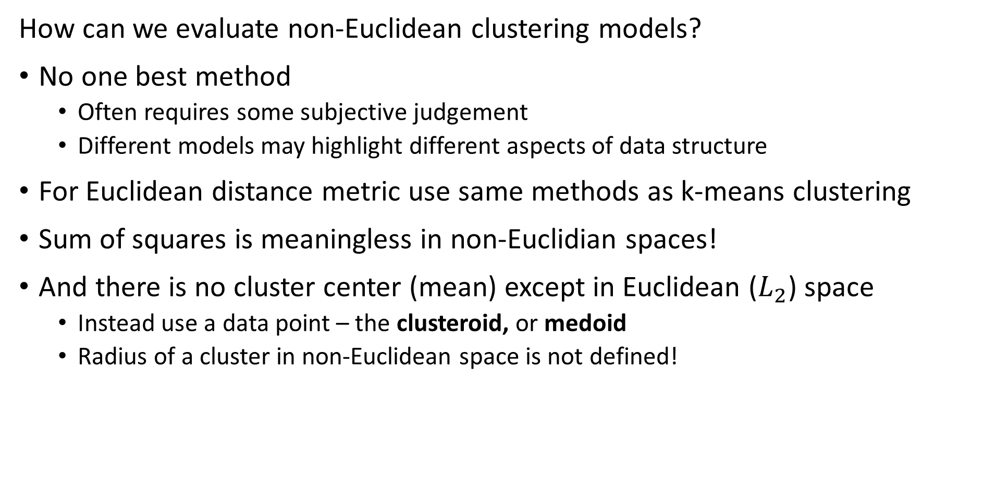
Evaluating Non-Euclidean Clustering
How can we evaluate non-Euclidean clustering models?
No one best method
Often requires some subjective judgement
Different models may highlight different aspects of data structure
For Euclidean distance metric use same methods as k-means clustering
Sum of squares is meaningless in non-Euclidian spaces!
And there is no cluster center (mean) except in Euclidean ($L_{2}$) space
Instead use a data point – the clusteroid, or medoid
Radius of a cluster in non-Euclidean space is not defined!

Slide 61
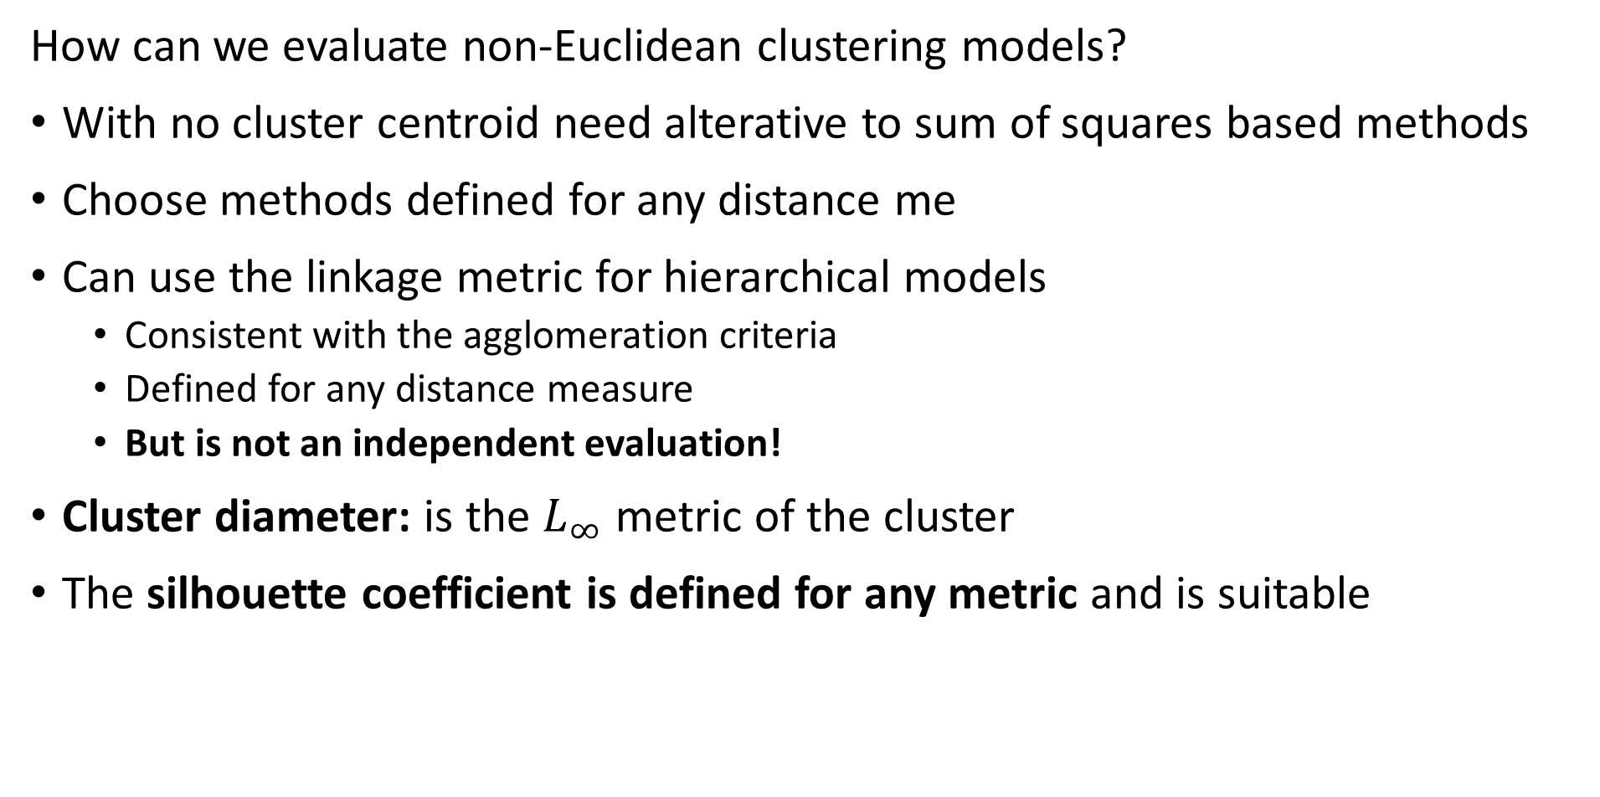
Evaluating Non-Euclidean Clustering
How can we evaluate non-Euclidean clustering models?
With no cluster centroid need alterative to sum of squares based methods
Choose methods defined for any distance me
Can use the linkage metric for hierarchical models
Consistent with the agglomeration criteria
Defined for any distance measure
But is not an independent evaluation!
Cluster diameter: is the $L_{∞}$ metric of the cluster
The silhouette coefficient is defined for any metric and is suitable

Slide 62
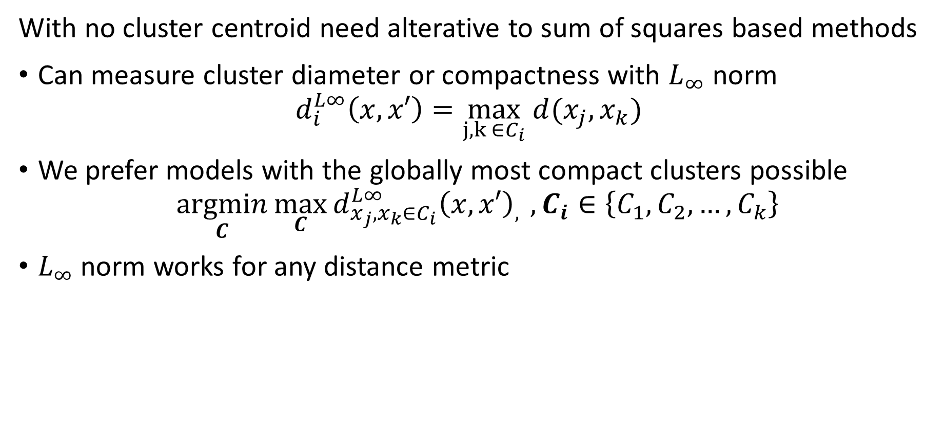
Evaluating Clustering Models
With no cluster centroid need alterative to sum of squares based methods
Can measure cluster diameter or compactness with $L_{∞}$ norm
$$d_{i}^{L∞}\left(x,x′\right)=\max_{j,k ∈C_{i}} {d(x_{j},x_{k})}_{ }{ }$$
We prefer models with the globally most compact clusters possible
$$\underset{C}{argmin}{\max_{C}{{d_{x_{j},x_{k}∈C_{i}}^{L∞}\left(x,x′\right)}_{, }},C_{i}∈\left\{C_{1},C_{2},…,C_{k}\right\}}$$
$L_{∞}$ norm works for any distance metric

Slide 63
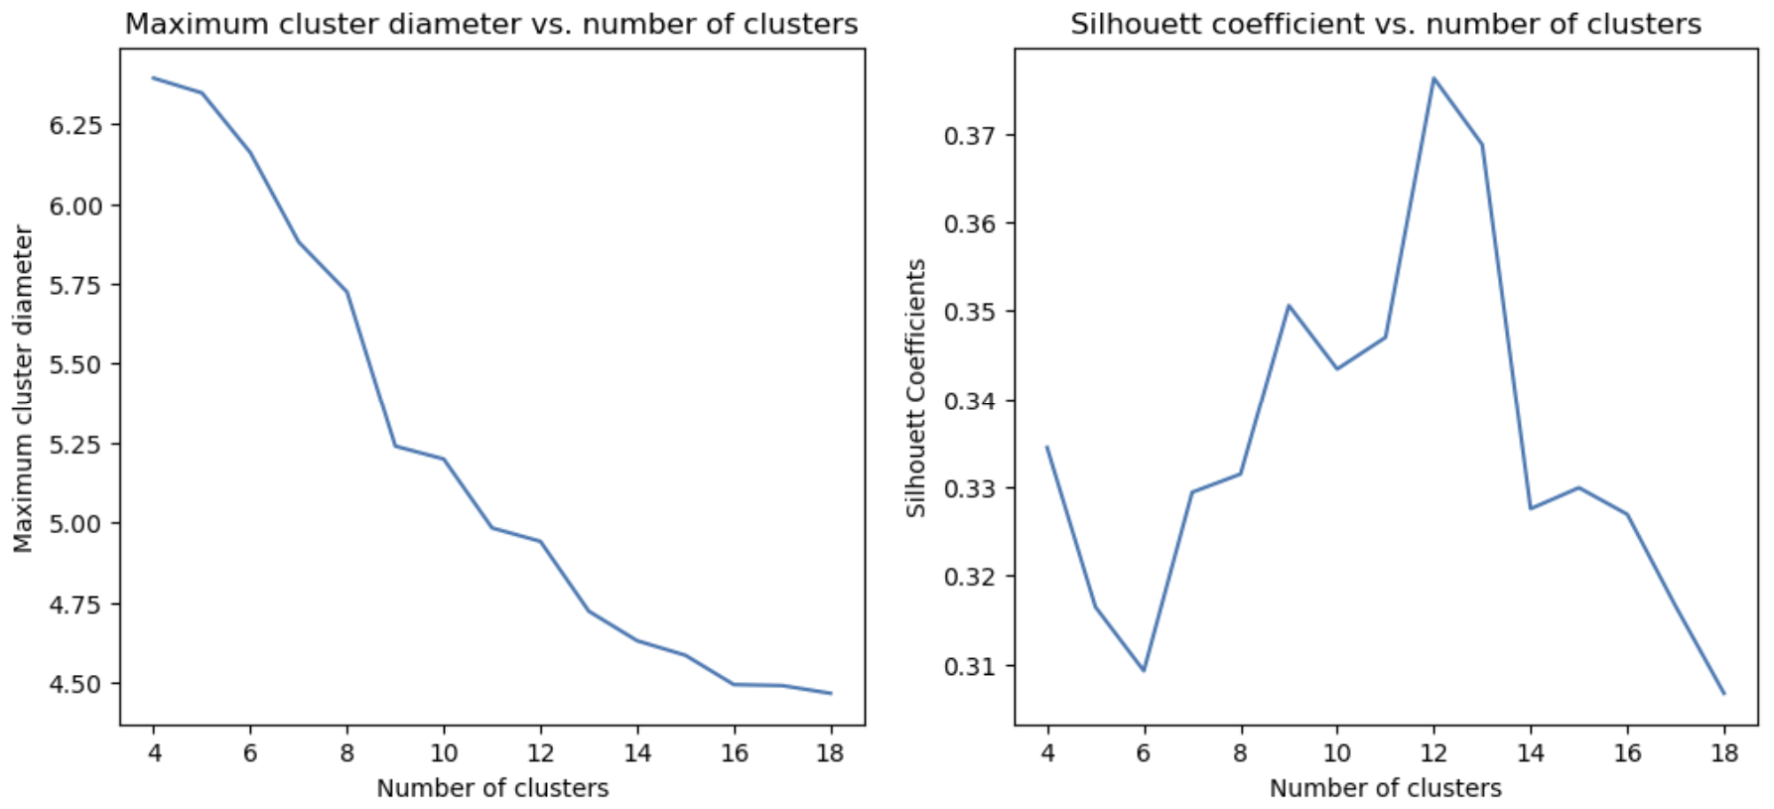
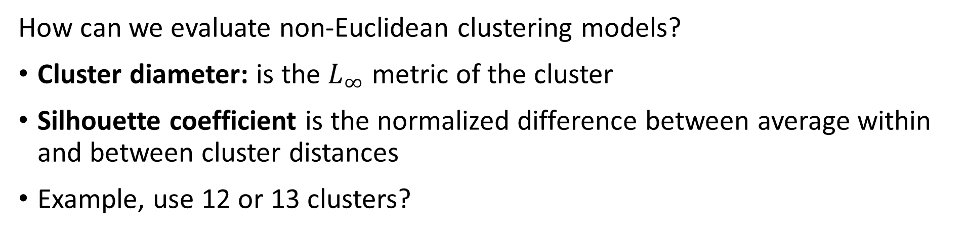
Evaluating Non-Euclidean Clustering
How can we evaluate non-Euclidean clustering models?
Cluster diameter: is the $L_{∞}$ metric of the cluster
Silhouette coefficient is the normalized difference between average within and between cluster distances
Example, use 12 or 13 clusters?

Slide 64
K-Mediods and CLARA

Slide 65
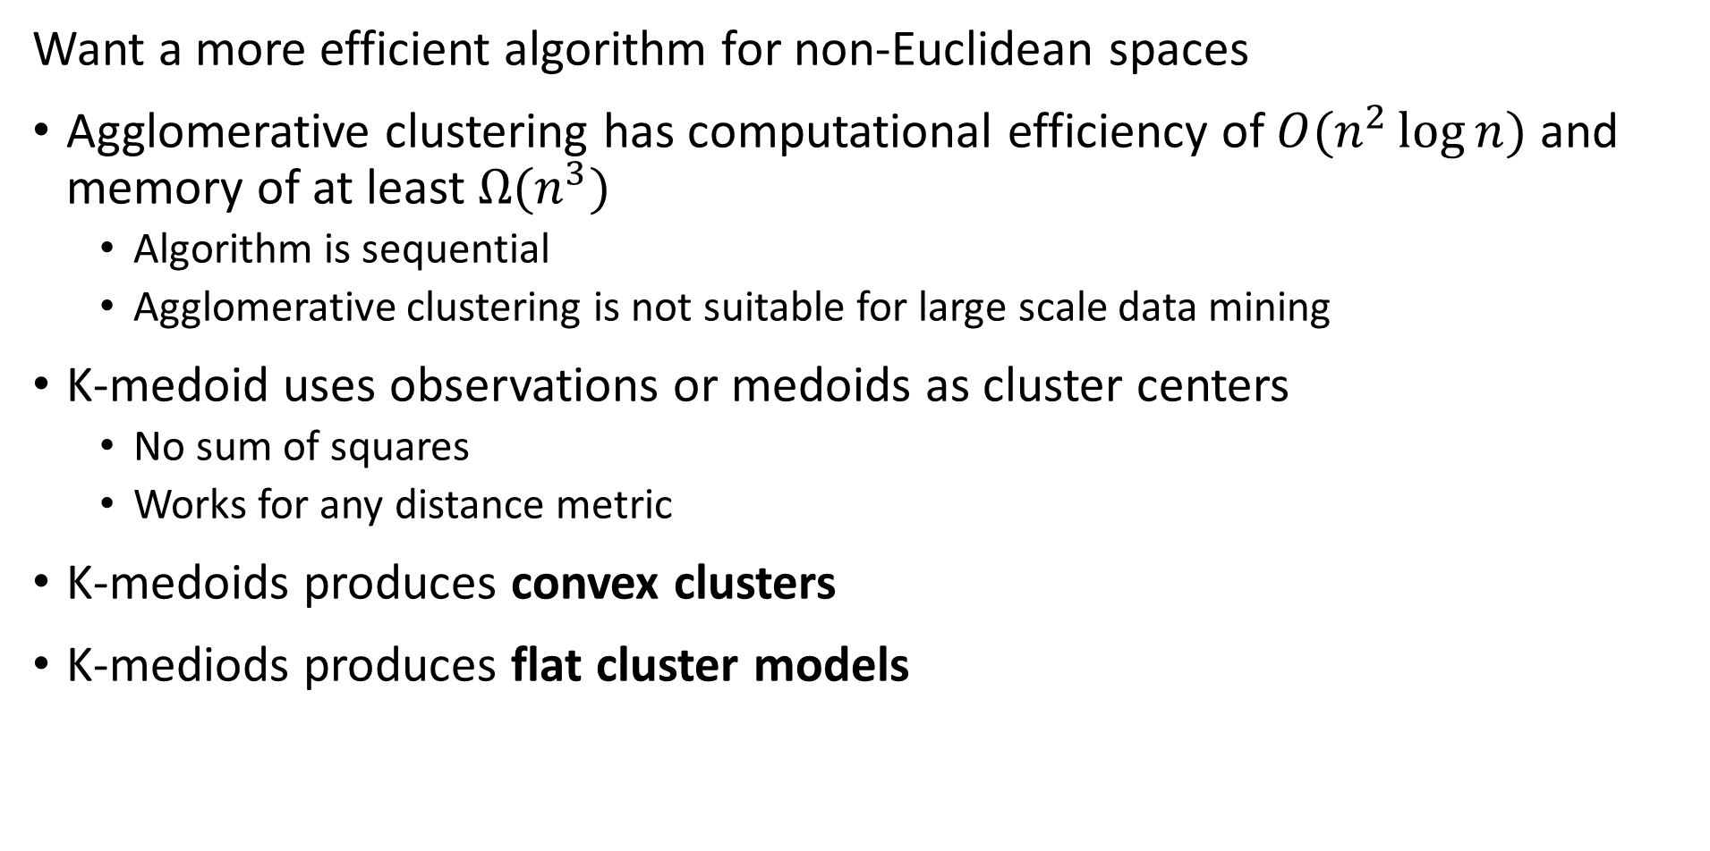
K-medoids Algorithm
Want a more efficient algorithm for non-Euclidean spaces
Agglomerative clustering has computational efficiency of $O(n^{2}\log{n})$ and memory of at least $Ω(n^{3})$
Algorithm is sequential
Agglomerative clustering is not suitable for large scale data mining
K-medoid uses observations or medoids as cluster centers
No sum of squares
Works for any distance metric
K-medoids produces convex clusters
K-mediods produces flat cluster models

Slide 66
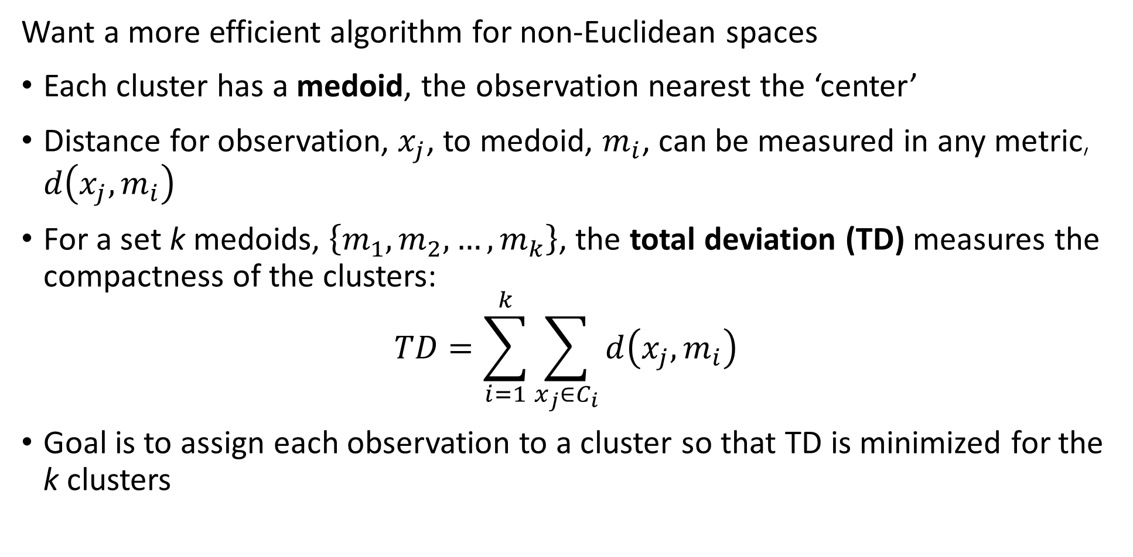
K-medoids Algorithm
Want a more efficient algorithm for non-Euclidean spaces
Each cluster has a medoid, the observation nearest the ‘center’
Distance for observation, $x_{j}$, to medoid, $m_{i}$, can be measured in any metric, $d\left(x_{j},m_{i}\right)$
For a set k medoids, $\left\{m_{1},m_{2},…,m_{k}\right\}$, the total deviation (TD) measures the compactness of the clusters:
$$TD=\sum_{i=1}^{k}{\sum_{x_{j}∈C_{i}}^{ }{d\left(x_{j},m_{i}\right)}}$$
Goal is to assign each observation to a cluster so that TD is minimized for the k clusters

Slide 67
K-medoids Algorithm
Many variations of the k-medoids have been developed
Partitioning Around Mediods (PAM) algorithm, was an early k-medoid algorithm
PAM algorithm has two steps:
Build step finds initial cluster assignments
Swap step improves cluster assignments

Slide 68
K-medoids Algorithm
Partitioning Around Mediods (PAM) algorithm was early k-medoid algorithm
Build step finds initial cluster assignments
# Find first medoid by greedy algorithm
Find a medoid observation with minimum total deviation (TD)
Assign as m1
# Find remaining medoids by greedy partitioning
For j in range(2,k):
find observation that partitions the observations with minimum TD
Assign as mj
Build is a greedy algorithm
Once an observation is assigned as a medoid the assignment is fixed
Build algorithm empirically superior to random starts for k-medoids

Slide 69
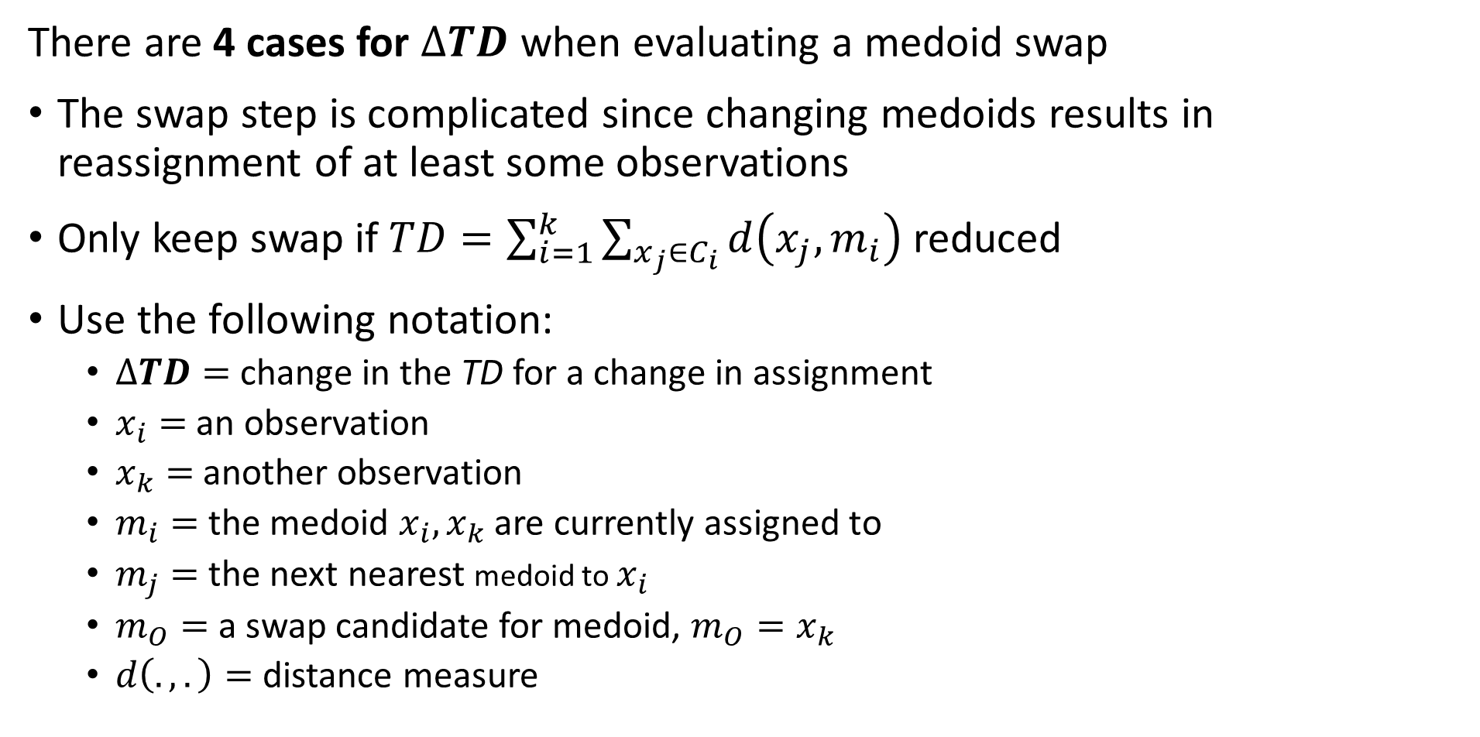
K-medoids Algorithm
There are 4 cases for $∆TD$ when evaluating a medoid swap
The swap step is complicated since changing medoids results in reassignment of at least some observations
Only keep swap if$TD=\sum_{i=1}^{k}{\sum_{x_{j}∈C_{i}}^{ }{d\left(x_{j},m_{i}\right)}}$ reduced
Use the following notation:
$∆TD=$ change in the TD for a change in assignment
$x_{i}=$ an observation
$x_{k}=$ another observation
$m_{i}=$ the medoid $x_{i},x_{k}$ are currently assigned to
$m_{j}=$ the next nearest medoid to $x_{i}$
$m_{O}=$ a swap candidate for medoid, $m_{O}=x_{k}$
$d\left(.,.\right)=$ distance measure

Slide 70
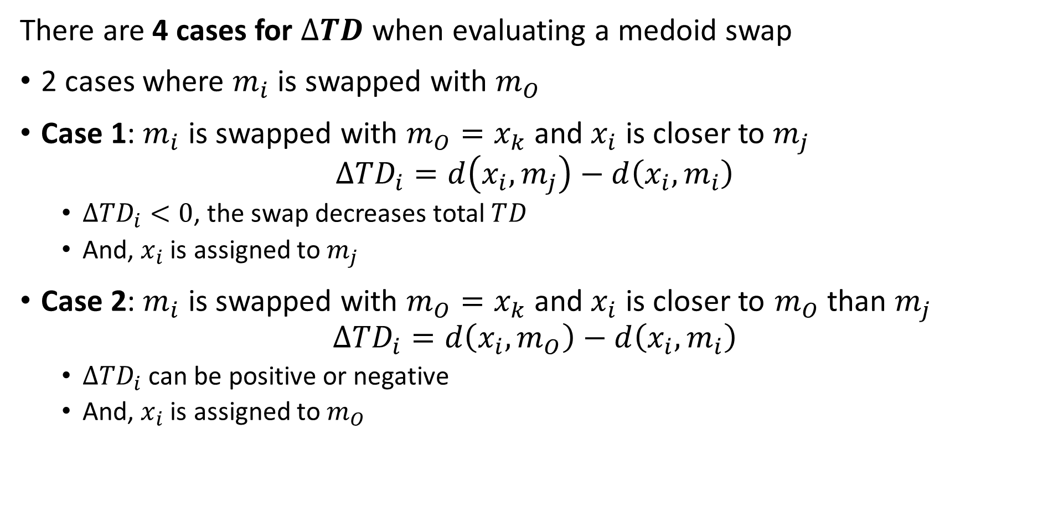
K-medoids Algorithm
There are 4 cases for $∆TD$ when evaluating a medoid swap
2 cases where $m_{i}$ is swapped with $m_{O}$
Case 1: $m_{i}$ is swapped with $m_{O}=x_{k}$ and $x_{i}$ is closer to $m_{j}$
$$∆TD_{i}=d\left(x_{i},m_{j}\right)−d\left(x_{i},m_{i}\right)$$
$∆TD_{i}<0$, the swap decreases total $TD_{ }$
And, $x_{i}$ is assigned to $m_{j}$
Case 2: $m_{i}$ is swapped with $m_{O}=x_{k}$ and $x_{i}$ is closer to $m_{O}$ than $m_{j}$
$$∆TD_{i}=d\left(x_{i},m_{O}\right)−d\left(x_{i},m_{i}\right)$$
$∆TD_{i}$ can be positive or negative
And, $x_{i}$ is assigned to $m_{O}$

Slide 71
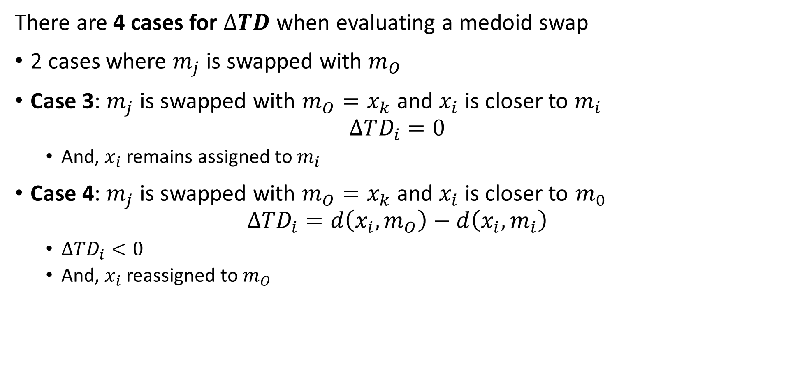
K-medoids Algorithm
There are 4 cases for $∆TD$ when evaluating a medoid swap
2 cases where $m_{j}$ is swapped with $m_{O}$
Case 3: $m_{j}$ is swapped with $m_{O}=x_{k}$ and $x_{i}$ is closer to $m_{i}$
$$∆TD_{i}=0$$
And, $x_{i}$ remains assigned to $m_{i}$
Case 4: $m_{j}$ is swapped with $m_{O}=x_{k}$ and $x_{i}$ is closer to $m_{0}$
$$∆TD_{i}=d\left(x_{i},m_{O}\right)−d\left(x_{i},m_{i}\right)$$
$∆TD_{i}<0$
And, $x_{i}$ reassigned to $m_{O}$

Slide 72
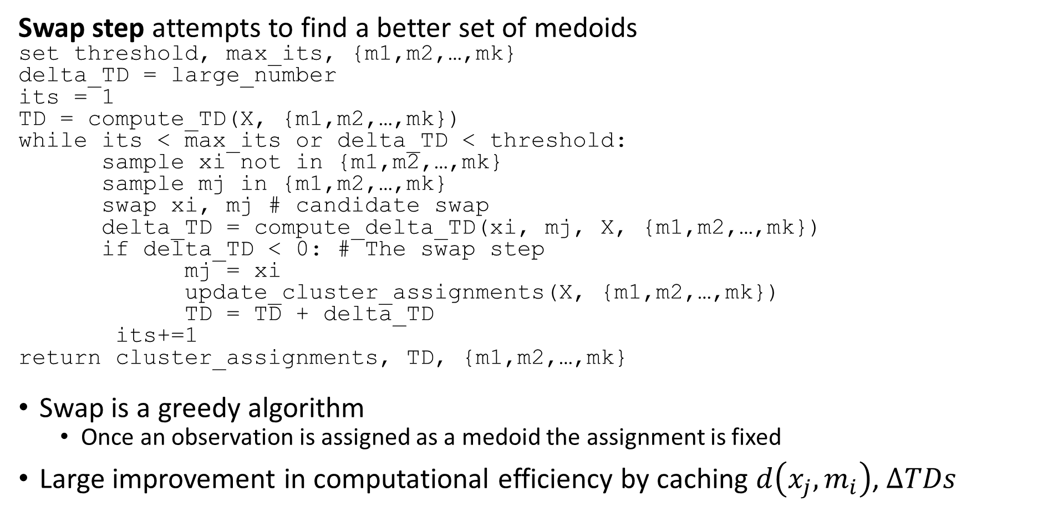
K-medoids Algorithm
Swap step attempts to find a better set of medoids
set threshold, max_its, {m1,m2,…,mk}
delta_TD = large_number
its = 1
TD = compute_TD(X, {m1,m2,…,mk})
while its < max_its or delta_TD < threshold:
sample xi not in {m1,m2,…,mk}
sample mj in {m1,m2,…,mk}
swap xi, mj # candidate swap
delta_TD = compute_delta_TD(xi, mj, X, {m1,m2,…,mk})
if delta_TD < 0: # The swap step
mj = xi
update_cluster_assignments(X, {m1,m2,…,mk})
TD = TD + delta_TD
its+=1
return cluster_assignments, TD, {m1,m2,…,mk}
Swap is a greedy algorithm
Once an observation is assigned as a medoid the assignment is fixed
Large improvement in computational efficiency by caching $d\left(x_{j},m_{i}\right)$, $∆TDs$

Slide 73
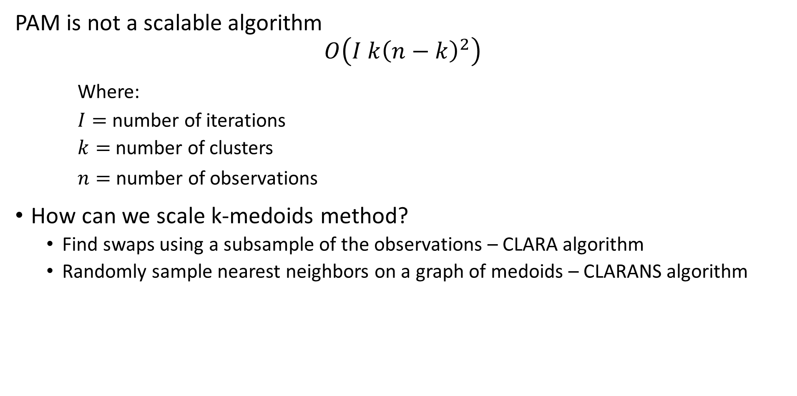
K-medoids Algorithm
PAM is not a scalable algorithm
$$O\left(I k{\left(n−k\right)}^{2}\right)$$
Where:
$I=$ number of iterations
$k=$ number of clusters
$n=$ number of observations
How can we scale k-medoids method?
Find swaps using a subsample of the observations – CLARA algorithm
Randomly sample nearest neighbors on a graph of medoids – CLARANS algorithm

Slide 74
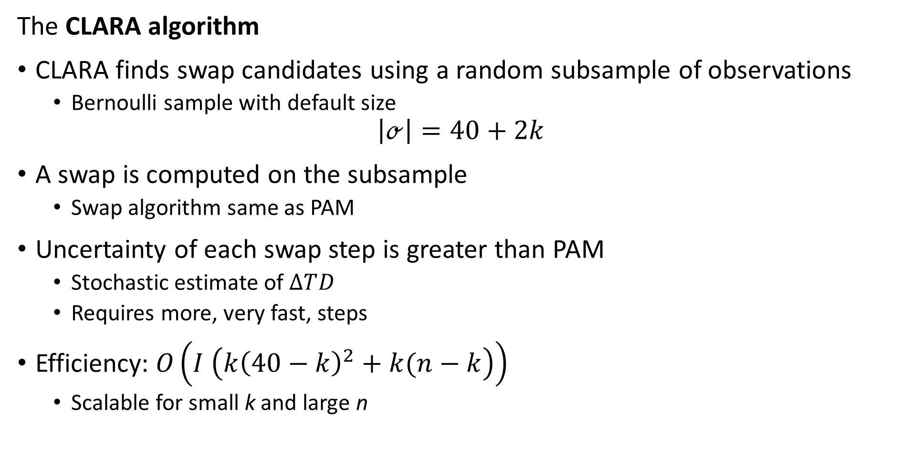
K-medoids Algorithm
The CLARA algorithm
CLARA finds swap candidates using a random subsample of observations
Bernoulli sample with default size
$$\left|ℴ\right|=40+2k$$
A swap is computed on the subsample
Swap algorithm same as PAM
Uncertainty of each swap step is greater than PAM
Stochastic estimate of $∆TD_{ }$
Requires more, very fast, steps
Efficiency: $O\left(I \left(k{\left(40−k\right)}^{2}+k(n−k\right)\right)$
Scalable for small k and large n

Slide 75
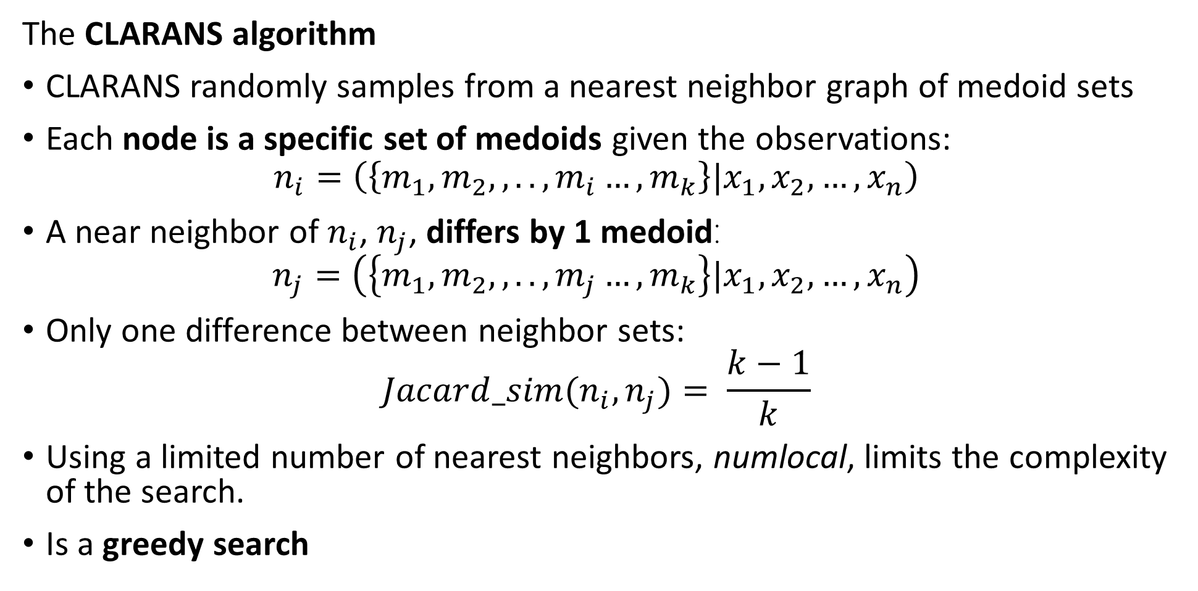
K-medoids Algorithm
The CLARANS algorithm
CLARANS randomly samples from a nearest neighbor graph of medoid sets
Each node is a specific set of medoids given the observations:
$$n_{i}=\left(\left\{m_{1},m_{2},,..,m_{i}…,m_{k}\right\}|x_{1},x_{2},…,x_{n}\right)$$
A near neighbor of $n_{i}$, $n_{j}$, differs by 1 medoid:
$$n_{j}=\left(\left\{m_{1},m_{2},,..,m_{j}…,m_{k}\right\}|x_{1},x_{2},…,x_{n}\right)$$
Only one difference between neighbor sets:
$$Jacard_sim(n_{i},n_{j})= \frac{k−1}{k}$$
Using a limited number of nearest neighbors, numlocal, limits the complexity of the search.
Is a greedy search

Slide 76
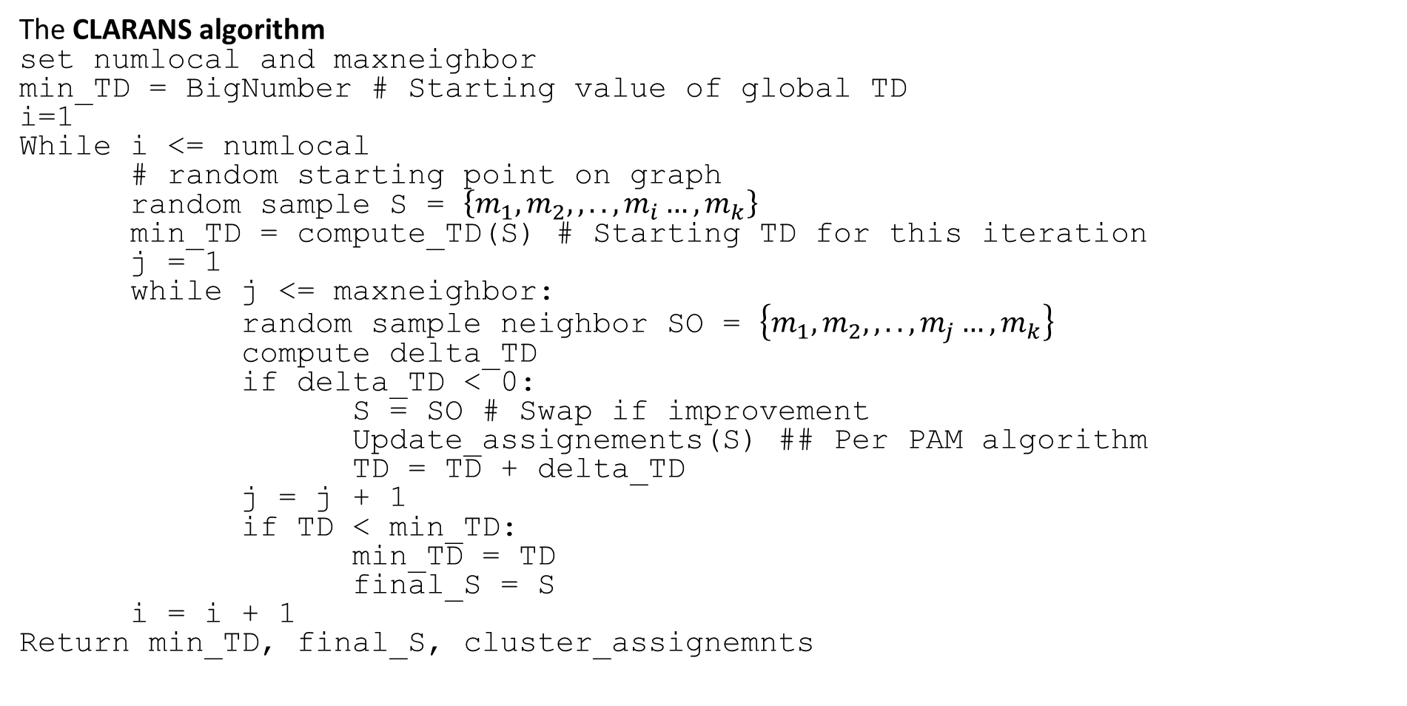
K-medoids Algorithm
The CLARANS algorithm
set numlocal and maxneighbor
min_TD = BigNumber # Starting value of global TD
i=1
While i <= numlocal
# random starting point on graph
random sample S = $\left\{m_{1},m_{2},,..,m_{i}…, m_{k}\right\}$
min_TD = compute_TD(S) # Starting TD for this iteration
j = 1
while j <= maxneighbor:
random sample neighbor SO = $\left\{m_{1},m_{2},,..,m_{j}…,m_{k}\right\}$
compute delta_TD
if delta_TD < 0:
S = SO # Swap if improvement
Update_assignements(S) ## Per PAM algorithm
TD = TD + delta_TD
j = j + 1
if TD < min_TD:
min_TD = TD
final_S = S
i = i + 1
Return min_TD, final_S, cluster_assignemnts

Slide 77
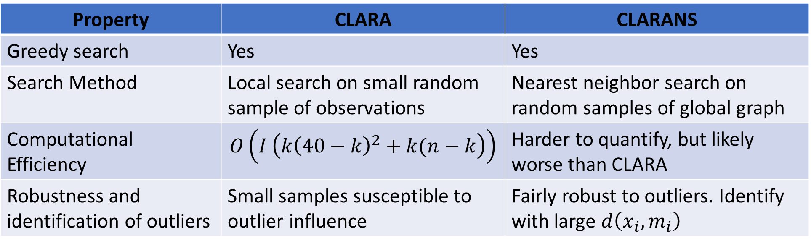
K-medoids Algorithm
Compare CLARA and CLARANS algorithms
Property | CLARA | CLARANS
Greedy search | Yes | Yes
Search Method | Local search on small random sample of observations | Nearest neighbor search on random samples of global graph
Computational Efficiency | $$O\left(I \left(k{\left(40−k\right)}^{2}+k(n−k\right)\right)$$ | Harder to quantify, but likely worse than CLARA
Robustness and identification of outliers | Small samples susceptible to outlier influence | Fairly robust to outliers. Identify with large $d\left(x_{i},m_{i}\right)$

Slide 78
K-medoids Algorithm
There is on-going research into scalable K-medoids algorithms
The original PAM algorithm was first published as Chapter 2 of Finding Groups in Data, Kaufmann and Rousseeuw, Wiley, 1990
The original CLARANS paper is behind paywalls, for a review of k-medoids methods including CLARANS: a method for clustering objects for spatial data, Ng and Hue, 2002
A recently developed algorithm to significantly improve the scalability of k-medoids algorithm can be found in Faster k-Medoids Clustering: Improving the PAM, CLARA, and CLARANS Algorithms, Schubert and Rousseeuw, 2019
For a reasonable up to date review and comparison of K-medoids algorithms see An Overview of Partitioning Algorithms in Clustering Techniques, Skaget and Pandya, 2016

Slide 79
K-medoids Algorithm
Python API software for K-medoids algorithms
The PAM and CLARA algorithms are implemented in Scikit-Extra package
Conforms to Scikit standards for API and good documentation
A versions of the PAM algorithm, CLARANS algorithm and several other clustering algorithms and utilities are implemented in the Pyclustering package
Unfortunately, this package has some rough edges and is not well documented

Slide 80
Summary

Slide 81
Summary
Unsupervised learning methods learn structure of data
Structure is learned by determining association between cases
Association based on measures of proximity, distance or dissimilarity
Clustering algorithms are data mining methods
Data mining seeks to find interesting relationships in data
We have already encountered feature importance as a data mining method

Slide 82
Summary
Algorithms can use different distance or dissimilarity metrics
Structure based on distance metrics
Different algorithms use different metrics
What are the ideal properties of clusters?
Good clusters have two properties
Compactness: We what the clusters to be small with members close to each other
Separation: We want the clusters are well separated, a closeness property

Slide 83
Summary
Different models and dissimilarity metrics will give different results
Dissimilarity metrics usually matter more than model choice
But which one should we use?
Evaluation is a significant problem with for unsupervised learning
There are no labels for objective evaluation
Evaluation is often subjective
But, do we have to pick one best model?
No
Different models can show different useful relationships

Slide 84
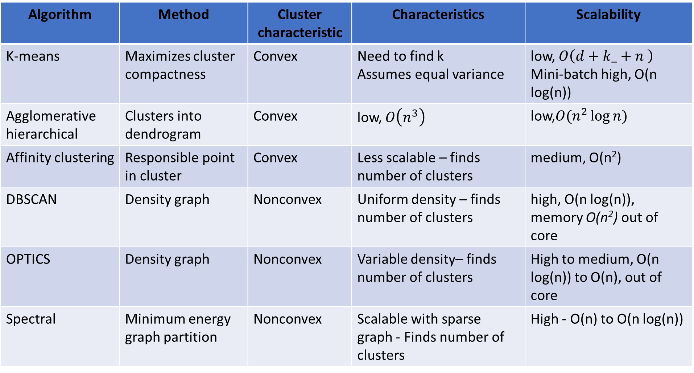
Summary
Algorithm | Method | Cluster characteristic | Characteristics | Scalability
K-means | Maximizes cluster compactness | Convex | Need to find k Assumes equal variance | low, $O\left({d+k_+n}^{ }\right)$ Mini-batch high, O(n log(n))
Agglomerative hierarchical | Clusters into dendrogram | Convex | low, $O\left(n^{3}\right)$ | low,$O(n^{2}\log{n})$
Affinity clustering | Responsible point in cluster | Convex | Less scalable – finds number of clusters | medium, O(n²)
DBSCAN | Density graph | Nonconvex | Uniform density – finds number of clusters | high, O(n log(n)), memory O(n²) out of core
OPTICS | Density graph | Nonconvex | Variable density– finds number of clusters | High to medium, O(n log(n)) to O(n), out of core
Spectral | Minimum energy graph partition | Nonconvex | Scalable with sparse graph - Finds number of clusters | High - O(n) to O(n log(n))

