Slide 1

CSCI E-96 Data Mining, Exploration and Discovery Introduction to Dimensionality Reduction Part 1
Steve Elston
Copyright 2020,2021, 2022, 2023, 2024, 2025, Stephen F Elston. All rights reserved.

Slide 2
Lesson Overview
Dimensionality reduction is widely used in data mining
Curse of Dimensionality!
Introduction to dimensionality reduction
Principal component analysis (PCA)
Singular value decomposition (SVD)
Kernel principal component analysis

Slide 3
Curse of Dimensionality!

Slide 4
What Could Possibly Go Wrong? Curse of Dimensionality!
Cluster models scale poorly with dimensionality
Consider sampling required to maintain the same uniformly distributed sampling density in a hypercube:
An example of the Curse of Dimensionality!
Dimensions | Samples
1 | 10
2 | 100
3 | 1,000
5 | 10⁵
10 | 10¹⁰

Slide 5
What Could Possibly Go Wrong? Curse of Dimensionality
The curse of dimensionality means that all clusters are the same in high dimensions
Sampling density decreases exponentially
Distances converge to the same length in a high dimensional space
The choice of metric does not help
All distances are the same in high dimensions!
Implication is that high-dimensional cluster models are easy to overfit!!

Slide 6
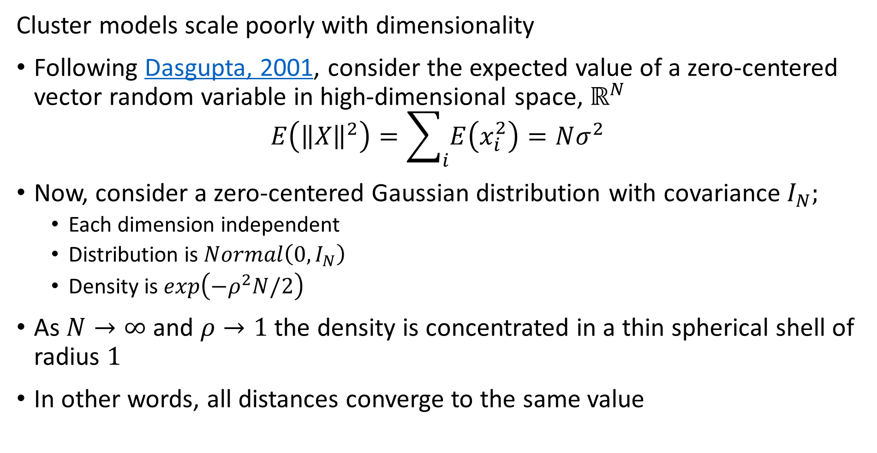
What Could Possibly Go Wrong? Curse of Dimensionality
Cluster models scale poorly with dimensionality
Following Dasgupta, 2001, consider the expected value of a zero-centered vector random variable in high-dimensional space, $ℝ^{N}$
$$E\left({\left\|X\right\|}^{2}\right)=\sum_{i}{E\left(x_{i}^{2}\right)=Nσ^{2}}$$
Now, consider a zero-centered Gaussian distribution with covariance $I_{N};$
Each dimension independent
Distribution is$Normal\left(0,I_{N}\right)$
Density is $exp\left(−ρ^{2}N/2\right)$
As $N→∞$ and $ρ→1$ the density is concentrated in a thin spherical shell of radius $1$
In other words, all distances converge to the same value

Slide 7
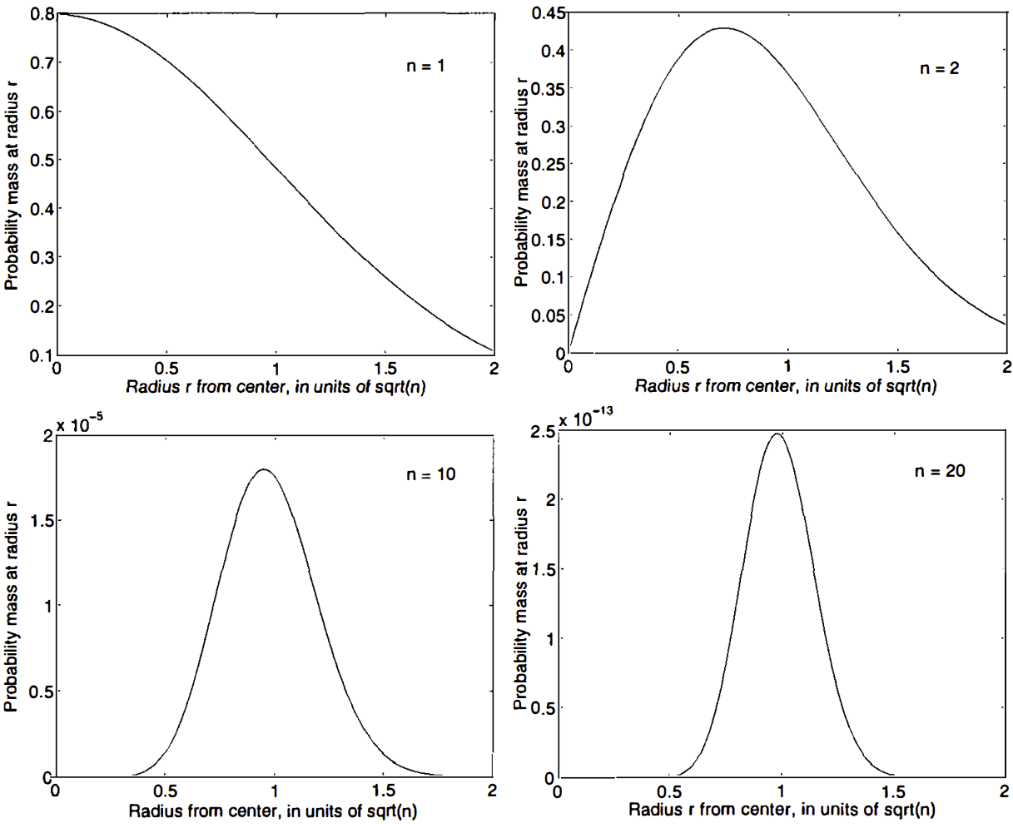
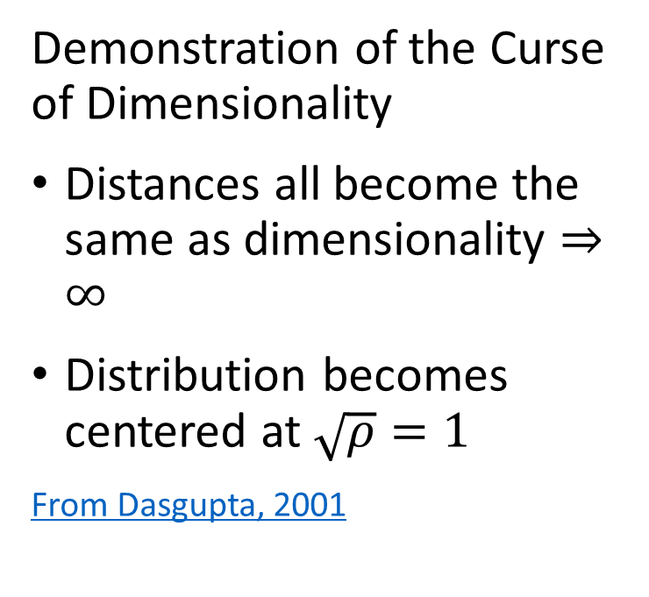
What Could Possibly Go Wrong? Curse of Dimensionality
Demonstration of the Curse of Dimensionality
Distances all become the same as dimensionality $⇒∞$
Distribution becomes centered at $\sqrt{ρ}=1$
From Dasgupta, 2001

Slide 8
What Could Possibly Go Wrong? Curse of Dimensionality
How can we extend clustering to higher dimensions?
Reducing dimensionality can help
Need to create a lower dimensional embedding
But how?
PCA is a linear projection
Several families of alternatives
Subspace clustering
Random projection
Manifold learning
Variational autoencoders (VAE) – beyond the scope of this course
For introduction to VAEs, see Kingma and Welling, 2019

Slide 9
Introduction to Dimensionality Reduction

Slide 10
Introduction to Dimensionality Reduction
Dimensionality reduction is widely used in data mining
Human understanding of high dimensional spaces is poor at best
For most people, perception of data relationships starts to diminish beyond about four or five dimensions
Exploration of complex spaces can be aided by projection into lower dimensional space
Most algorithms converge better in lower dimensional spaces
High dimensional spaces leads to over-fit models
Example: clustering in high dimensional spaces can lead to fragmentation
Dimensionality reduction can improve results
Example; spectral clustering uses projection to lower dimensional space

Slide 11
Introduction to Dimensionality Reduction
Why is dimensionality reduction possible?
Consider the information content of each feature
Information of a feature is only unique if it is independent of all other features
Dependent features have redundant information
Dimensionality can be reduced if features are dependent
Almost always the case in real-world data
Linear dependency, e.g. correlation
Nonlinear dependency
Feature values lie on a low-dimensional manifold in a higher dimensional space
Dependency implies effective dimensionality less than number of features

Slide 12
Introduction to Dimensionality Reduction
What are the properties good dimensionality reduction algorithms?
Goal is to find a mapping to the lower dimensional manifold or embedding space
Embedding should minimize error with respect to the original data
Ideally, reconstruct original data by inverse transformation
Embedding should preserve distances
Distances or similarities should not be distorted by transformation

Slide 13
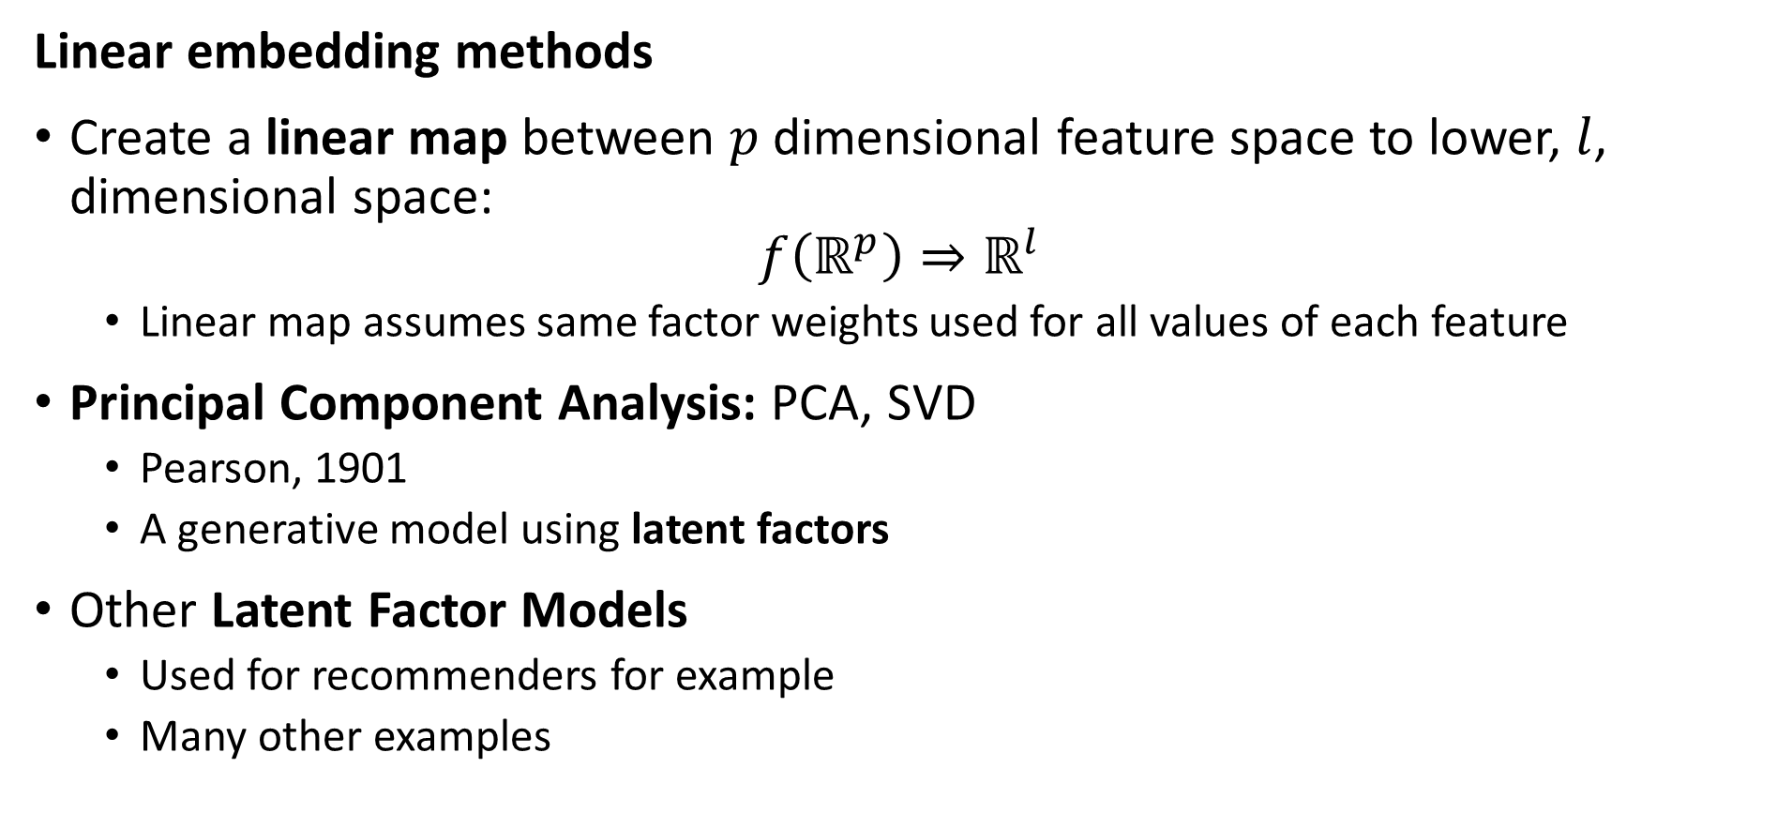
Introduction to Dimensionality Reduction
Linear embedding methods
Create a linear map between $p$ dimensional feature space to lower, $l$, dimensional space:
$$f\left(ℝ^{p}\right)⇒ℝ^{l}$$
Linear map assumes same factor weights used for all values of each feature
Principal Component Analysis: PCA, SVD
Pearson, 1901
A generative model using latent factors
Other Latent Factor Models
Used for recommenders for example
Many other examples

Slide 14
Introduction to Dimensionality Reduction
Nonlinear embedding methods
Kernel PCA – topic today
Projection methods for high dimensional spaces – Part 2
Manifold learning for visualization - Part 2
Spectral embedding
UMAP
Etc……
Deep autoencoders, other NN-based embedding methods
Beyond the scope of this course
For a well written tutorial on using VAEs as image generative models see this post by the amazing Lily Wang of NVIDIA, 2018

Slide 15
Linear Embedding with PCA

Slide 16
Linear Dimensionality Reduction - PCA
PCA applies a linear projection from sample space to an orthogonal space
Start with the original features of the model matrix in the p-dimensional sample space
Compute a linear transformation to an orthogonal latent space
Principle (1st) axis with highest variance
Each axis is orthogonal to the others, explaining maximum remaining variance
First l projection axes define orthogonal lower dimensional space, l < p

Slide 17
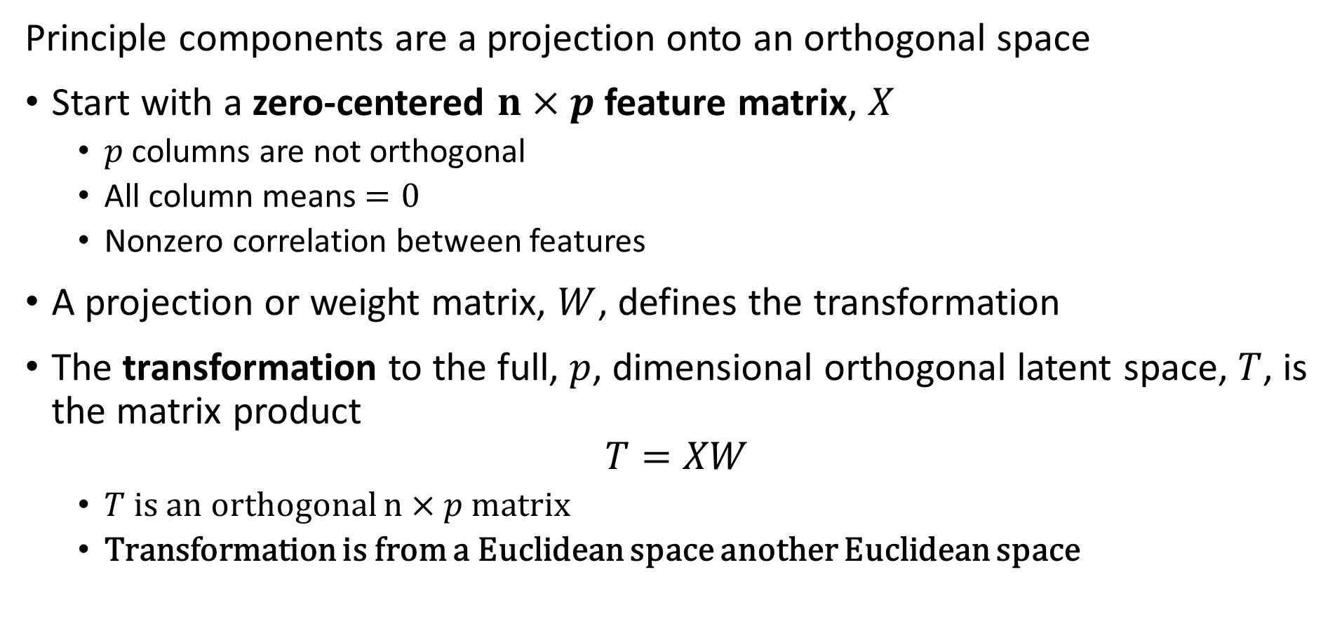
Principle Component Decomposition
Principle components are a projection onto an orthogonal space
Start with a zero-centered $n×p$ feature matrix, $X$
$p$ columns are not orthogonal
All column means $=0$
Nonzero correlation between features
A projection or weight matrix, $W$, defines the transformation
The transformation to the full, $p$, dimensional orthogonal latent space, $T$, is the matrix product
$$T=XW$$
$T$ is an orthogonal $n×p$ matrix
Transformation is from a Euclidean space another Euclidean space

Slide 18
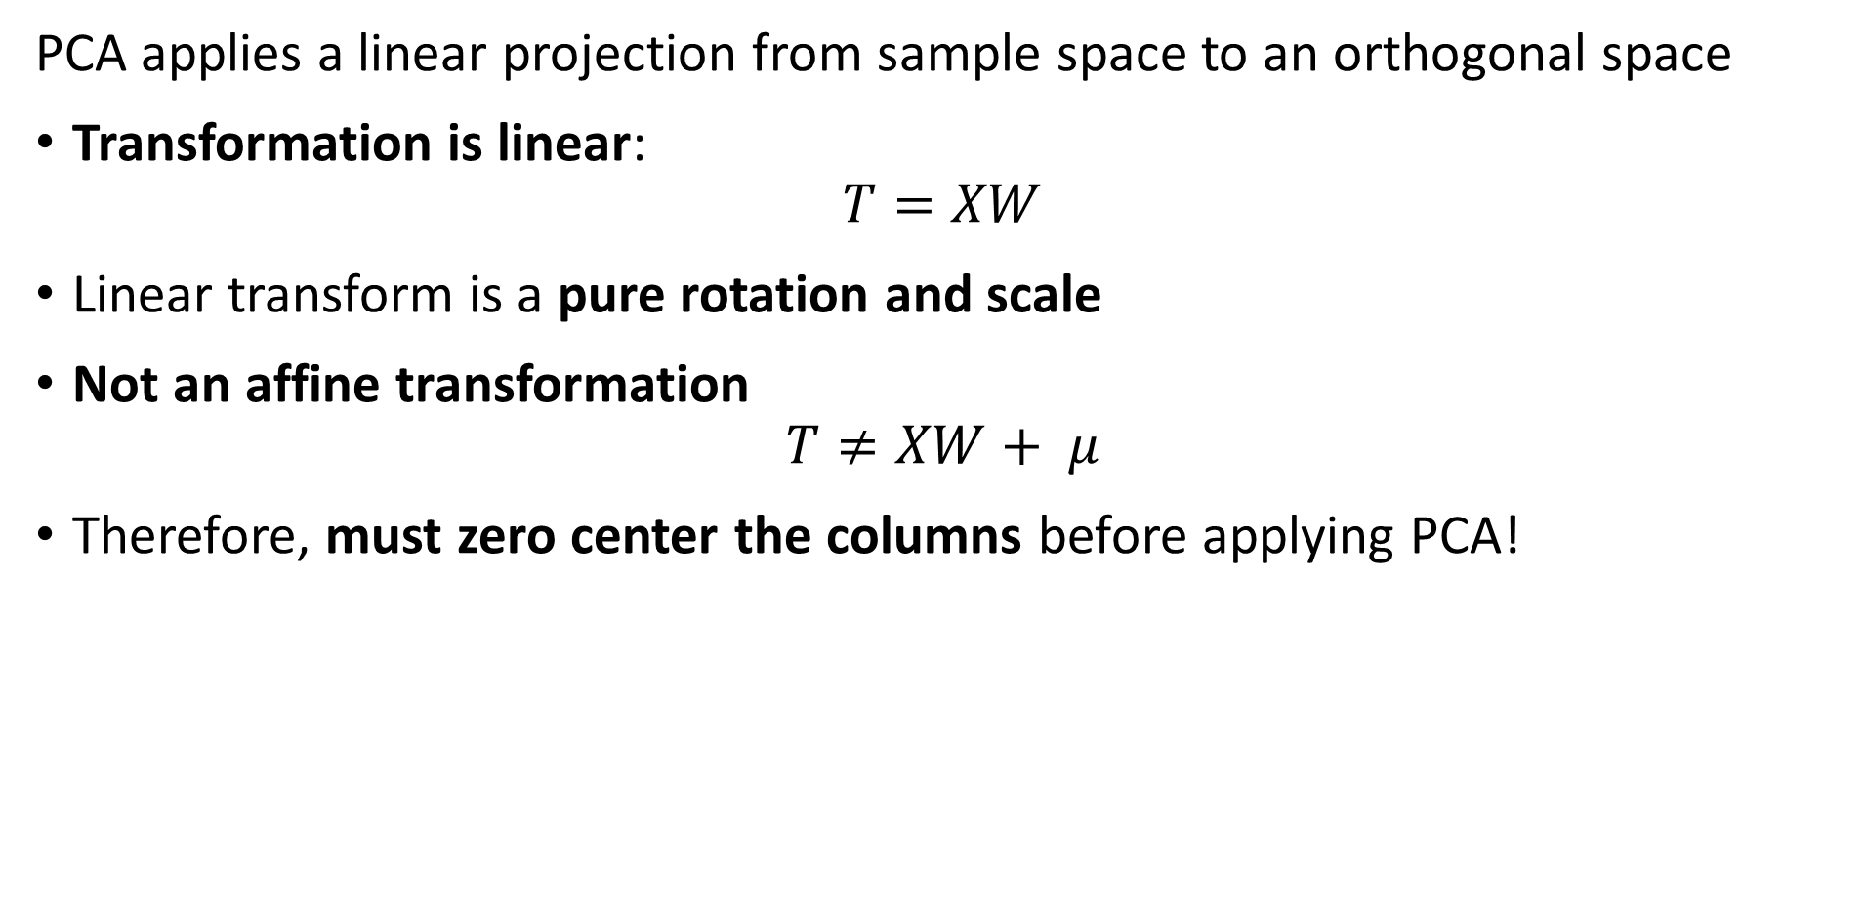
Linear Dimensionality Reduction - PCA
PCA applies a linear projection from sample space to an orthogonal space
Transformation is linear:
$$T=XW$$
Linear transform is a pure rotation and scale
Not an affine transformation
$$T≠XW+ μ$$
Therefore, must zero center the columns before applying PCA!

Slide 19
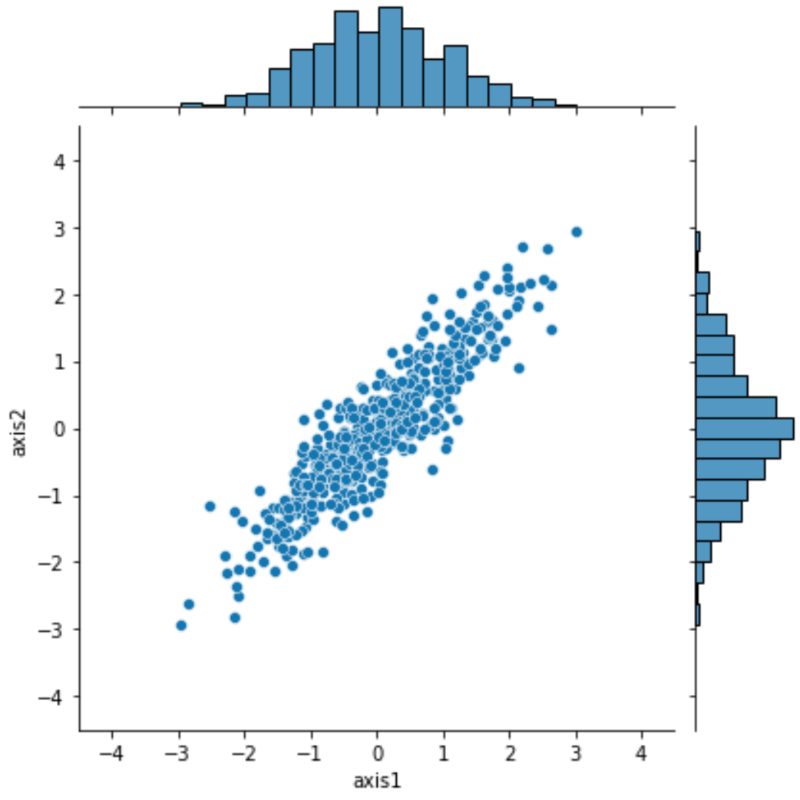
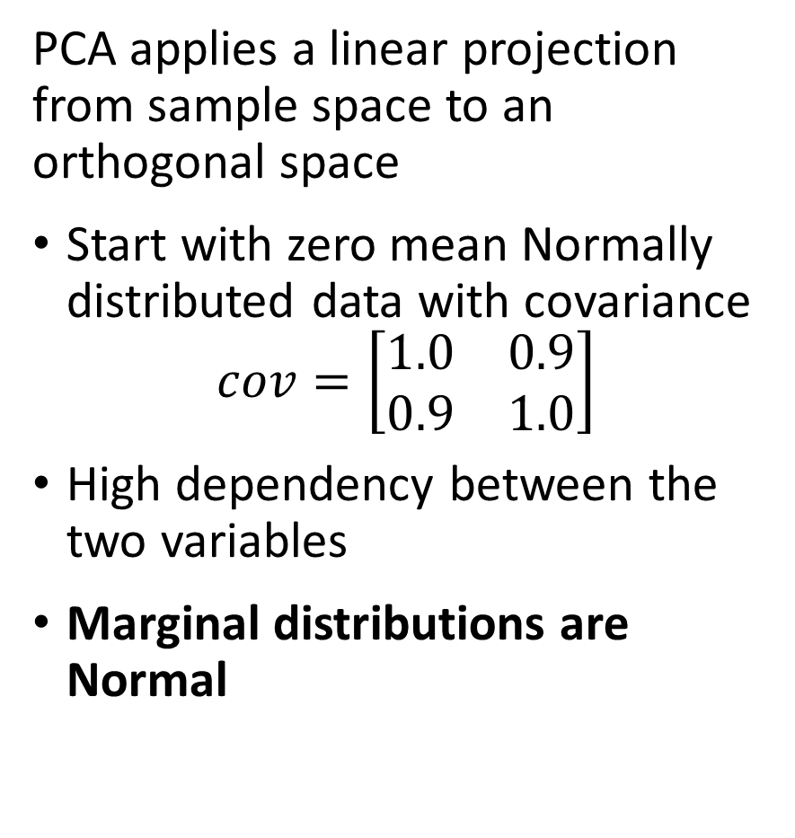
Linear Dimensionality Reduction - PCA
PCA applies a linear projection from sample space to an orthogonal space
Start with zero mean Normally distributed data with covariance
$$cov=\left[\begin{matrix}1.0 & 0.9 \\ 0.9 & 1.0\end{matrix}\right]$$
High dependency between the two variables
Marginal distributions are Normal

Slide 20
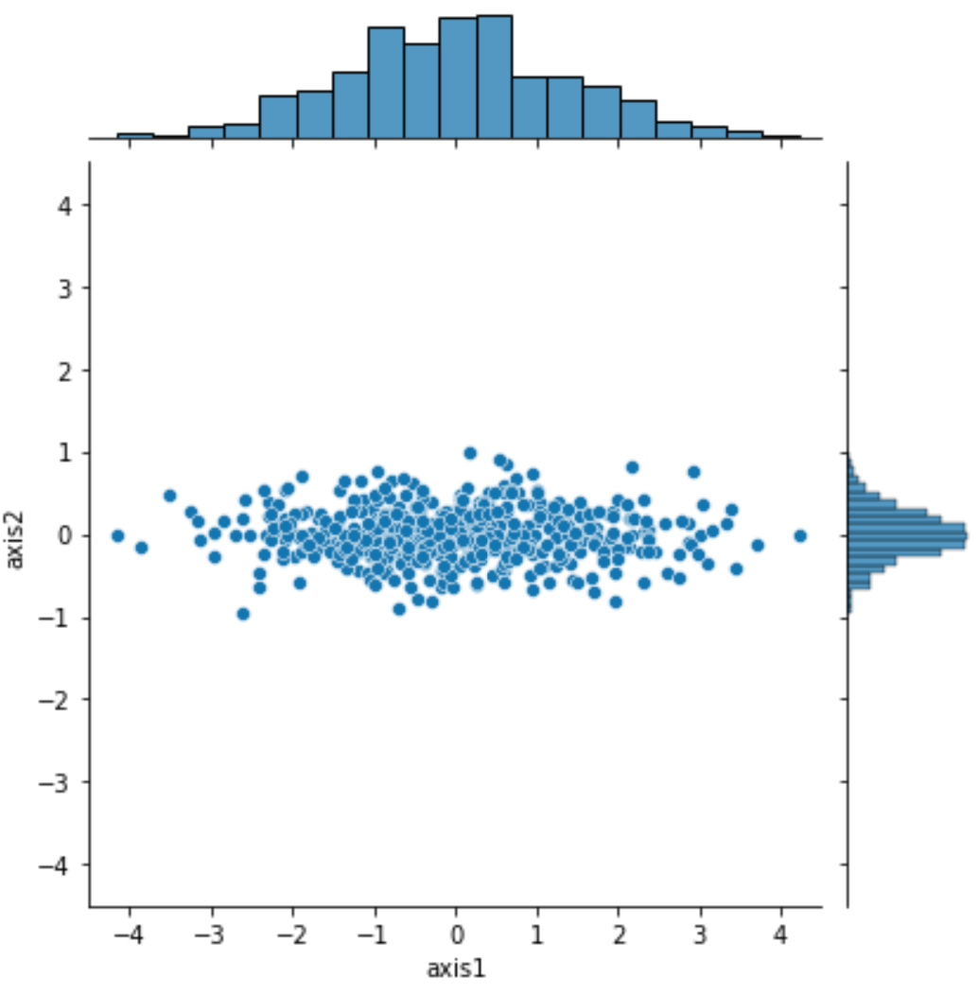
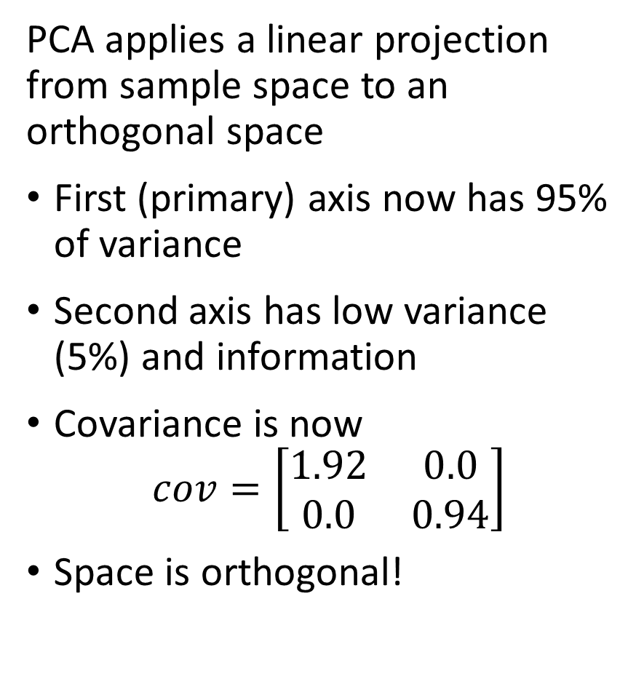
Linear Dimensionality Reduction - PCA
PCA applies a linear projection from sample space to an orthogonal space
First (primary) axis now has 95% of variance
Second axis has low variance (5%) and information
Covariance is now
$$cov=\left[\begin{matrix}1.92 & 0.0 \\ 0.0 & 0.94\end{matrix}\right]$$
Space is orthogonal!

Slide 21
Principal Component Dimensionality Reduction

Slide 22
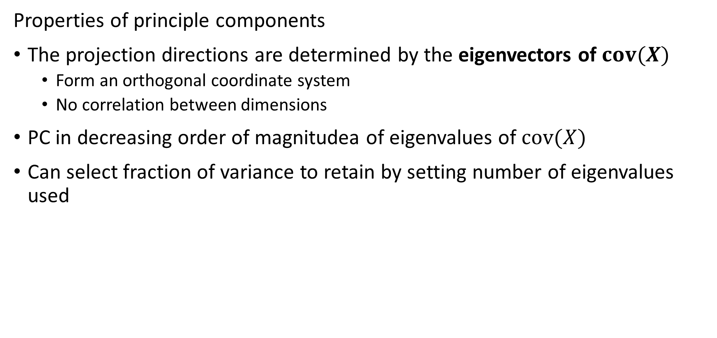
Principle Component Decomposition
Properties of principle components
The projection directions are determined by the eigenvectors of $cov(X)$
Form an orthogonal coordinate system
No correlation between dimensions
PC in decreasing order of magnitudea of eigenvalues of $cov(X)$
Can select fraction of variance to retain by setting number of eigenvalues used

Slide 23
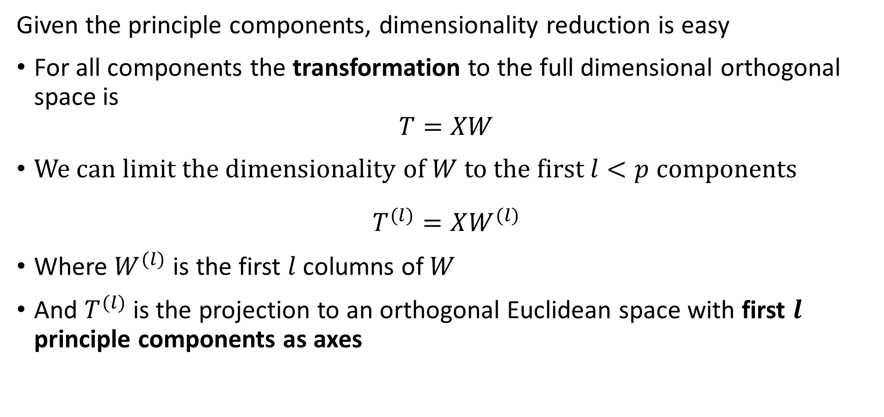
Principle Component Decomposition
Given the principle components, dimensionality reduction is easy
For all components the transformation to the full dimensional orthogonal space is
$$T=XW$$
We can limit the dimensionality of $W$ to the first $l<p$ components
$$T^{(l)}=XW^{(l)}$$
Where $W^{(l)}$ is the first $l$ columns of $W$
And $T^{(l)}$ is the projection to an orthogonal Euclidean space with first $l$ principle components as axes

Slide 24
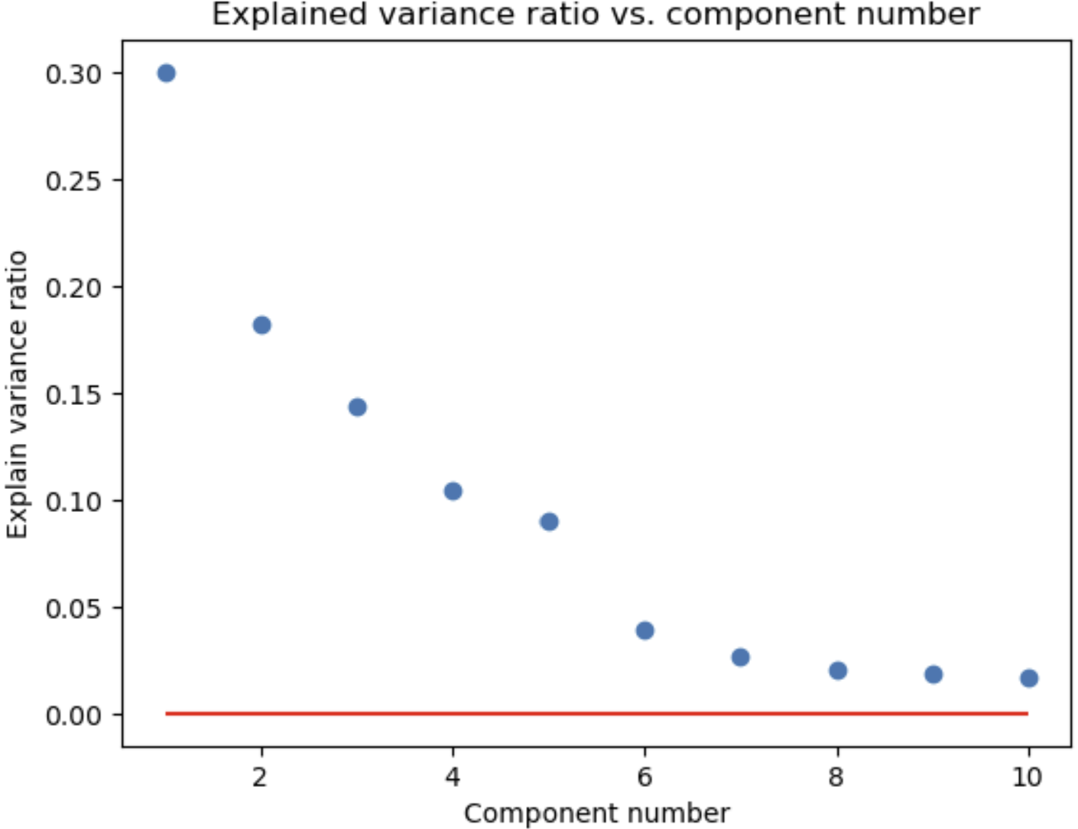

Principle Component Decomposition
How many components do you need?
Need to retain enough components to explain most of the variance
explained variance 1st component
explained variance 2nd component
$l$ components
Apparent random variation – irreducible error

Slide 25
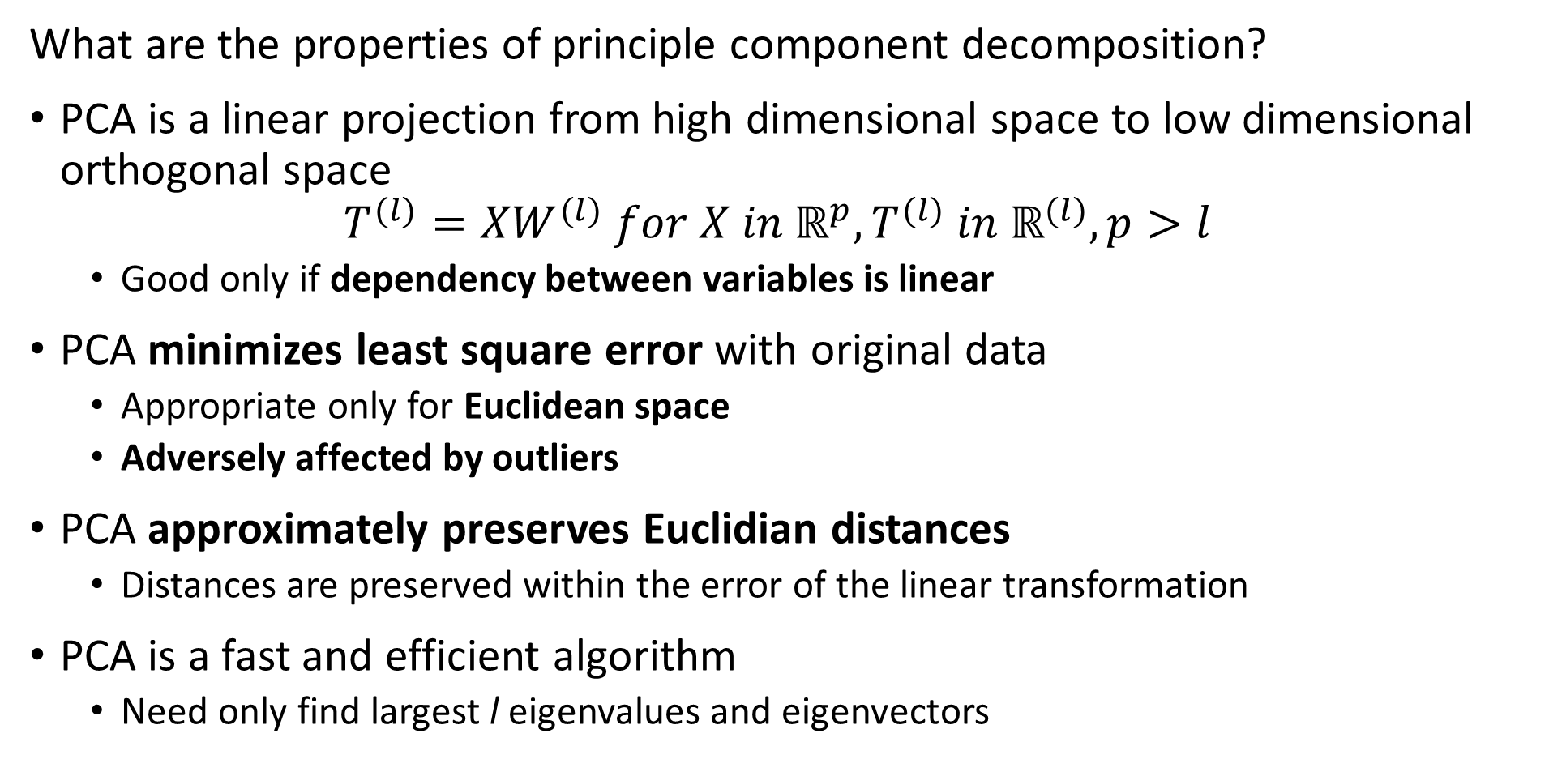
Principle Component Decomposition
What are the properties of principle component decomposition?
PCA is a linear projection from high dimensional space to low dimensional orthogonal space
$$T^{(l)}=XW^{(l)} for X in ℝ^{p},T^{(l)} in ℝ^{(l)}, p>l$$
Good only if dependency between variables is linear
PCA minimizes least square error with original data
Appropriate only for Euclidean space
Adversely affected by outliers
PCA approximately preserves Euclidian distances
Distances are preserved within the error of the linear transformation
PCA is a fast and efficient algorithm
Need only find largest l eigenvalues and eigenvectors

Slide 26
Principle Component Decomposition
Data preparation for PCA
Treat outliers since PCA susceptible
Details are problem dependent
If outliers inherent in data, consider nonlinear method like spectral decomposition
Demean the variables
PCA is a linear transformation
But not an affine transformation!
Transforming variables to unit variance can improve convergence
Particularly important in high dimensions

Slide 27
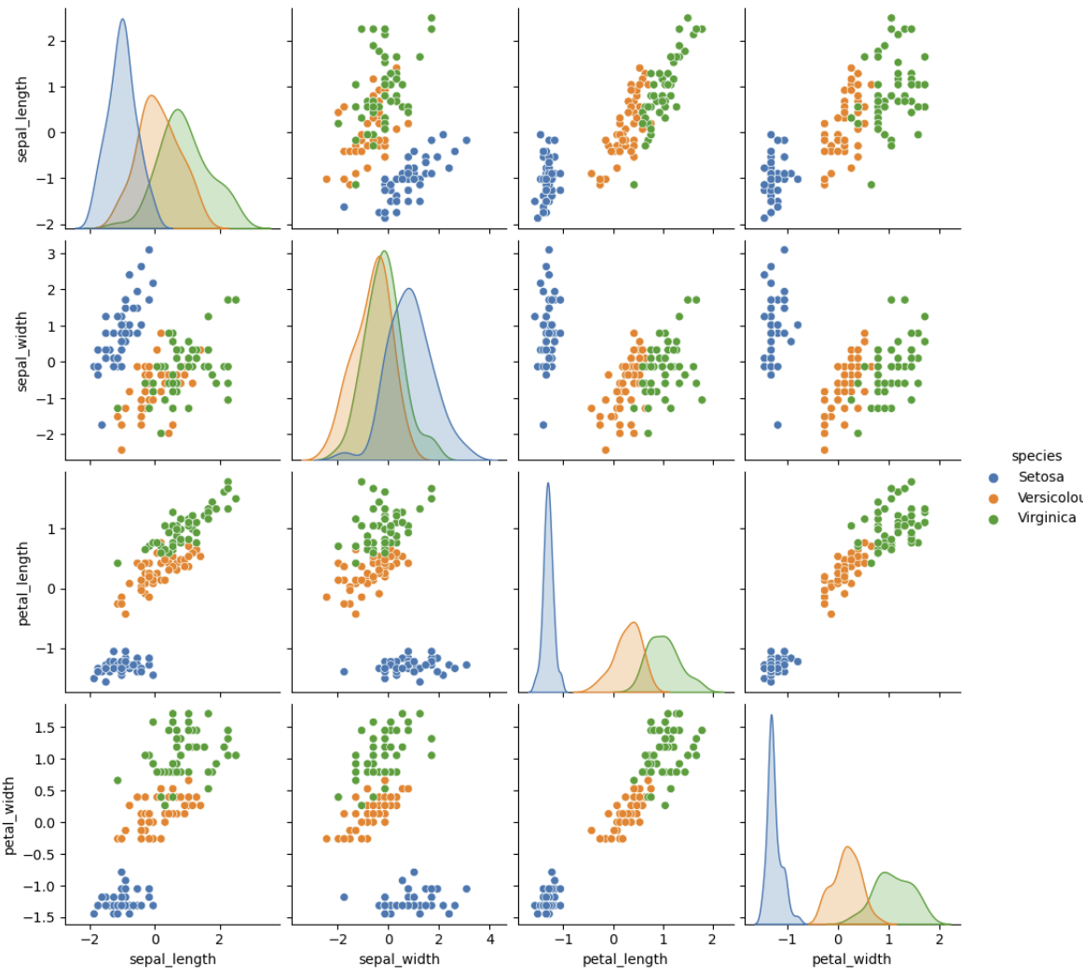
Principle Component Decomposition
Example, Iris dataset
3 spices of iris flowers
4 dimensions of measurements
1 species well separated
2 species overlap in all dimensions

Slide 28
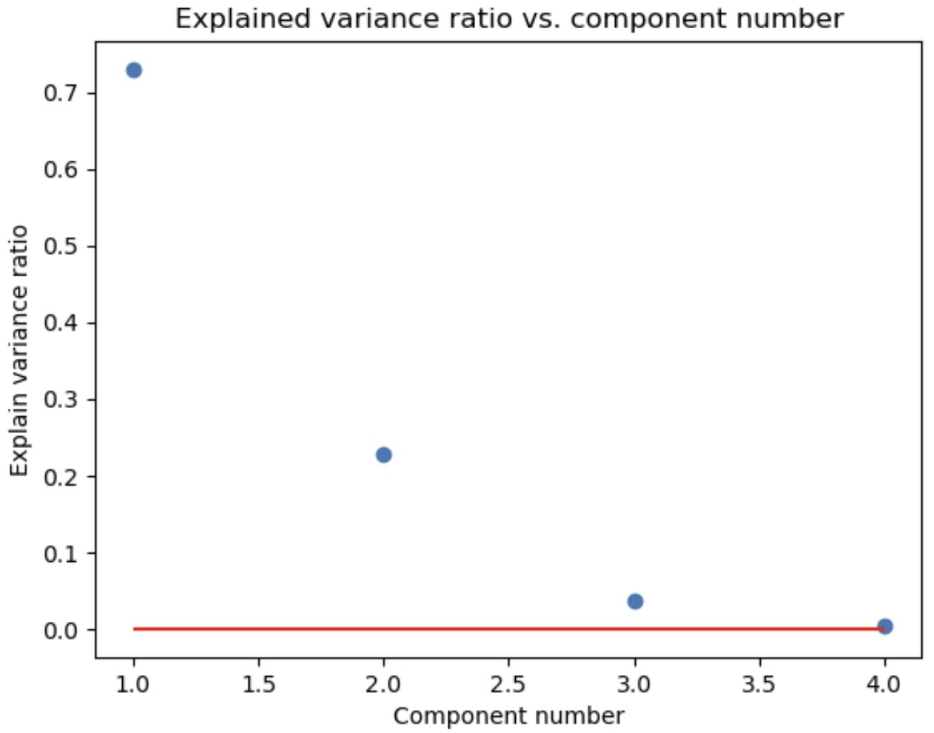
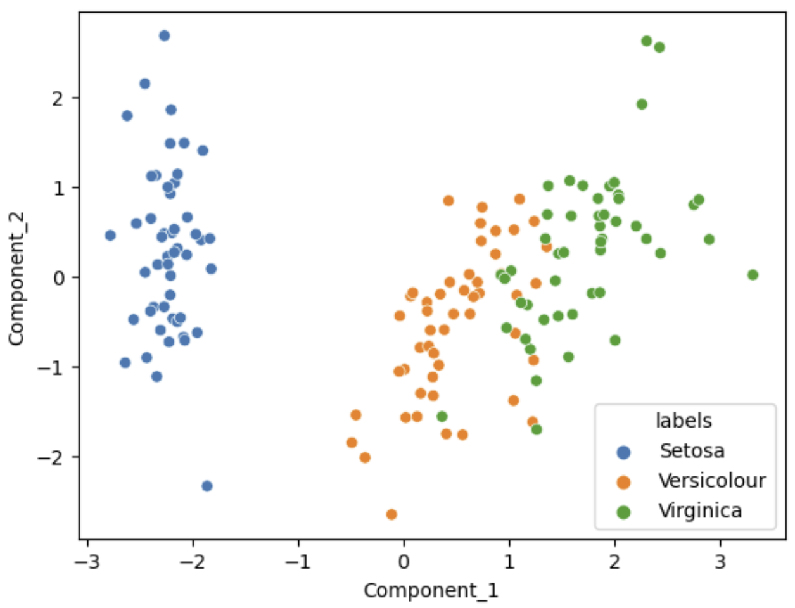
Principle Component Decomposition
Example, first 2 principle components explain about 95% of variance for Iris dataset
Variance ratio by PCA component
Scatterplot of first 2 PCA Components

Slide 29
Singular Value Decomposition

Slide 30
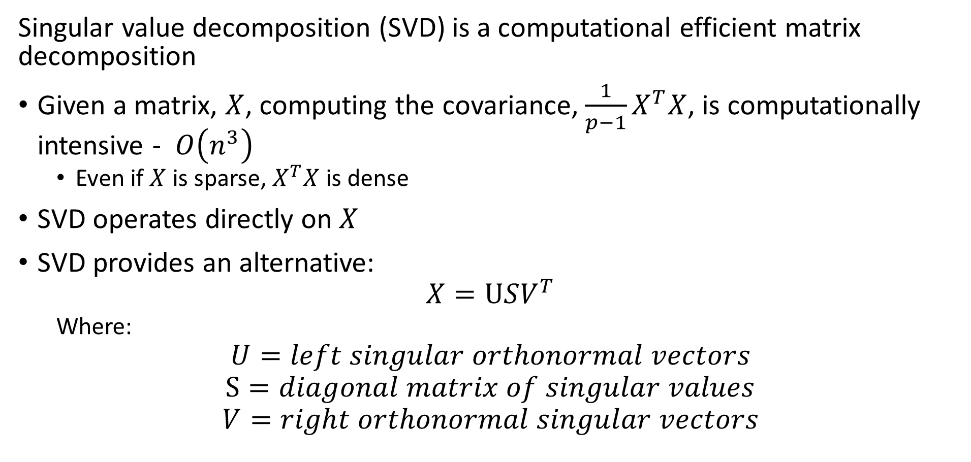
Singular Value Decomposition
Singular value decomposition (SVD) is a computational efficient matrix decomposition
Given a matrix, $X$, computing the covariance, ${\frac{1}{p−1}X}^{T}X$, is computationally intensive - $O\left(n^{3}\right)$
Even if $X$ is sparse, $X^{T}X$ is dense
SVD operates directly on $X$
SVD provides an alternative:
$$X=USV^{T}$$
Where:
$$U=left singular orthonormal vectors$$
$$S=diagonal matrix of singular values$$
$$V=right orthonormal singular vectors$$

Slide 31
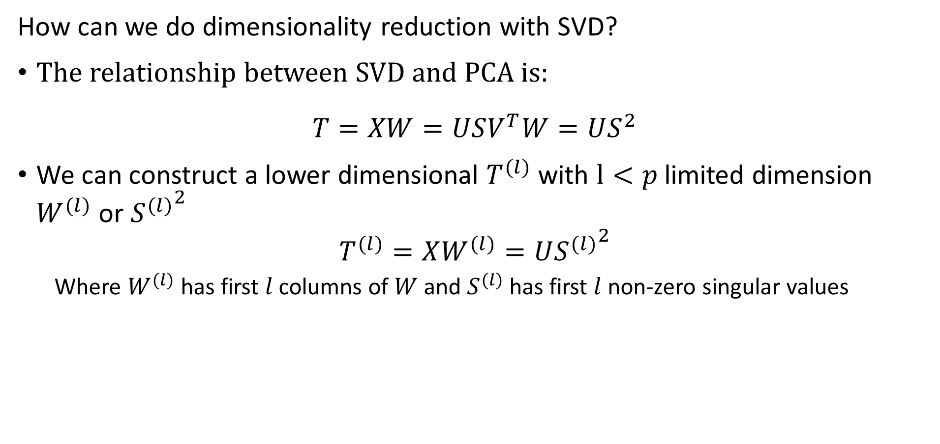
Singular Value Decomposition
How can we do dimensionality reduction with SVD?
The relationship between SVD and PCA is:
$$T=XW=USV^{T}W=US^{2}$$
We can construct a lower dimensional $T^{(l)}$ with $l<p$ limited dimension $W^{(l)}$ or ${S^{(l)}}^{2}$
$$T^{(l)}=XW^{(l)}=U{S^{(l)}}^{2}$$
Where $W^{(l)}$ has first $l$ columns of $W$ and $S^{(l)}$ has first $l$ non-zero singular values

Slide 32
Nonlinear Embedding with Kernel PCA

Slide 33
Nonlinear Kernel PCA
For many problems a linear map does not provide optimal projections!
How can we transform a nonlinear space to a linear space?
Use a kernel transformation
Kernel methods map original nonlinear space to higher dimensional linear space
Perform PCA in the linear space

Slide 34
Understanding nonlinear case
Start with 2-dimensional feature space, X = [x₁,x₂]
2- values = {circle,plus}
Is there any optimal separating hyperplane?
No!
The optimal separator is nonlinear
Feature 2
Feature 1

Slide 35
Understanding nonlinear case
Observations are not linearly separable in the original feature space
Transform problem to a new space where observations are linearly separable
X3
Kernel Transformation to new space
X1
Feature 2
Separating Hyperplane
Feature 1
X2

Slide 36
Kernels for nonlinear separation
What types of functions can we use as basis functions?
Any orthogonal set of functions
Polynomials – supported by Scikit-learn
Radial basis functions – default in Scikit-learn
Hyperbolic tangent functions – supported in Scikit-learn, and used in some neural networks
And many other basis functions –
Dictionary learning
Fourier expansions, Wavelet functions, etc.
Supported in Scikit-learn
We will not discuss this method further here

Slide 37
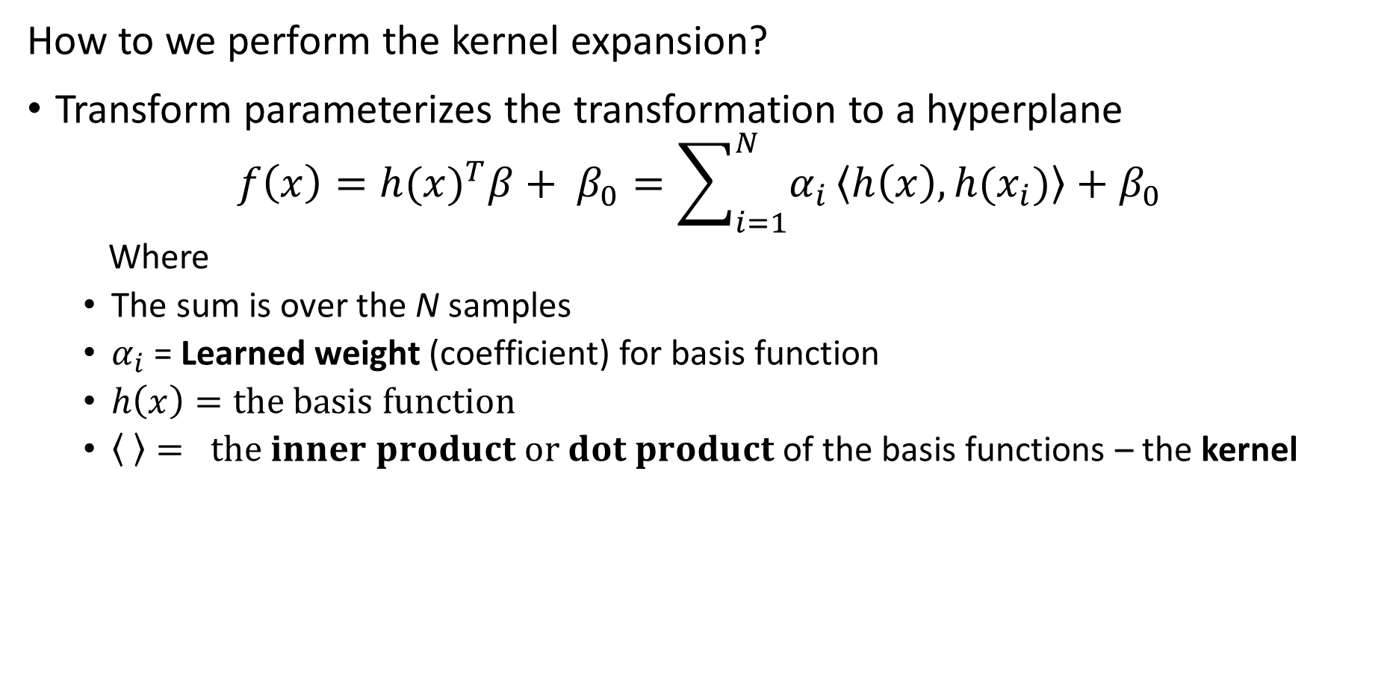
Mapping to Linear Space with a Kernel
How to we perform the kernel expansion?
Transform parameterizes the transformation to a hyperplane
$$f\left(x\right)=h(x)^{T}β+ β_{0}=\sum_{i=1}^{N}{α_{i}}\left\langle h\left(x\right),h(x_{i})\right\rangle +β_{0}$$
Where
The sum is over the N samples
$α_{i}$ = Learned weight (coefficient) for basis function
$h\left(x\right)=the basis function$
$\left\langle \right\rangle = the inner product or dot product$ of the basis functions – the kernel

Slide 38
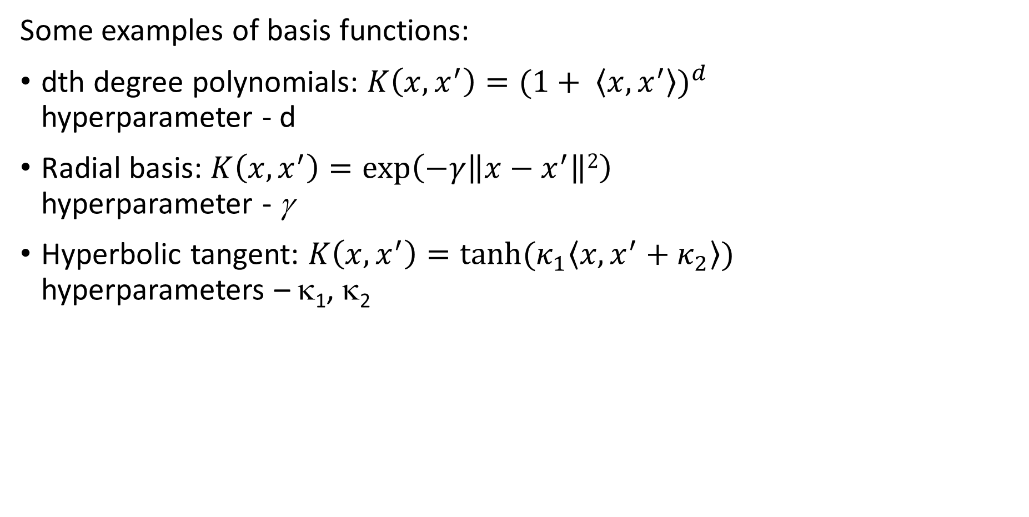
Kernels nonlinear separation
Some examples of basis functions:
dth degree polynomials: $K\left(x,x^{′}\right)=(1+ \left\langle x,x^{′}\right\rangle )^{d}$ hyperparameter - d
Radial basis: $K\left(x,x^{′}\right)=\exp\left(−γ\left\|x−x^{′}\right\|2\right)$ hyperparameter - γ
Hyperbolic tangent: $K\left(x,x^{′}\right)=tanh⁡(κ_{1}\left\langle x,x^{′}+κ_{2}\right\rangle )$ hyperparameters – κ₁, κ₂

Slide 39
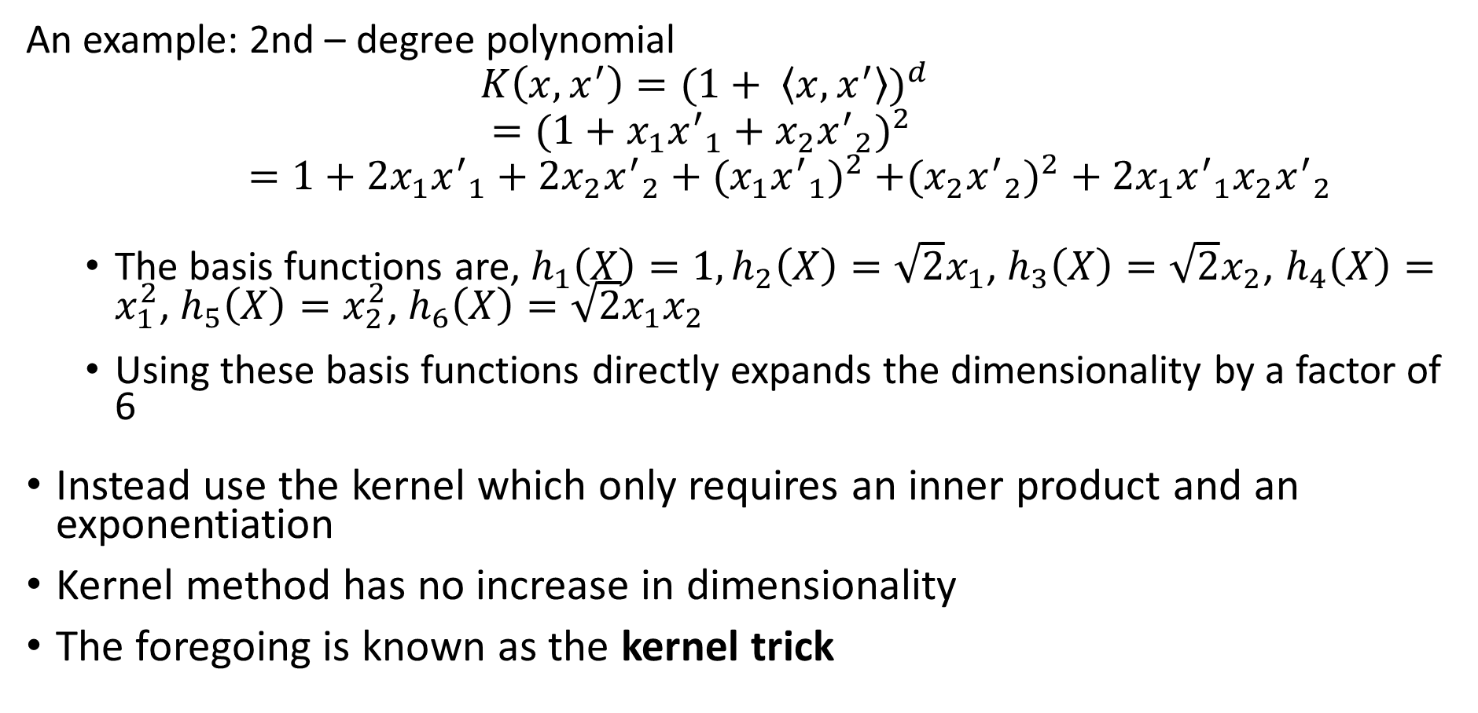
Kernels nonlinear separation
An example: 2nd – degree polynomial
$$K\left(x,x^{′}\right)=(1+ \left\langle x,x^{′}\right\rangle )^{d}$$
$$=(1+x_{1}{x^{′}}_{1}+x_{2}{x^{′}}_{2})^{2 }$$
$=1+2x_{1}{x^{′}}_{1}+{2x}_{2}{x^{′}}_{2}+({x_{1}{x^{′}}_{1})}^{2}$ $+({x_{2}{x^{′}}_{2})}^{2}+2x_{1}{x^{′}}_{1}x_{2}{x^{′}}_{2}$
The basis functions are, $h_{1}\left(X\right)=1, h_{2}\left(X\right)=\sqrt{2}x_{1}$, $h_{3}\left(X\right)=\sqrt{2}x_{2}$, $h_{4}\left(X\right)=x_{1}^{2}$, $h_{5}\left(X\right)=x_{2}^{2}$, $h_{6}\left(X\right)=\sqrt{2}x_{1}x_{2}$
Using these basis functions directly expands the dimensionality by a factor of 6
Instead use the kernel which only requires an inner product and an exponentiation
Kernel method has no increase in dimensionality
The foregoing is known as the kernel trick

Slide 40
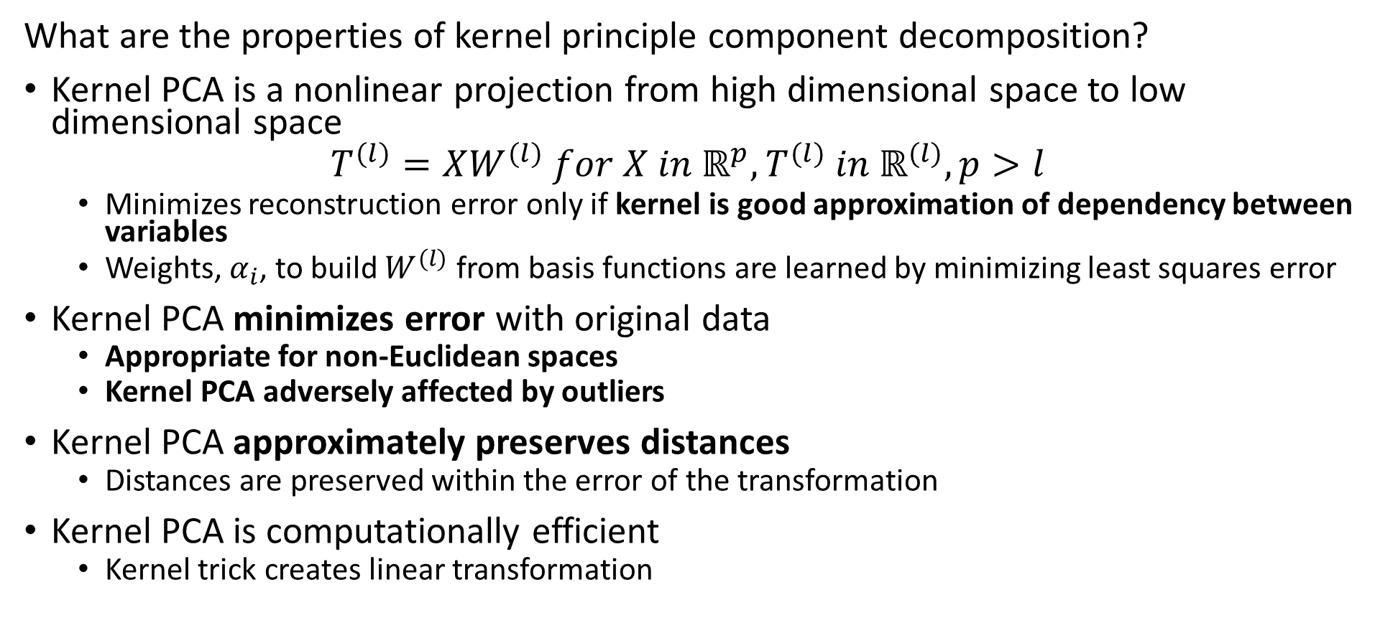
Kernel Principle Component Decomposition
What are the properties of kernel principle component decomposition?
Kernel PCA is a nonlinear projection from high dimensional space to low dimensional space
$$T^{(l)}=XW^{(l)} for X in ℝ^{p},T^{(l)} in ℝ^{(l)}, p>l$$
Minimizes reconstruction error only if kernel is good approximation of dependency between variables
Weights, $α_{i}$, to build $W^{(l)}$ from basis functions are learned by minimizing least squares error
Kernel PCA minimizes error with original data
Appropriate for non-Euclidean spaces
Kernel PCA adversely affected by outliers
Kernel PCA approximately preserves distances
Distances are preserved within the error of the transformation
Kernel PCA is computationally efficient
Kernel trick creates linear transformation

Slide 41
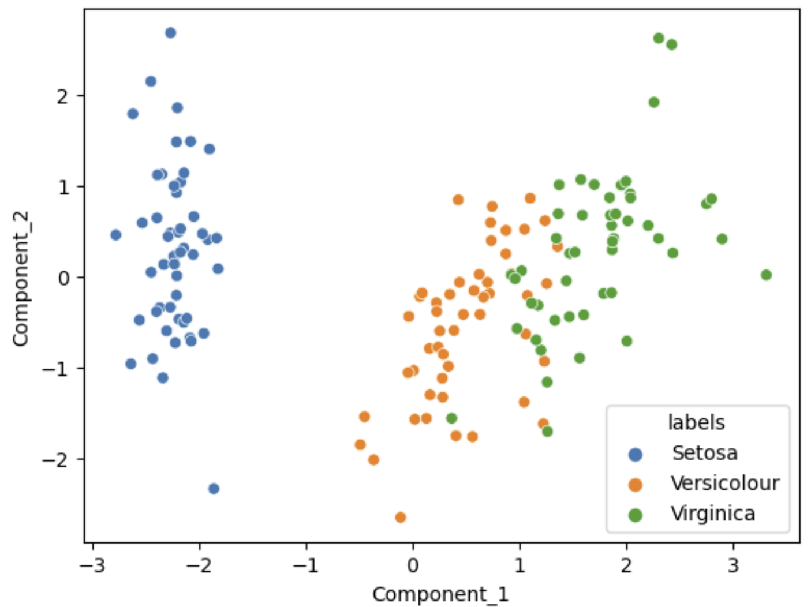
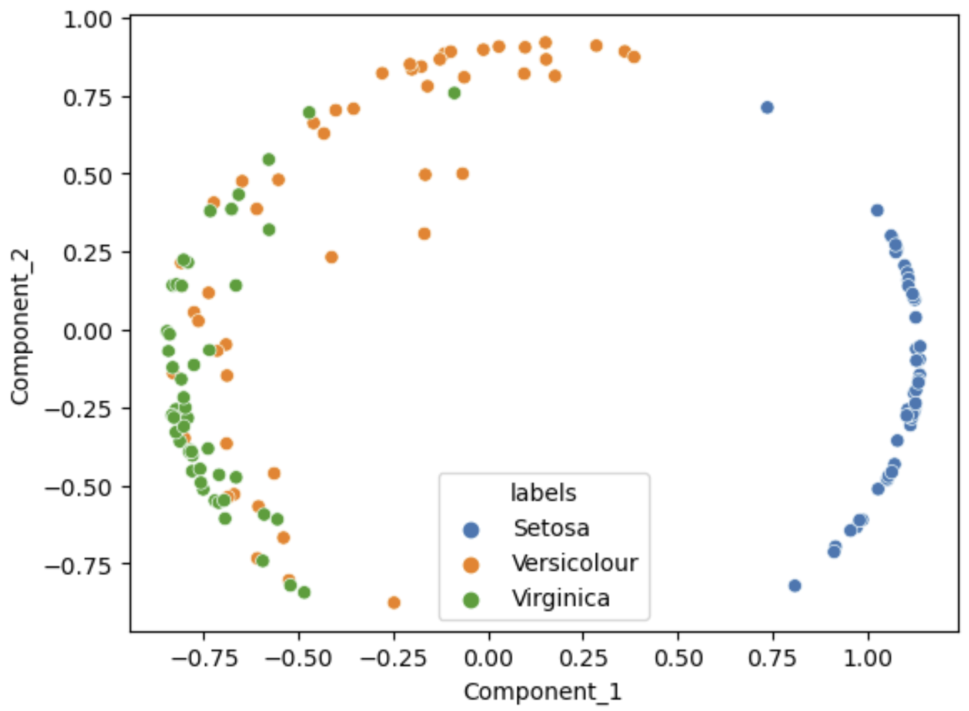
Kernel Principle Component Decomposition
Kernel PCA creates a nonlinear projection
Linear PCA
Kernel PCA, cosine kernel

Slide 42
Summary
Dimensionality reduction is widely used in data mining
Introduction to dimensionality reduction
Principle component analysis (PCA)
Singular value decomposition (SVD)
Kernel principle component analysis for non-linear projection

