Slide 1

CSCI E-108 Data Mining, Exploration and Discovery Learning to Rank and Recommender Algorithms
Steve Elston
Copyright 2020,2021, 2022, 2023, 2024, 2025, Stephen F Elston. All rights reserved.

Slide 2
Why Recommender Systems?
Catalogs of user choices are growing
Users need recommendations to navigate these vast choices
Many areas require recommendations
Physical products
Hospitality – Hotels, restaurants,…
Books
News articles
Music
Movies and TV shows
App stores
Matching people with required job skills
…
Economic impact of recommenders is massive!

Slide 3
Why Recommender Systems?
Catalogs of user choices are growing
In the physical world user choice is limited to small number of items
Items on the shelves of a store
News articles printed on paper
Books in a book store
Music in a music store
People submitting paper resumes for a job
Movies at a theater
…
But, in the online word the choices are nearly limitless
Choice is no longer limited by physical constraints
Most of the choices are rarely purchased
Users will rarely find these choices on their own
This is known as the long tail

Slide 4
Why Recommender Systems?
With large catalogs there are many items which are obscure and rarely purchased
Users unlikely to find rarely purchased items without recommender
Probability of Finding Item
Items commonly purchased
Items rarely purchased
Frequency of purchase

Slide 5
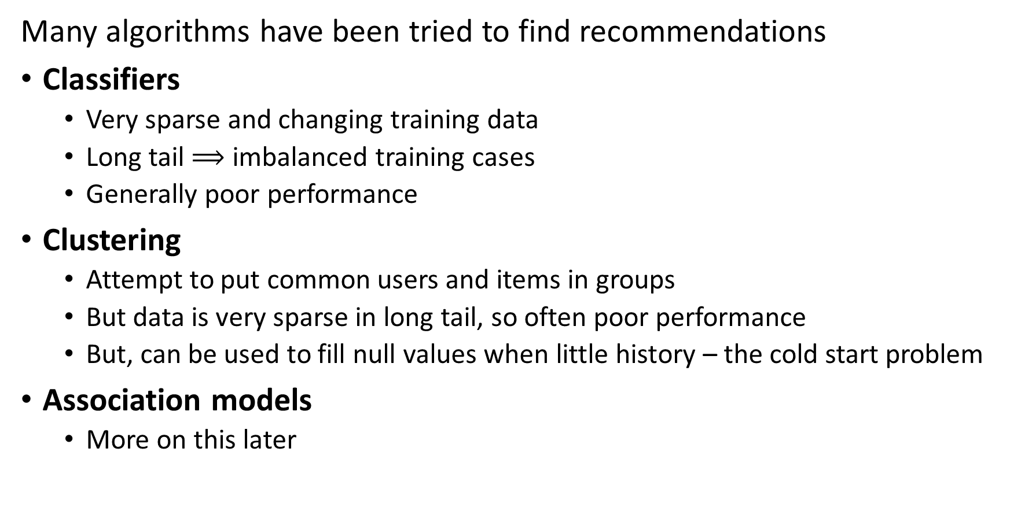
Recommender Systems
Many algorithms have been tried to find recommendations
Classifiers
Very sparse and changing training data
Long tail $⟹$ imbalanced training cases
Generally poor performance
Clustering
Attempt to put common users and items in groups
But data is very sparse in long tail, so often poor performance
But, can be used to fill null values when little history – the cold start problem
Association models
More on this later

Slide 6
Recommender Systems
Recommenders are an example of learning to rank (LTR) algorithms
Learning to rank is a widely used concept
Information retrieval
Recommenders
Recommenders return a ranked list of items
A more sophisticated form of LTR algorithm adjust for bias
Unbiased learning to rank (ULTR) algorithms

Slide 7
Recommender Systems
Many algorithms have been tried to find recommendations
Algorithms based on similarity search dominate
Content based systems
Find items with common properties by similarity search
Related to frequent item set algorithms – Last lesson of course
Collaborative filtering
Based on similarity between items or between users
Formerly widely used algorithm
Has cold-start problem

Slide 8
Recommender Systems
Resources for massively scalable recommenders
For examples of using graph recommender models at massive scale with Neo4j, see Graph Powered Machine Learning, Alessandro Negro, Manning, 2021
For an example of building scalable collaborative filtering and neural collaborative filtering recommenders in Keras, see this example by Siddhartha Banerjee
The Torch Rec system from Meta supports building massive scale recommenders using sharding and embedding algorithms
Twitter’s recommender uses a complex combination of NLP, social graph analysis and recommendation generation

Slide 9
Dataset
There is a growing list of recommender datasets
GitHub site with links to multiple other sites
Page with recommender dataset on Papers with Code
List of recommender datasets on Kagel

Slide 10
Generating Recommendations is Hard!

Slide 11
Why is Making a Good Recommender Hard?
Creating a good recommender algorithm for the real-world is hard!
We do not have purchase information on new users or new items –
The cold-start problem!
Human users have variable behavior
Naïve solutions do not address long-tail
Negative sampling bias – Never collect samples when user does not take action
Position bias – Users only see top few items on recommendation list
These biases are strongly interdependent!

Slide 12
Why is Making a Good Recommender Hard?
Creating a good recommender algorithm for the real-world is hard!
Cold start problem for new or rarely purchased items
New items are constantly added to digital catalogs
No reviews
No purchase history
Must rely on item similarity
Cold start problem for new users
No or few reviews or purchases
Similarity measures can be limited – little or no profile information
Must rely on other approaches – frequent item set search

Slide 13
Why is Making a Good Recommender Hard?
Creating a good recommender algorithm for the real-world is hard!
People have complex behavior
Have variable taste – may change mind what they are looking for
May have multiple interests – e.g. user may want both classic country and baroque music
More than one person accessing user account – e.g. a family
User ratings are not constant with time
Average rating of movies have increased with time
Game ratings decline with age
Fad products come and go quikly over time
…
Data quality often limits recommender performance more than algorithm choice!

Slide 14
Why is Making a Good Recommender Hard?
Creating a good recommender algorithm for the real-world is hard!
Recommender data suffers from negative sampling bias
We can only sample when user takes positive action
Click through
Purchase
…
Many selections in a massive catalog are rarely or never selected by any user
New items are constantly added to digital catalogs
The result is very sparse data with mostly missing values

Slide 15
Why is Making a Good Recommender Hard?
Creating a good recommender algorithm for the real-world is hard!
Recommender data suffers from negative sampling bias
We only get feedback about actions users take
Never know why users do not take action
Only have positive results (clicks)
Example: consider a model with only binary response for an app store:
Value is 1 if user downloaded an app
Value is 0 if user did not download the app
If 1, we do not know if the user liked the app or not
If 0, we do not know if user did not want the app or never knew of its existence
Position bias arises from negative sampling bias

Slide 16
Why is Making a Good Recommender Hard?
Creating a good recommender algorithm for the real-world is hard!
Click probability depends on the position in the search results
Users typically do not see choices far down the list
We never know the probability of click through for some items
Items in the tail suffer position bias
Popularity of the top items in the list is biased upward by frequent clicks
Bias propagates to new recommendation lists, increasing subsequent bias
Position bias leads to negative sampling bias

Slide 17
Embedding for Recommenders

Slide 18
Recommender Systems
Effective embeddings are essential for recommendations
Algorithms typically operate on features in an embedding space
Often use hash sketches
Learned embedding spaces
Good embeddings must have several properties
Uniqueness for each category embedded
Equal similarity between classes, to prevent bias
Reduction of high dimensionality, to reduce computation and memory use
High Shannon entropy, ensuring all dimensions of the embedding contain information

Slide 19
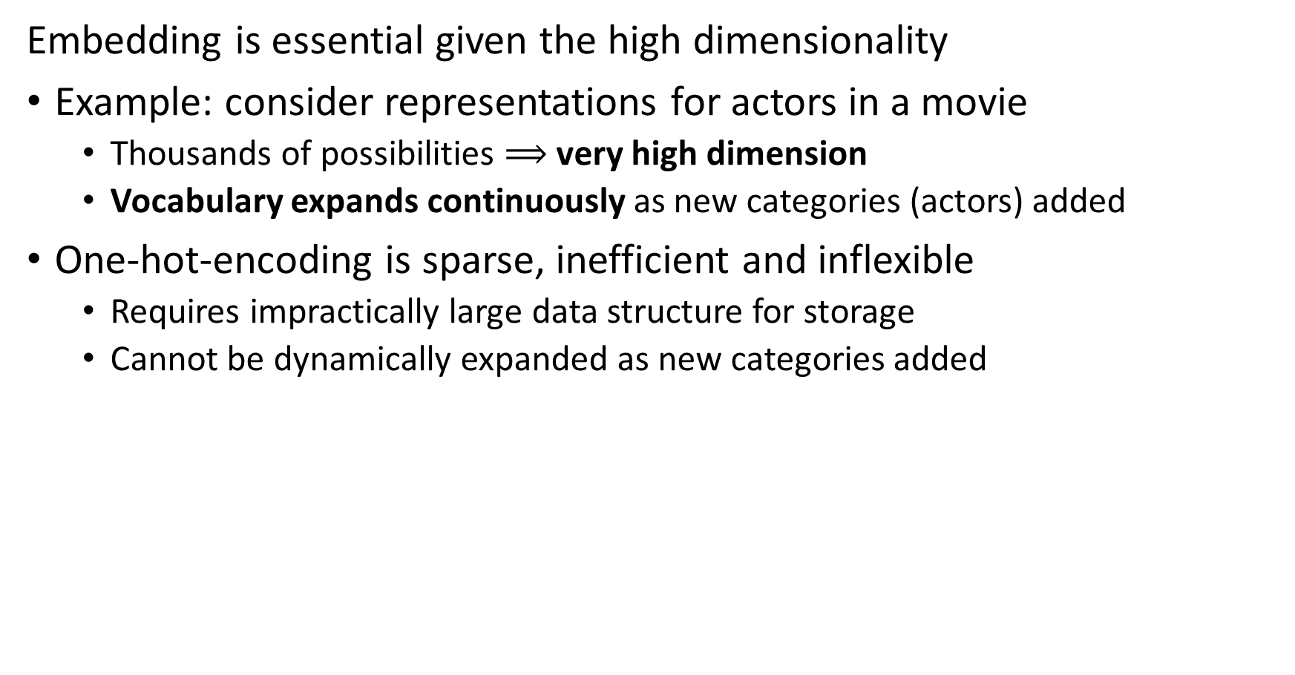
Embedding is Essential for Recommender Algorithms
Embedding is essential given the high dimensionality
Example: consider representations for actors in a movie
Thousands of possibilities $⟹$ very high dimension
Vocabulary expands continuously as new categories (actors) added
One-hot-encoding is sparse, inefficient and inflexible
Requires impractically large data structure for storage
Cannot be dynamically expanded as new categories added

Slide 20
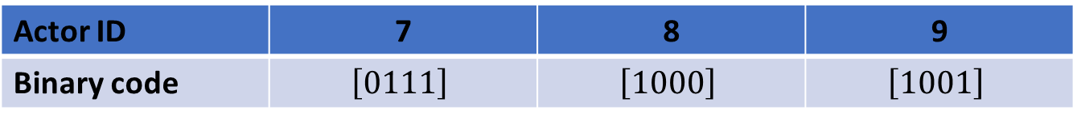
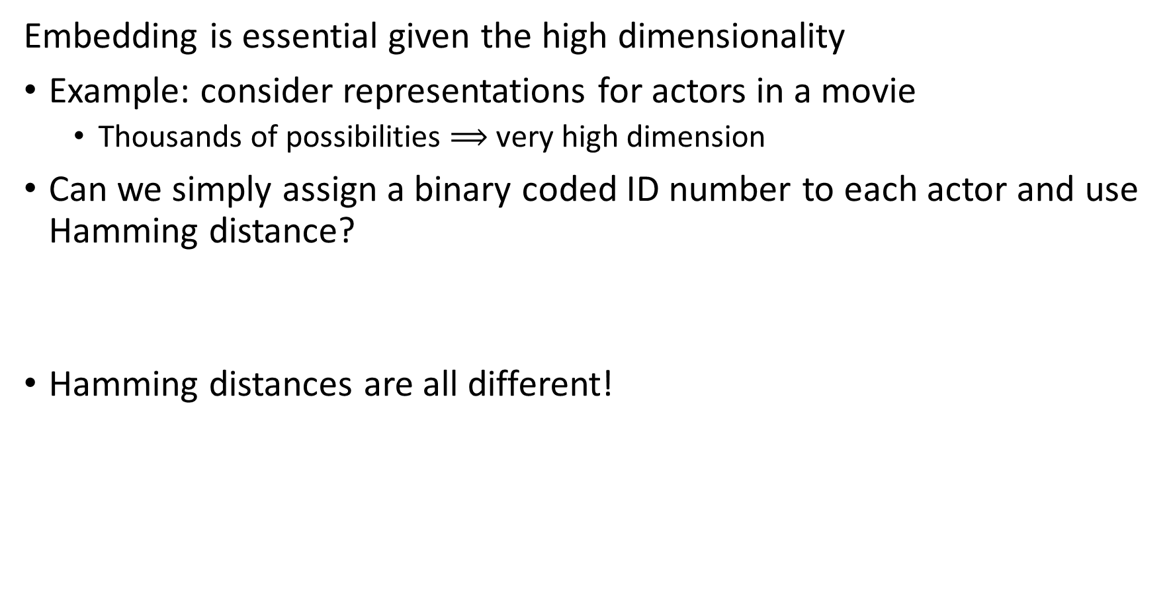
Embedding is Essential for Recommender Algorithms
Embedding is essential given the high dimensionality
Example: consider representations for actors in a movie
Thousands of possibilities $⟹$ very high dimension
Can we simply assign a binary coded ID number to each actor and use Hamming distance?
Hamming distances are all different!
Actor ID | 7 | 8 | 9
Binary code | $$\left[0111\right]$$ | $$\left[1000\right]$$ | $$\left[1001\right]$$
Actor ID | 7 | 8 | 9
7
8 | 4
9 | 3 | 1

Slide 21


Embedding is Essential for Recommender Algorithms
Embedding is essential given the high dimensionality
Example: consider representations for actors in a movie
Thousands of possibilities $⟹$ very high dimension
We can use a hash embedding or the ‘hash trick’
Hash category to fixed length embedding vector
Example:
Category
Cat
Dog
Parrot
Gold Fish
Hamster
Cat | Dog | Parrot | Gold Fish | Hamster
0 | 1 | 1 | 0 | 0
1 | 0 | 1 | 1 | 0
1 | 0 | 1 | 1 | 1
0 | 1 | 0 | 1 | 1
0 | 1 | 1 | 0 | 1
Binary Hash Function h$\left(x\right)$

Slide 22
Embedding is Essential for Recommender Algorithms
Embedding is essential given the high dimensionality
We can use a hash embedding or the ‘hash trick’
Hash category to fixed length embedding vector
Hash collisions create non-uniqueness in coding features
How can we reduce hash collisions?
Use longer hash word
Use multiple hash functions
Randomize hash words by using binary sign hash multiplier – inner products become zero-centered
Feature hashing is well supported in many machine learninging packages including, Scikit-learn and TensorFlow (Keras)

Slide 23
Embedding is Essential for Recommender Algorithms
Embedding is essential given the high dimensionality
Hash trick has several limitations
Hash collisions reduce uniqueness
Hash values do not maintain high entropy, e.g. the information content of the hash word is low
To overcome these deficiencies, Zang, et. al., 2020, proposed deep hash embedding (DHE)

Slide 24
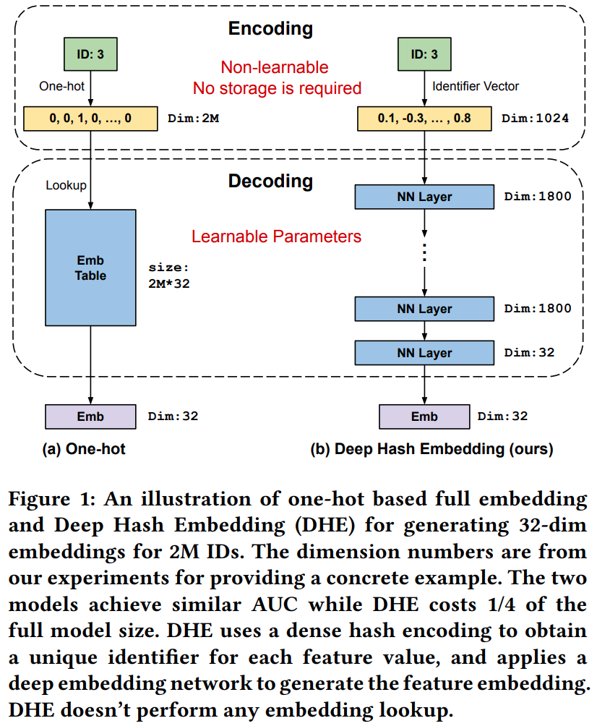
Embedding is Essential for Recommender Algorithms
Embedding is essential given the high dimensionality
Zang, et. al., 2020, proposed deep hash embedding (DHE)
DHE uses a deep neural network to learn optimal embeddings

Slide 25
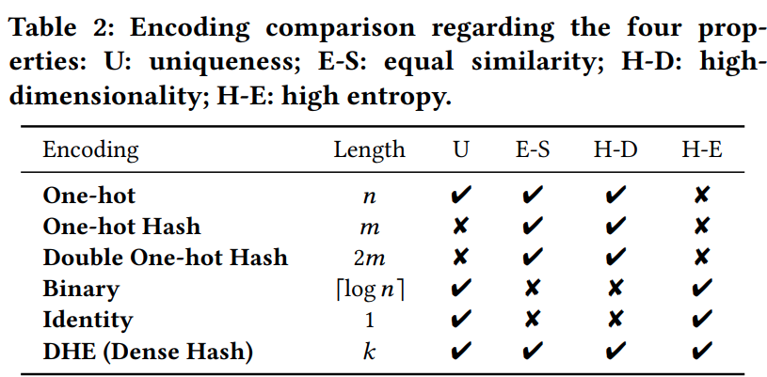
Embedding is Essential for Recommender Algorithms
Embedding is essential given the high dimensionality
Zang, et. al., 2020, proposed deep hash embedding (DHE)
DHE uses a deep neural network to learn optimal embeddings
DHE exhibits each of the optimal properties for feature hashing

Slide 26
Representation for Recommenders

Slide 27
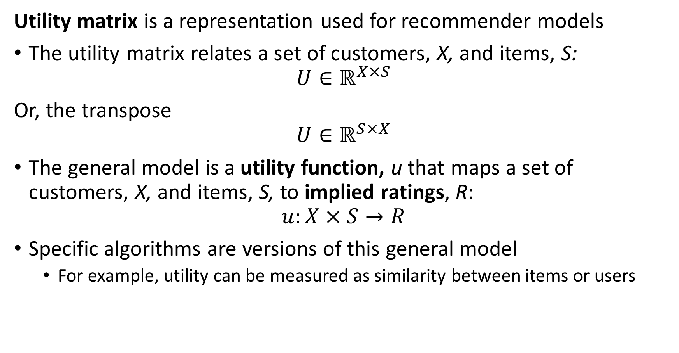
General Recommender Model
Utility matrix is a representation used for recommender models
The utility matrix relates a set of customers, X, and items, S:
$$U∈ℝ^{X×S}$$
Or, the transpose
$$U∈ℝ^{S×X}$$
The general model is a utility function, u that maps a set of customers, X, and items, S, to implied ratings, R:
$$u:X×S→R$$
Specific algorithms are versions of this general model
For example, utility can be measured as similarity between items or users

Slide 28
Representation for Recommender Algorithms
What representation can we use for recommender algorithms?
A utility matrix
Users in the rows, item ratings or purchases in the columns
Or the transpose
We can create a similar data structure using feature or user embeddings
 | Star Wars | The Matrix | Green Book | Frozen | Lady Bird | Jurassic Park | Schindler’s List | My Neighbor Totoro
Mary |  |  | 4 |  | 5 |  | 4 | 5
Bob | 4 | 5 |  |  | 1
Raj |  |  | 4 |  |  |  | 5
Maria | 3 | 4 |  | 5 | 4 |  | 3 | 5
Kevin |  |  | 5 |  |  | 2 | 5
Janell | 5 | 4 |  |  |  |  |  | 2

Slide 29
Representation for Recommender Algorithms
What representation can we use for recommender algorithms?
Notice that most users have watched only a few movies
There is only limited similarity information between users
 | Star Wars | The Matrix | Green Book | Frozen | Lady Bird | Jurassic Park | Schindler’s List | My Neighbor Totoro
Mary |  |  | 4 |  | 5 |  | 4 | 5
Bob | 4 | 5 |  |  | 1
Raj |  |  | 4 |  |  |  | 5
Maria | 3 | 4 |  | 5 | 4 |  | 3 | 5
Kevin |  |  | 5 |  |  | 2 | 5
Janell | 5 | 4 |  |  |  |  |  | 2

Slide 30
Representation for Recommender Algorithms
What representation can we use for recommender algorithms?
Do we always have ratings from users?
No! Many people will buy, watch, or listen without ever rating
Click-throughs are inherently binary
Often, only have binary response
 | Star Wars | The Matrix | Green Book | Frozen | Lady Bird | Jurassic Park | Schindler’s List | My Neighbor Totoro
Mary |  |  | 4 |  | 5 |  | 4 | 5
Bob | 4 | 5 |  |  | 1
Raj |  |  | ✔ |  |  |  | ✔
Maria | ✔ | ✔ |  | ✔ | ✔ |  | ✔ | ✔
Kevin |  |  | ✔ |  |  | ✔ | ✔
Janell | 5 | 4 |  |  |  |  |  | 2

Slide 31
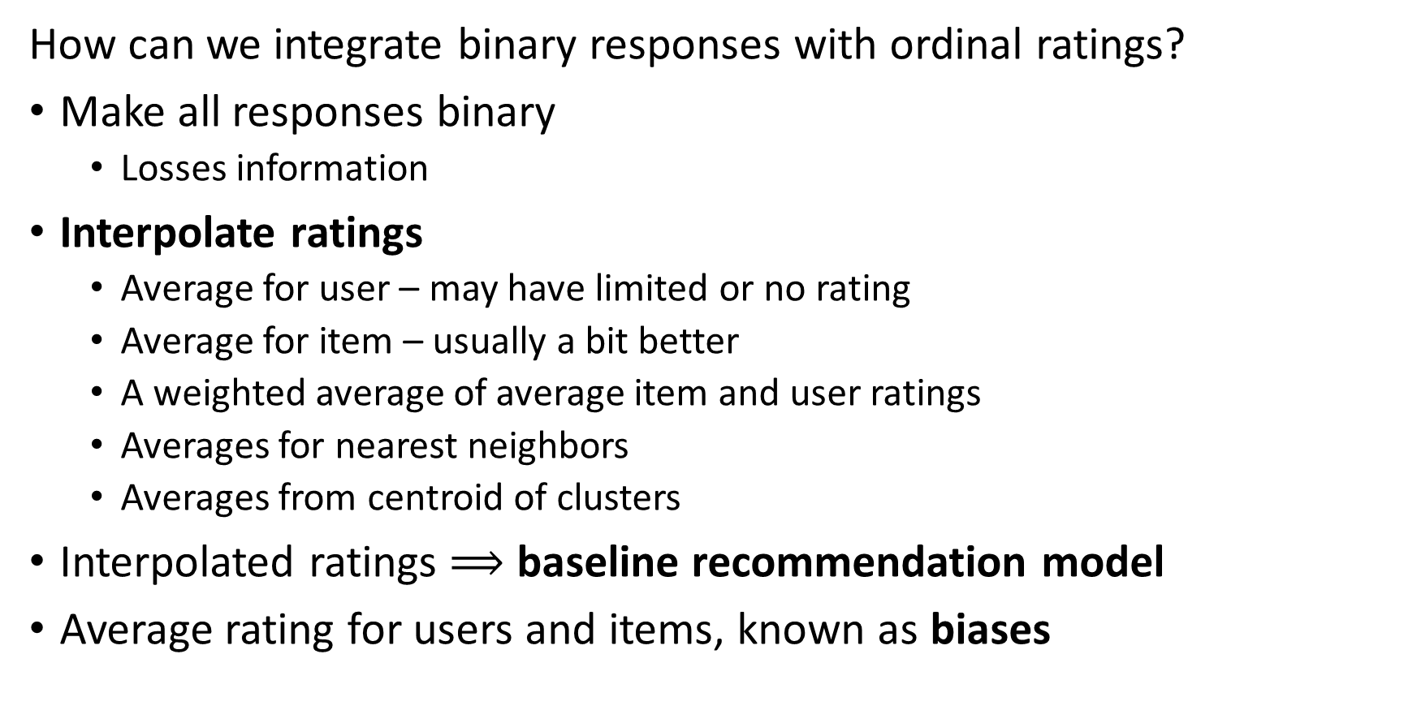
Representation for Recommender Algorithms
How can we integrate binary responses with ordinal ratings?
Make all responses binary
Losses information
Interpolate ratings
Average for user – may have limited or no rating
Average for item – usually a bit better
A weighted average of average item and user ratings
Averages for nearest neighbors
Averages from centroid of clusters
Interpolated ratings $⟹$ baseline recommendation model
Average rating for users and items, known as biases

Slide 32
Representation for Recommender Algorithms
Is Maria only one person?
Maybe not – multiple people share accounts
Perhaps the Maria account represents several people in a household?
 | Star Wars | The Matrix | Green Book | Frozen | Lady Bird | Jurassic Park | Schindler’s List | My Neighbor Totoro
Mary |  |  | 4 |  | 5 |  | 4 | 5
Bob | 4 | 5 |  |  | 1
Raj |  |  | 4 |  |  |  | 5
Maria | 3 | 4 |  | 5 | 4 |  | 3 | 5
Kevin |  |  | 5 |  |  | 2 | 5
Janell | 5 | 4 |  |  |  |  |  | 2

Slide 33








Representation for Recommender Algorithms
Graph representation of utility matrix
One type of node represents users
One type of node represents items
Weighted edges associate users and items – e.g. item ratings or similarity
Is a bipartite graph
Graph representation is inherently sparse
Many state of the art recommender algorithms are graph-based
$$U_{1}$$
$$I_{1}$$
$$U_{2}$$
$$I_{2}$$
$$U_{3}$$
$$I_{3}$$
…
…
$$U_{n}$$
$$I_{n}$$

Slide 34
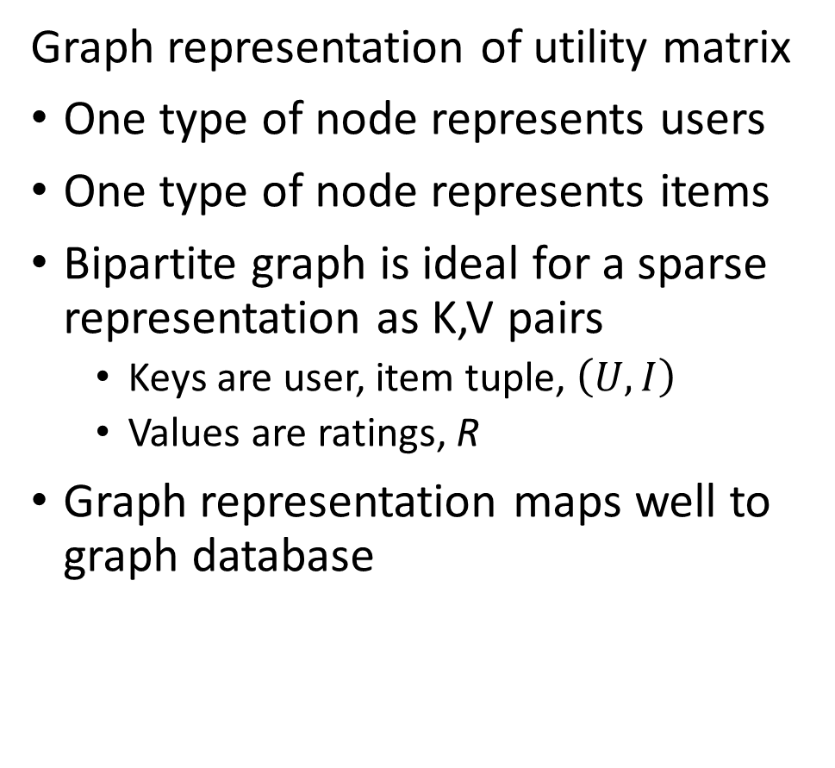
Representation for Recommender Algorithms
Graph representation of utility matrix
One type of node represents users
One type of node represents items
Bipartite graph is ideal for a sparse representation as K,V pairs
Keys are user, item tuple, $\left(U,I\right)$
Values are ratings, R
Graph representation maps well to graph database
$$U_{1}$$
$$I_{1}$$
$$U_{2}$$
$$I_{2}$$
$$U_{3}$$
$$I_{3}$$
…
…
$$U_{n}$$
$$I_{n}$$

Slide 35
Content Based Recommenders

Slide 36
Content Based Recommenders
How can we build a content-based recommender?
Based on similarity of item and user profiles
Is unsupervised similarity search
Can use most any similarity metric, with default of cosine
Goal: Recommend related items to user
Example: recommend movie
Find movies with similar actors, director, writers, etc. to user profile

Slide 37
Content Based Recommenders
How can we build a content-based recommender?
Item profiles (characteristics)
Acquired from item descriptions
No item cold-start problem
Feature map from embedding
User profile based on activity
Searches (natural language)
Click-through (binary)
Purchases (binary)
Ratings (ordinal)
Can combine data types, concatenate embeddings
Amazon uses mini-hashing, Luo, 2022, for large scale Item similarity search

Slide 38





Content Based Recommenders
How can we build a content-based recommender?
User profile of searchers, purchases and ratings of bicycle water bottles
Present recommended
items
Many possible similar items from item descriptions (choices)
Filter on k highest similarity between user and item profiles

Slide 39
Content Based Recommenders
How can we build a content-based recommender?
Extracting consistent item characteristics can be difficult
Descriptions often inconsistent
Different sources code and format characteristics differently
Integrate categorical and numerical characteristics
Categorical features
Use dense embedding
Unstructured text descriptions
Use neural embedding of natural language
Use embedding space for similarity search

Slide 40
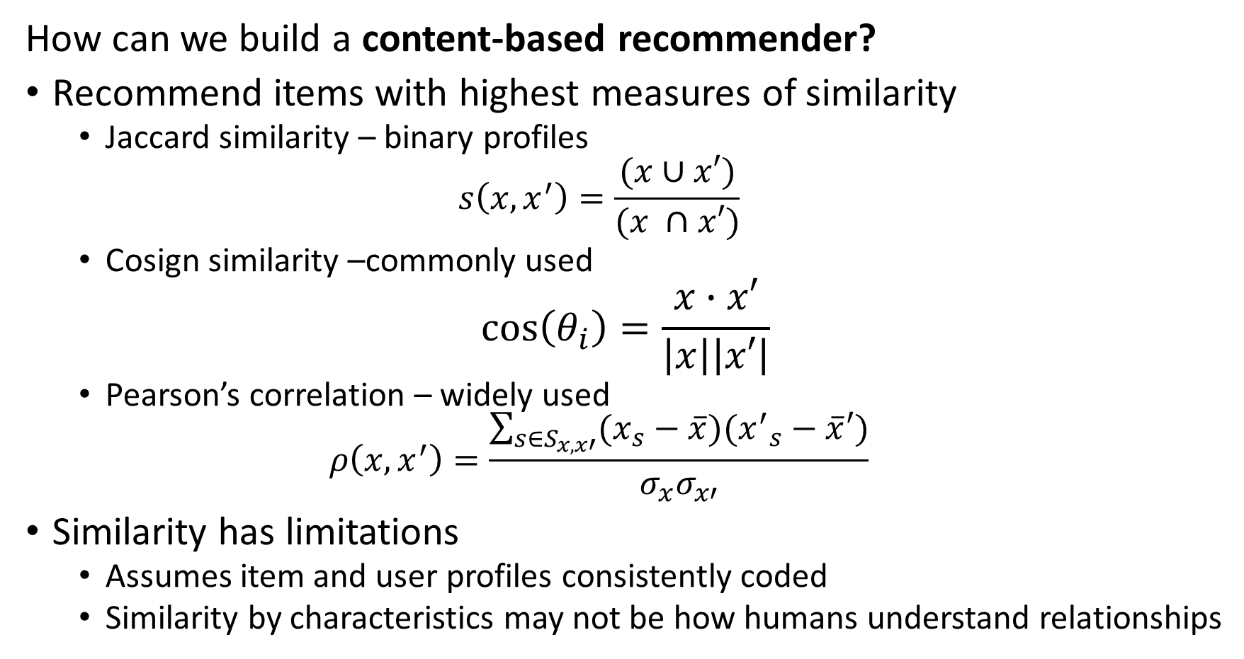
Content Based Recommenders
How can we build a content-based recommender?
Recommend items with highest measures of similarity
Jaccard similarity – binary profiles
$$s\left(x,x^{′}\right)=\frac{(x∪x′)}{(x ∩x′)}$$
Cosign similarity –commonly used
$$\cos\left(θ_{i}\right)=\frac{x∙x′}{\left|x\right|\left|x′\right|}$$
Pearson’s correlation – widely used
$$ρ\left(x,x^{′}\right)=\frac{\sum_{s∈S_{x,x′}}^{ }{(x_{s}−\overline{x})({x^{′}}_{s}−\overline{x}′)}}{σ_{x}σ_{x′}}$$
Similarity has limitations
Assumes item and user profiles consistently coded
Similarity by characteristics may not be how humans understand relationships

Slide 41
Content Based Recommenders
Advantages of content-based recommenders
No need for data on other users, e.g. ratings
Recommend new and unpopular item by profile alone
No cold start problem for items
Works for users with unusual tastes
No first-rater problem
Outcome is explainable
Easy to understand ranking by similarity

Slide 42
Content Based Recommenders
Disadvantages of content-based recommenders
Finding features for profile is hard
Inconsistent descriptions
Information in unstructured data; text, images
Cold start problem for new user with no profile
Can give over-specialized recommendations
Will never find item without similarity to user search
Does not account for user with multiple interests
Does not use information from other users; e.g. ratings

Slide 43
Collaborative Filtering

Slide 44
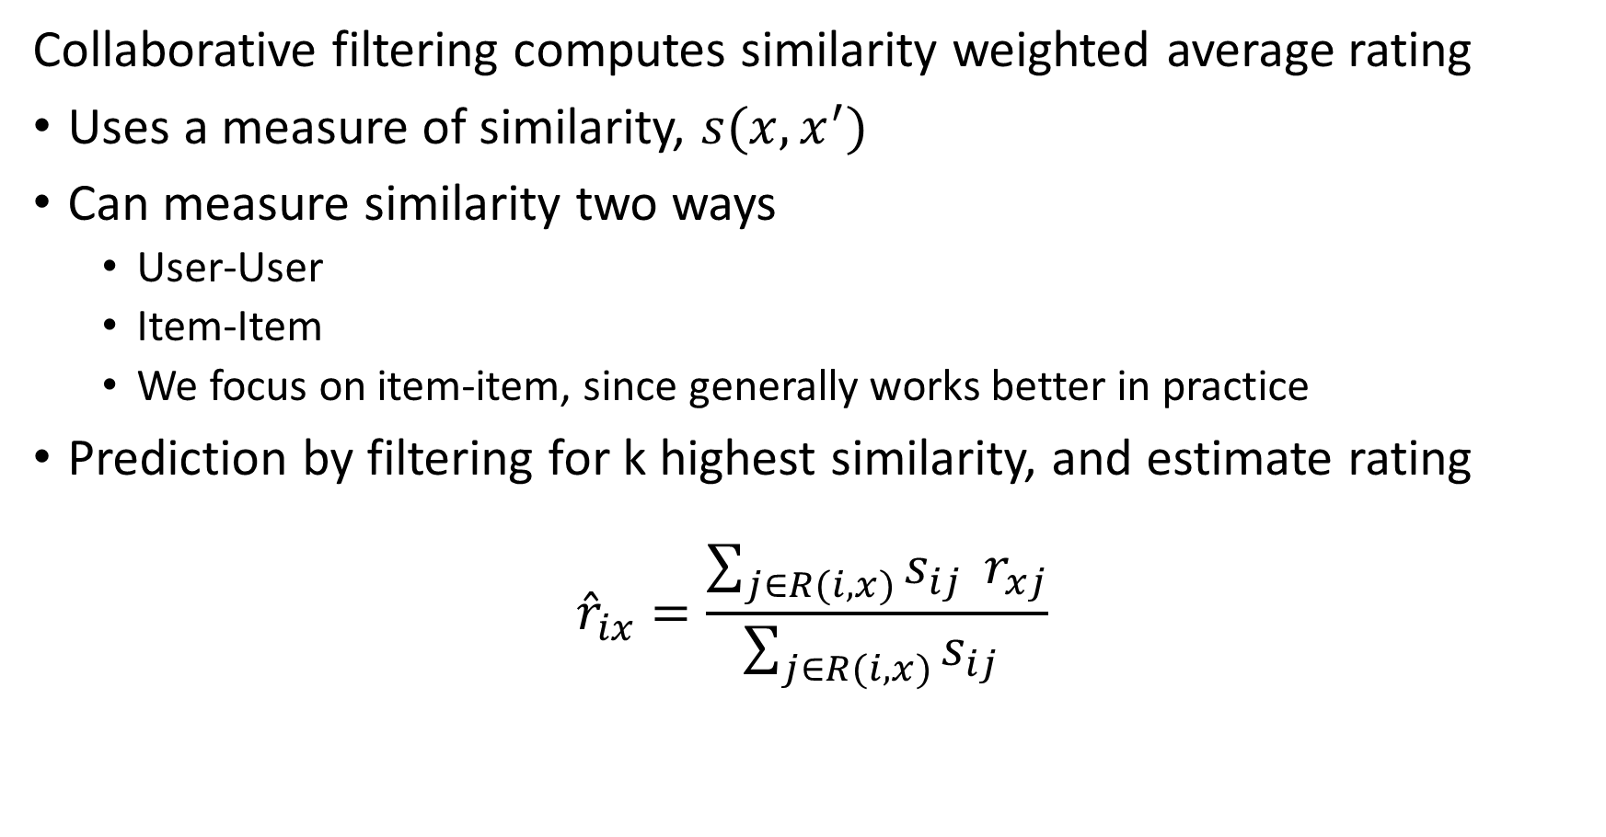
Collaborative Filter Recommenders
Collaborative filtering computes similarity weighted average rating
Uses a measure of similarity, $s(x,x^{′})$
Can measure similarity two ways
User-User
Item-Item
We focus on item-item, since generally works better in practice
Prediction by filtering for k highest similarity, and estimate rating
$${\hat{r}}_{ix}=\frac{\sum_{j∈R(i,x)}^{ }{s_{ij } r_{xj}}}{\sum_{j∈R(i,x)}^{ }{s_{ij} }}$$

Slide 45
Collaborative Filter Recommenders
Example of collaborative filtering
Start with a utility matrix
Here we use ratings, but can use feature embeddings with same basic algorithm
Users
 | 1 | 2 | 3 | 4 | 5 | 6 | 7 | 8 | 9 | 10 | 11
1 | 4 |  | 5 |  |  | 5 | ? |  | 3 |  | 1
2 | 1 | 2 |  |  | 4 |  |  | 4 | 5
3 | 5 | 3 | 4 |  | 3 |  | 2 | 1 |  | 4 | 2
4 | 2 |  |  | 4 |  |  | 5 |  | 4 | 2
5 | 2 |  |  |  |  | 2 | 4 | 3 | 4
6 | 4 |  |  | 2 |  |  | 3 |  | 3 |  | 1
Items

Slide 46
Collaborative Filter Recommenders
Example of collaborative filtering
Want to predict implied rating for user 7 of item 1
Compute the mean and Variance of the item ratings
Subtract mean rating from item rating
Users
 | 1 | 2 | 3 | 4 | 5 | 6 | 7 | 8 | 9 | 10 | 11 | Mean Rating | Variance
1 | 4 |  | 5 |  |  | 5 | ? |  | 3 |  | 1 | 3.60 | 2.80
2 | 1 | 2 |  |  | 4 |  |  | 4 | 5 |  |  | 3.20 | 2.7
3 | 5 | 3 | 4 |  | 3 |  | 2 | 1 |  | 4 | 2 | 3.00 | 1.71
4 | 2 |  |  | 4 |  |  | 5 |  | 4 | 2 |  | 3.40 | 1.8
5 | 2 |  |  |  |  | 2 | 4 | 3 | 4 |  |  | 3.00 | 1.00
6 | 4 |  |  | 2 |  |  | 3 |  | 3 |  | 1 | 2.60 | 1.30
Items

Slide 47
Collaborative Filter Recommenders
Example of collaborative filtering
Compute Pearson’s Correlation between item 1 ratings and other items
Two items have high correlation similarity
Users
 | 1 | 2 | 3 | 4 | 5 | 6 | 7 | 8 | 9 | 10 | 11 | Pearson Correlation | Jaccard Similarity
1 | 4 |  | 5 |  |  | 5 | ? |  | 3 |  | 1
2 | 1 | 2 |  |  | 4 |  |  | 4 | 5 |  |  | -1.0 | 0.18
3 | 5 | 3 | 4 |  | 3 |  | 2 | 1 |  | 4 | 2 | 0.84 | 0.27
4 | 2 |  |  | 4 |  |  | 5 |  | 4 | 2 |  | -1.0 | 0.18
5 | 2 |  |  |  |  | 2 | 4 | 3 | 4 |  |  | -0.87 | 0.27
6 | 4 |  |  | 2 |  |  | 3 |  | 3 |  | 1 | 1.0 | 0.27
Items

Slide 48
Collaborative Filter Recommenders
Example of collaborative filtering
Compute weighted rating = (0.84*2 + 1.0*3)/(0.84+1.0) = 2.54
Users
 | 1 | 2 | 3 | 4 | 5 | 6 | 7 | 8 | 9 | 10 | 11 | Pearson Correlation | Jaccard Similarity
1 | 4 |  | 5 |  |  | 5 | 3 |  | 3 |  | 1
2 | 1 | 2 |  |  | 4 |  |  | 4 | 5 |  |  | -1.0 | 0.18
3 | 5 | 3 | 4 |  | 3 |  | 2 | 1 |  | 4 | 2 | 0.84 | 0.27
4 | 2 |  |  | 4 |  |  | 5 |  | 4 | 2 |  | -1.0 | 0.18
5 | 2 |  |  |  |  | 2 | 4 | 3 | 4 |  |  | -0.87 | 0.27
6 | 4 |  |  | 2 |  |  | 3 |  | 3 |  | 1 | 1.0 | 0.27
Items

Slide 49
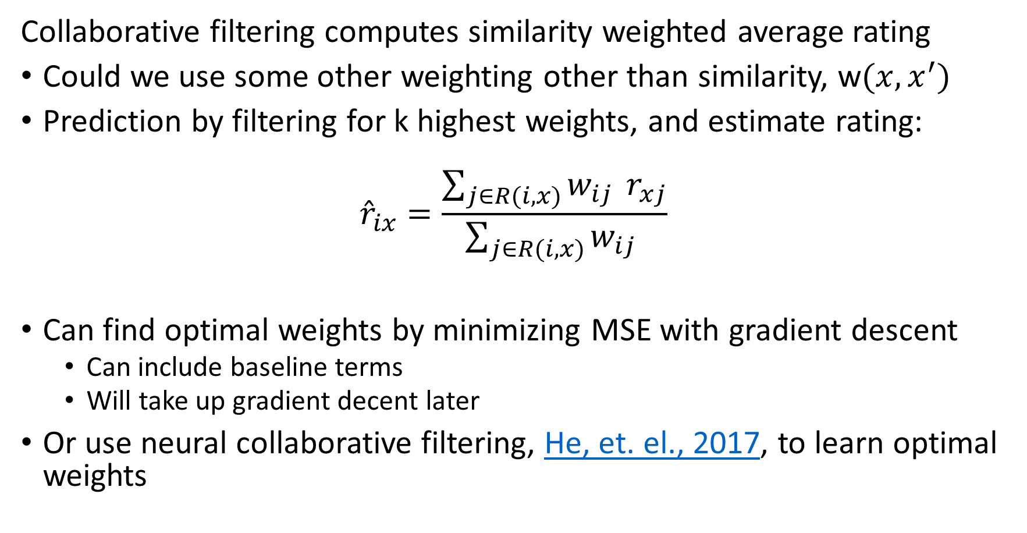
Collaborative Filter Recommenders
Collaborative filtering computes similarity weighted average rating
Could we use some other weighting other than similarity, w$(x,x^{′})$
Prediction by filtering for k highest weights, and estimate rating:
$${\hat{r}}_{ix}=\frac{\sum_{j∈R(i,x)}^{ }{w_{ij } r_{xj}}}{\sum_{j∈R(i,x)}^{ }{w_{ij} }}$$
Can find optimal weights by minimizing MSE with gradient descent
Can include baseline terms
Will take up gradient decent later
Or use neural collaborative filtering, He, et. el., 2017, to learn optimal weights

Slide 50
Evaluating Recommenders

Slide 51
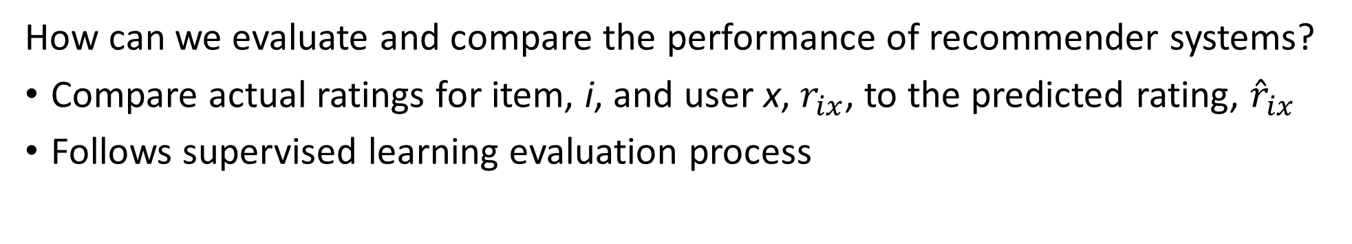
Evaluating Recommenders
How can we evaluate and compare the performance of recommender systems?
Compare actual ratings for item, i, and user x, $r_{ix}$, to the predicted rating, ${\hat{r}}_{ix}$
Follows supervised learning evaluation process
Users
Compare estimated rating to actual ratings
Choose evaluation metrics
Start with full data sample
Hold back Bernoulli sampled fraction of data
Train model
Evaluate using metric
4 |  | 3 |  |  | 2
 | 5 | 4 |  | 2 |  | 1
2 |  |  | 5 |  | 5
 | 3 | 3 |  | 2 | 4
5 |  | 5 | 3 |  |  | 4 | 1
 | 3 |  | 5 |  | 5 |  | 5
2 | 4 | 5 |  |  | 1
 | 3 |  | 4 |  | 3 |  | 2
4 |  | 3 |  |  | 2
 | 5 | 4 |  | 2 |  | 1
2 |  |  | 5 |  | 5
 | 3 | 3 |  | 2 | 4
5 |  | 5 | 3 |  |  | 4 | 1
 | 3 |  | 5 |  | 5 |  | 5
2 | 4 | 5 |  |  | 1
 | 3 |  | 4 |  | 3 |  | 2
Items

Slide 52
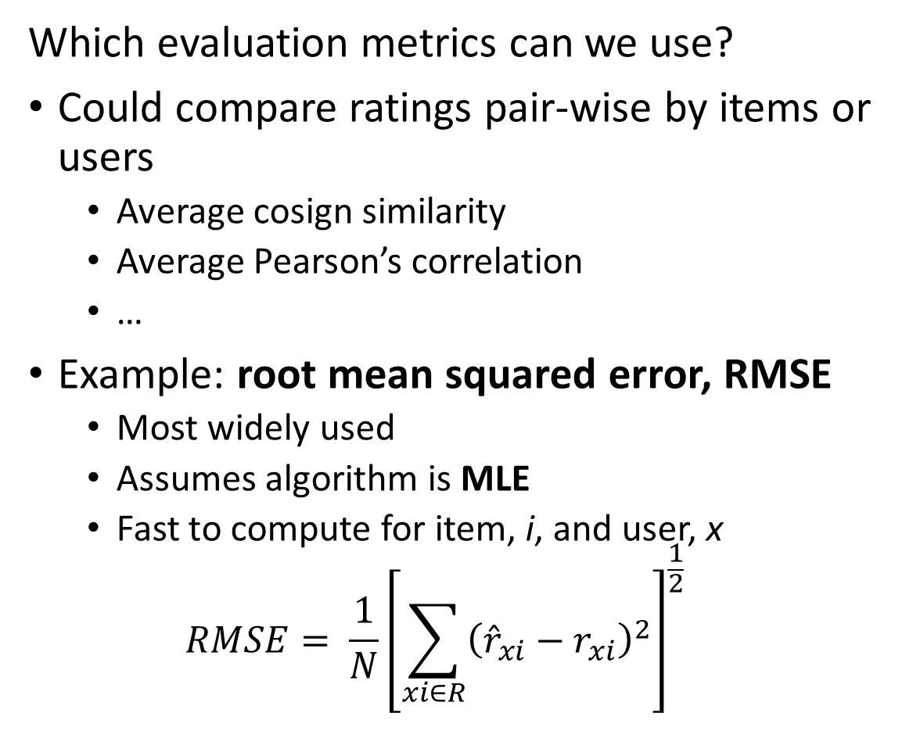
Evaluating Recommenders
Which evaluation metrics can we use?
Could compare ratings pair-wise by items or users
Average cosign similarity
Average Pearson’s correlation
…
Example: root mean squared error, RMSE
Most widely used
Assumes algorithm is MLE
Fast to compute for item, i, and user, x
$$RMSE= \frac{1}{N}{\left[\sum_{xi∈R}^{ }{{\left({\hat{r}}_{xi}−r_{xi}\right)}^{2}}\right]}^{\frac{1}{2}}$$
Users
4 |  | 3 |  |  | 2
 | 5 | 4 |  | 2 |  | 1
2 |  |  | 5 |  | 5
 | 3 | 3 |  | 2 | 4
5 |  | 5 | 3 |  |  | 4 | 1
 | 3 |  | 5 |  | 5 |  | 5
2 | 4 | 5 |  |  | 1
 | 3 |  | 4 |  | 3 |  | 2
Items

Slide 53
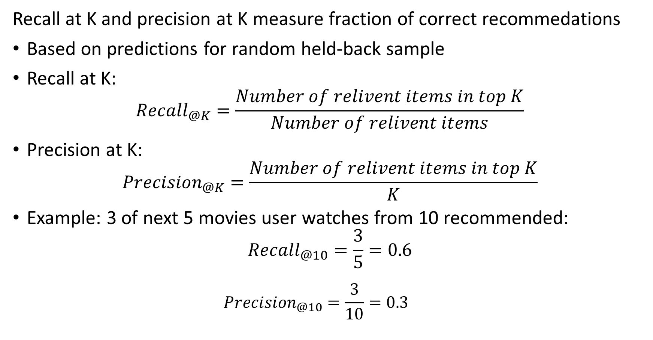
Evaluating Recommenders
Recall at K and precision at K measure fraction of correct recommedations
Based on predictions for random held-back sample
Recall at K:
$${Recall}_{@K}=\frac{Number of relivent items in top K}{Number of relivent items}$$
Precision at K:
$${Precision}_{@K}=\frac{Number of relivent items in top K}{K}$$
Example: 3 of next 5 movies user watches from 10 recommended:
$${Recall}_{@10}=\frac{3}{5}=0.6$$
$${Precision}_{@10}=\frac{3}{10}=0.3$$

Slide 54
Evaluating Recommenders
Can we apply cross validation to recommender algorithms?
Yes! Use K-fold CV method
Randomly sample data into K-folds (subsets)
Round robin hold back one fold for evaluation and train model on K-1 folds
Base evaluation on mean and variance of K performance metric sets
CV is an effective tool for comparing performance of models
In theory, can use nested CV for hyperparameter search
But computation can be prohibitive – data can be massive
Can limit folds and number of hyperparameter values

Slide 55
Latent Variable Models

Slide 56
Latent Factor Recommenders
Latent factor recommenders are powerful models
Latent variables are a low-dimensional and dense embedding of the spare response data
Data values can be dense or sparse
Example, numeric features are typically dense
Categorical features with high dimensionality are sparsely coded
Negative sampling bias results in few positive responses
Imbalanced training cases
An embedding space used to overcome these problems
Embedding spaces contain latent factors
Latent factors that are not observable

Slide 57
Latent Factor Recommenders
Latent factor recommenders are powerful models
Uses a non-negative matrix decomposition of the utility matrix
Compute missing ratings from matrix decomposition
But, need a trick!
Utility matrix is not square: wide, n users by m items
Typically, n << m, or sometimes m < n
Many missing values, negative sample bias
Standard SVD biased by 0 filling

Slide 58
Latent Factor Recommenders
Latent factor recommenders are powerful models
What are factor models?
Statistical factor models attempt to explain data
Factors define a low-dimensional embedding space
Embeddings are explanatory factors
Algorithm learns factor weights
Can use observable factors
Example; factors for film, director, writer, lead actors
Unobservable factors are called latent factors
Latent since these factors cannot be observed
Factors weights learned from observed data

Slide 59
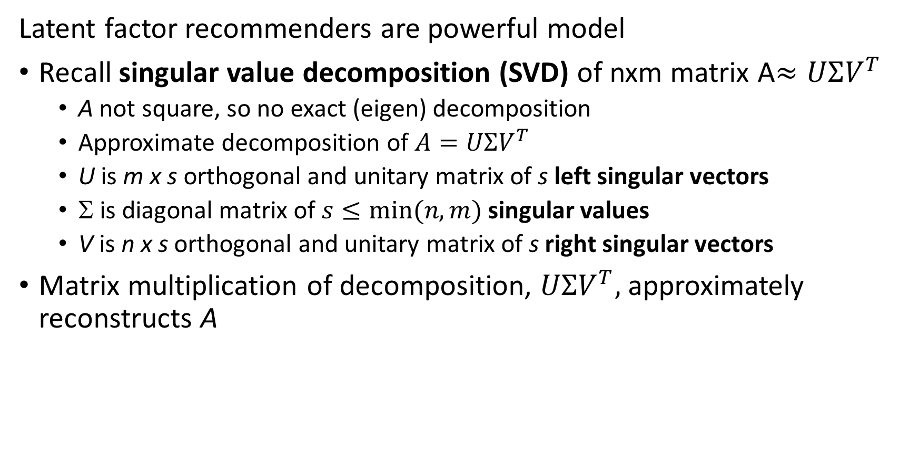
Latent Factor Recommenders
Latent factor recommenders are powerful model
Recall singular value decomposition (SVD) of nxm matrix A$≈UΣV^{T}$
A not square, so no exact (eigen) decomposition
Approximate decomposition of $A=UΣV^{T}$
U is m x s orthogonal and unitary matrix of s left singular vectors
Σ is diagonal matrix of $s≤min⁡(n,m)$ singular values
V is n x s orthogonal and unitary matrix of s right singular vectors
Matrix multiplication of decomposition, $UΣV^{T},$ approximately reconstructs A

Slide 60







Latent Factor Recommenders
Can we perform SVD decomposition the on utility matrix, A$≈UΣV^{T}$
Problem, SVD biased by missing values and produces negative ratings
Reconstruction of utility matrix is biased
Users
$$U$$
$$∑$$
$$VT$$
4 |  | 3 |  |  | 2
 | 5 | 4 |  | 2 |  | 1
2 |  |  | 5 |  | 5
 | 3 | 3
5 |  | 5
 | 3 |  | 5
2 | 4
 | 3 |  | 4
$$×$$
$$×$$
$$≈$$
Items

Slide 61



Latent Factor Recommenders
Perform non-negative factorization of utility matrix, A$≈PQ^{T}$
Wait! Don’t need SVD, A$≈UΣV^{T}$
Don’t care about the orthonormal properties of, $U,V^{ }$
Need a decomposition that works with missing values
Use non-negative matrix factorization, $A≈PQ^{T}$
Where,$QT≈ΣV^{T},P≈U$
Users
Factors
Users
4 |  | 3 |  |  | 2
 | 5 | 4 |  | 2 |  | 1
2 |  |  | 5 |  | 5
 | 3 | 3
5 |  | 5
 | 3 |  | 5
2 | 4
 | 3 |  | 4
$$≈$$
$$×$$
Factors
Items
Items

Slide 62



Latent Factor Recommenders
Can we perform decomposition on the utility matrix, A
How can we interpret this $A≈PQ^{T}$ decomposition?
Different factors for items and users
Vectors of explanatory factors for the values of the utility matrix
Inner product of Factor weights predicts the rating values
Users
Factors
Users
4 |  | 3 |  |  | 2
 | 5 | 4 |  | 2 |  | 1
2 |  |  | 5 |  | 5
 | 3 | 3
5 |  | 5
 | 3 |  | 5
2 | 4
 | 3 |  | 4
$$≈$$
$$×$$
Factors
Items
Items

Slide 63

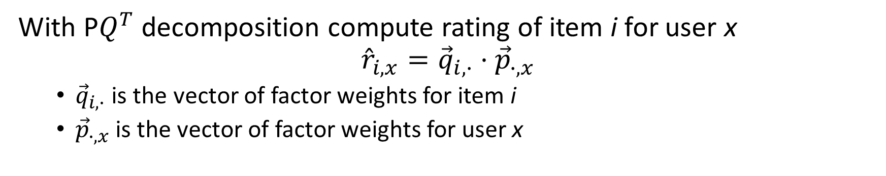



Latent Factor Recommenders
With P$Q^{T}$ decomposition compute rating of item i for user x
$${\hat{r}}_{i,x}={\vec{q}}_{i,∙}⋅{\vec{p}}_{∙,x}$$
${\vec{q}}_{i,∙}$ is the vector of factor weights for item i
${\vec{p}}_{∙,x}$is the vector of factor weights for user x
Users
Factors
Users
4 |  | 3 |  |  | 2
 | 5 | 4 |  | 2 |  | 1
2 |  |  | 5 |  | 5
 | 3 | 3 |  | ?
5 |  | 5
 | 3 |  | 5
2 | 4
 | 3 |  | 4
$$≈$$
$$×$$
Factors
$${\vec{q}}_{i,∙}$$
Items
Items
$${\vec{p}}_{∙,x}$$

Slide 64
Solving For Factor Weights

Slide 65
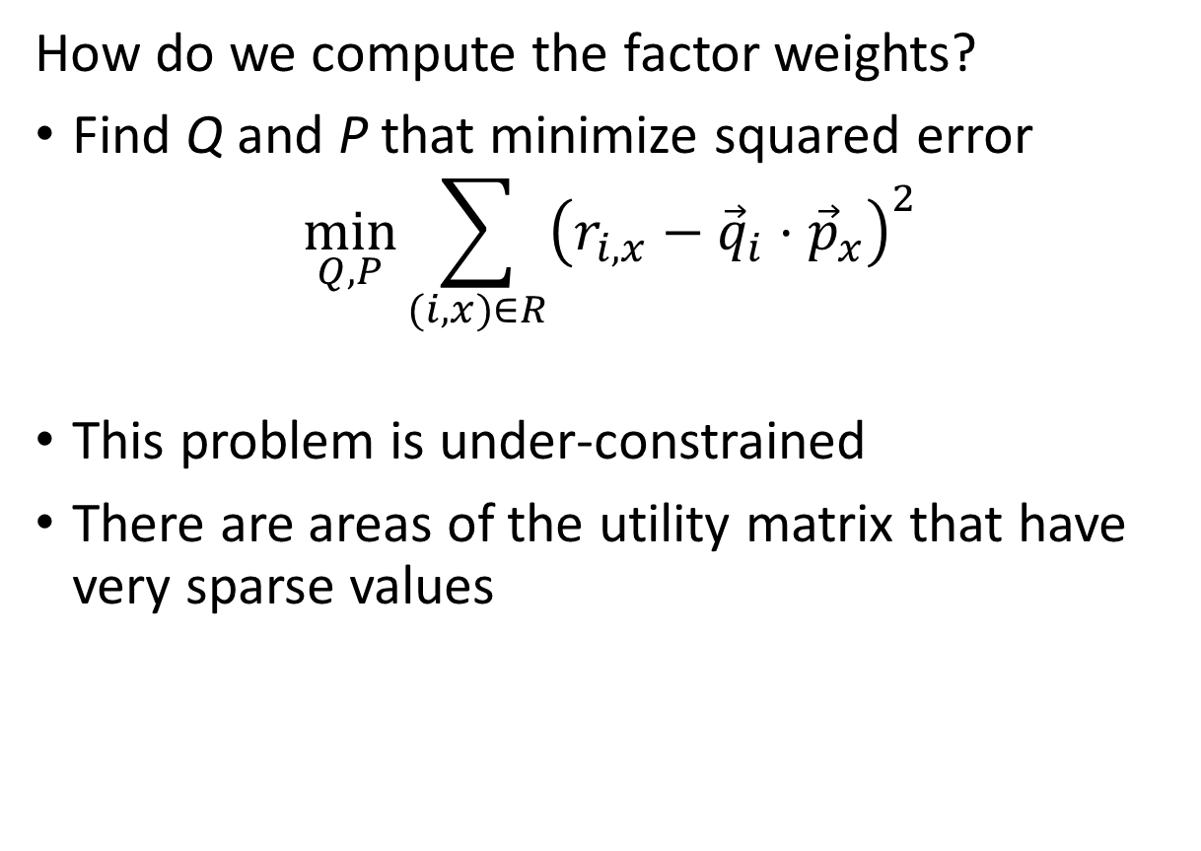
Latent Factor Recommenders
How do we compute the factor weights?
Find Q and P that minimize squared error
$$\min_{Q, P}{\sum_{(i,x)∈R}^{ }{{\left(r_{i,x}−{\vec{q}}_{i}⋅{\vec{p}}_{x}\right)}^{2}}}$$
This problem is under-constrained
There are areas of the utility matrix that have very sparse values
4 |  | 3 |  |  | 2
 | 5 | 4 |  | 2 |  | 1
2 |  |  | 5 |  | 5
 | 3 | 3
5 |  | 5
 | 3 |  | 5
2 | 4
 | 3 |  | 4
4 |  | 3 |  |  | 2
 | 5 | 4 |  | 2 |  | 1
2 |  |  | 5 |  | 5
 | 3 | 3
5 |  | 5
 | 3 |  | 5
2 | 4
 | 3 |  | 4

Slide 66
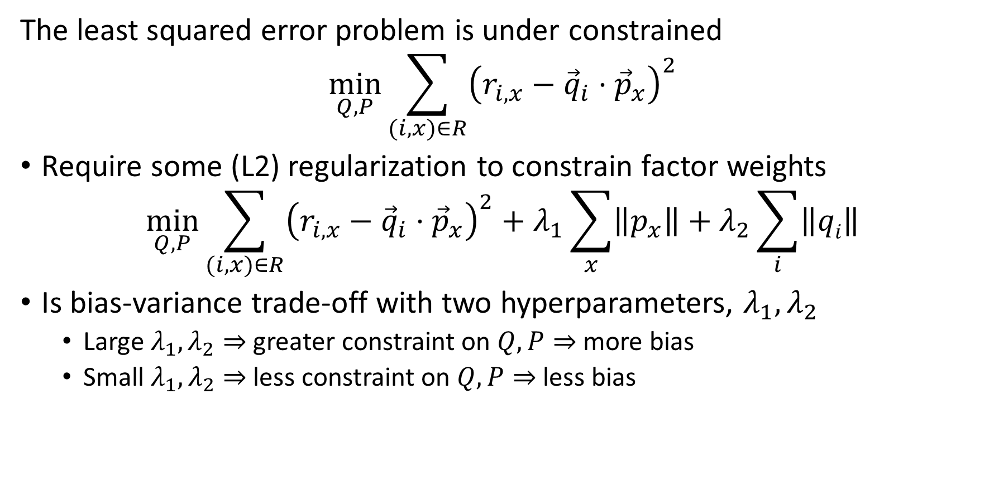
Latent Factor Recommenders
The least squared error problem is under constrained
$$\min_{Q, P}{\sum_{(i,x)∈R}^{ }{{\left(r_{i,x}−{\vec{q}}_{i}⋅{\vec{p}}_{x}\right)}^{2}}}$$
Require some (L2) regularization to constrain factor weights
$$\min_{Q, P}{\sum_{(i,x)∈R}^{ }{{\left(r_{i,x}−{\vec{q}}_{i}⋅{\vec{p}}_{x}\right)}^{2}+λ_{1}\sum_{x}{\left\|p_{x}\right\|}+λ_{2}\sum_{i}{\left\|qi\right\|}}}$$
Is bias-variance trade-off with two hyperparameters, $λ_{1},λ_{2}$
Large $λ_{1},λ_{2}⇒$ greater constraint on $Q,P⇒$ more bias
Small $λ_{1},λ_{2}⇒$ less constraint on $Q,P⇒$ less bias

Slide 67
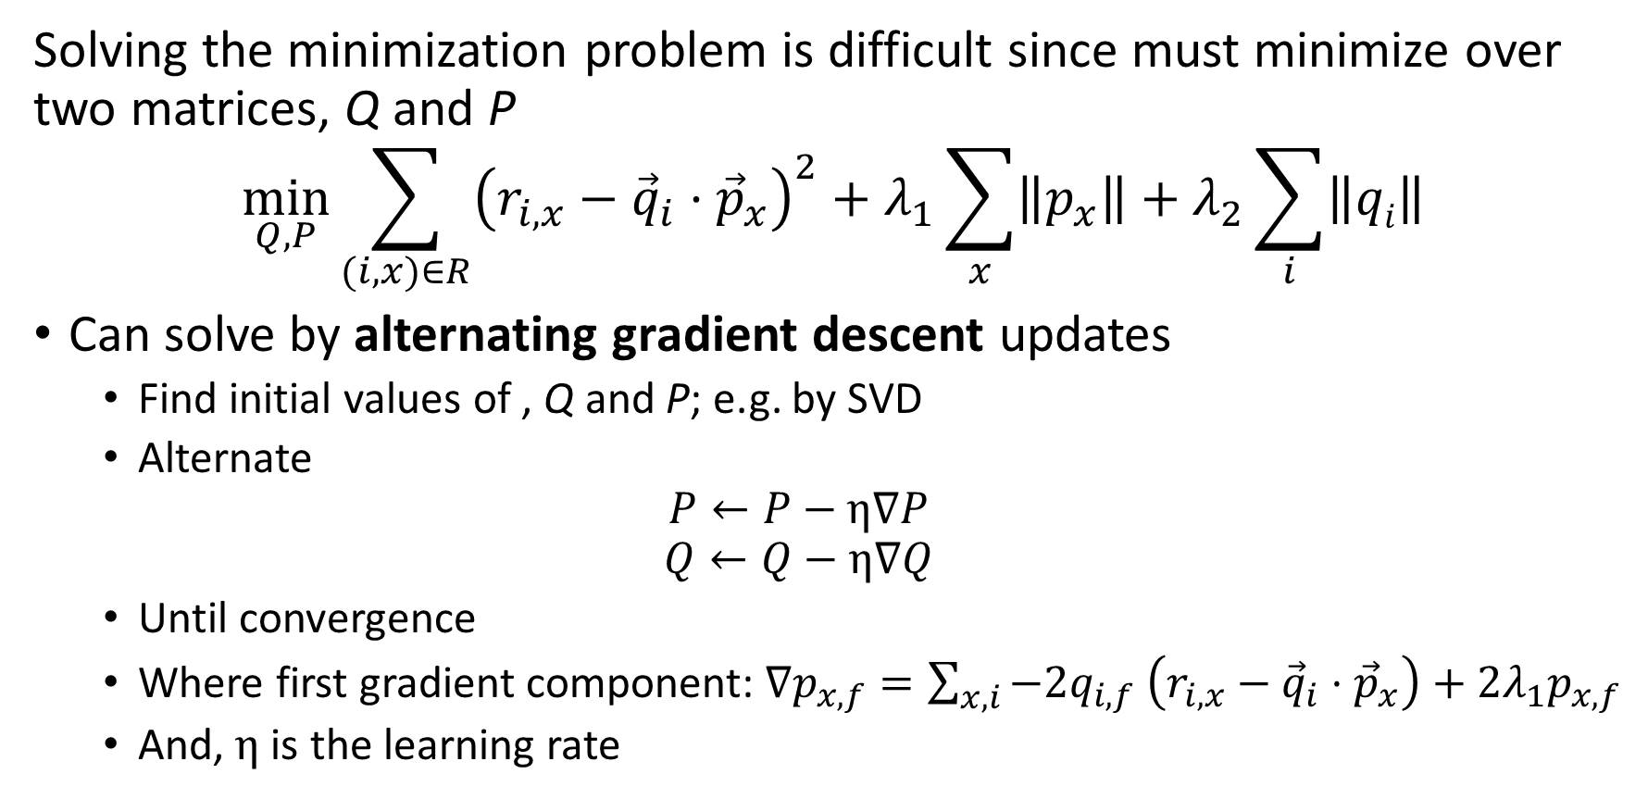
Latent Factor Recommenders
Solving the minimization problem is difficult since must minimize over two matrices, Q and P
$$\min_{Q, P}{\sum_{(i,x)∈R}^{ }{{\left(r_{i,x}−{\vec{q}}_{i}⋅{\vec{p}}_{x}\right)}^{2}+λ_{1}\sum_{x}{\left\|p_{x}\right\|}+λ_{2}\sum_{i}{\left\|qi\right\|}}}$$
Can solve by alternating gradient descent updates
Find initial values of , Q and P; e.g. by SVD
Alternate
$$P←P−η∇P$$
$$Q←Q−η∇Q$$
Until convergence
Where first gradient component: $∇p_{x,f}=\sum_{x,i}^{ }{−2q_{i,f}}$ $\left(r_{i,x}−{\vec{q}}_{i}⋅{\vec{p}}_{x}\right)+{2λ}_{1}p_{x,f}$
And, $η$ is the learning rate

Slide 68
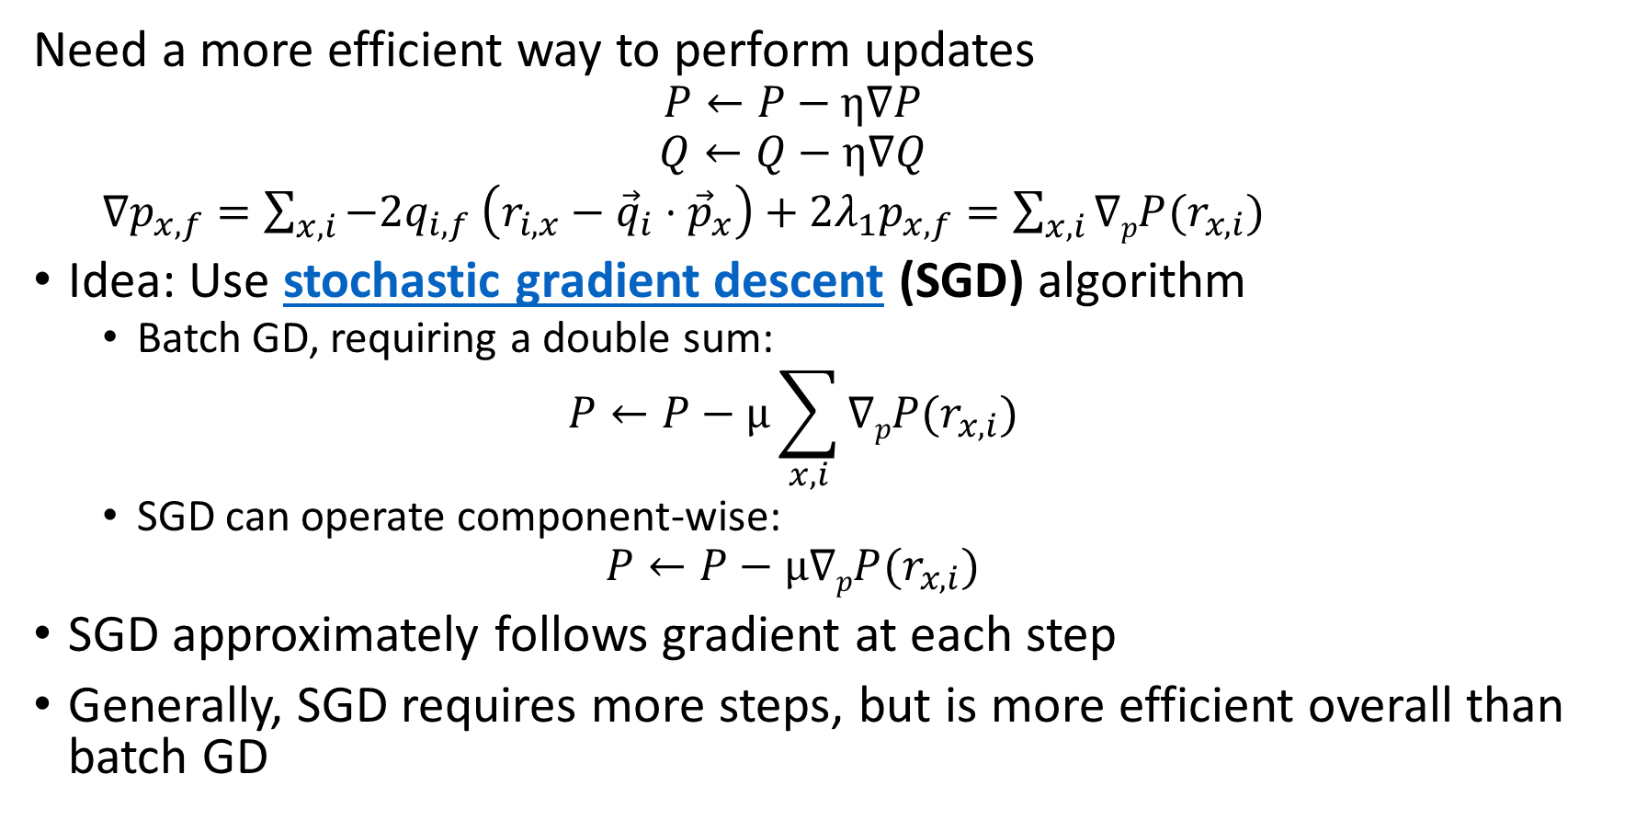
Latent Factor Recommenders
Need a more efficient way to perform updates
$$P←P−η∇P$$
$$Q←Q−η∇Q$$
$∇p_{x,f}=\sum_{x,i}^{ }{−2q_{i,f}}$ $\left(r_{i,x}−{\vec{q}}_{i}⋅{\vec{p}}_{x}\right)+{2λ}_{1}p_{x,f}=\sum_{x,i}^{ }{∇pP(r_{x,i})}$
Idea: Use stochastic gradient descent (SGD) algorithm
Batch GD, requiring a double sum:
$$P←P−μ\sum_{x,i}^{ }{∇pP(r_{x,i})}$$
SGD can operate component-wise:
$$P←P−μ∇pP(r_{x,i})$$
SGD approximately follows gradient at each step
Generally, SGD requires more steps, but is more efficient overall than batch GD

Slide 69
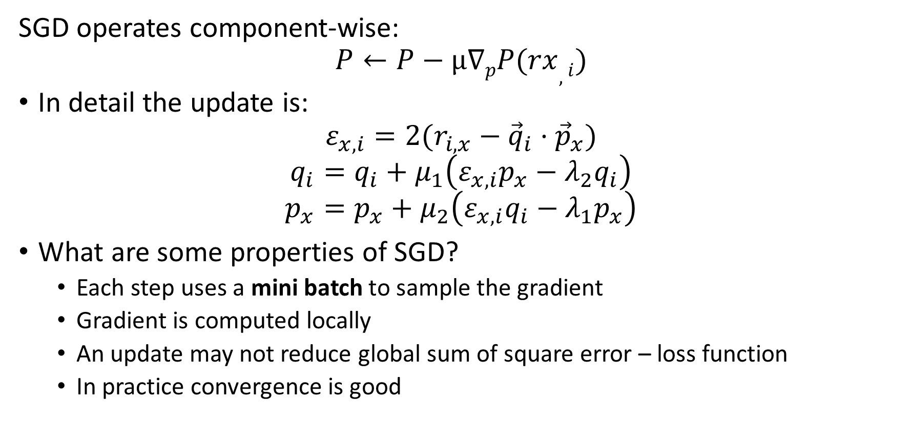
Latent Factor Recommenders
SGD operates component-wise:
$$P←P−μ∇pP(rx,i)$$
In detail the update is:
$$ε_{x,i}=2(r_{i,x}−{\vec{q}}_{i}⋅{\vec{p}}_{x})$$
$$q_{i}=q_{i}+μ_{1}\left(ε_{x,i}p_{x}−λ_{2}q_{i}\right)$$
$$p_{x}=p_{x}+μ_{2}\left(ε_{x,i}q_{i}−λ_{1}p_{x}\right)$$
What are some properties of SGD?
Each step uses a mini batch to sample the gradient
Gradient is computed locally
An update may not reduce global sum of square error – loss function
In practice convergence is good

Slide 70
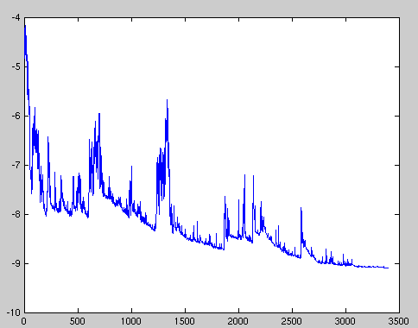
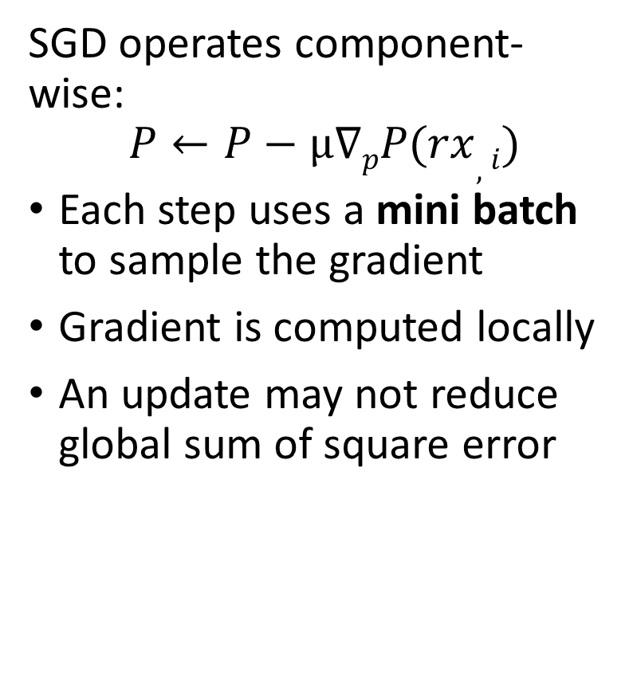
Latent Factor Recommenders
SGD operates component-wise:
$$P←P−μ∇pP(rx,i)$$
Each step uses a mini batch to sample the gradient
Gradient is computed locally
An update may not reduce global sum of square error
Sum of Square Loss
Update steps – iterations
Credit: Wiki Commons

Slide 71
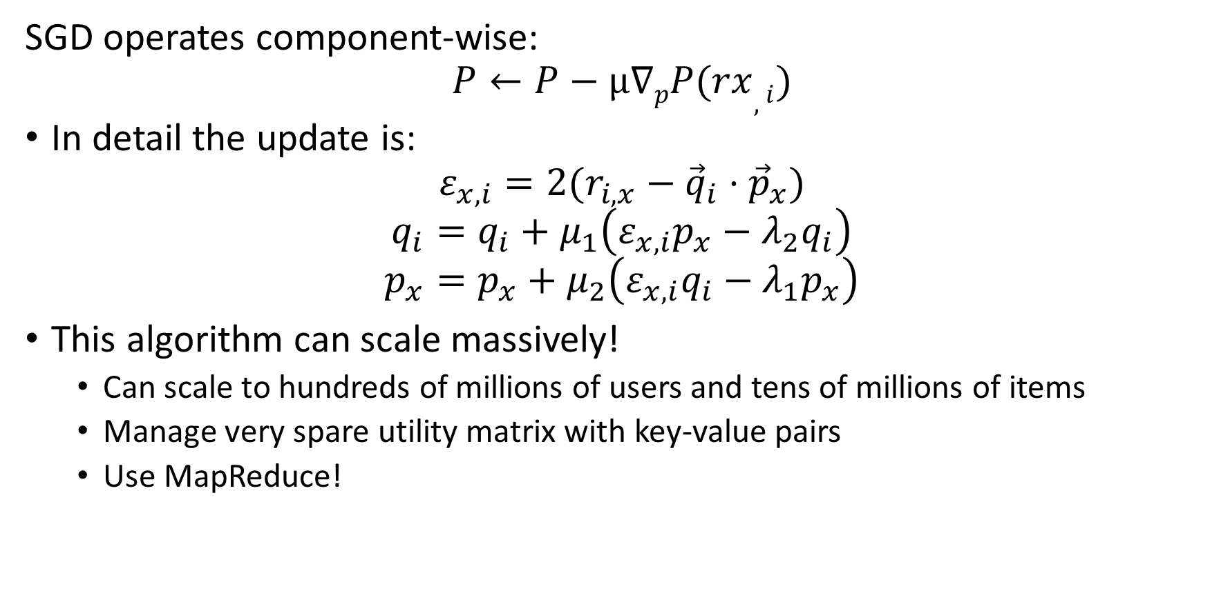
Latent Factor Recommenders
SGD operates component-wise:
$$P←P−μ∇pP(rx,i)$$
In detail the update is:
$$ε_{x,i}=2(r_{i,x}−{\vec{q}}_{i}⋅{\vec{p}}_{x})$$
$$q_{i}=q_{i}+μ_{1}\left(ε_{x,i}p_{x}−λ_{2}q_{i}\right)$$
$$p_{x}=p_{x}+μ_{2}\left(ε_{x,i}q_{i}−λ_{1}p_{x}\right)$$
This algorithm can scale massively!
Can scale to hundreds of millions of users and tens of millions of items
Manage very spare utility matrix with key-value pairs
Use MapReduce!

Slide 72
Latent Factor Models with Baseline

Slide 73
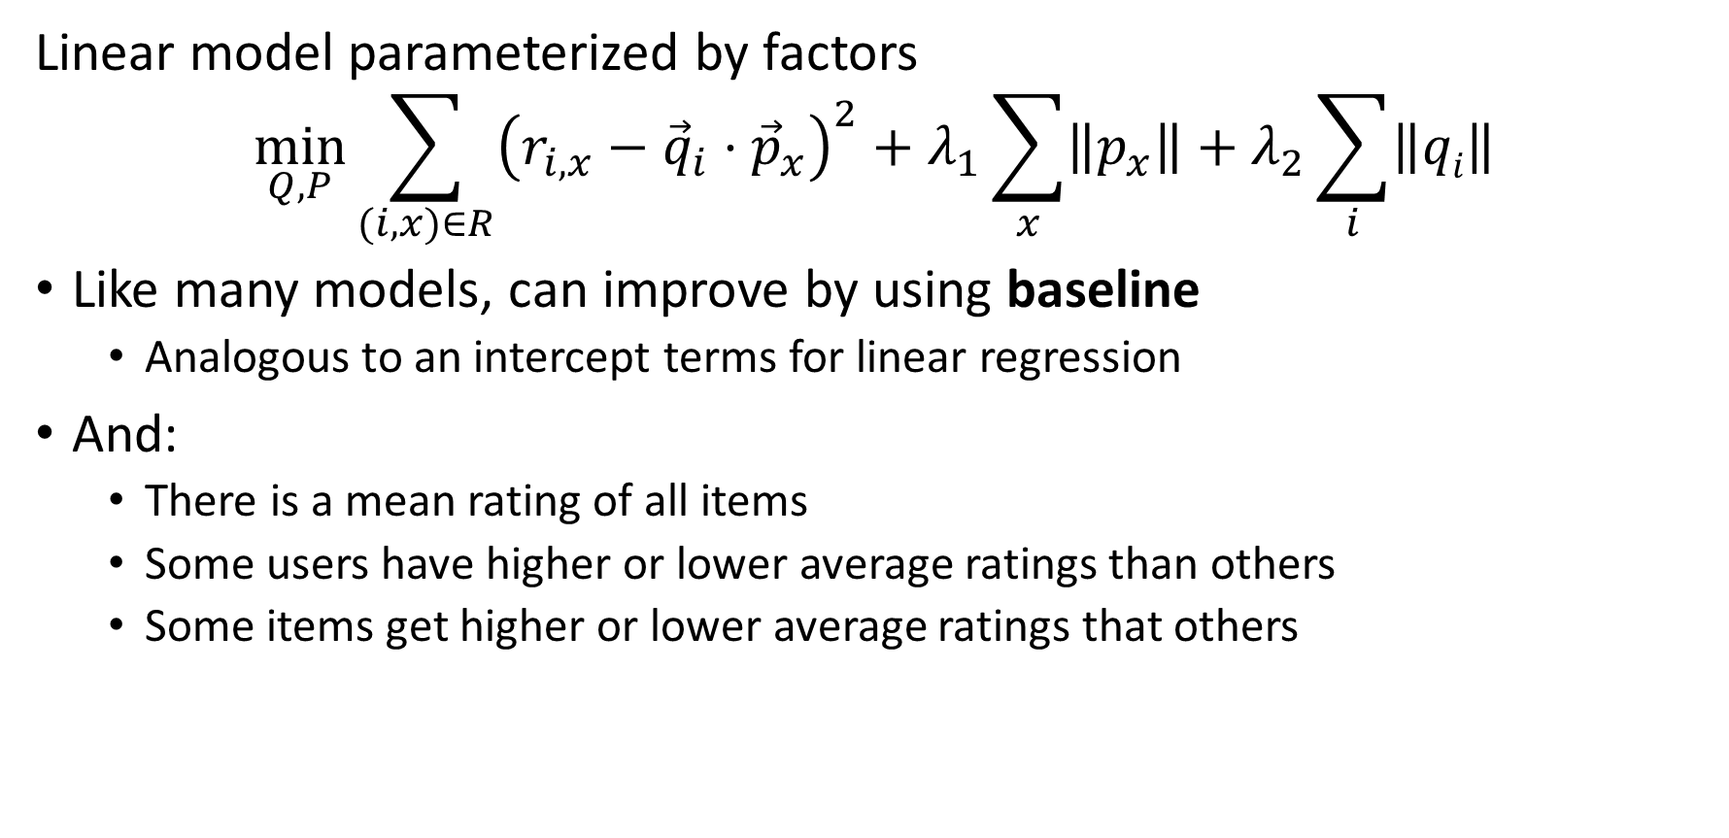
Latent Factor Recommenders
Linear model parameterized by factors
$$\min_{Q, P}{\sum_{(i,x)∈R}^{ }{{\left(r_{i,x}−{\vec{q}}_{i}⋅{\vec{p}}_{x}\right)}^{2}+λ_{1}\sum_{x}{\left\|p_{x}\right\|}+λ_{2}\sum_{i}{\left\|qi\right\|}}}$$
Like many models, can improve by using baseline
Analogous to an intercept terms for linear regression
And:
There is a mean rating of all items
Some users have higher or lower average ratings than others
Some items get higher or lower average ratings that others

Slide 74
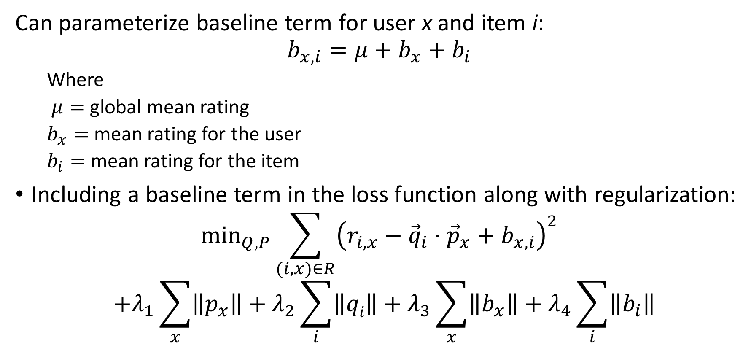
Latent Factor Recommenders
Can parameterize baseline term for user x and item i:
$$b_{x,i}={μ+b}_{x}+b_{i}$$
Where
$μ=$ global mean rating
$b_{x}=$ mean rating for the user
$b_{i}=$ mean rating for the item
Including a baseline term in the loss function along with regularization:
$$\min_{Q, P}{\sum_{(i,x)∈R}^{ }{{\left(r_{i,x}−{\vec{q}}_{i}⋅{\vec{p}}_{x}+b_{x,i}\right)}^{2}}}$$
$${+λ_{1}\sum_{x}{\left\|p_{x}\right\|}+λ_{2}\sum_{i}{\left\|qi\right\|}+λ_{3}\sum_{x}^{ }{\left\|b_{x}\right\|+λ_{4}\sum_{i}^{ }{\left\|b_{i}\right\|}}}$$

Slide 75
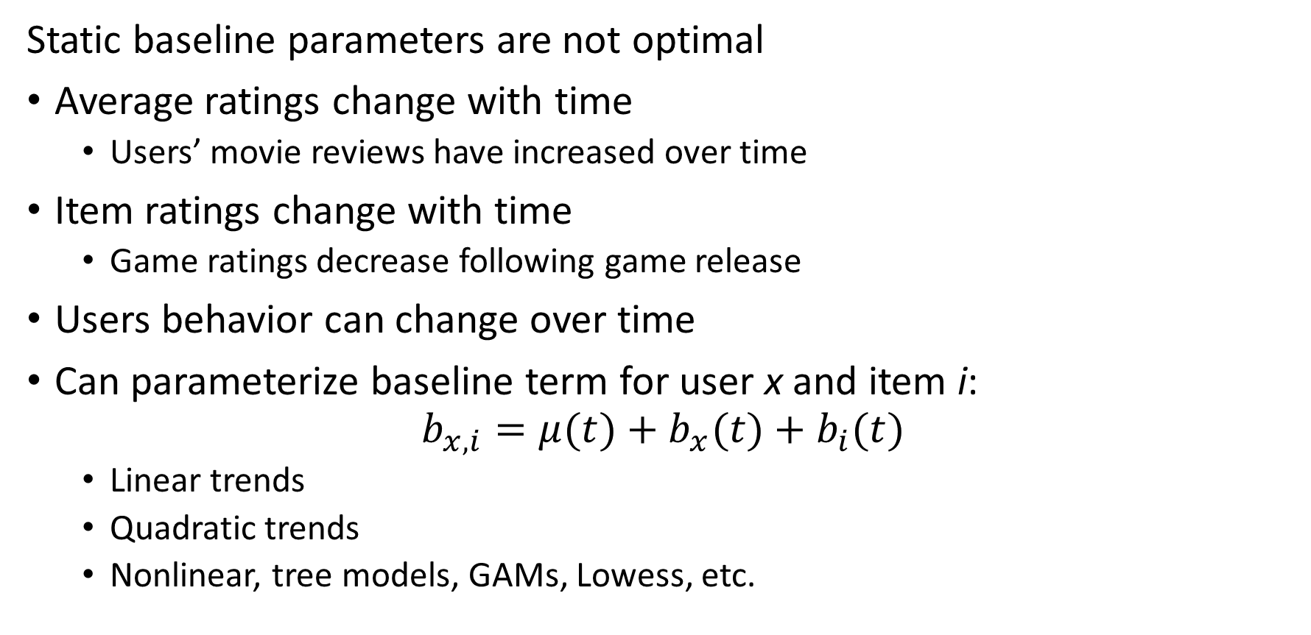
Latent Factor Recommenders
Static baseline parameters are not optimal
Average ratings change with time
Users’ movie reviews have increased over time
Item ratings change with time
Game ratings decrease following game release
Users behavior can change over time
Can parameterize baseline term for user x and item i:
$$b_{x,i}={μ(t)+b}_{x}(t)+b_{i}(t)$$
Linear trends
Quadratic trends
Nonlinear, tree models, GAMs, Lowess, etc.

Slide 76
Latent Factor Recommenders
State of the art recommenders require additional baseline terms
Peoples’ opinions differ in many systematic ways
Regional differences
Product category differences
…
Can add baseline terms for observable factors
Selection of factors is solution specific
May be time dependent

Slide 77
Neural Recommender Architectures

Slide 78
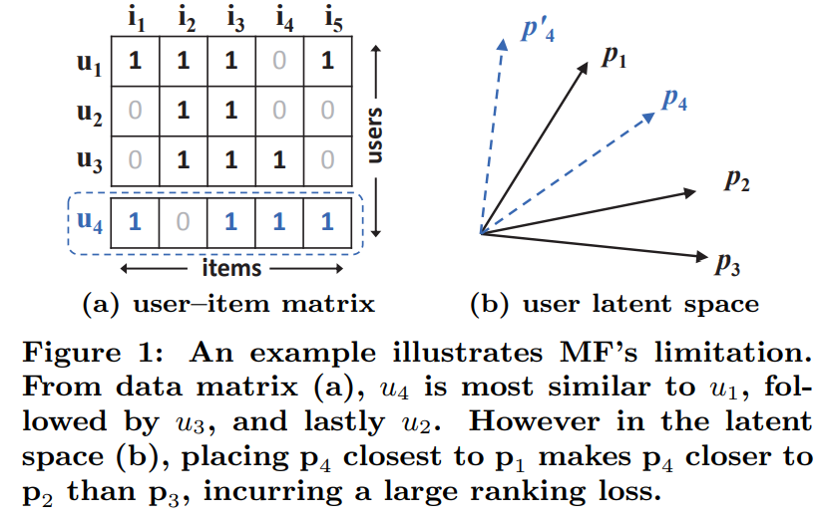
Neural Collaborative Filtering
Neural collaborative filtering, He et.al., 2017, uses a multi-layer perceptron to compute recommendation ranks
Why do we need non-linear collaborative filtering?
Interaction terms are inherently nonlinear
He, et. al., provide an example where binary coding of user features leads to misleading similarity, compared to Jaccard similarity
Correct ranking requires learning a nonlinear interaction with a neural network
From He, et. al., 2016

Slide 79
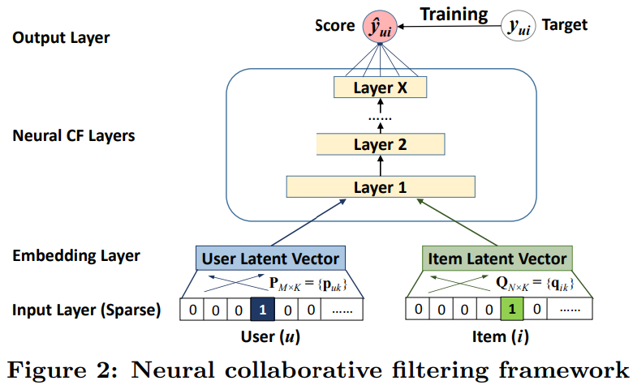
Neural Collaborative Filtering
Neural collaborative filtering, He et.al., 2017, uses a multi-layer perceptron to compute similarity and rank recommendations
Error (score) is minimized in training
Recommendation ranks computed with NN layers, including nonlinear interaction terms
User and item dense latent embedding vectors are computed
Inputs are sparse user and item identification vectors
From He, et. al., 2016

Slide 80
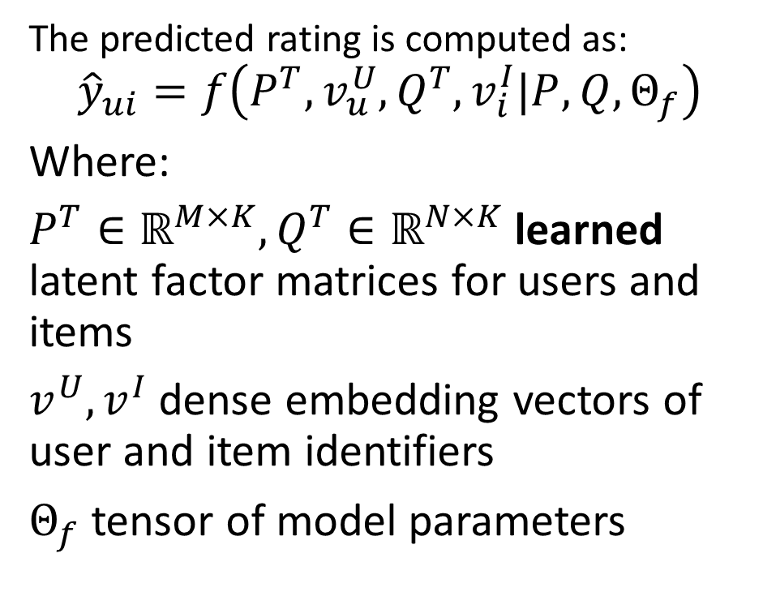
Neural Collaborative Filtering
Neural collaborative filtering, He et.al., 2016, uses a multi-layer perceptron to compute similarity and rank recommendations
The predicted rating is computed as:
$${\hat{y}}_{ui}=f\left(P^{T},v_{u}^{U},Q^{T},v_{i}^{I}|P,Q,Θ_{f}\right)$$
Where:
$P^{T}∈ℝ^{M×K},Q^{T}∈ℝ^{N×K}$ learned latent factor matrices for users and items
$v_{ }^{U}, v_{ }^{I}$ dense embedding vectors of user and item identifiers
$Θ_{f}$ tensor of model parameters
From He, et. al., 2016

Slide 81
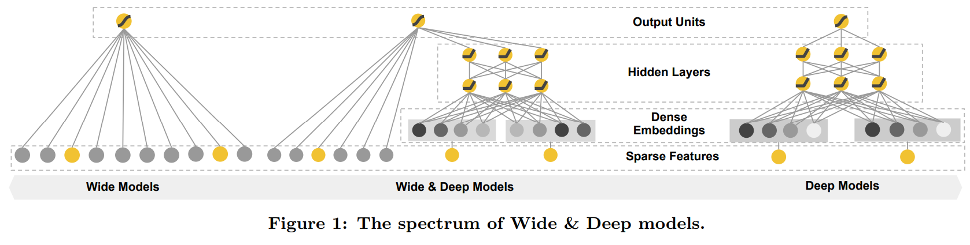
Wide and Deep Architectures
Wide and deep architecture, Chang, et. al., 2016, is a hybrid model combine neural encoding with linear matrix factorization
Linear model with wide sparse latent space and matrix factorization
Hybrid model uses linear matrix factorization for sparse latent features and neural network for dense latent feature
Nonlinear model with dense latent space and neural network
From Chang et. al., 2016

Slide 82
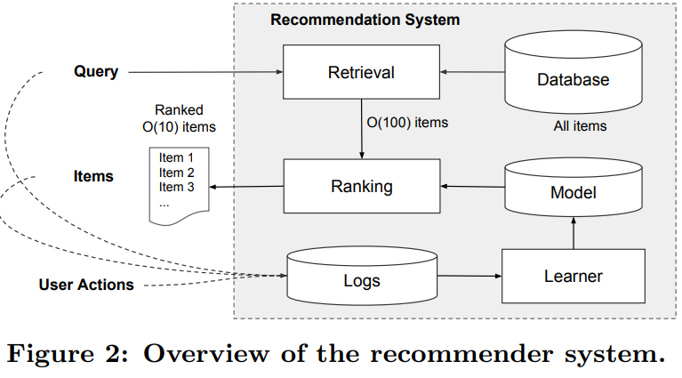
Wide and Deep Architectures
Wide and deep architecture, Chang, et. al., 2016, has 2 stages
Retrieval stage uses a hybrid of similarity search on query algorithms to generate candidates
Ranking stage assigns positions (ranks) to items for presentation to user
From Chang et. al., 2016

Slide 83
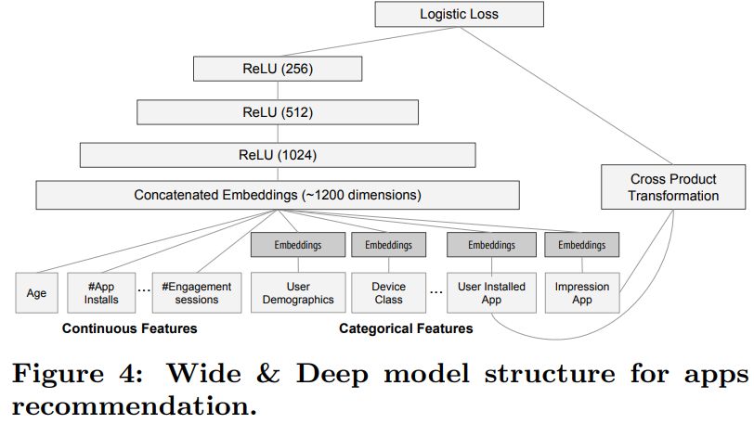
Wide and Deep Architectures
Wide and deep architecture, Chang, et. al., 2016 accommodates both sparse categorical and dense numeric features
Concatenated emedding encodes all features
Sparse features (e.g. categorical) require dense embedding, or hashing
Dense features (e.g. numeric) features require no embedding
From Chang et. al., 2016

Slide 84
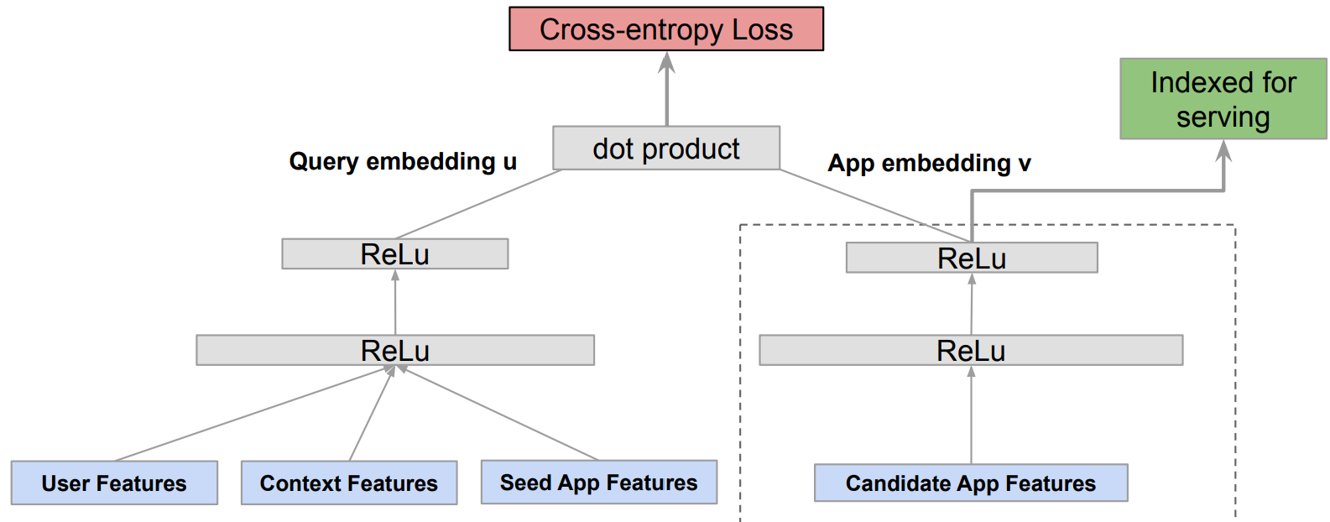
Two-Tower Architectures
Two-tower architectures are a prevalent in modern production recommenders
User query embedding
Item feature embedding
Architecture introduced by Zhao, et. al, 2019, for Google Play
Example, proposed by Yang et. al., 2020 of Google Research
Query tower
Item tower
From Yang et. al., 2020

Slide 85
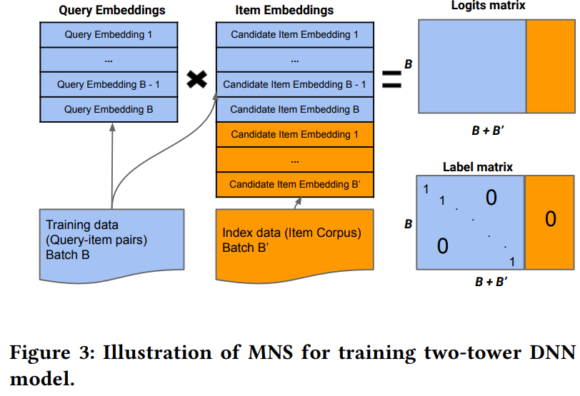
Two-Tower Architectures
Yang, et. al., 2020 introduced mixed negative sampling (MNS) for dealing with the negative sampling bias
MNS adds a uniformly sampled stream of negative samples from the entire catalog (corpus)
Embeddings of additional negative samples are appended to item embeddings
Adding negative sample of size 2-3 x positive samples reduces negative sampling bias
From Yang et. al., 2020

Slide 86
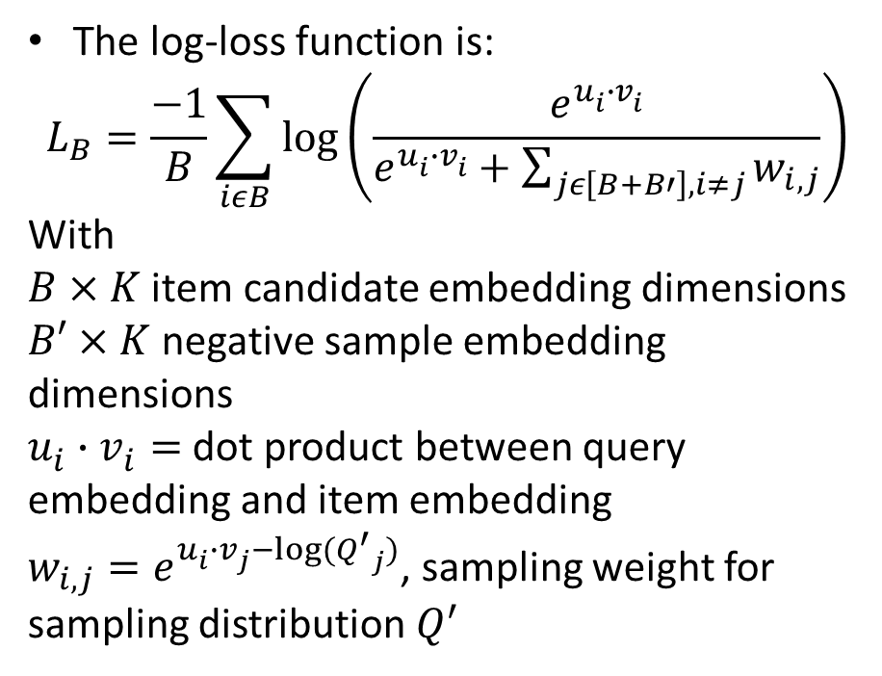
Two-Tower Architectures
Yang, et. al., 2020 introduced mixed negative sampling (NMS) for dealing with the negative sampling bias
The log-loss function is:
$$L_{B}=\frac{−1}{B}\sum_{iεB}{\log\left(\frac{e^{u_{i}^{ }∙v_{i}^{ }}}{e^{u_{i}^{ }∙v_{i}^{ }}+\sum_{jε\left[B+B′\right], i≠j}{w_{i,j}}}\right)}$$
With
$B×K$ item candidate embedding dimensions
$B′×K$ negative sample embedding dimensions
$u_{i}^{ }∙v_{i}^{ }=$ dot product between query embedding and item embedding
$w_{i,j}=e^{u_{i}^{ }∙v_{j}^{ }−log⁡({Q^{′}}_{j})}$, sampling weight for sampling distribution $Q^{′}$
From Yang et. al., 2020

Slide 87
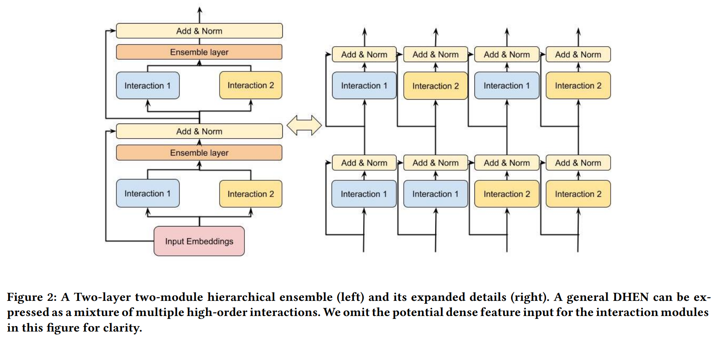
DHEN, Deep and Hierarchical Ensemble Recommender
Meta’s DHEN deep and hierarchical ensemble recommender, Zhang, et, al,2022, uses multiple similarity search algorithms in a two-stage, two-tower, architecture
DEHN architecture uses a hierarchy of several models for interactions for features in an embedding space
An NVIDIA team of Schifferer, et. al,. 2022 used a similar apprach
From Zhang et. al., 2022

Slide 88
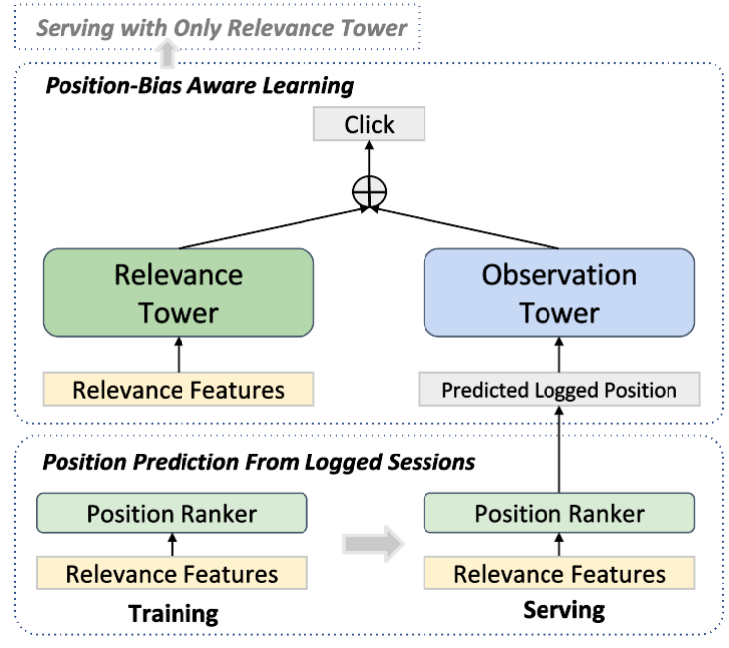
DHEN, Deep and Hierarchical Ensemble Recommender
Zang, et. al., 2022, explore the causal relationship between the position tower and the relevance tower
Relevance tower performs similarity search on items and/or users
Observation tower computes position bias adjustment
Uses log information on user behavior and context
Adjusts ranking to limit position bias
From Zang et. al., 2022

Slide 89
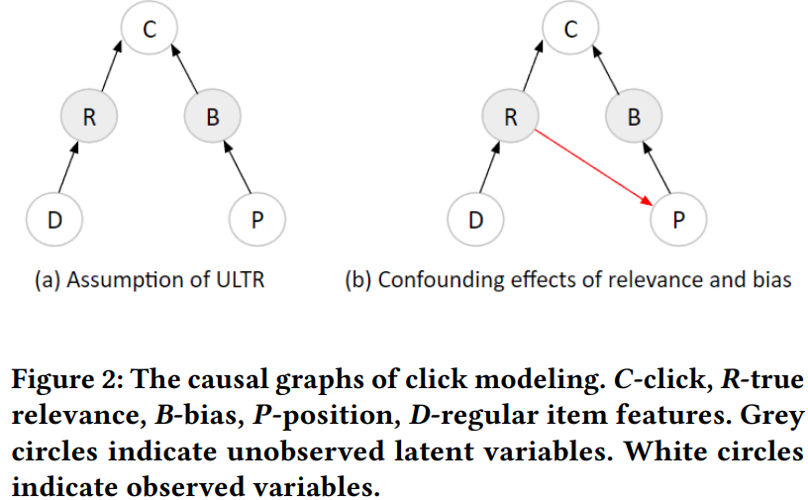
DHEN, Deep and Hierarchical Ensemble Recommender
Zang, et. al., 2022, explore the causal relationship between the position tower and the relevance tower
Relevance tower performs similarity search on items and/or users assuming independence
But user actions are not independent of position with a causal relationship!
From Zang et. al., 2022

Slide 90
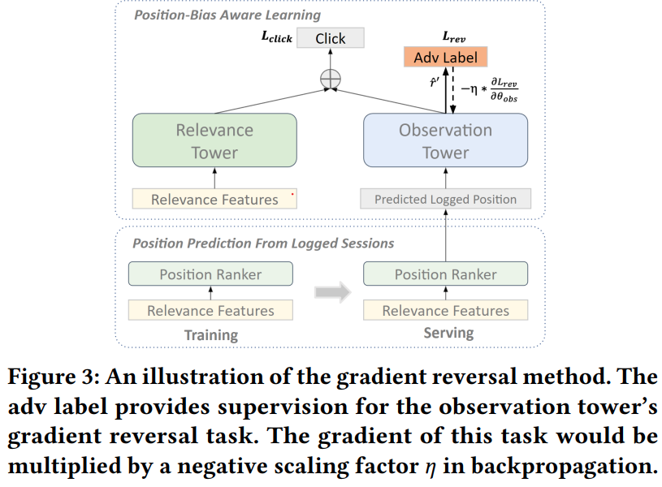
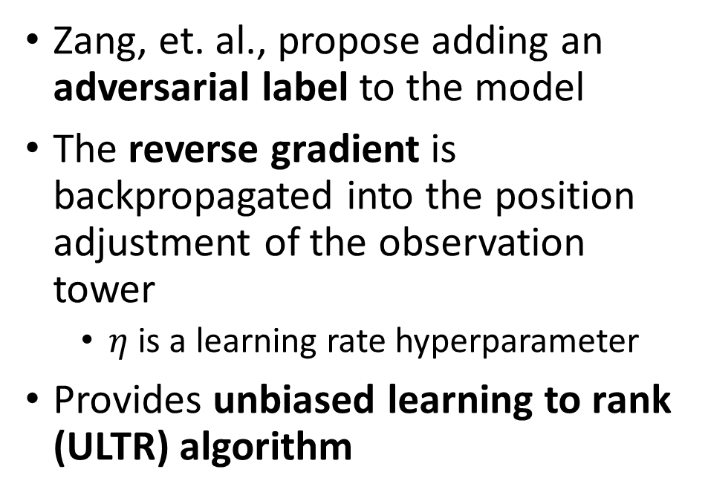
DHEN, Deep and Hierarchical Ensemble Recommender
Zang, et. al., 2022, explore the causal relationship between the position tower and the relevance tower
Zang, et. al., propose adding an adversarial label to the model
The reverse gradient is backpropagated into the position adjustment of the observation tower
$η$ is a learning rate hyperparameter
Provides unbiased learning to rank (ULTR) algorithm
From Zang et. al., 2022

Slide 91
Hybrid Models

Slide 92
Complex recommenders
Deep neural networks have had a significant impact on recommenders
Deep neural networks are used to create embedding spaces
Deep neural networks can learn complex feature interactions
Example: user has downloaded Netflix app AND Pandora app
Too many potential interaction of linear factor model
Alternative is association model

Slide 93
Hybrid Recommenders
Can combine methods
May improve performance if errors are reasonably uncorrelated
Possibly overcome cold start problem
Different models can help with cold start problem
Baseline estimates
Use clustering methods to find similar users and items
Can start with semi-supervised (content-based) systems
Initially use item profiles
Combine with matrix factorization results as more data acquired

Slide 94
Recommender Ensembles
Can we create ensembles of recommenders
Yes!
Can use different algorithms to overcome some cold start problems
Winners of the Netflix prize used complex ensembles
BellKor team solution
Big chaos solution
But, these solutions are complex and may not be worth effort

Slide 95
Summary

Slide 96
Summary
Economic impact of recommenders is massive!
Online catalogs have a long tail
Many rarely purchased and reviewed items
Users will not find items in the tail without a recommender
Recommender algorithms connect users with items
Creating a good recommender algorithm for the real-world is hard!
People have complex and variable behavior
User ratings are not constant with time
Cold start problem for new items
Cold start problem for new users

Slide 97
Summary
Many algorithms have been tried to find recommendations
Content based systems
Find items with common properties
Related to frequent item set algorithms
Collaborative filtering
Based on similarity between items and between users
Widely used algorithms
Has cold-start problem

Slide 98
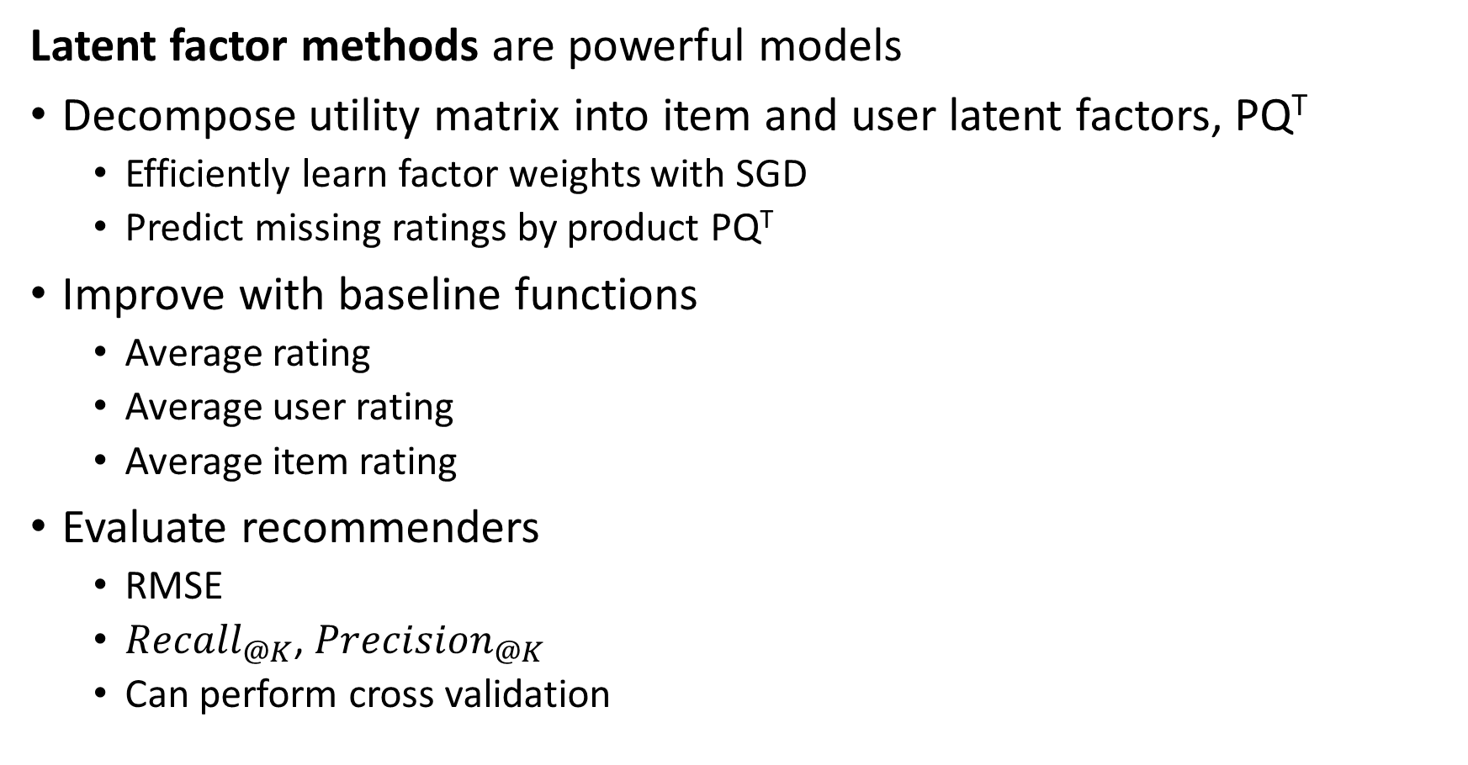
Summary
Latent factor methods are powerful models
Decompose utility matrix into item and user latent factors, PQ^{T}
Efficiently learn factor weights with SGD
Predict missing ratings by product PQ^{T}
Improve with baseline functions
Average rating
Average user rating
Average item rating
Evaluate recommenders
RMSE
${Recall}_{@K}$, ${Precision}_{@K}$
Can perform cross validation

