Slide 1

CSCI E-96 Data Mining, Exploration and Discovery Introduction to Clustering Models
Steve Elston
Copyright 2020,2021, Stephen F Elston. All rights reserved.

Slide 2
Introduction to Data Mining with Unsupervised Clustering Models

Slide 3
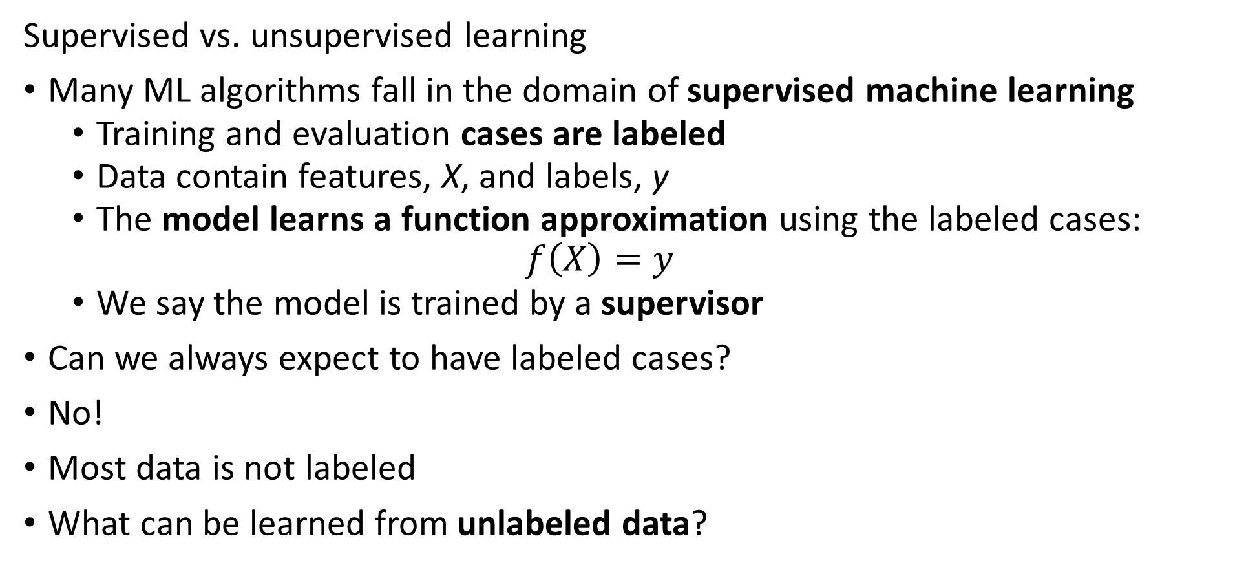
Introduction to Unsupervised Learning
Supervised vs. unsupervised learning
Many ML algorithms fall in the domain of supervised machine learning
Training and evaluation cases are labeled
Data contain features, X, and labels, y
The model learns a function approximation using the labeled cases:
$$f\left(X\right)=y$$
We say the model is trained by a supervisor
Can we always expect to have labeled cases?
No!
Most data is not labeled
What can be learned from unlabeled data?

Slide 4
Introduction to Unsupervised Learning
Why should we care about unsupervised learning?
Most data is not labeled
Learning data structure is useful in many data mining solutions:
Find groups of similar purchases
Discover unusual or outlier events
Similar genes in microassay data
Find groups of people with similar behaviors – e.g. voting
Find patients with related symptoms
Data compression algorithms
And many more...

Slide 5
Introduction to Unsupervised Learning
Many types of unsupervised learning algorithms
Search algorithms – PageRank, HITS,…
Clustering models – today’s topic
Embedding models – PCA, manifold embedding,… - future lesson
Recommender models
Social network models
Association models – e.g. market basket analysis
And many more…………
All methods depend on measures of distance or similarity

Slide 6
Introduction to Unsupervised Learning
Without labeled data, what can a model learn?
Clustering algorithms are data mining methods
Data mining seeks to find interesting relationships in data
Wish to find groups or associations that help us understand complex relationships in data
Cluster models create an embedding
Embed a high-dimensional feature space in a low dimensional space
Cluster assignments are a low-dimensional embedding
Embeddings can greatly enhance understanding of relationships in data

Slide 7
Common Properties of Cluster Models

Slide 8
Properties of Cluster Models
Without labeled data, what can a model learn?
Can learn structure of data
Structure is learned by determining association between cases
Association based on measures of proximity, similarity
Or, minimum distance or dissimilarity

Slide 9
Properties of Cluster Models
Properties of unsupervised learning models
Algorithms can use different distance or dissimilarity metrics
Structure based on distance metrics
Different algorithms use different metrics
What are the ideal properties of clusters?
Compactness: minimum distance between members of a cluster, a closeness property
Separation: maximum distance between clusters, a confidence property

Slide 10
Properties of Cluster Models
There are a wide variety of unsupervised learning models
Different dissimilarity metrics will give different results
Dissimilarity metrics usually matter more than model choice
But which one should we use?
Evaluation is a significant problem for unsupervised learning
There are no labels for objective evaluation
Evaluation is often subjective
Do we have to pick one best model?
No
Different models can show different useful relationships
In practice, try lots of models, keep the few useful ones

Slide 11
Properties of Cluster Models
There is no one best clustering model!
There are many classes of models
Models seeking compactness
Models seeking affinity between points
Models seeking high density regions

Slide 12
Distance and Similarity Measures for Cluster Models

Slide 13
Measuring distance or dissimilarity
Structure in data is based on dissimilarity measured by some distance metric
The variables or cases generally have multiple observations or measurements
Distance measures are therefore multivariate
Distance metrics can be computed for three types of variables
Numeric distance for numeric variables
Rank difference for ordinal variables
Coded difference, usually binary, for unordered categorical variables

Slide 14
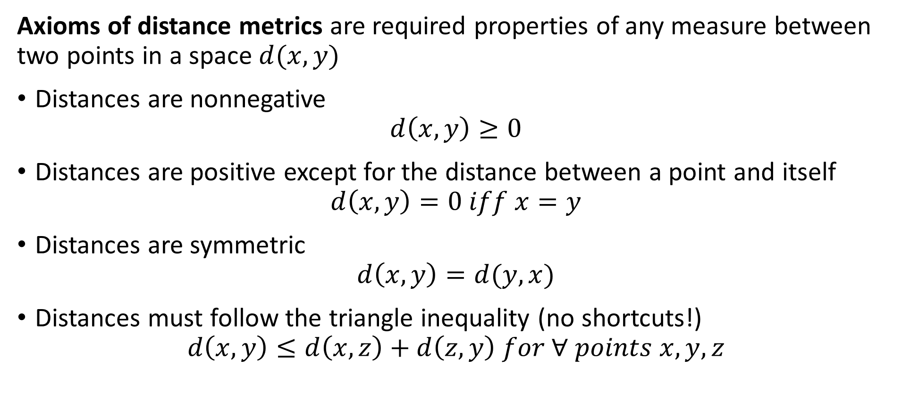
Measuring distance or dissimilarity
Axioms of distance metrics are required properties of any measure between two points in a space $d(x,y)$
Distances are nonnegative
$$d\left(x,y\right)≥0$$
Distances are positive except for the distance between a point and itself
$$d\left(x,y\right)=0 iff x=y$$
Distances are symmetric
$$d\left(x,y\right)=d(y,x)$$
Distances must follow the triangle inequality (no shortcuts!)
$$d\left(x,y\right)≤d\left(x,z\right)+d\left(z,y\right) for ∀ points x,y,z$$

Slide 15
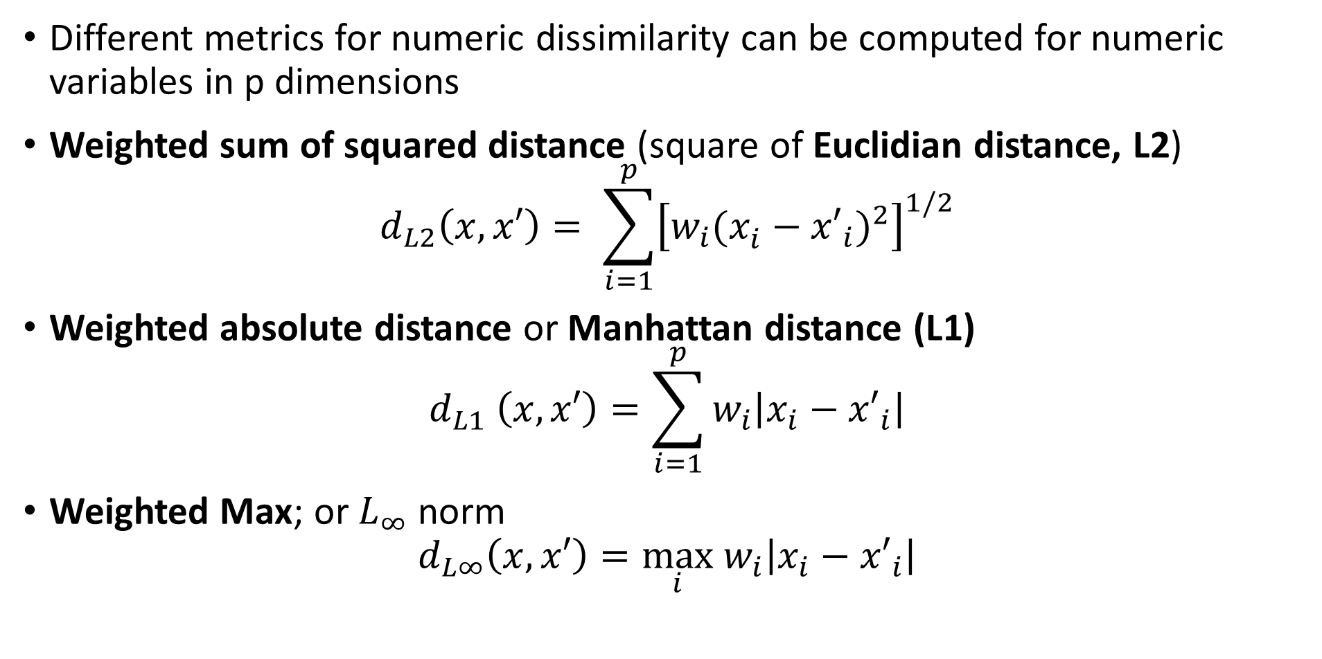
Measuring distance or dissimilarity
Different metrics for numeric dissimilarity can be computed for numeric variables in p dimensions
Weighted sum of squared distance (square of Euclidian distance, L2)
$$d_{L2}\left(x,x′\right)= \sum_{i=1}^{p}{{\left[w_{i}(x_{i}^{ }−{x′}_{i})^{2}\right]}^{1/2}}$$
Weighted absolute distance or Manhattan distance (L1)
$$d_{L1} \left(x,x′\right)=\sum_{i=1}^{p}{w_{i}\left|x_{i}−{x′}_{i}\right|}$$
Weighted Max; or $L_{∞}$ norm
$$d_{L∞}\left(x,x′\right)=\max_{i} w_{i}\left|x_{i}−{x′}_{i}\right|$$

Slide 16
K-Means Clustering Models

Slide 17
K-Means Clustering
The K-means clustering algorithm is arguably the most widely used method
Long history
One of the first data mining algorithms
First proposed as a coding method by Stuart Lloyd in 1957 – not published until 1982
Term ‘k-means’ coined by Jason MacQueen in 1967
The goal of the k-means algorithm is to find the best k clusters

Slide 18
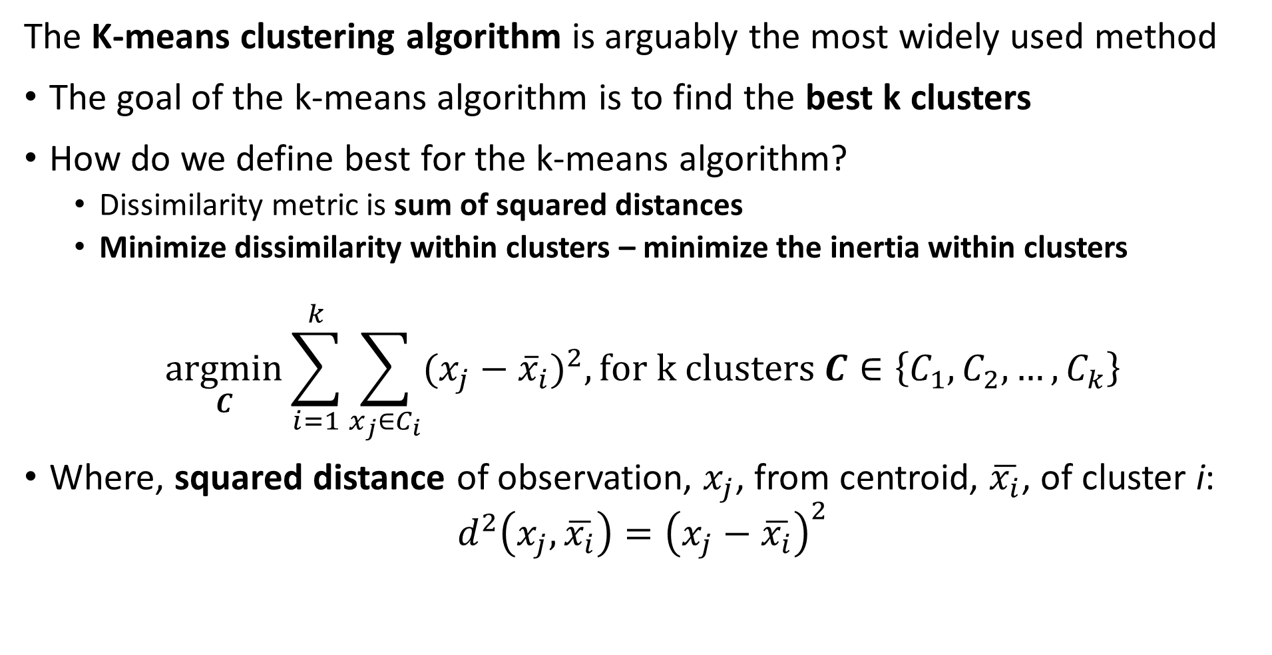
K-Means Clustering
The K-means clustering algorithm is arguably the most widely used method
The goal of the k-means algorithm is to find the best k clusters
How do we define best for the k-means algorithm?
Dissimilarity metric is sum of squared distances
Minimize dissimilarity within clusters – minimize the inertia within clusters
$$\underset{C}{argmin}{\sum_{i=1}^{k}{\sum_{x_{j}∈C_{i}}^{ }{(x_{j}−{\overline{x}}_{i})^{2}, for k clusters C∈\left\{C_{1},C_{2},…,C_{k}\right\}}}}$$
Where, squared distance of observation, $x_{j}$, from centroid, $\overline{x_{i}}$, of cluster i:
$$d^{2}\left(x_{j},\overline{x_{i}}\right)={\left(x_{j}−\overline{x_{i}}\right)}^{2}$$

Slide 19
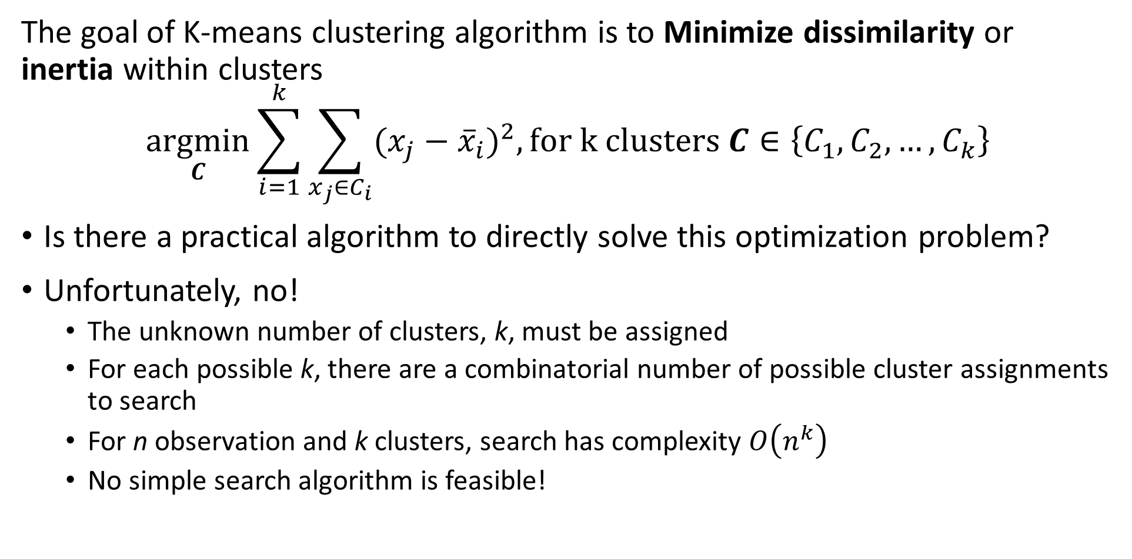
K-Means Clustering
The goal of K-means clustering algorithm is to Minimize dissimilarity or inertia within clusters
$$\underset{C}{argmin}{\sum_{i=1}^{k}{\sum_{x_{j}∈C_{i}}^{ }{(x_{j}−{\overline{x}}_{i})^{2}, for k clusters C∈\left\{C_{1},C_{2},…,C_{k}\right\}}}}$$
Is there a practical algorithm to directly solve this optimization problem?
Unfortunately, no!
The unknown number of clusters, k, must be assigned
For each possible k, there are a combinatorial number of possible cluster assignments to search
For n observation and k clusters, search has complexity $O\left(n^{k}\right)$
No simple search algorithm is feasible!

Slide 20
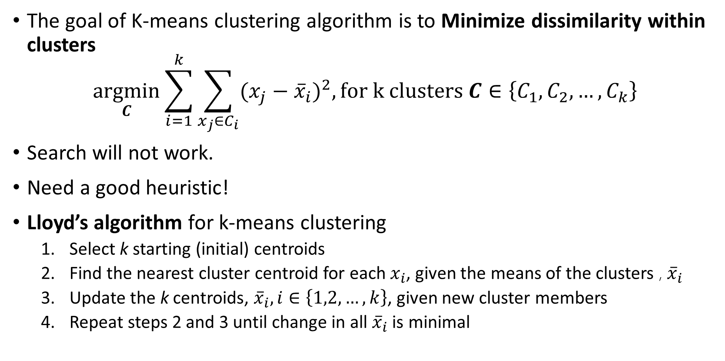
K-Means Clustering
The goal of K-means clustering algorithm is to Minimize dissimilarity within clusters
$$\underset{C}{argmin}{\sum_{i=1}^{k}{\sum_{x_{j}∈C_{i}}^{ }{(x_{j}−{\overline{x}}_{i})^{2}, for k clusters C∈\left\{C_{1},C_{2},…,C_{k}\right\}}}}$$
Search will not work.
Need a good heuristic!
Lloyd’s algorithm for k-means clustering
Select k starting (initial) centroids
Find the nearest cluster centroid for each $x_{i}$, given the means of the clusters , ${\overline{x}}_{i}$
Update the k centroids, ${\overline{x}}_{i}, i∈\left\{1,2,…,k\right\}$, given new cluster members
Repeat steps 2 and 3 until change in all ${\overline{x}}_{i}$ is minimal

Slide 21
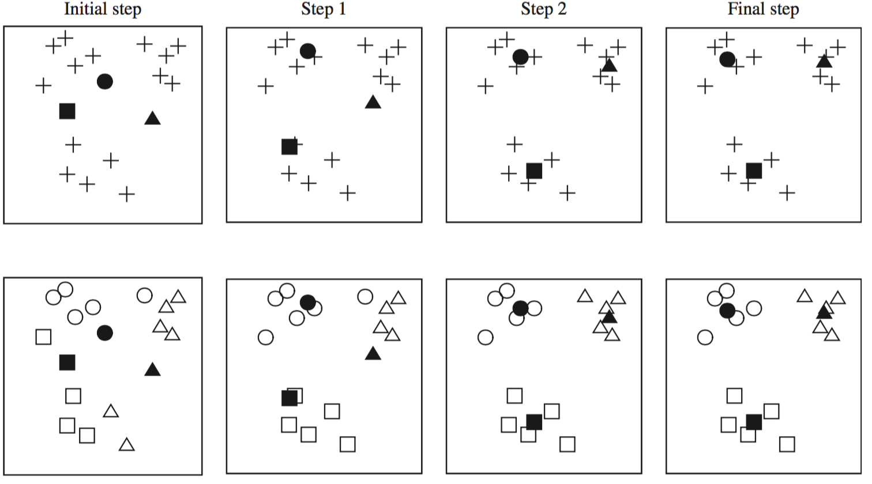
K-Means Clustering
Lloyd’s algorithm for k-means clustering, initializes with random start and iterates over several steps
Credit: Data Mining, Practical Machine Learning Tools and Techniques, Whitten et. al., fourth edition, 2016

Slide 22
K-Means Clustering
Lloyd’s algorithm for k-means clustering, initializes with random start and iterates over several steps
X
X
X
X
X
X
X
X
X
X
X
X
X
X
Start with data points
Initial cluster assignments
Update cluster centers and assignments
Iterate cluster centers and assignments until convergence
Assign Random cluster centers

Slide 23
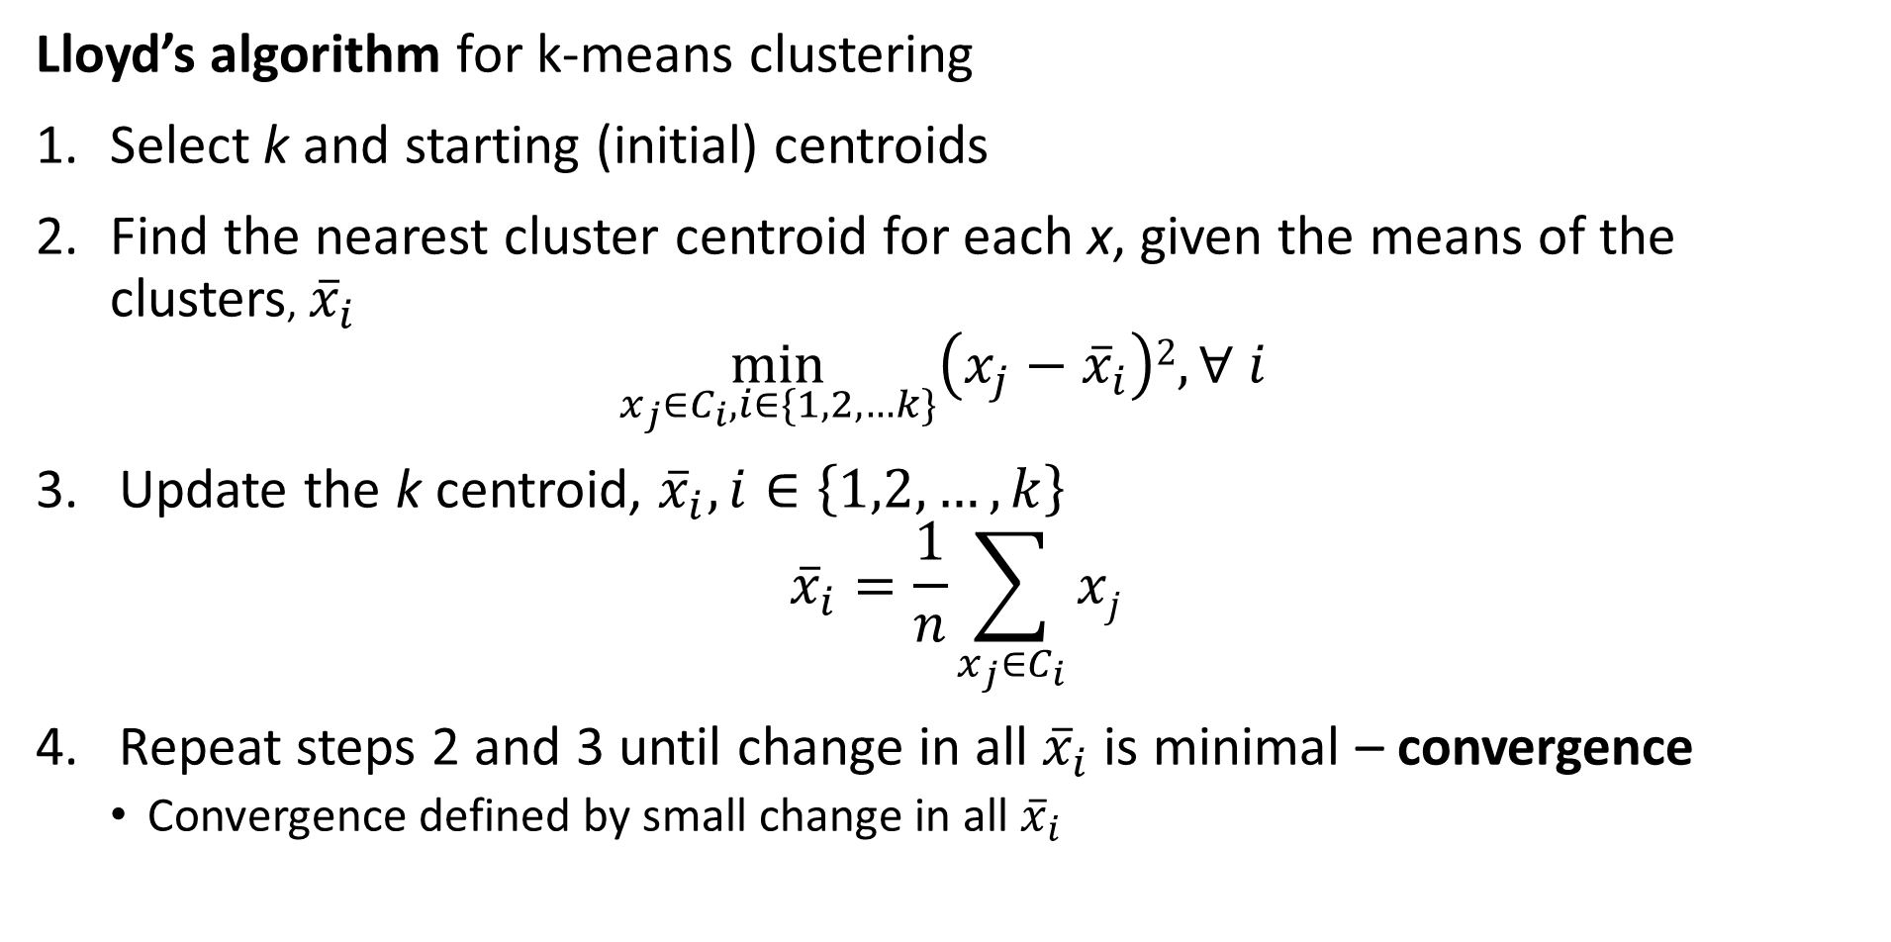
K-Means Clustering
Lloyd’s algorithm for k-means clustering
Select k and starting (initial) centroids
Find the nearest cluster centroid for each x, given the means of the clusters, ${\overline{x}}_{i}$
$$\min_{x_{j}∈C_{i},i∈\{1,2,…k\}}\left(x_{j}−{\overline{x}}_{i}\right)2, ∀ i$$
Update the k centroid, ${\overline{x}}_{i}, i∈\left\{1,2,…,k\right\}$
$${\overline{x}}_{i}=\frac{1}{n}\sum_{x_{j}∈C_{i}}{xj}$$
Repeat steps 2 and 3 until change in all ${\overline{x}}_{i}$ is minimal – convergence
Convergence defined by small change in all ${\overline{x}}_{i}$

Slide 24
K-Means Clustering
There are several difficulties with using the k-means algorithm
Using sum of square distance leads to only convex clusters
What is the value of k, the number of clusters?
The number of clusters should reflect fundamental organization of the data
Is there anyway to know k in advance for high dimensional problems?
No, k is found empirically, and the selection is often a bit subjective
How to find good starting values of the centroids?
At convergence the resulting clusters depend on the starting values
Is there any algorithm for finding good starting values?
No!
So, multiple random starts are often used
Copyright 2020, Stephen F Elston. All rights reserved.

Slide 25
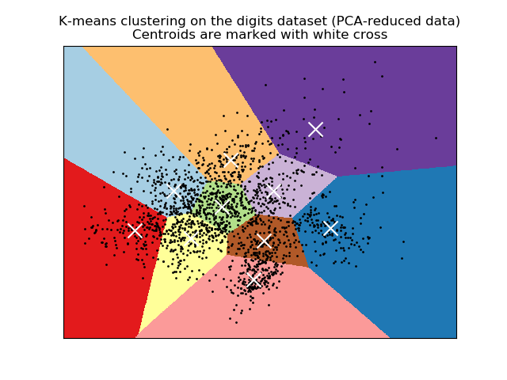
K-Means Clustering
K-means clustering produces convex clusters
Clusters are linearly separated
Clusters are Voronoi regions
Analogous to k-NN algorithm of supervised learning
Credit: Scikit-Learn development team; Pedregosa et al., JMLR 12, pp. 2825-2830, 2011

Slide 26
Evaluating Clustering Models

Slide 27
Evaluating Clustering Models
How do we evaluate clustering models?
No direct measure as with supervised machine learning
Can we use cross validation?
No, not directly, we have no labels
Use metrics that measure the properties of the clusters
Compactness of clusters
Separation between clusters
For k-means clustering the distance metric is quadratic
Use sum of square metrics

Slide 28
Evaluating Clustering Models
How do we evaluate clustering models?
Within and between cluster sum of squares
Can compare cluster models
Determine k
Other methods
Silhouette coefficients – Useful for small datasets
Calinski-Harabasz index
Many others…….
Notice that all of these methods assume clusters are Normally distributed!

Slide 29
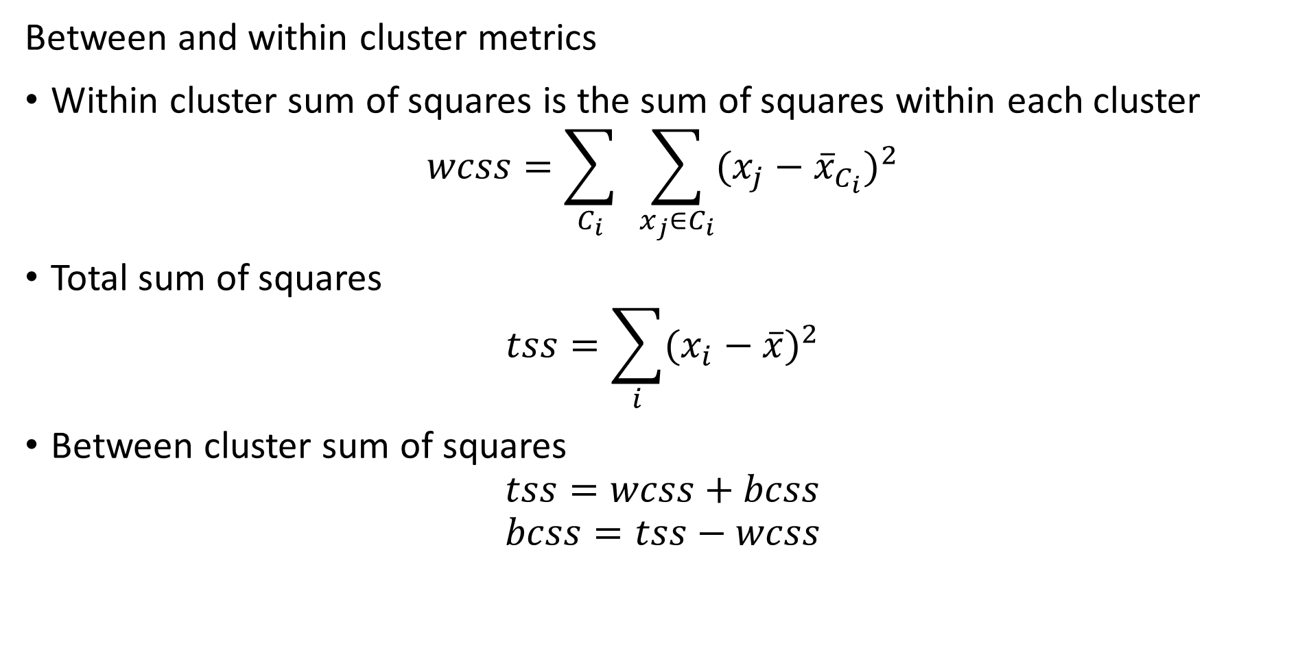
Evaluating Clustering Models
Between and within cluster metrics
Within cluster sum of squares is the sum of squares within each cluster
$$wcss=\sum_{C_{i}}^{ }{ }\sum_{x_{j}∈C_{i}}{(x_{j}−{\overline{x}}_{C_{i}})^{2}}$$
Total sum of squares
$$tss=\sum_{i}{(x_{i}−\overline{x})^{2}}$$
Between cluster sum of squares
$$tss=wcss+bcss$$
$$bcss=tss−wcss$$

Slide 30
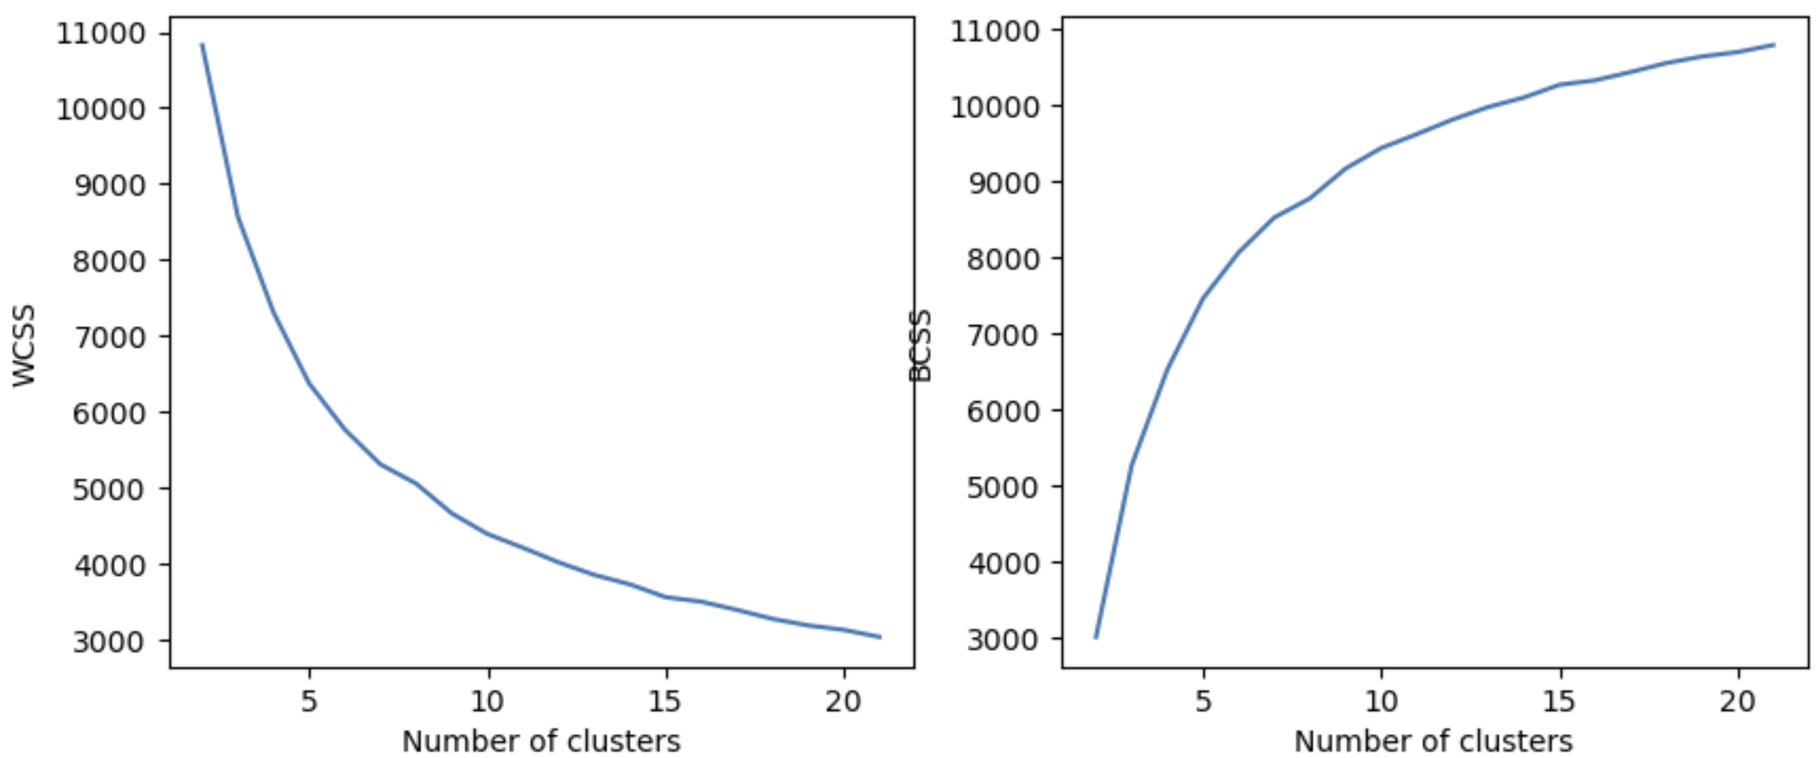
Evaluating Clustering Models
Use WCSS and BCSS to compare clustering models
Limit number of clusters where WCSS and BCSS have marginal changes

Slide 31
Evaluating Clustering Models
Use WCSS to find best number of clusters
Can use knee in WCSS curve to determine best k
In the example shown, pick k=8, k=9, or K=10
Prefer simpler models – Occam’s razor!
Too many clusters is an over-fit model

Slide 32
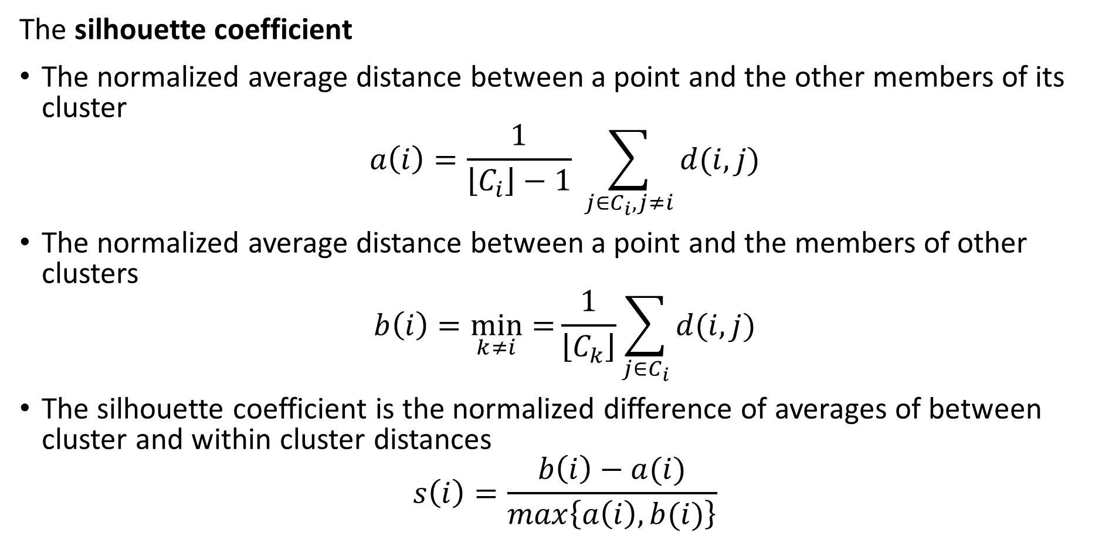
Evaluating Clustering Models
The silhouette coefficient
The normalized average distance between a point and the other members of its cluster
$$a\left(i\right)=\frac{1}{\left\lfloor C_{i}\right\rfloor −1} \sum_{j∈C_{i},j≠i}^{ }{d(i,j)}$$
The normalized average distance between a point and the members of other clusters
$$b\left(i\right)=\min_{k≠i}{=}\frac{1}{\left\lfloor C_{k}\right\rfloor }\sum_{j∈C_{i}}^{ }{d(i,j)}$$
The silhouette coefficient is the normalized difference of averages of between cluster and within cluster distances
$$s\left(i\right)=\frac{b\left(i\right)−a(i)}{max\left\{a\left(i\right),b(i)\right\}}$$

Slide 33
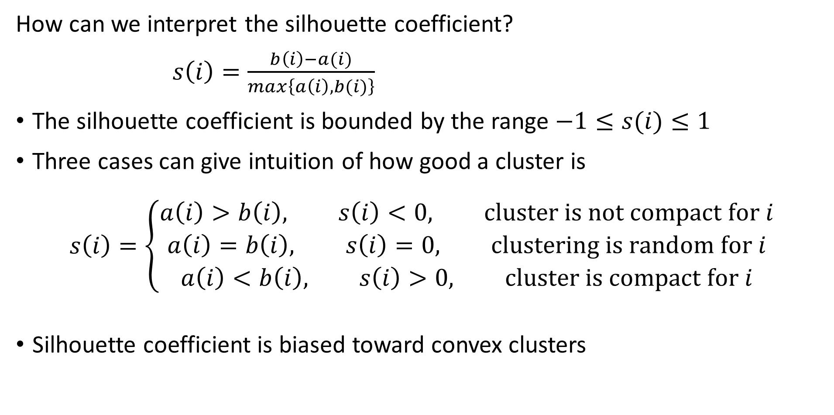
Evaluating Clustering Models
How can we interpret the silhouette coefficient?
$s\left(i\right)=\frac{b\left(i\right)−a(i)}{max\left\{a\left(i\right),b(i)\right\}}$
The silhouette coefficient is bounded by the range $−1≤s(i)≤1$
Three cases can give intuition of how good a cluster is
$$s\left(i\right)=\left\{\begin{aligned}a\left(i\right)>b\left(i\right), s\left(i\right)<0, cluster is not compact for i \\ a\left(i\right)=b\left(i\right), s\left(i\right)=0, clustering is random for i \\ a\left(i\right)<b\left(i\right), s\left(i\right)>0, cluster is compact for i\end{aligned}\right.$$
Silhouette coefficient is biased toward convex clusters

Slide 34
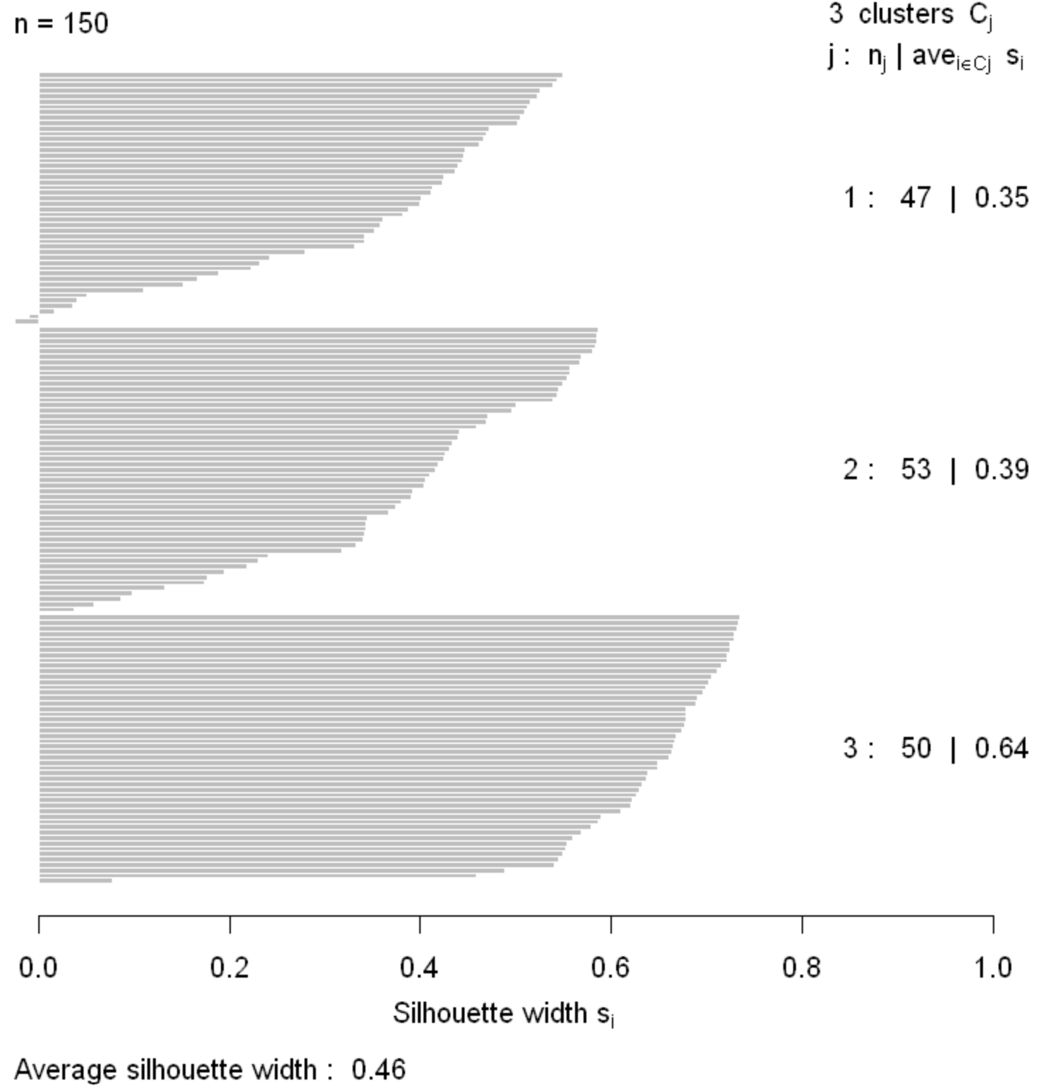
Evaluating Clustering Models
Silhouette coefficients can be graphed
Plot shows how compact and well separated the clusters are
Negative silhouette coefficients indicate sample incorrectly clustered

Slide 35
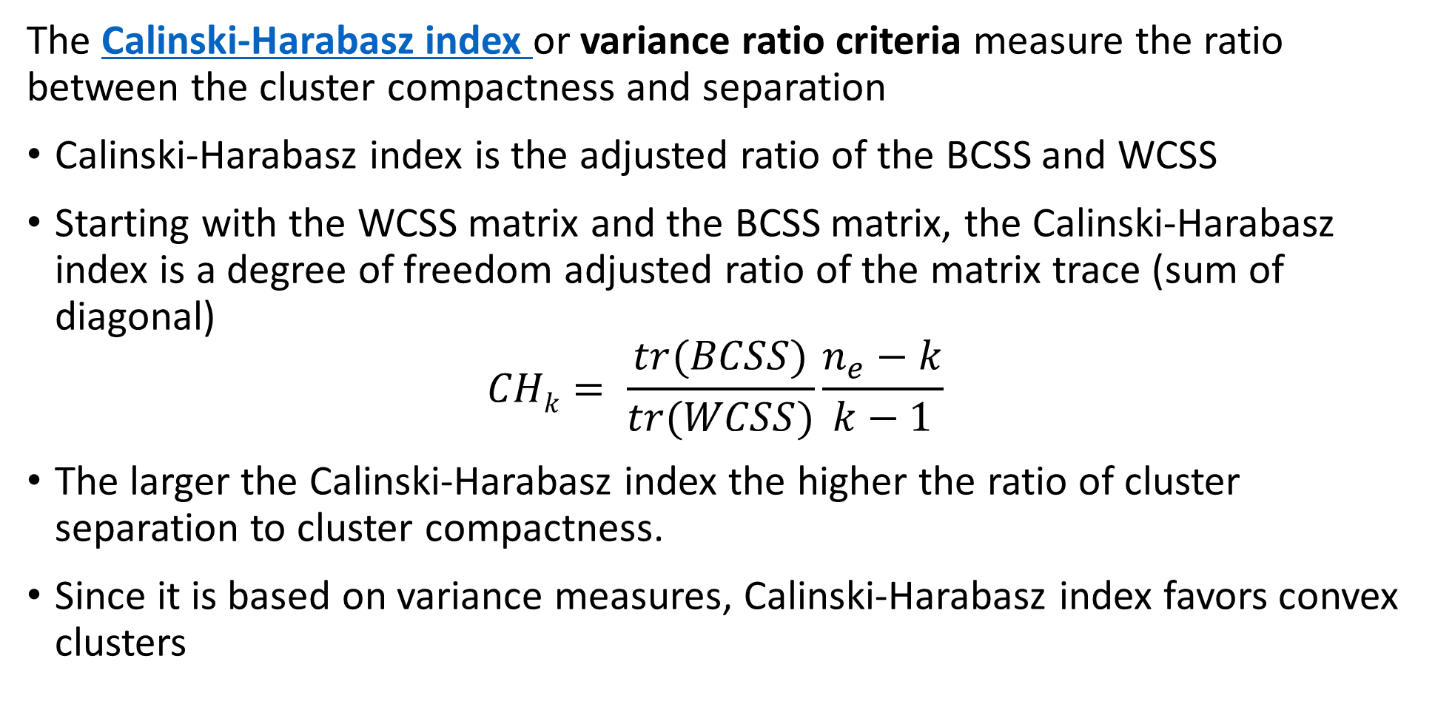
Evaluating Clustering Models
The Calinski-Harabasz index or variance ratio criteria measure the ratio between the cluster compactness and separation
Calinski-Harabasz index is the adjusted ratio of the BCSS and WCSS
Starting with the WCSS matrix and the BCSS matrix, the Calinski-Harabasz index is a degree of freedom adjusted ratio of the matrix trace (sum of diagonal)
$$CHk= \frac{tr(BCSS)}{tr(WCSS)}\frac{n_{e}−k}{k−1}$$
The larger the Calinski-Harabasz index the higher the ratio of cluster separation to cluster compactness.
Since it is based on variance measures, Calinski-Harabasz index favors convex clusters

Slide 36
Mini-Batch K-Means
Mini-batch K-means improves scaling of the algorithm
The basic K-means algorithm requires that all data be held in main memory at once
Limits scalability for massive data sets
The mini-batch K-means algorithm is an alternative
Follows same steps as standard K-means algorithm
Updates based on repeated mini-batch (small) samples of massive data set
Incrementally update cluster centers and membership on each mini-batch
Using small mini-batch samples makes updates stochastic in nature
Convergence to result of batch (standard) algorithm on average
Can be small differences (stochastic error) compared to batch algorithm

Slide 37
Mini-Batch K-Means
Mini-batch K-means improves scaling of the algorithm
Mini-batch k-means algorithm
A randomly Bernoulli sort the samples – use a hash at scale
Round-robin, take a mini-batch sub-sample – typically round binary number
Update the cluster centers
Update cluster membership
Repeat 2-4 above until stopping criteria is reached
Notice that the addition rounds repeat the samples
In practice this does not create much bias
For large samples this generally hardly matters

Slide 38
Hierarchical Clustering Models

Slide 39
Hierarchical Clustering Algorithms
Are there other ways to create compact clusters?
K-means algorithms form clusters with maximum compactness
Clusters have minimum variance or inertia
Hierarchical clustering algorithms create compact clusters
Algorithm sequentially considers groups of points
Maximum compact clusters created at each step of sequential algorithm
Create hierarchy of possible clusters
One cluster with all samples at the top
Single sample clusters at the bottom - singletons

Slide 40
Hierarchical Clustering Algorithms
Are there other ways to create compact clusters?
Hierarchy is a form of graph: a tree
Tree graph has no cycles
Tree graph splits on nodes
Edge length is distance between groups – clusters

Slide 41
Hierarchical Clustering Algorithms
Two possible approaches to hierarchical clustering
Divisive clustering – top down
Start will all samples in one large clusters
Recursively split into compact clusters
Stop when only single samples at leaves – singletons
Not discussed further here
Agglomerative clustering – bottom up
Start with each sample in an individual cluster - singletons
Build maximumly compact clusters, until all samples in one cluster
Forms a tree with singletons at the leaves and all samples at the root

Slide 42
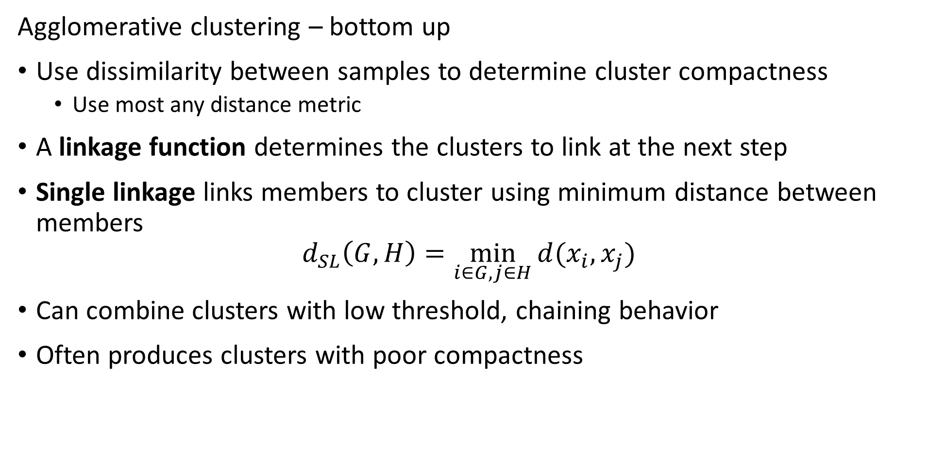
Hierarchical Clustering Algorithms
Agglomerative clustering – bottom up
Use dissimilarity between samples to determine cluster compactness
Use most any distance metric
A linkage function determines the clusters to link at the next step
Single linkage links members to cluster using minimum distance between members
$$d_{SL}\left(G,H\right)=\min_{i∈G,j∈H}{d(x_{i},x_{j})}$$
Can combine clusters with low threshold, chaining behavior
Often produces clusters with poor compactness

Slide 43
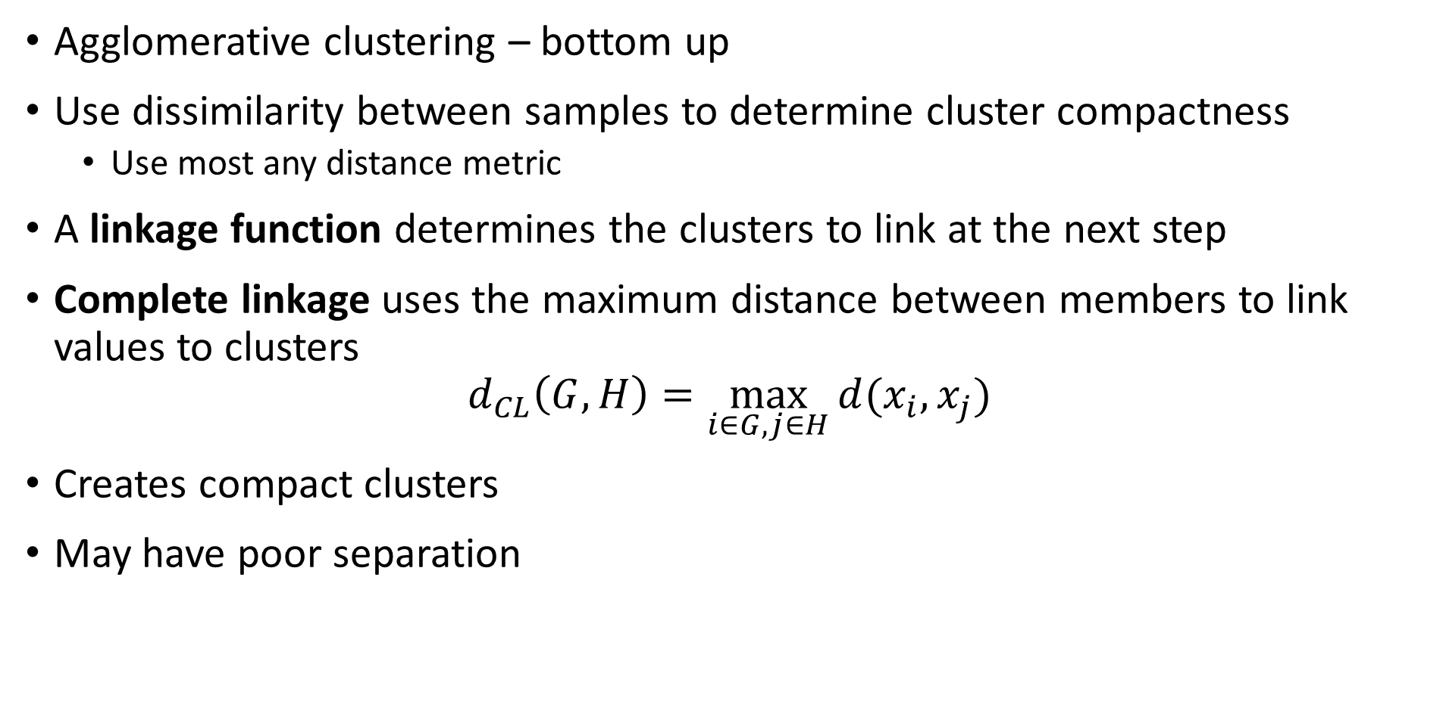
Hierarchical Clustering Algorithms
Agglomerative clustering – bottom up
Use dissimilarity between samples to determine cluster compactness
Use most any distance metric
A linkage function determines the clusters to link at the next step
Complete linkage uses the maximum distance between members to link values to clusters
$$d_{CL}\left(G,H\right)=\max_{i∈G,j∈H}{d(x_{i},x_{j})}$$
Creates compact clusters
May have poor separation

Slide 44
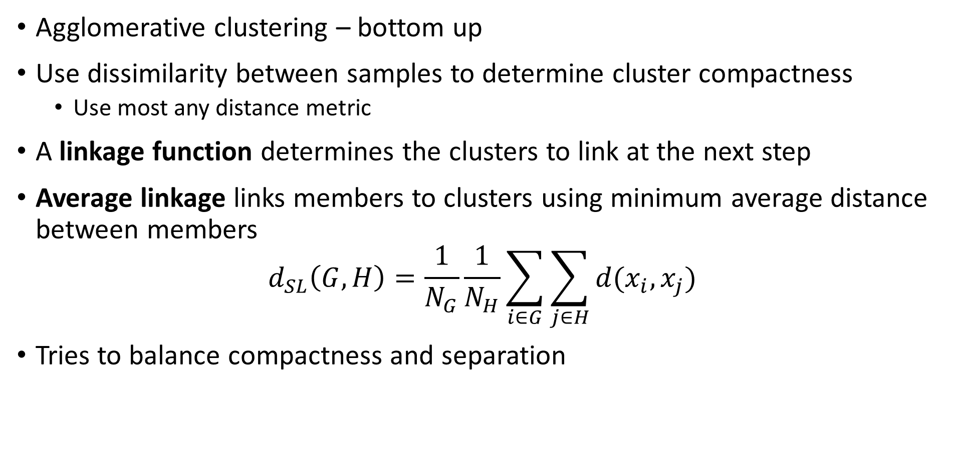
Hierarchical Clustering Algorithms
Agglomerative clustering – bottom up
Use dissimilarity between samples to determine cluster compactness
Use most any distance metric
A linkage function determines the clusters to link at the next step
Average linkage links members to clusters using minimum average distance between members
$$d_{SL}\left(G,H\right)=\frac{1}{N_{G}}\frac{1}{N_{H}}\sum_{i∈G}^{ }{\sum_{j∈H}^{ }{d(x_{i},x_{j})}}$$
Tries to balance compactness and separation

Slide 45
Agglomerative Clustering Example
Start with data points in a 2-dimensional Euclidian space
Use Euclidean distance and average linkage to find the first points to link –the leaves of the hierarchy
Continue to link points into clusters
At termination of algorithm all points are linked at root of hierarchy
5
3
2
6
4
1

Slide 46
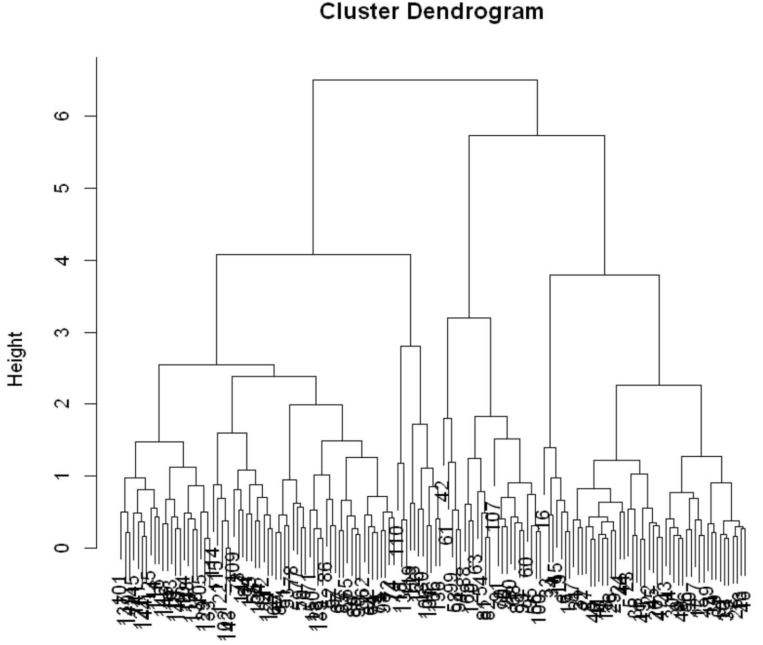
Hierarchical Clustering
Hierarchical cluster creates dendrogram
Number of clusters determined by depth of cut point
For example the cut-point shown results in 6 clusters
Or maybe 3 clusters?
Need some domain knowledge to determine which is useful

Slide 47
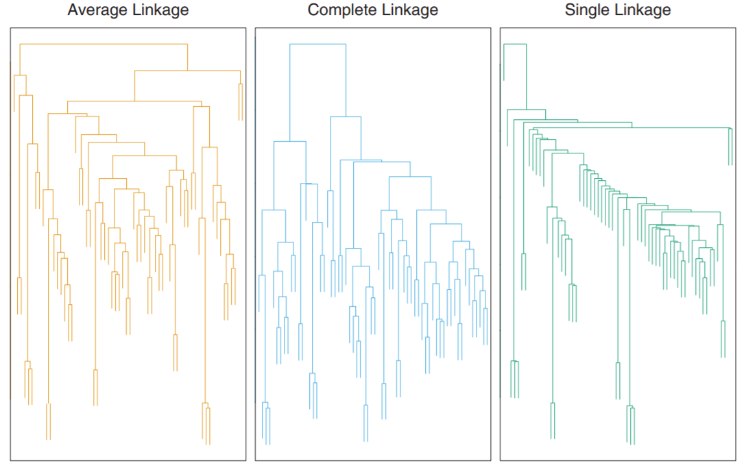
Hierarchical Clustering
Example of microasay of human tumors
The dendrograms are quite different
Choice of linkage function creates different hierarchy
Credit: Hastie, Tibsheirani and Friedeman, 2009

Slide 48
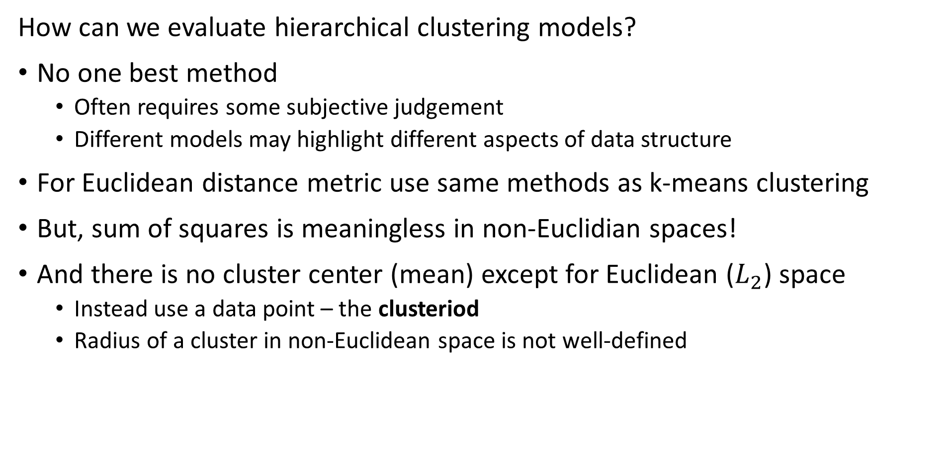
Evaluating Hierarchical Clustering
How can we evaluate hierarchical clustering models?
No one best method
Often requires some subjective judgement
Different models may highlight different aspects of data structure
For Euclidean distance metric use same methods as k-means clustering
But, sum of squares is meaningless in non-Euclidian spaces!
And there is no cluster center (mean) except for Euclidean ($L_{2}$) space
Instead use a data point – the clusteriod
Radius of a cluster in non-Euclidean space is not well-defined

Slide 49
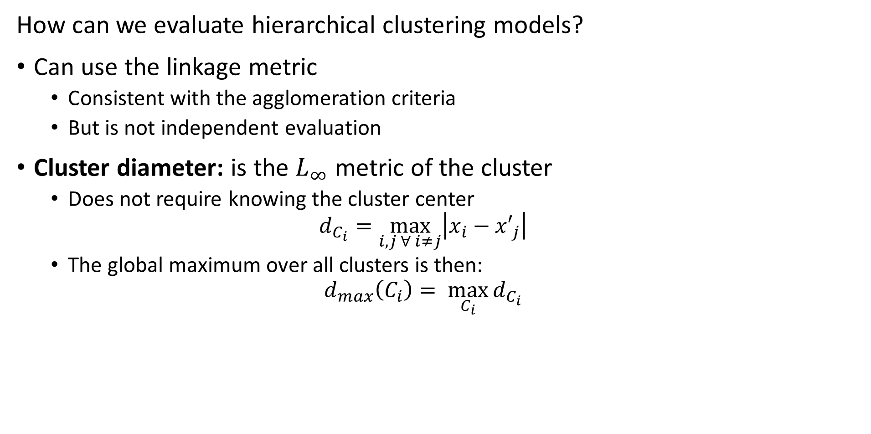
Evaluating Hierarchical Clustering
How can we evaluate hierarchical clustering models?
Can use the linkage metric
Consistent with the agglomeration criteria
But is not independent evaluation
Cluster diameter: is the $L_{∞}$ metric of the cluster
Does not require knowing the cluster center
$$d_{C_{i}}=\max_{i,j ∀ i≠j}\left|x_{i}−{x′}_{j}\right|$$
The global maximum over all clusters is then:
$$d_{max}\left(C_{i}\right)= \max_{C_{i}}{d_{C_{i}}}$$

Slide 50
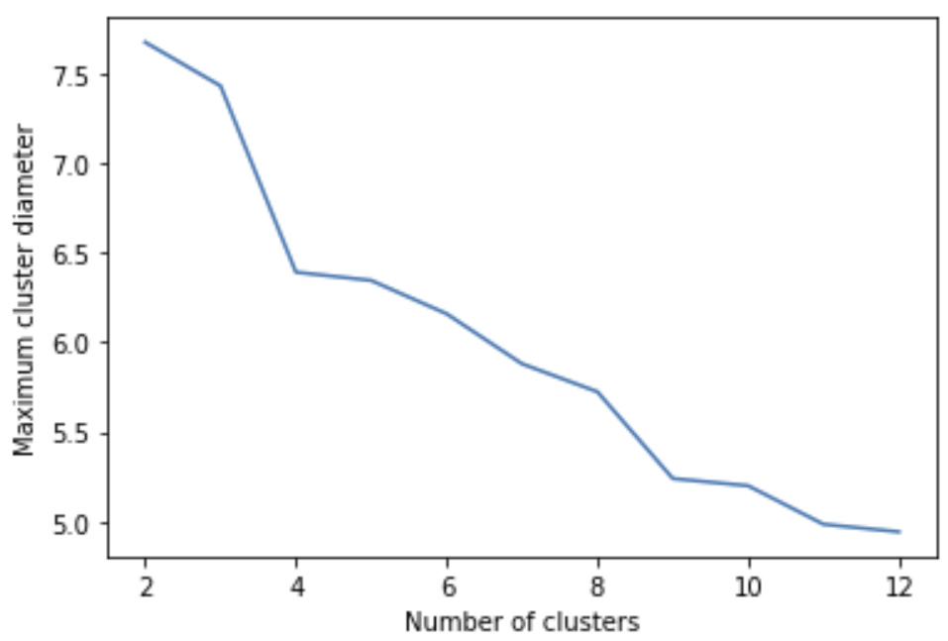
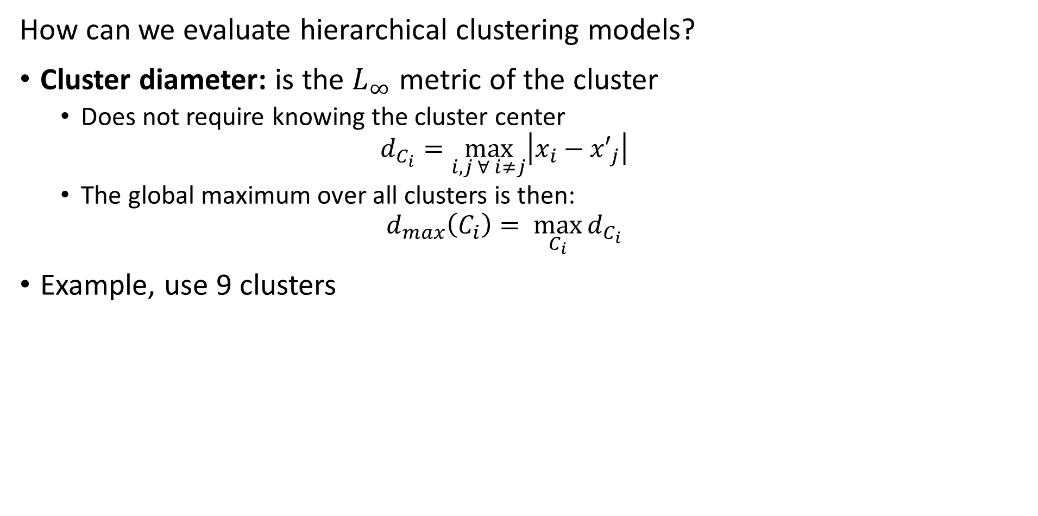
Evaluating Hierarchical Clustering
How can we evaluate hierarchical clustering models?
Cluster diameter: is the $L_{∞}$ metric of the cluster
Does not require knowing the cluster center
$$d_{C_{i}}=\max_{i,j ∀ i≠j}\left|x_{i}−{x′}_{j}\right|$$
The global maximum over all clusters is then:
$$d_{max}\left(C_{i}\right)= \max_{C_{i}}{d_{C_{i}}}$$
Example, use 9 clusters

Slide 51
Clustering in High Dimensions and The Curse of Dimensionality!

Slide 52
What Could Possibly Go Wrong? Curse of Dimensionality!
Cluster models scale poorly with dimensionality
Consider sampling required to maintain the same uniformly distributed density in a hypercube:
An example of the Curse of Dimensionality!
Dimensions | Samples
1 | 10
2 | 100
3 | 1,000
5 | 10⁵
10 | 10¹⁰

Slide 53
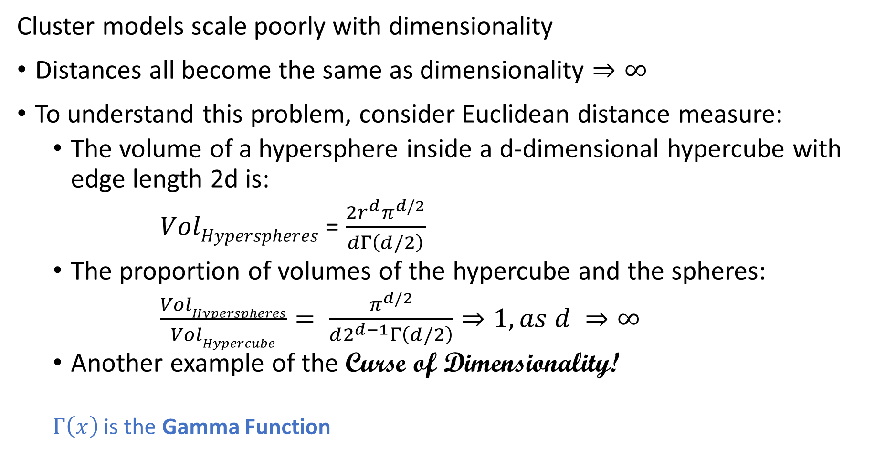
What Could Possibly Go Wrong? Curse of Dimensionality
Cluster models scale poorly with dimensionality
Distances all become the same as dimensionality $⇒∞$
To understand this problem, consider Euclidean distance measure:
The volume of a hypersphere inside a d-dimensional hypercube with edge length 2d is:
$VolHyperspheres$ = $\frac{2r^{d}π^{d/2}}{dΓ\left(d/2\right)}$
The proportion of volumes of the hypercube and the spheres:
$\frac{VolHyperspheres}{VolHypercube}= \frac{π^{d/2}}{d2^{d−1}Γ\left(d/2\right)}⇒1, as d ⇒∞$
Another example of the Curse of Dimensionality!
$Γ\left(x\right)$ is the Gamma Function

Slide 54
What Could Possibly Go Wrong? Curse of Dimensionality
The curse of dimensionality means that all clusters are the same in high dimensions
Sampling density decreases exponentially
Distances are converge to the same size in a finite space
The choice of metric does not help
Implication is that high-dimensional cluster models are easy to overfit!!
Reducing dimensionality can help

Slide 55
Graph-Based Clustering Models

Slide 56
Graph Based Clustering Models
Many cluster models use a graph to model relationships
A graph is constructed for the distance or similarity relationships
Observations (samples) are nodes
Edges connect samples
Edge weights are distance or similarity
Relationships on the graph are used to separate data into clusters
Several commonly used classes of clustering algorithms are graph-based
Hierarchical
Affinity clustering
Density clustering
Spectral clustering

Slide 57
Affinity Clustering
Can we build a clustering algorithm using a relationship to a few prototypes or exemplar points?
Yes
Affinity clustering uses a message passing algorithm to find these responsible or exemplar points and create a graph of cluster members
Affinity clustering provides useful results in several areas
Document similarity
Computer vision
Computational genetics

Slide 58
Affinity Clustering
Can we build a clustering algorithm using a relationship to a few prototypes or exemplar points?
The number of representative points, and clusters, are determined by the algorithms
No need to specify number of clusters apriori
The message passing algorithm iteratively determines
Responsibility, r(i,k), of sample k to be the exemplar of sample i
Availability, a(i,k), of sample k to be a member of cluster with exemplar i
Exemplar points are central nodes on a graph
Graph components have no edges between them
Samples in component are connected to the exemplars by undirected edges

Slide 59
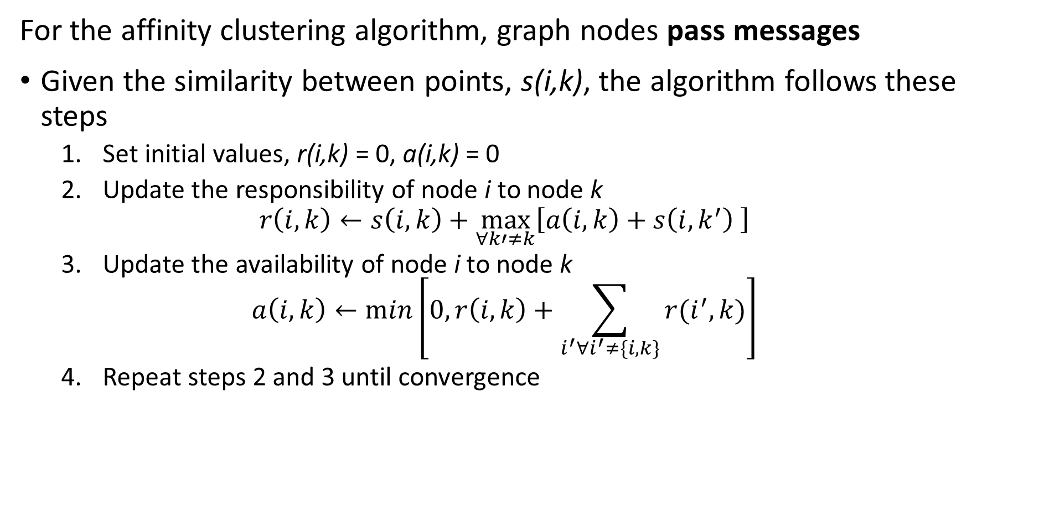
Affinity Clustering
For the affinity clustering algorithm, graph nodes pass messages
Given the similarity between points, s(i,k), the algorithm follows these steps
Set initial values, r(i,k) = 0, a(i,k) = 0
Update the responsibility of node i to node k
$$r\left(i,k\right)←s\left(i,k\right)+\max_{∀k′≠k}{⁡\left[a\left(i,k\right)+s\left(i,k^{′}\right) \right]}$$
Update the availability of node i to node k
$$a\left(i,k\right)←min⁡\left[0,r\left(i,k\right)+\sum_{i^{′}∀i^{′}≠\{i,k\}}^{ }{r(i^{′},k)}\right]$$
Repeat steps 2 and 3 until convergence

Slide 60
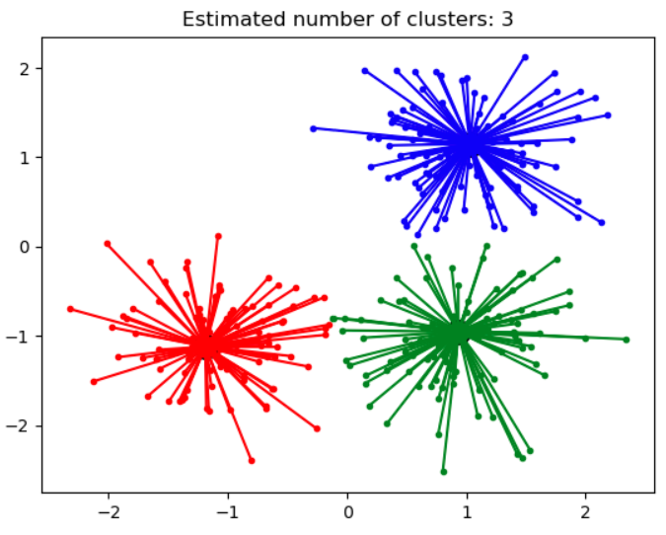
Affinity Clustering
Affinity propagation determines a number of clusters
Clusters linearly separated and convex
Can define clusters as Voronoi regions
Different similarity metrics create different clusters
Algorithm can be slow, O(n²) complexity
Credit: Scikit-Learn development team; Pedregosa et al., JMLR 12, pp. 2825-2830, 2011

Slide 61
Density Clustering
Using sample density is another way to form clusters
High density points form clusters
How can we find high density points?
Find points with large number of near neighbors
Form clusters around these high density points
Naive algorithms have high complexity
Scalable algorithms are largely heuristic
Many algorithms, including
DBSCAN
OPTICS

Slide 62
Density Clustering
DBSCAN is the first (1996) large-scale density-based clustering algorithm
Still in use today
Many variations created
Scales to out of memory dataset size
DBSCAN minimizes the number of passes through the data base
DBSCAN finds a graph of nearest neighbors
Core points define the high density areas
Reachable non-core points are in a cluster but not core
Unreachable points are not in a cluster
Graph edge is bidirectional if both points are core
Graph edges from core to reachable non-core point are unidirectional

Slide 63
Density Clustering
DBSCAN has two hyperparameters
minPts is the minimum number of near neighbors a core point must have
ε is the maximum distance between neighbors
How do we define reachability?
Must have a path on the graph between points p₁ and p_{n}
The path can pass through other points, {p₁,p₂,…,p_{n}}
Distance to neighbors must be less than ε
Points not reachable from any other point are not reachable
DBSCAN makes passes thorough a database to create the graph
Highly scalable, O(n log(n))
Uses memory, O(n²)

Slide 64
Density Clustering
What are the steps of DBSCAN?
Start with some samples or observations
For each point, find near neighbors within distance ε
A point is core if it has > minPts near neighbors (2 in this example)
If two point are core, connect with undirected edge
If point is non-core, connect with directed edge
If point further that ε from neighbors, point is non-reachable
Result is a graph

Slide 65
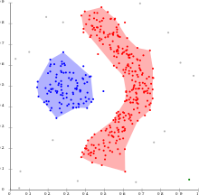
Density Clustering
What are some properties of DBSCAN?
Can find non-convex clusters
Is fast and efficient
Optimized for uniform sample density of clusters with fixed ε and minPts
Selecting maximum distance to neighbors, ε, is difficult in high dimensions
Clusters depend on distance metric
Clusters robust to noise, non-reachable samples
Credit: Wikipedia commons

Slide 66
Density Clustering
How can we overcome the limitations of DBSCAN?
Optimized for uniform density clusters
Hard to find good value of ε in high dimensions
The OPTICS algorithm is an attempt to improve on DBSCAN
OPTICS uses a heuristic to find two distances
Core distance determines if a sample is core
Reachability distance determines if one sample is reachable from the other

Slide 67
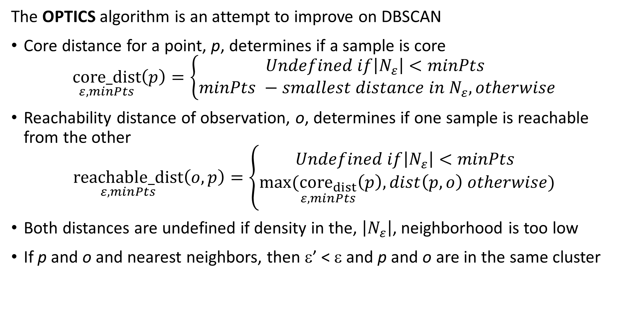
Density Clustering
The OPTICS algorithm is an attempt to improve on DBSCAN
Core distance for a point, p, determines if a sample is core
$$\underset{ε,minPts}{core_dist}\left(p\right)=\left\{\begin{aligned}Undefined if\left|N_{ε}\right|<minPts \\ minPts −smallest distance in N_{ε}, otherwise\end{aligned}\right.$$
Reachability distance of observation, o, determines if one sample is reachable from the other
$$\underset{ε,minPts}{reachable_dist}\left(o,p\right)=\left\{\begin{aligned}Undefined if\left|N_{ε}\right|<minPts \\ max⁡(\underset{ε,minPts}{{core}_{dist}}\left(p\right),dist\left(p,o\right) otherwise)\end{aligned}\right.$$
Both distances are undefined if density in the, $\left|N_{ε}\right|$, neighborhood is too low
If p and o and nearest neighbors, then ε’ < ε and p and o are in the same cluster

Slide 68
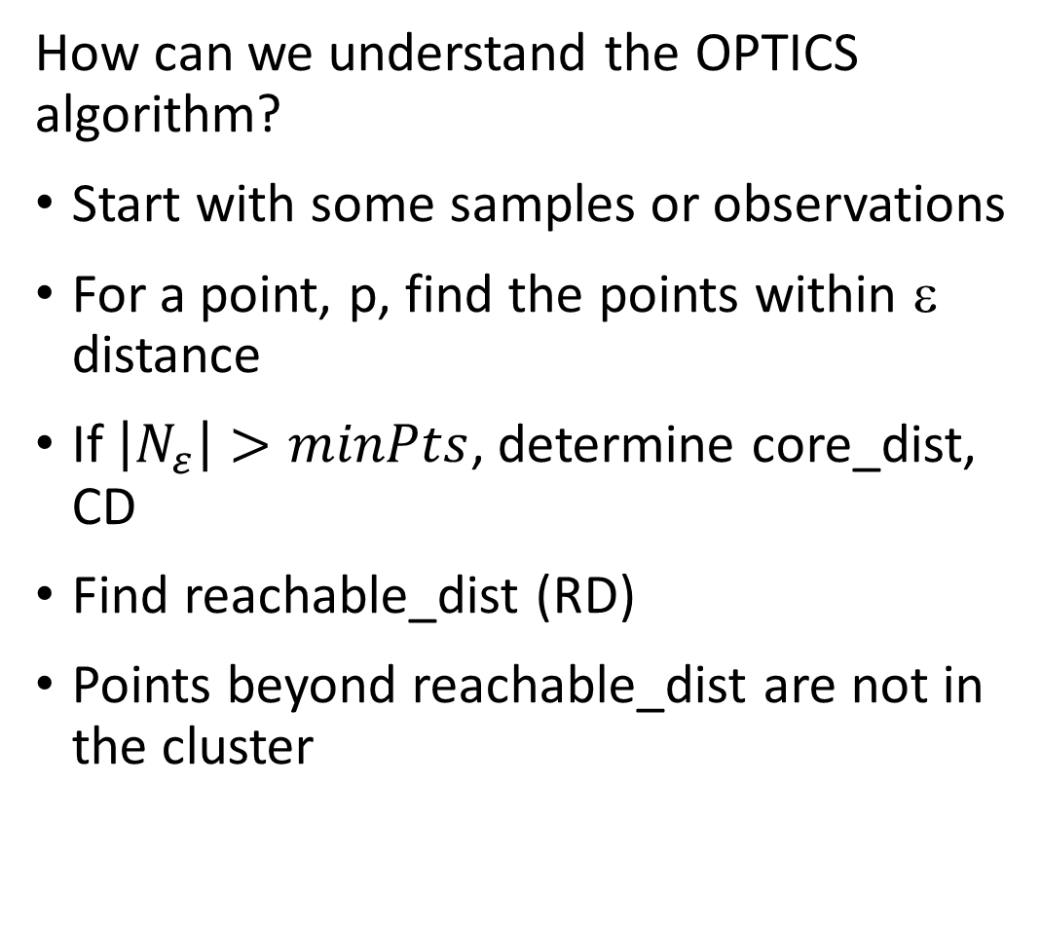
Density Clustering
How can we understand the OPTICS algorithm?
Start with some samples or observations
For a point, p, find the points within ε distance
If $\left|N_{ε}\right|>minPts$, determine core_dist, CD
Find reachable_dist (RD)
Points beyond reachable_dist are not in the cluster
ε
CD
RD

Slide 69
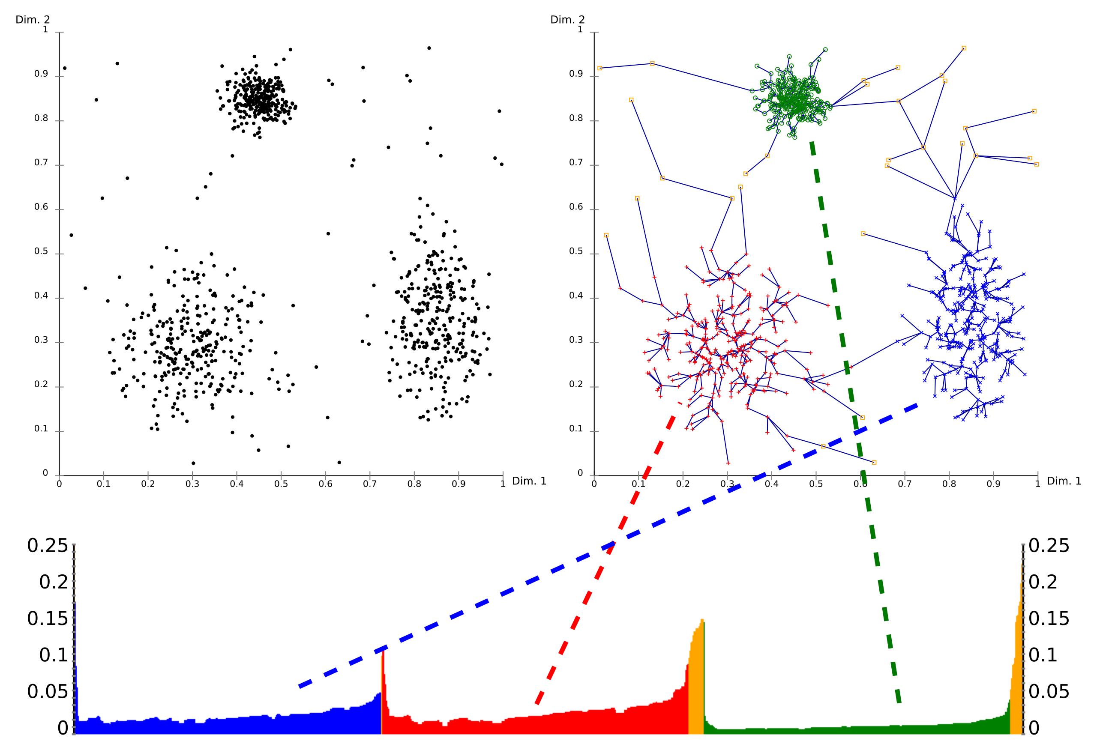
Density Clustering
What are some properties of OPTICS?
OPTICS builds a graph with the distances determining clusters
The graph defines a dendrogram
The reachability plot (bottom) shows the path distances in the dendrogram
A cutoff on the reachability plot defines the clusters
Credit: Wikipedia commons

Slide 70
Density Clustering
What are some properties of OPTICS?
Dynamically determining core_dist helps with variable sample density
Computation complexity higher on average than DBSCAN
Credit: Wikipedia commons

Slide 71
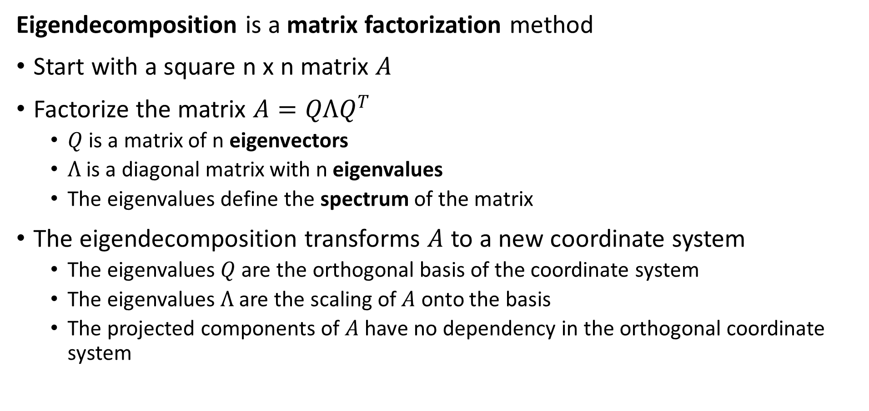
Review of Eigenvalues and Eigenvectors
Eigendecomposition is a matrix factorization method
Start with a square n x n matrix $A$
Factorize the matrix $A=QΛQ^{T}$
$Q$ is a matrix of n eigenvectors
$Λ$ is a diagonal matrix with n eigenvalues
The eigenvalues define the spectrum of the matrix
The eigendecomposition transforms $A$ to a new coordinate system
The eigenvalues $Q$ are the orthogonal basis of the coordinate system
The eigenvalues $Λ$ are the scaling of $A$ onto the basis
The projected components of $A$ have no dependency in the orthogonal coordinate system

Slide 72
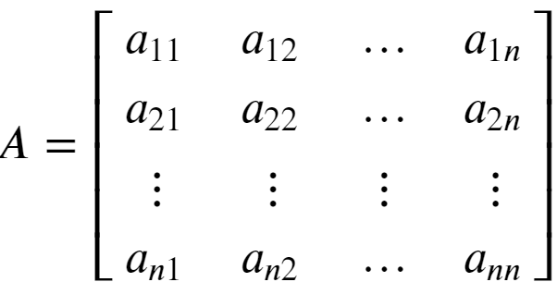

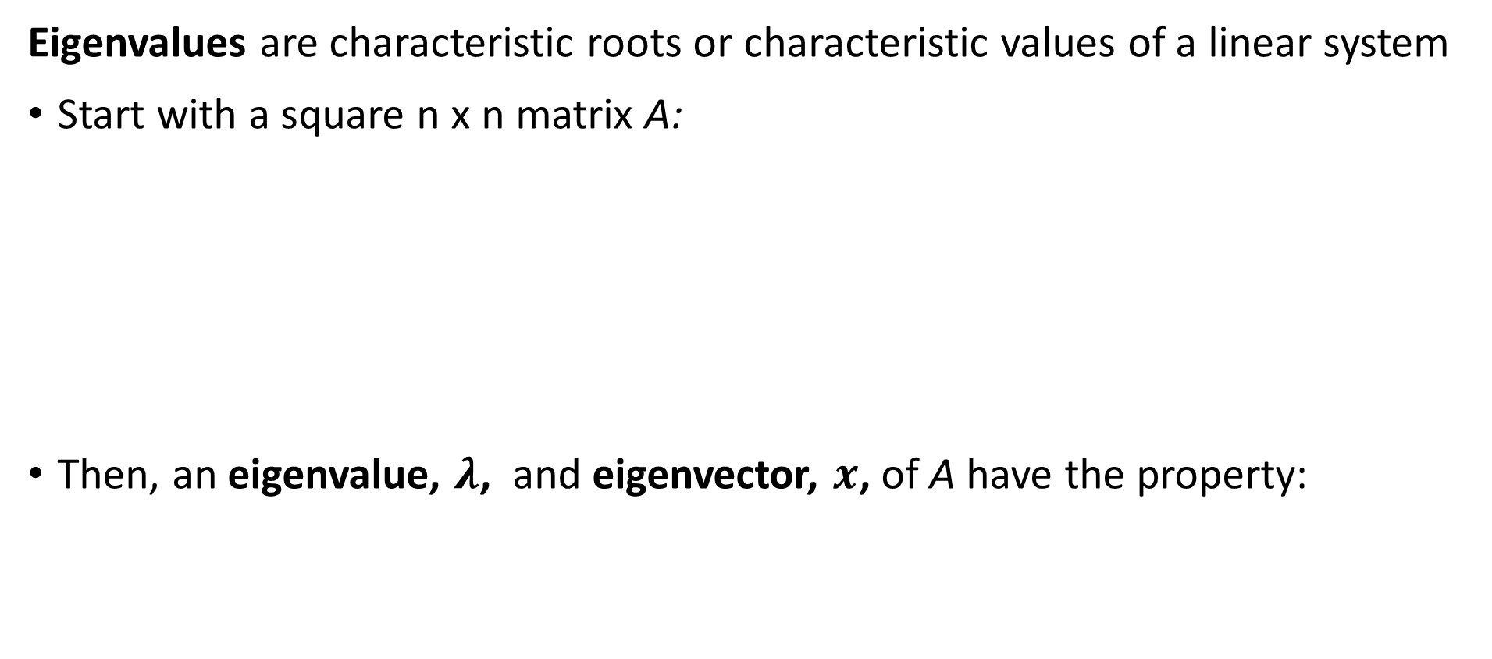
Review of Eigenvalues and Eigenvectors
Eigenvalues are characteristic roots or characteristic values of a linear system
Start with a square n x n matrix A:
Then, an eigenvalue, $λ$, and eigenvector, $x$, of A have the property:

Slide 73
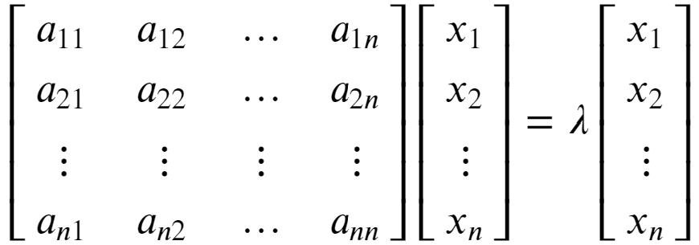


Review of Eigenvalues and Eigenvectors
Eigenvalues are characteristic roots or characteristic values of a linear system
Start with the eigenvalue, eigenvector relationship:
To see that λ is a root of A we can rearrange as follows:

Slide 74

Review of Eigenvalues
Eigenvalues are characteristic roots or characteristic values of a linear system
An n x n matrix A will have n eigenvalues
Find eigenvalues by solving
Solve n equations involving the determinant:
For more detail on determinants see: https://en.wikipedia.org/wiki/Determinant
Copyright 2020, Stephen F Elston. All rights reserved.

Slide 75


Review of Eigenvalues and Eigenvectors
Each eigenvalue of a square matrix is associated with an eigenvector
There is a left and right eigenvector for each eigenvalue
The right eigenvector has the following relationship to the matrix A and eigenvalue λ:
Notice that the right eigenvector is to the right of the matrix

Slide 76



Review of Eigenvalues and Eigenvectors
Each eigenvalue of a square matrix is associated with an eigenvector
There is also a left eigenvector with the following relationship to the matrix A and eigenvalue l:
Notice that the left eigenvector is to the left of the matrix

Slide 77


Review of Eigenvalues and Eigenvectors
Each eigenvalue of a square matrix is associated with an eigenvector
The l2 norm of any eigenvector is constrained to 1.0:
This property means that the matrix of n eigenvectors, Q, is unitary
For a full rank matrix, each eigenvector is orthogonal to every other eigenvector, and linearly independent
Thus, for diagonal matrix of n eigenvalues, Λ, an n x n matrix, A, can be factored:

Slide 78
Spectral Clustering
Steps of spectral clustering algorithm
Start with samples
Construct graph
3-nearest-neighbors in this case
Need not be reciprocal
Use undirected edges
Edge weights are similarity
Association matrix constructed from graph
Weighted by similarity between points
Compute graph Laplacian
Perform clustering on eigenvectors of graph Laplacian to partition graph

Slide 79
Spectral Clustering
Steps of spectral clustering algorithm
Construct the graph of the samples
Fully connected graph
K-nearest-neighbor graph
For node i, node j can be a nearest neighbor, but the reverse need not be true
Or can use symmetric nearest neighbors
The edges are undirected and weighted
Weights are the similarity of between the samples
The weighted association matrix is constructed
Full matrix for fully connected graph
Sparse matrix for nearest-neighbor graph – faster algorithm!
Need not be symmetric

Slide 80
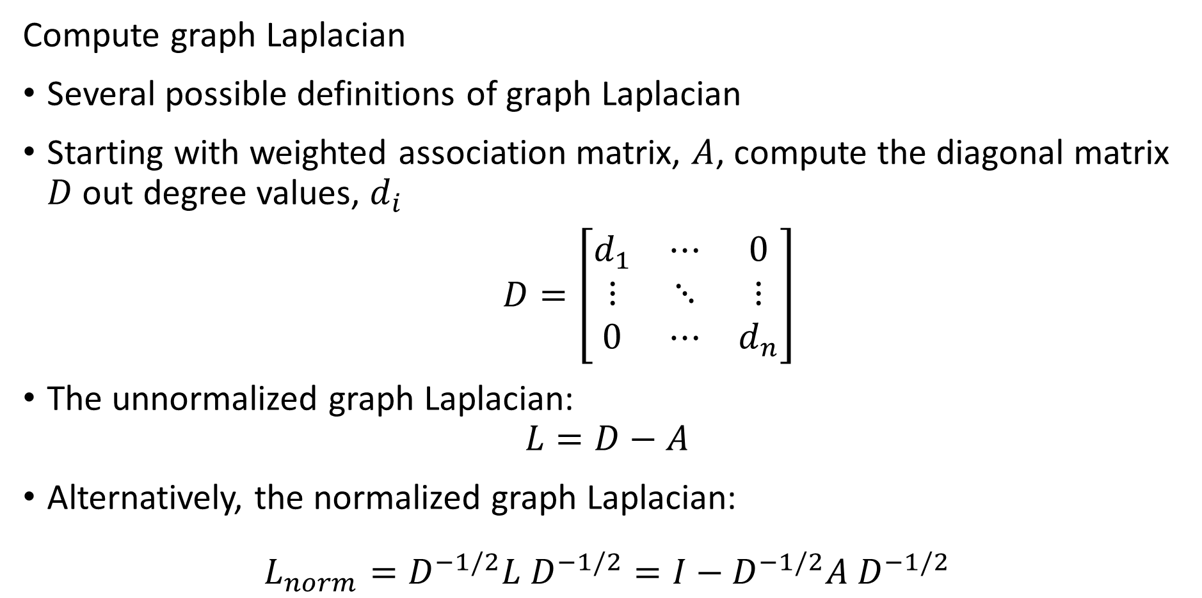
Spectral Clustering
Compute graph Laplacian
Several possible definitions of graph Laplacian
Starting with weighted association matrix, $A$, compute the diagonal matrix $D$ out degree values, $d_{i}$
$D=\left[\begin{matrix}d_{1} & ⋯ & 0 \\ ⋮ & ⋱ & ⋮ \\ 0 & ⋯ & d_{n}\end{matrix}\right]$
The unnormalized graph Laplacian:
$$L=D−A$$
Alternatively, the normalized graph Laplacian:
$$L_{norm}=D^{−1/2}{L D}^{−1/2}=I−D^{−1/2}{A D}^{−1/2}$$

Slide 81
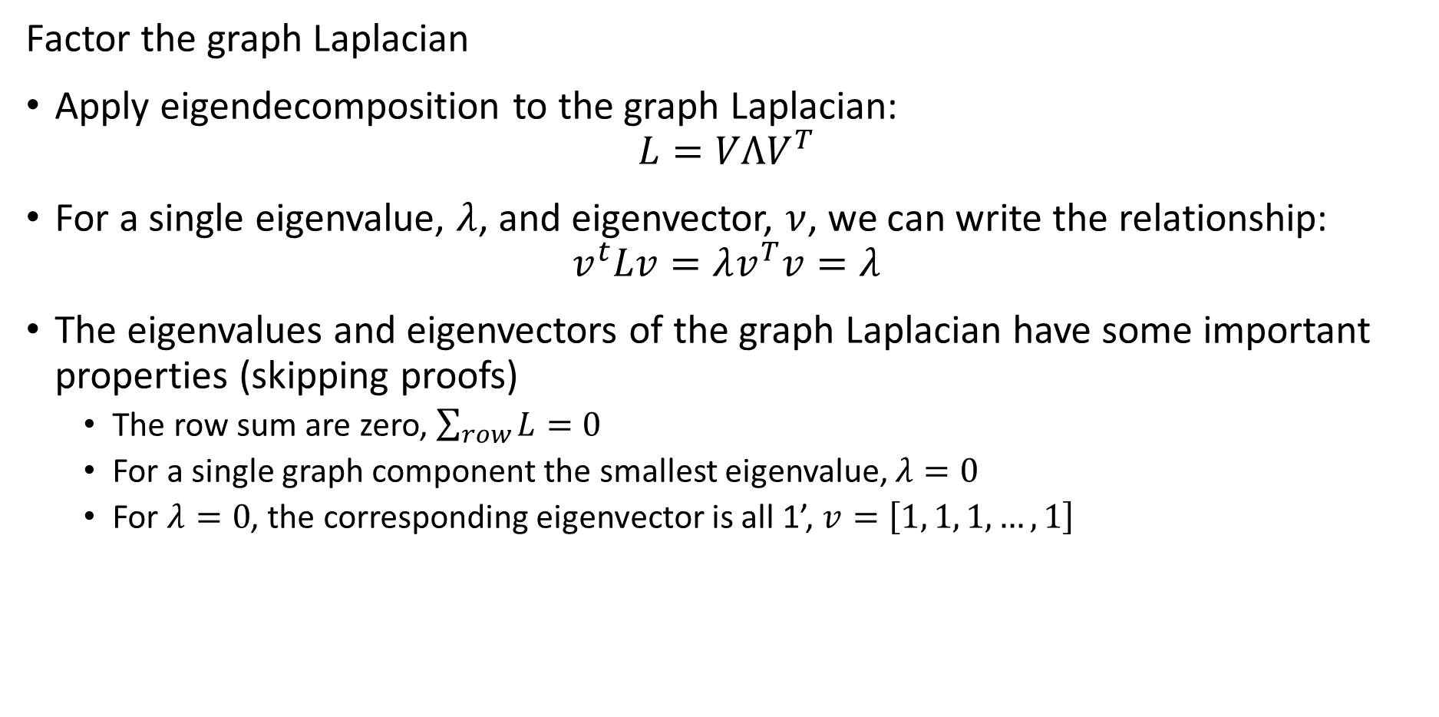
Spectral Clustering
Factor the graph Laplacian
Apply eigendecomposition to the graph Laplacian:
$$L=VΛV^{T}$$
For a single eigenvalue, $λ$, and eigenvector, $ν$, we can write the relationship:
$$v^{t}Lv=λv^{T}v=λ$$
The eigenvalues and eigenvectors of the graph Laplacian have some important properties (skipping proofs)
The row sum are zero, $\sum_{row}{L}=0$
For a single graph component the smallest eigenvalue, $λ=0$
For $λ=0$, the corresponding eigenvector is all 1’, $v=\left[1, 1, 1, …, 1\right]$

Slide 82
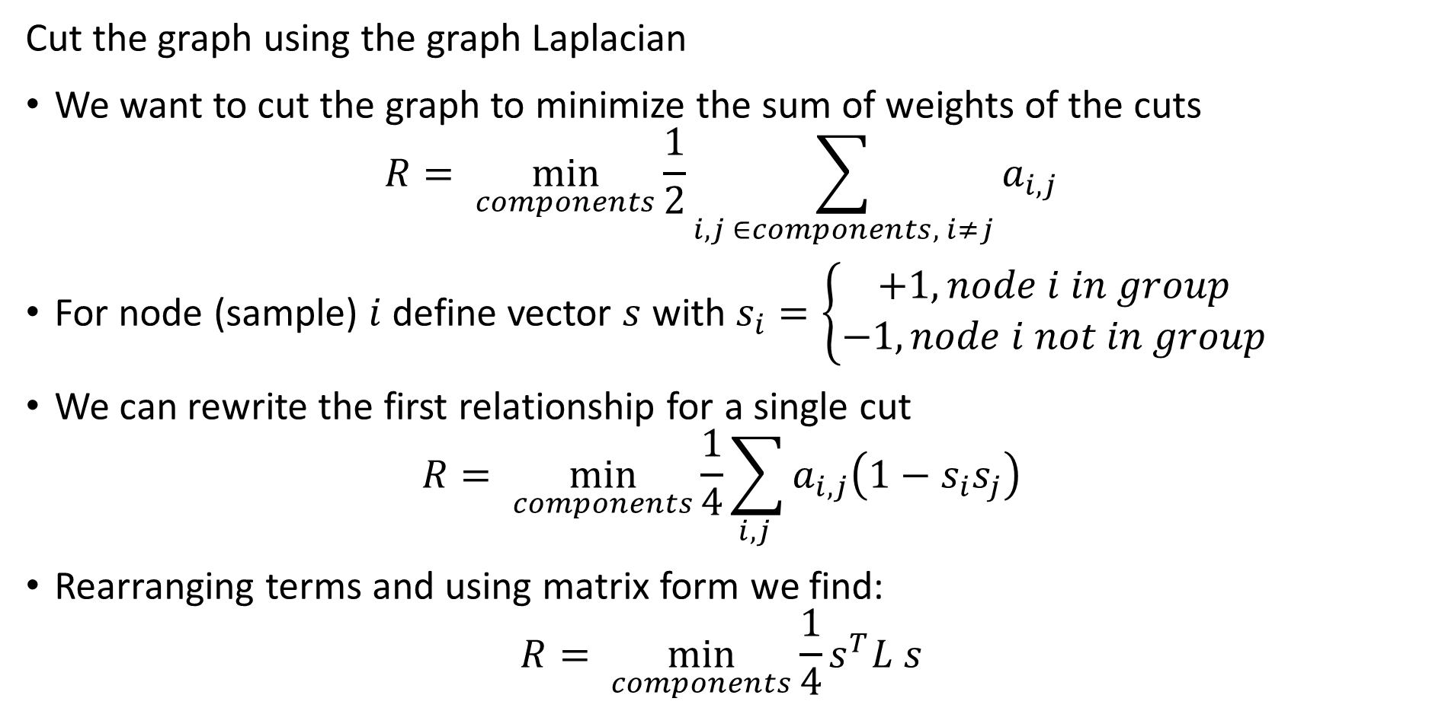
Spectral Clustering
Cut the graph using the graph Laplacian
We want to cut the graph to minimize the sum of weights of the cuts
$$R= \min_{components}{\frac{1}{2}\sum_{i,j ∈components, i≠j}{a_{i,j}}}$$
For node (sample) $i$ define vector $s$ with $s_{i}=\left\{\begin{aligned}+1, node i in group \\ −1, node i not in group\end{aligned}\right.$
We can rewrite the first relationship for a single cut
$$R= \min_{components}{\frac{1}{4}\sum_{i,j }{a_{i,j}\left(1−s_{i}s_{j}\right)}}$$
Rearranging terms and using matrix form we find:
$$R= \min_{components}{\frac{1}{4}s^{T}L s}$$

Slide 83
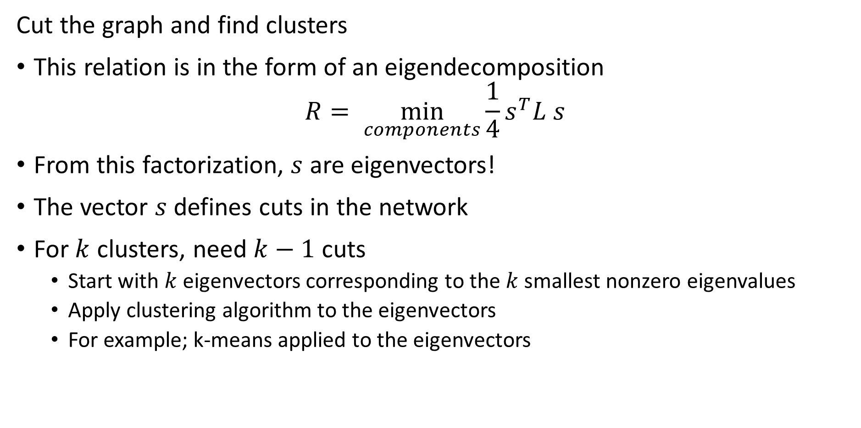
Spectral Clustering
Cut the graph and find clusters
This relation is in the form of an eigendecomposition
$$R= \min_{components}{\frac{1}{4}s^{T}L s}$$
From this factorization, $s$ are eigenvectors!
The vector $s$ defines cuts in the network
For $k$ clusters, need $k−1$ cuts
Start with $k$ eigenvectors corresponding to the $k$ smallest nonzero eigenvalues
Apply clustering algorithm to the eigenvectors
For example; k-means applied to the eigenvectors

Slide 84
Spectral Clustering
Spectral clustering is a graph-based state of the art clustering method
Spectral clustering follows these steps:
Construct the association matrix
Compute the graph Laplacian from the association matrix
Factor the graph Laplacian
Partition the graph by k eigenvectors
Apply clustering algorithm to eigenvectors
In summary, spectral clustering constructs clusters on the orthogonal projection of the Laplacian matrix
For a rigorous introduction to spectral clustering see this tutorial article by von Luxburg

Slide 85
Summary
Unsupervised learning methods learn structure of data
Structure is learned by determining association between cases
Association based on measures of proximity, distance or dissimilarity
Clustering algorithms are data mining methods
Data mining seeks to find interesting relationships in data
We have already encountered feature importance as a data mining method

Slide 86
Summary
Algorithms can use different distance or dissimilarity metrics
Structure based on distance metrics
Different algorithms use different metrics
What are the ideal properties of clusters?
Good clusters have two properties
Compactness: We what the clusters to be small with members close to each other
Separation: We want the clusters are well separated, a closeness property

Slide 87
Summary
Different models and dissimilarity metrics will give different results
Dissimilarity metrics usually matter more than model choice
But which one should we use?
Evaluation is a significant problem with for unsupervised learning
There are no labels for objective evaluation
Evaluation is often subjective
But, do we have to pick one best model?
No
Different models can show different useful relationships

Slide 88
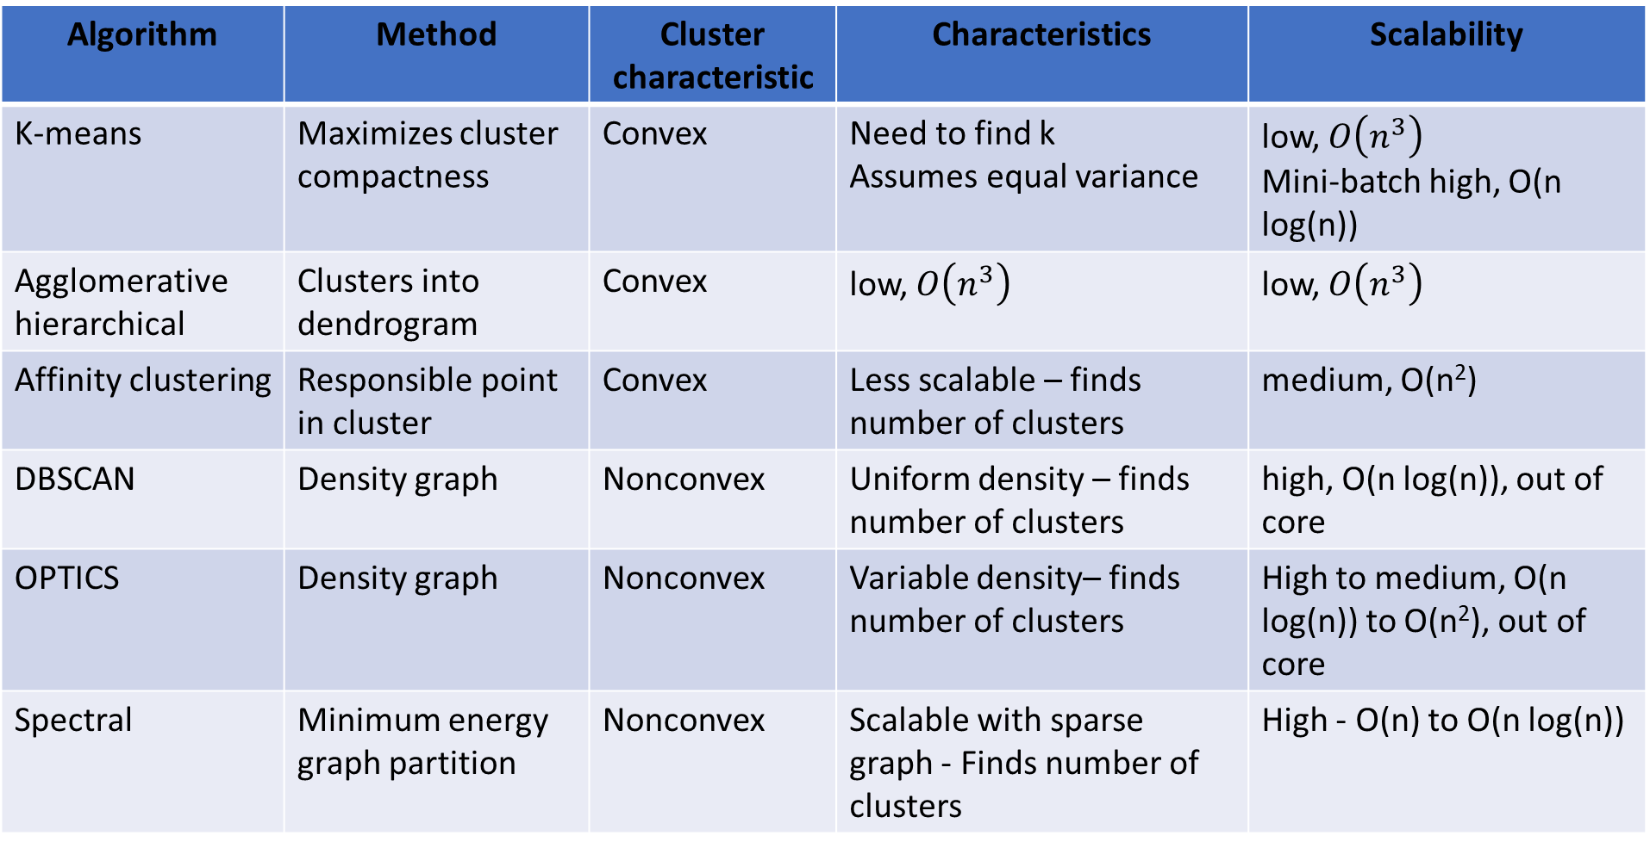
Summary
Algorithm | Method | Cluster characteristic | Characteristics | Scalability
K-means | Maximizes cluster compactness | Convex | Need to find k Assumes equal variance | low, $O\left(n^{3}\right)$ Mini-batch high, O(n log(n))
Agglomerative hierarchical | Clusters into dendrogram | Convex | low, $O\left(n^{3}\right)$ | low, $O\left(n^{3}\right)$
Affinity clustering | Responsible point in cluster | Convex | Less scalable – finds number of clusters | medium, O(n²)
DBSCAN | Density graph | Nonconvex | Uniform density – finds number of clusters | high, O(n log(n)), out of core
OPTICS | Density graph | Nonconvex | Variable density– finds number of clusters | High to medium, O(n log(n)) to O(n²), out of core
Spectral | Minimum energy graph partition | Nonconvex | Scalable with sparse graph - Finds number of clusters | High - O(n) to O(n log(n))

