Slide 1

CSCI E-96 Data Mining, Discovery and Exploration Efficient Similarity Search
Steve Elston
Copyright 2021, 2022, 2023, 2024, 2025, Stephen F Elston. All rights reserved.

Slide 2
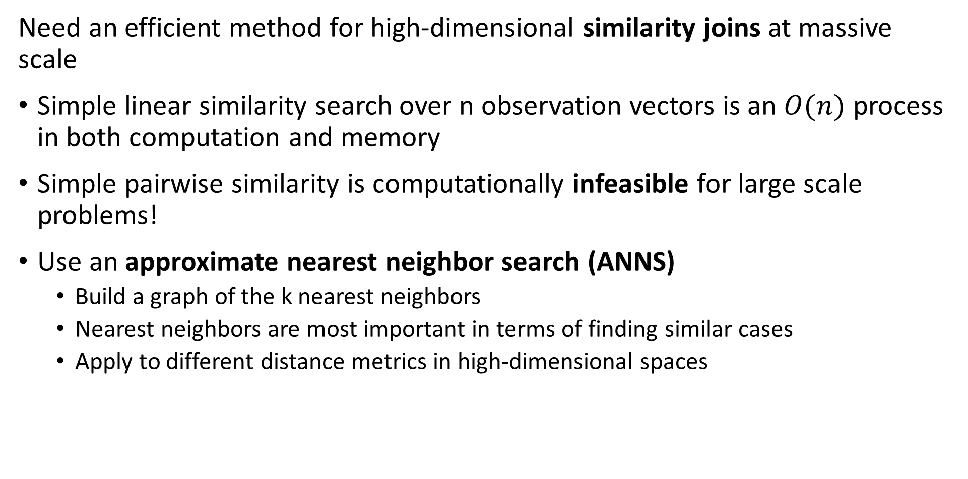
Similarity Search at Scale
Need an efficient method for high-dimensional similarity joins at massive scale
Simple linear similarity search over n observation vectors is an $O(n)$ process in both computation and memory
Simple pairwise similarity is computationally infeasible for large scale problems!
Use an approximate nearest neighbor search (ANNS)
Build a graph of the k nearest neighbors
Nearest neighbors are most important in terms of finding similar cases
Apply to different distance metrics in high-dimensional spaces

Slide 3
Similarity Search at Scale
Need an efficient method for high-dimensional similarity joins at massive scale
Constructing nearest-neighbor graphs
Retrieval Augmented Generation (RAG) models for generative AI
Cluster models
Dimensionality reduction
Find similar products and for recommendation
Find similar documents
Web search
Document search
Deduplication
Plagiarism detection
Search for similar images

Slide 4
Similarity Search at Scale
Pipeline for similarity joins at massive scale
Our goal is to find rapidly approximate nearest neighbors with high recall
No one method can achieve this goal
In practice use a pipeline which concatenates several methods
Dimensionality Reduction
Create D dimensional numeric embedding vectors
PCA
Neural Embedding
Padding
Etc.
Coarse Quantization
Reduce scope for ANN search
Inverted file - IVF
IVF Product quantization (IVF-PQ)
Inverted Multi-Index (IMI)
IVF Hierarchical Navigable Small Worlds (HNSW)
Etc…
Fine Quantizaton
Further reduce search scope and improve recall
Exhaustive search – Flat
Residual PQ
Locally Sensitive Hashing (LSH)
Search Refinemnet
Increase recall for NN search
Flat
Refine algorithm

Slide 5
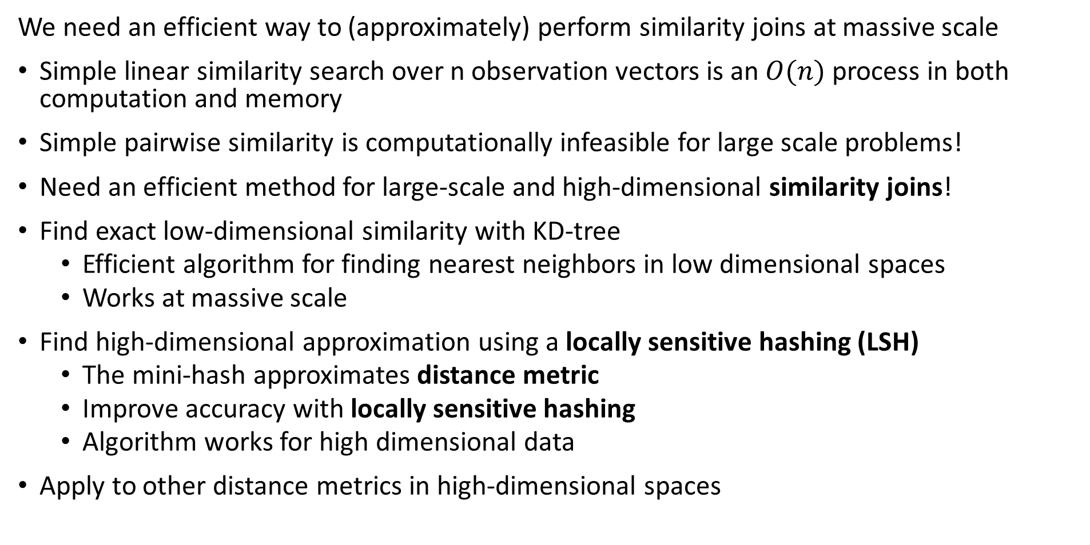
Similarity Search at Scale
We need an efficient way to (approximately) perform similarity joins at massive scale
Simple linear similarity search over n observation vectors is an $O(n)$ process in both computation and memory
Simple pairwise similarity is computationally infeasible for large scale problems!
Need an efficient method for large-scale and high-dimensional similarity joins!
Find exact low-dimensional similarity with KD-tree
Efficient algorithm for finding nearest neighbors in low dimensional spaces
Works at massive scale
Find high-dimensional approximation using a locally sensitive hashing (LSH)
The mini-hash approximates distance metric
Improve accuracy with locally sensitive hashing
Algorithm works for high dimensional data
Apply to other distance metrics in high-dimensional spaces

Slide 6
Similarity Search at Scale
Dimensionality reduction often applied to similarity serarch
It is easier to search in a lower-dimensional space
Many possible transformations to lower-dimensional embedding space
Often need a nearest neighbor similarity search first!
Can use a neural network to find an embedding space, but computationally intensive
Ideally want an orthogonal embedding space
More on dimensionality reduction later in the course

Slide 7
Flat Similarity Search

Slide 8
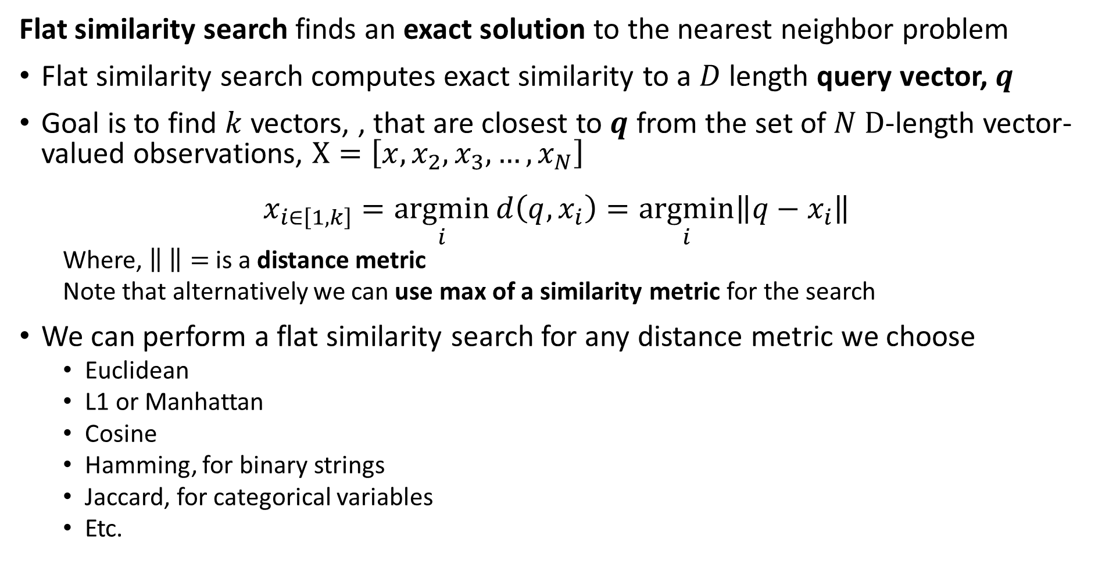
Flat similarity search finds exact solution
Flat similarity search finds an exact solution to the nearest neighbor problem
Flat similarity search computes exact similarity to a $D$ length query vector, $q$
Goal is to find $k$ vectors, , that are closest to $q$ from the set of $N D$-length vector-valued observations, $X=\left[x,x_{2},x_{3},…,x_{N}\right]$
$$x_{i∈\left[1,k\right]}=\underset{i}{argmin}{d\left(q, x_{i}\right)}=\underset{i}{argmin}{{\left\|q−x_{i}\right\|}^{ }}$$
Where, $\left\| \right\|=$ is a distance metric
Note that alternatively we can use max of a similarity metric for the search
We can perform a flat similarity search for any distance metric we choose
Euclidean
L1 or Manhattan
Cosine
Hamming, for binary strings
Jaccard, for categorical variables
Etc.

Slide 9
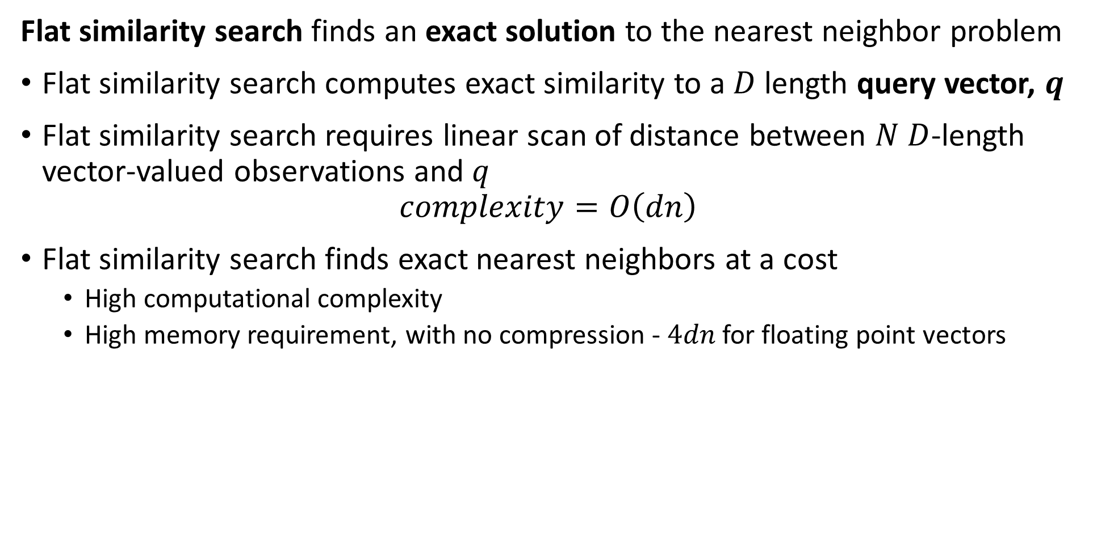
Flat similarity search finds exact solution
Flat similarity search finds an exact solution to the nearest neighbor problem
Flat similarity search computes exact similarity to a $D$ length query vector, $q$
Flat similarity search requires linear scan of distance between $N$ $D$-length vector-valued observations and $q$
$$complexity=O\left(dn\right)$$
Flat similarity search finds exact nearest neighbors at a cost
High computational complexity
High memory requirement, with no compression - $4dn$ for floating point vectors

Slide 10
Flat similarity search finds exact solution
Is any similarity search truly exact?
Unlikely!
Distance is dependent on the distance metric used
Dimensionality reduction provides only an approximate representation of original vector
Vector valued observations are subject to noise
In reality we only need an NN similarity search good enough for our task

Slide 11
Evaluation of ANNS

Slide 12
Evaluation of ANNS
How do we objectively evaluate ANNS algorithms
There are three dimensions of performance
Recall measures the fraction of true NNs found by the algorithm
Memory use can be the biggest constraint for massive data sets
Speed can be important for many applications
Is an invariable trade off between these three dimensions
Example, we can have high recall if we have sufficient memory and computational capacity
Generally we must pick two of the three dimensions and accept the third

Slide 13
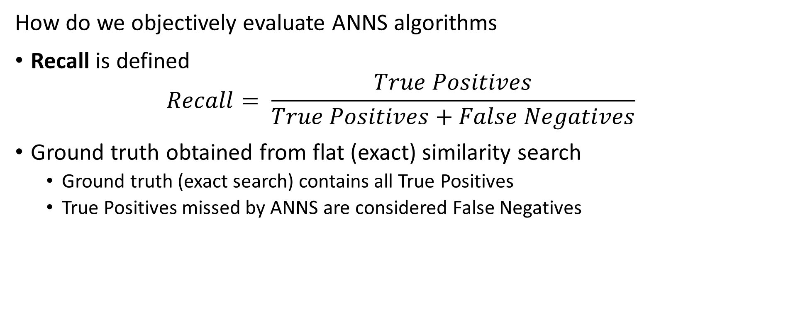
Evaluation of ANNS
How do we objectively evaluate ANNS algorithms
Recall is defined
$$Recall= \frac{True Positives}{True Positives+False Negatives}$$
Ground truth obtained from flat (exact) similarity search
Ground truth (exact search) contains all True Positives
True Positives missed by ANNS are considered False Negatives

Slide 14
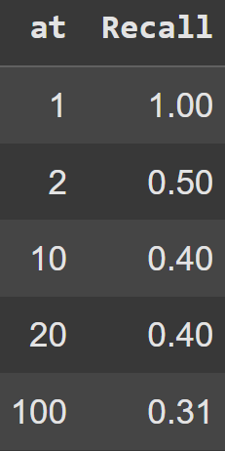
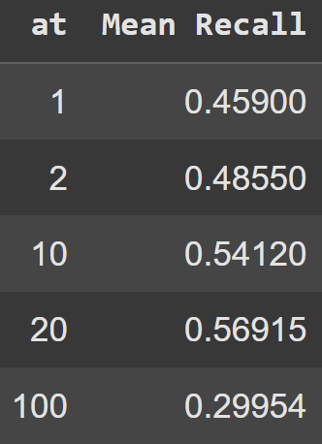
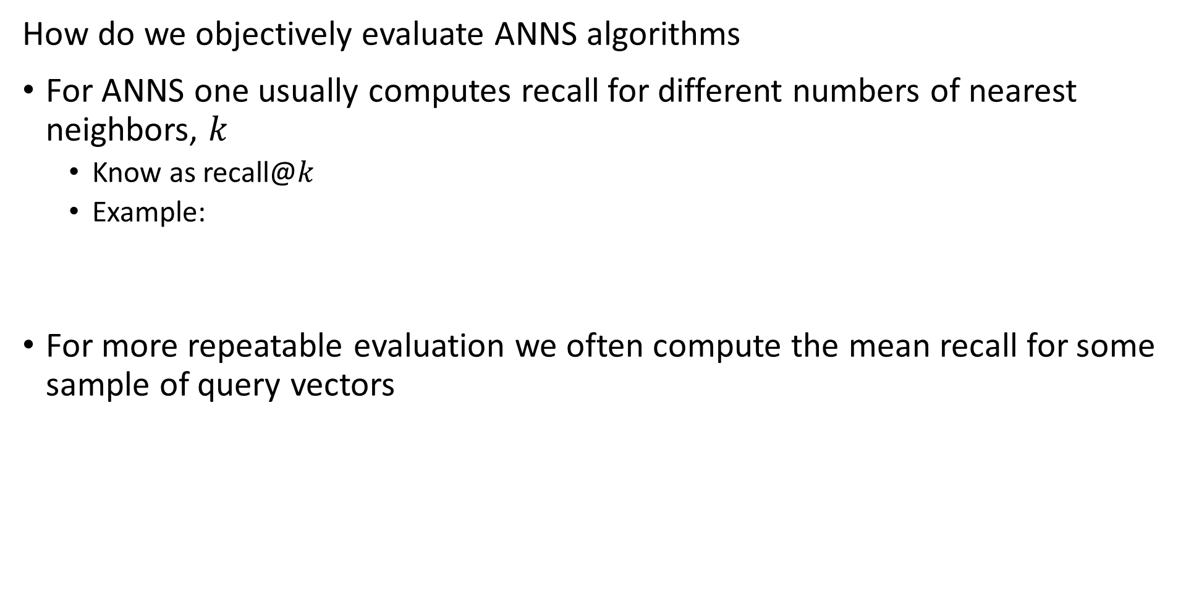
Evaluation of ANNS
How do we objectively evaluate ANNS algorithms
For ANNS one usually computes recall for different numbers of nearest neighbors, $k$
Know as recall@$k$
Example:
For more repeatable evaluation we often compute the mean recall for some sample of query vectors

Slide 15
Inverted File Systems

Slide 16
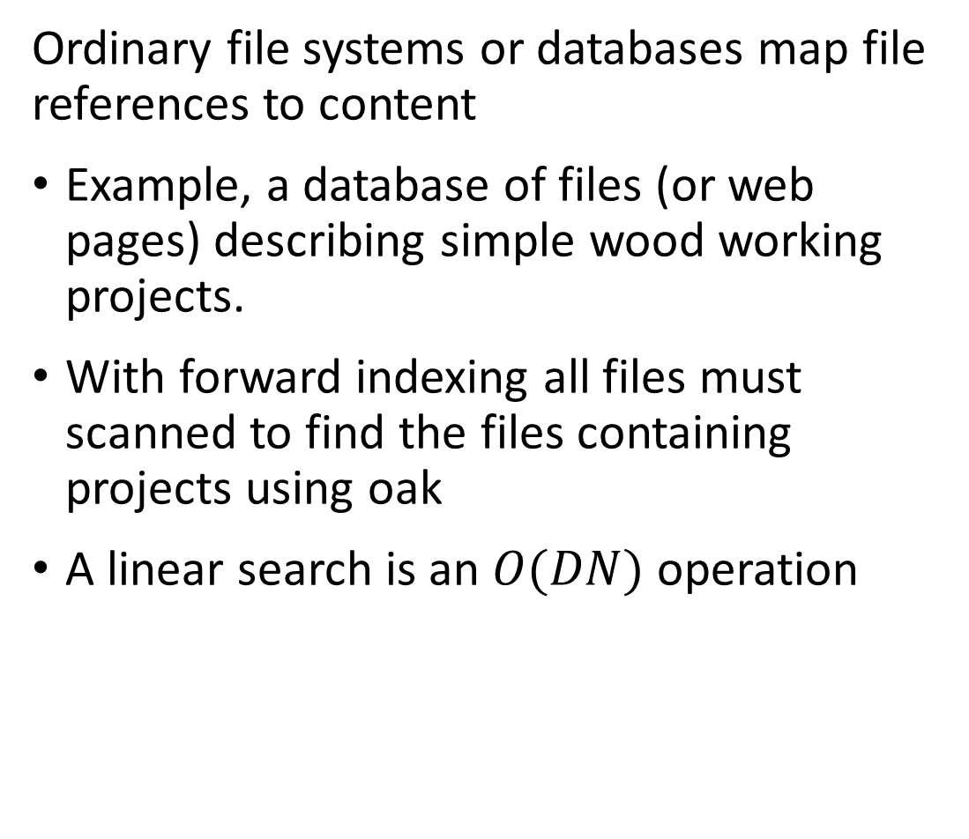
Inverted file systems enable look-up by value
Ordinary file systems or databases map file references to content
Example, a database of files (or web pages) describing simple wood working projects.
With forward indexing all files must scanned to find the files containing projects using oak
A linear search is an $O(DN)$ operation
File ID
101
102
103
104
105
106
107
108
109
110
111
112
113
114
115
Wood type
Oak
Pine
Oak
Maple
Fir
Maple
Fir
Oak
Maple
Fir
Maple
Pine
Maple
Oak
Oak

Slide 17
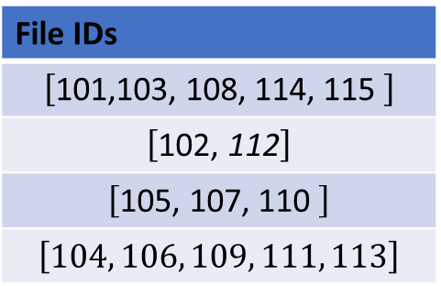
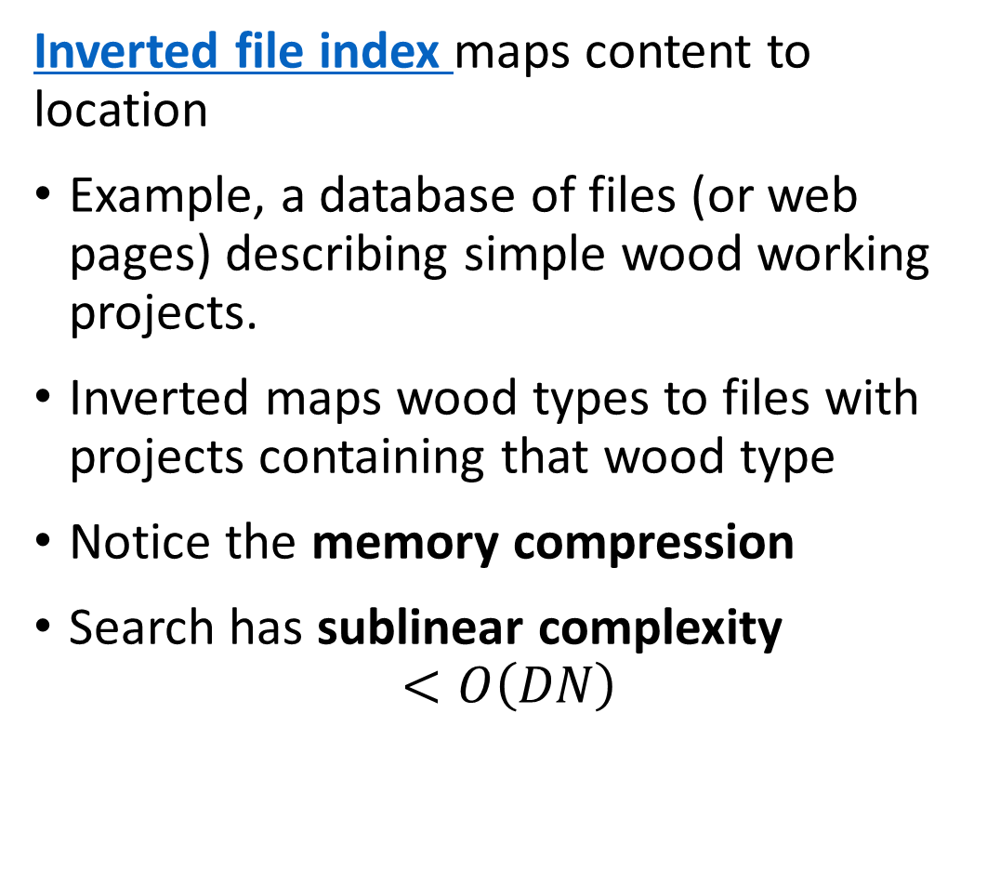
Inverted file systems enable look-up by value
Inverted file index maps content to location
Example, a database of files (or web pages) describing simple wood working projects.
Inverted maps wood types to files with projects containing that wood type
Notice the memory compression
Search has sublinear complexity
$$<O\left(DN\right)$$
Wood type
Oak
Pine
Fir
Maple
File IDs
$$\left[\text{101,}\text{103, }\text{108,} \text{114,} \text{115 }\right]$$
$$\left[\text{10}\text{2}\text{,}\text{ 112}\right]$$
$$\left[\text{10}\text{5}\text{, 1}\text{07}\text{, 11}\text{0} \right]$$
$$\left[104, 106, 109, 111, 113\right]$$

Slide 18
Coarse Quantization

Slide 19















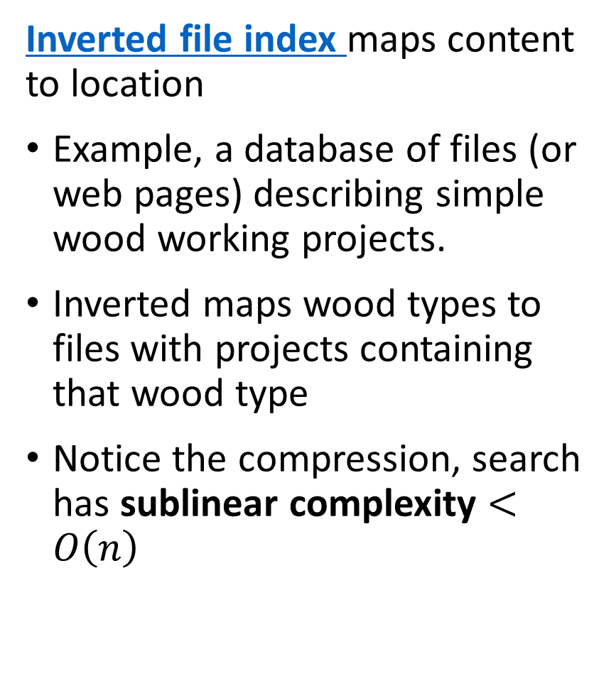



Coarse coding divides the search region
Inverted file index maps content to location
Example, a database of files (or web pages) describing simple wood working projects.
Inverted maps wood types to files with projects containing that wood type
Notice the compression, search has sublinear complexity $<O\left(n\right)$
$$c_{4}$$
$$c_{5}$$
$$c_{3}$$
$$c_{2}$$
$$c_{6}$$
$$c_{14}$$
$$c_{1}$$
$$c_{7}$$
$$c_{8}$$
$$c_{13}$$
$$c_{15}$$
$$c_{10}$$
$$c_{9}$$
$$c_{16}$$
$$c_{12}$$
$$c_{17}$$
$$c_{11}$$
$$c_{18}$$

Slide 20
Coarse coding divides the search region
Coarse coding speeds NN search by reducing scope
To speed NN search by orders of magnitude limit scope of search
Coarse coding divides the search scope into small cells
Similar vectors are within the cells
Can use the cell ids in an inverted index for fast lookup of similar vectors

Slide 21
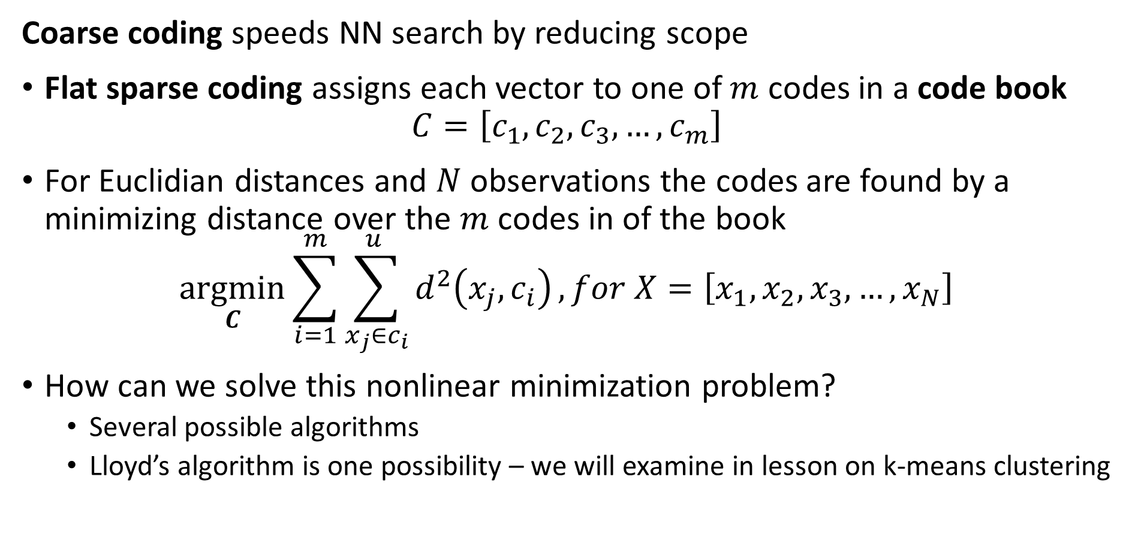
Coarse coding divides the search region
Coarse coding speeds NN search by reducing scope
Flat sparse coding assigns each vector to one of $m$ codes in a code book
$$C=\left[c_{1},c_{2},c_{3},…,c_{m}\right]$$
For Euclidian distances and $N$ observations the codes are found by a minimizing distance over the $m$ codes in of the book
$$\underset{C}{argmin}{\sum_{i=1}^{m}{\sum_{x_{j}∈c_{i}}^{u }{d^{2}\left(x_{j},c_{i}\right)}}}, for X=\left[x_{1},x_{2},x_{3},…,x_{N}\right]$$
How can we solve this nonlinear minimization problem?
Several possible algorithms
Lloyd’s algorithm is one possibility – we will examine in lesson on k-means clustering

Slide 22
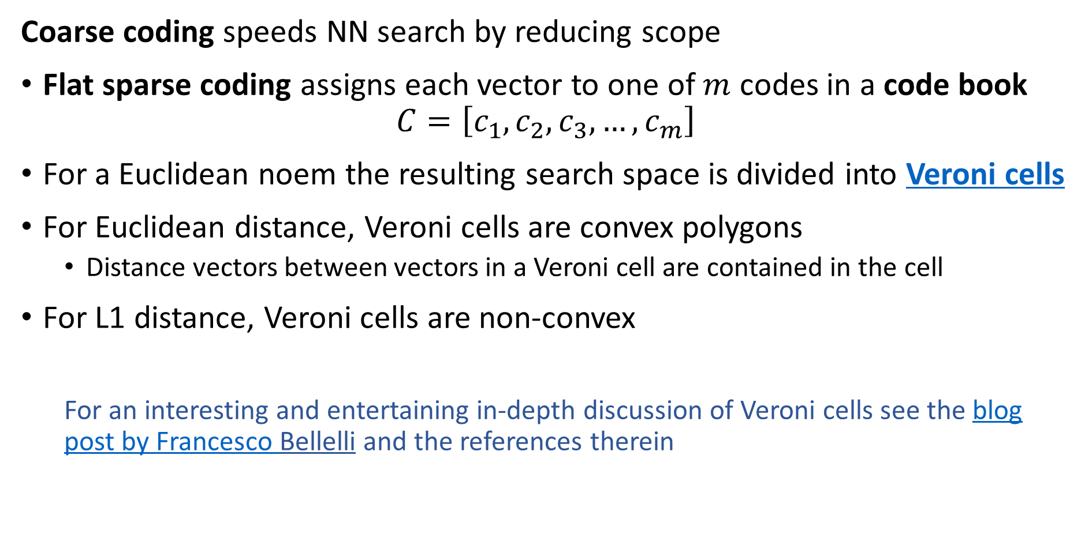
Coarse coding divides the search region
Coarse coding speeds NN search by reducing scope
Flat sparse coding assigns each vector to one of $m$ codes in a code book
$$C=\left[c_{1},c_{2},c_{3},…,c_{m}\right]$$
For a Euclidean noem the resulting search space is divided into Veroni cells
For Euclidean distance, Veroni cells are convex polygons
Distance vectors between vectors in a Veroni cell are contained in the cell
For L1 distance, Veroni cells are non-convex
For an interesting and entertaining in-depth discussion of Veroni cells see the blog post by Francesco Bellelli and the references therein

Slide 23

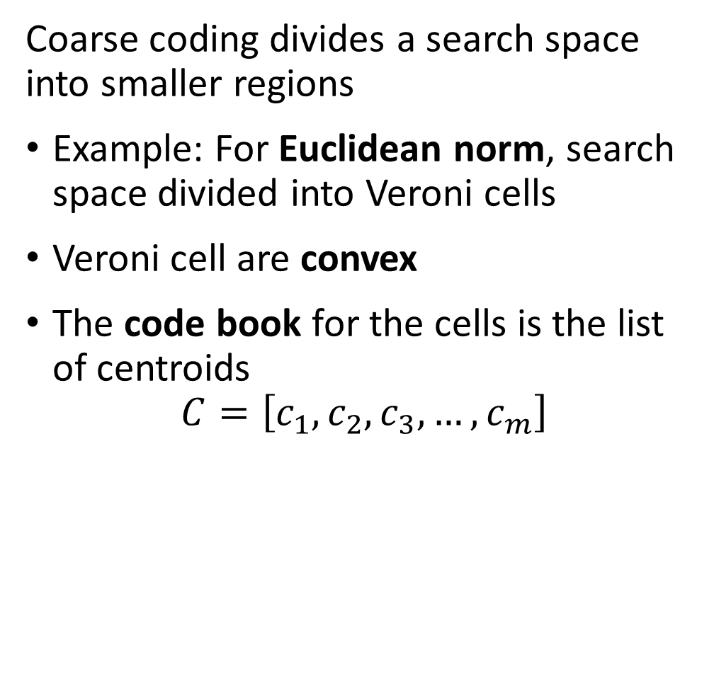







Coarse coding divides the search region
Coarse coding divides a search space into smaller regions
Example: For Euclidean norm, search space divided into Veroni cells
Veroni cell are convex
The code book for the cells is the list of centroids
$$C=\left[c_{1},c_{2},c_{3},…,c_{m}\right]$$
$$c_{3}$$
$$c_{2}$$
$$c_{7}$$
$$c_{1}$$
$$c_{4}$$
$$c_{8}$$
$$c_{6}$$
$$c_{5}$$

Slide 24
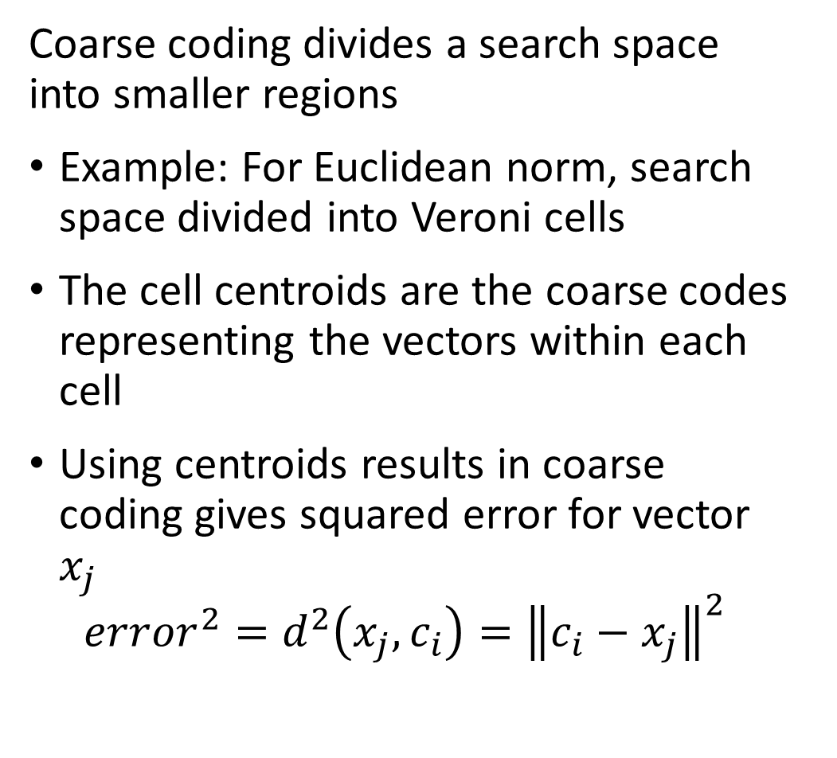
Coarse coding divides the search region
Coarse coding divides a search space into smaller regions
Example: For Euclidean norm, search space divided into Veroni cells
The cell centroids are the coarse codes representing the vectors within each cell
Using centroids results in coarse coding gives squared error for vector $x_{j}$
$${error}^{2}=d^{2}\left(x_{j},c_{i}\right)={\left\|c_{i}−x_{j}\right\|}^{2}$$
$$c_{3}$$
$$c_{2}$$
$$c_{7}$$
$$c_{1}$$
$$c_{4}$$
$$c_{8}$$
$$c_{6}$$
$$c_{5}$$

Slide 25
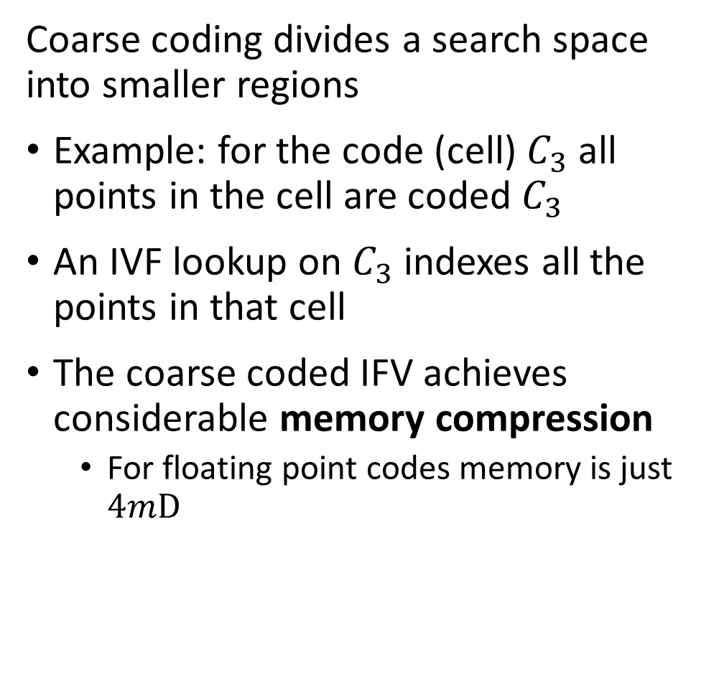
Coarse coding divides the search region
Coarse coding divides a search space into smaller regions
Example: for the code (cell) $C_{3}$ all points in the cell are coded $C_{3}$
An IVF lookup on $C_{3}$ indexes all the points in that cell
The coarse coded IFV achieves considerable memory compression
For floating point codes memory is just $4mD$
$$c_{3}$$
$$c_{2}$$
$$c_{7}$$
$$c_{1}$$
$$c_{4}$$
$$c_{8}$$
$$c_{6}$$
$$c_{5}$$

Slide 26
Product Quantization

Slide 27
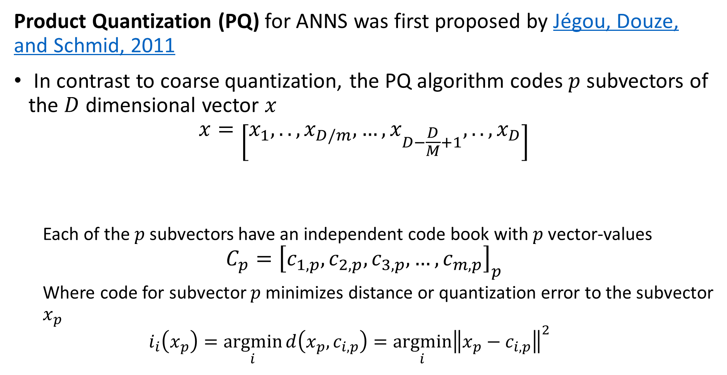
Product Quantization
Product Quantization (PQ) for ANNS was first proposed by Jégou, Douze, and Schmid, 2011
In contrast to coarse quantization, the PQ algorithm codes $p$ subvectors of the $D$ dimensional vector $x$
$$x=\left[x_{1},..,x_{D/m},…,x_{D−\frac{D}{M}+1},..,x_{D}\right]$$
Each of the $p$ subvectors have an independent code book with $p$ vector-values
$$C_{p}={\left[c_{1,p},c_{2,p},c_{3,p},…,c_{m,p}\right]}_{p}$$
Where code for subvector $p$ minimizes distance or quantization error to the subvector $x_{p}$
$$i_{i}\left(x_{p}\right)=\underset{i}{argmin}{d\left(x_{p}, c_{i,p}\right)}=\underset{i}{argmin}{{\left\|x_{p}−c_{i,p}\right\|}^{2}}$$
Subvector 1
Subvector p

Slide 28
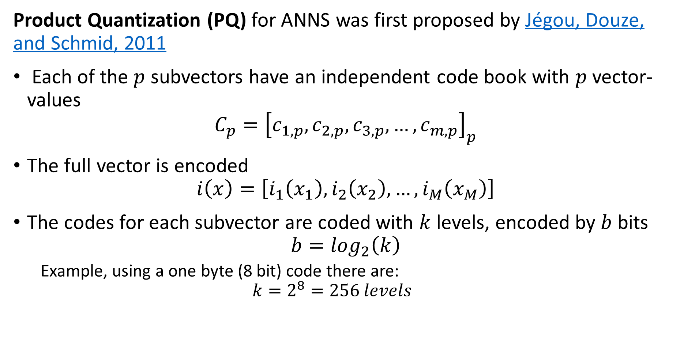
Product Quantization
Product Quantization (PQ) for ANNS was first proposed by Jégou, Douze, and Schmid, 2011
Each of the $p$ subvectors have an independent code book with $p$ vector-values
$$C_{p}={\left[c_{1,p},c_{2,p},c_{3,p},…,c_{m,p}\right]}_{p}$$
The full vector is encoded
$$i\left(x\right)=\left[i_{1}\left(x_{1}\right),i_{2}\left(x_{2}\right),…,i_{M}\left(x_{M}\right)\right]$$
The codes for each subvector are coded with $k$ levels, encoded by $b$ bits
$$b=\log_{2}\left(k\right)$$
Example, using a one byte (8 bit) code there are:
$$k=2^{8}=256 levels$$

Slide 29
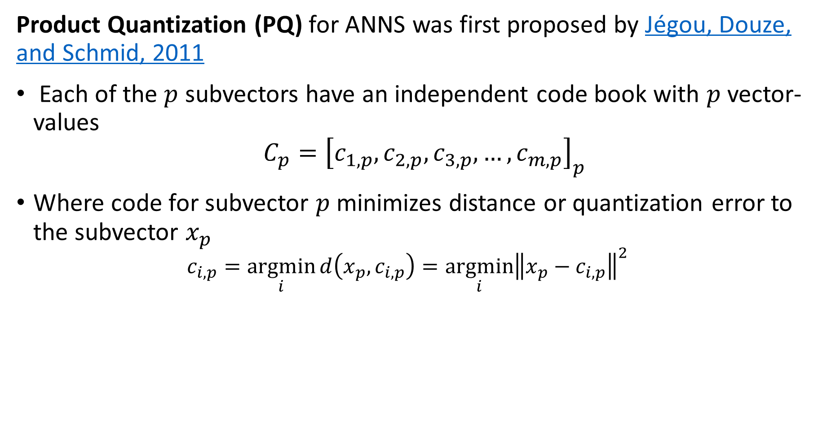
Product Quantization
Product Quantization (PQ) for ANNS was first proposed by Jégou, Douze, and Schmid, 2011
Each of the $p$ subvectors have an independent code book with $p$ vector-values
$$C_{p}={\left[c_{1,p},c_{2,p},c_{3,p},…,c_{m,p}\right]}_{p}$$
Where code for subvector $p$ minimizes distance or quantization error to the subvector $x_{p}$
$$c_{i,p}=\underset{i}{argmin}{d\left(x_{p}, c_{i,p}\right)}=\underset{i}{argmin}{{\left\|x_{p}−c_{i,p}\right\|}^{2}}$$

Slide 30
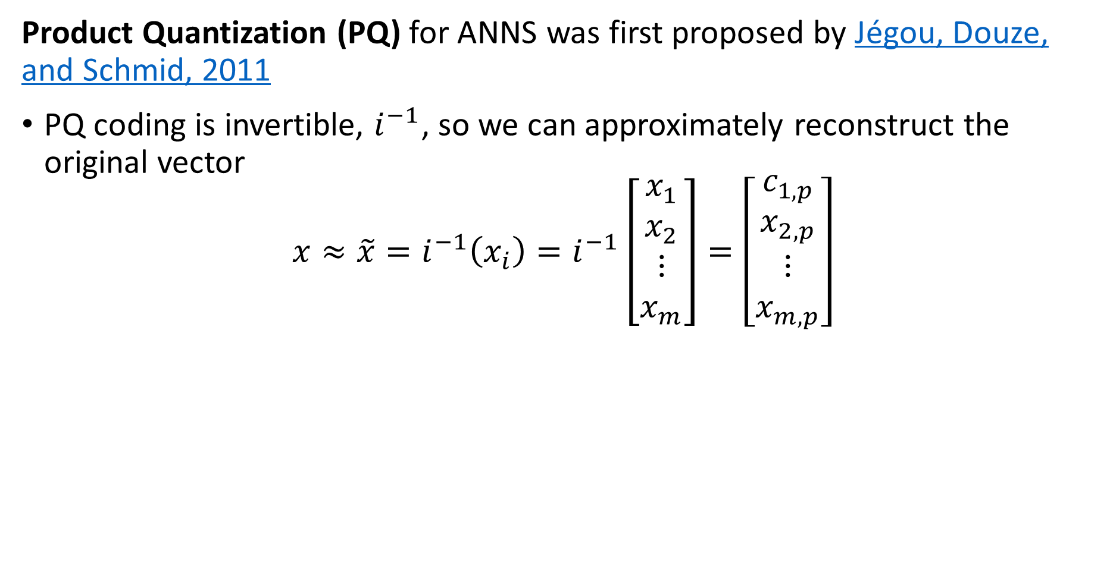
Product Quantization
Product Quantization (PQ) for ANNS was first proposed by Jégou, Douze, and Schmid, 2011
PQ coding is invertible, $i^{−1}$, so we can approximately reconstruct the original vector
$$x≈\tilde{x}=i^{−1}\left(x_{i}\right)=i^{−1}\left[\begin{matrix}x_{1} \\ x_{2} \\ \begin{matrix}⋮ \\ x_{m}\end{matrix}\end{matrix}\right]=\left[\begin{matrix}c_{1,p} \\ x_{2,p} \\ \begin{matrix}⋮ \\ x_{m,p}\end{matrix}\end{matrix}\right]$$

Slide 31
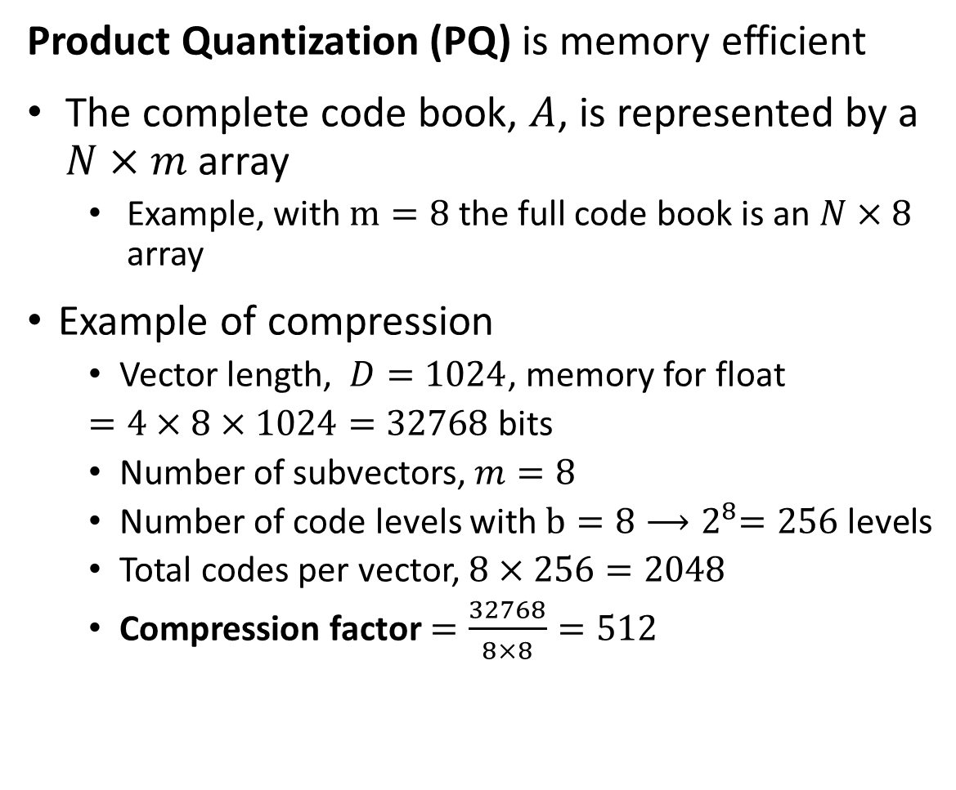


Product Quantization
Product Quantization (PQ) is memory efficient
The complete code book, $A$, is represented by a $N×m$ array
Example, with $m=8$ the full code book is an $N×8$ array
Example of compression
Vector length, $D=1024$, memory for float
$=4×8×1024=32768$ bits
Number of subvectors, $m=8$
Number of code levels with $b=8{⟶2}^{8}=256$ levels
Total codes per vector, $8×256=2048$
Compression factor $=\frac{32768}{8×8}=512$
$$m$$
0 ,0
0 ,1
. . .
0 ,k-1
1 ,0
1 ,1
. . .
1 ,k-1
2 ,0
2 ,1
. . .
2 ,k-1
3 ,0
3 ,1
. . .
3 ,k-1
$$N$$
.
.
.
.
.
.
.
.
.
N-2 ,0
N-2 ,1
. . .
N-2 ,k-1
N-1,0
N-1,1
. . .
N-1,k-1

Slide 32
Hierarchical Navigable Small World (HNSW) Graphs

Slide 33
Hierarchical Navigable Small World Graphs
Hierarchical navigable small world (HNSW) graphs for ANNS where first proposed for ANNS by Malkov and Yashunin, 2011
A HNSW graph performs an ANNS on a hierarchy of graphs in two greedy search steps
Search through hierarchy from top to bottom with increasing detail, ‘zooming in’
Search at most detailed level, ‘zooming out’
HNSW graphs incorporate several concepts
Probabilistic hierarchical search
Proximity graphs
Navigable small world graphs

Slide 34
Building KD-Trees

Slide 35
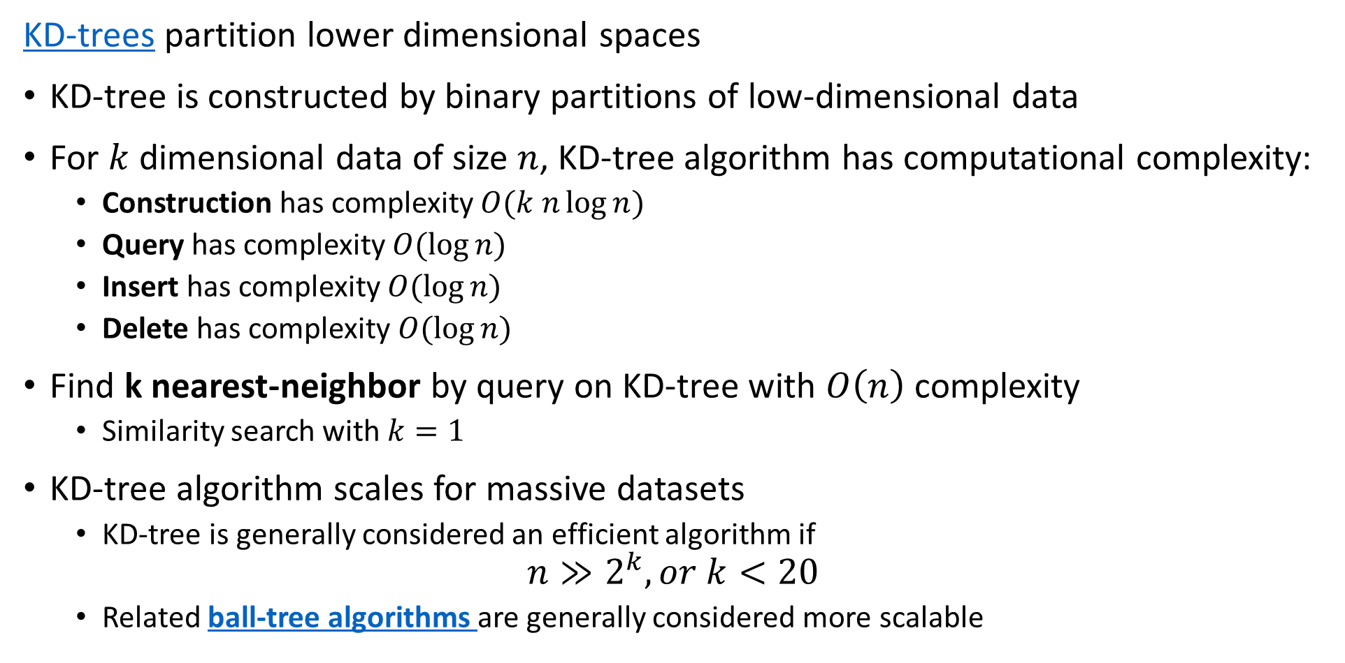
KD-Trees
KD-trees partition lower dimensional spaces
KD-tree is constructed by binary partitions of low-dimensional data
For $k$ dimensional data of size $n$, KD-tree algorithm has computational complexity:
Construction has complexity $O(k n\log{n})$
Query has complexity $O(\log{n})$
Insert has complexity $O(\log{n})$
Delete has complexity $O(\log{n})$
Find k nearest-neighbor by query on KD-tree with $O\left(n\right)$ complexity
Similarity search with $k=1$
KD-tree algorithm scales for massive datasets
KD-tree is generally considered an efficient algorithm if
$$n≫2^{k}, or k<20$$
Related ball-tree algorithms are generally considered more scalable

Slide 36
KD-Trees
A KD-tree is constructed by binary partitions through these steps
Start with the set of observations
Number of observations per leaf is defined – a hyperparameter
Splits are along the axes of the data space
Axes are sampled round-robin or randomly
On each axis split point is determined
Split is on observation closest to median, mean or other measure
Splitting hyperplane is perpendicular to the axis selected
Observations in region split are partitioned left and right of hyperplane
Repeat steps 2-6 until leaf has less than required number of observations
The termination condition

Slide 37
KD-Trees
Many sources discussing details of KD-tree algorithms, their limitations and the pitfalls, with a few suggestions
Chapter from Andrew Moore’s PhD dissertation
Chapters 8, 9, 10, 11 of Advanced Algorithms and Data Structures, Marcello La Rocca, Manning, 2021
Wikipedia article
For a fairly theoretical but comprehensive review paper on approximate nearest neighbor search algorithms see Andoni, Indyk and Razenshteyn, 2018

Slide 38
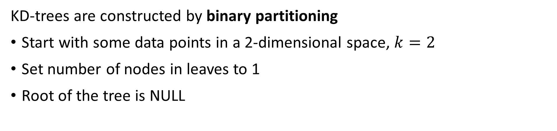


KD-Trees
KD-trees are constructed by binary partitioning
Start with some data points in a 2-dimensional space, $k=2$
Set number of nodes in leaves to 1
Root of the tree is NULL
$$x_{2}$$
A
B
C
J
J
D
E
G
F
I
H
$$x_{1}$$

Slide 39
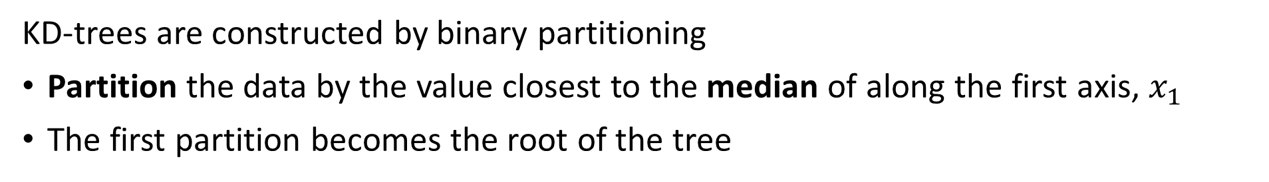
KD-Trees
KD-trees are constructed by binary partitioning
Partition the data by the value closest to the median of along the first axis, $x_{1}$
The first partition becomes the root of the tree
E
$$x_{2}$$
A
B
C
J
J
D
E
G
F
I
H
$$x_{1}$$

Slide 40
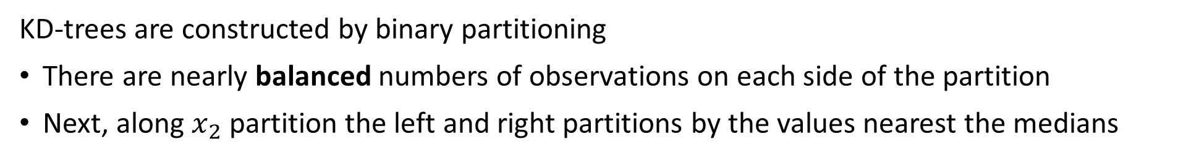
KD-Trees
KD-trees are constructed by binary partitioning
There are nearly balanced numbers of observations on each side of the partition
Next, along $x_{2}$ partition the left and right partitions by the values nearest the medians
E
$$x_{2}$$
A
B
D
G
C
J
J
D
E
G
F
I
H
K
$$x_{1}$$

Slide 41
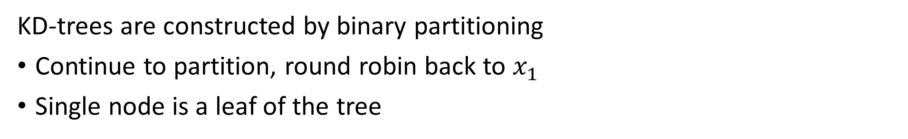
KD-Trees
KD-trees are constructed by binary partitioning
Continue to partition, round robin back to $x_{1}$
Single node is a leaf of the tree
E
$$x_{2}$$
A
B
D
G
C
J
J
J
H
C
K
D
E
G
F
I
H
K
$$x_{1}$$

Slide 42
KD-Trees
KD-trees are constructed by binary partitioning
Now there are only leaves to add to the tree
E
$$x_{2}$$
A
B
D
C
G
J
J
J
H
C
K
D
E
G
A
B
J
F
I
F
I
H
K
$$x_{1}$$

Slide 43
Similarity Queries on KD-Trees

Slide 44
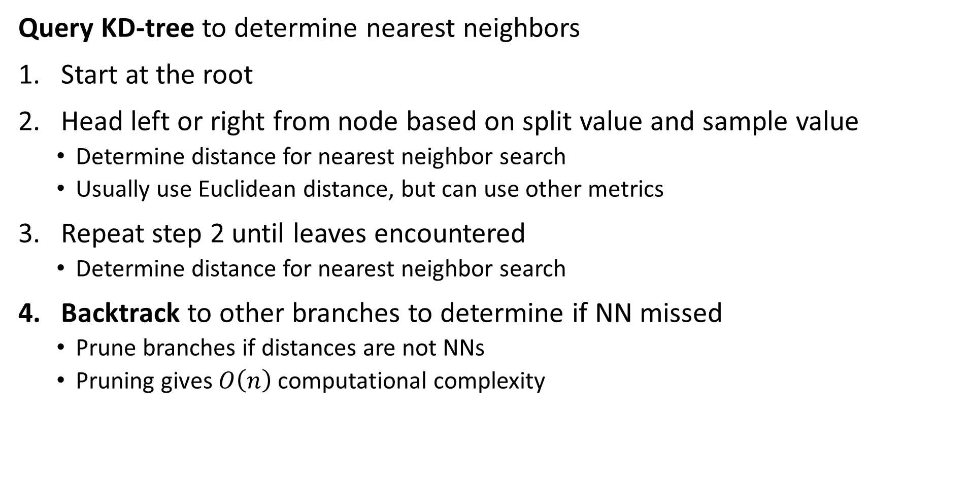
KD-Trees
Query KD-tree to determine nearest neighbors
Start at the root
Head left or right from node based on split value and sample value
Determine distance for nearest neighbor search
Usually use Euclidean distance, but can use other metrics
Repeat step 2 until leaves encountered
Determine distance for nearest neighbor search
Backtrack to other branches to determine if NN missed
Prune branches if distances are not NNs
Pruning gives $O\left(n\right)$ computational complexity

Slide 45
KD-Trees
Can rapidly perform 3-nearest neighbor query a KD-Tree by following the node splits
Start with a new observation, Z
E
$$x_{2}$$
A
B
D
C
G
J
J
J
H
C
K
D
E
G
A
B
J
F
I
F
Z
I
H
K
$$x_{1}$$

Slide 46
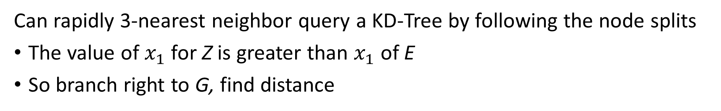
KD-Trees
Can rapidly 3-nearest neighbor query a KD-Tree by following the node splits
The value of $x_{1}$ for Z is greater than $x_{1}$ of E
So branch right to G, find distance
E
$$x_{2}$$
A
B
D
C
G
J
J
J
H
C
K
D
E
G
A
B
J
F
I
F
Z
I
H
K
$$x_{1}$$

Slide 47
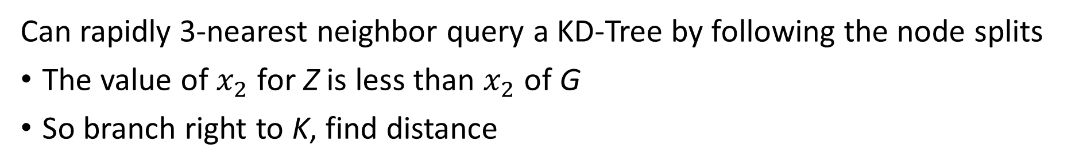
KD-Trees
Can rapidly 3-nearest neighbor query a KD-Tree by following the node splits
The value of $x_{2}$ for Z is less than $x_{2}$ of G
So branch right to K, find distance
E
$$x_{2}$$
A
B
D
C
G
J
J
J
H
C
K
D
E
G
A
B
J
F
I
F
Z
I
H
K
$$x_{1}$$

Slide 48
KD-Trees
Can rapidly 3-nearest neighbor query a KD-Tree by following the node splits
Z has nearest neighbors on graph I, G, K
But is there a nearer neighbor on the graph?
E
$$x_{2}$$
A
B
D
C
G
J
J
J
H
C
K
D
E
G
A
B
J
F
I
F
Z
I
H
K
$$x_{1}$$

Slide 49
KD-Trees
Can rapidly 3-nearest neighbor query a KD-Tree by following the node splits
We need to backtrack to determine if there is a nearer neighbor on another branch
Backtracking to K then to branch with F, finding a nearer neighbor than K
E
$$x_{2}$$
A
B
D
C
G
J
J
J
H
C
K
D
E
G
A
B
J
F
I
F
Z
I
H
K
$$x_{1}$$

Slide 50
KD-Trees
Can rapidly 3-nearest neighbor query a KD-Tree by following the node splits
Continue backtracking to K then to branch to C and J, but no nearer neighbor
We can prune the branch with C and J from the search
E
$$x_{2}$$
A
B
D
C
G
J
J
J
H
C
K
D
E
G
A
B
J
F
I
F
Z
I
H
K
$$x_{1}$$

Slide 51
KD-Trees
Can rapidly query a KD-Tree by following the video splits
The backtrack arrives at the root, terminating the algorithm
E
$$x_{2}$$
A
B
D
C
G
J
J
J
H
C
K
D
E
G
A
B
J
F
I
F
Z
I
H
K
$$x_{1}$$

Slide 52
Mini-Hashes and Sketches For Similarity Search

Slide 53
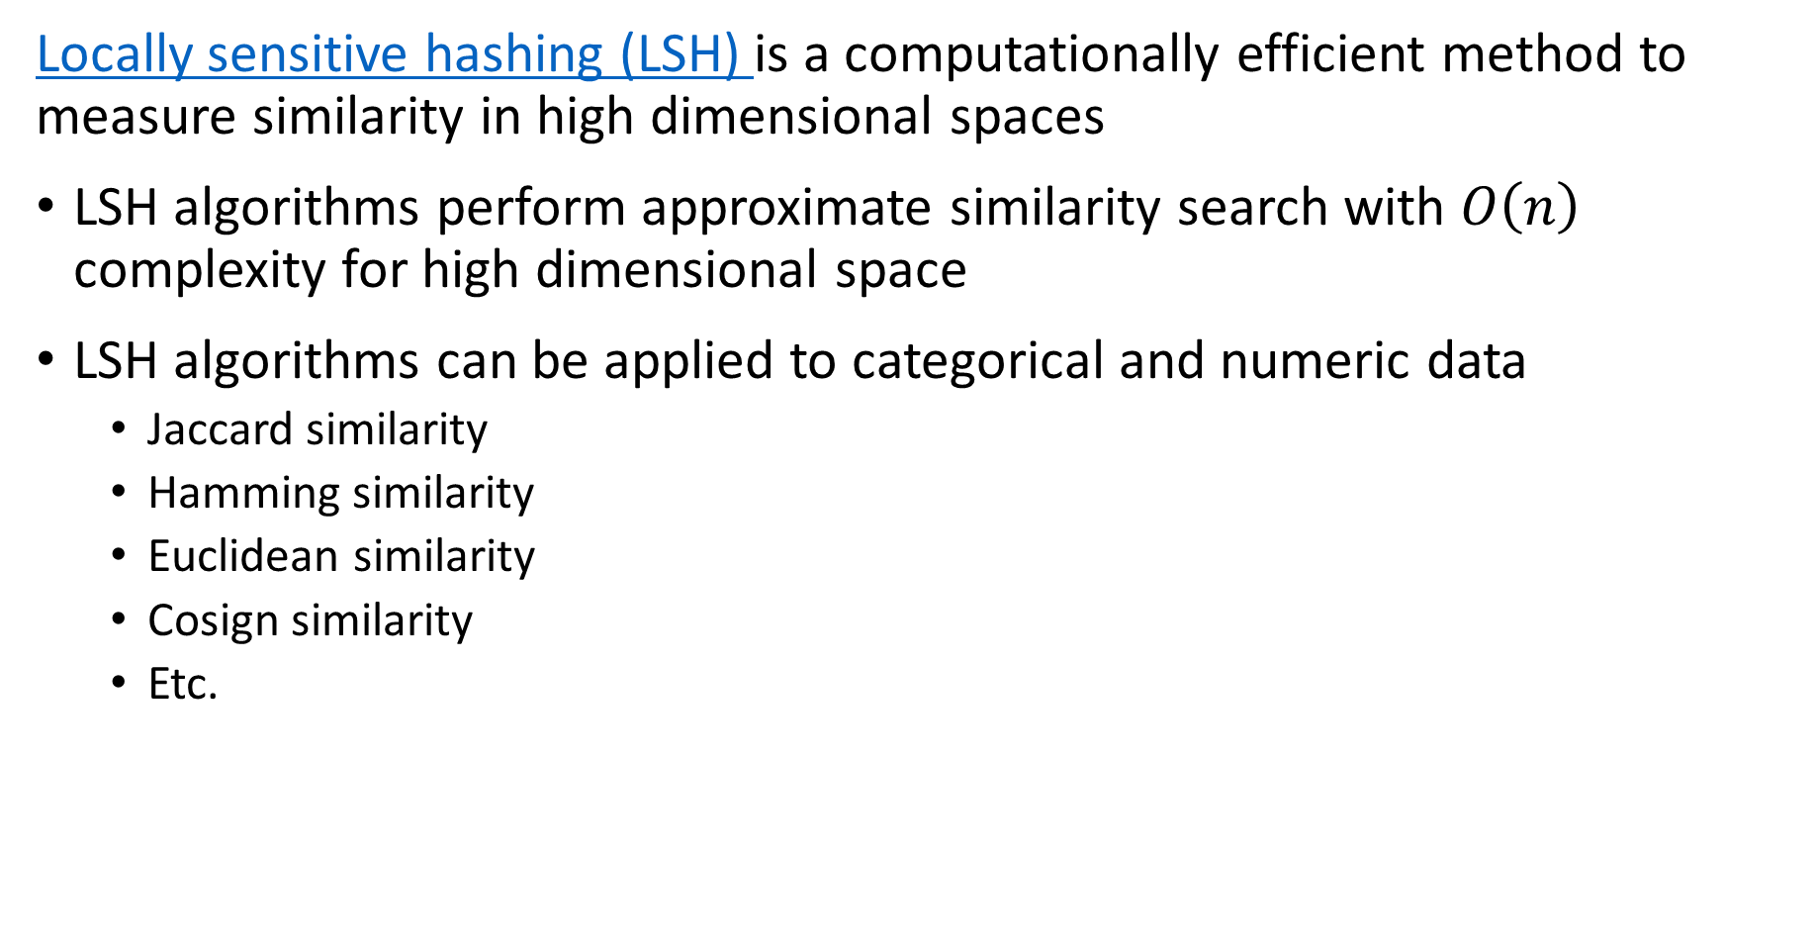
Locally Sensitive Hashing
Locally sensitive hashing (LSH) is a computationally efficient method to measure similarity in high dimensional spaces
LSH algorithms perform approximate similarity search with $O\left(n\right)$ complexity for high dimensional space
LSH algorithms can be applied to categorical and numeric data
Jaccard similarity
Hamming similarity
Euclidean similarity
Cosign similarity
Etc.

Slide 54
Locally Sensitive Hashing
Example, process flow for LSH for document similarity
Goal is to perform similarity search between documents in corpus
Process involves three steps
Similar workflow for images and other content
Document Corpus
Mini-hashing to create sketch
Similarity approximated by LSH
Shingling of document

Slide 55
Shingling Documents
We need an efficient method to measure the similarity of documents
Document is any collection of text
Email, or tweet
Web page or part of a web page
Contract
Chapter of a book or entire book
……
Shingling the document creates a representation used to measure similarity
Shingles are short overlapping strings extracted from the document
A few characters
A few words

Slide 56
Shingling Documents
Shingling the document creates a representation for measuring similarity at massive scale
Shingles can be different sizes – usually character shingles
Example: find the 2-shingles of the following string:
String = aghetfghqew
Set of 2-shingles = {ag, gh, he, et, tf, fg, hq, qe, ew}
Shingle, gh, only in set once
Example: now find the 3-shingles of the same sting:
3-shingles = {agh, ghe, het, etf, tfg, fgh, ghq, hqe, qew}
Example: find the word 3-shingles of the following sentence:
Sentence = this is an uninteresting sentence used for this example
3-shingles = {this is an, is an uninteresting, an uninteresting sentence,
uninteresting sentence used, sentence used for,
used for this, for this example}

Slide 57
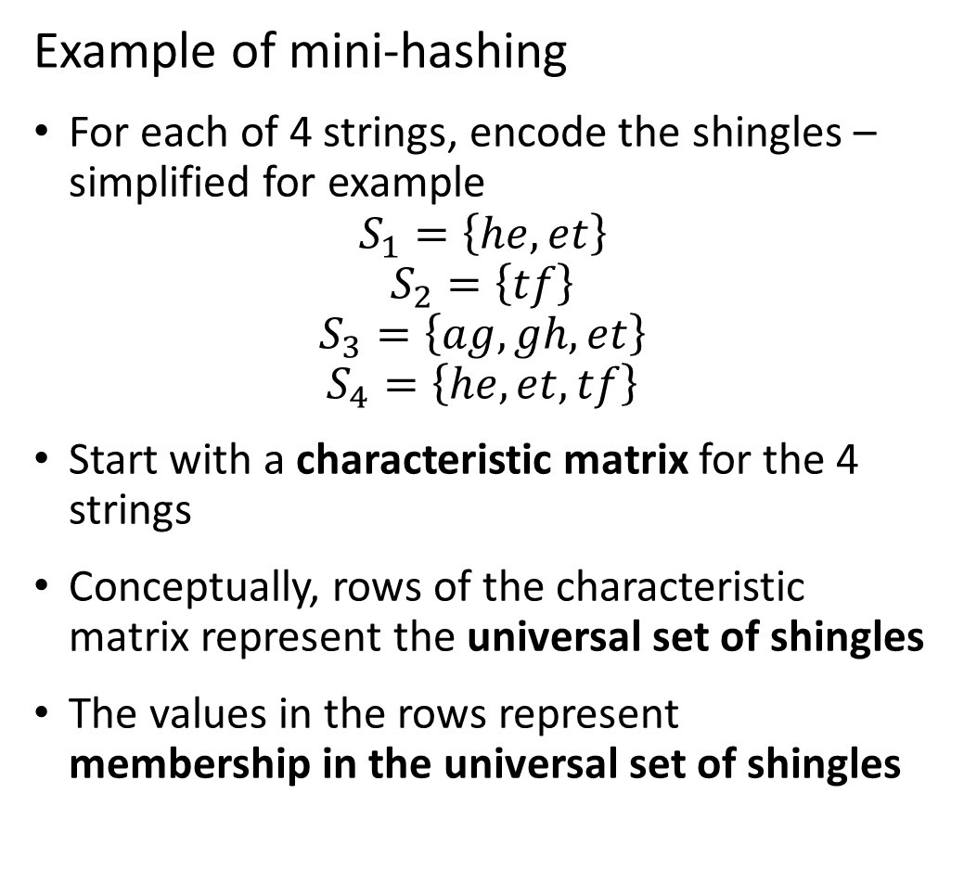
Mini-Hashing for Similarity
Example of mini-hashing
For each of 4 strings, encode the shingles – simplified for example
$$S_{1}=\left\{he,et\right\}$$
$$S_{2}=\left\{tf\right\}$$
$$S_{3}=\left\{ag,gh,et\right\}$$
$$S_{4}=\left\{he,et,tf\right\}$$
Start with a characteristic matrix for the 4 strings
Conceptually, rows of the characteristic matrix represent the universal set of shingles
The values in the rows represent membership in the universal set of shingles
Universal Set | S₁ | S₂ | S₃ | S₄
ag | 0 | 0 | 1 | 0
gh | 0 | 0 | 1 | 0
he | 1 | 0 | 0 | 1
et | 1 | 0 | 1 | 1
tf | 0 | 1 | 0 | 1

Slide 58
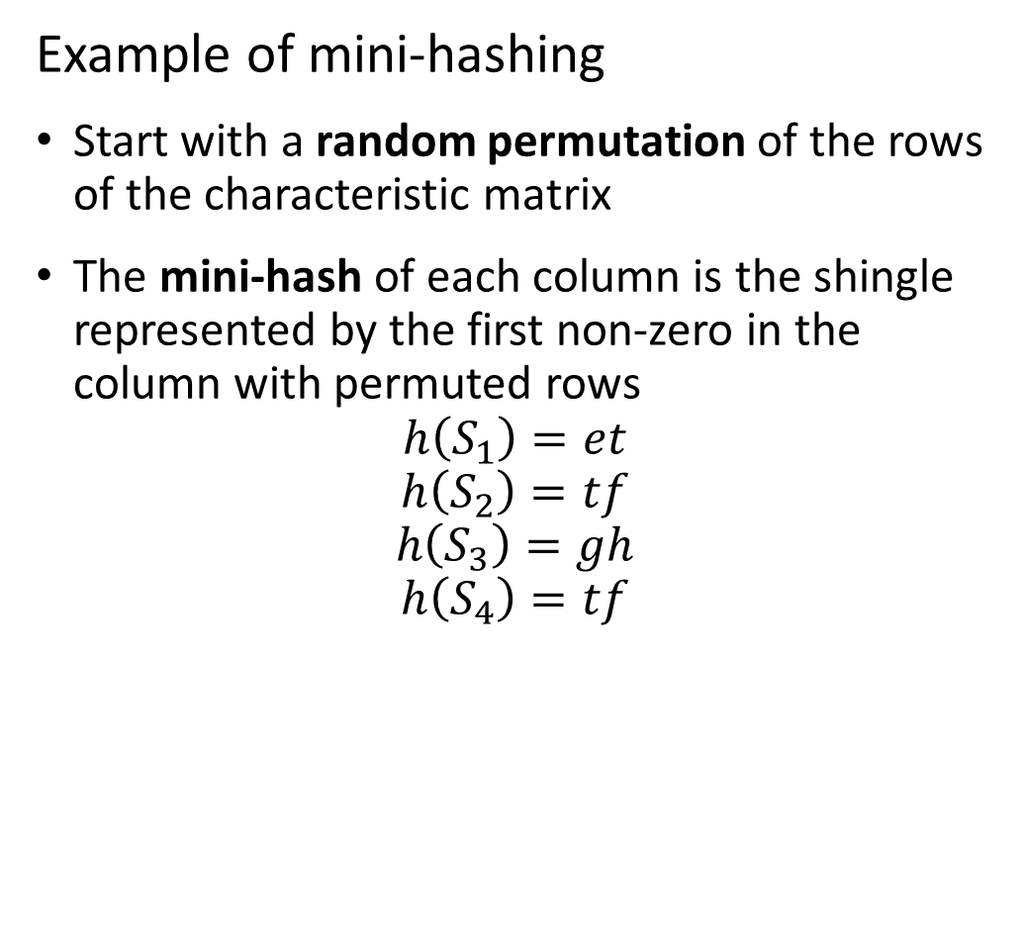
Mini-Hashing for Similarity
Example of mini-hashing
Start with a random permutation of the rows of the characteristic matrix
The mini-hash of each column is the shingle represented by the first non-zero in the column with permuted rows
$$h\left(S_{1}\right)=et$$
$$h\left(S_{2}\right)=tf$$
$$h\left(S_{3}\right)=gh$$
$$h\left(S_{4}\right)=tf$$
Character | S₁ | S₂ | S₃ | S₄
gh | 0 | 0 | 1 | 0
ag | 0 | 0 | 1 | 0
tf | 0 | 1 | 0 | 1
et | 1 | 0 | 1 | 1
he | 1 | 0 | 0 | 1

Slide 59
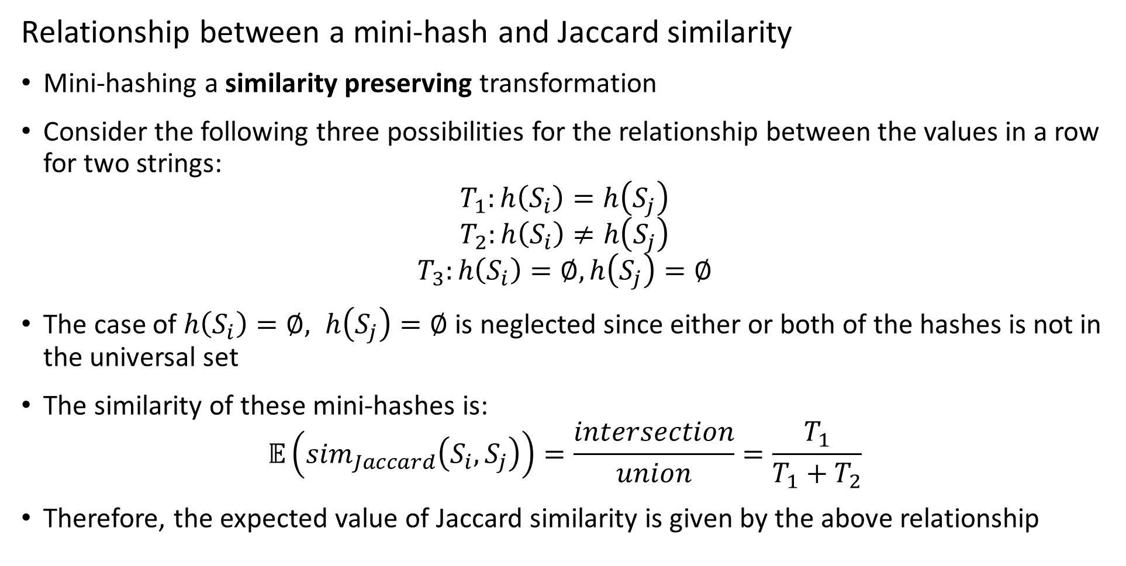
Mini-hashing for Similarity
Relationship between a mini-hash and Jaccard similarity
Mini-hashing a similarity preserving transformation
Consider the following three possibilities for the relationship between the values in a row for two strings:
$$T_{1}:h\left(S_{i}\right)=h\left(S_{j}\right)$$
$$T_{2}:h\left(S_{i}\right)≠h\left(S_{j}\right)$$
$$T_{3}:h\left(S_{i}\right)=∅, h\left(S_{j}\right)=∅$$
The case of $h\left(S_{i}\right)=∅, h\left(S_{j}\right)=∅$ is neglected since either or both of the hashes is not in the universal set
The similarity of these mini-hashes is:
$$𝔼\left({sim}_{Jaccard}\left(S_{i},S_{j}\right)\right)=\frac{intersection}{union}=\frac{T_{1}}{T_{1}+T_{2}}$$
Therefore, the expected value of Jaccard similarity is given by the above relationship

Slide 60
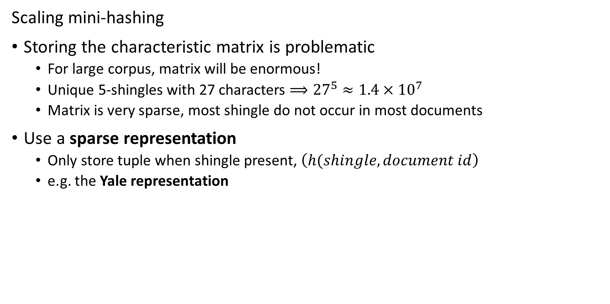
Mini-hashing for Similarity
Scaling mini-hashing
Storing the characteristic matrix is problematic
For large corpus, matrix will be enormous!
Unique 5-shingles with 27 characters $⟹{27}^{5}≈1.4×{10}^{7}$
Matrix is very sparse, most shingle do not occur in most documents
Use a sparse representation
Only store tuple when shingle present, $\left(h(shingle,document id\right)$
e.g. the Yale representation

Slide 61
Mini-hashing for Similarity
Scaling mini-hashing
Large scale applications can have millions of shingled documents
Permuting rows at scale is clearly impractical!
What is a better approach?
Use a mini-hash to compute a randomized index (bucket) for each row
Can create many mini-hashes by using different row bucket hashes

Slide 62
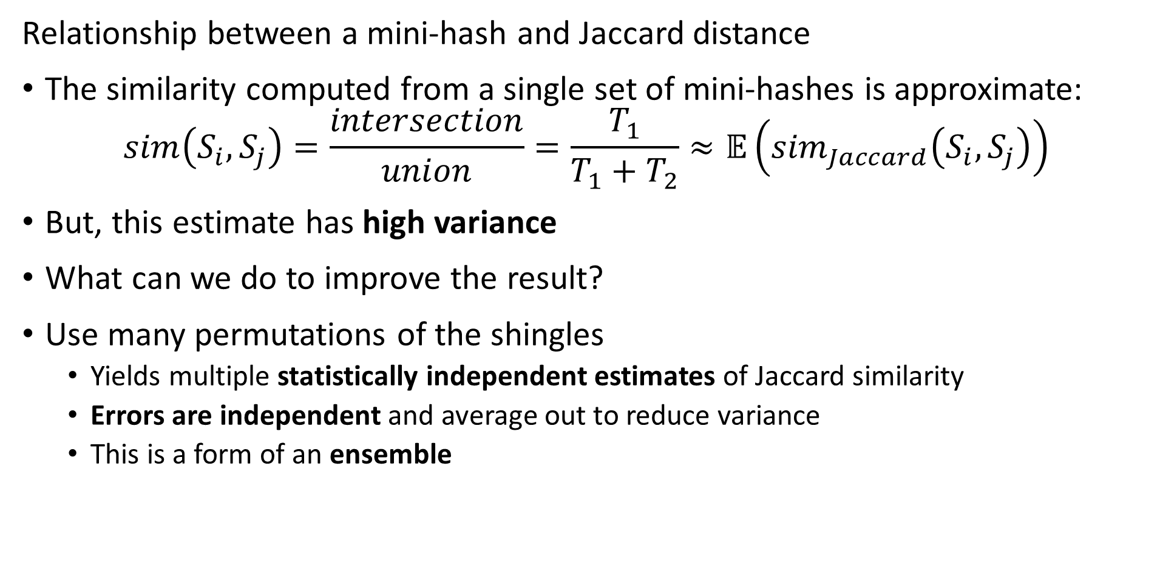
Mini-hashing for Similarity
Relationship between a mini-hash and Jaccard distance
The similarity computed from a single set of mini-hashes is approximate:
$$sim\left(S_{i},S_{j}\right)=\frac{intersection}{union}=\frac{T_{1}}{T_{1}+T_{2}}≈𝔼\left({sim}_{Jaccard}\left(S_{i},S_{j}\right)\right)$$
But, this estimate has high variance
What can we do to improve the result?
Use many permutations of the shingles
Yields multiple statistically independent estimates of Jaccard similarity
Errors are independent and average out to reduce variance
This is a form of an ensemble

Slide 63
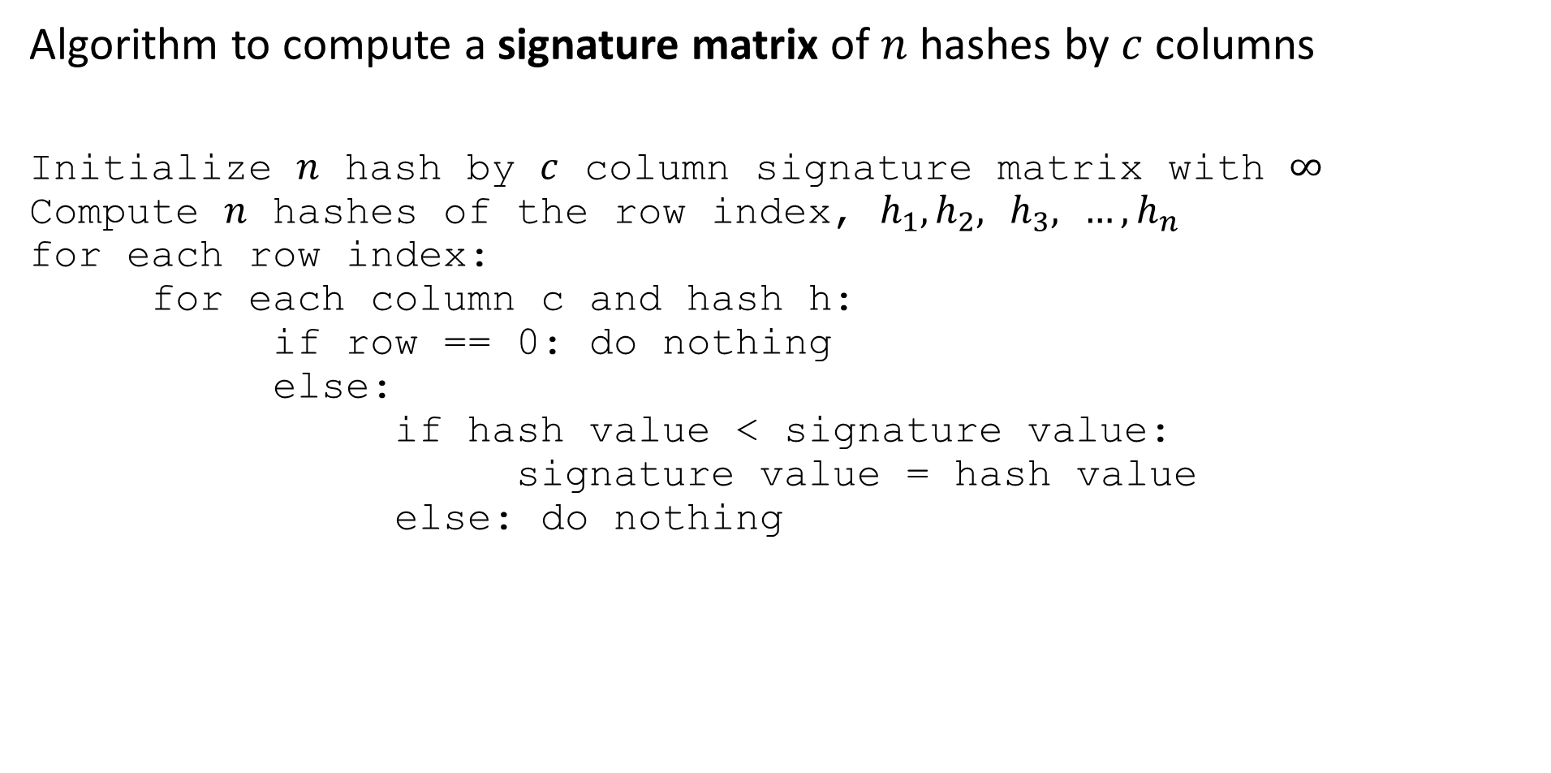
Mini-hashing for similarity
Algorithm to compute a signature matrix of $n$ hashes by $c$ columns
Initialize $n$ hash by $c$ column signature matrix with $∞$
Compute $n$ hashes of the row index, $h_{1},h_{2},$ $h_{3},$ ${…, h}_{n}$
for each row index:
for each column c and hash h:
if row == 0: do nothing
else:
if hash value < signature value:
signature value = hash value
else: do nothing

Slide 64
Mini-hashing for Similarity
Working with multiple mini-hashes
Example: using two independent hashes creates two sets of random permutations of row indices:
Use many more hash function in practice
Initial Index | S₁ | S₂ | S₃ | S₄ | 3x + 1 mod 5 | 7x + 1 mod 5
0 | 0 | 0 | 1 | 0 | 1 | 1
1 | 0 | 0 | 1 | 0 | 4 | 3
2 | 0 | 1 | 0 | 1 | 2 | 0
3 | 1 | 0 | 1 | 1 | 0 | 2
4 | 1 | 0 | 0 | 1 | 3 | 4

Slide 65

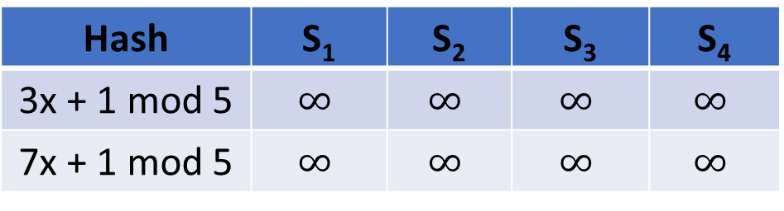
Mini-hashing for Similarity
Improving similarity estimates
Signature matrix contains a summary of the mini hash for each row index permutation
The initialize signature matrix with $∞$ values
Hash | S₁ | S₂ | S₃ | S₄
3x + 1 mod 5 | $$∞$$ | $$∞$$ | $$∞$$ | $$∞$$
7x + 1 mod 5 | $$∞$$ | $$∞$$ | $$∞$$ | $$∞$$

Slide 66

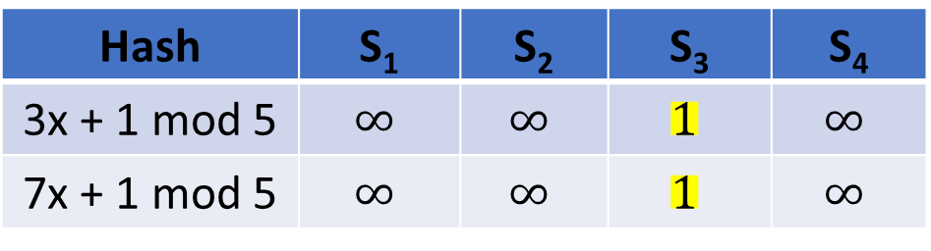
Mini-hashing for Similarity
Working with multiple mini-hashes
Start with row index 0
Both hash values are 1, only column $S_{3}≠0⟹$ updated signature matrix:
Initial Index | S₁ | S₂ | S₃ | S₄ | 3x + 1 mod 5 | 7x + 1 mod 5
0 | 0 | 0 | 1 | 0 | 1 | 1
1 | 0 | 0 | 1 | 0 | 4 | 3
2 | 0 | 1 | 0 | 1 | 2 | 0
3 | 1 | 0 | 1 | 1 | 0 | 2
4 | 1 | 0 | 0 | 1 | 3 | 4
Hash | S₁ | S₂ | S₃ | S₄
3x + 1 mod 5 | $$∞$$ | $$∞$$ | $$1$$ | $$∞$$
7x + 1 mod 5 | $$∞$$ | $$∞$$ | $$1$$ | $$∞$$

Slide 67

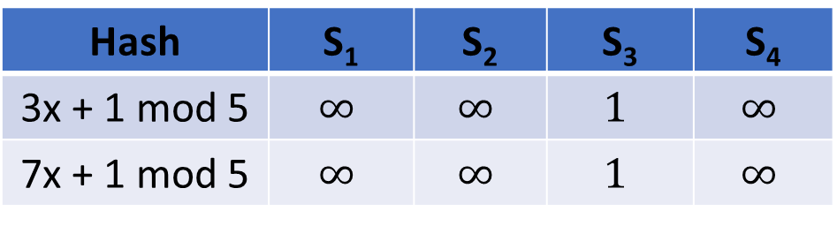
Mini-hashing for Similarity
Working with multiple mini-hashes
Next row index = 1
Only column $S_{3}≠0$ and $1<h_{1}, 1<h_{2}⟹$no update of signature matrix:
Initial Index | S₁ | S₂ | S₃ | S₄ | 3x + 1 mod 5 | 7x + 1 mod 5
0 | 0 | 0 | 1 | 0 | 1 | 1
1 | 0 | 0 | 1 | 0 | 4 | 3
2 | 0 | 1 | 0 | 1 | 2 | 0
3 | 1 | 0 | 1 | 1 | 0 | 2
4 | 1 | 0 | 0 | 1 | 3 | 4
Hash | S₁ | S₂ | S₃ | S₄
3x + 1 mod 5 | $$∞$$ | $$∞$$ | $$1$$ | $$∞$$
7x + 1 mod 5 | $$∞$$ | $$∞$$ | $$1$$ | $$∞$$

Slide 68

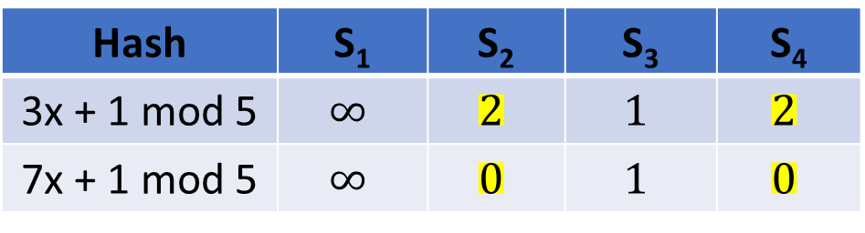
Mini-hashing for Similarity
Working with multiple mini-hashes
Next row index = 2
$S_{2}≠0$, $S_{4}≠0$ $⟹$update signature matrix:
Initial Index | S₁ | S₂ | S₃ | S₄ | 3x + 1 mod 5 | 7x + 1 mod 5
0 | 0 | 0 | 1 | 0 | 1 | 1
1 | 0 | 0 | 1 | 0 | 4 | 3
2 | 0 | 1 | 0 | 1 | 2 | 0
3 | 1 | 0 | 1 | 1 | 0 | 2
4 | 1 | 0 | 0 | 1 | 3 | 4
Hash | S₁ | S₂ | S₃ | S₄
3x + 1 mod 5 | $$∞$$ | $$2$$ | $$1$$ | $$2$$
7x + 1 mod 5 | $$∞$$ | $$0$$ | $$1$$ | $$0$$

Slide 69

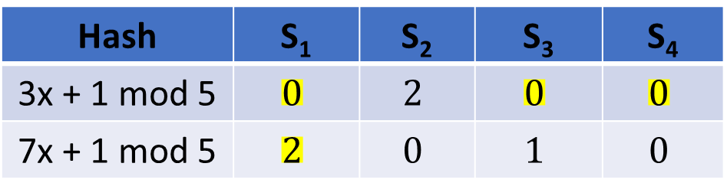
Mini-hashing for Similarity
Working with multiple mini-hashes
Next row index = 3
${S_{1}≠0\text{,} S}_{3}≠0$, $S_{4}≠0$ $⟹$update signature matrix:
Initial Index | S₁ | S₂ | S₃ | S₄ | 3x + 1 mod 5 | 7x + 1 mod 5
0 | 0 | 0 | 1 | 0 | 1 | 1
1 | 0 | 0 | 1 | 0 | 4 | 3
2 | 0 | 1 | 0 | 1 | 2 | 0
3 | 1 | 0 | 1 | 1 | 0 | 2
4 | 1 | 0 | 0 | 1 | 3 | 4
Hash | S₁ | S₂ | S₃ | S₄
3x + 1 mod 5 | $$0$$ | $$2$$ | $$0$$ | $$0$$
7x + 1 mod 5 | $$2$$ | $$0$$ | $$1$$ | $$0$$

Slide 70

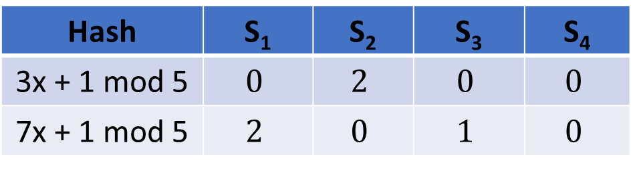
Mini-hashing for Similarity
Working with multiple mini-hashes
Next row index = 4
${S_{1}≠0\text{,} }_{ }S_{4}≠0$ $⟹$no update of signature matrix:
Initial Index | S₁ | S₂ | S₃ | S₄ | 3x + 1 mod 5 | 7x + 1 mod 5
0 | 0 | 0 | 1 | 0 | 1 | 1
1 | 0 | 0 | 1 | 0 | 4 | 3
2 | 0 | 1 | 0 | 1 | 2 | 0
3 | 1 | 0 | 1 | 1 | 0 | 2
4 | 1 | 0 | 0 | 1 | 3 | 4
Hash | S₁ | S₂ | S₃ | S₄
3x + 1 mod 5 | $$0$$ | $$2$$ | $$0$$ | $$0$$
7x + 1 mod 5 | $$2$$ | $$0$$ | $$1$$ | $$0$$

Slide 71
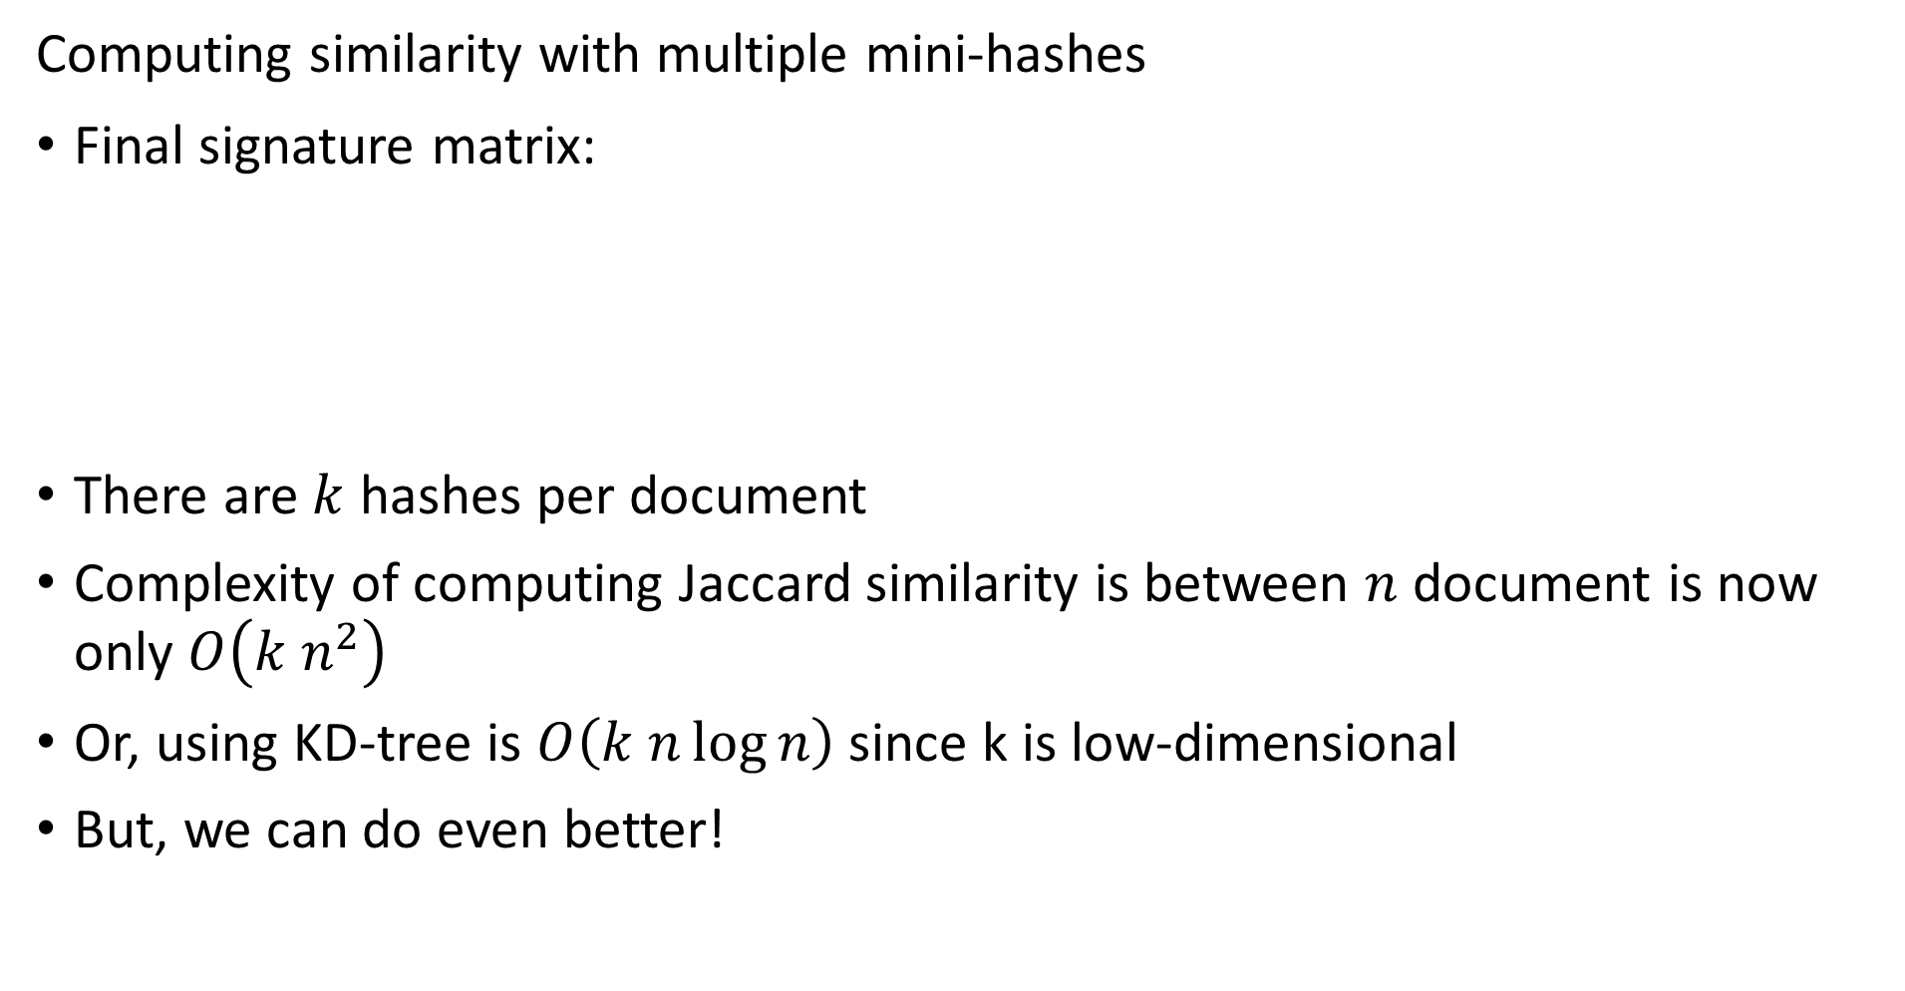

Mini-hashing for Similarity
Computing similarity with multiple mini-hashes
Final signature matrix:
There are $k$ hashes per document
Complexity of computing Jaccard similarity is between $n$ document is now only $O\left(k n^{2}\right)$
Or, using KD-tree is $O\left(k n\log{n}\right)$ since k is low-dimensional
But, we can do even better!
Hash | S₁ | S₂ | S₃ | S₄
3x + 1 mod 5 | $$0$$ | $$2$$ | $$0$$ | $$0$$
7x + 1 mod 5 | $$2$$ | $$0$$ | $$1$$ | $$0$$

Slide 72

Mini-hashing for Similarity
Computing similarity with multiple mini-hashes
Final signature matrix:
Compute pairwise similarity
Hash | S₁ | S₂ | S₃ | S₄
3x + 1 mod 5 | $$0$$ | $$2$$ | $$0$$ | $$0$$
7x + 1 mod 5 | $$2$$ | $$0$$ | $$1$$ | $$0$$
Pair | Mini-hash similarity | Exact Jaccard sim
sim$\left(S_{1},S_{2}\right)$ | 0 | 2/5
sim$\left(S_{1},S_{3}\right)$ | 1/2 | 2/5
sim$\left(S_{1},S_{4}\right)$ | 1/2 | 4/5
sim$\left(S_{2},S_{3}\right)$ | 0 | 1/5
sim$\left(S_{2},S_{4}\right)$ | 1/2 | 3/5
sim$\left(S_{3},S_{4}\right)$ | 1/2 | 1/5

Slide 73

Mini-hashing for Similarity
Compare similarity metrics
Poor agreement between min-hash and Jaccard similarity
Agreement will improve with more mini-hashes
Compare non-Euclidean Jaccard and Cosine similarity
We don’t expect perfect agreement
But rank approximately the same
Pair | Mini-hash similarity | Exact Jaccard sim | Cosine Sim
sim$\left(S_{1},S_{2}\right)$ | 0 | 2/5 | 0.0
sim$\left(S_{1},S_{3}\right)$ | 1/2 | 2/5 | 0.32
sim$\left(S_{1},S_{4}\right)$ | 1/2 | 4/5 | 0.64
sim$\left(S_{2},S_{3}\right)$ | 0 | 1/5 | 0.0
sim$\left(S_{2},S_{4}\right)$ | 1/2 | 3/5 | 0.37
sim$\left(S_{3},S_{4}\right)$ | 1/2 | 1/5 | 0.29

Slide 74
Locally Sensitive Hashing

Slide 75

Locally Sensitive Hashing
Probability of error from mini-hashing
Consider the Jaccard similarity between two documents:
${sim}_{Jaccard}\left(s_{i},s_{j}\right)=s$
The probability that all $r$ mini-hashes agree is: $s^{r}$
The probability that at least 1 of the mini-hashes disagree: $1−s^{r}$

Slide 76

Locally Sensitive Hashing
Probability of error from mini-hashing
The probability that all $r$ mini-hash signatures agree is: $s^{r}$
The probability that at least 1 of the mini-hashes disagree: $1−s^{r}$
For $r=5$ we see the following sensitivity of the decision function:
The sensitivity to positive cases is low, poor sensitivity to discoveries!
S | Probability Positive | Probability Negative | Expected Positive Pairs per 1000
0.1 | 1.0000E-05 | 9.9999E-01 | 0.01
0.2 | 3.2000E-04 | 9.9968E-01 | 0.32
0.3 | 2.4300E-03 | 9.9757E-01 | 2.43
0.4 | 1.0240E-02 | 9.8976E-01 | 10.24
0.5 | 3.1250E-02 | 9.6875E-01 | 31.25
0.6 | 7.7760E-02 | 9.2224E-01 | 77.76
0.7 | 1.6807E-01 | 8.3193E-01 | 168.07
0.8 | 3.2768E-01 | 6.7232E-01 | 327.68
0.9 | 5.9049E-01 | 4.0951E-01 | 590.49

Slide 77
Locally Sensitive Hashing
Probability of error from mini-hashing
Using mini-hashes yields low sensitivity to positive cases
How can we improve on local sensitivity?
We employ b bands of r mini-hashes per band
Signature 1
Band 1
Signature 2
…
Signature r
Signature 1
Band 2
Signature 2
…
Signature r
…
Signature 1
Band b
Signature 2
…
Signature r

Slide 78

Locally Sensitive Hashing
Probability of error from mini-hashing
With $b$bands of $r$ mini-hashes we can find the sensitivity of positives for a given Jaccard similarity between two documents
The probability for $b$ bands that all $r$ mini-hashes agree is: ${\left(s^{r}\right)}^{b}$
The probability that at least 1 of the $r$ mini-hashes disagree in the $b$ bands: $1−{\left(1−s^{r}\right)}^{b}$

Slide 79

Locally Sensitive Hashing
Probability of error from banded mini-hashing
For $r=5$ and $b=20$ we find the following sensitivities:
Sensitivity to positive cases has increased significantly!
Some increase in false positive cases, increased false discovery rate
S | Probability Positive | Probability Negative | Expected Positive Pairs per 1000
0.1 | 1.9998E-04 | 9.9980E-01 | 0.20
0.2 | 6.3806E-03 | 9.9362E-01 | 6.38
0.3 | 4.7494E-02 | 9.5251E-01 | 47.49
0.4 | 1.8605E-01 | 8.1395E-01 | 186.05
0.5 | 4.7005E-01 | 5.2995E-01 | 470.05
0.6 | 8.0190E-01 | 1.9810E-01 | 801.90
0.7 | 9.7478E-01 | 2.5219E-02 | 974.78
0.8 | 9.9964E-01 | 3.5606E-04 | 999.64
0.9 | 1.0000E+00 | 1.7591E-08 | 1000.00

Slide 80

Locally Sensitive Hashing
Probabilities from banded mini-hashing

Slide 81

Locally Sensitive Functions
Model to understand locally sensitive hashing
Set thresholds, $d_{1}$ and $d_{2}$, to define a decision rule
Consider distance measures $d\left(x, x^{′}\right)$ generated from a family of functions, $f\left(x\right) ε ℱ$ with decision rule:
If $d\left(x,x^{′}\right)≤d_{1}$, then $p\left(f\left(x\right)=f\left(x′\right)\right)≥p_{1}=p(match)$
and $d\left(x,x′\right)≥d_{2}$, then $p\left(f\left(x\right)=f\left(x′\right)\right)≤p_{2}=p(false match)$
We say $ℱ$ is $\left(d_{1},d_{2},p_{1},p_{2}\right)$ sensitive
Consider how local sensitivity is constructed for Jaccard similarity:
${sim}_{J}\left(x,x^{′}\right)=1−d_{j}(x,x^{′})$
For mini-hash function $f(x)$, ${sim}_{J}\left(x,x^{′}\right)=p\left(f\left(x\right)=f\left(x′\right)\right)$
Therefore, $ℱ$ is $\left(d_{1},d_{2},1−d_{1},1−d_{2}\right)$ sensitive
It is easy to see the more sensitive the hash function the more sensitive the decision rule

Slide 82

Locally Sensitive Functions
Model to understand locally sensitive hashing
Example of the $\left(d_{1},d_{2}, p_{1}, p_{2}\right)$ family for Jaccard similarity
Set the thresholds $d_{1}=0.3$ and $d_{2}=0.6$
Then:
Probability of match $≥1−d_{1}=1−0.3=0.7$
Probability of false positive $≤1−d_{2}=1−0.6=0.4$
Is a $\left(0.3,0.6, 0.7, 0.4\right)$ family

Slide 83


Locally Sensitive Functions
Model to understand locally sensitive hashing
Can visualize relationship between hash function and sensitivity of the decision rule
Higher sensitivity, smaller $d_{1}$ and larger $d_{2}$, increases probability of correct decision
False Negative
False Positive
Credit; Leskovec et.al. 2020

Slide 84
Improving LSH

Slide 85

Improving Locally Sensitive Functions
How can we improve local sensitivity of a family of functions $ℱ$?
Start with $sen\left(ℱ\right)=\left(d_{1},d_{2},p_{1},p_{2}\right)$
Construct a new family from $ℱ$, called $ℱ′$ by AND-construction
Construct family from $r$ distance function: $ℱ^{′}=\left\{f_{1},f_{2},…,f_{r}\right\}$
Assuming independence of the distance functions:
$$sen\left(ℱ^{′}\right)=\left(d_{1},d_{2},{( p_{1}^{ })}^{r},{(p_{2})}^{r}\right)$$
AND-construction uses agreement – logical AND
AND-construction decreases both decision thresholds, since $p_{1}^{ },p_{2}^{ }<1$

Slide 86

Improving Locally Sensitive Functions
How can we improve local sensitivity of a family of functions $ℱ$?
Can also use OR-construction
Construct family from $b$ distance function: $ℱ^{′}=\left\{f_{1},f_{2},…,f_{b}\right\}$
Assume independence of the distance functions:
$$sen\left(ℱ^{′}\right)=\left(d_{1},d_{2},{1−( 1−p_{1}^{ })}^{b},{1−({1−p}_{2})}^{b}\right)$$
OR-construction is positive if any mini-hash exceeds threshold – OR operator
OR-construction increases both decision thresholds, since $p_{1}^{ },p_{2}^{ }<1$

Slide 87

Improving Locally Sensitive Functions
How can we improve local sensitivity of a family of functions $ℱ$?
Can get the best of both by combining AND-construction and OR-construction
r hashes per band
d bands
Option 1: AND-OR-Construction – apply AND-Construction first then apply OR-Construction, giving sensitivity:
$$1−{\left(1−p^{r}\right)}^{b}$$
Option 2: OR-AND-Construction – apply OR-Construction first then apply AND-Construction, giving sensitivity:
$${\left(1−{\left(1−p\right)}^{b}\right)}^{r}$$

Slide 88

Improving Locally Sensitive Functions
How can we improve local sensitivity of a family of functions $ℱ$?
Example: $d=4$ and $r=4$
Increased sensitivity for both constructions
AND-OR-Construction slightly biased to negative cases
OR-AND-Construction slightly biased to positive cases
p | AND-OR-Construction | OR-AND-Construction
0.1 | 3.9994E-04 | 1.3987E-02
0.2 | 6.3847E-03 | 1.2150E-01
0.3 | 3.2008E-02 | 3.3345E-01
0.4 | 9.8535E-02 | 5.7395E-01
0.5 | 2.2752E-01 | 7.7248E-01
0.6 | 4.2605E-01 | 9.0147E-01
0.7 | 6.6655E-01 | 9.6799E-01
0.8 | 8.7850E-01 | 9.9362E-01
0.9 | 9.8601E-01 | 9.9960E-01

Slide 89


Improving Locally Sensitive Functions
How can we improve local sensitivity of a family of functions $ℱ$?
Example: AND-OR construction of LSH decision function
Optimal choice of $b,r$ given $n$
Notice, slope of decision function increases with $n$

Slide 90

Efficient LSH
What is an efficient algorithm for LSH?
Pairwise comparison is inefficient
$\frac{n(n−1)}{2}$ pairs
Computational complexity $O\left(n^{2}\right)$
Or $O\left(k n\log{n}\right)$ for KD-tree
Use hash buckets to find candidate pairs
Band of signature matrix hash to bucket
More than one hash in bucket is candidate pair
Hashing algorithm with computational complexity $O\left(n^{ }\right)$!

Slide 91
Efficient LSH
Candidate 1 1
Candidate 2
Hash Table
Signature 1
Signature 1
Hash 1
Efficient algorithm for LSH uses hash table
Start with hash table
Signatures arranged in bands
Hash signatures in bands to hash buckets
Match hash to same bucket indicates high similarity
Band 1
Signature 2
Signature 2
Hash 2
…
…
Hash 3
Signature r
Signature r
Hash 4
Signature 1
Signature 1
Hash 5
Band 2
Signature 2
Signature 2
Hash 6
…
…
Hash 7
Signature r
Signature r
Hash 8
…
…
…
Signature 1
Signature 1
Hash n-2
Band b
Signature 2
Signature 2
Hash 2 n-1
…
…
Hash n
Signature r
Signature r

Slide 92
LSH With Other Similarity Metrics

Slide 93

LSH with Hamming Distance
Can create a locally sensitive hash family from Hamming distance
Hamming distance, $h\left(x,y\right)$, is number of symbol differences between two strings
For strings of length l, $f_{i}\left(x\right)=f_{i}\left(y\right)$ iff vectors x and y agree in ith position with probability $1−h\left(x,y\right)/l$
For the hash family, $ℱ=\{f_{1},f_{2},f_{3},…,f_{d}\}$:
$$sen\left(ℱ\right)=\left(d_{1},d_{2},p_{1},p_{2}\right)=(d_{1},d_{2},1−\frac{d_{1}}{l},1−\frac{d_{2}}{l})$$
For string length l limited to l hashes
Limits steepness of the decision function

Slide 94
LSH for Numeric Variables
How can LSH be applied to numeric variables?
Can create hashes to estimate cosine distance
Cosine distances computed with numeric (real) variables
Uses computationally efficient dot products as hashes
Apply LSH to find cosine distance estimates

Slide 95


LSH for Numeric Variables
Review Cosine Similarity
$$d\left(x,x^{′}\right)=cos\left(θ_{i}\right)=\frac{x∙x′}{\left|x\right|\left|x′\right|}$$
Points at (2,1) and (4,3)
What is the distance between them?
Cosine distance
$$dcos\left(x,x^{′}\right)=\frac{2∗4 +1∗3}{{\left(2^{2}+1^{2}\right)}^{1/2}{\left(4^{2}+3^{2}\right)}^{1/2}}= \frac{11}{5^{1/2}{25}^{1/2}}=0.984$$
(4,3)
X₂
θ
(2,1)
X₁

Slide 96

LSH for Numeric Variables
Create hashes with random hyperplanes
Start with two vectors, x,y
Choose a hyperplane H at random
Hyperplane defined by a perpendicular vector, v
$$H⋅v=0$$
Dot products of v with x, y have opposite signs:
$$y⋅v⇒+$$
$$x⋅v⇒−$$
Or if v has opposite sign:
$$y⋅−v⇒−$$
$$x⋅−v⇒+$$
y
v
θ
x
H

Slide 97

LSH for Numeric Variables
Create hashes with random hyperplanes
Choose another hyperplane H at random with orthogonal vector v
Dot products of v with x,y have same signs:
$$y⋅v⇒+$$
$$x⋅v⇒+$$
Or if v has same sign:
$$y⋅−v⇒−$$
$$x⋅−v⇒−$$
Therefore expected probability that dot product with orthogonal vector have opposite signs:
$$E\left[P\left(+,−\right)\right]=θ/π$$
y
v
θ
x
H

Slide 98

LSH for Numeric Variables
The $sen\left(ℱ\right)=\left(d_{1},d_{2},p_{1},p_{1}\right)$ family for cosine distance hashes
Using cosine hashes, $f\left(x\right)=f(y)$ iif the dot products x$⋅v$ and $y⋅v$ have the same sign, then:
$$sen\left(ℱ\right)=\left(d_{1},d_{2},p_{1},p_{2}\right)=(d_{1},d_{2},\frac{\left(π−d_{1}\right)}{π},\frac{\left(π−d_{2}\right)}{π})$$

Slide 99

LSH for Numeric Variables
Use sketches to simplify cosine distance LSH
Need to compute a number of hashes to accurately estimate $θ$
Must average out error of each hash (estimate)
Sketches can speed this calculation
Use random vectors with $±1$ values,
Example, $\left[+1,−1,−1,+1,…,−1\right]$
Hash family, $ℱ$, is sign of dot products of variables with random vectors
For n dimensional data, limited to $2^{n}$ possible hashes
Most useful for very high-dimensional variables
See the MMDS book for similar method for Euclidean spaces

Slide 100

Summary
Key points for this lesson
Shingle documents for similarity measures
Set of all shingles organized into characteristic matrix with rows represented by the universal set
Mini-hashing shingles creates signature matrix as compact representation
LSH uses $sen\left(𝓕\right)=\left(d_{1},d_{2},p_{1},p_{2}\right)$ family of hash functions, $ℱ$
LSH creates sigmodal decision function with high slope
AND-OR and OR-AND construction for banded signature matrix creates more sensitive decision function
Cosine similarity and Hamming distance result in $sen\left(ℱ\right)=\left(d_{1},d_{2},p_{1},p_{2}\right)$ hash function families

