Slide 1

CSCI E-96 Data Mining, Exploration and Discovery Introduction to Dimensionality Reduction
Steve Elston
Copyright 2020,2021, 2022, Stephen F Elston. All rights reserved.

Slide 2
Lesson Overview
Dimensionality reduction is widely used in data mining
Projection methods for high dimensions
Manifold learning and visualization

Slide 3
Introduction to Dimensionality Reduction
Why is dimensionality reduction possible?
Consider the information content of each feature
Information of a feature is only unique if it is independent of all other features
Dependent features have redundant information
Dimensionality can be reduced if features are dependent
Almost always the case in real-world data
Linear dependency
Nonlinear dependency
Dependency implies effective dimensionality less than number of features

Slide 4
Introduction to Dimensionality Reduction
Dimensionality reduction is widely used in data mining
Human understanding of high dimensional spaces is difficult at best
For most people, perception of data relationships starts to dimension beyond 4 or dimensions
Exploration of complex spaces can be aided by projection into lower dimensional space
Most algorithms converge better in lower dimensional spaces
High dimensional spaces can leave Lto over-fitting of data mining algorithms
For example, clustering in high dimensional spaces can lead fragmentation of the data
Dimensionality reduction can improve results
Example; spectral clustering uses projection to lower dimensional space

Slide 5
Clustering in High Dimensions and The Curse of Dimensionality!

Slide 6
What Could Possibly Go Wrong? Curse of Dimensionality!
Cluster models scale poorly with dimensionality
Consider sampling required to maintain the same uniformly distributed density in a hypercube:
An example of the Curse of Dimensionality!
Dimensions | Samples
1 | 10
2 | 100
3 | 1,000
5 | 10⁵
10 | 10¹⁰

Slide 7
What Could Possibly Go Wrong? Curse of Dimensionality
Cluster models scale poorly with dimensionality
Distances all become the same as dimensionality $⇒∞$
To understand this problem, consider Euclidean distance measure:
The volume of a hypersphere inside a n-dimensional hypercube with edge length 2d is:
$VolHyperspheres$ = $\frac{2r^{n}π^{n/2}}{dΓ\left(d/2\right)}$
The proportion of volumes of the hypercube and the spheres:
$\frac{VolHyperspheres}{VolHypercube}= \frac{π^{n/2}}{d2^{n−1}Γ\left(n/2\right)}⇒1, as d ⇒∞$
Another example of the Curse of Dimensionality!
$Γ\left(x\right)$ is the Gamma Function

Slide 8
What Could Possibly Go Wrong? Curse of Dimensionality
The curse of dimensionality means that all clusters are the same in high dimensions
Sampling density decreases exponentially
Distances converge to the same size in a high dimensional space
The choice of metric does not help
All distances are the same in high dimensions!
Implication is that high-dimensional cluster models are easy to overfit!!

Slide 9
What Could Possibly Go Wrong? Curse of Dimensionality
How can we extend clustering to higher dimensions?
Reducing dimensionality can help
Need to create a lower dimensional embedding
But how?
PCA is a linear projection
Several families of alternatives
Subspace clustering
Random projection
Manifold learning

Slide 10
What Could Possibly Go Wrong? Curse of Dimensionality
How can we extend clustering to higher dimensions?
Reducing dimensionality can help
Need to create a lower dimensional embedding
But how?
Subspace clustering samples many subspaces to find embedding
Limited scalability since there are infinite possible subspaces
Heuristic, downward closure property, improves scalability - addressed in a subsequent lesson
Python subspace clustering package in Chong You’s GitHub repository

Slide 11
What Could Possibly Go Wrong? Curse of Dimensionality
How can we extend clustering to higher dimensions?
Reducing dimensionality can help
Need to create a lower dimensional embedding
But how?
Random projection methods used randomized sampling to find an approximate embedding space
Trade-off between error and lower dimensions governed by the Johnson-Lindenstrauss lemma
Error increases as dimensionality of embedding space decreases
Topic in dimensionality reduction lesson
Well supported in Scikit Learn

Slide 12
What Could Possibly Go Wrong? Curse of Dimensionality
How can we extend clustering to higher dimensions?
Reducing dimensionality can help
Need to create a lower dimensional embedding
But how?
Manifold Learning finds projection of high-dimensional space onto a low-dimensional manifold – lesson on dimensionality reduction
Many commonly used unsupervised methods
Spectral embedding
t-distributed Stochastic Neighbor Embedding (t-SNE)
…..
Well supported in Scikit-Learn

Slide 13
Projection Methods

Slide 14
Projection Methods
How can we overcome the curse of dimensionality?
Random projection methods samples random directions
Alternative to PCA
Error of the random projection to lower dimensional space is bounded
Distance is therefore preserved
Random projections in Euclidean space tend to create spherical clusters
Spherical clusters are easier for many algorithms to deal with

Slide 15
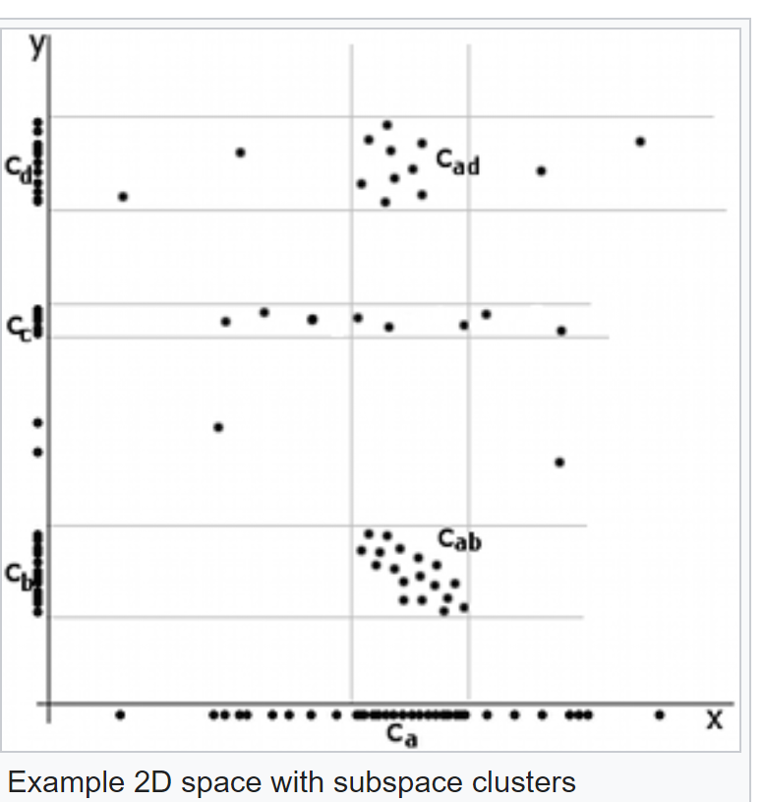
Projection Methods
Example of difficult dimensionality reduction
Clusters aligned along axis
Apparent cluster along axis
No apparent cluster along axis

Slide 16
Projection Methods
Example of difficult dimensionality reduction
Highest variance direction aligned with axis
Largest eigenvalues for eigenvector along axes
Principal components same as axes
No dimensionality reduction
First Principal Compoent
Second Principle Component

Slide 17
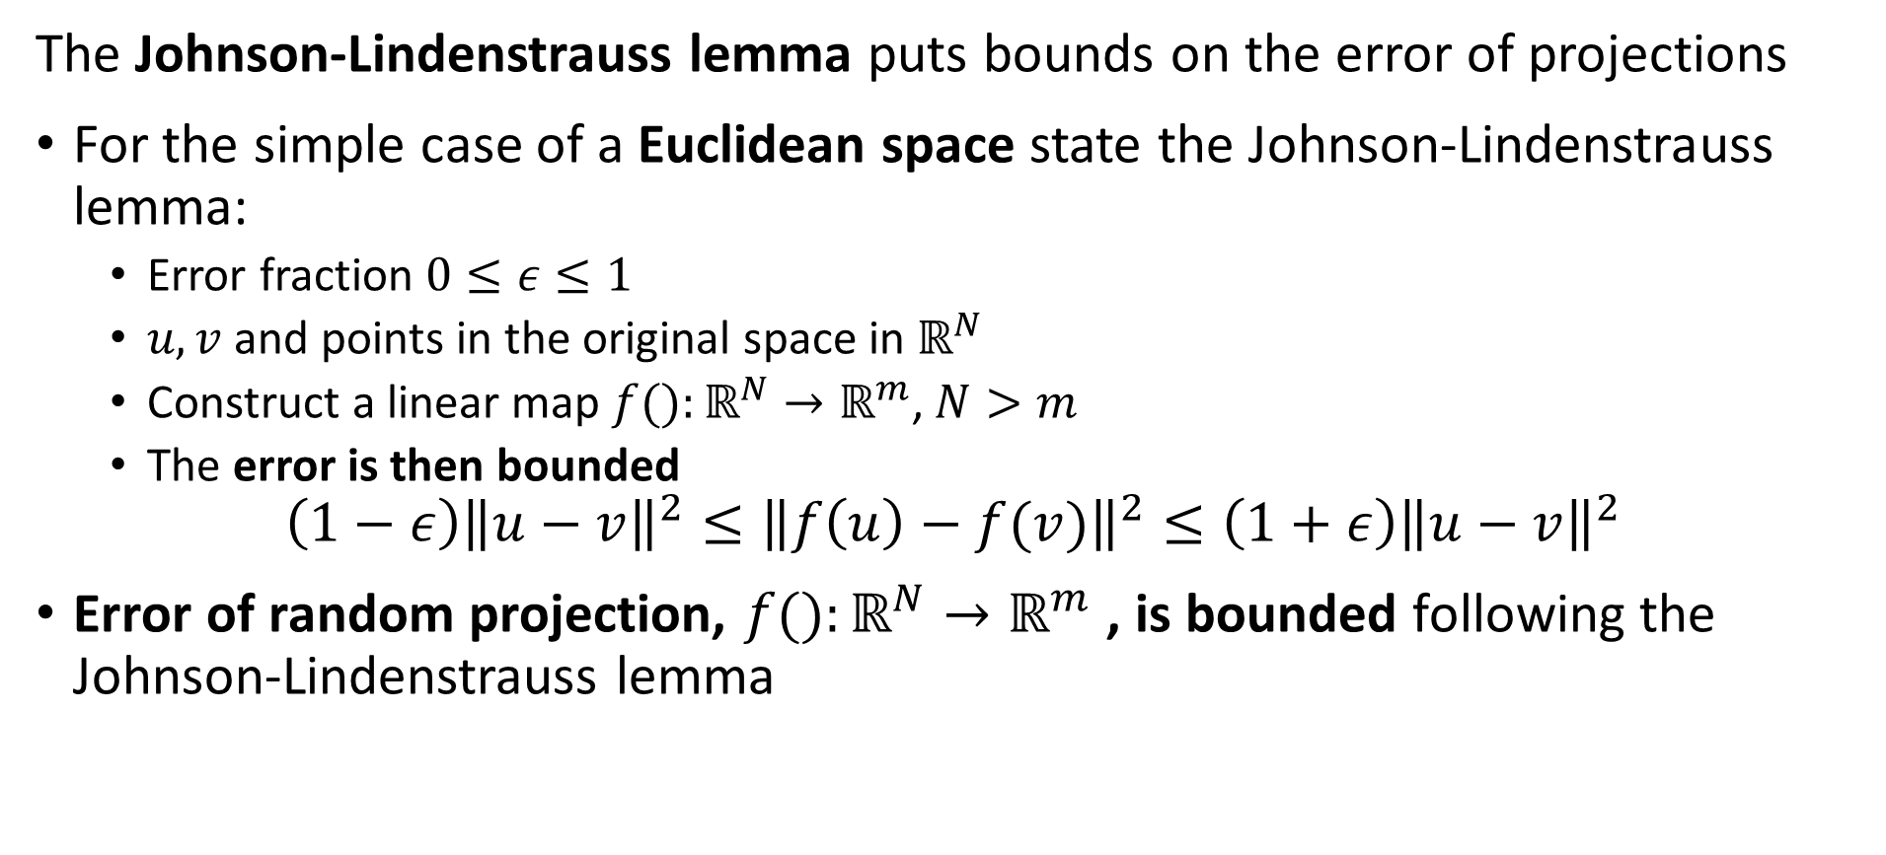
Projection Methods
The Johnson-Lindenstrauss lemma puts bounds on the error of projections
For the simple case of a Euclidean space state the Johnson-Lindenstrauss lemma:
Error fraction $0≤ε≤1$
$u,v$ and points in the original space in $ℝ^{N}$
Construct a linear map $f():ℝ^{N}→ℝ^{m}$, $N>m$
The error is then bounded
$$\left(1−ε\right){\left\|u−v\right\|}^{2}≤{\left\|f\left(u\right)−f(v)\right\|}^{2}≤\left(1+ε\right){\left\|u−v\right\|}^{2}$$
Error of random projection, $f():ℝ^{N}→ℝ^{m}$ , is bounded following the Johnson-Lindenstrauss lemma

Slide 18
Manifold Learning

Slide 19
Manifold Learning
Map high-dimensional space to a low dimensional manifold
A manifold is a low dimensional surface in a high-dimensional space
Linear manifold is a hyperplane
Nonlinear manifolds for more complex embeddings
Often used as a visualization technique
Human perception generally fails beyond a few dimensions
Mapping to a manifold creates low-dimensional projection of complex data relationships

Slide 20
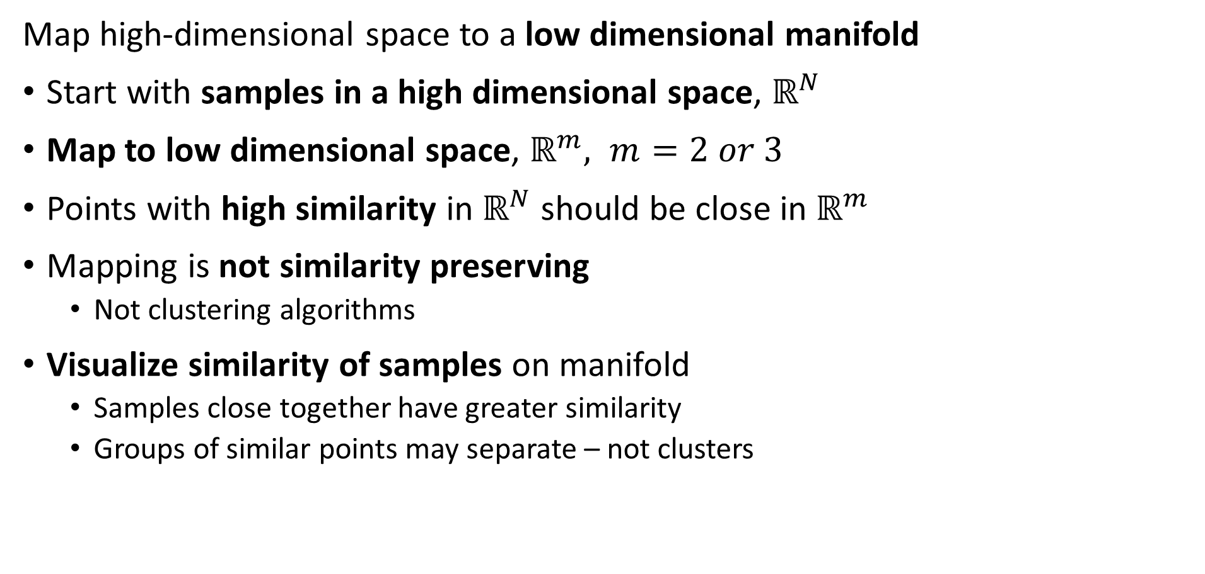
Manifold Learning
Map high-dimensional space to a low dimensional manifold
Start with samples in a high dimensional space, $ℝ^{N}$
Map to low dimensional space, $ℝ^{m}, m=2 or 3$
Points with high similarity in $ℝ^{N}$ should be close in $ℝ^{m}$
Mapping is not similarity preserving
Not clustering algorithms
Visualize similarity of samples on manifold
Samples close together have greater similarity
Groups of similar points may separate – not clusters

Slide 21
Manifold Learning
Map high-dimensional space to a low dimensional manifold
Many algorithms have been developed
Scikit-Learn supports 8 algorithms
We will look at two in detail:
Spectral embedding
t-distributed Stochastic Neighbor Embedding, t-SNE

Slide 22
Spectral Embedding
Spectral embedding uses graph-based construction
Creates a low-dimensional map of high dimensional space
Closely related to spectral clustering algorithm
Uses eigendecomposition of graph Laplacian
Maps to nonlinear manifold from high-dimensional space
Supported in Scikit-Learn

Slide 23
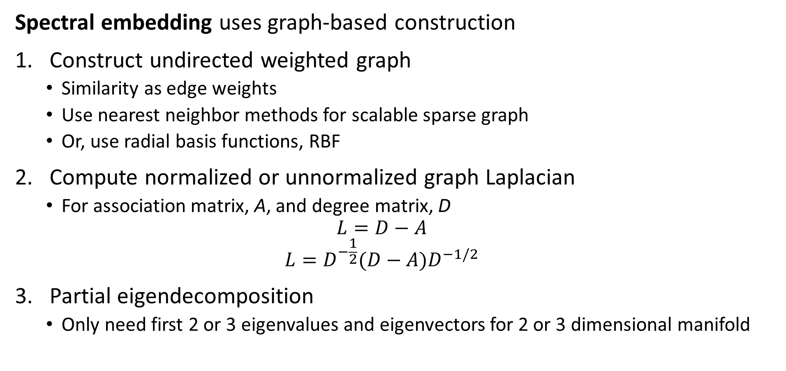
Spectral Embedding
Spectral embedding uses graph-based construction
Construct undirected weighted graph
Similarity as edge weights
Use nearest neighbor methods for scalable sparse graph
Or, use radial basis functions, RBF
Compute normalized or unnormalized graph Laplacian
For association matrix, A, and degree matrix, D
$$L=D−A$$
$$L=D^{−\frac{1}{2}}(D−A)D^{−1/2}$$
Partial eigendecomposition
Only need first 2 or 3 eigenvalues and eigenvectors for 2 or 3 dimensional manifold

Slide 24
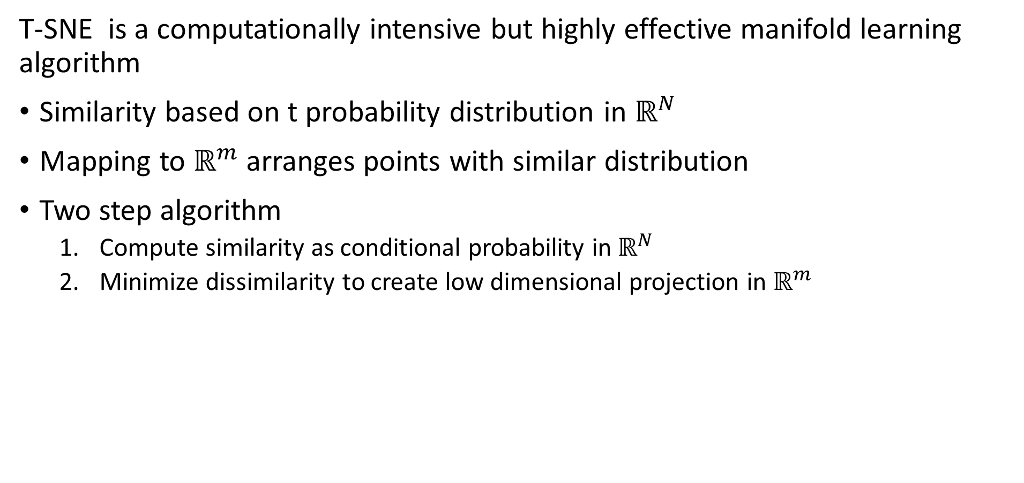
t-SNE
T-SNE is a computationally intensive but highly effective manifold learning algorithm
Similarity based on t probability distribution in $ℝ^{N}$
Mapping to $ℝ^{m}$ arranges points with similar distribution
Two step algorithm
Compute similarity as conditional probability in $ℝ^{N}$
Minimize dissimilarity to create low dimensional projection in $ℝ^{m}$

Slide 25
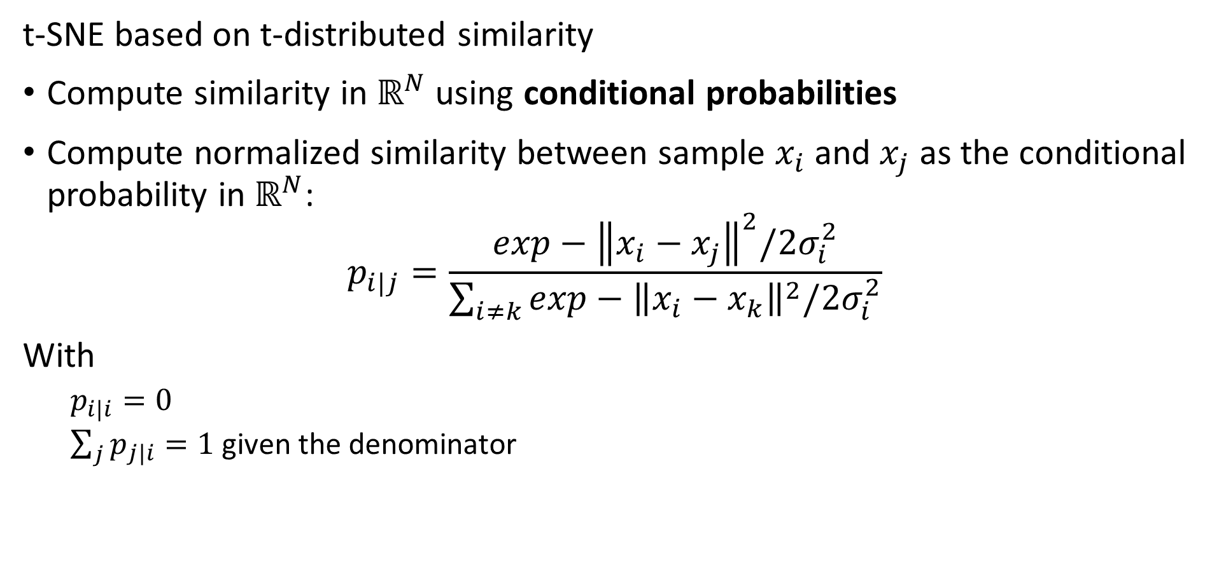
t-SNE
t-SNE based on t-distributed similarity
Compute similarity in $ℝ^{N}$ using conditional probabilities
Compute normalized similarity between sample $x_{i}$ and $x_{j}$ as the conditional probability in $ℝ^{N}$:
$$p_{i|j}=\frac{exp−{\left\|x_{i}−x_{j}\right\|}^{2}/2σ_{i}^{2}}{\sum_{i≠k}^{ }{exp−{\left\|x_{i}−x_{k}\right\|}^{2}/2σ_{i}^{2}}}$$
With
$p_{i|i}=0$
$\sum_{j}{p_{j|i}}=1$ given the denominator

Slide 26
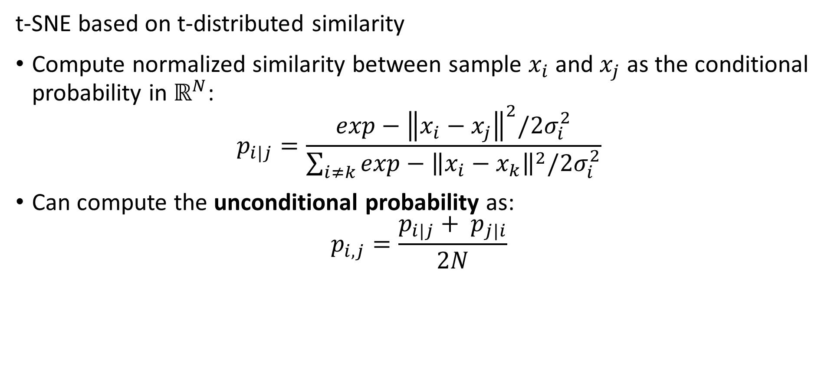
t-SNE
t-SNE based on t-distributed similarity
Compute normalized similarity between sample $x_{i}$ and $x_{j}$ as the conditional probability in $ℝ^{N}$:
$$p_{i|j}=\frac{exp−{\left\|x_{i}−x_{j}\right\|}^{2}/2σ_{i}^{2}}{\sum_{i≠k}^{ }{exp−{\left\|x_{i}−x_{k}\right\|}^{2}/2σ_{i}^{2}}}$$
Can compute the unconditional probability as:
$$p_{i,j}=\frac{p_{i|j}+ p_{j|i}}{2N}$$

Slide 27
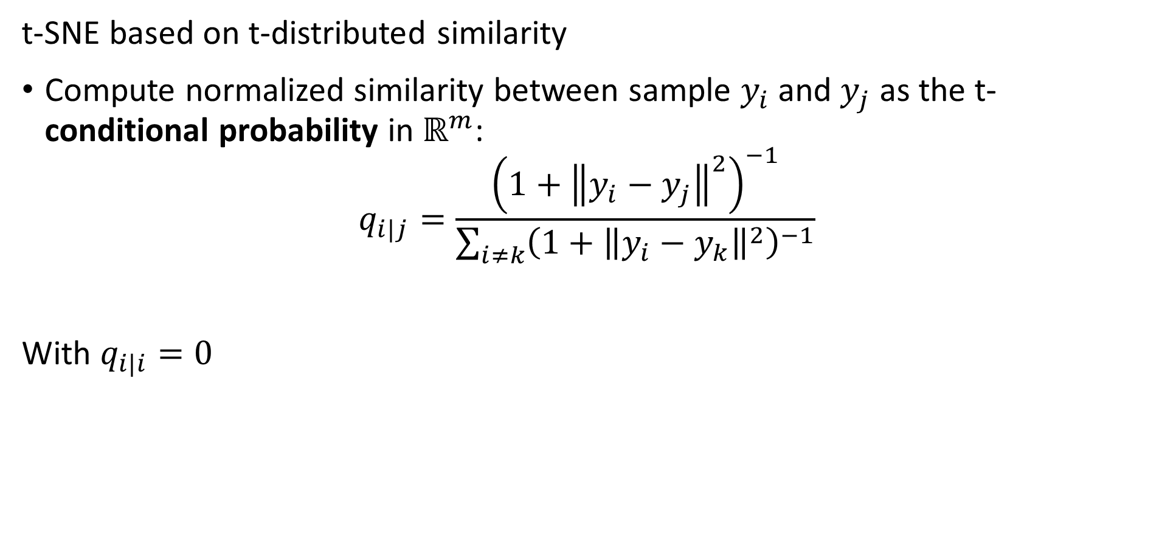
t-SNE
t-SNE based on t-distributed similarity
Compute normalized similarity between sample $y_{i}$ and $y_{j}$ as the t-conditional probability in $ℝ^{m}$:
$$q_{i|j}=\frac{{\left(1+{\left\|y_{i}−y_{j}\right\|}^{2}\right)}^{−1}}{\sum_{i≠k}{{\left(1+{\left\|y_{i}−y_{k}\right\|}^{2}\right)}^{−1}}}$$
With $q_{i|i}=0$

Slide 28
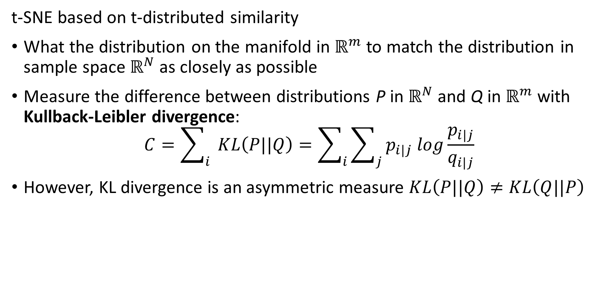
t-SNE
t-SNE based on t-distributed similarity
What the distribution on the manifold in $ℝ^{m}$ to match the distribution in sample space $ℝ^{N}$ as closely as possible
Measure the difference between distributions P in $ℝ^{N}$ and Q in $ℝ^{m}$ with Kullback-Leibler divergence:
$$C=\sum_{i}{ }KL\left(P||Q\right)=\sum_{i}{\sum_{j}{p_{i|j} log\frac{p_{i|j}}{q_{i|j}}}}$$
However, KL divergence is an asymmetric measure $KL\left(P||Q\right)≠KL\left(Q||P\right)$

Slide 29
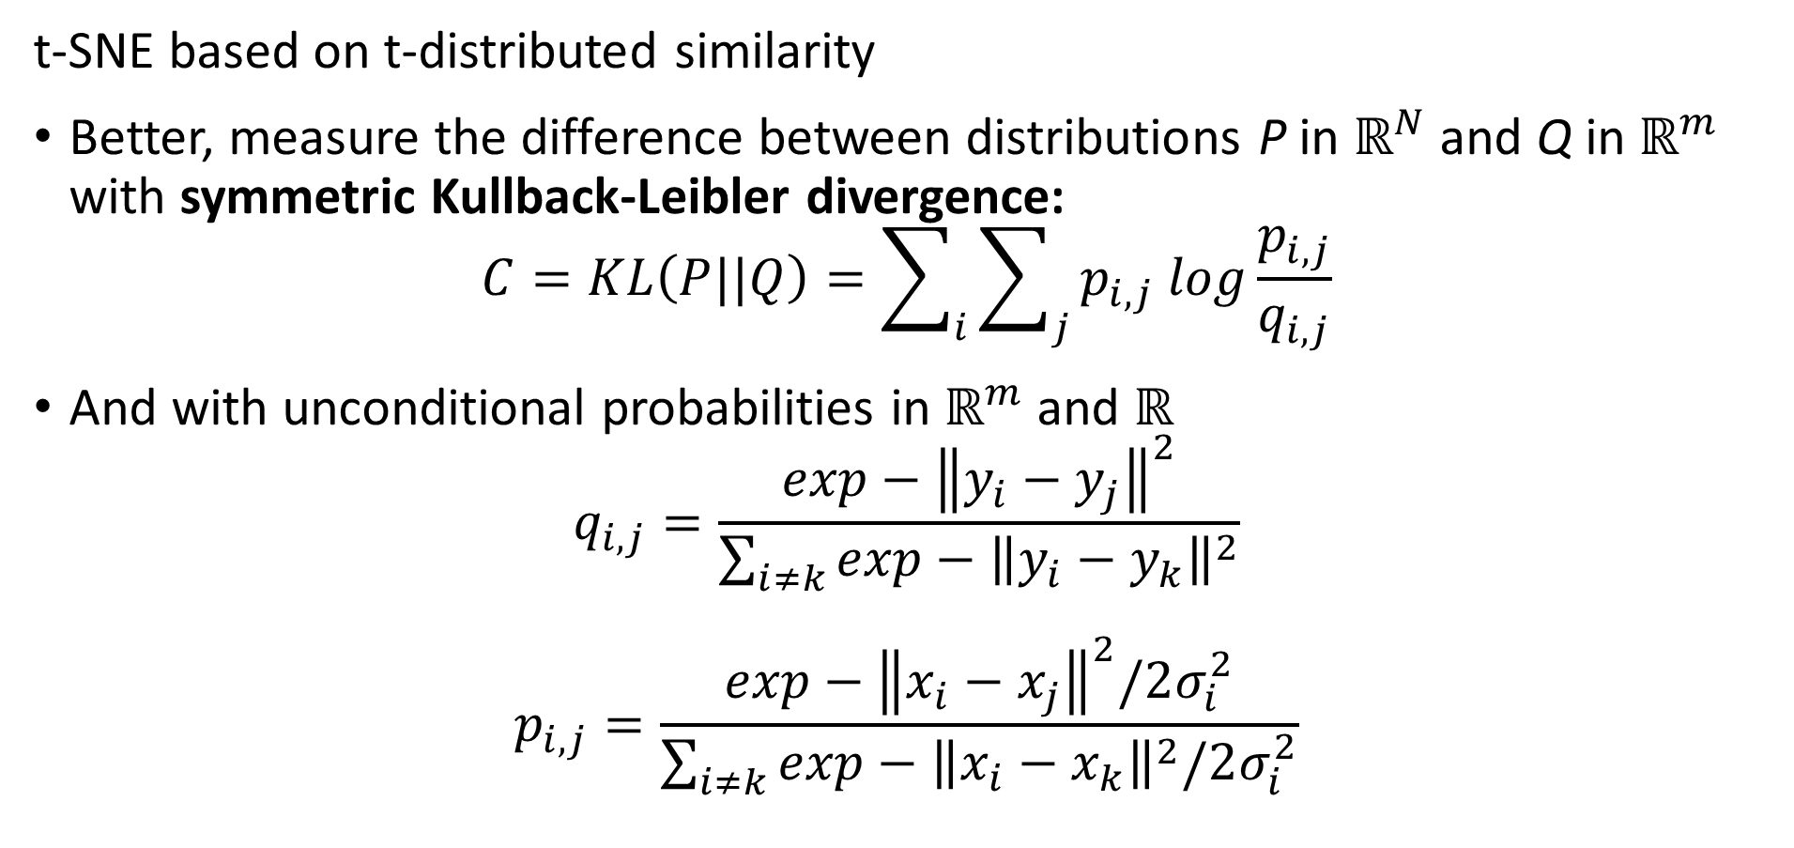
t-SNE
t-SNE based on t-distributed similarity
Better, measure the difference between distributions P in $ℝ^{N}$ and Q in $ℝ^{m}$ with symmetric Kullback-Leibler divergence:
$$C=KL\left(P||Q\right)=\sum_{i}{\sum_{j}{p_{i,j} log\frac{p_{i,j}}{q_{i,j}}}}$$
And with unconditional probabilities in $ℝ^{m}$ and $ℝ^{}$
$$q_{i,j}=\frac{exp−{\left\|y_{i}−y_{j}\right\|}^{2}}{\sum_{i≠k}^{ }{exp−{\left\|y_{i}−y_{k}\right\|}^{2}}}$$
$$p_{i,j}=\frac{exp−{\left\|x_{i}−x_{j}\right\|}^{2}/2σ_{i}^{2}}{\sum_{i≠k}^{ }{exp−{\left\|x_{i}−x_{k}\right\|}^{2}/2σ_{i}^{2}}}$$

Slide 30
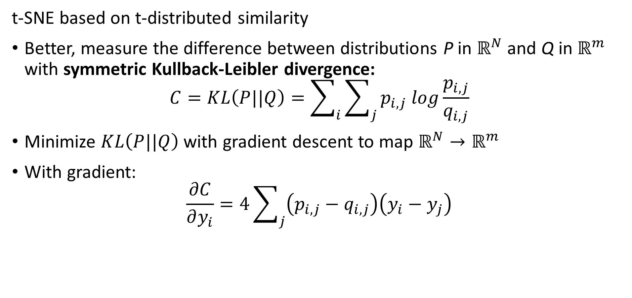
t-SNE
t-SNE based on t-distributed similarity
Better, measure the difference between distributions P in $ℝ^{N}$ and Q in $ℝ^{m}$ with symmetric Kullback-Leibler divergence:
$$C=KL\left(P||Q\right)=\sum_{i}{\sum_{j}{p_{i,j} log\frac{p_{i,j}}{q_{i,j}}}}$$
Minimize $KL\left(P||Q\right)$ with gradient descent to map $ℝ^{N}→ℝ^{m}$
With gradient:
$$\frac{∂C}{∂y_{i}}=4\sum_{j}{\left(p_{i,j}−q_{i,j}\right)\left(y_{i}−y_{j}\right)}$$

Slide 31
Summary
Dimensionality reduction is widely used in data mining
Introduction to dimensionality reduction
Review of eigenvalues and eigenvectors
Principle component analysis (PCA)
Singular value decomposition (SVD)
Kernel principle component analysis
Manifold learning

