Slide 1

CSCI E-96 Data Mining, Exploration and Discovery Introduction to Dimensionality Reduction Part 1
Steve Elston
Copyright 2020,2021, 2022, 2023, 2024, Stephen F Elston. All rights reserved.

Slide 2
Lesson Overview
Dimensionality reduction is widely used in data mining
Introduction to dimensionality reduction
Principle component analysis (PCA)
Singular value decomposition (SVD)
Kernel principle component analysis

Slide 3
What Could Possibly Go Wrong? Curse of Dimensionality!
Cluster models scale poorly with dimensionality
Consider sampling required to maintain the same uniformly distributed density in a hypercube:
An example of the Curse of Dimensionality!
Dimensions | Samples
1 | 10
2 | 100
3 | 1,000
5 | 10⁵
10 | 10¹⁰

Slide 4
What Could Possibly Go Wrong? Curse of Dimensionality
The curse of dimensionality means that all clusters are the same in high dimensions
Sampling density decreases exponentially
Distances converge to the same size in a high dimensional space
The choice of metric does not help
All distances are the same in high dimensions!
Implication is that high-dimensional cluster models are easy to overfit!!

Slide 5
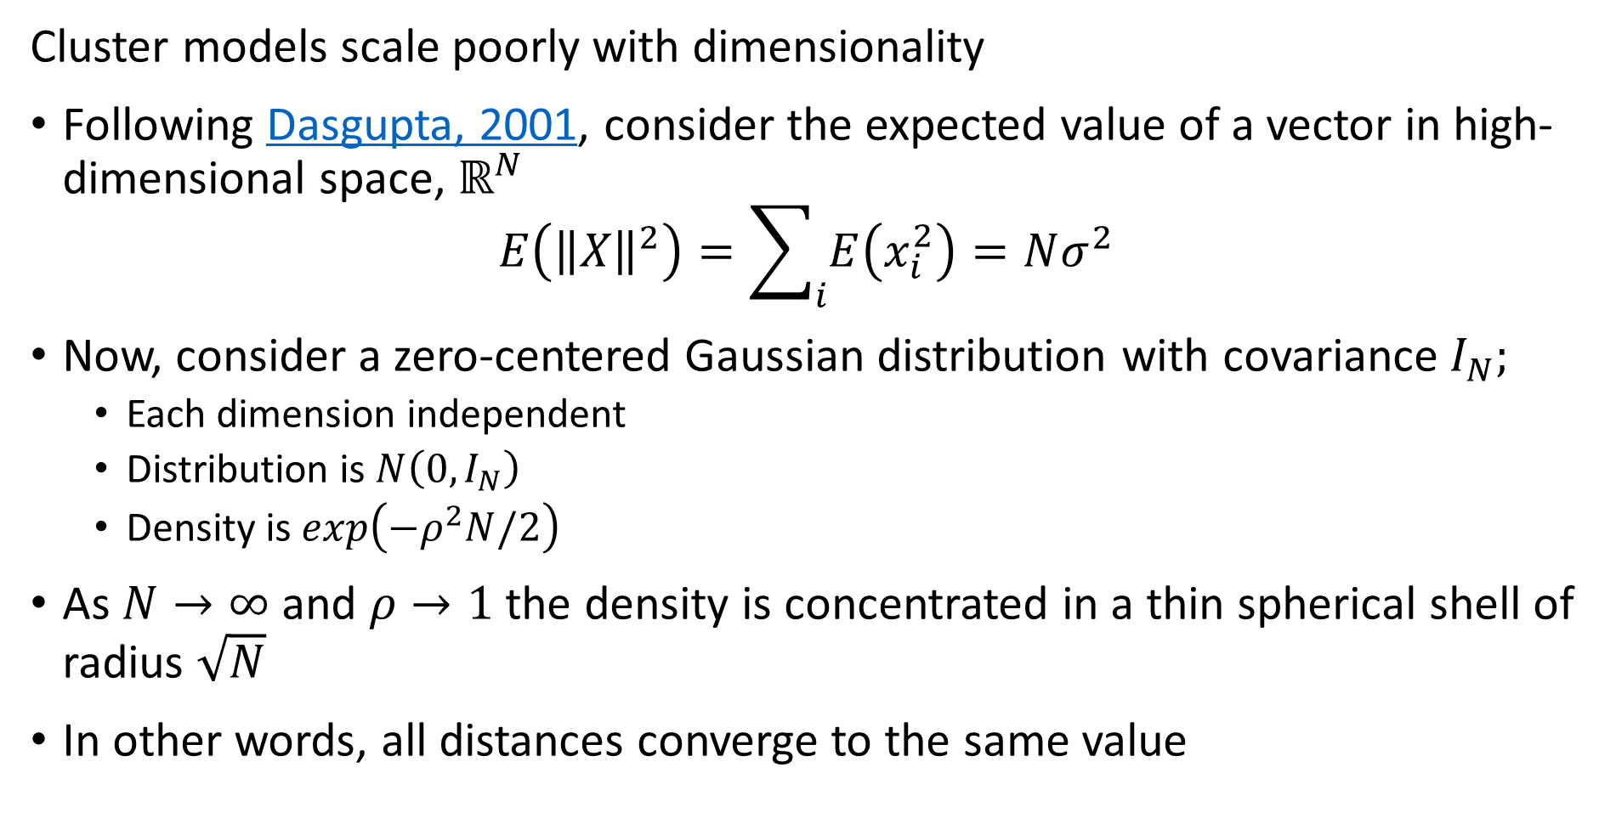
What Could Possibly Go Wrong? Curse of Dimensionality
Cluster models scale poorly with dimensionality
Following Dasgupta, 2001, consider the expected value of a vector in high-dimensional space, $ℝ^{N}$
$$E\left({\left\|X\right\|}^{2}\right)=\sum_{i}{E\left(x_{i}^{2}\right)=Nσ^{2}}$$
Now, consider a zero-centered Gaussian distribution with covariance $I_{N};$
Each dimension independent
Distribution is$N\left(0,I_{N}\right)$
Density is $exp\left(−ρ^{2}N/2\right)$
As $N→∞$ and $ρ→1$ the density is concentrated in a thin spherical shell of radius $\sqrt{N}$
In other words, all distances converge to the same value

Slide 6
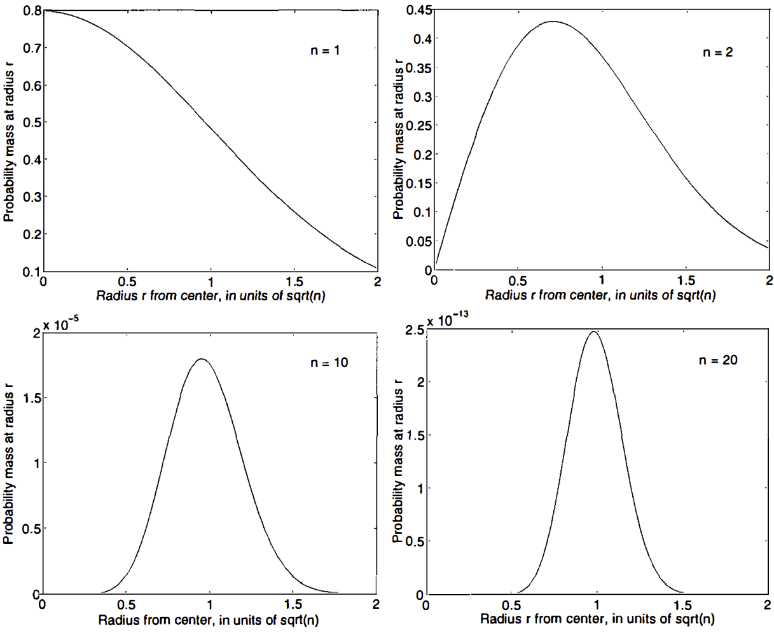
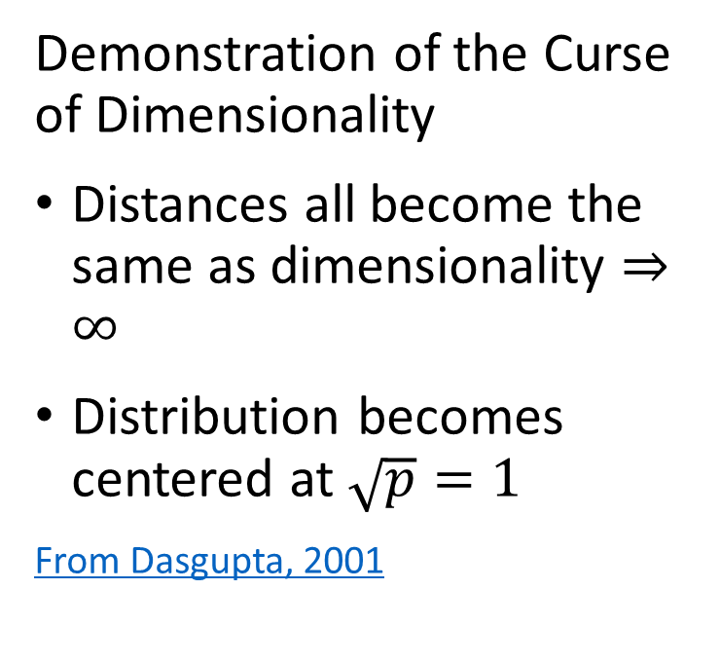
What Could Possibly Go Wrong? Curse of Dimensionality
Demonstration of the Curse of Dimensionality
Distances all become the same as dimensionality $⇒∞$
Distribution becomes centered at $\sqrt{p}=1$
From Dasgupta, 2001

Slide 7
What Could Possibly Go Wrong? Curse of Dimensionality
How can we extend clustering to higher dimensions?
Reducing dimensionality can help
Need to create a lower dimensional embedding
But how?
PCA is a linear projection
Several families of alternatives
Subspace clustering
Random projection
Manifold learning

Slide 8
Introduction to Dimensionality Reduction

Slide 9
Introduction to Dimensionality Reduction
Dimensionality reduction is widely used in data mining
Human understanding of high dimensional spaces is difficult at best
For most people, perception of data relationships starts to diminish beyond about dimensions
Exploration of complex spaces can be aided by projection into lower dimensional space
Most algorithms converge better in lower dimensional spaces
High dimensional spaces can lead to over-fitting of data mining algorithms
Example: clustering in high dimensional spaces can lead to fragmentation
Dimensionality reduction can improve results
Example; spectral clustering uses projection to lower dimensional space

Slide 10
Introduction to Dimensionality Reduction
Why is dimensionality reduction possible?
Consider the information content of each feature
Information of a feature is only unique if it is independent of all other features
Dependent features have redundant information
Dimensionality can be reduced if features are dependent
Almost always the case in real-world data
Linear dependency
Nonlinear dependency
Feature values lie on a low-dimensional manifold in a higher dimensional space
Dependency implies effective dimensionality less than number of features

Slide 11
Introduction to Dimensionality Reduction
What are the properties good dimensionality reduction algorithms?
Goal is to find a mapping to the lower dimensional manifold or embedding space
Embedding should minimize error with respect to the original data
Ideally, reconstruct original data by inverse transformation
Embedding should preserve distances
Distances or similarities should not be distorted by transformation

Slide 12
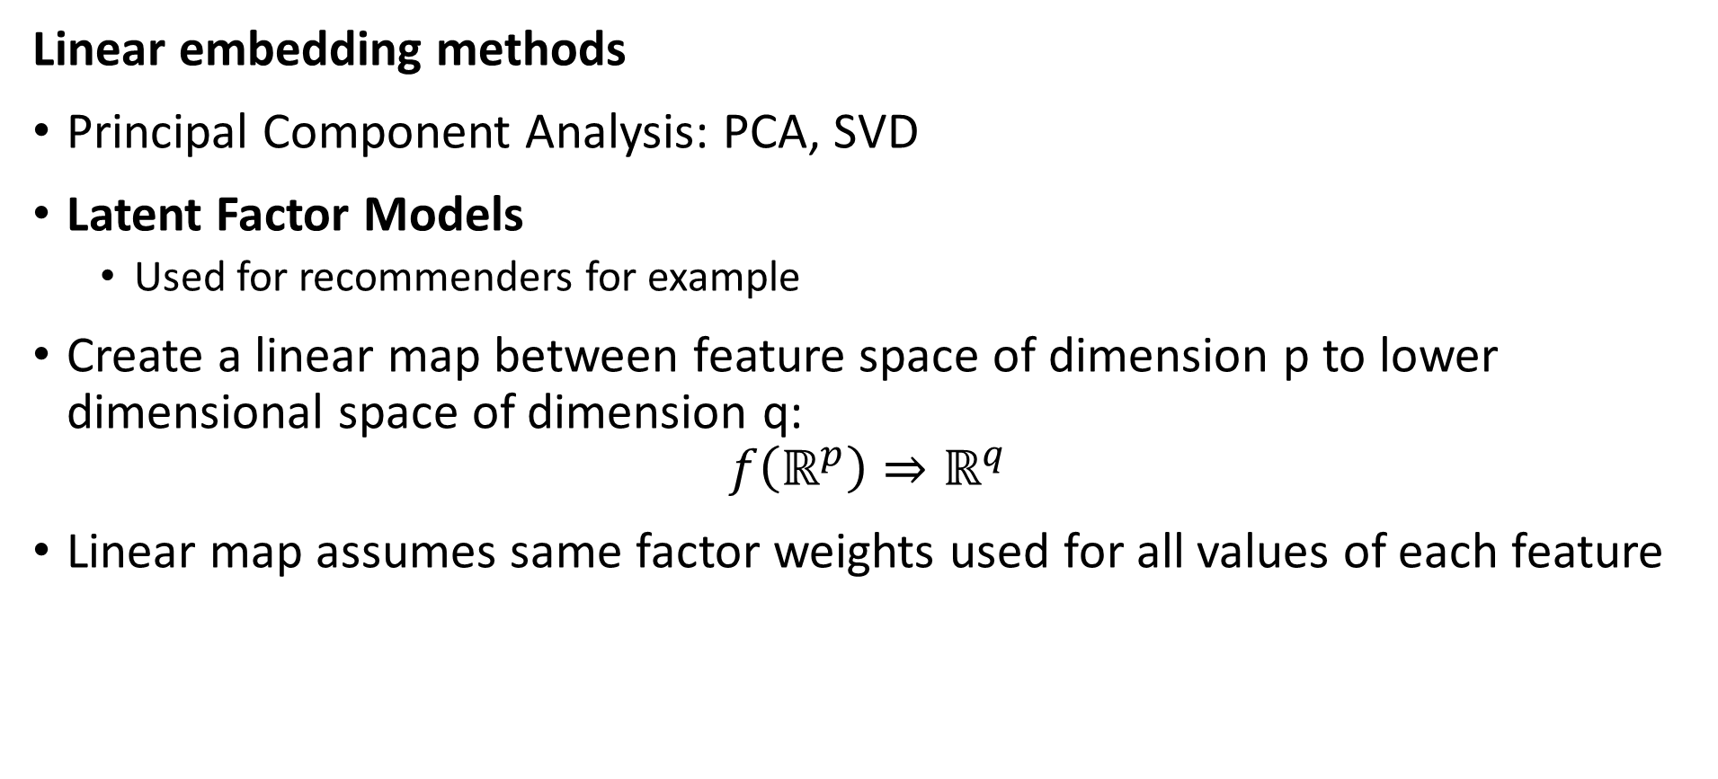
Introduction to Dimensionality Reduction
Linear embedding methods
Principal Component Analysis: PCA, SVD
Latent Factor Models
Used for recommenders for example
Create a linear map between feature space of dimension p to lower dimensional space of dimension q:
$$f\left(ℝ^{p}\right)⇒ℝ^{q}$$
Linear map assumes same factor weights used for all values of each feature

Slide 13
Introduction to Dimensionality Reduction
Nonlinear embedding methods
Kernel PCA – topic today
Projection methods for high dimensional spaces – Part 2
Manifold learning for visualization - Part 2
Spectral embedding
UMAP
Etc……
Deep autoencoders, other NN-based embedding methods – Beyond the scope of this course

Slide 14
Review of Eigendecomposition

Slide 15

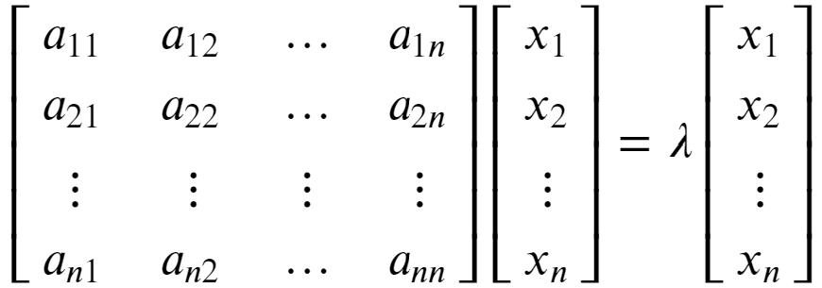


Review of Eigenvalues and Eigenvectors
Eigenvalues are characteristic roots or characteristic values of a linear system
Start with the eigenvalue, eigenvector relationship:
To see that λ is a root of A we can rearrange as follows:

Slide 16
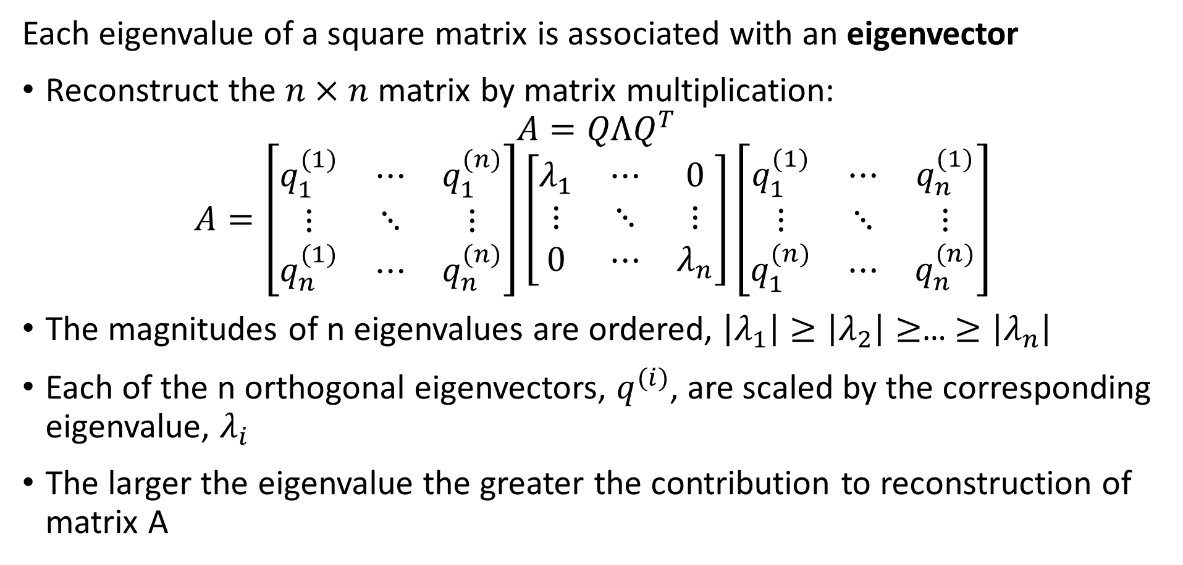
Review of Eigenvalues and Eigenvectors
Each eigenvalue of a square matrix is associated with an eigenvector
Reconstruct the $n×n$ matrix by matrix multiplication:
$$A=QΛQ^{T}$$
$$A=\left[\begin{matrix}q_{1}^{(1)} & ⋯ & q_{1}^{(n)} \\ ⋮ & ⋱ & ⋮ \\ q_{n}^{(1)} & ⋯ & q_{n}^{(n)}\end{matrix}\right]\left[\begin{matrix}λ_{1} & ⋯ & 0 \\ ⋮ & ⋱ & ⋮ \\ 0 & ⋯ & λ_{n}\end{matrix}\right]{\left[\begin{matrix}q_{1}^{(1)} & ⋯ & q_{n}^{(1)} \\ ⋮ & ⋱ & ⋮ \\ q_{1}^{(n)} & ⋯ & q_{n}^{(n)}\end{matrix}\right]}^{ }$$
The magnitudes of n eigenvalues are ordered, $\left|λ_{1}\right|≥\left|λ_{2}\right|≥$… $≥\left|λ_{n}\right|$
Each of the n orthogonal eigenvectors, $q_{ }^{(i)}$, are scaled by the corresponding eigenvalue, $λ_{i}$
The larger the eigenvalue the greater the contribution to reconstruction of matrix A

Slide 17
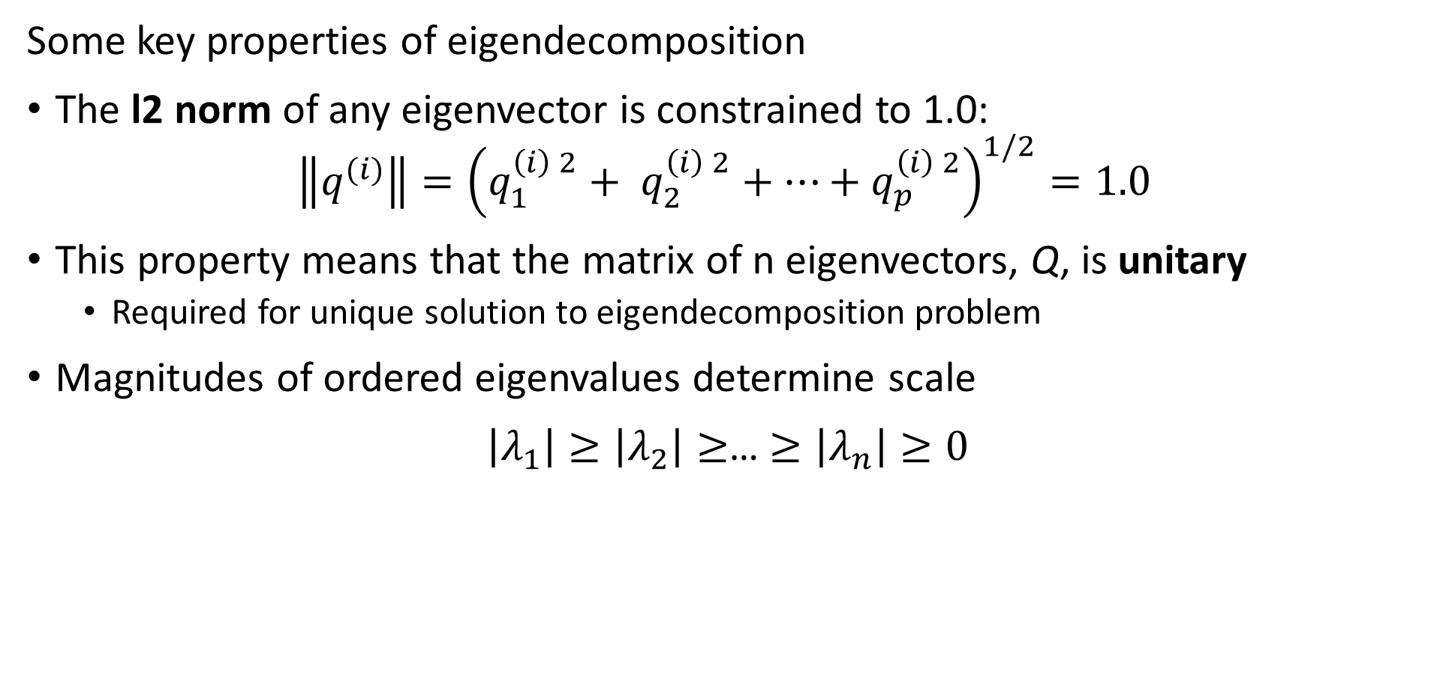
Review of Eigenvalues and Eigenvectors
Some key properties of eigendecomposition
The l2 norm of any eigenvector is constrained to 1.0:
$$\left\|q^{(i)}\right\|={\left(q_{1}^{\left(i\right) 2}+ q_{2}^{\left(i\right) 2}+…+q_{p}^{\left(i\right) 2}\right)}^{1/2}=1.0$$
This property means that the matrix of n eigenvectors, Q, is unitary
Required for unique solution to eigendecomposition problem
Magnitudes of ordered eigenvalues determine scale
$\left|λ_{1}\right|≥\left|λ_{2}\right|≥$… $≥\left|λ_{n}\right|≥0$

Slide 18
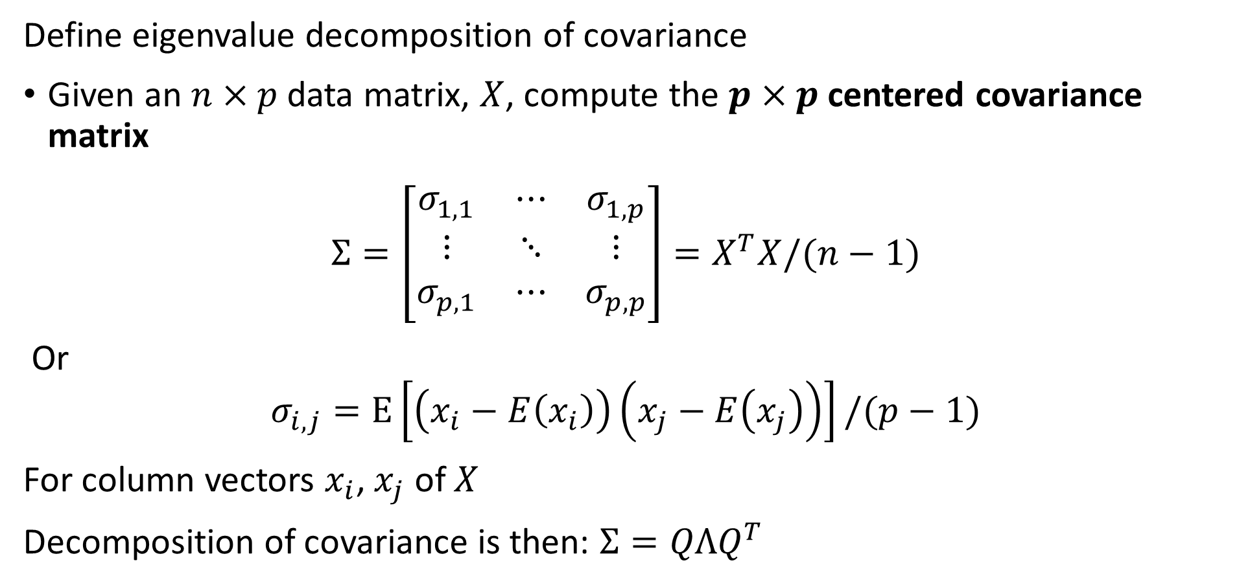
Principle Component Decomposition
Define eigenvalue decomposition of covariance
Given an $n×p$ data matrix, $X$, compute the $p×p$centered covariance matrix
$$Σ=\left[\begin{matrix}σ_{1,1} & ⋯ & σ_{1,p} \\ ⋮ & ⋱ & ⋮ \\ σ_{p,1} & ⋯ & σ_{p,p}\end{matrix}\right]=X^{T}X/(n−1)$$
Or
$$σ_{i,j}=E\left[\left(x_{i}−E\left(x_{i}\right)\right)\left(x_{j}−E\left(x_{j}\right)\right)\right]/(p−1)$$
For column vectors $x_{i}$, $x_{j}$ of $X$
Decomposition of covariance is then: $Σ=QΛQ^{T}$

Slide 19
Linear Embedding with PCA

Slide 20
Linear Dimensionality Reduction - PCA
PCA applies a linear projection from sample space to an orthogonal space
Start with the original features of the model matrix in the sample space
Compute a linear transformation to an orthogonal space
Principle (1st) axis with highest variance
Each axis is orthogonal to the others, explaining maximum remaining variance
Transform projects data into an orthogonal space

Slide 21
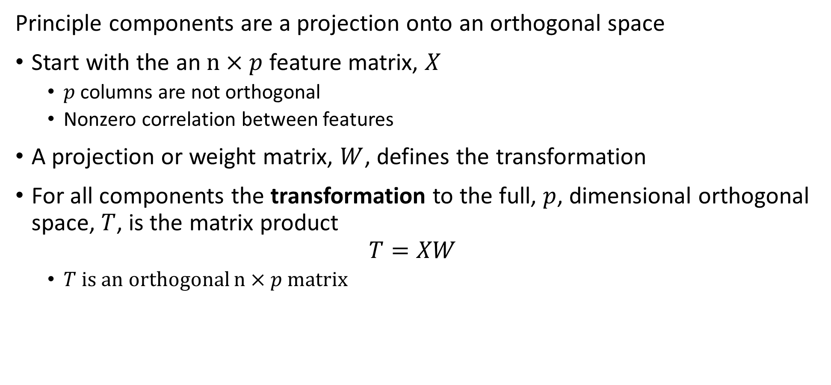
Principle Component Decomposition
Principle components are a projection onto an orthogonal space
Start with the an $n×p$ feature matrix, $X$
$p$ columns are not orthogonal
Nonzero correlation between features
A projection or weight matrix, $W$, defines the transformation
For all components the transformation to the full, $p$, dimensional orthogonal space, $T$, is the matrix product
$$T=XW$$
$T$ is an orthogonal $n×p$ matrix

Slide 22
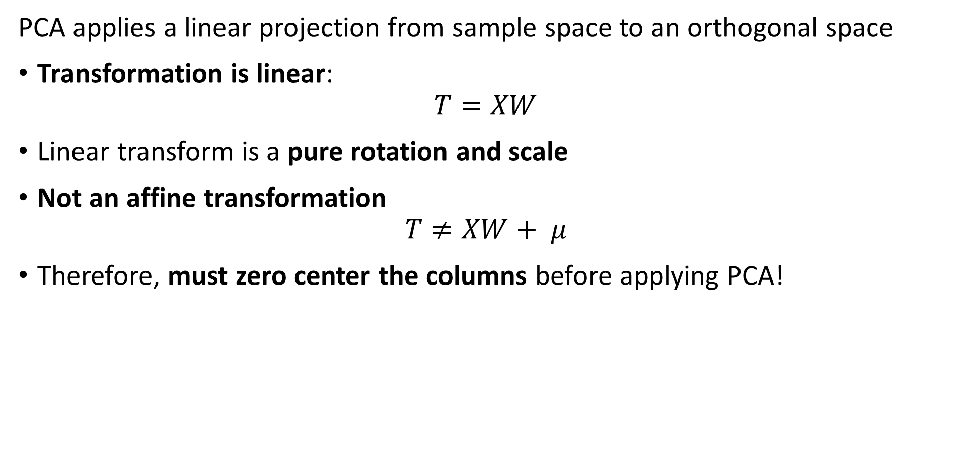
Linear Dimensionality Reduction - PCA
PCA applies a linear projection from sample space to an orthogonal space
Transformation is linear:
$$T=XW$$
Linear transform is a pure rotation and scale
Not an affine transformation
$$T≠XW+ μ$$
Therefore, must zero center the columns before applying PCA!

Slide 23
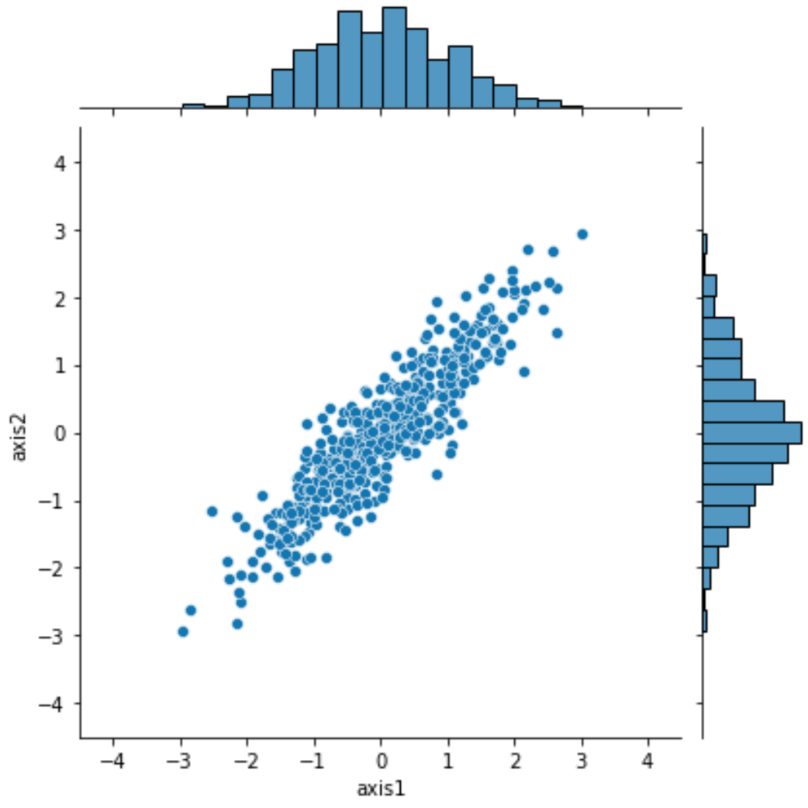
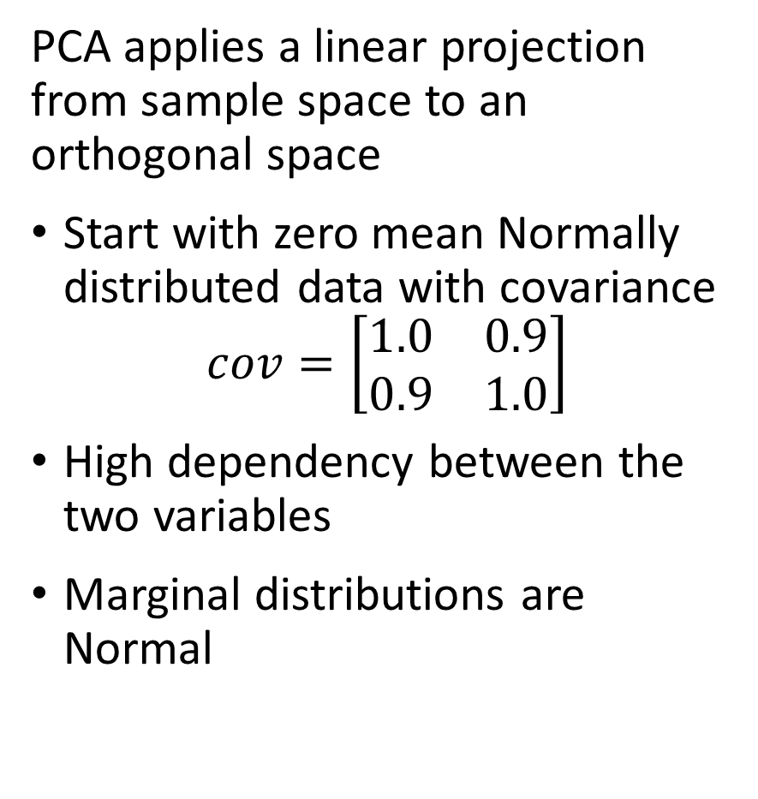
Linear Dimensionality Reduction - PCA
PCA applies a linear projection from sample space to an orthogonal space
Start with zero mean Normally distributed data with covariance
$$cov=\left[\begin{matrix}1.0 & 0.9 \\ 0.9 & 1.0\end{matrix}\right]$$
High dependency between the two variables
Marginal distributions are Normal

Slide 24
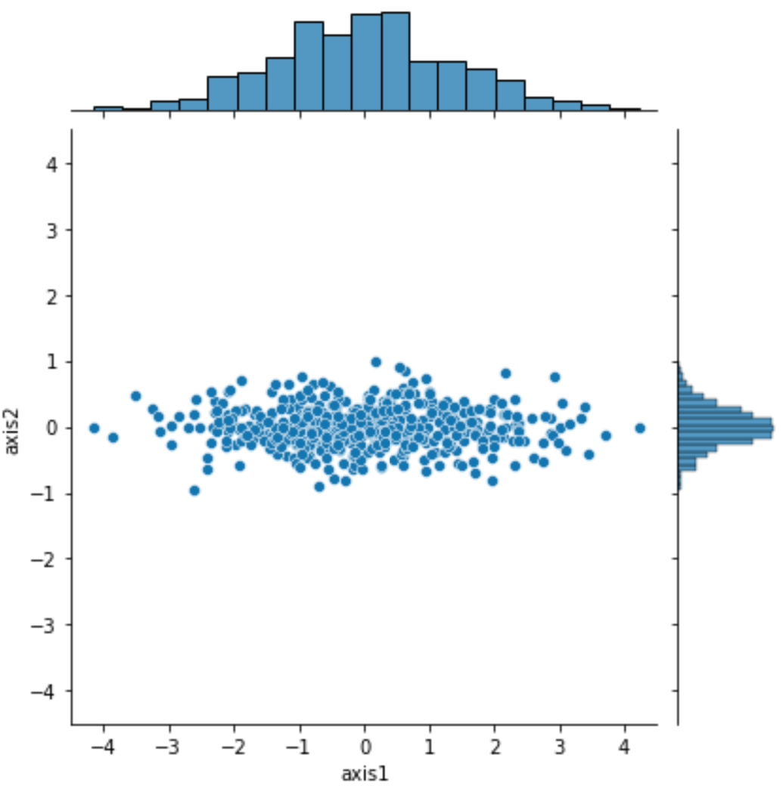
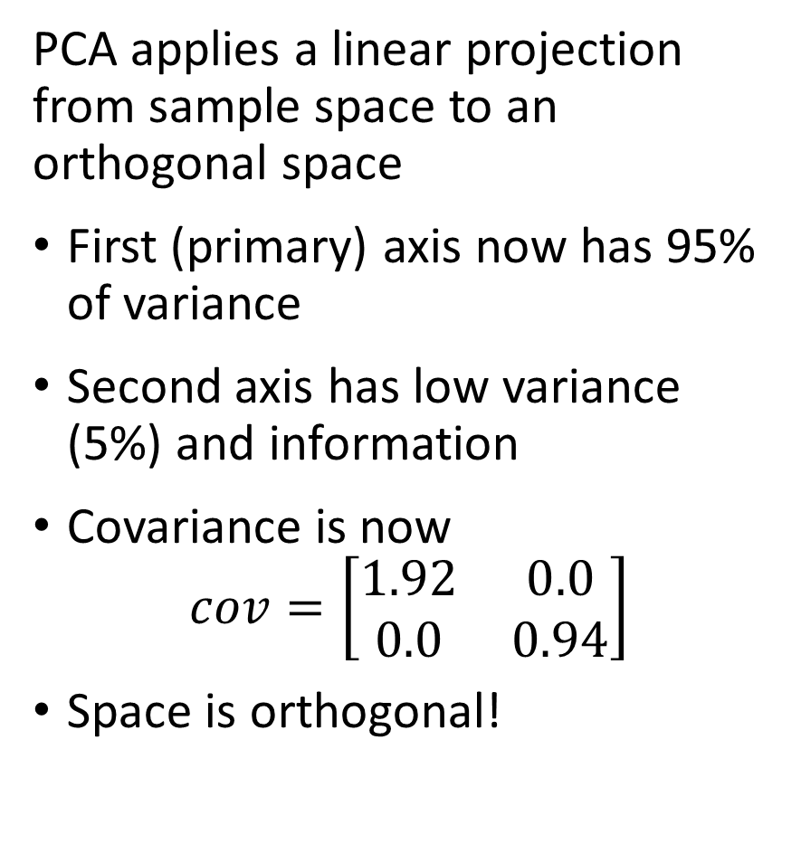
Linear Dimensionality Reduction - PCA
PCA applies a linear projection from sample space to an orthogonal space
First (primary) axis now has 95% of variance
Second axis has low variance (5%) and information
Covariance is now
$$cov=\left[\begin{matrix}1.92 & 0.0 \\ 0.0 & 0.94\end{matrix}\right]$$
Space is orthogonal!

Slide 25
Principal Component Dimensionality Reduction

Slide 26
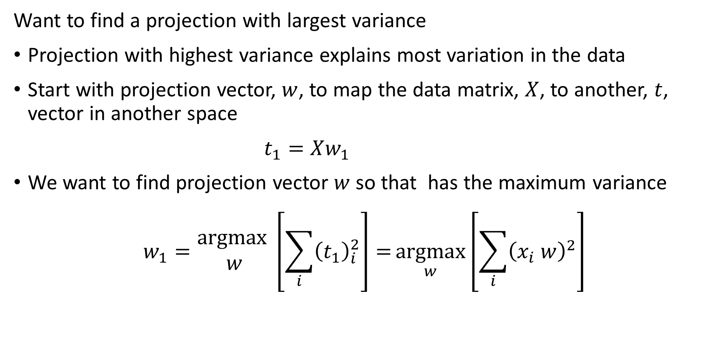
Principle Component Decomposition
Want to find a projection with largest variance
Projection with highest variance explains most variation in the data
Start with projection vector, $w$, to map the data matrix, $X$, to another, $t$, vector in another space
$t_{1}=Xw_{1}$
We want to find projection vector $w$ so that has the maximum variance
$$w_{1}=\underset{ }{\begin{aligned}argmax \\ w\end{aligned}}\left[\sum_{i}{{\left(t_{1}\right)}_{i}^{2}}\right]={\underset{w}{argmax}\left[\sum_{i}{{\left(x_{i} w\right)}_{ }^{2}}\right]}$$

Slide 27
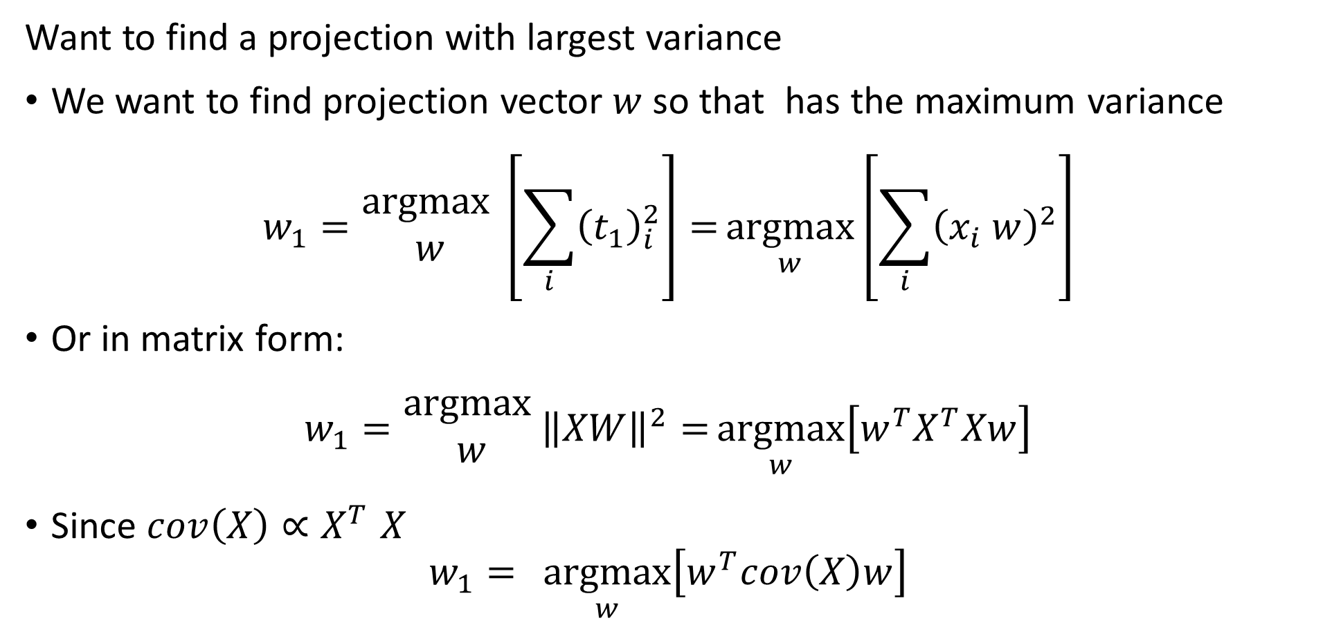
Principle Component Decomposition
Want to find a projection with largest variance
We want to find projection vector $w$ so that has the maximum variance
$$w_{1}=\underset{ }{\begin{aligned}argmax \\ w\end{aligned}}\left[\sum_{i}{{\left(t_{1}\right)}_{i}^{2}}\right]={\underset{w}{argmax}\left[\sum_{i}{{\left(x_{i} w\right)}_{ }^{2}}\right]}$$
Or in matrix form:
$$w_{1}=\underset{ }{\begin{aligned}argmax \\ w\end{aligned}}{\left\|XW\right\|}^{2}={\underset{w}{argmax}\left[w^{T}X^{T}Xw\right]}$$
Since $cov\left(X\right){∝X}^{T}X$
$$w_{1}={\underset{w}{argmax}\left[w^{T}cov\left(X\right)w\right]}$$

Slide 28
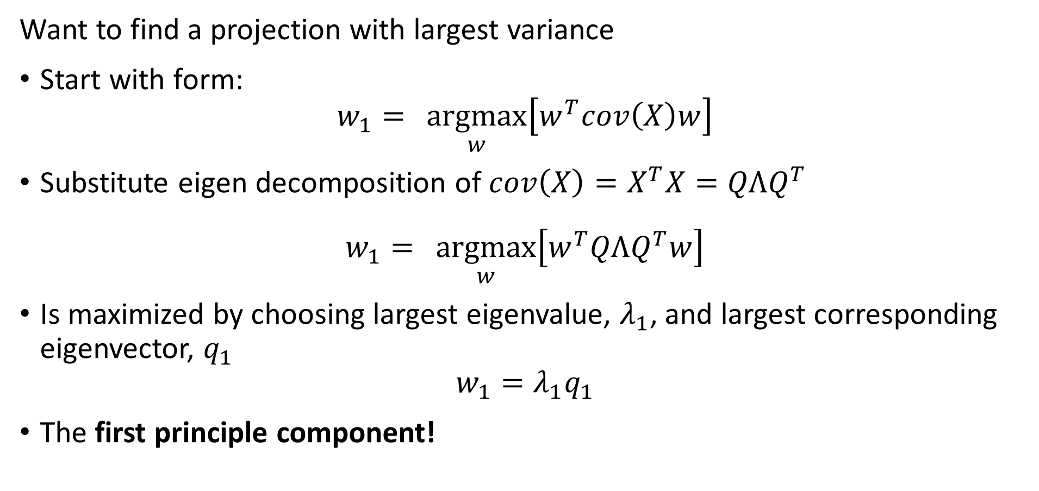
Principle Component Decomposition
Want to find a projection with largest variance
Start with form:
$$w_{1}={\underset{w}{argmax}\left[w^{T}cov\left(X\right)w\right]}$$
Substitute eigen decomposition of $cov\left(X\right)=X^{T}X=QΛQ^{T}$
$$w_{1}={\underset{w}{argmax}\left[w^{T}QΛQ^{T}w\right]}$$
Is maximized by choosing largest eigenvalue, $λ_{1}$, and largest corresponding eigenvector, $q_{1}$
$$w_{1}=λ_{1}q_{1}$$
The first principle component!

Slide 29
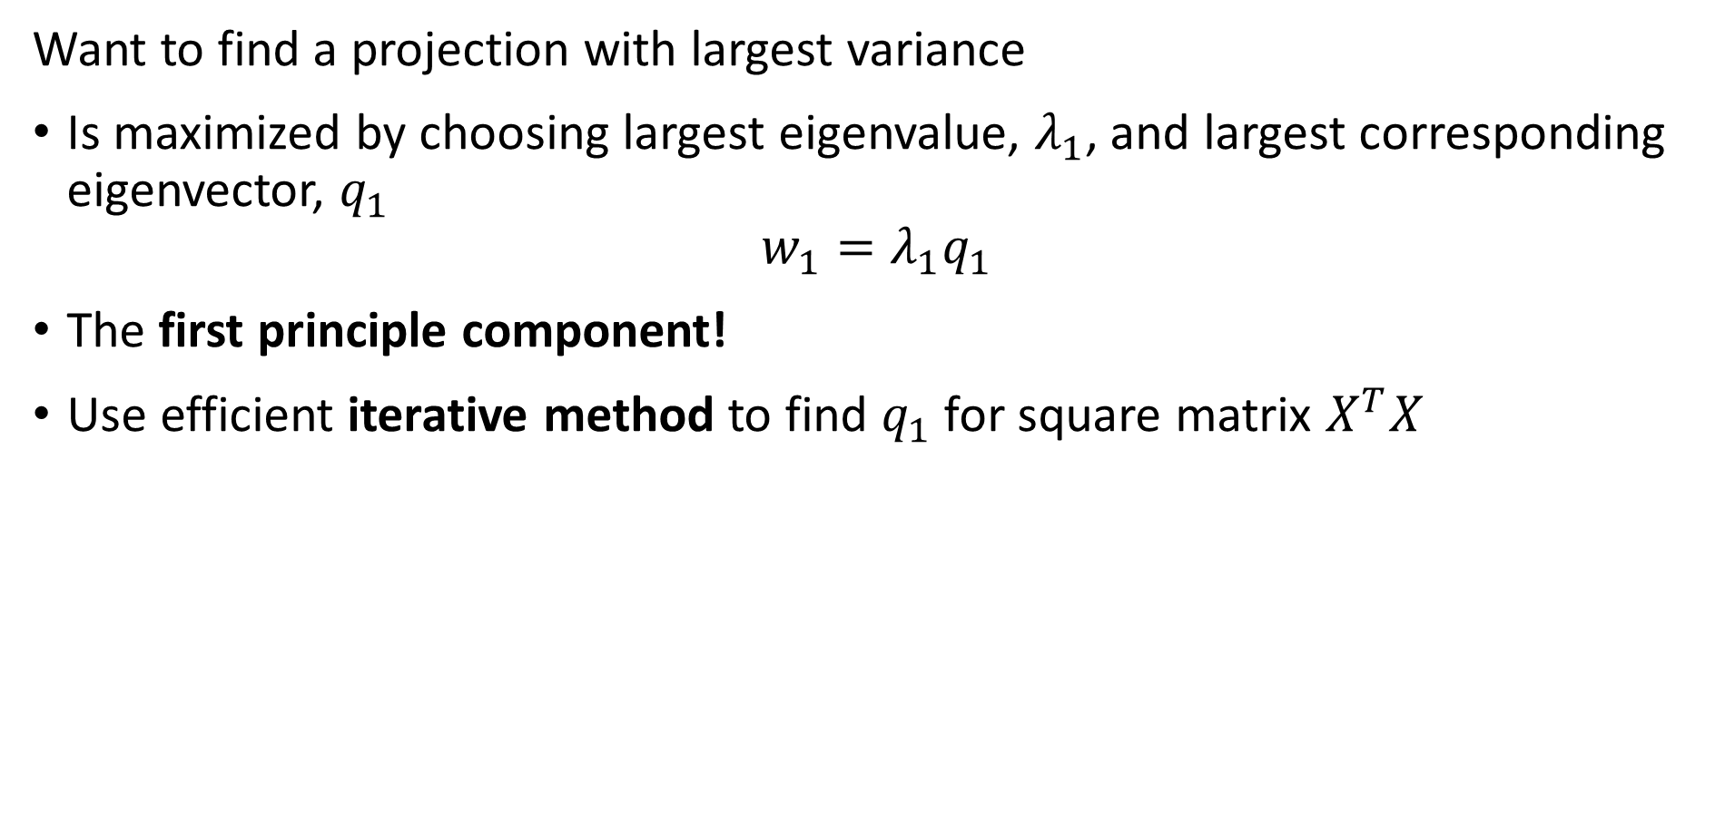
Principle Component Decomposition
Want to find a projection with largest variance
Is maximized by choosing largest eigenvalue, $λ_{1}$, and largest corresponding eigenvector, $q_{1}$
$$w_{1}=λ_{1}q_{1}$$
The first principle component!
Use efficient iterative method to find $q_{1}$ for square matrix $X^{T}X$

Slide 30
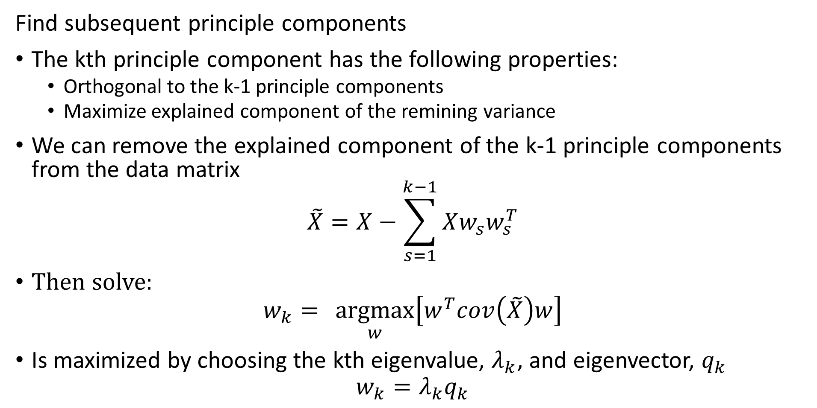
Principle Component Decomposition
Find subsequent principle components
The kth principle component has the following properties:
Orthogonal to the k-1 principle components
Maximize explained component of the remining variance
We can remove the explained component of the k-1 principle components from the data matrix
$$\tilde{X}=X−\sum_{s=1}^{k−1}{Xw_{s}w_{s}^{T}}$$
Then solve:
$$w_{k}={\underset{w}{argmax}\left[w^{T}cov\left(\tilde{X}\right)w\right]}$$
Is maximized by choosing the kth eigenvalue, $λ_{k}$, and eigenvector, $q_{k}$
$$w_{k}=λ_{k}q_{k}$$

Slide 31
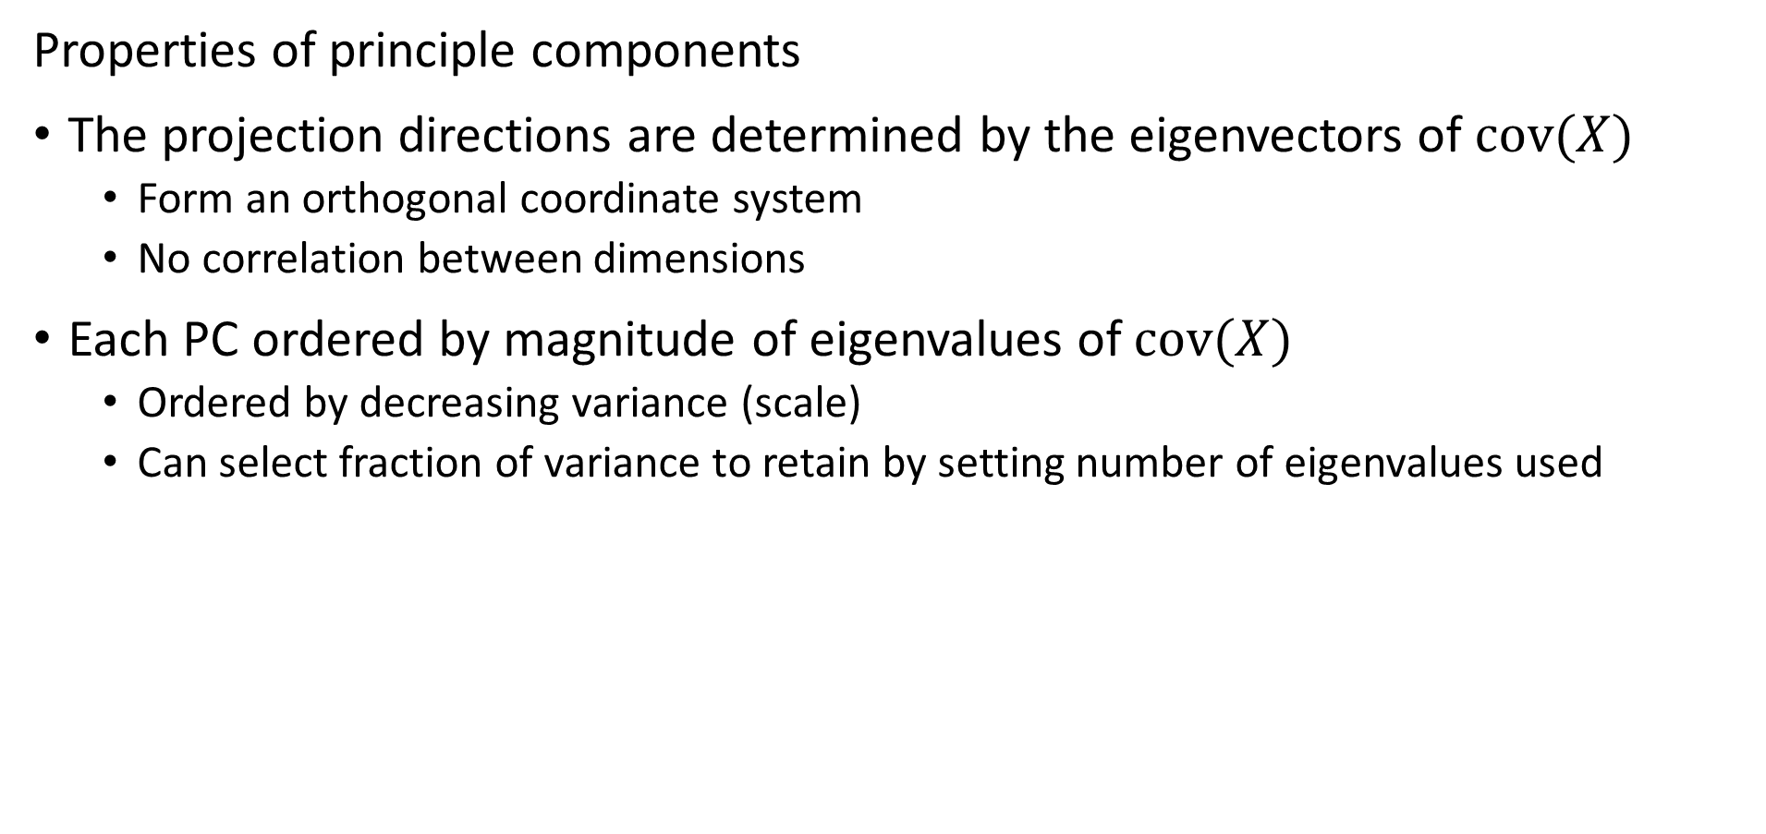
Principle Component Decomposition
Properties of principle components
The projection directions are determined by the eigenvectors of $cov(X)$
Form an orthogonal coordinate system
No correlation between dimensions
Each PC ordered by magnitude of eigenvalues of $cov(X)$
Ordered by decreasing variance (scale)
Can select fraction of variance to retain by setting number of eigenvalues used

Slide 32
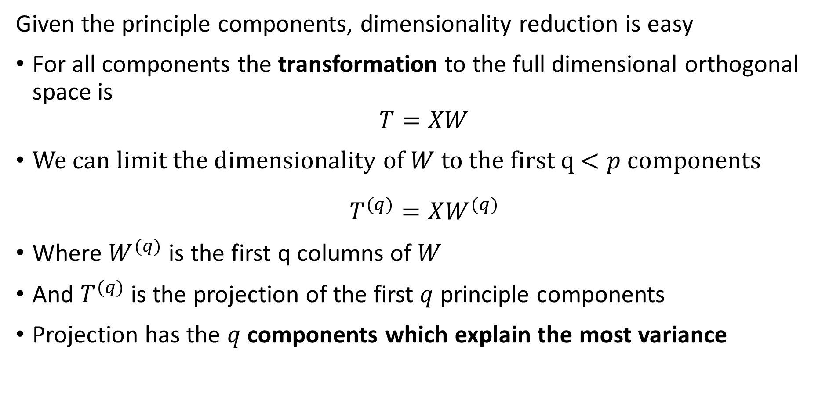
Principle Component Decomposition
Given the principle components, dimensionality reduction is easy
For all components the transformation to the full dimensional orthogonal space is
$$T=XW$$
We can limit the dimensionality of $W$ to the first q $<p$ components
$$T^{(q)}=XW^{(q)}$$
Where $W^{(q)}$ is the first q columns of $W$
And $T^{(q)}$ is the projection of the first $q$ principle components
Projection has the $q$ components which explain the most variance

Slide 33
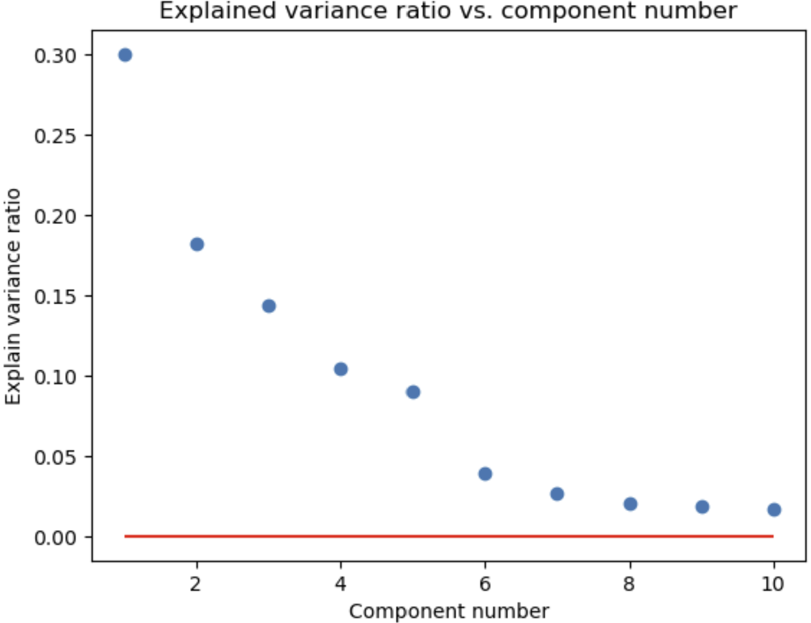
Principle Component Decomposition
How many components do you need?
Need to retain enough components to explain most of the variance
q components explain most variance
Apparent random variation – irreducible error

Slide 34
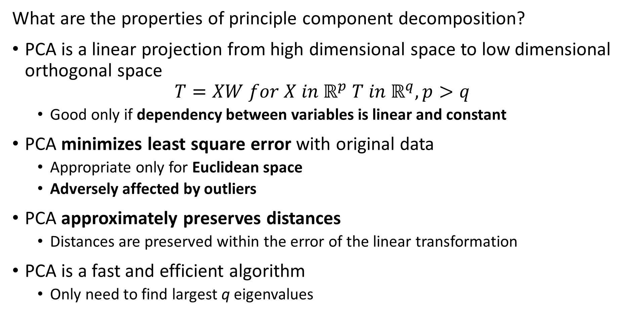
Principle Component Decomposition
What are the properties of principle component decomposition?
PCA is a linear projection from high dimensional space to low dimensional orthogonal space
$$T=XW for X in ℝ^{p} T in ℝ^{q}, p>q$$
Good only if dependency between variables is linear and constant
PCA minimizes least square error with original data
Appropriate only for Euclidean space
Adversely affected by outliers
PCA approximately preserves distances
Distances are preserved within the error of the linear transformation
PCA is a fast and efficient algorithm
Only need to find largest q eigenvalues

Slide 35
Principle Component Decomposition
Data preparation for PCA
Treat outliers since PCA susceptible
Details are problem dependent
If outliers inherent in data, consider nonlinear method like spectral decomposition
Demean the variables
PCA is a linear transformation
But not an affine transformation!
Transforming variables to unit variance can improve convergence
Particularly important in high dimensions

Slide 36
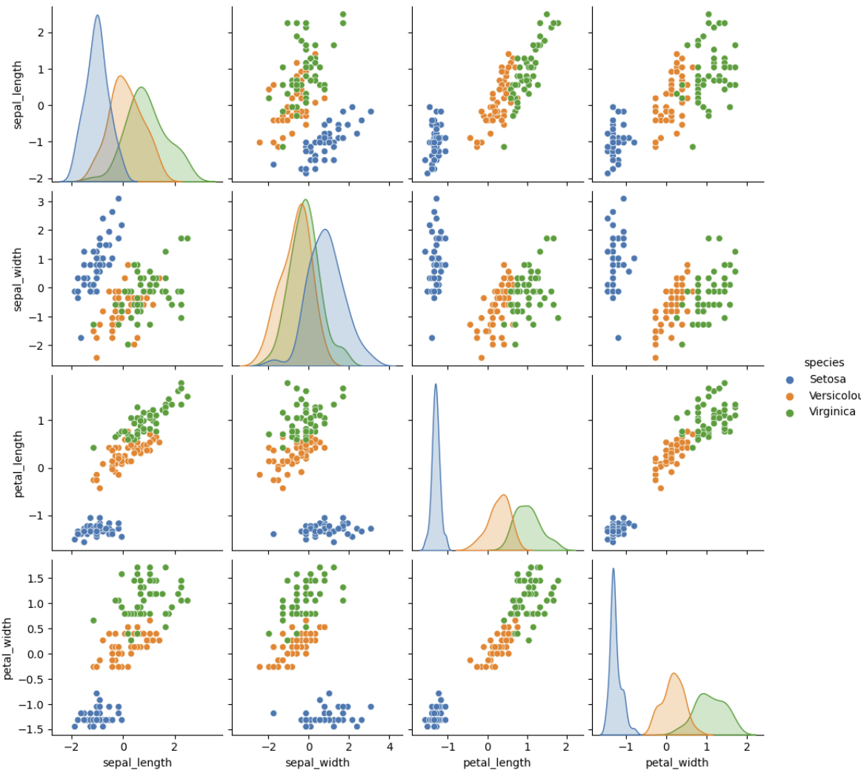
Principle Component Decomposition
Example, Iris dataset
3 spices of iris flowers
4 dimensions of measurements
1 species well separated
2 species overlap in all dimensions

Slide 37
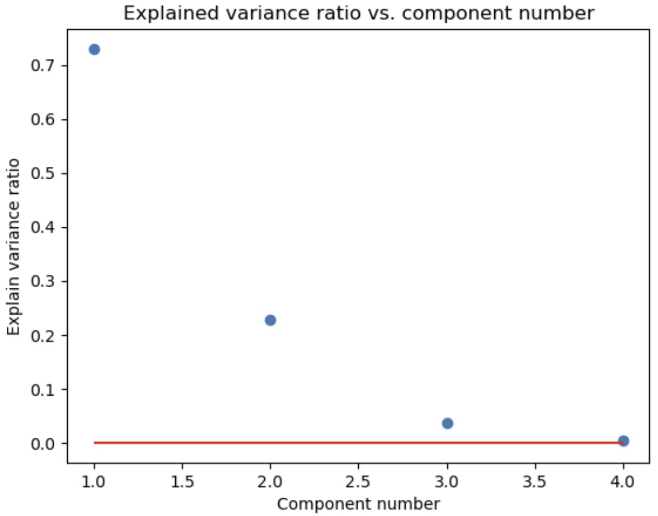
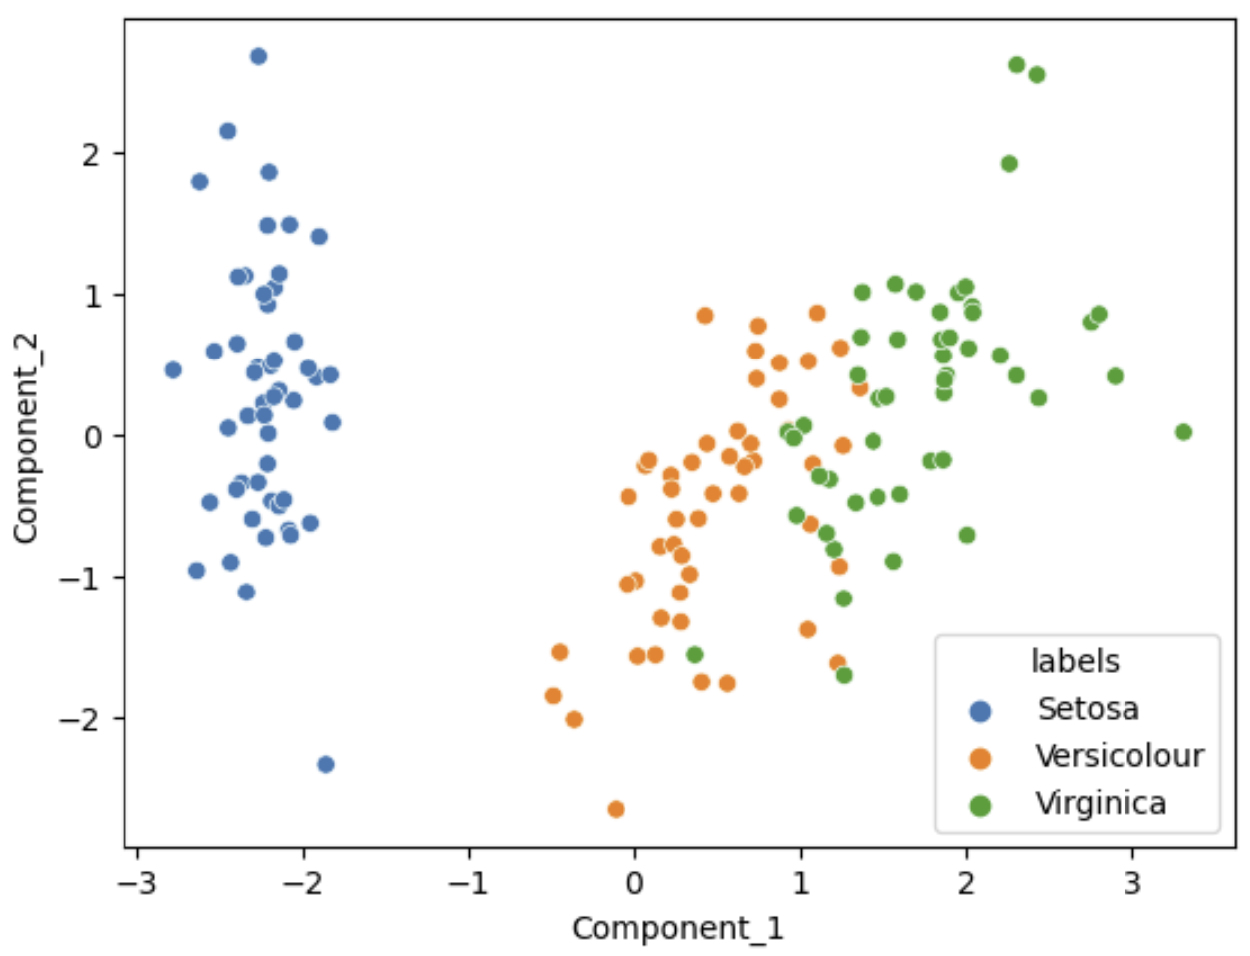
Principle Component Decomposition
Example, Iris dataset
Variance ratio by PCA component
Scatterplot of first 2 PCA Components

Slide 38
Singular Value Decomposition

Slide 39
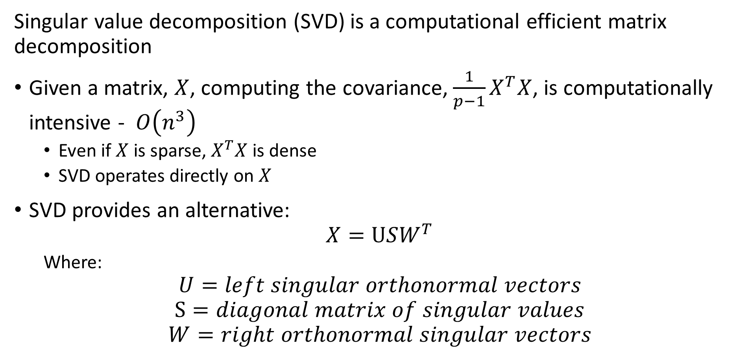
Singular Value Decomposition
Singular value decomposition (SVD) is a computational efficient matrix decomposition
Given a matrix, $X$, computing the covariance, ${\frac{1}{p−1}X}^{T}X$, is computationally intensive - $O\left(n^{3}\right)$
Even if $X$ is sparse, $X^{T}X$ is dense
SVD operates directly on $X$
SVD provides an alternative:
$$X=USW^{T}$$
Where:
$$U=left singular orthonormal vectors$$
$$S=diagonal matrix of singular values$$
$$W=right orthonormal singular vectors$$

Slide 40
Singular Value Decomposition
Singular value decomposition (SVD) is a computational efficient matrix decomposition
At scale, can directly apply SVD to massive feature matrices
But SVD is not good for sparse matrices, particularly with many 0s
But, we do not need the full decomposition!
Decompose into low-dimensional embedding factors
Example: factor model for recommenders

Slide 41
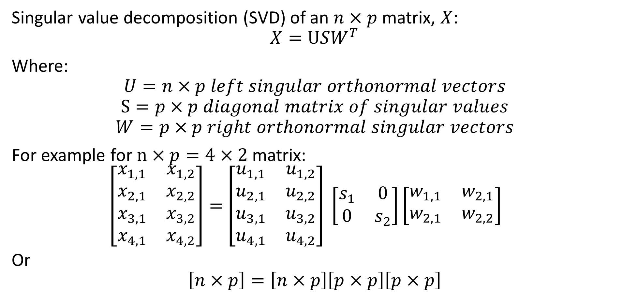
Singular Value Decomposition
Singular value decomposition (SVD) of an $n×p$ matrix, $X$:
$$X=USW^{T}$$
Where:
$$U=n×p left singular orthonormal vectors$$
$$S=p×p diagonal matrix of singular values$$
$$W=p×p right orthonormal singular vectors$$
For example for $n×p=4×2$ matrix:
$\left[\begin{matrix}x_{1,1} & x_{1,2} \\ x_{2,1} & x_{2,2} \\ x_{3,1} & x_{3,2} \\ x_{4,1} & x_{4,2}\end{matrix}\right]=$ $\left[\begin{matrix}u_{1,1} & u_{1,2} \\ u_{2,1} & u_{2,2} \\ u_{3,1} & u_{3,2} \\ u_{4,1} & u_{4,2}\end{matrix}\right] \left[\begin{matrix}s_{1} & 0 \\ 0 & s_{2}\end{matrix}\right]\left[\begin{matrix}w_{1,1} & w_{2,1} \\ w_{2,1} & w_{2,2}\end{matrix}\right]$
Or
$$\left[n×p\right]=\left[n×p\right]\left[p×p\right]\left[p×p\right]$$

Slide 42
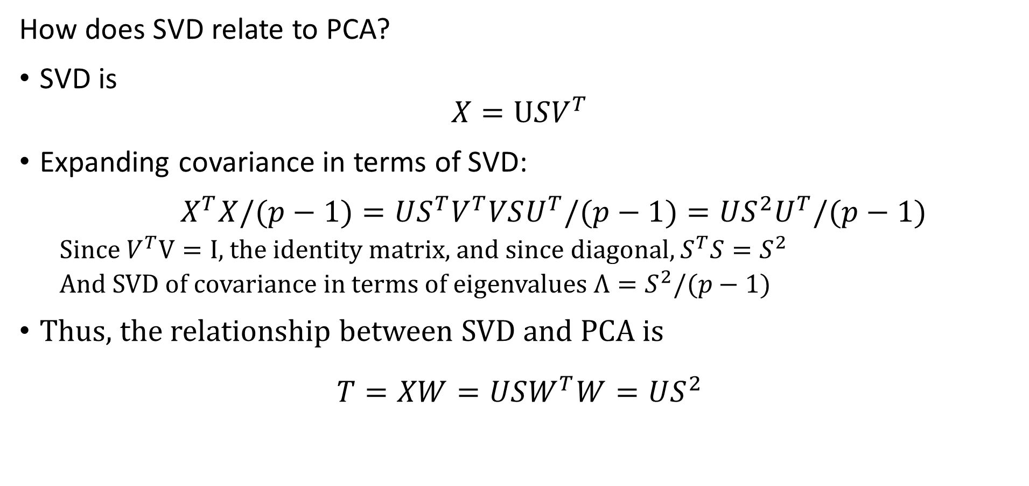
Singular Value Decomposition
How does SVD relate to PCA?
SVD is
$$X=USV^{T}$$
Expanding covariance in terms of SVD:
$X^{T}X/(p−1)=US^{T}V^{T}VSU^{T}/(p−1)=US^{2}U^{T}/(p−1)$
Since $V^{T}V=I$, the identity matrix, and since diagonal, $S^{T}S{=S}^{2}$
And SVD of covariance in terms of eigenvalues ${Λ=S}^{2}/(p−1)$
Thus, the relationship between SVD and PCA is
$$T=XW=USW^{T}W=US^{2}$$

Slide 43
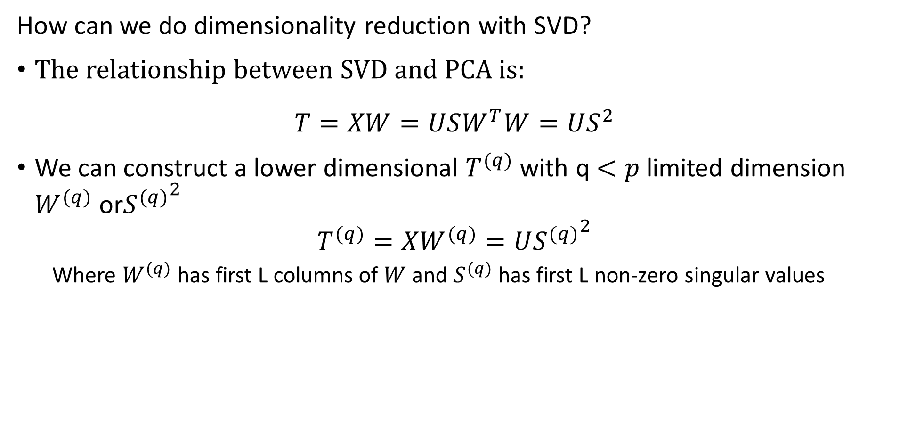
Singular Value Decomposition
How can we do dimensionality reduction with SVD?
The relationship between SVD and PCA is:
$$T=XW=USW^{T}W=US^{2}$$
We can construct a lower dimensional $T^{(q)}$ with q $<p$ limited dimension $W^{(q)}$ or${S^{(q)}}^{2}$
$$T^{(q)}=XW^{(q)}=U{S^{(q)}}^{2}$$
Where $W^{(q)}$ has first L columns of $W$ and $S^{(q)}$ has first L non-zero singular values

Slide 44
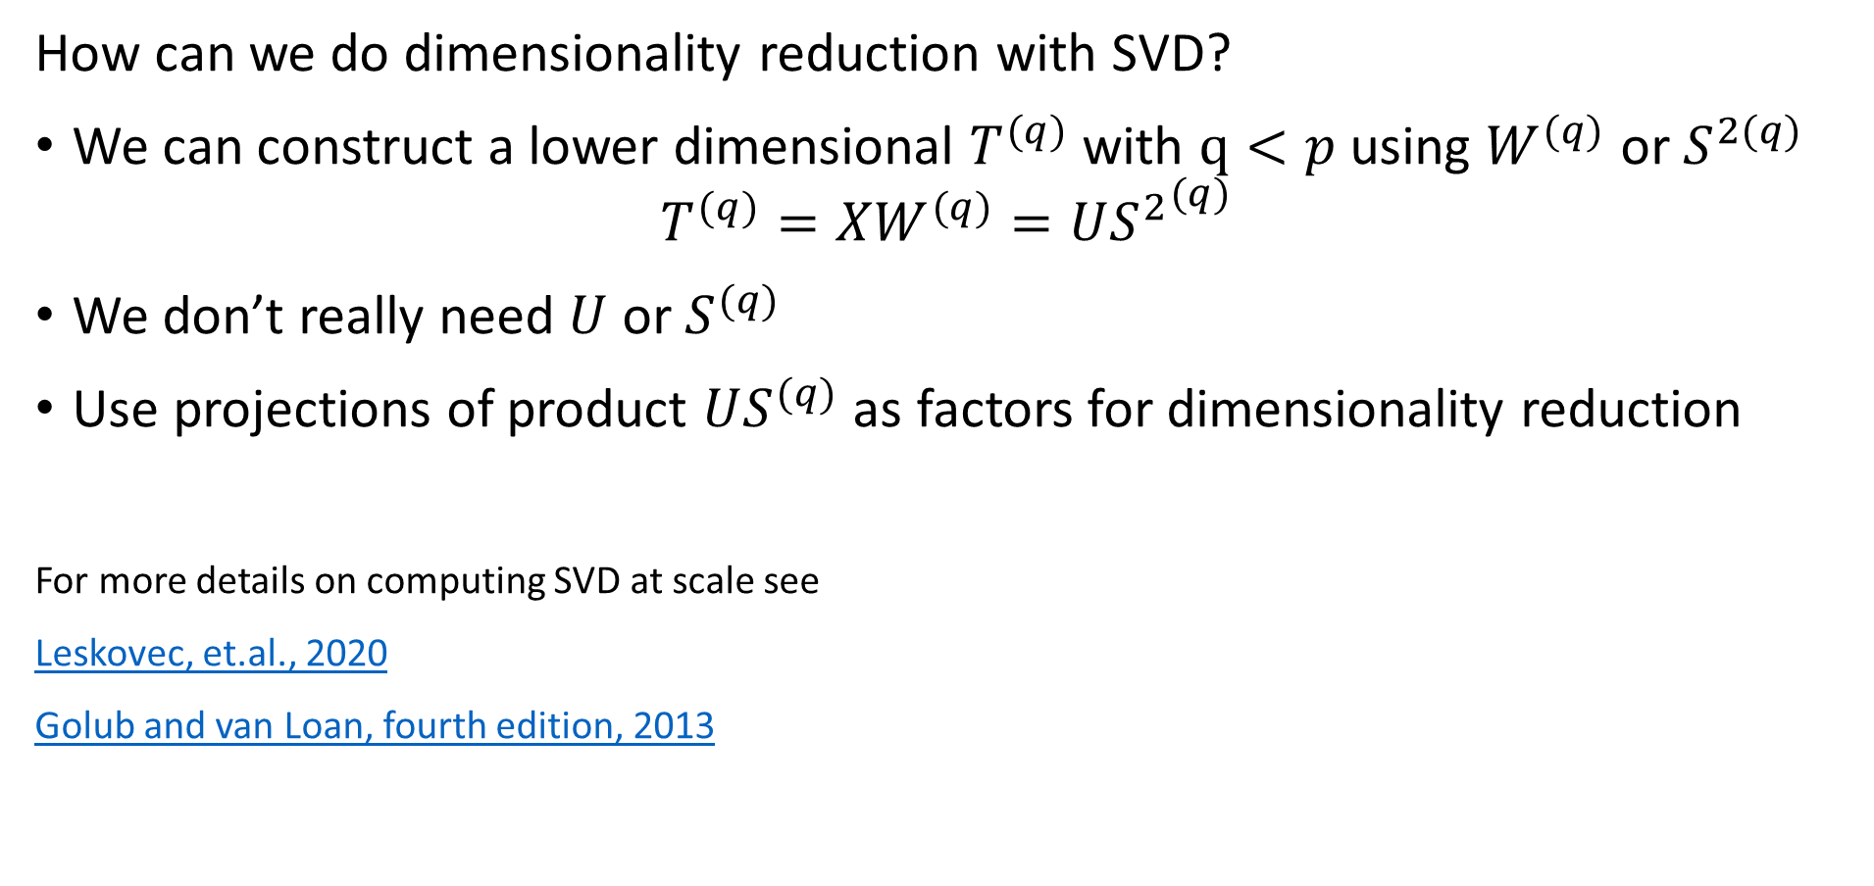
Singular Value Decomposition
How can we do dimensionality reduction with SVD?
We can construct a lower dimensional $T^{(q)}$ with $q<p$ using $W^{(q)}$ or $S^{2(q)}$
$$T^{(q)}=XW^{(q)}={US^{2}}^{(q)}$$
We don’t really need $U$ or $S^{(q)}$
Use projections of product $US^{(q)}$ as factors for dimensionality reduction
For more details on computing SVD at scale see
Leskovec, et.al., 2020
Golub and van Loan, fourth edition, 2013

Slide 45
Nonlinear Embedding with Kernel PCA

Slide 46
Nonlinear Kernel PCA
For many problems a linear map does not provide optimal projections!
How can we transform a nonlinear space to a linear space?
Use a kernel transformation
Kernel methods map original nonlinear space to higher dimensional linear space
Perform PCA in the linear space

Slide 47
Understanding nonlinear case
Start with 2-dimensional feature space, X = [x₁,x₂]
2- values = {circle,plus}
Is there any optimal separating hyperplane?
No!
The optimal separator is nonlinear
Feature 2
Feature 1

Slide 48
Understanding nonlinear case
Observations are not linearly separable in the original feature space
Transform problem to a new space where observations are linearly separable
X3
Kernel Transformation to new space
X1
Feature 2
Separating Hyperplane
Feature 1
X2

Slide 49
Kernels for nonlinear separation
What types of functions can we use as basis functions?
Any orthogonal set of functions
Polynomials – supported by Scikit-learn
Radial basis functions – default in Scikit-learn
Hyperbolic tangent functions – supported in Scikit-learn, and used in some neural networks
And many other basis functions –
Dictionary learning
Fourier expansions, Wavelet functions, etc.
Supported in Scikit-learn
We will not discuss this method further here

Slide 50
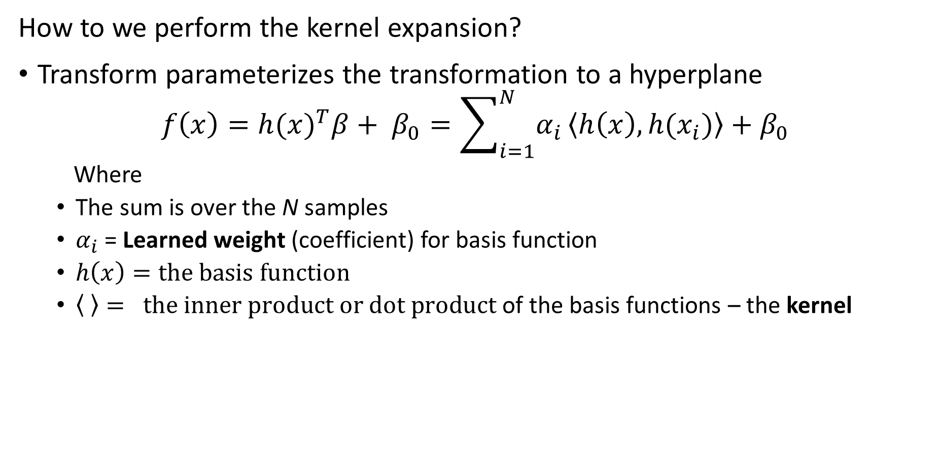
Mapping to Linear Space with a Kernel
How to we perform the kernel expansion?
Transform parameterizes the transformation to a hyperplane
$$f\left(x\right)=h(x)^{T}β+ β_{0}=\sum_{i=1}^{N}{α_{i}}\left\langle h\left(x\right),h(x_{i})\right\rangle +β_{0}$$
Where
The sum is over the N samples
$α_{i}$ = Learned weight (coefficient) for basis function
$h\left(x\right)=the basis function$
$\left\langle \right\rangle = the inner product or dot product$ of the basis functions – the kernel

Slide 51
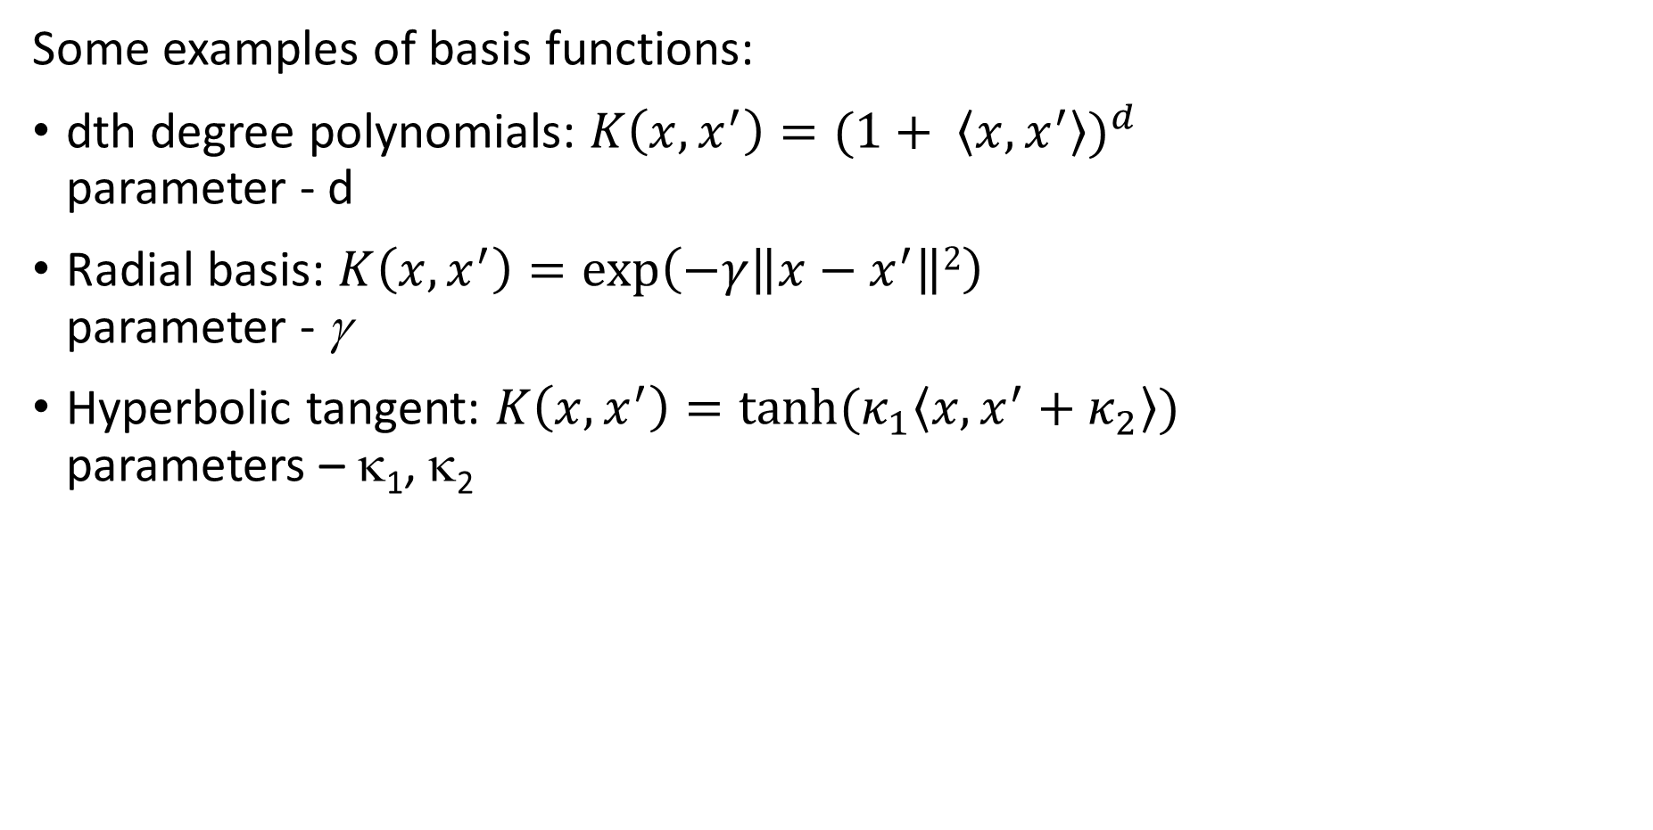
Kernels nonlinear separation
Some examples of basis functions:
dth degree polynomials: $K\left(x,x^{′}\right)=(1+ \left\langle x,x^{′}\right\rangle )^{d}$ parameter - d
Radial basis: $K\left(x,x^{′}\right)=\exp\left(−γ\left\|x−x^{′}\right\|2\right)$ parameter - γ
Hyperbolic tangent: $K\left(x,x^{′}\right)=tanh⁡(κ_{1}\left\langle x,x^{′}+κ_{2}\right\rangle )$ parameters – κ₁, κ₂

Slide 52
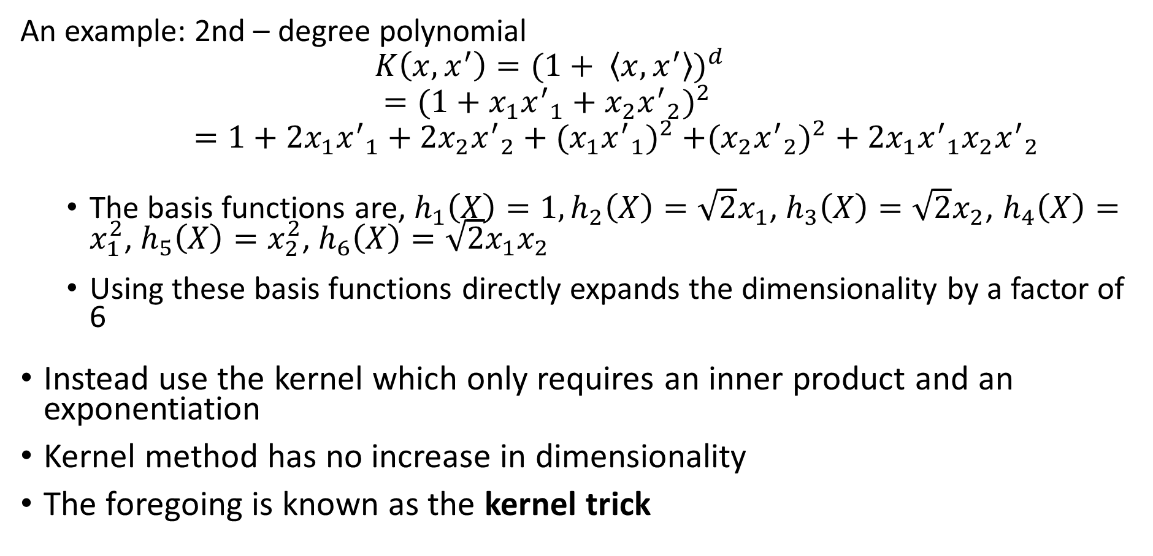
Kernels nonlinear separation
An example: 2nd – degree polynomial
$$K\left(x,x^{′}\right)=(1+ \left\langle x,x^{′}\right\rangle )^{d}$$
$$=(1+x_{1}{x^{′}}_{1}+x_{2}{x^{′}}_{2})^{2 }$$
$=1+2x_{1}{x^{′}}_{1}+{2x}_{2}{x^{′}}_{2}+({x_{1}{x^{′}}_{1})}^{2}$ $+({x_{2}{x^{′}}_{2})}^{2}+2x_{1}{x^{′}}_{1}x_{2}{x^{′}}_{2}$
The basis functions are, $h_{1}\left(X\right)=1, h_{2}\left(X\right)=\sqrt{2}x_{1}$, $h_{3}\left(X\right)=\sqrt{2}x_{2}$, $h_{4}\left(X\right)=x_{1}^{2}$, $h_{5}\left(X\right)=x_{2}^{2}$, $h_{6}\left(X\right)=\sqrt{2}x_{1}x_{2}$
Using these basis functions directly expands the dimensionality by a factor of 6
Instead use the kernel which only requires an inner product and an exponentiation
Kernel method has no increase in dimensionality
The foregoing is known as the kernel trick

Slide 53
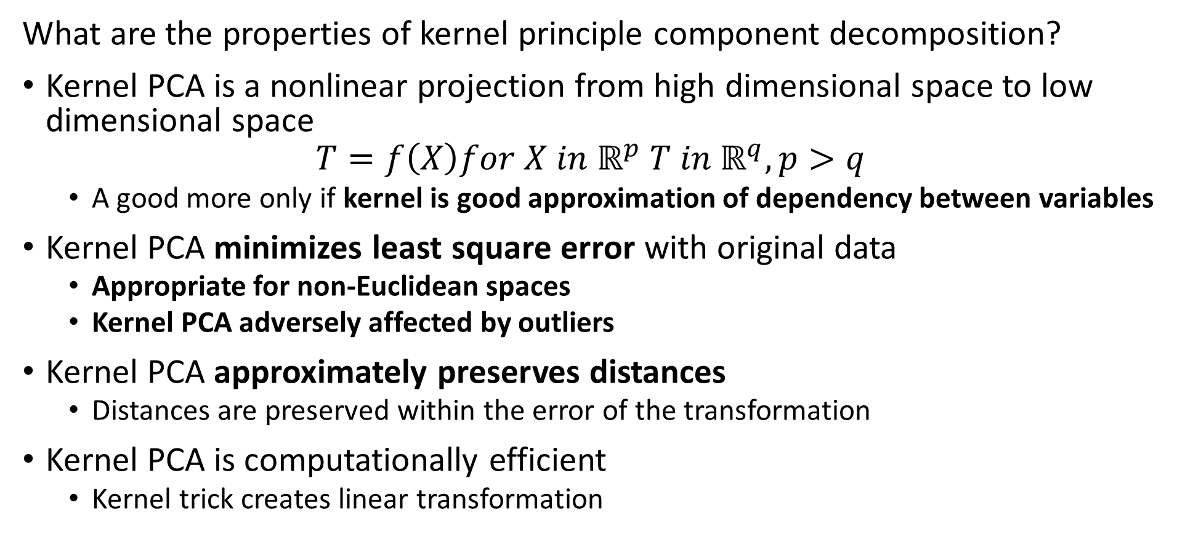
Kernel Principle Component Decomposition
What are the properties of kernel principle component decomposition?
Kernel PCA is a nonlinear projection from high dimensional space to low dimensional space
$$T=f\left(X\right)for X in ℝ^{p} T in ℝ^{q}, p>q$$
A good more only if kernel is good approximation of dependency between variables
Kernel PCA minimizes least square error with original data
Appropriate for non-Euclidean spaces
Kernel PCA adversely affected by outliers
Kernel PCA approximately preserves distances
Distances are preserved within the error of the transformation
Kernel PCA is computationally efficient
Kernel trick creates linear transformation

Slide 54
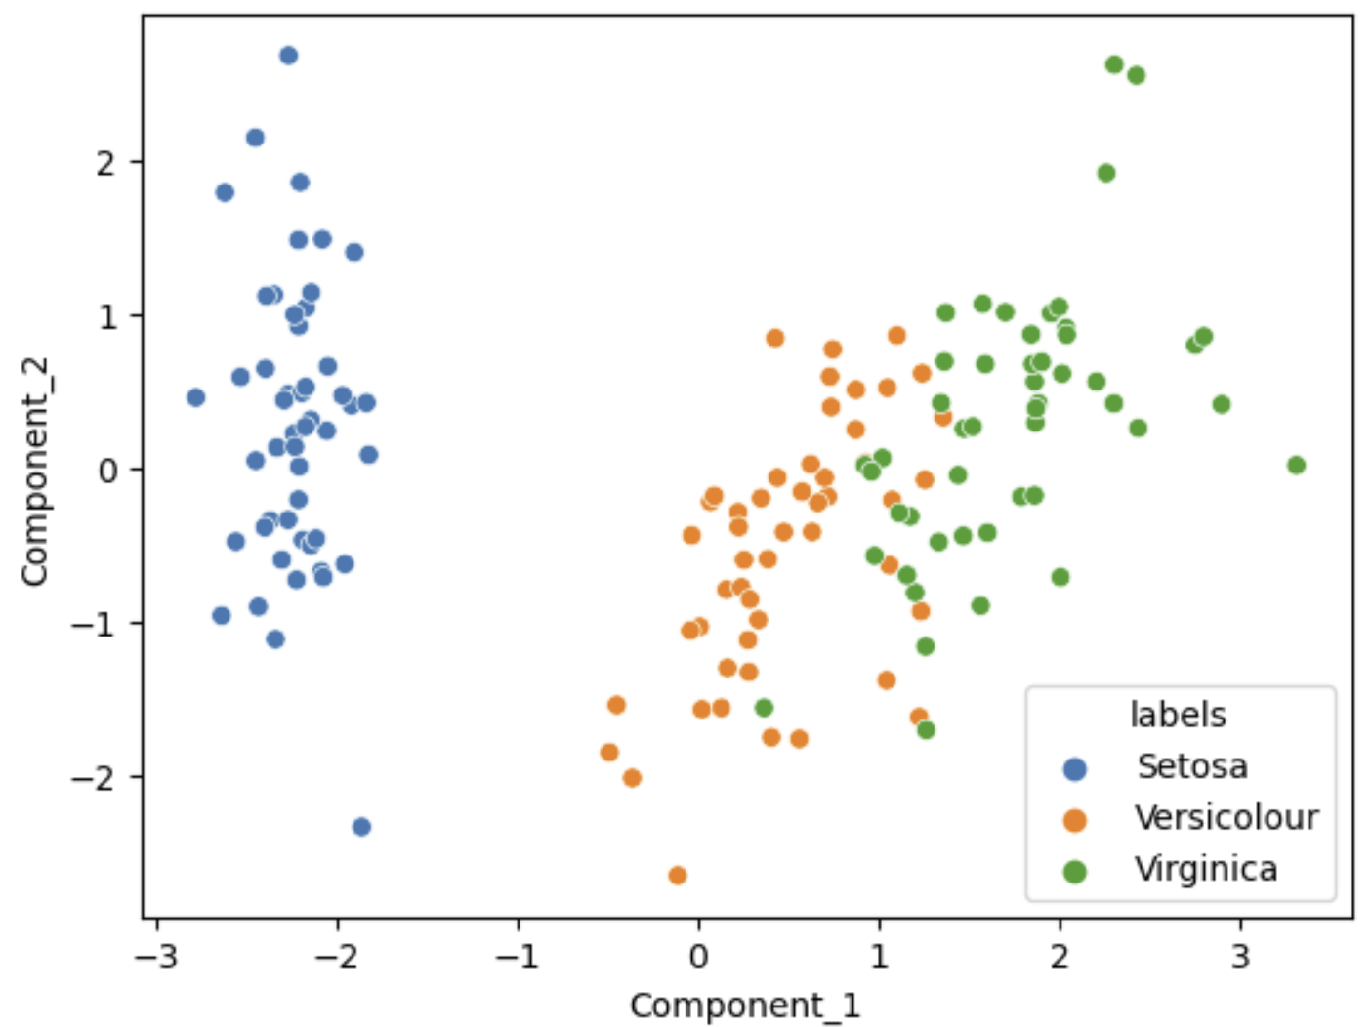
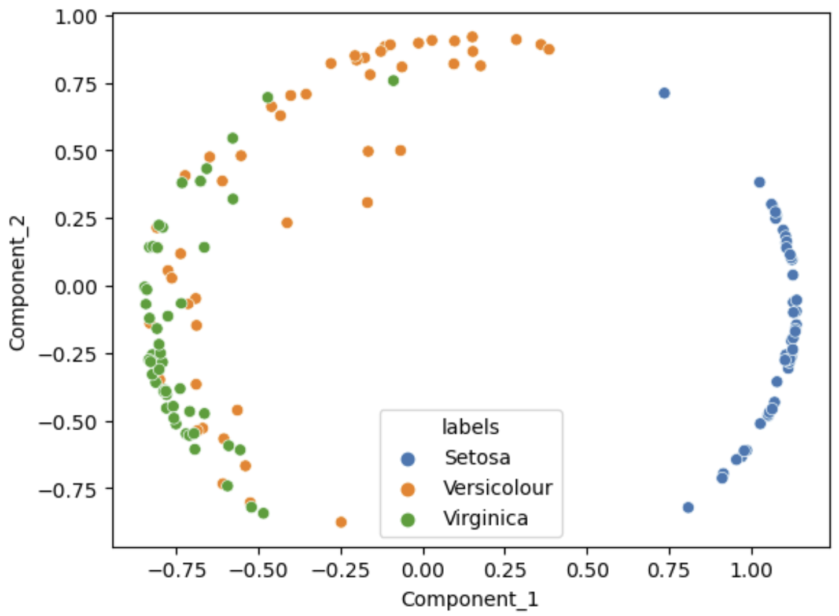
Kernel Principle Component Decomposition
Kernel PCA creates a nonlinear projection
Linear PCA
Kernel PCA, cosine kernel

Slide 55
Summary
Dimensionality reduction is widely used in data mining
Introduction to dimensionality reduction
Review of eigenvalues and eigenvectors
Principle component analysis (PCA)
Singular value decomposition (SVD)
Kernel principle component analysis for non-linear projection

