Slide 1

CSCI E-96 Data Mining, Discovery and Exploration Distance and Similarity Measures Part I
Steve Elston
Copyright 2021, Stephen F Elston. All rights reserved.

Slide 2
Measuring similarity and dissimilarity
Many data mining algorithms search for the most similar or dissimilar cases
Searching for documents with similar content
Finding customers with similar purchasing habits
Discover similar mRNA sequences
Similarity between two sensor streams
Etc.

Slide 3
Measuring similarity and dissimilarity
Measuring similarity and dissimilarity is fundamental to data mining
A wide range of metrics used in data mining
The metrics used must fit the nature of the data and the analysis
Binary data
Text strings
Numeric data
Ordinal data; e.g. ratings
Unordered categorical data
There is no one best metric!

Slide 4
Measuring distance or dissimilarity
Relationships between variables in a dataset are often based on dissimilarity using a distance metric
The variables or cases have multiple observations or measurements
Distance measures are therefore multivariate
Maps two vector values to a real scalar value
Distance metrics can be computed for three types of variables
Numeric distance for numeric variables
Rank difference for ordinal variables
Coded difference, for unordered categorical variables

Slide 5
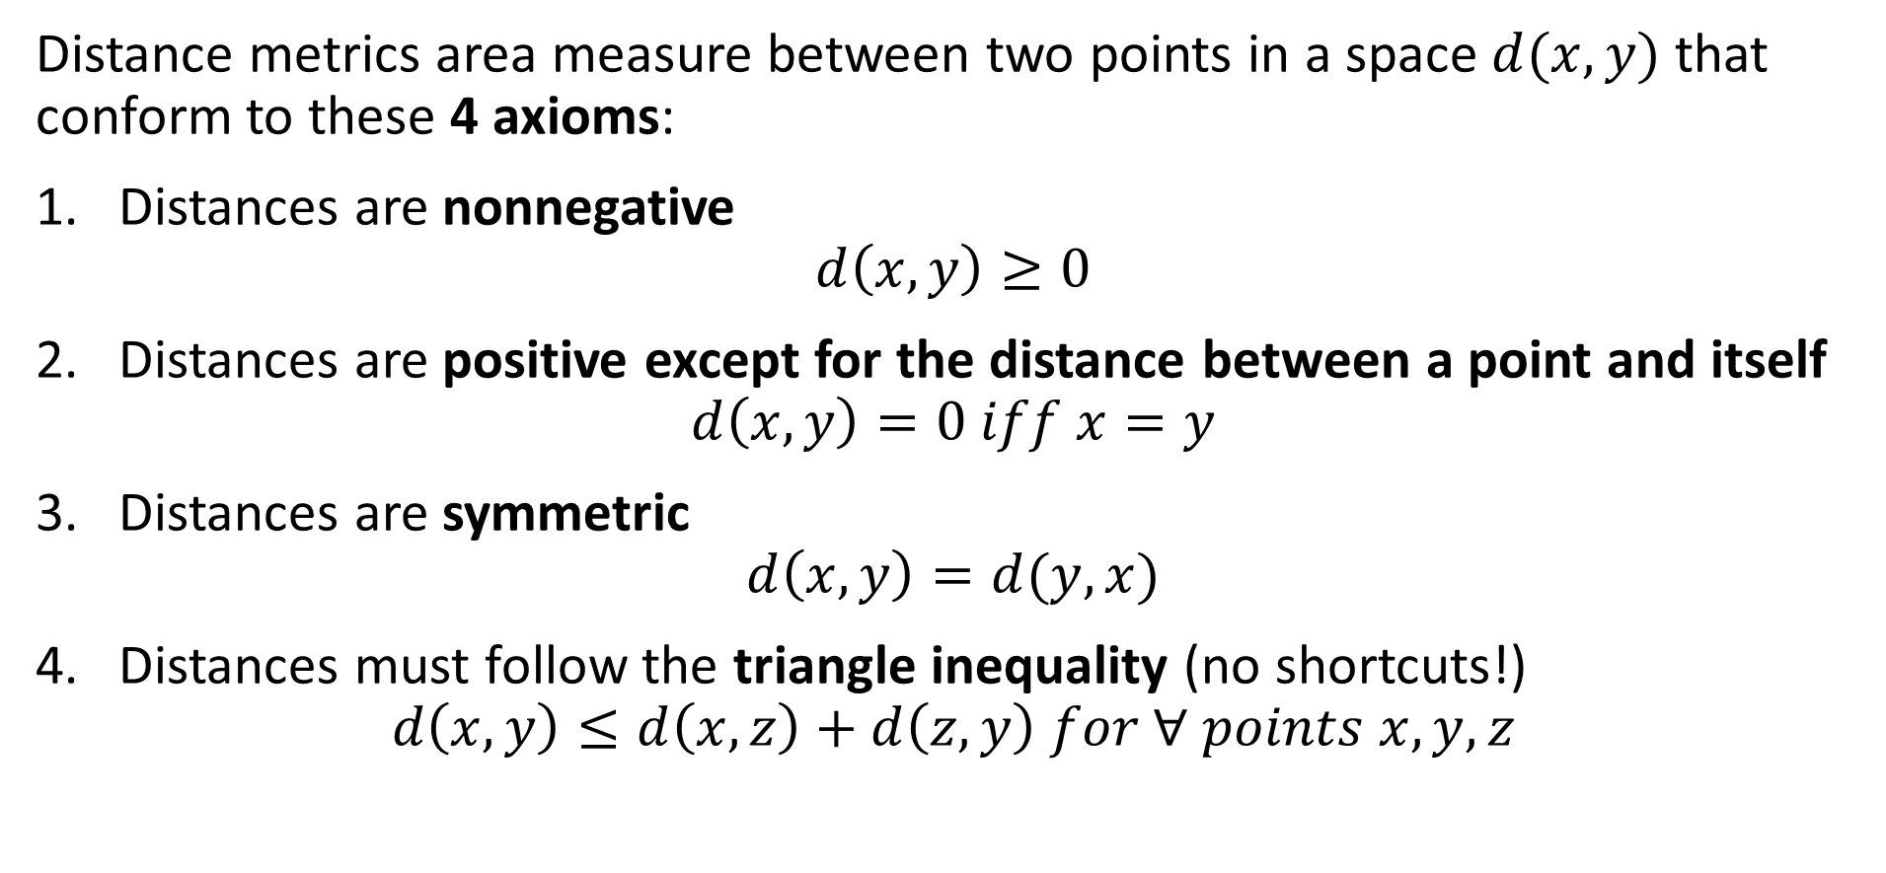
Measuring distance or dissimilarity
Distance metrics area measure between two points in a space $d(x,y)$ that conform to these 4 axioms:
Distances are nonnegative
$$d\left(x,y\right)≥0$$
Distances are positive except for the distance between a point and itself
$$d\left(x,y\right)=0 iff x=y$$
Distances are symmetric
$$d\left(x,y\right)=d(y,x)$$
Distances must follow the triangle inequality (no shortcuts!)
$$d\left(x,y\right)≤d\left(x,z\right)+d\left(z,y\right) for ∀ points x,y,z$$

Slide 6
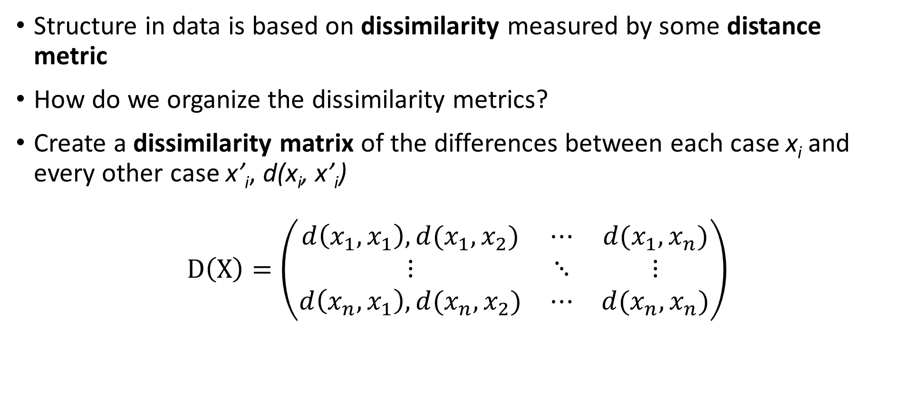
Measuring distance or dissimilarity
Structure in data is based on dissimilarity measured by some distance metric
How do we organize the dissimilarity metrics?
Create a dissimilarity matrix of the differences between each case x_{i} and every other case x’_{i}, d(x_{i}, x’_{i})
$$D\left(X\right)=\left(\begin{matrix}d\left(x_{1},x_{1}\right), d(x_{1},x_{2}) & ⋯ & d(x_{1},x_{n}) \\ ⋮ & ⋱ & ⋮ \\ d\left(x_{n},x_{1}\right),d(x_{n},x_{2}) & ⋯ & d(x_{n},x_{n})\end{matrix}\right)$$

Slide 7
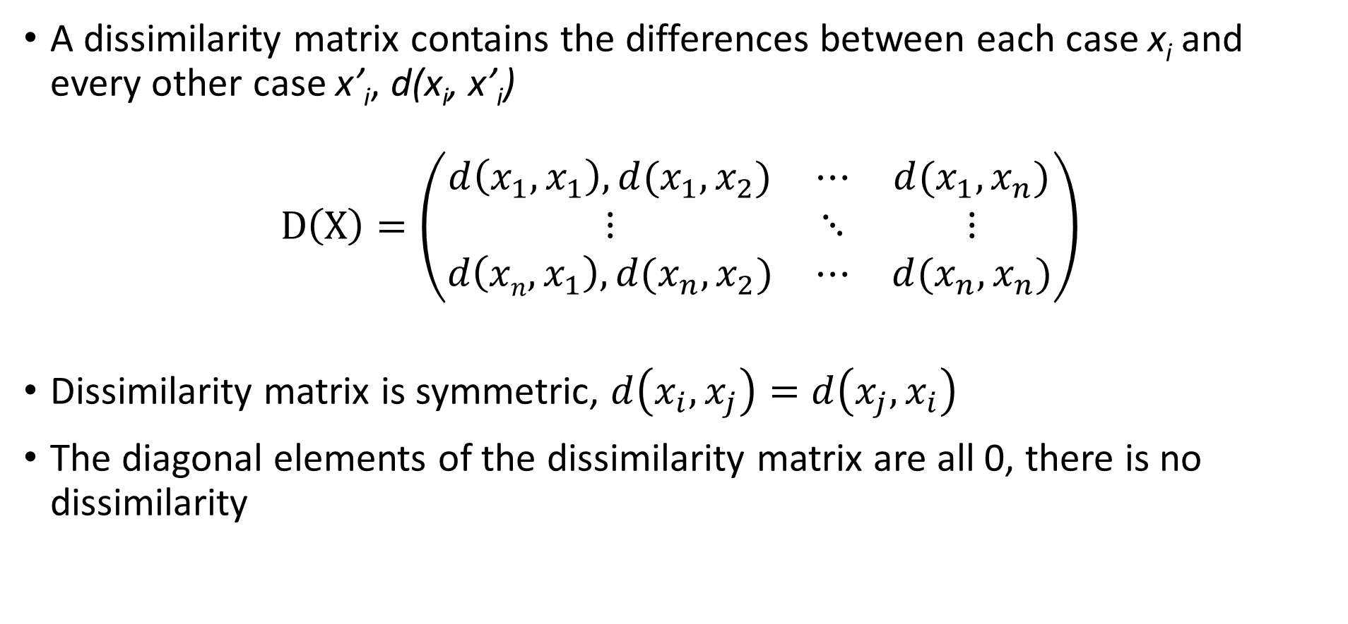
Measuring distance or dissimilarity
A dissimilarity matrix contains the differences between each case x_{i} and every other case x’_{i}, d(x_{i}, x’_{i})
$$D\left(X\right)=\left(\begin{matrix}d\left(x_{1},x_{1}\right), d(x_{1},x_{2}) & ⋯ & d(x_{1},x_{n}) \\ ⋮ & ⋱ & ⋮ \\ d\left(xn,x_{1}\right),d(x_{n},x_{2}) & ⋯ & d(x_{n},x_{n})\end{matrix}\right)$$
Dissimilarity matrix is symmetric, $d\left(x_{i},x_{j}\right)=d\left(x_{j},x_{i}\right)$
The diagonal elements of the dissimilarity matrix are all 0, there is no dissimilarity

Slide 8
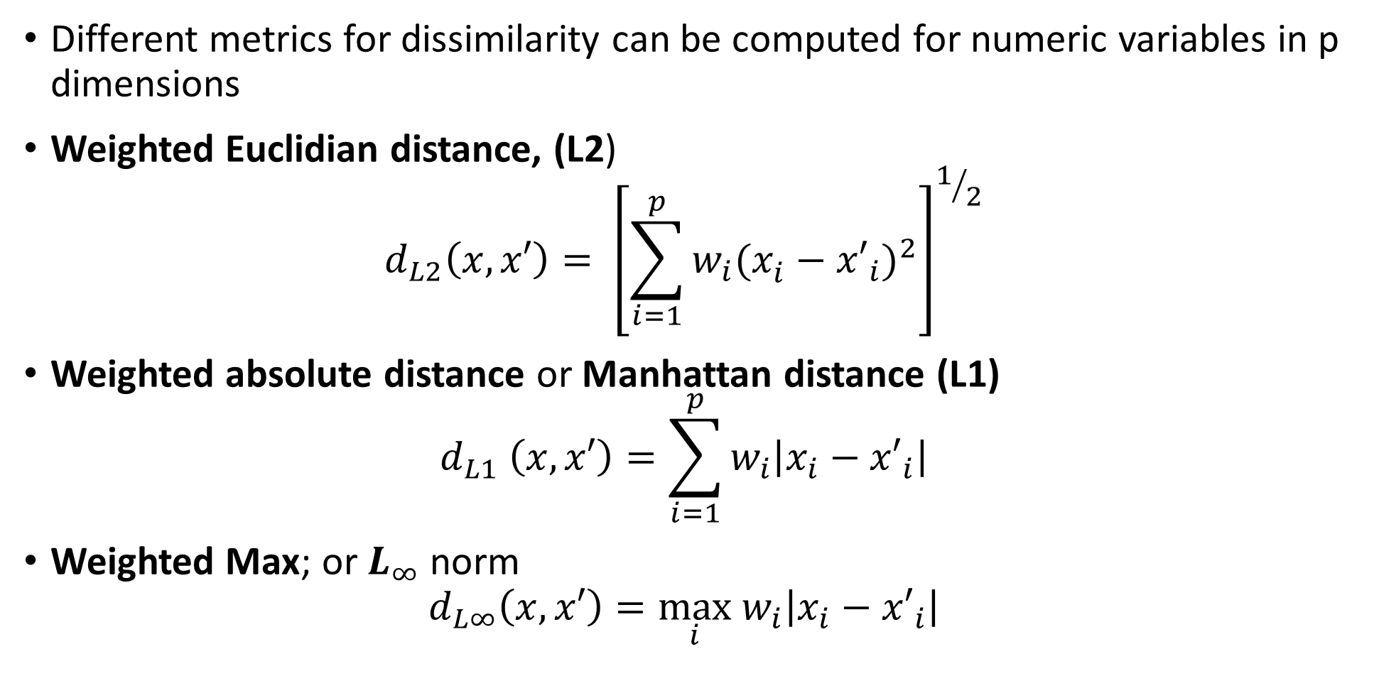
Measuring distance or dissimilarity
Different metrics for dissimilarity can be computed for numeric variables in p dimensions
Weighted Euclidian distance, (L2)
$$d_{L2}\left(x,x′\right)= {\left[\sum_{i=1}^{p}{w_{i}(x_{i}^{ }−{x′}_{i})^{2}}\right]}^{1/2}$$
Weighted absolute distance or Manhattan distance (L1)
$$d_{L1} \left(x,x′\right)=\sum_{i=1}^{p}{w_{i}\left|x_{i}−{x′}_{i}\right|}$$
Weighted Max; or $L_{∞}$ norm
$$d_{L∞}\left(x,x′\right)=\max_{i} w_{i}\left|x_{i}−{x′}_{i}\right|$$

Slide 9
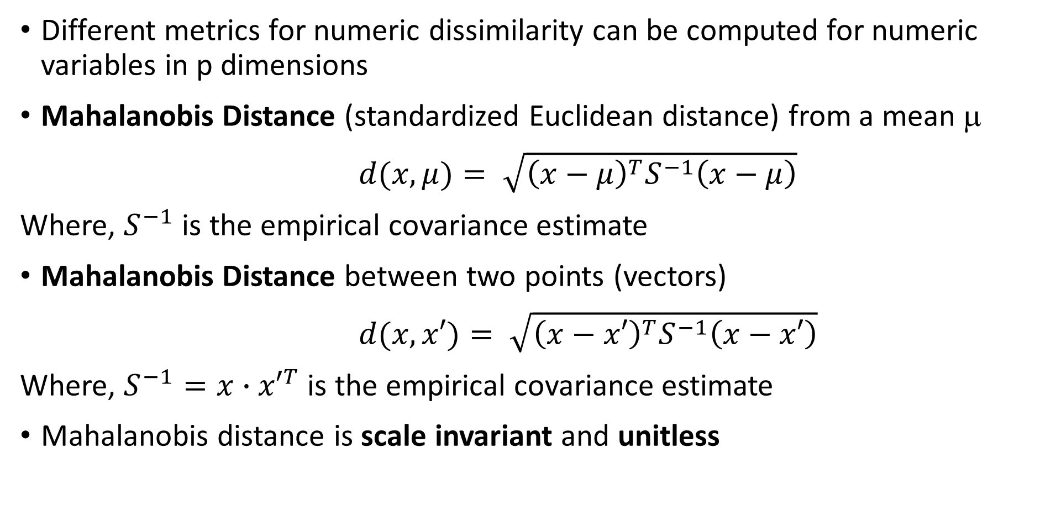
Measuring distance or dissimilarity
Different metrics for numeric dissimilarity can be computed for numeric variables in p dimensions
Mahalanobis Distance (standardized Euclidean distance) from a mean μ
$d(x,μ)= \sqrt{{\left(x−μ\right)}^{T}S^{−1}\left(x−μ\right)}$
Where, $S^{−1}$ is the empirical covariance estimate
Mahalanobis Distance between two points (vectors)
$d(x,x′)= \sqrt{{\left(x−x′\right)}^{T}S^{−1}\left(x−x′\right)}$
Where, $S^{−1}=x∙{x′}^{T}$ is the empirical covariance estimate
Mahalanobis distance is scale invariant and unitless

Slide 10
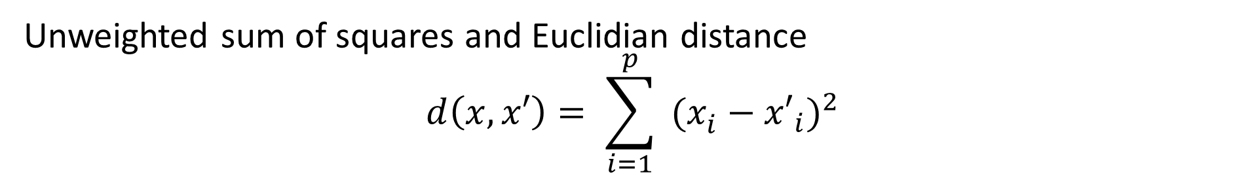
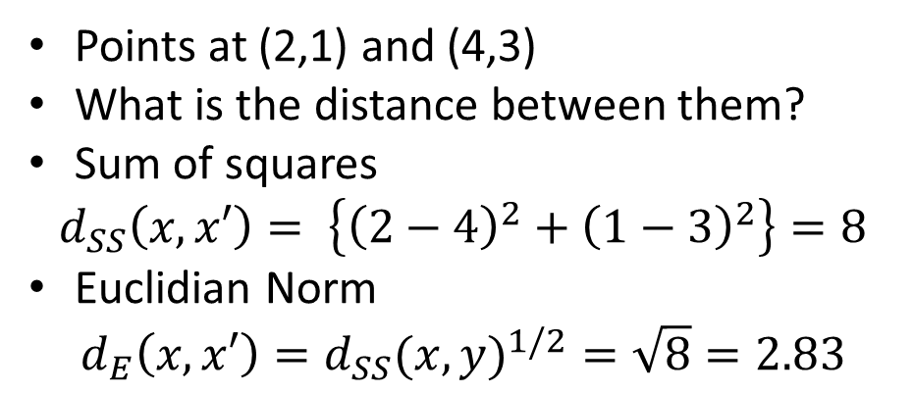
Measuring distance or dissimilarity
Unweighted sum of squares and Euclidian distance
$$d\left(x,x′\right)= \sum_{i=1}^{p}{ (x_{i}^{ }−{x′}_{i})^{2}}$$
Points at (2,1) and (4,3)
What is the distance between them?
Sum of squares
$$d_{SS}\left(x,x′\right)= \left\{{\left(2−4\right)}^{2}+{\left(1−3\right)}^{2}\right\}=8$$
Euclidian Norm
$$d_{E}\left(x,x′\right)={d_{SS}(x,y)}^{1/2}=\sqrt{8}=2.83$$
(4,3)
X₂
Euclidian Norm is ‘crow-flies’ distance
(2,1)
X₁

Slide 11

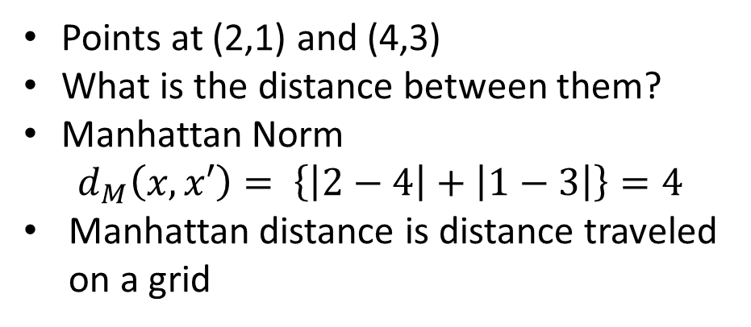
Measuring distance or dissimilarity
Manhattan Norm
$$d\left(x,x′\right)=\sum_{i=1}^{p}{\left|x_{i}−{x′}_{i}\right|}$$
Points at (2,1) and (4,3)
What is the distance between them?
Manhattan Norm
$$d_{M}\left(x,x′\right)= \left\{\left|2−4\right|+\left|1−3\right|\right\}=4$$
Manhattan distance is distance traveled on a grid
(4,3)
X₂
(2,1)
X₁

Slide 12
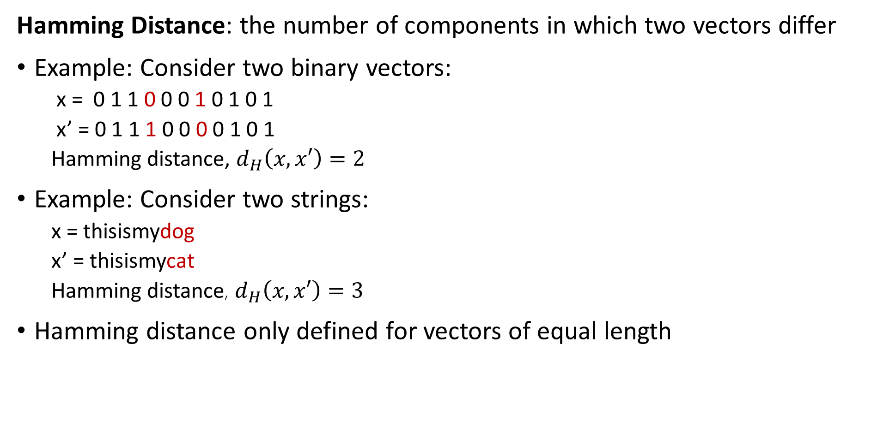
Measuring distance or dissimilarity
Hamming Distance: the number of components in which two vectors differ
Example: Consider two binary vectors:
x = 0 1 1 0 0 0 1 0 1 0 1
x’ = 0 1 1 1 0 0 0 0 1 0 1
Hamming distance, $d_{H}\left(x,x′\right)=2$
Example: Consider two strings:
x = thisismydog
x’ = thisismycat
Hamming distance, $d_{H}\left(x,x′\right)=3$
Hamming distance only defined for vectors of equal length

Slide 13
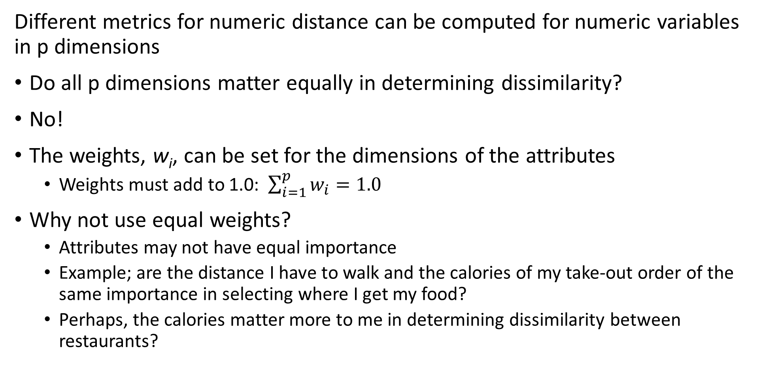
Measuring distance or dissimilarity
Different metrics for numeric distance can be computed for numeric variables in p dimensions
Do all p dimensions matter equally in determining dissimilarity?
No!
The weights, w_{i}, can be set for the dimensions of the attributes
Weights must add to 1.0: $\sum_{i=1}^{p}{w_{i}=1.0}$
Why not use equal weights?
Attributes may not have equal importance
Example; are the distance I have to walk and the calories of my take-out order of the same importance in selecting where I get my food?
Perhaps, the calories matter more to me in determining dissimilarity between restaurants?

Slide 14
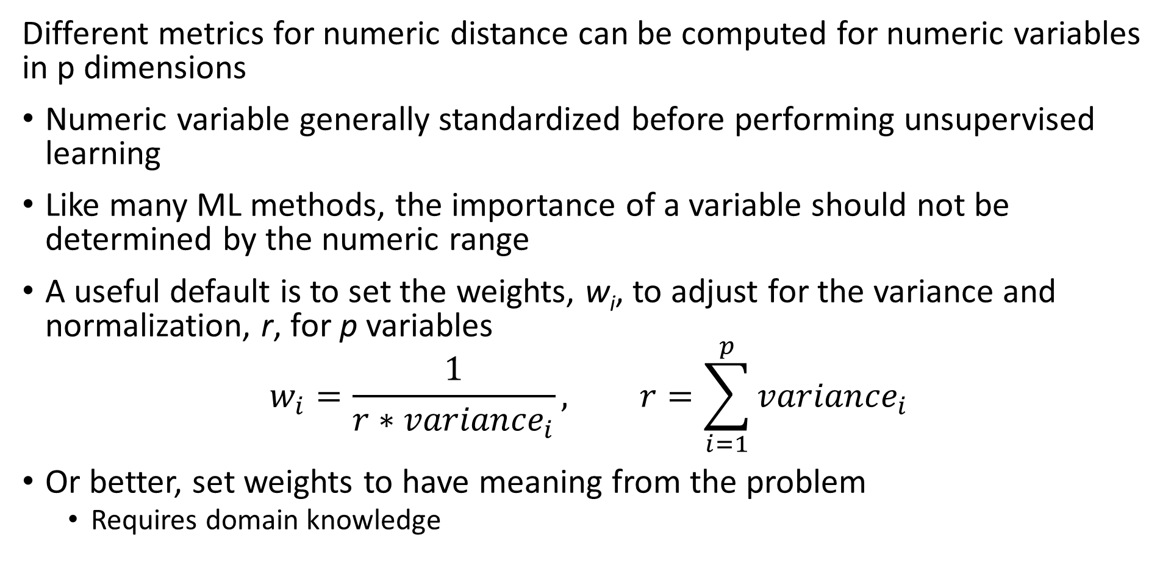
Measuring distance or dissimilarity
Different metrics for numeric distance can be computed for numeric variables in p dimensions
Numeric variable generally standardized before performing unsupervised learning
Like many ML methods, the importance of a variable should not be determined by the numeric range
A useful default is to set the weights, w_{i}, to adjust for the variance and normalization, r, for p variables
$$w_{i}=\frac{1}{r∗{variance}_{i}}, r=\sum_{i=1}^{p}{{variance}_{i}}$$
Or better, set weights to have meaning from the problem
Requires domain knowledge

Slide 15
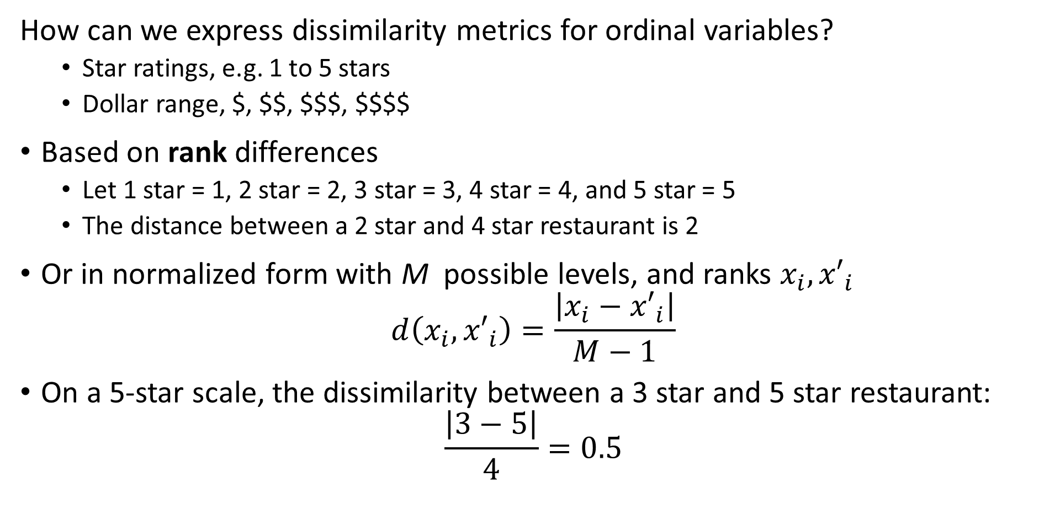
Measuring distance or dissimilarity
How can we express dissimilarity metrics for ordinal variables?
Star ratings, e.g. 1 to 5 stars
Dollar range, $, $$, $$$, $$$$
Based on rank differences
Let 1 star = 1, 2 star = 2, 3 star = 3, 4 star = 4, and 5 star = 5
The distance between a 2 star and 4 star restaurant is 2
Or in normalized form with M possible levels, and ranks $x_{i},{x′}_{i}$
$$d\left(x_{i},{x′}_{i}\right)=\frac{\left|x_{i}−{x′}_{i}\right|}{M−1}$$
On a 5-star scale, the dissimilarity between a 3 star and 5 star restaurant:
$$\frac{\left|3−5\right|}{4}=0.5$$

Slide 16
Measuring distance or dissimilarity
How can we express dissimilarity metrics for unordered categorical variables?
Use a coding scheme
e.g. a binary scheme, 1 if different categories, 0 if the same
Then normalize
e.g., normalize by dividing by number of categories
Example; restaurant type from 5 choices:
Vegetarian, Thai, Mexican, Pizza, Burgers,….
Distance Vegetarian to Burgers = 1/5 = 0.2
Distance Burgers to Burgers = 0
Can have more complex scheme if required

Slide 17
Measuring distance or dissimilarity
Can we combine dissimilarities of different types of variables
Yes, but with carefully!
Scaling important or, some variable types dominate as a result of coding
The numeric range of values must be similar
e.g. We do not want ordinal variables to dominate numeric and categorical
But, weighting is problem dependent!
Unfortunately, no simple procedure for correct weighting
Do I care more about the star rating or type of food at a restaurant?

Slide 18
Measuring distance or dissimilarity
An example of computing dissimilarity between restaurants
Absolute dissimilarity between R1 and R4, a Mexican and vegetarian restaurant
[¼ + |0.8-0.3| + |0.7-0.1| + |3-1|/2 + |5-4|/4]/5 = [0.25 + 0.5 + 0.6 + 0.5 + 0.25]/5 = 0.42
Absolute dissimilarity between R2 and R3, two pizza places
[0 + |0.9-0.8| + |0.6-0.4| + |2-3|/2 + |4-3|/4]/5 = [0 + 0.1 + 0.2 + 0.5 + 0.25]/5 = 0.21
Restaurant | Type | Calories | Distance | Price Range | Stars
R1 | Mexican | 0.8 | 0.1 | $ | 4
R2 | Pizza | 0.9 | 0.4 | $$ | 3
R3 | Pizza | 0.8 | 0.6 | $$$ | 4
R4 | Vegetarian | 0.3 | 0.7 | $$$ | 5
R5 | Thai | 0.6 | 0.3 | $$ | 4

Slide 19
Measuring distance or dissimilarity
Another example of computing dissimilarity between restaurants
Squared dissimilarity between R1 and R4, a Mexican and vegetarian restaurant
[0.25² + 0.5² + 0.6² + 0.5² + 0.25²]/5 = [0.125 + 0.25 + 0.36 + 0.25 + 0.125]/5 = 0.212
Squared dissimilarity between R2 and R3, two pizza places
[0 + 0.1² + 0.2² + 0.5² + 0.25²]/5 = [0 + 0.01 + 0.04 + 0.25 + 0.125]/5 = 0.085
Restaurant | Type | Calories | Distance | Price Range | Stars
R1 | Mexican | 0.8 | 0.1 | $ | 4
R2 | Pizza | 0.9 | 0.4 | $$ | 3
R3 | Pizza | 0.8 | 0.6 | $$$ | 4
R4 | Vegetarian | 0.3 | 0.7 | $$$ | 5
R5 | Thai | 0.6 | 0.3 | $$ | 4

Slide 20
Measuring distance or dissimilarity
How much do different metrics matter?
A lot!
Compare dissimilarity metrics between the restaurants
The squared distance emphasizes larger differences in feature values
Manhattan distance less sensitive to extreme differences
 | Mexican – Vegetarian | 2 Pizza Places
Absolute distance | 0.42 | 0.21
Squared distance | 0.212 | 0.085

Slide 21
Measuring distance and similarity
Do we always work with dissimilarity?
No!
Some methods use measures of similarity
The closer points in a space are (smaller distance) the more similar they are
In many cases, similarity measures can be transform to dissimilarity
For data with positive and negative coding similarity must be in the range [-1,1]
Similarity = 1, maximum similarity, points are at the same location in the space
Similarity = 0, points are orthogonal in the space, no similarity
Similarity = -1, minimum similarity, points have completely opposite coding
For non-negative data similarity in range [0,1]
Example, binary data

Slide 22
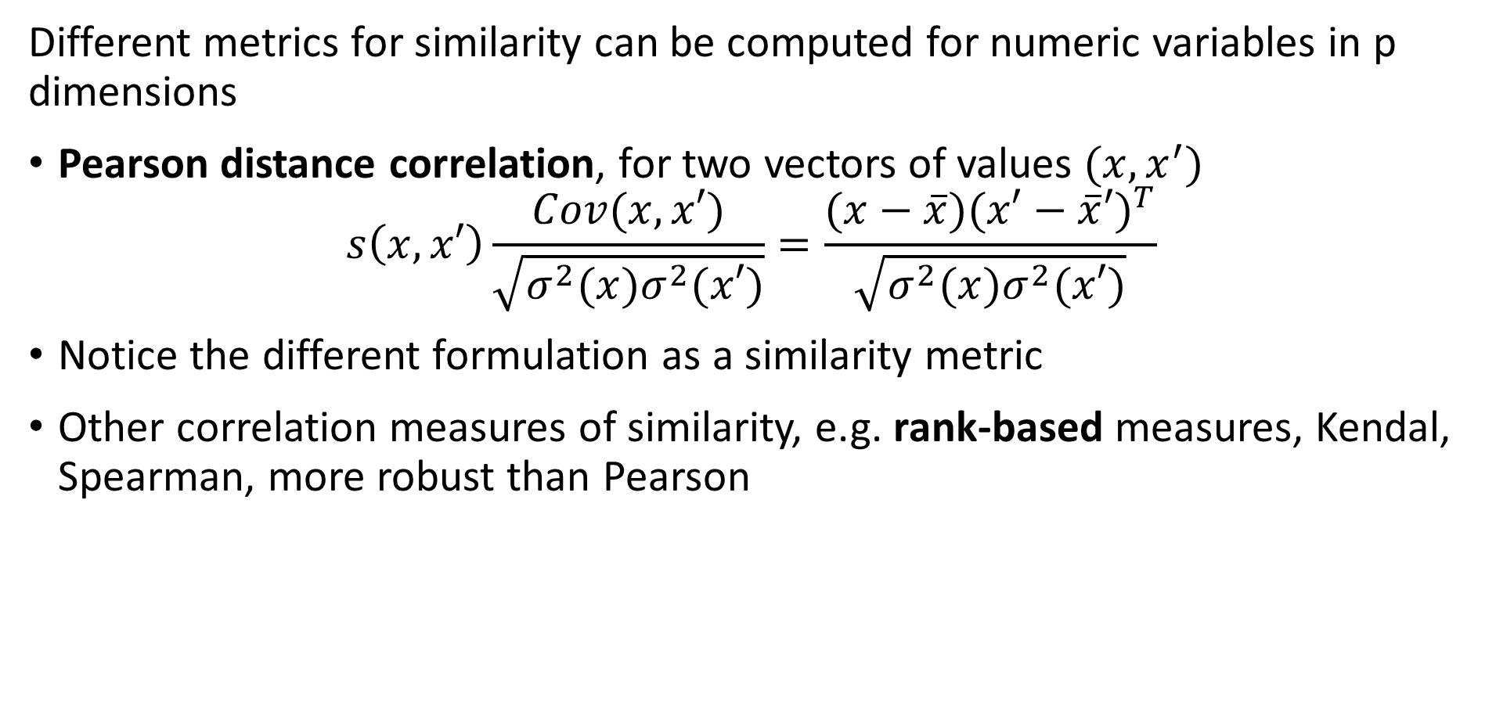
Measuring Similarity
Different metrics for similarity can be computed for numeric variables in p dimensions
Pearson distance correlation, for two vectors of values $(x,x^{′})$
$$s\left(x,x′\right)\frac{Cov(x,x′)}{\sqrt{σ^{2}(x)σ^{2}(x′)}}=\frac{(x−\overline{x}){(x′−\overline{x}′)}^{T}}{\sqrt{σ^{2}(x)σ^{2}(x′)}}$$
Notice the different formulation as a similarity metric
Other correlation measures of similarity, e.g. rank-based measures, Kendal, Spearman, more robust than Pearson

Slide 23
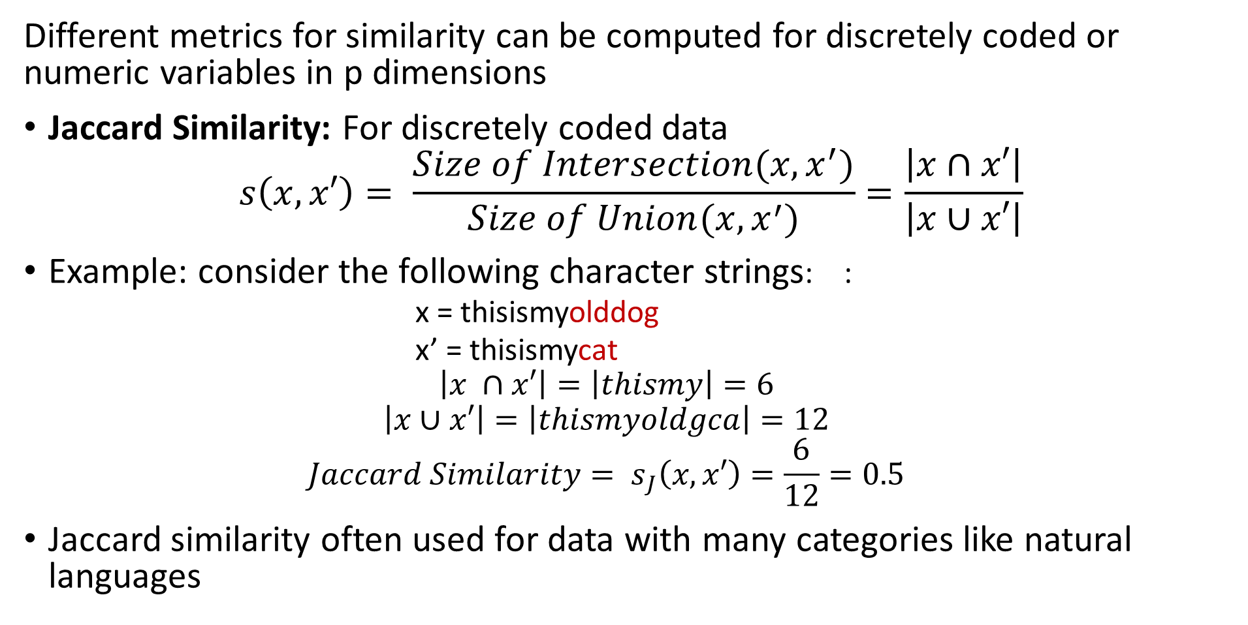
Measuring Similarity
Different metrics for similarity can be computed for discretely coded or numeric variables in p dimensions
Jaccard Similarity: For discretely coded data
$$s\left(x,x′\right)= \frac{Size of Intersection(x,x^{′})}{Size of Union(x,x^{′})}=\frac{\left|x∩x′\right|}{\left|x∪x′\right|}$$
Example: consider the following character strings: :
x = thisismyolddog
x’ = thisismycat
$$\left|x ∩x′\right|=\left|thismy\right|=6$$
$$\left|x∪x′\right|=\left|thismyoldgca\right|=12$$
$${Jaccard Similarity= s}_{J}\left(x,x′\right)=\frac{6}{12}=0.5$$
Jaccard similarity often used for data with many categories like natural languages

Slide 24
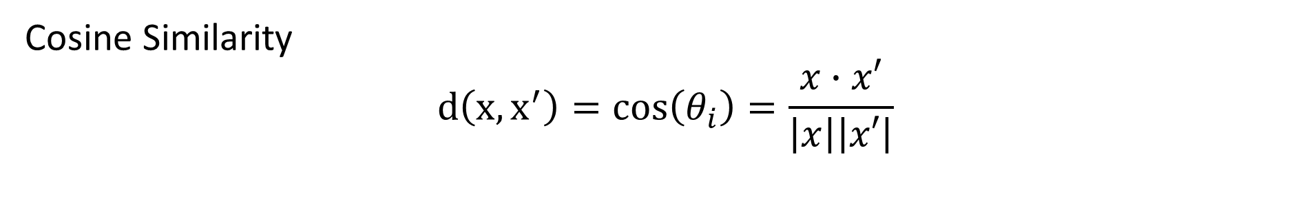
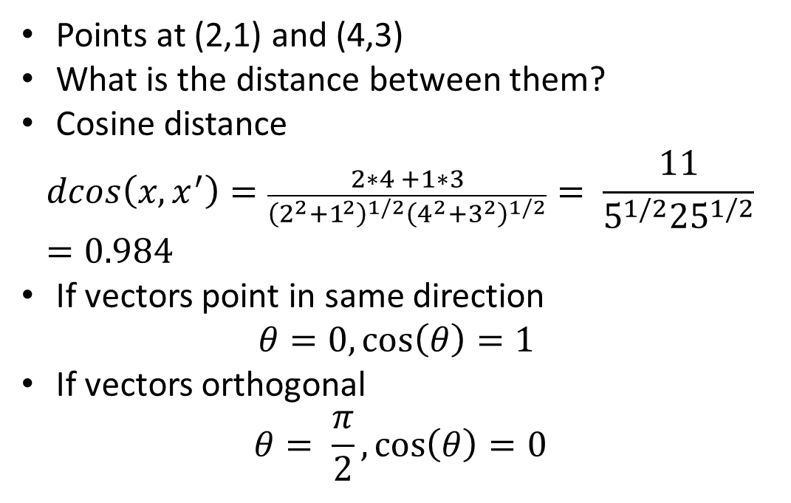
Measuring Similarity
Cosine Similarity
$$d\left(x,x^{′}\right)=cos\left(θ_{i}\right)=\frac{x∙x′}{\left|x\right|\left|x′\right|}$$
Points at (2,1) and (4,3)
What is the distance between them?
Cosine distance
$$dcos\left(x,x^{′}\right)=\frac{2∗4 +1∗3}{{\left(2^{2}+1^{2}\right)}^{1/2}{\left(4^{2}+3^{2}\right)}^{1/2}}= \frac{11}{5^{1/2}{25}^{1/2}}=0.984$$
If vectors point in same direction
$$θ=0,\cos\left(θ\right)=1$$
If vectors orthogonal
$$θ= \frac{π}{2},\cos\left(θ\right)=0$$
(4,3)
X₂
θ
(2,1)
X₁

Slide 25
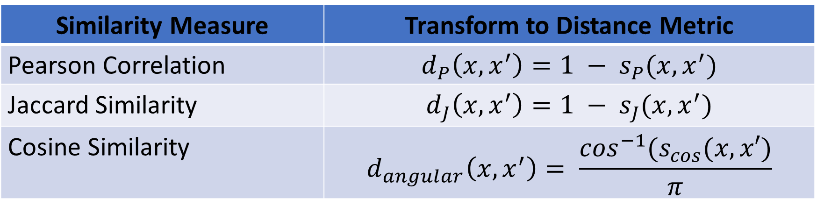
Relationship Between Similarity and Distance
Some similarity measures can be transformed to distance metrics
Transform is an inverse function
Resulting distance usually has limited range (limited support)
Examples:
Similarity Measure | Transform to Distance Metric
Pearson Correlation | $$d_{P}\left(x,x^{′}\right)=1 − s_{P}(x,x^{′})$$
Jaccard Similarity | $$d_{J}\left(x,x^{′}\right)=1 − s_{J}(x,x^{′})$$
Cosine Similarity | $$d_{angular}\left(x,x^{′}\right)= \frac{\cos^{−1}(s_{cos}(x,x′)}{π}$$

Slide 26
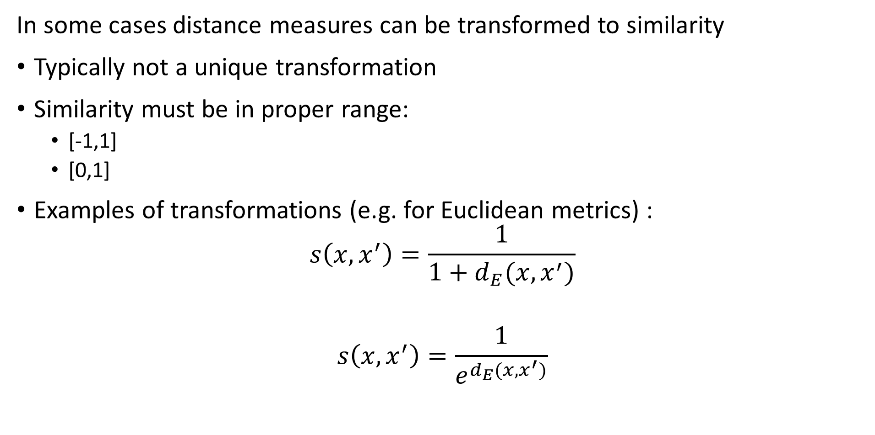
Relationship Between Distance and Similarity
In some cases distance measures can be transformed to similarity
Typically not a unique transformation
Similarity must be in proper range:
[-1,1]
[0,1]
Examples of transformations (e.g. for Euclidean metrics) :
$$s\left(x,x^{′}\right)=\frac{1}{1+d_{E}(x,x^{′})}$$
$$s\left(x,x^{′}\right)=\frac{1}{e^{d_{E}(x,x^{′})}}$$

Slide 27
CSCI E-96 Data Mining, Discovery and Exploration Distance and Similarity Measures Part II
Steve Elston
Copyright 2021, Stephen F Elston. All rights reserved.

Slide 28
Shingling Documents
We need an efficient method to measure the similarity of documents
Document is any collection of text
Email, or tweet
Web page or part of a web page
Contract
Chapter of a book or entire book
……
Shingling the document creates a representation used to measure similarity
Shingles are short overlapping strings extracted from the document
A few characters
A few words

Slide 29
Shingling Documents
Shingling the document creates a representation used to measure similarity
Shingles can be found at various sizes
Example: find the 2-shingles of the following string:
String = aghetfgrqew
2-shingles = {ag, gh, he, et, tf, fg, gr, rq, qe, ew}
Example: now find the 3- shingles of the same sting:
3-shingles = {agh, ghe, het, etf, tfg, fgr, grq, rqe, qew}
Example: find the 3-shingles of the following sentence:
Sentence = this is an uninteresting sentence used for this example
3-shingles = {this is an, is an uninteresting, an uninteresting sentence,
uninteresting sentence used, sentence used for,
used for this, for this example}

Slide 30
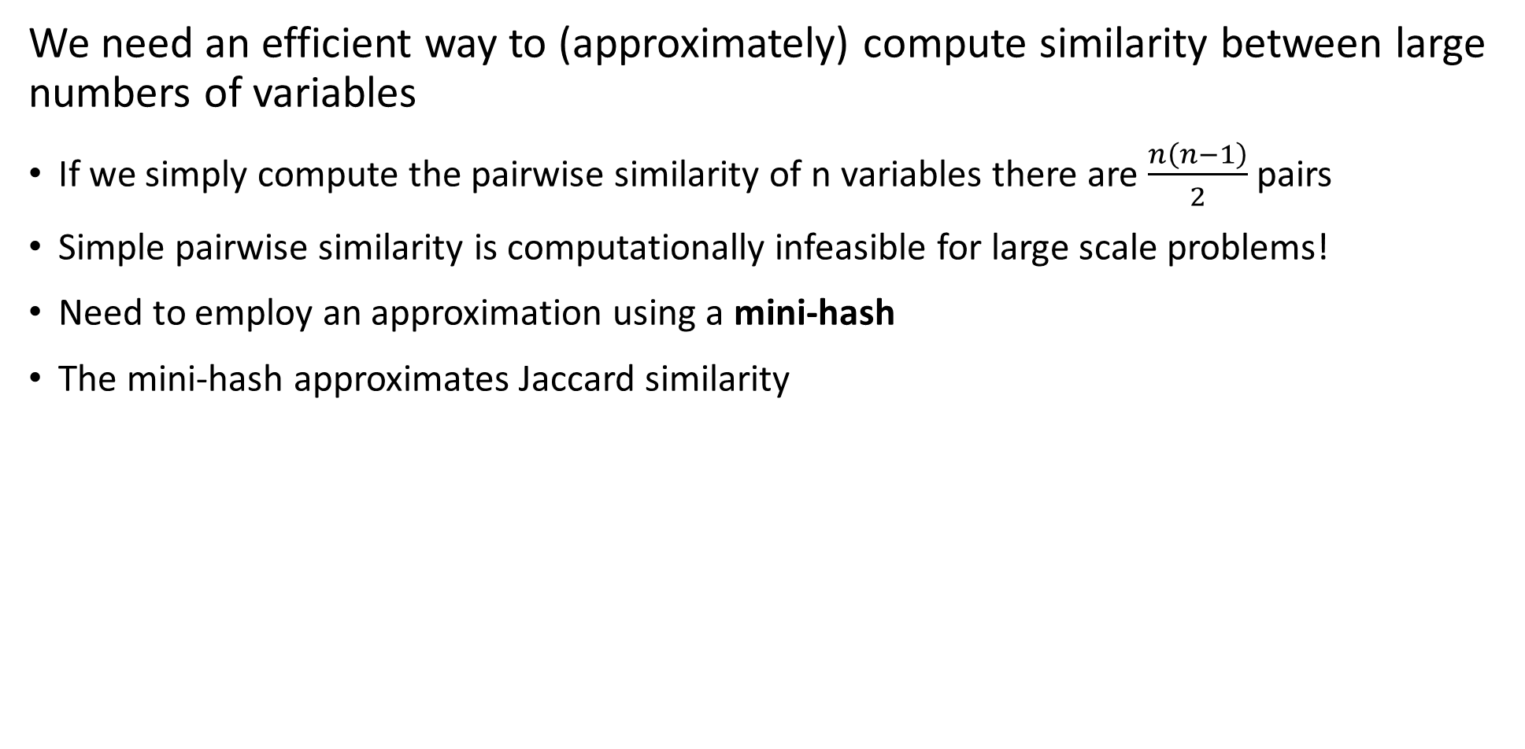
Mini-Hashing for Similarity
We need an efficient way to (approximately) compute similarity between large numbers of variables
If we simply compute the pairwise similarity of n variables there are $\frac{n\left(n−1\right)}{2}$ pairs
Simple pairwise similarity is computationally infeasible for large scale problems!
Need to employ an approximation using a mini-hash
The mini-hash approximates Jaccard similarity

Slide 31
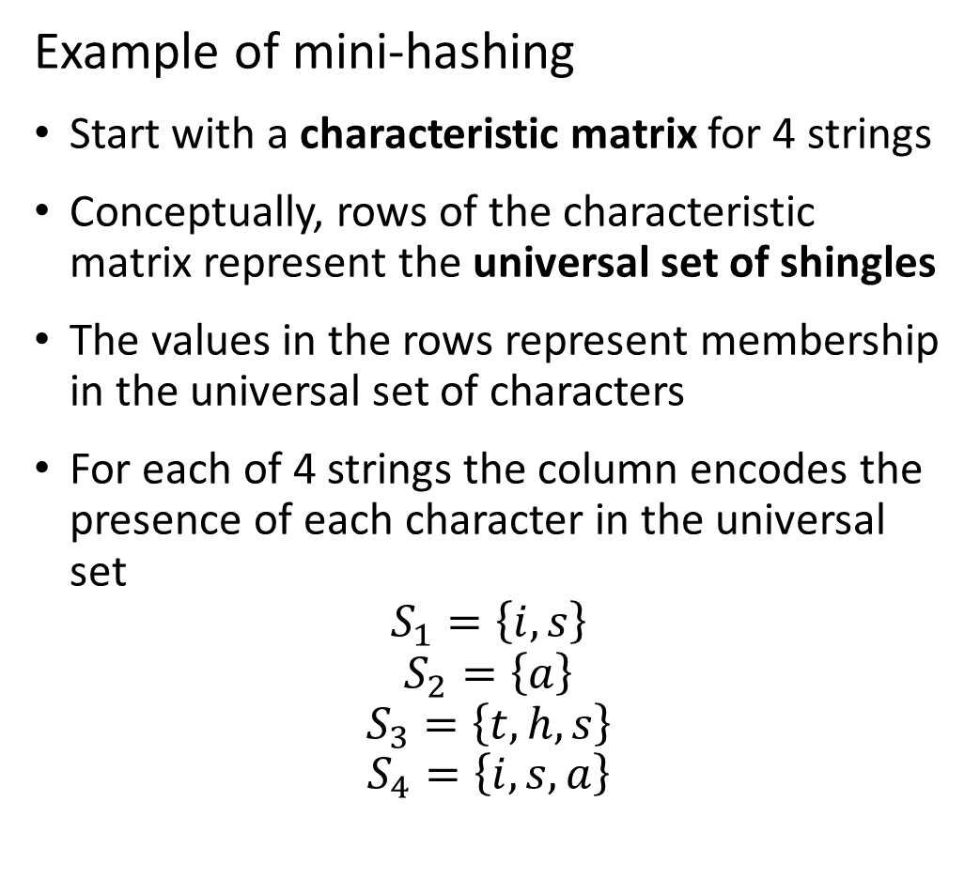
Mini-Hashing for Similarity
Example of mini-hashing
Start with a characteristic matrix for 4 strings
Conceptually, rows of the characteristic matrix represent the universal set of shingles
The values in the rows represent membership in the universal set of characters
For each of 4 strings the column encodes the presence of each character in the universal set
$$S_{1}=\left\{i,s\right\}$$
$$S_{2}=\left\{a\right\}$$
$$S_{3}=\left\{t,h,s\right\}$$
$$S_{4}=\left\{i,s,a\right\}$$
Universal Set | S₁ | S₂ | S₃ | S₄
t | 0 | 0 | 1 | 0
h | 0 | 0 | 1 | 0
i | 1 | 0 | 0 | 1
s | 1 | 0 | 1 | 1
a | 0 | 1 | 0 | 1

Slide 32
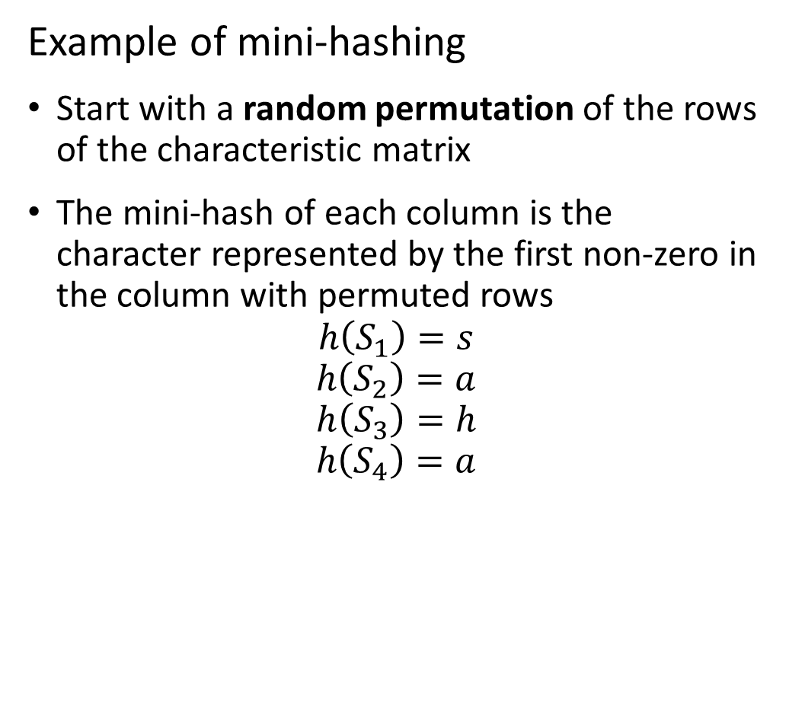
Mini-Hashing for Similarity
Example of mini-hashing
Start with a random permutation of the rows of the characteristic matrix
The mini-hash of each column is the character represented by the first non-zero in the column with permuted rows
$$h\left(S_{1}\right)=s$$
$$h\left(S_{2}\right)=a$$
$$h\left(S_{3}\right)=h$$
$$h\left(S_{4}\right)=a$$
Character | S₁ | S₂ | S₃ | S₄
h | 0 | 0 | 1 | 0
t | 0 | 0 | 1 | 0
a | 0 | 1 | 0 | 1
s | 1 | 0 | 1 | 1
i | 1 | 0 | 0 | 1

Slide 33
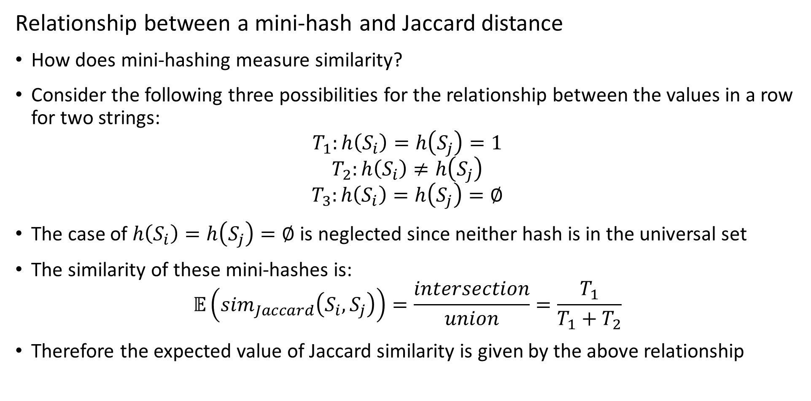
Mini-hashing for Similarity
Relationship between a mini-hash and Jaccard distance
How does mini-hashing measure similarity?
Consider the following three possibilities for the relationship between the values in a row for two strings:
$$T_{1}:h\left(S_{i}\right)=h\left(S_{j}\right)=1$$
$$T_{2}:h\left(S_{i}\right)≠h\left(S_{j}\right)$$
$$T_{3}:h\left(S_{i}\right)=h\left(S_{j}\right)=∅$$
The case of $h\left(S_{i}\right)=h\left(S_{j}\right)=∅$ is neglected since neither hash is in the universal set
The similarity of these mini-hashes is:
$$𝔼\left({sim}_{Jaccard}\left(S_{i},S_{j}\right)\right)=\frac{intersection}{union}=\frac{T_{1}}{T_{1}+T_{2}}$$
Therefore the expected value of Jaccard similarity is given by the above relationship

Slide 34
Mini-hashing for Similarity
Scaling mini-hashing
Large scale applications can have millions shingled documents
Permuting rows at scale is clearly impractical
What is a better approach?
Use a hash to compute a randomized index (bucket) for each row
Can create many mini-hashes by using different row bucket hashes

Slide 35
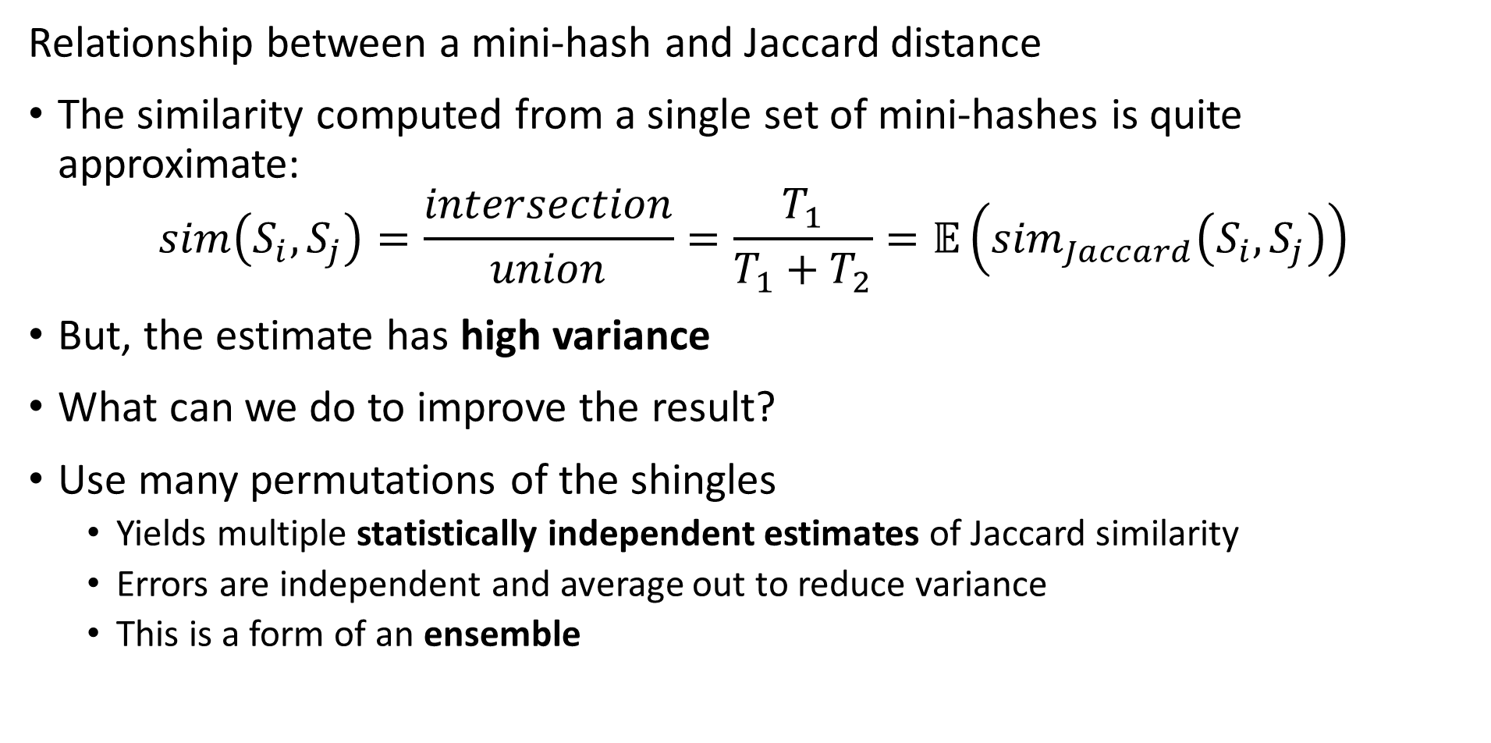
Mini-hashing for Similarity
Relationship between a mini-hash and Jaccard distance
The similarity computed from a single set of mini-hashes is quite approximate:
$$sim\left(S_{i},S_{j}\right)=\frac{intersection}{union}=\frac{T_{1}}{T_{1}+T_{2}}=𝔼\left({sim}_{Jaccard}\left(S_{i},S_{j}\right)\right)$$
But, the estimate has high variance
What can we do to improve the result?
Use many permutations of the shingles
Yields multiple statistically independent estimates of Jaccard similarity
Errors are independent and average out to reduce variance
This is a form of an ensemble

Slide 36
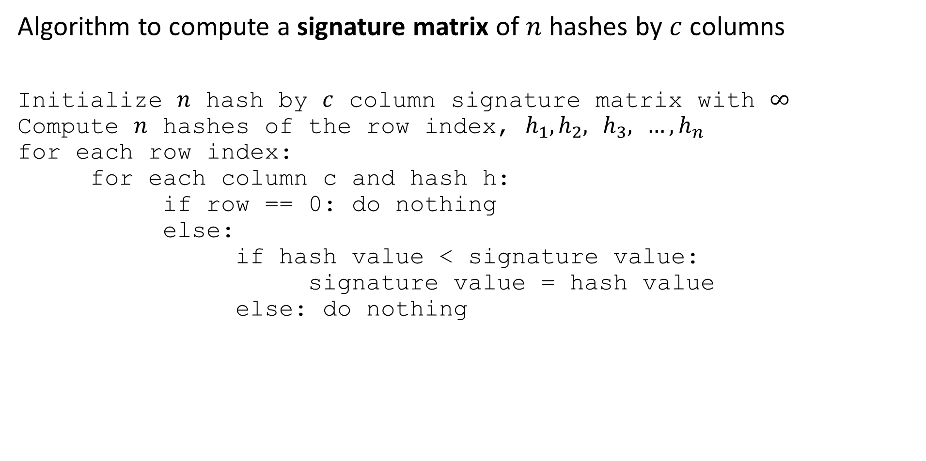
Mini-hashing for similarity
Algorithm to compute a signature matrix of $n$ hashes by $c$ columns
Initialize $n$ hash by $c$ column signature matrix with $∞$
Compute $n$ hashes of the row index, $h_{1},h_{2},$ $h_{3},$ ${…, h}_{n}$
for each row index:
for each column c and hash h:
if row == 0: do nothing
else:
if hash value < signature value:
signature value = hash value
else: do nothing

Slide 37
Mini-hashing for Similarity
Working with multiple mini-hashes
Example: using two independent hashes creates two sets of random values:
Use many more hash function in practice
Initial Index | S₁ | S₂ | S₃ | S₄ | 3x + 1 mod 5 | 7x + 1 mod 5
0 | 0 | 0 | 1 | 0 | 1 | 1
1 | 0 | 0 | 1 | 0 | 4 | 3
2 | 0 | 1 | 0 | 1 | 2 | 0
3 | 1 | 0 | 1 | 1 | 0 | 2
4 | 1 | 0 | 0 | 1 | 3 | 4

Slide 38

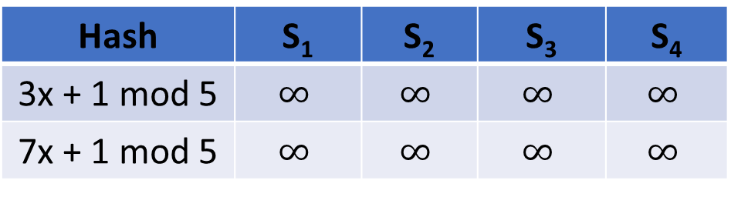
Mini-hashing for Similarity
Improving similarity estimates
The initialized signature matrix contains $∞$ values
Hash | S₁ | S₂ | S₃ | S₄
3x + 1 mod 5 | $$∞$$ | $$∞$$ | $$∞$$ | $$∞$$
7x + 1 mod 5 | $$∞$$ | $$∞$$ | $$∞$$ | $$∞$$

Slide 39

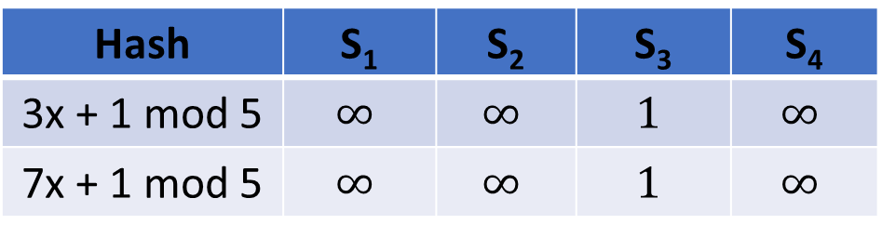
Mini-hashing for Similarity
Working with multiple mini-hashes
Start with row index 0
Both hash values are 1, only column $S_{3}≠0⟹$ updated signature matrix:
Initial Index | S₁ | S₂ | S₃ | S₄ | 3x + 1 mod 5 | 7x + 1 mod 5
0 | 0 | 0 | 1 | 0 | 1 | 1
1 | 0 | 0 | 1 | 0 | 4 | 3
2 | 0 | 1 | 0 | 1 | 2 | 0
3 | 1 | 0 | 1 | 1 | 0 | 2
4 | 1 | 0 | 0 | 1 | 3 | 4
Hash | S₁ | S₂ | S₃ | S₄
3x + 1 mod 5 | $$∞$$ | $$∞$$ | $$1$$ | $$∞$$
7x + 1 mod 5 | $$∞$$ | $$∞$$ | $$1$$ | $$∞$$

Slide 40

Mini-hashing for Similarity
Working with multiple mini-hashes
Next row index = 1
Only column $S_{3}≠0$ and $h_{1}<1, h_{2}<1⟹$no update of signature matrix:
Initial Index | S₁ | S₂ | S₃ | S₄ | 3x + 1 mod 5 | 7x + 1 mod 5
0 | 0 | 0 | 1 | 0 | 1 | 1
1 | 0 | 0 | 1 | 0 | 4 | 3
2 | 0 | 1 | 0 | 1 | 2 | 0
3 | 1 | 0 | 1 | 1 | 0 | 2
4 | 1 | 0 | 0 | 1 | 3 | 4
Hash | S₁ | S₂ | S₃ | S₄
3x + 1 mod 5 | $$∞$$ | $$∞$$ | $$1$$ | $$∞$$
7x + 1 mod 5 | $$∞$$ | $$∞$$ | $$1$$ | $$∞$$

Slide 41


Mini-hashing for Similarity
Working with multiple mini-hashes
Next row index = 2
$S_{2}≠0$, $S_{4}≠0$ $⟹$update signature matrix:
Initial Index | S₁ | S₂ | S₃ | S₄ | 3x + 1 mod 5 | 7x + 1 mod 5
0 | 0 | 0 | 1 | 0 | 1 | 1
1 | 0 | 0 | 1 | 0 | 4 | 3
2 | 0 | 1 | 0 | 1 | 2 | 0
3 | 1 | 0 | 1 | 1 | 0 | 2
4 | 1 | 0 | 0 | 1 | 3 | 4
Hash | S₁ | S₂ | S₃ | S₄
3x + 1 mod 5 | $$∞$$ | $$2$$ | $$1$$ | $$2$$
7x + 1 mod 5 | $$∞$$ | $$0$$ | $$1$$ | $$0$$

Slide 42

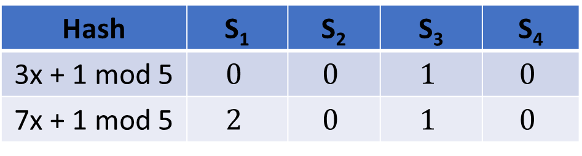
Mini-hashing for Similarity
Working with multiple mini-hashes
Next row index = 3
${S_{1}≠0\text{,} S}_{3}≠0$, $S_{4}≠0$ $⟹$update signature matrix:
Initial Index | S₁ | S₂ | S₃ | S₄ | 3x + 1 mod 5 | 7x + 1 mod 5
0 | 0 | 0 | 1 | 0 | 1 | 1
1 | 0 | 0 | 1 | 0 | 4 | 3
2 | 0 | 1 | 0 | 1 | 2 | 0
3 | 1 | 0 | 1 | 1 | 0 | 2
4 | 1 | 0 | 0 | 1 | 3 | 4
Hash | S₁ | S₂ | S₃ | S₄
3x + 1 mod 5 | $$0$$ | $$0$$ | $$1$$ | $$0$$
7x + 1 mod 5 | $$2$$ | $$0$$ | $$1$$ | $$0$$

Slide 43

Mini-hashing for Similarity
Working with multiple mini-hashes
Next row index = 4
${S_{2}≠0\text{,} }_{ }S_{4}≠0$ $⟹$but no update of signature matrix:
Initial Index | S₁ | S₂ | S₃ | S₄ | 3x + 1 mod 5 | 7x + 1 mod 5
0 | 0 | 0 | 1 | 0 | 1 | 1
1 | 0 | 0 | 1 | 0 | 4 | 3
2 | 0 | 1 | 0 | 1 | 2 | 0
3 | 1 | 0 | 1 | 1 | 0 | 2
4 | 1 | 0 | 0 | 1 | 3 | 4
Hash | S₁ | S₂ | S₃ | S₄
3x + 1 mod 5 | $$0$$ | $$0$$ | $$1$$ | $$0$$
7x + 1 mod 5 | $$2$$ | $$0$$ | $$1$$ | $$0$$

Slide 44
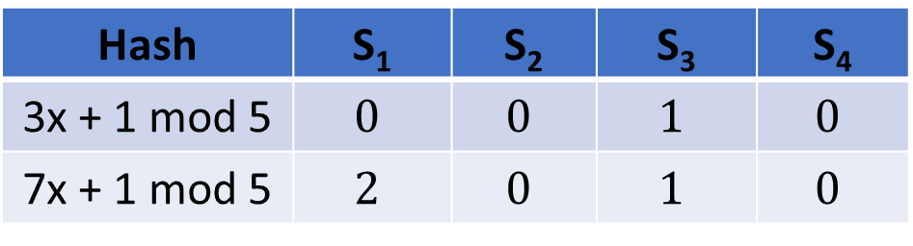
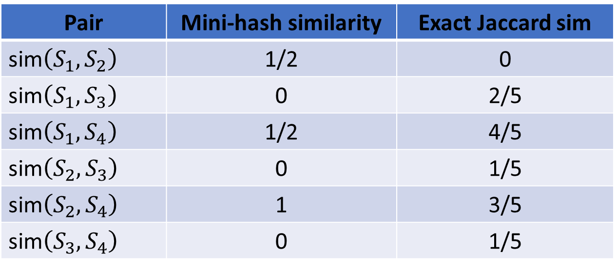
Mini-hashing for Similarity
Computing similarity with multiple mini-hashes
Final signature matrix:
Compute pairwise similarity
Hash | S₁ | S₂ | S₃ | S₄
3x + 1 mod 5 | $$0$$ | $$0$$ | $$1$$ | $$0$$
7x + 1 mod 5 | $$2$$ | $$0$$ | $$1$$ | $$0$$
Pair | Mini-hash similarity | Exact Jaccard sim
sim$\left(S_{1},S_{2}\right)$ | 1/2 | 0
sim$\left(S_{1},S_{3}\right)$ | 0 | 2/5
sim$\left(S_{1},S_{4}\right)$ | 1/2 | 4/5
sim$\left(S_{2},S_{3}\right)$ | 0 | 1/5
sim$\left(S_{2},S_{4}\right)$ | 1 | 3/5
sim$\left(S_{3},S_{4}\right)$ | 0 | 1/5

Slide 45
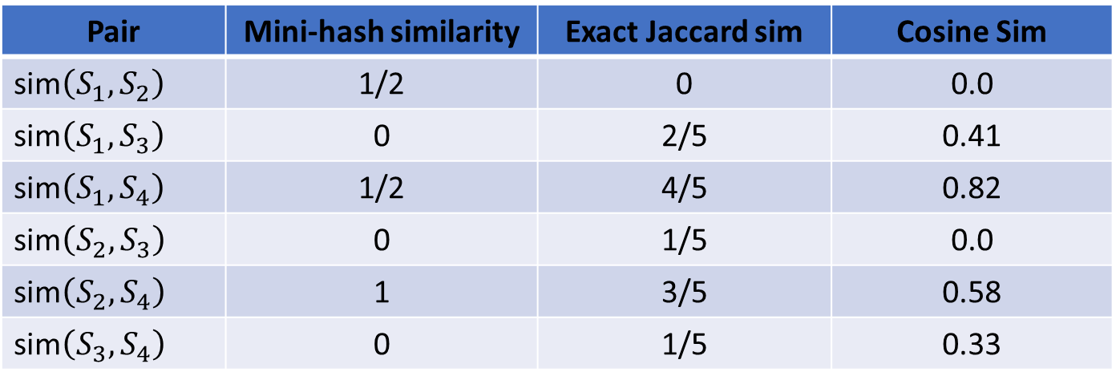
Mini-hashing for Similarity
Compare similarity metrics
Reasonable agreement between min-hash and Jaccard similarity
Agreement will improve as more mini-hashes used
Compare non-Euclidean Jaccard and Cosine similarity
We don’t expect perfect agreement
But rank approximately the same
Pair | Mini-hash similarity | Exact Jaccard sim | Cosine Sim
sim$\left(S_{1},S_{2}\right)$ | 1/2 | 0 | 0.0
sim$\left(S_{1},S_{3}\right)$ | 0 | 2/5 | 0.41
sim$\left(S_{1},S_{4}\right)$ | 1/2 | 4/5 | 0.82
sim$\left(S_{2},S_{3}\right)$ | 0 | 1/5 | 0.0
sim$\left(S_{2},S_{4}\right)$ | 1 | 3/5 | 0.58
sim$\left(S_{3},S_{4}\right)$ | 0 | 1/5 | 0.33

Slide 46

Locally Sensitive Hashing
Probability of error from mini-hashing
Consider the Jaccard similarity between two documents:
${sim}_{Jaccard}\left(s_{i},s_{j}\right)=s$
The probability that all $r$ mini-hashes agree is: $s^{r}$
The probability that at least 1 of the mini-hashes disagree: $1−s^{r}$

Slide 47

Locally Sensitive Hashing
Probability of error from mini-hashing
The probability that all $r$ mini-hash signatures agree is: $s^{r}$
The probability that at least 1 of the mini-hashes disagree: $1−s^{r}$
For $r=5$ we see the following sensitivity of the decision function:
The sensitivity to positive cases is low!
S | Probability Positive | Probability Negative | Expected Positive Pairs per 1000
0.1 | 1.0000E-05 | 9.9999E-01 | 0.01
0.2 | 3.2000E-04 | 9.9968E-01 | 0.32
0.3 | 2.4300E-03 | 9.9757E-01 | 2.43
0.4 | 1.0240E-02 | 9.8976E-01 | 10.24
0.5 | 3.1250E-02 | 9.6875E-01 | 31.25
0.6 | 7.7760E-02 | 9.2224E-01 | 77.76
0.7 | 1.6807E-01 | 8.3193E-01 | 168.07
0.8 | 3.2768E-01 | 6.7232E-01 | 327.68
0.9 | 5.9049E-01 | 4.0951E-01 | 590.49

Slide 48
Locally Sensitive Hashing
Probability of error from mini-hashing
Using mini-hashes yields low sensitivity to positive cases
How can we improve on local sensitivity?
We compute b bands of r mini-hashes
Mini-hash 1
Band 1
Mini-hash 2
…
Mini-hash r
Mini-hash 1
Band 2
Mini-hash 2
…
Mini-hash r
…
Mini-hash 1
Band b
Mini-hash 2
…
Mini-hash r

Slide 49
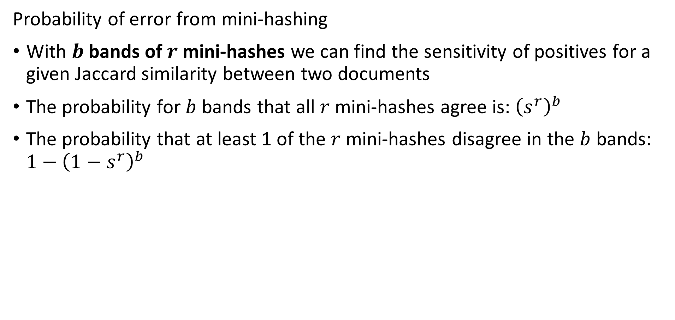
Locally Sensitive Hashing
Probability of error from mini-hashing
With $b$bands of $r$ mini-hashes we can find the sensitivity of positives for a given Jaccard similarity between two documents
The probability for $b$ bands that all $r$ mini-hashes agree is: ${\left(s^{r}\right)}^{b}$
The probability that at least 1 of the $r$ mini-hashes disagree in the $b$ bands: $1−{\left(1−s^{r}\right)}^{b}$

Slide 50

Locally Sensitive Hashing
Probability of error from mini-hashing
For $r=5$ and $b=20$ we find the following sensitivities:
Sensitivity to positive cases has increased significantly!
Some increase in false positive cases
S | Probability Positive | Probability Negative | Expected Positive Pairs per 1000
0.1 | 1.9998E-04 | 9.9980E-01 | 0.20
0.2 | 6.3806E-03 | 9.9362E-01 | 6.38
0.3 | 4.7494E-02 | 9.5251E-01 | 47.49
0.4 | 1.8605E-01 | 8.1395E-01 | 186.05
0.5 | 4.7005E-01 | 5.2995E-01 | 470.05
0.6 | 8.0190E-01 | 1.9810E-01 | 801.90
0.7 | 9.7478E-01 | 2.5219E-02 | 974.78
0.8 | 9.9964E-01 | 3.5606E-04 | 999.64
0.9 | 1.0000E+00 | 1.7591E-08 | 1000.00

Slide 51
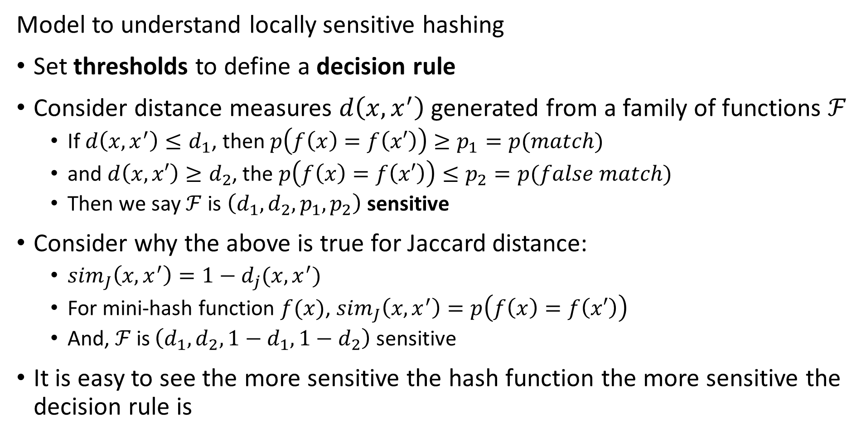
Locally Sensitive Functions
Model to understand locally sensitive hashing
Set thresholds to define a decision rule
Consider distance measures $d\left(x, x^{′}\right)$ generated from a family of functions $ℱ$
If $d\left(x,x^{′}\right)≤d_{1}$, then $p\left(f\left(x\right)=f\left(x′\right)\right)≥p_{1}=p(match)$
and $d\left(x,x′\right)≥d_{2}$, the $p\left(f\left(x\right)=f\left(x′\right)\right)≤p_{2}=p(false match)$
Then we say $ℱ$ is $\left(d_{1},d_{2},p_{1},p_{2}\right)$ sensitive
Consider why the above is true for Jaccard distance:
${sim}_{J}\left(x,x^{′}\right)=1−d_{j}(x,x^{′})$
For mini-hash function $f(x)$, ${sim}_{J}\left(x,x^{′}\right)=p\left(f\left(x\right)=f\left(x′\right)\right)$
And, $ℱ$ is $\left(d_{1},d_{2},1−d_{1},1−d_{2}\right)$ sensitive
It is easy to see the more sensitive the hash function the more sensitive the decision rule is

Slide 52
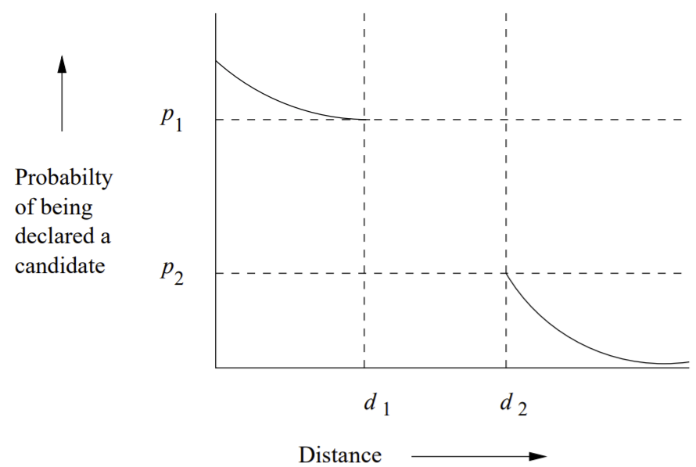
Locally Sensitive Functions
Model to understand locally sensitive hashing
Can visualize relationship between hash function and sensitivity of the decision rule
Higher sensitivity increases probability of correct decision
Credit; Leskovec et.al. 2020

Slide 53
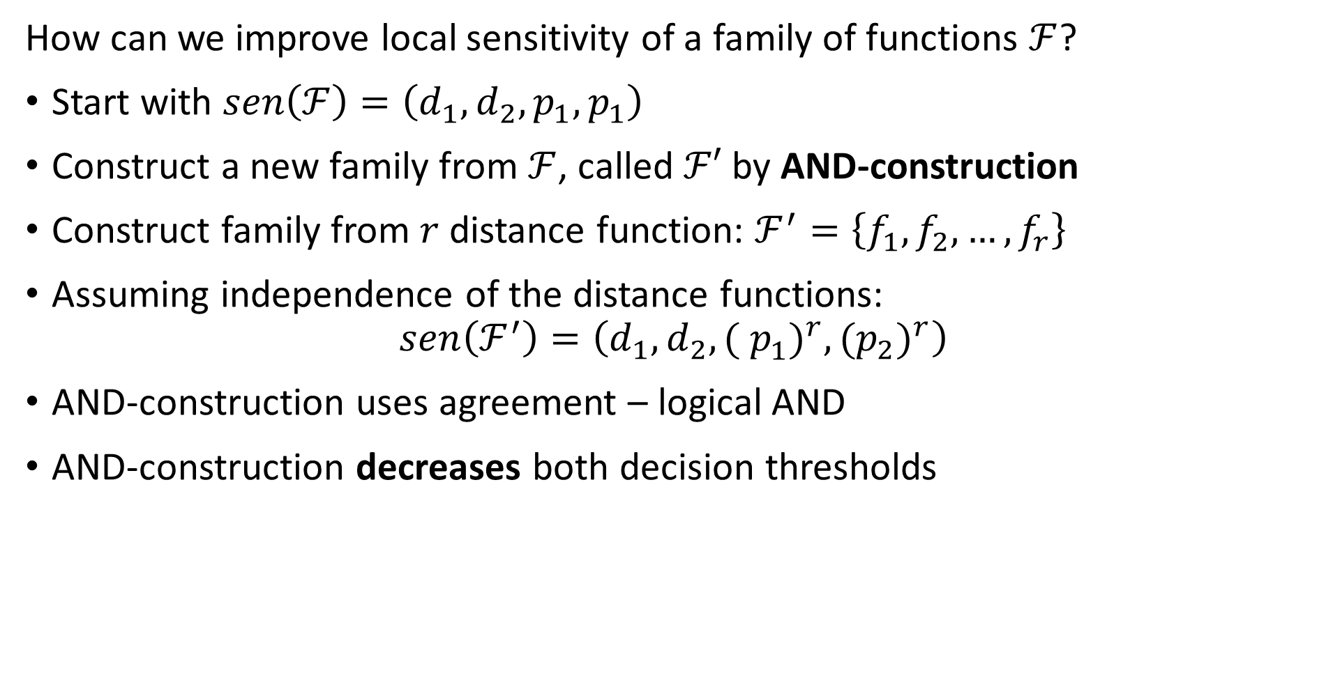
Improving Locally Sensitive Functions
How can we improve local sensitivity of a family of functions $ℱ$?
Start with $sen\left(ℱ\right)=\left(d_{1},d_{2},p_{1},p_{1}\right)$
Construct a new family from $ℱ$, called $ℱ′$ by AND-construction
Construct family from $r$ distance function: $ℱ^{′}=\left\{f_{1},f_{2},…,f_{r}\right\}$
Assuming independence of the distance functions:
$$sen\left(ℱ^{′}\right)=\left(d_{1},d_{2},{( p_{1}^{ })}^{r},{(p_{2})}^{r}\right)$$
AND-construction uses agreement – logical AND
AND-construction decreases both decision thresholds

Slide 54
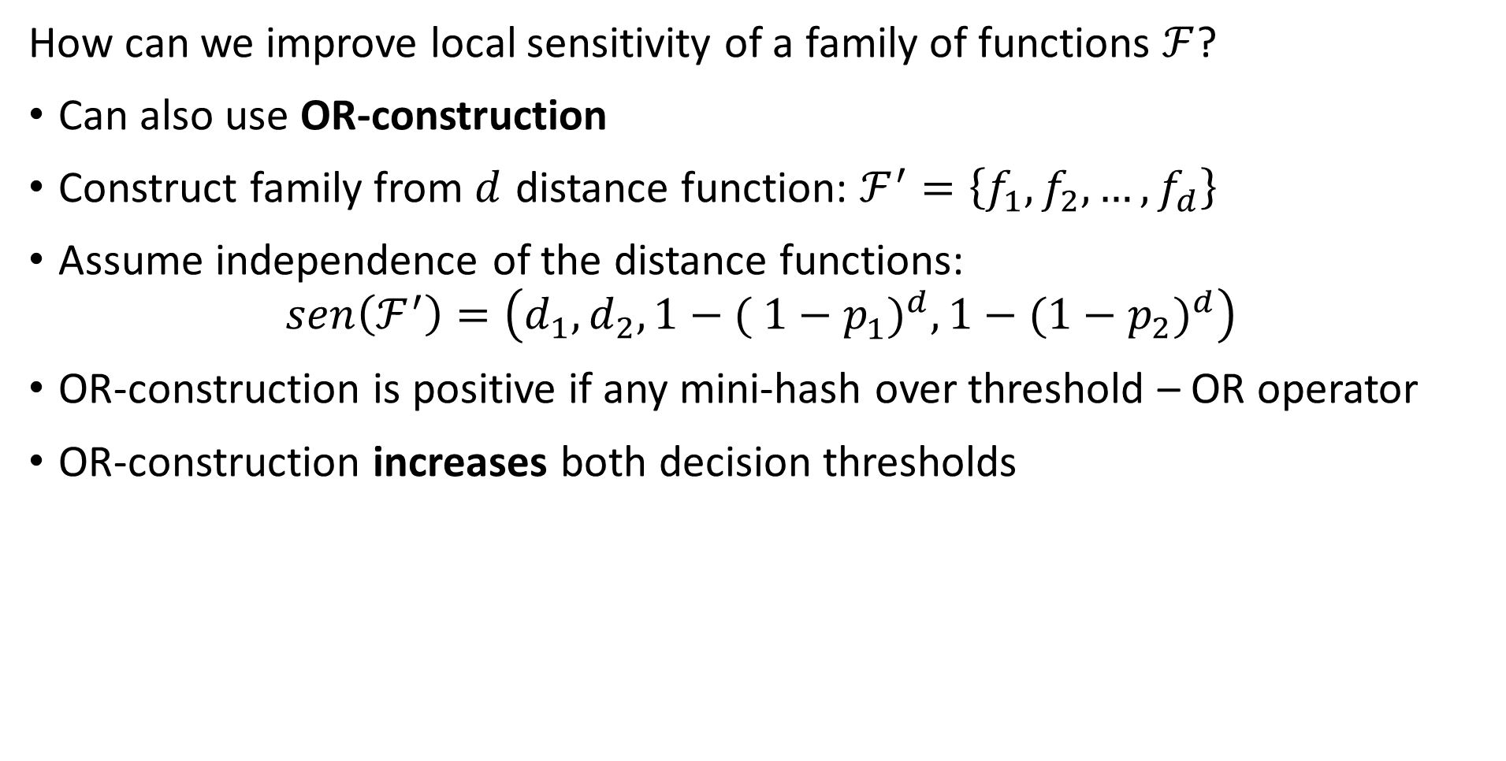
Improving Locally Sensitive Functions
How can we improve local sensitivity of a family of functions $ℱ$?
Can also use OR-construction
Construct family from $d$ distance function: $ℱ^{′}=\left\{f_{1},f_{2},…,f_{d}\right\}$
Assume independence of the distance functions:
$$sen\left(ℱ^{′}\right)=\left(d_{1},d_{2},{1−( 1−p_{1}^{ })}^{d},{1−({1−p}_{2})}^{d}\right)$$
OR-construction is positive if any mini-hash over threshold – OR operator
OR-construction increases both decision thresholds

Slide 55
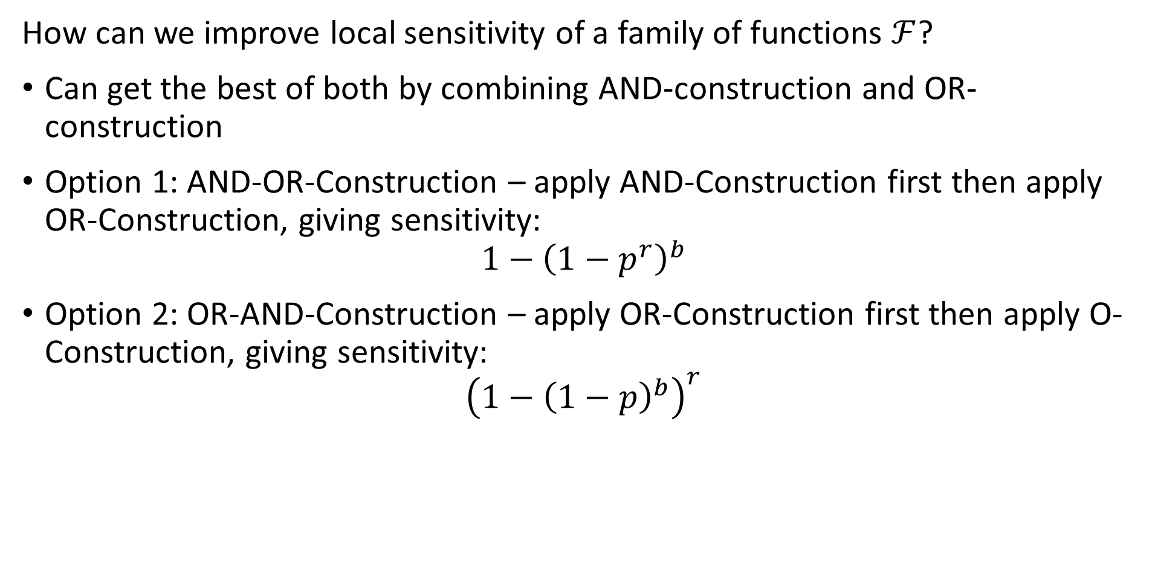
Improving Locally Sensitive Functions
How can we improve local sensitivity of a family of functions $ℱ$?
Can get the best of both by combining AND-construction and OR-construction
Option 1: AND-OR-Construction – apply AND-Construction first then apply OR-Construction, giving sensitivity:
$$1−{\left(1−p^{r}\right)}^{b}$$
Option 2: OR-AND-Construction – apply OR-Construction first then apply O-Construction, giving sensitivity:
$${\left(1−{\left(1−p\right)}^{b}\right)}^{r}$$

Slide 56

Improving Locally Sensitive Functions
How can we improve local sensitivity of a family of functions $ℱ$?
Example: $d=4$ and $r=4$
Increased sensitivity for both constructions
AND-OR-Construction slightly biased to negative cases
OR-AND-Construction slightly biased to positive cases
p | AND-OR-Construction | OR-AND-Construction
0.1 | 3.9994E-04 | 1.3987E-02
0.2 | 6.3847E-03 | 1.2150E-01
0.3 | 3.2008E-02 | 3.3345E-01
0.4 | 9.8535E-02 | 5.7395E-01
0.5 | 2.2752E-01 | 7.7248E-01
0.6 | 4.2605E-01 | 9.0147E-01
0.7 | 6.6655E-01 | 9.6799E-01
0.8 | 8.7850E-01 | 9.9362E-01
0.9 | 9.8601E-01 | 9.9960E-01

