Slide 1

CSCI E-96 Data Mining, Exploration and Discovery Document and Web Search Algorithms
Steve Elston
Copyright 2021, 2022, 2023, 2024, 2025, Stephen F Elston. All rights reserved.

Slide 2
Lesson Overview
Focus on introducing graph theory through web search
Introduction to the web search problem
Appling vector search for information retrieval
Brief introduction to text embedding with the BERT family of models
Introduction to Markov processes and random walks
The PageRank algorithm
Damped PageRank

Slide 3
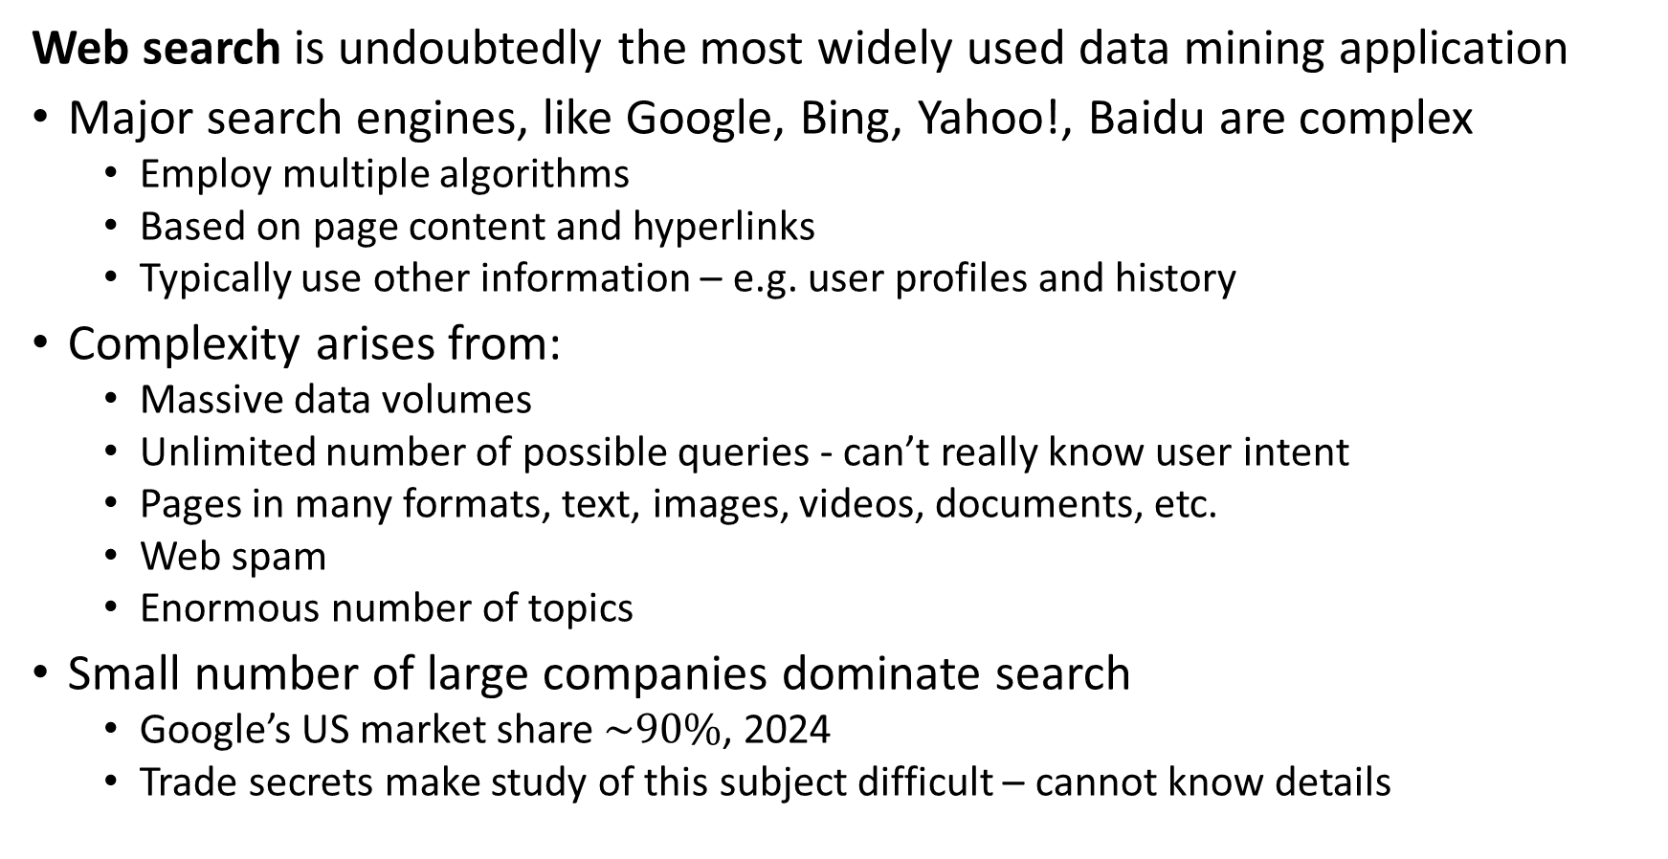
Introduction to Web Searching
Web search is undoubtedly the most widely used data mining application
Major search engines, like Google, Bing, Yahoo!, Baidu are complex
Employ multiple algorithms
Based on page content and hyperlinks
Typically use other information – e.g. user profiles and history
Complexity arises from:
Massive data volumes
Unlimited number of possible queries - can’t really know user intent
Pages in many formats, text, images, videos, documents, etc.
Web spam
Enormous number of topics
Small number of large companies dominate search
Google’s US market share $\sim 90\%$, 2024
Trade secrets make study of this subject difficult – cannot know details

Slide 4
Introduction to Web Searching
Many pitfalls in web search
Limited length query may not incorporate semantics and context
Natural language used for query is often ambiguous
Example: Query for ‘Jaguar numbers’ could refer to an endangered large cat, an automobile, a sports team, or maybe something else??
Keywords are not unique to a topic
Example: ‘Bank’ can refer to a financial institution, the edge of river, or the trajectory of an aircraft
Keywords have synonyms
Example of two queries with different key words but identical symantics
“What has been the loss of farm land in the US in 2024”
“How many cultivated acers were lost in the US durring 2024”

Slide 5
Information Retrieval
Web search is a subset of the general information retrevial problem
Search of documents, medical, legal, technical, etc.
Question and response systems
Retrieval augmented generation (RAG)
Conversational assistance
Genomics research
Etc.

Slide 6
Introduction to Web Searching
What about the role of LLMs in search?
LLMs create a summary of documents discovered with a high similarity to a query
LLMs require an efficient search of documents (web) as basis of summary
Web search and ranking are key to effective summarization by LLMs

Slide 7
Components of Document Similarity Search Systems

Slide 8
Components of a Document Search System
Document search systems have a number of key components
Documents are sharded into smaller chunks that can be processed
Performance of embedding models degrades for long text strings
Transform shards to embedding vectors
Store embedding vectors in database as key-value pairs
Embed queries
Perform vector similarity search for responses to query
Rank responses

Slide 9


Document Vector Similarity Search
Document Shard
Vector
Document Shard
Vector
Embedding
Document Shard
Vector
Documents
Vector
$$⋮$$
$$⋮$$
Document Shard
Vector Database
Vector Search
Reranker
Ranked List
Query
Embedding
Query Vector

Slide 10
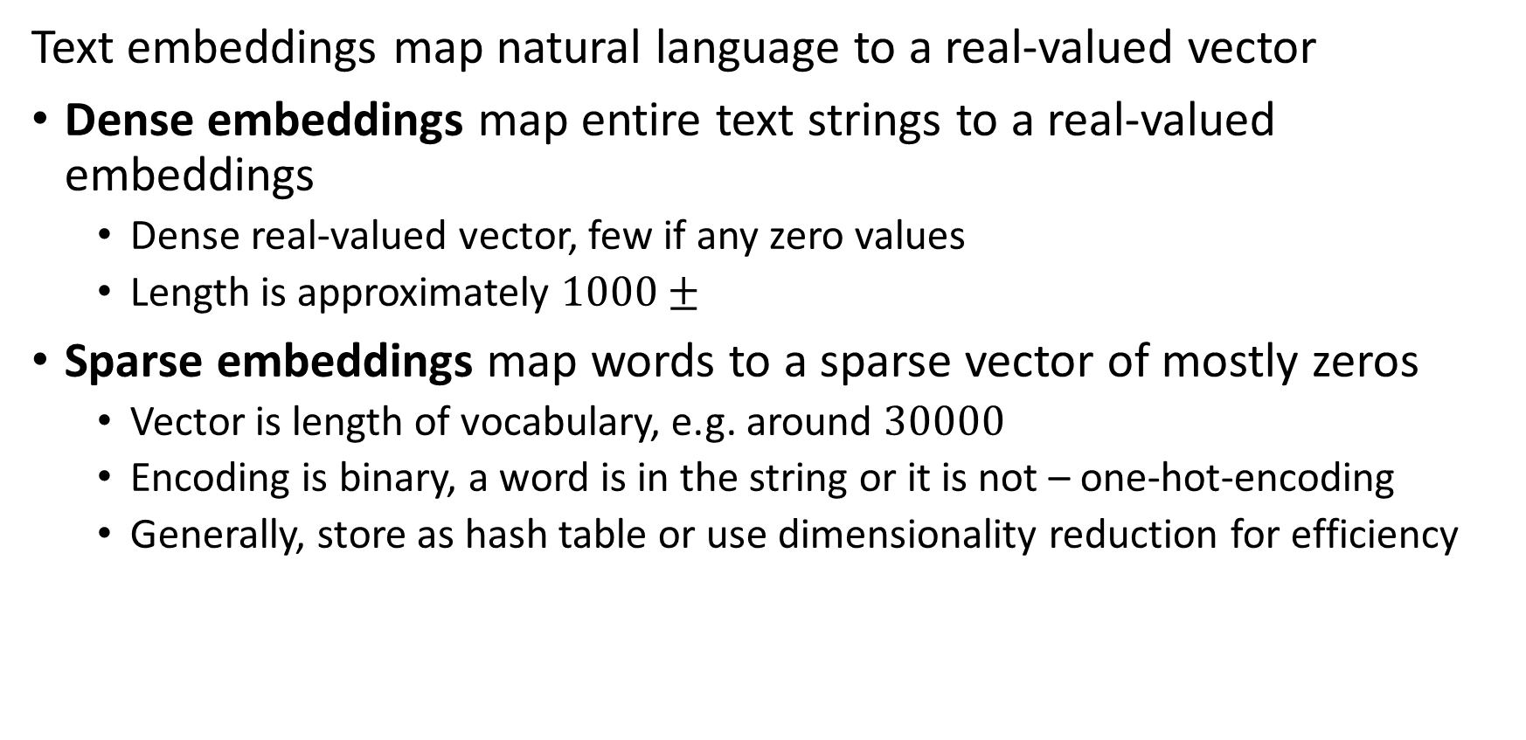
Text embeddings
Text embeddings map natural language to a real-valued vector
Dense embeddings map entire text strings to a real-valued embeddings
Dense real-valued vector, few if any zero values
Length is approximately $1000±$
Sparse embeddings map words to a sparse vector of mostly zeros
Vector is length of vocabulary, e.g. around $30000$
Encoding is binary, a word is in the string or it is not – one-hot-encoding
Generally, store as hash table or use dimensionality reduction for efficiency

Slide 11

Improving Document Vector Similarity Search at Massive Scale
Embedding vectors of documents
Vector
Vector
Fast approximate NN search results in large number of matches
Vector
ANN search results reranked by more exact, possibly slower, search algorithm
Vector
$$⋮$$
Embedding vectors of documents
Vector Database
ANN Vector Search
Reranker
Ranked List
Query Vector

Slide 12
Introduction to Web Searching
Google uses multiple algorithms to rank search results
Dense semantic search using embedding vectors from BERT family of algorithms
Search vector similarity between query and page embeddings
Sparse exact match search for key words
A sparse search over a fixed vocabulary with algorithms like SPLADE
Vector search for duplicate pages
Freshness metrics to prioritize up to date information
Ranking algorithms
Multiple algorithms, including the venerable and famous PageRank algorithm
These algorithms are common to the general information retrival problem

Slide 13
Short Introduction to BERT Models for Text Embedding

Slide 14
Overview of BERT models
Bidirectional encoder representation from transformer (BERT) models are a family of dense text embedding models
The original BERT model was introduced by Devlin, et. al., 2019
There is a large and growing family of fast, efficient and effective BERT models
DistilBERT, Sanh, et. al., 2019, a faster and lighter distillation of BERT
XlmROBERTa, Conneau, et. al., 2019, a larger mulit-language embedding model
LegalBERT, Chalkidis, et. al., 2020, trained on legal documents
FinBERT, Araci, 2019, trained on financial statements
Etc.

Slide 15
Overview of BERT models
Bidirectional encoder representation from transformer (BERT) models are a family of text embedding models
BERT is an encoder only model
Maps natural language tokens to an embedding
BERT uses a transformer attention model
We will not discuss the details here
For one of the many introductions to transformer models, see this tutorial on the HuggingFace web site
BERT process tokens bidirectionally
Tokens processed right to left
And, tokens processed left to right
Bidirectional processing allows BERT embeddings to represent semantics

Slide 16
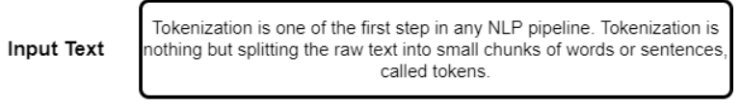
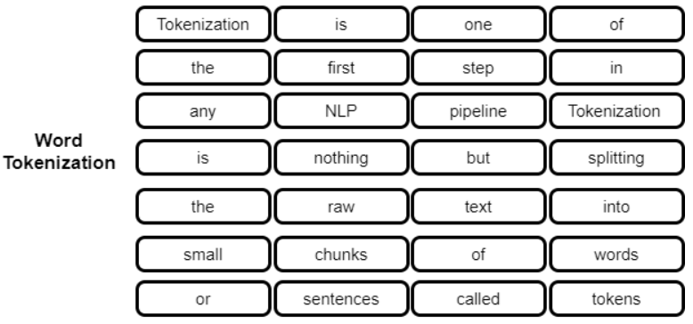
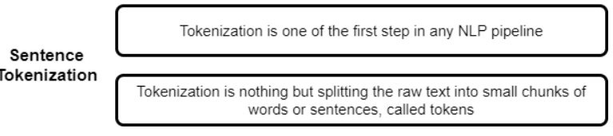
Overview of BERT models
(BERT) models process tokenized text
Natural language text processed by BERT must first be tokenized
Tokenization can be done at the word level
Tokenization can be done at the sentence or phrase level
Example from Kagel example notebook

Slide 17
Overview of BERT models
Tokenization can be performed at many levels
Models like BERT do not simply use tokenized words and sentences
Sub-word tokenization is used.
Example of the result shows both words, parts of words and other general tokes
['[PAD]', '[UNK]', '[START]', '[END]', '!', '#', '$', '%', '&', “’”]
['as', 'all', 'at', 'one’, ‘people', 're', 'like', 'if', 'our', 'from’]
['choose', 'consider', 'extraordinary', 'focus', 'generation’, ‘killed’,
'patterns', 'putting', 'scientific', 'wait’]
['##_', '##`', '##ย', '##ร', '##อ', '##–', '##—', '##’', '##♪', '##♫']
Example from TensorFlow Subword Tokenizer Documentation

Slide 18

Overview of BERT models
BERT token embedding has three components
Text tokens
Positional embeddings
Sentence embeddings
To capture semantics, BERT processes tokes both left to right and right to left
Image credit, Wikipedia Commons

Slide 19
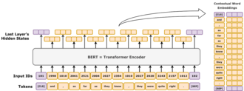
Overview of BERT models
BERT models output embedding vectors from input text
The final hidden state are the full token embeddings
Embedding vector for input text is created from the final hidden state
BERT encoder processes tokens in multiple transformer layers
Input IDs (keys) and embedded tokens (values) are bidirectionally processed by the BERT algorithm
Image credit, Wikipedia Commons

Slide 20
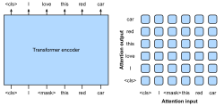
Overview of BERT models
BERT transformer layers use bidirectional attention to compute embeddings
Embedding hidden state is based on attention
Transformers compute bidirectional cross attention between input tokens to capture semantics
Token embeddings are input to transformer encoder layers
Image credit, Wikipedia Commons

Slide 21
Overview of BERT models
BERT uses self-supervised learning with two simultaneous steps
Masked language model (MLM) learns to predict masked (missing) tokens
A randomly sampled fraction of tokens are masked at the input
The loss function measures how well the model predicts the missing tokens
To ensure diversity, random tokens are used to compute the loss function about 10% of the time
Next sentence prediction learns to generate next sentence in a sequence
Loss function based on prediction if next sentence is the correct one
Random sentences are substituted to create the negative cases

Slide 22
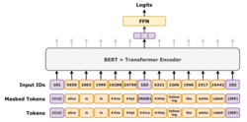
Overview of BERT models
BERT uses MLM as one self-supervised learning step
Embedding vector is used to predict missing tokens
Random input tokens are masked
Start with the full input sequence of tokens
Image credit, Wikipedia Commons

Slide 23
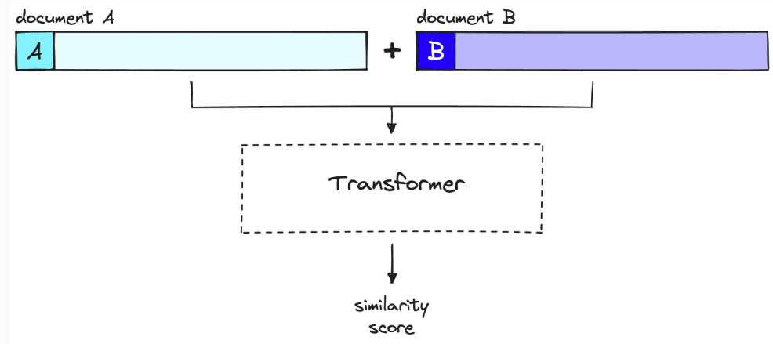
Reranking with Sentence BERT
Sentence BERT models can accurately score similarity between text strings
Inputs are query and candidate document
Transformer layers process both documents simultaneously
Similarity Scores ranked for final result
Image credit, Pincone Rerankers and Two-Stage Retrieval

Slide 24
Sparse Text Embedding

Slide 25

Overview of Sparse Encoding
Spare text embedding is an alternative to dense embedding
Spare encoders produce long vectors of mostly 0 values
Length of vector = length of vocabulary
Each vocabulary word encoded by position in the encoding vector
Any given document has only a fraction of total vocabulary
Example:
“A dog ran in from the street”
1
0
0
1
0
1
0
0
0
0
1
0
1
0
0
$$⋯$$
a
dog
this
in
these
both
at
half
from
the
who
road
street
alley
wind

Slide 26
Models for Image Embedding

Slide 27
Image embeddings
How can we do similarity search on images?
Vector embeddings can be found for other data, not just natural language
There are two commonly used methods to create embeddings for images
Similar methods are used for videos

Slide 28
Image embeddings
There are two commonly used methods to create embeddings for images
Using feature maps from convolutional neural networks or transformer networks
Network pretrained
Flatten multi-dimensional feature map is embedding
Contrastive language-image pre-training (CLIP) models
Model has both a text encoder and an image encoder
Contrastive learning used to find embeddings for similarity between text query and image

Slide 29
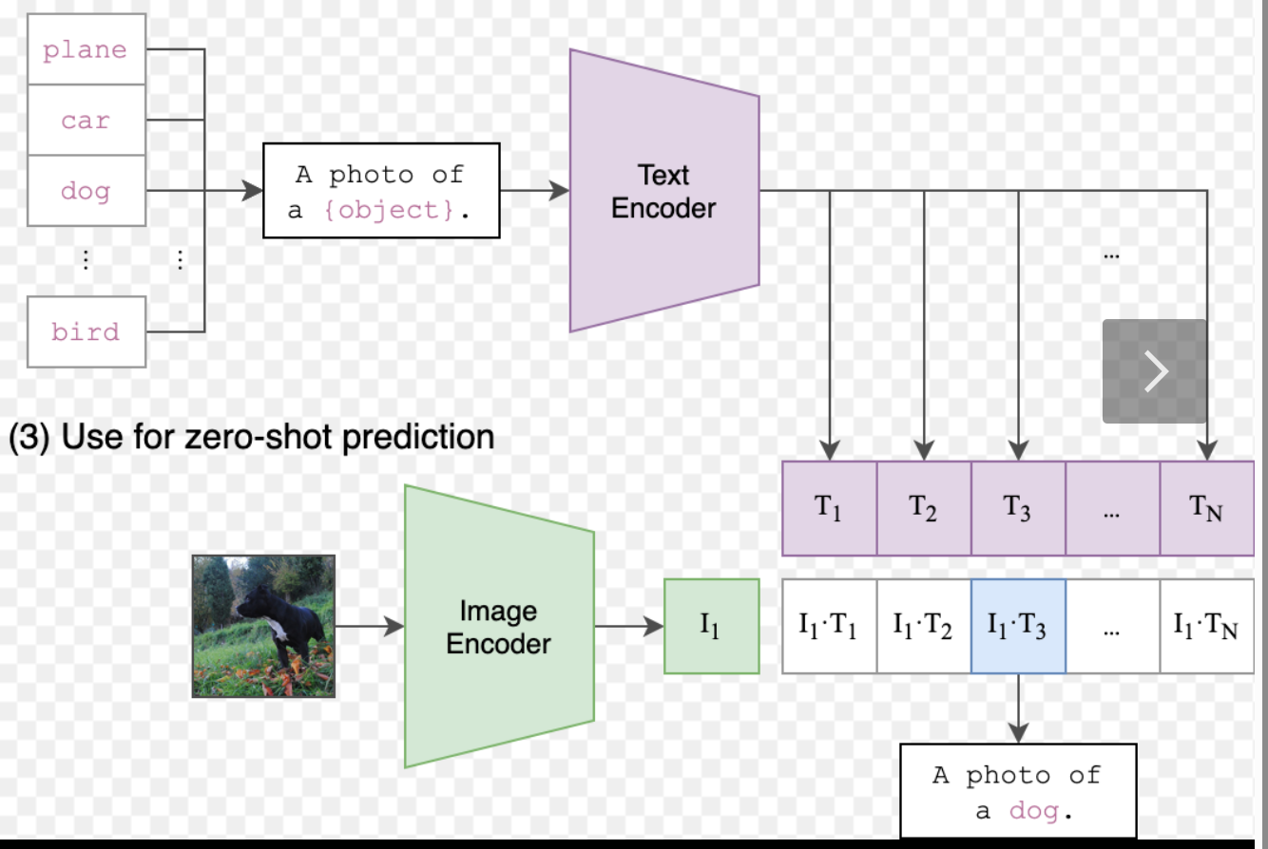
Image embeddings
How can we do similarity search on images?

Slide 30
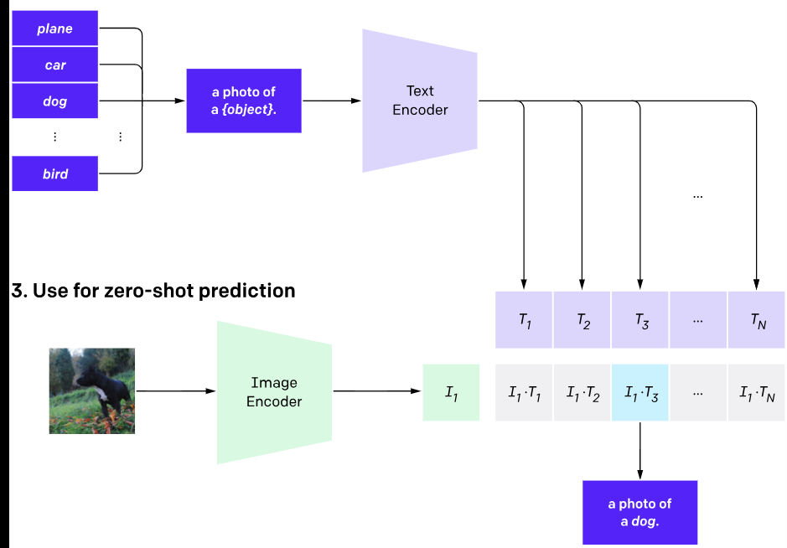
Image embeddings
How can we do similarity search on images?

Slide 31
Image embeddings
How can we do similarity search on images?
You can find an example of using the HuggingFace CLIP models here
You can find another example of image embeddings on the HuggingFace web site here

Slide 32
Introduction to Markov Processes

Slide 33
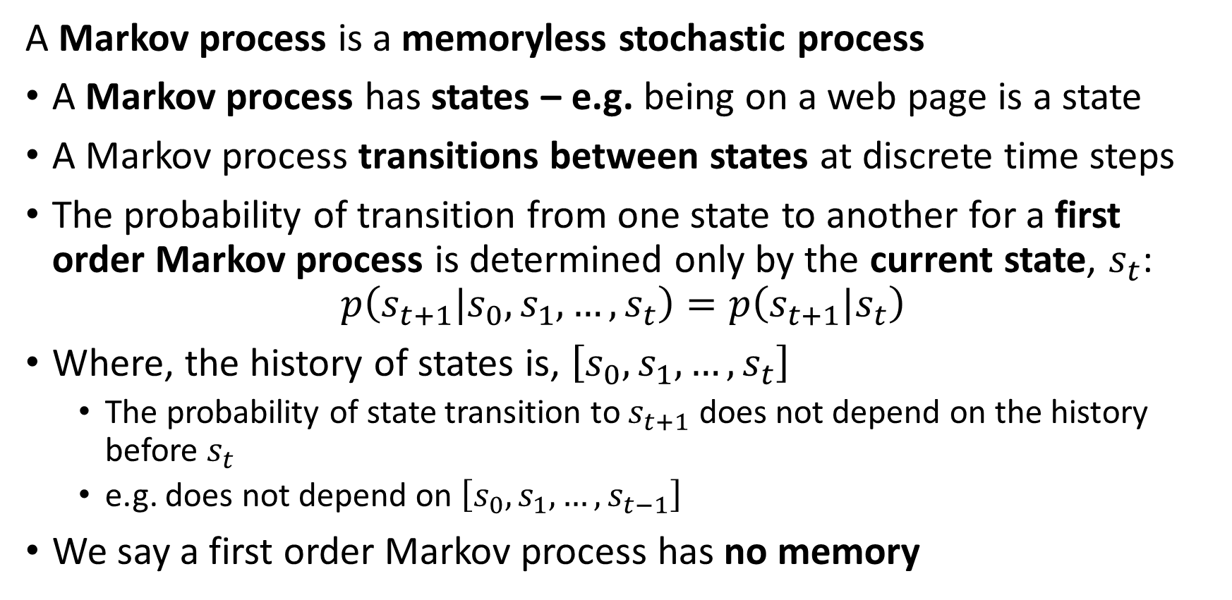
Introduction to Markov Processes
A Markov process is a memoryless stochastic process
A Markov process has states – e.g. being on a web page is a state
A Markov process transitions between states at discrete time steps
The probability of transition from one state to another for a first order Markov process is determined only by the current state, $s_{t}$:
$$p\left(s_{t+1}|s_{0},s_{1},…,s_{t}\right)=p\left(s_{t+1}|s_{t}\right)$$
Where, the history of states is, $\left[s_{0},s_{1},…,s_{t}\right]$
The probability of state transition to $s_{t+1}$ does not depend on the history before $s_{t}$
e.g. does not depend on $\left[s_{0},s_{1},…,s_{t−1}\right]$
We say a first order Markov process has no memory

Slide 34
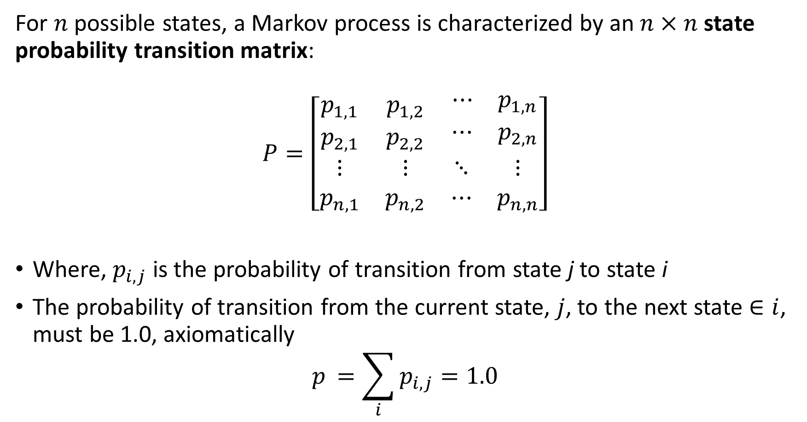
Introduction to Markov Processes
For $n$ possible states, a Markov process is characterized by an $n×n$ state probability transition matrix:
$$P=\left[\begin{matrix}p_{1,1} & p_{1,2} & \begin{matrix}⋯ & p_{1,n}\end{matrix} \\ p_{2,1} & p_{2,2} & \begin{matrix}⋯ & p_{2,n}\end{matrix} \\ \begin{matrix}⋮ \\ p_{n,1}\end{matrix} & \begin{matrix}⋮ \\ p_{n,2}\end{matrix} & \begin{matrix}⋱ & ⋮ \\ ⋯ & p_{n,n}\end{matrix}\end{matrix}\right]$$
Where, $p_{i,j}$ is the probability of transition from state j to state i
The probability of transition from the current state, $j$, to the next state $∈i$, must be 1.0, axiomatically
$$p_{ }=\sum_{i}^{ }{p_{i,j}=1.0}$$

Slide 35
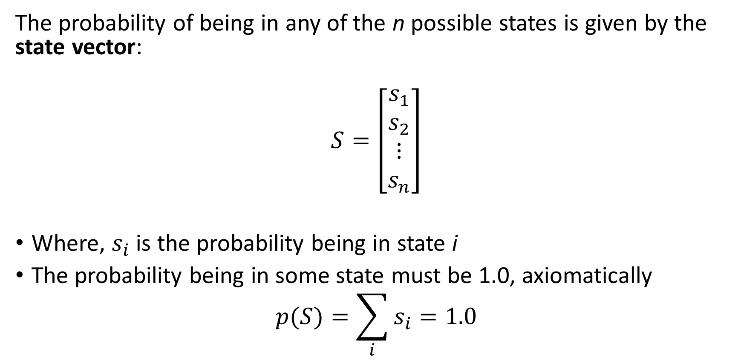
Introduction to Markov Processes
The probability of being in any of the n possible states is given by the state vector:
$$S=\left[\begin{matrix}s_{1} \\ s_{2} \\ \begin{matrix}⋮ \\ s_{n}\end{matrix}\end{matrix}\right]$$
Where, $s_{i}$ is the probability being in state i
The probability being in some state must be 1.0, axiomatically
$$p(S)=\sum_{i}^{ }{s_{i}=1.0}$$

Slide 36
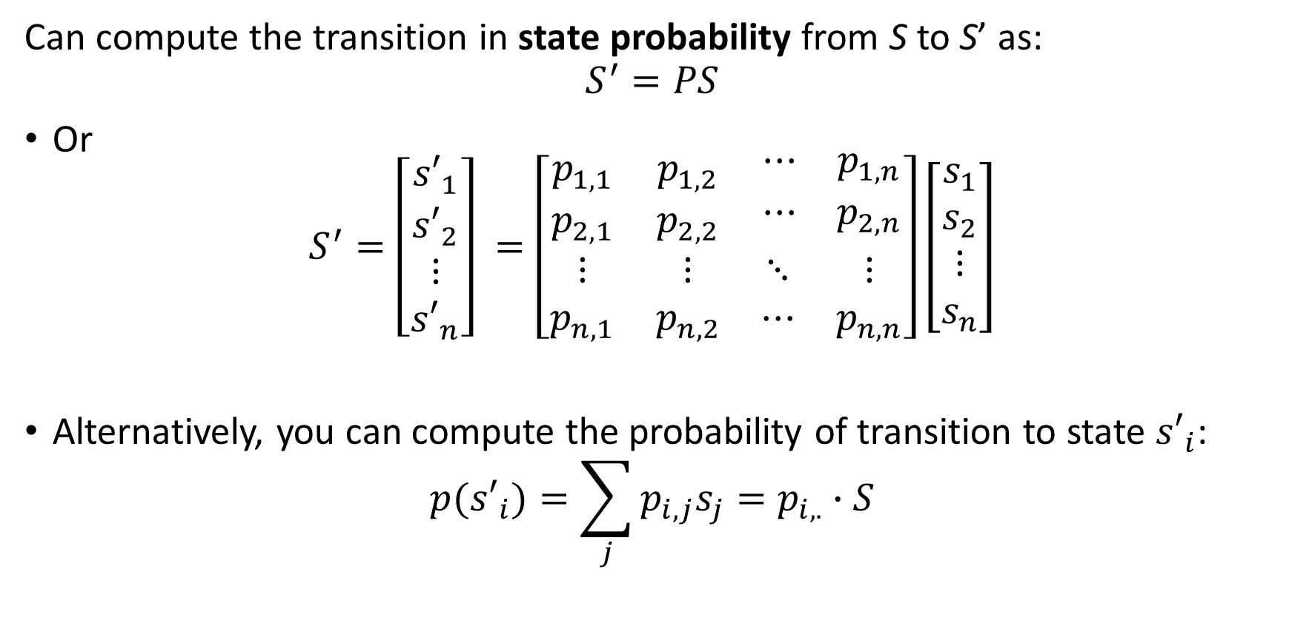
Introduction to Markov Processes
Can compute the transition in state probability from S to S’ as:
$$S^{′}=PS$$
Or
$$S^{′}=\left[\begin{matrix}{s′}_{1} \\ {s′}_{2} \\ \begin{matrix}⋮ \\ {s′}_{n}\end{matrix}\end{matrix}\right] =\left[\begin{matrix}p_{1,1} & p_{1,2} & \begin{matrix}⋯ & p_{1,n}\end{matrix} \\ p_{2,1} & p_{2,2} & \begin{matrix}⋯ & p_{2,n}\end{matrix} \\ \begin{matrix}⋮ \\ p_{n,1}\end{matrix} & \begin{matrix}⋮ \\ p_{n,2}\end{matrix} & \begin{matrix}⋱ & ⋮ \\ ⋯ & p_{n,n}\end{matrix}\end{matrix}\right]\left[\begin{matrix}s_{1} \\ s_{2} \\ \begin{matrix}⋮ \\ s_{n}\end{matrix}\end{matrix}\right]$$
Alternatively, you can compute the probability of transition to state ${s′}_{i}$:
$${p(s′}_{i})=\sum_{j}{p_{i,j}s_{j}}=p_{i,.}∙S$$

Slide 37
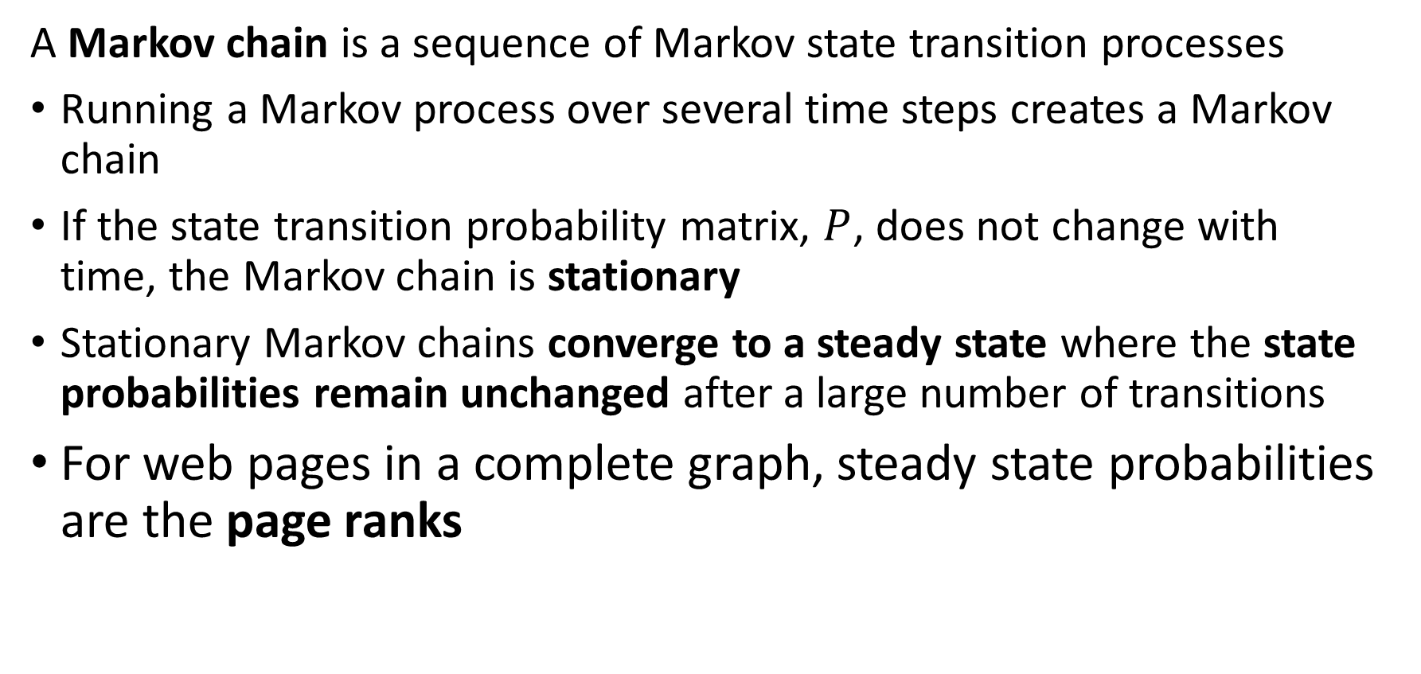
Introduction to Markov Processes
A Markov chain is a sequence of Markov state transition processes
Running a Markov process over several time steps creates a Markov chain
If the state transition probability matrix, $P$, does not change with time, the Markov chain is stationary
Stationary Markov chains converge to a steady state where the state probabilities remain unchanged after a large number of transitions
For web pages in a complete graph, steady state probabilities are the page ranks

Slide 38
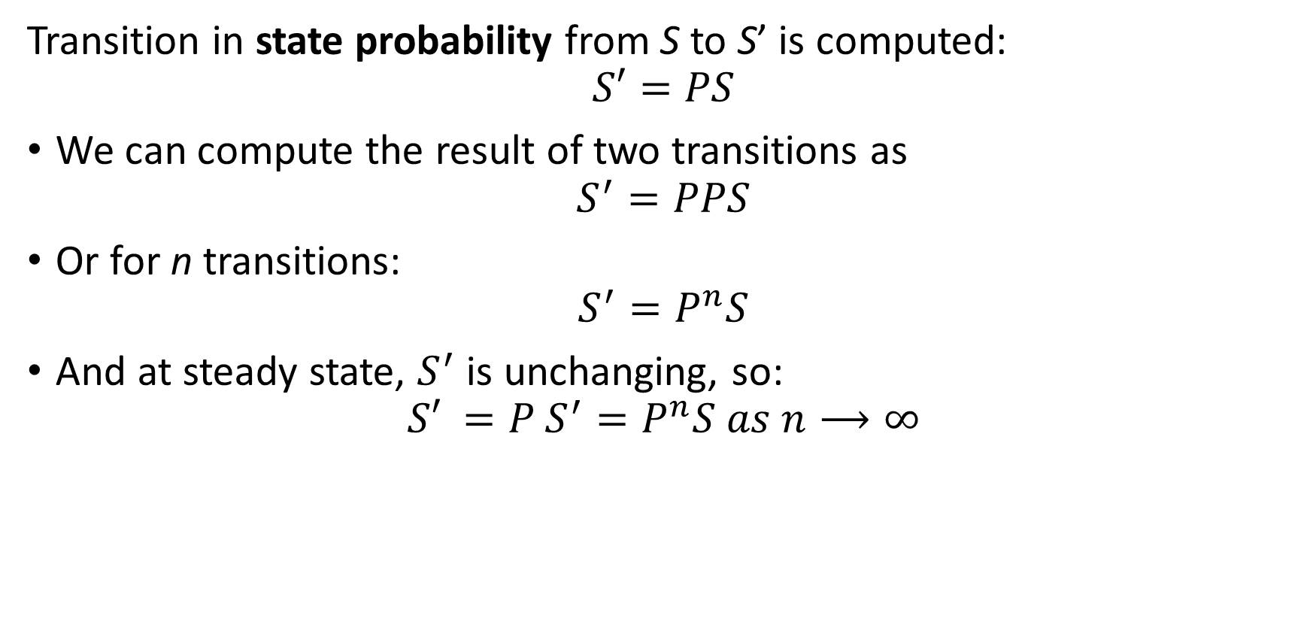
Introduction to Markov Processes
Transition in state probability from S to S’ is computed:
$$S′=PS$$
We can compute the result of two transitions as
$$S^{′}=PPS$$
Or for n transitions:
$$S^{′}=P^{n}S$$
And at steady state, $S^{′}$ is unchanging, so:
$${S′}^{ }=P^{ }S^{′}=P^{n}S as n⟶∞$$

Slide 39
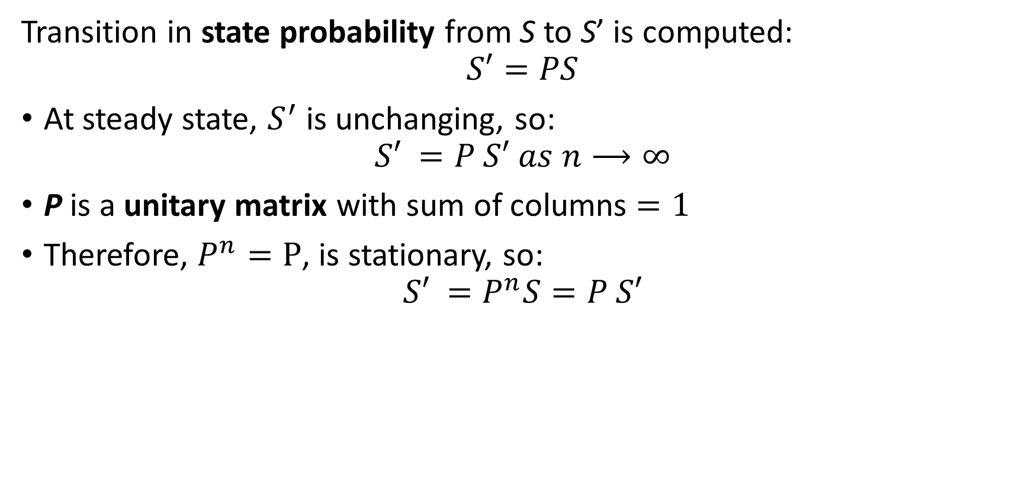
Introduction to Markov Processes
Transition in state probability from S to S’ is computed:
$$S′=PS$$
At steady state, $S^{′}$ is unchanging, so:
$${S′}^{ }=P^{ }S′ as n⟶∞$$
P is a unitary matrix with sum of columns $=1$
Therefore, $P^{n}=P$, is stationary, so:
$${S′}^{ }=P^{n}S=P^{ }S′$$

Slide 40
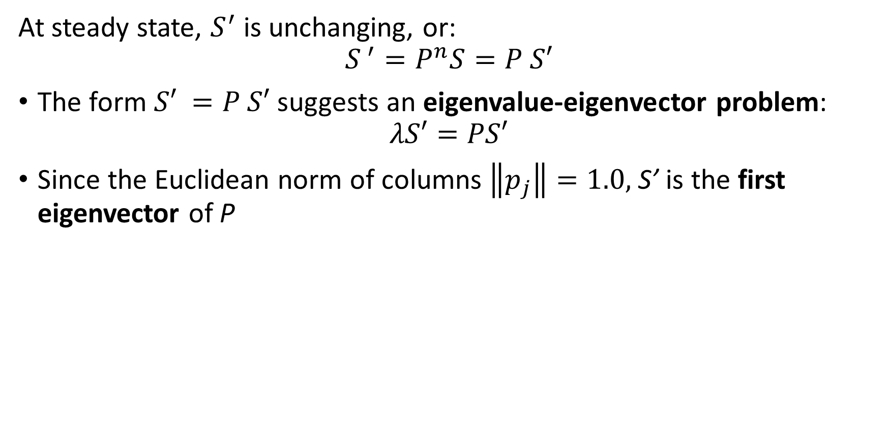
Introduction to Markov Processes
At steady state, $S^{′}$ is unchanging, or:
$$S^{ ′}=P^{n}S=P^{ }S′$$
The form ${S′}^{ }=P^{ }S′$ suggests an eigenvalue-eigenvector problem:
$$λS′=PS′$$
Since the Euclidean norm of columns $\left\|p_{j}\right\|=1.0,$ S’ is the first eigenvector of P

Slide 41
Overview of Web Search

Slide 42
Searching on the Web
Web search is an application of graph theory
The web is a very large directed graph
Nodes are pages
Pages contain content in most any form – text, video, audio, documents,…
Search results are presented as pages that best fit a user’s query
Directed edges are hyperlinks
Edges are directed from one page to another - outgoing
Pages can have multiple directed links
A page with a link to another page need not be linked by the other page – no symmetry!

Slide 43
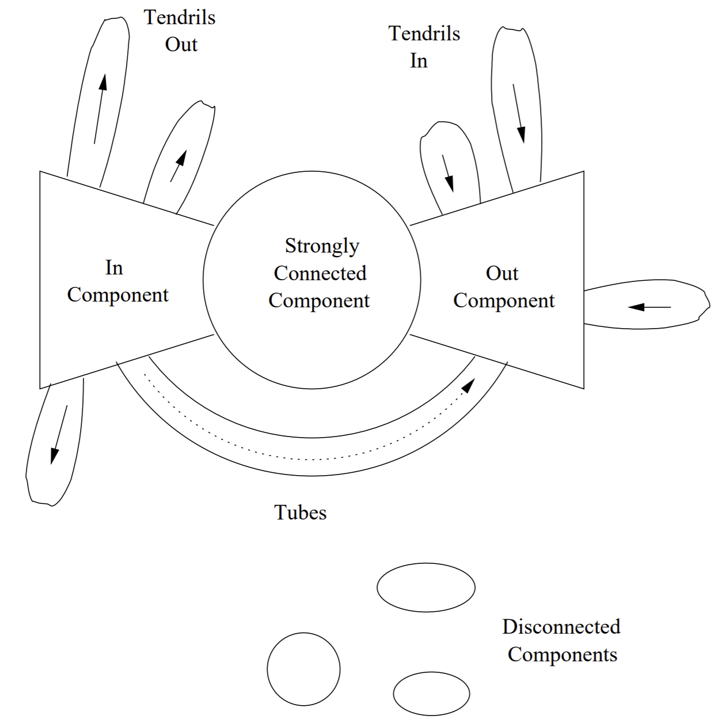
Searching on the Web
Structure of the web can be described by the bowtie model
Strongly connected core
Widely referenced pages
Both in and out links
In component comprises pages that link to the strongly connected core
Mostly links to strongly connected core
Few in-links
Out component are pages referenced by other pages
Few out-links

Slide 44
Searching on the Web
Structure of the web can be described by the bowtie model
Tendrils Out are links to pages with no out-links, called dead ends
Tendrils In are in-links to the Out Components from relatively isolated pages
Tubes connect directly from the In Component to the Out Component
Disconnected Components are groups of isolated pages which do not connect to the rest of the web – typically private networks

Slide 45
Learning the Structure of the Web

Slide 46
Learning the Structure of the Web
How can we learn the structure of the web?
The importance of a web page for a search can be measured by its centrality
Centrality is a measure of how important a graph node is with respect to the other nodes
Web pages
Social networks
Transportation networks
We assume the more central a web page is the more important it is as a search result
Centrality in networks is an old idea
Developed by Kratz, 1953, for scocialogical analysis of networks of people

Slide 47
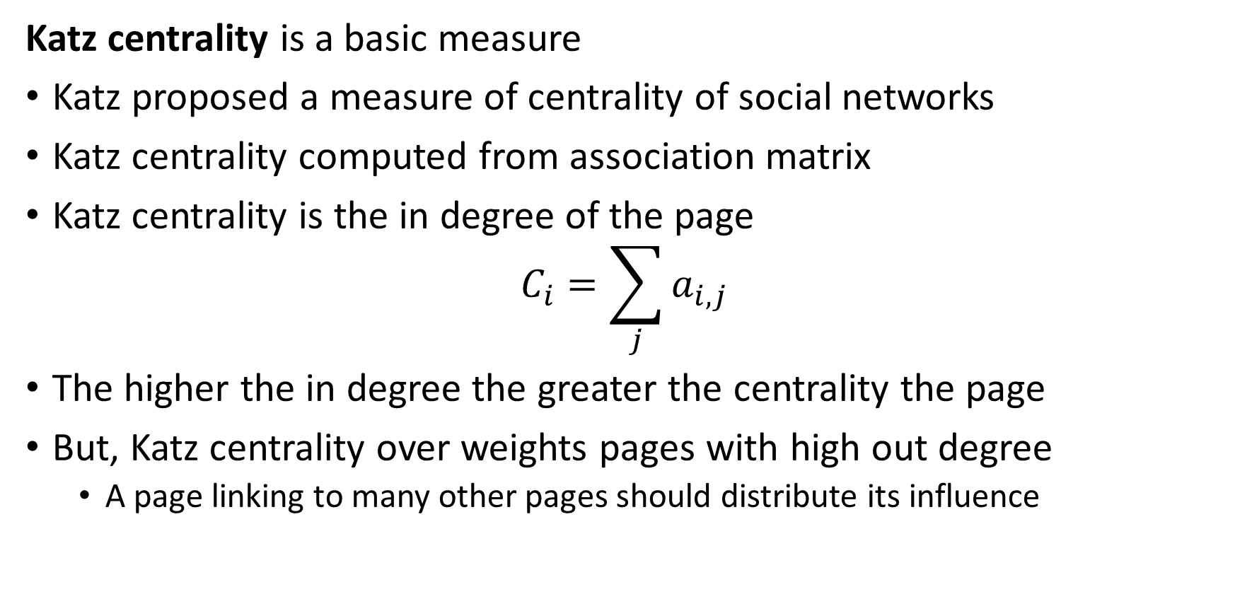
Measures of Centrality
Katz centrality is a basic measure
Katz proposed a measure of centrality of social networks
Katz centrality computed from association matrix
Katz centrality is the in degree of the page
$$C_{i}=\sum_{j}{a_{i,j}}$$
The higher the in degree the greater the centrality the page
But, Katz centrality over weights pages with high out degree
A page linking to many other pages should distribute its influence

Slide 48
Learning the Structure of the Web?
How can we learn the structure of the web?
Idea: randomly surf the web to discover links between pages
The surfer starts at a random page
Follows randomly chosen link out of page
Continues to follow random links from page to page
The probabilities of transitions into a page ranks the page’s importance
Assume high probability of landing on pages with many in-links
This is the basis of the PageRank algorithm
Is a steady state Markov processes!
PageRank is an unsupervised learning algorithm
Learns page importance without marked cases – no ground truth

Slide 49
Learning the Structure of the Web
Consider a small scale example
Pages are nodes of a directed graph
The directed edges represent hyperlinks from one page to another
The graph is complete - each page can be accessed by one or more steps from any other page
No self loops
No terminal nodes – dead ends
Transitions from one page to another on this graph represent a Markov process
Page 1
Page 3
Page 2
Page 4
Page 5

Slide 50
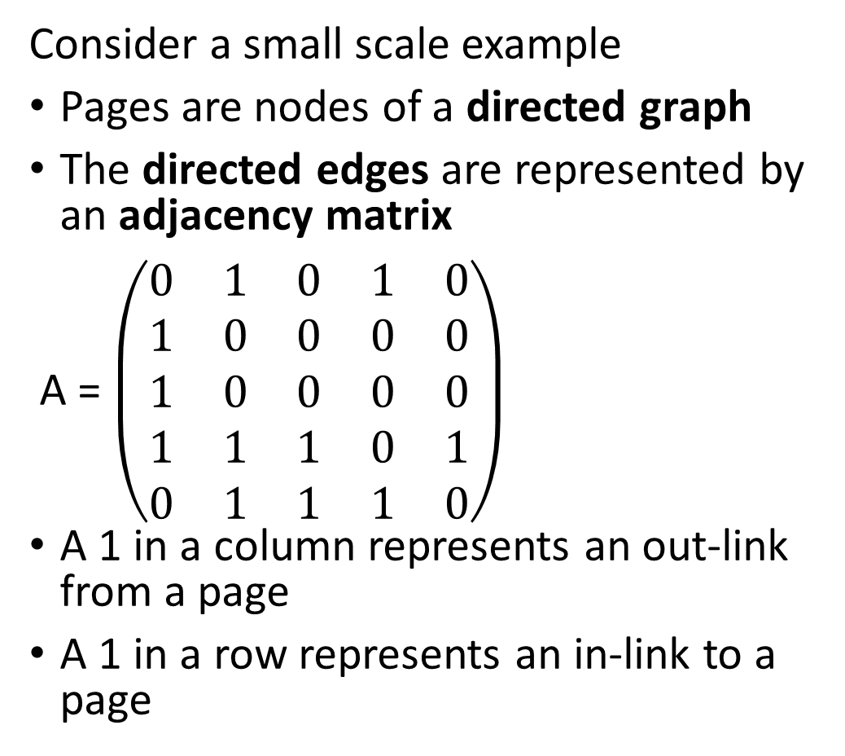
Learning the Structure of the Web
Consider a small scale example
Pages are nodes of a directed graph
The directed edges are represented by an adjacency matrix
A = $\left(\begin{matrix}0 & 1 & 0 & 1 & 0 \\ 1 & 0 & 0 & 0 & 0 \\ 1 & 0 & 0 & 0 & 0 \\ 1 & 1 & 1 & 0 & 1 \\ 0 & 1 & 1 & 1 & 0\end{matrix}\right)$
A 1 in a column represents an out-link from a page
A 1 in a row represents an in-link to a page
Page 1
Page 3
Page 2
Page 4
Page 5

Slide 51

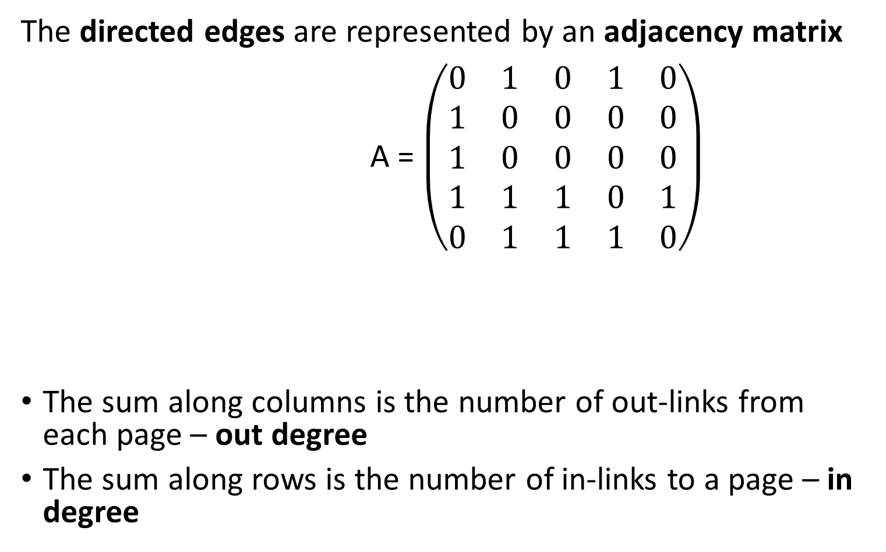

Learning the Structure of the Web
The directed edges are represented by an adjacency matrix
A = $\left(\begin{matrix}0 & 1 & 0 & 1 & 0 \\ 1 & 0 & 0 & 0 & 0 \\ 1 & 0 & 0 & 0 & 0 \\ 1 & 1 & 1 & 0 & 1 \\ 0 & 1 & 1 & 1 & 0\end{matrix}\right)$
The sum along columns is the number of out-links from each page – out degree
The sum along rows is the number of in-links to a page – in degree
$$\sum_{ rows}{=in degree}=\left(\begin{matrix}2 \\ 1 \\ 1 \\ 4 \\ 3\end{matrix}\right)$$
$$\sum_{columns}{=out degree}=\left(\begin{matrix}3 & 3 & 2 & 2 & 1\end{matrix}\right)$$

Slide 52
Simple PageRank Algorithm

Slide 53
Simple PageRank
Compute the PageRank of the complete graph of 5 web pages
Complete graph defines a stochastic Markov process
PageRank normalizes influence of out degree of page
Inverse out degree weight of page reduces influence of pages with large out degree
Distributes influence equally between pages linked
At convergence the probabilities of being on a page is its PageRank
Compute PageRank probabilities with a Markov chain
Known as the iterative PageRank algorithm
An efficient algorithm to find a first eigenvector

Slide 54
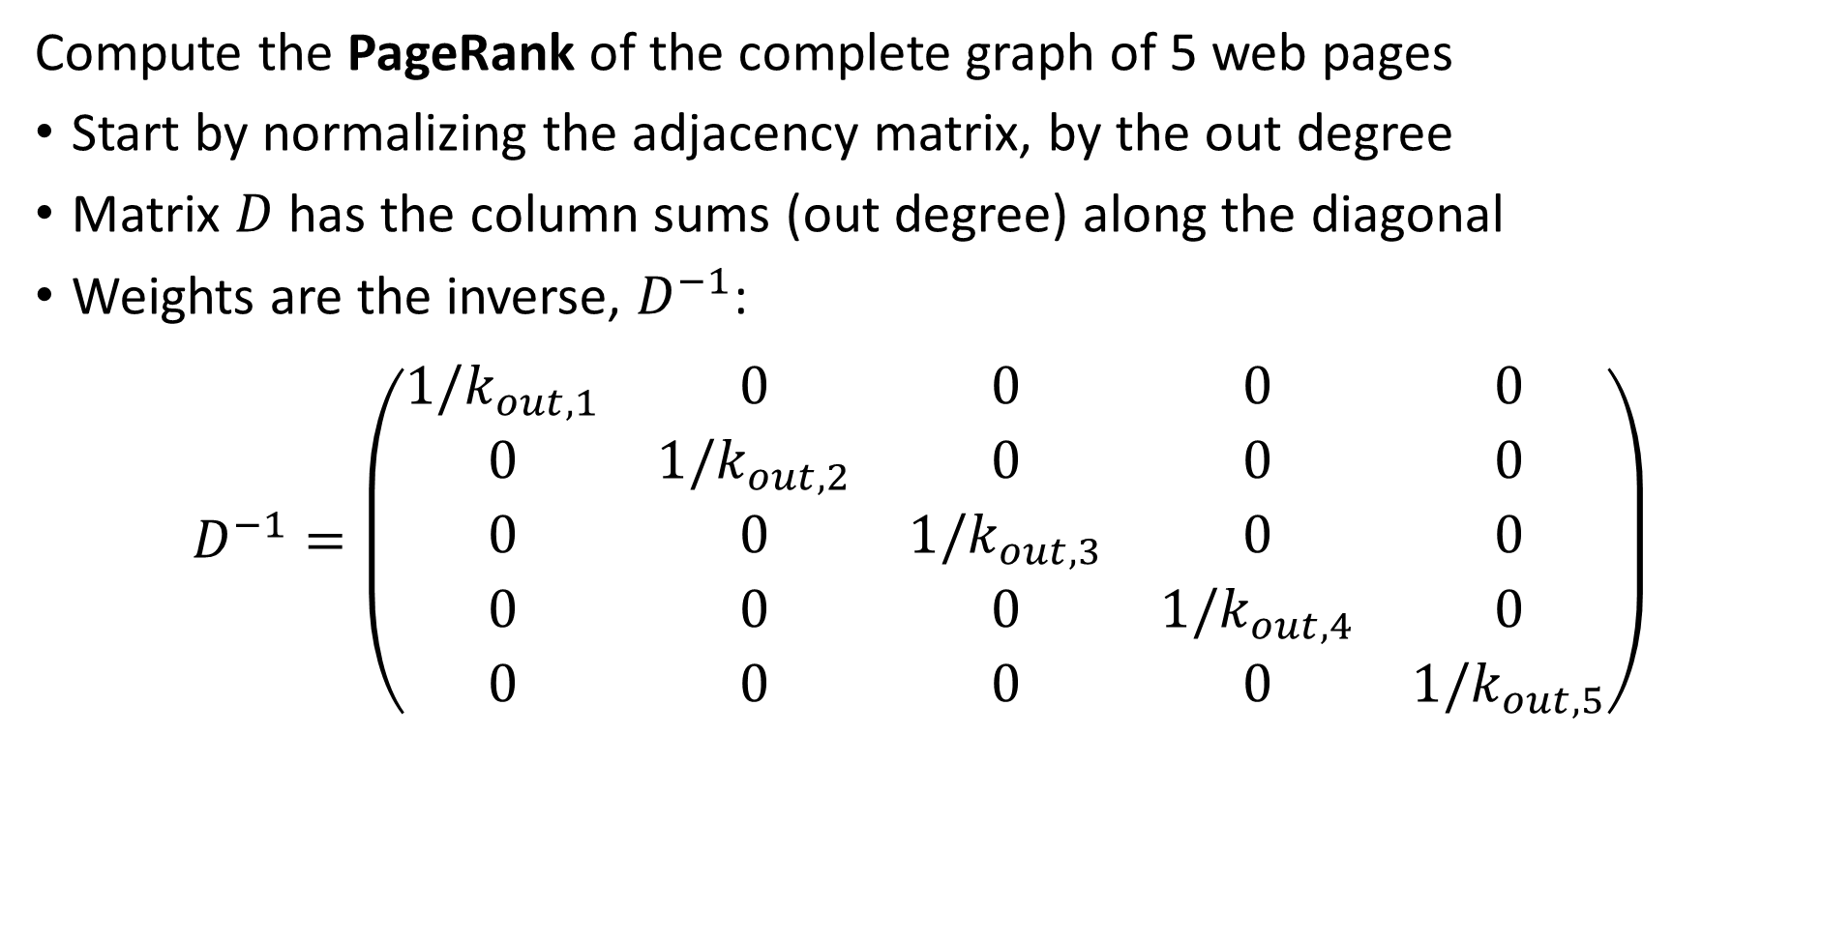
Simple PageRank
Compute the PageRank of the complete graph of 5 web pages
Start by normalizing the adjacency matrix, by the out degree
Matrix $D$ has the column sums (out degree) along the diagonal
Weights are the inverse, $D^{−1}$:
$$D^{−1}=\left(\begin{matrix}1/k_{out,1} & 0 & 0 & 0 & 0 \\ 0 & 1/k_{out,2} & 0 & 0 & 0 \\ 0 & 0 & 1/k_{out,3} & 0 & 0 \\ 0 & 0 & 0 & 1/k_{out,4} & 0 \\ 0 & 0 & 0 & 0 & 1/k_{out,5}\end{matrix}\right)$$

Slide 55
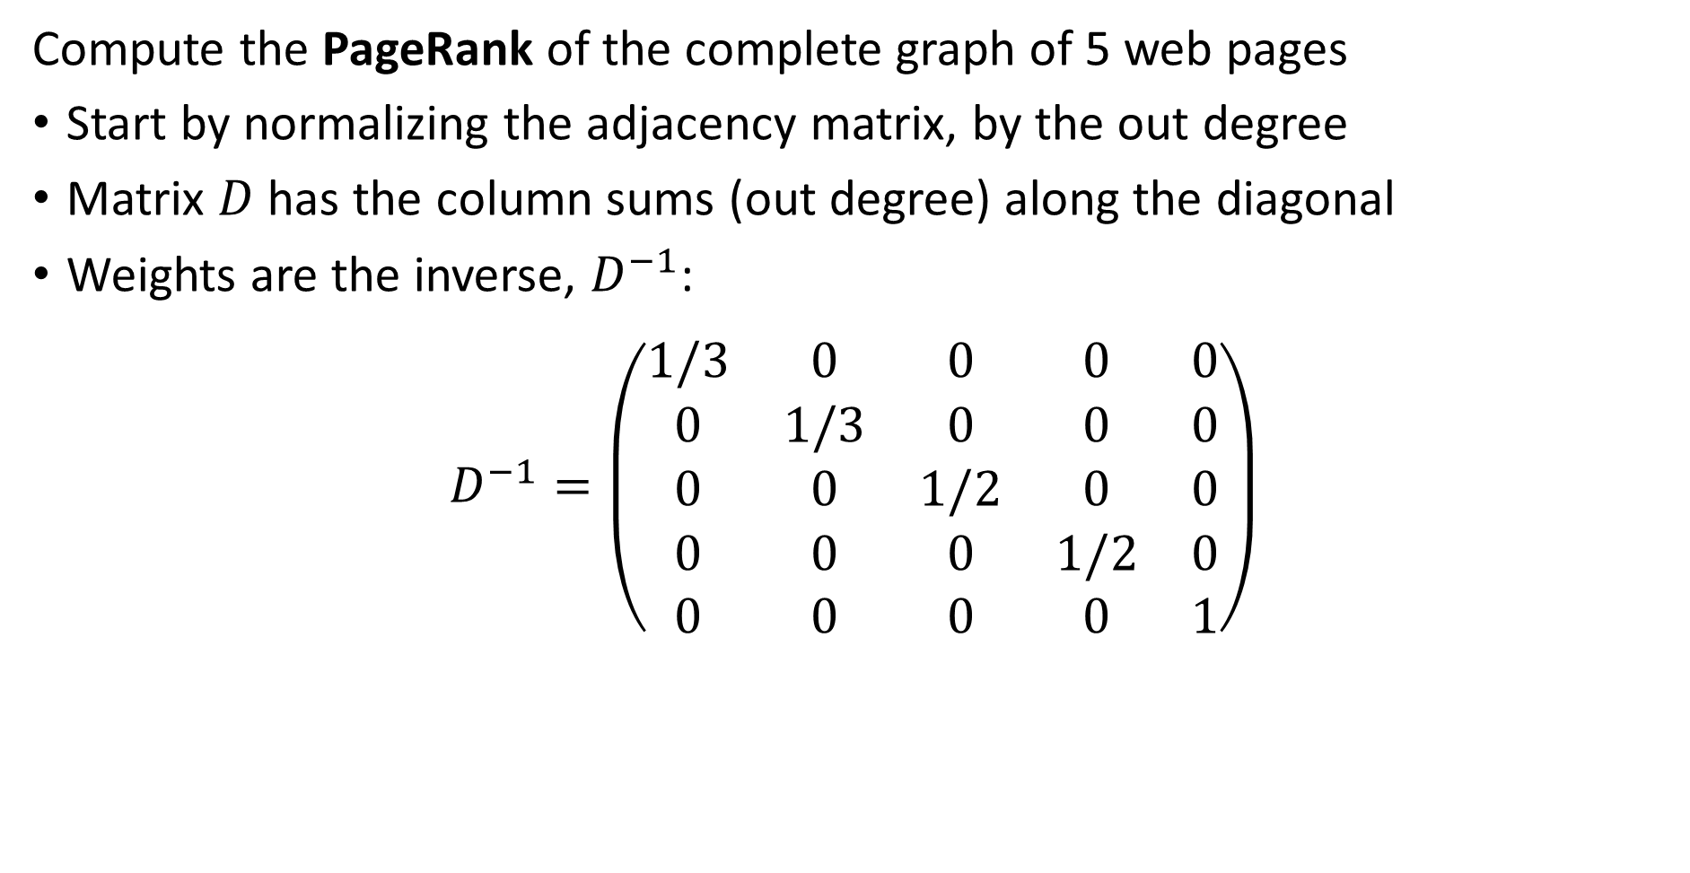
Simple PageRank
Compute the PageRank of the complete graph of 5 web pages
Start by normalizing the adjacency matrix, by the out degree
Matrix $D$ has the column sums (out degree) along the diagonal
Weights are the inverse, $D^{−1}$:
$$D^{−1}=\left(\begin{matrix}1/3 & 0 & 0 & 0 & 0 \\ 0 & 1/3 & 0 & 0 & 0 \\ 0 & 0 & 1/2 & 0 & 0 \\ 0 & 0 & 0 & 1/2 & 0 \\ 0 & 0 & 0 & 0 & 1\end{matrix}\right)$$

Slide 56
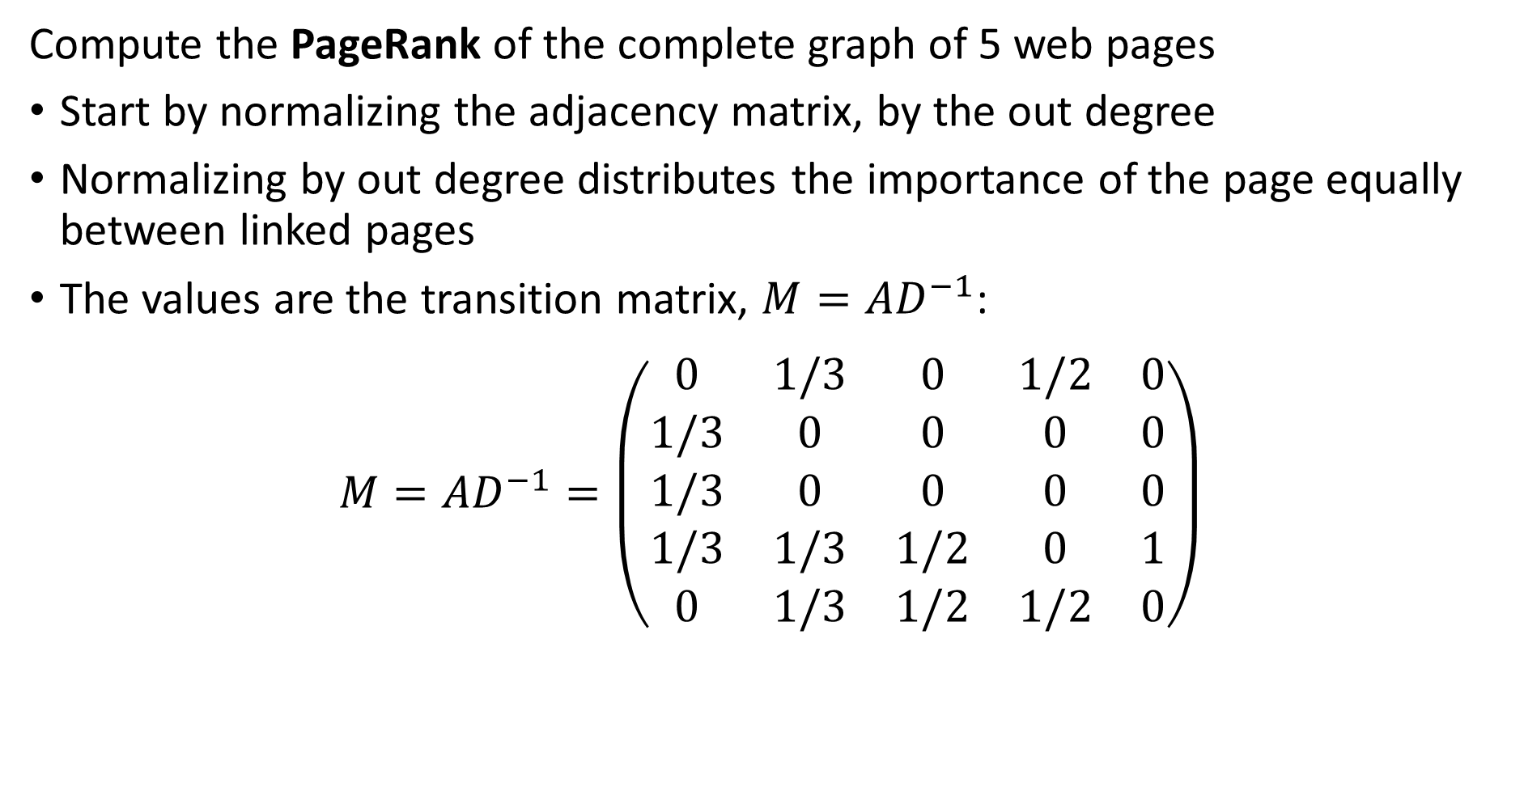
Simple PageRank
Compute the PageRank of the complete graph of 5 web pages
Start by normalizing the adjacency matrix, by the out degree
Normalizing by out degree distributes the importance of the page equally between linked pages
The values are the transition matrix, $M=AD^{−1}$:
$${M=AD}^{−1}=\left(\begin{matrix}0 & 1/3 & 0 & 1/2 & 0 \\ 1/3 & 0 & 0 & 0 & 0 \\ 1/3 & 0 & 0 & 0 & 0 \\ 1/3 & 1/3 & 1/2 & 0 & 1 \\ 0 & 1/3 & 1/2 & 1/2 & 0\end{matrix}\right)$$

Slide 57
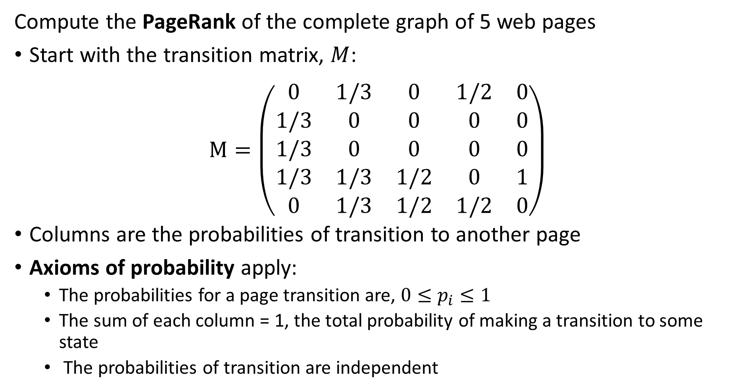
Simple PageRank
Compute the PageRank of the complete graph of 5 web pages
Start with the transition matrix, $M$:
$$M=\left(\begin{matrix}0 & 1/3 & 0 & 1/2 & 0 \\ 1/3 & 0 & 0 & 0 & 0 \\ 1/3 & 0 & 0 & 0 & 0 \\ 1/3 & 1/3 & 1/2 & 0 & 1 \\ 0 & 1/3 & 1/2 & 1/2 & 0\end{matrix}\right)$$
Columns are the probabilities of transition to another page
Axioms of probability apply:
The probabilities for a page transition are, $0≤p_{i}≤1$
The sum of each column = 1, the total probability of making a transition to some state
The probabilities of transition are independent

Slide 58
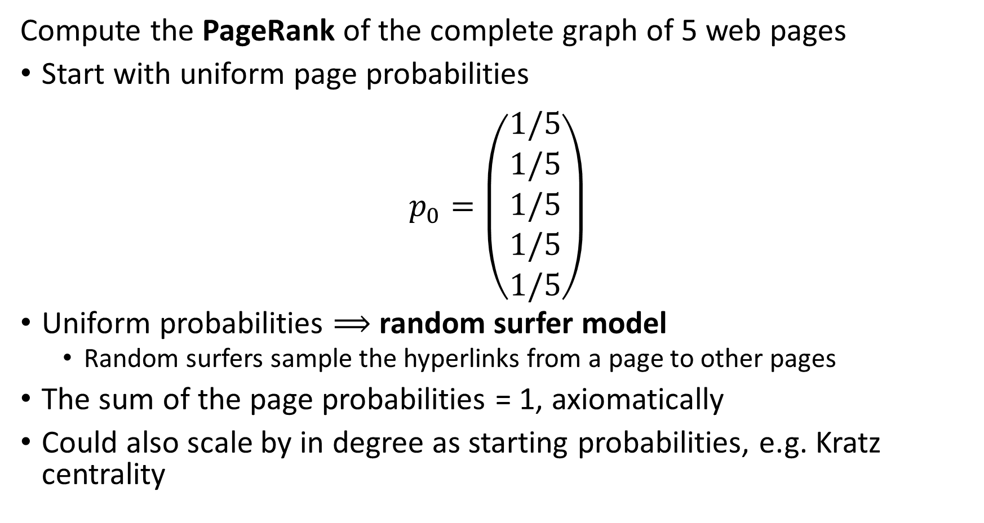
Simple PageRank
Compute the PageRank of the complete graph of 5 web pages
Start with uniform page probabilities
$$p_{0}=\left(\begin{matrix}1/5 \\ 1/5 \\ 1/5 \\ 1/5 \\ 1/5\end{matrix}\right)$$
Uniform probabilities $⟹$ random surfer model
Random surfers sample the hyperlinks from a page to other pages
The sum of the page probabilities = 1, axiomatically
Could also scale by in degree as starting probabilities, e.g. Kratz centrality

Slide 59
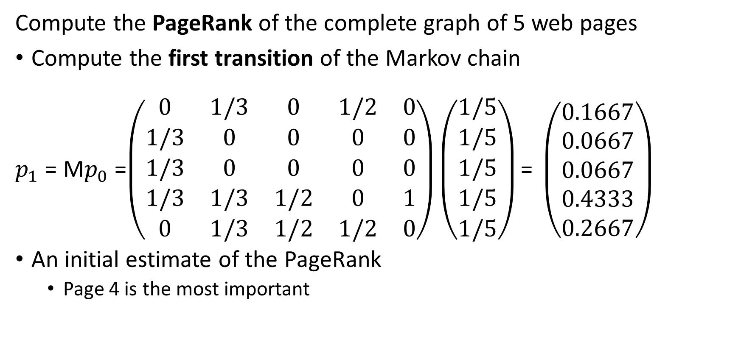
Simple PageRank
Compute the PageRank of the complete graph of 5 web pages
Compute the first transition of the Markov chain
$p_{1}$ = M$p_{0}$ =$\left(\begin{matrix}0 & 1/3 & 0 & 1/2 & 0 \\ 1/3 & 0 & 0 & 0 & 0 \\ 1/3 & 0 & 0 & 0 & 0 \\ 1/3 & 1/3 & 1/2 & 0 & 1 \\ 0 & 1/3 & 1/2 & 1/2 & 0\end{matrix}\right)\left(\begin{matrix}1/5 \\ 1/5 \\ 1/5 \\ 1/5 \\ 1/5\end{matrix}\right)\text{= }\left(\begin{matrix}0.1667 \\ 0.0667 \\ 0.0667 \\ 0.4333 \\ 0.2667\end{matrix}\right)$
An initial estimate of the PageRank
Page 4 is the most important

Slide 60
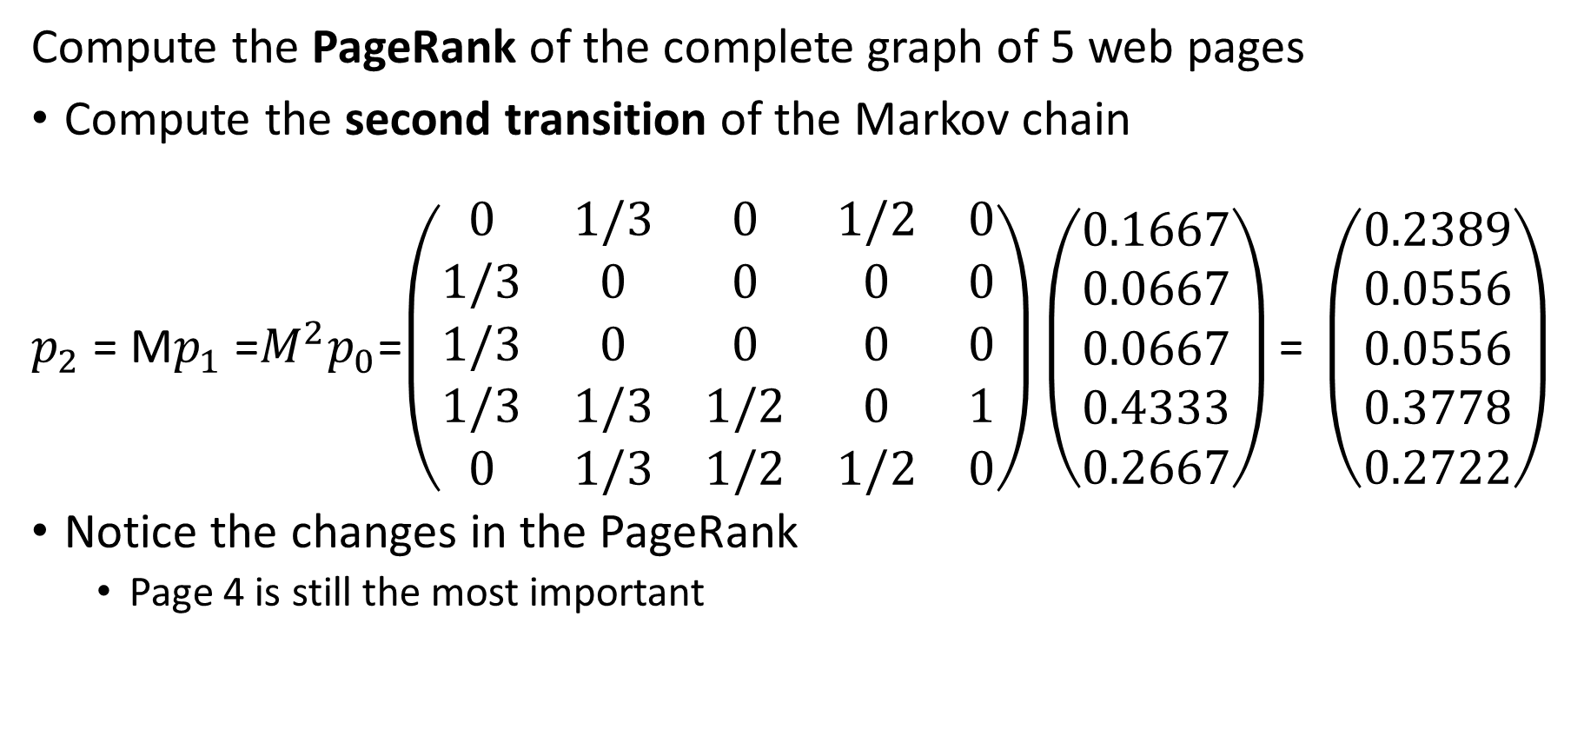
Simple PageRank
Compute the PageRank of the complete graph of 5 web pages
Compute the second transition of the Markov chain
$p_{2}$ = M$p_{1}$ =$M^{2}p_{0}$=$\left(\begin{matrix}0 & 1/3 & 0 & 1/2 & 0 \\ 1/3 & 0 & 0 & 0 & 0 \\ 1/3 & 0 & 0 & 0 & 0 \\ 1/3 & 1/3 & 1/2 & 0 & 1 \\ 0 & 1/3 & 1/2 & 1/2 & 0\end{matrix}\right)\left(\begin{matrix}0.1667 \\ 0.0667 \\ 0.0667 \\ 0.4333 \\ 0.2667\end{matrix}\right)\text{= }\left(\begin{matrix}0.2389 \\ 0.0556 \\ 0.0556 \\ 0.3778 \\ 0.2722\end{matrix}\right)$
Notice the changes in the PageRank
Page 4 is still the most important

Slide 61
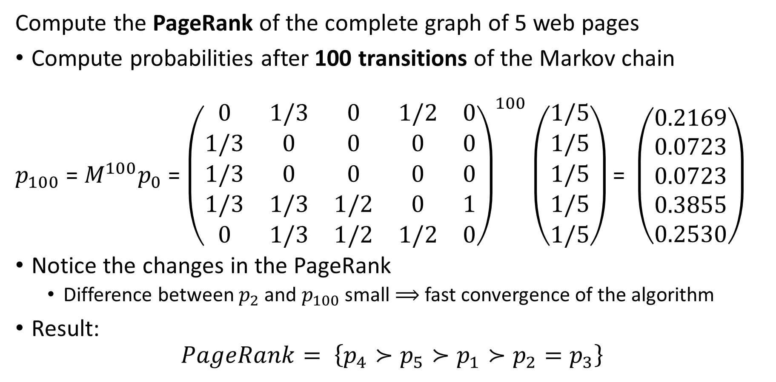
Simple PageRank
Compute the PageRank of the complete graph of 5 web pages
Compute probabilities after 100 transitions of the Markov chain
$p_{100}$ = $M^{100}p_{0}$ = ${\left(\begin{matrix}0 & 1/3 & 0 & 1/2 & 0 \\ 1/3 & 0 & 0 & 0 & 0 \\ 1/3 & 0 & 0 & 0 & 0 \\ 1/3 & 1/3 & 1/2 & 0 & 1 \\ 0 & 1/3 & 1/2 & 1/2 & 0\end{matrix}\right)}^{100}\left(\begin{matrix}1/5 \\ 1/5 \\ 1/5 \\ 1/5 \\ 1/5\end{matrix}\right)\text{= }\left(\begin{matrix}0.2169 \\ 0.0723 \\ 0.0723 \\ 0.3855 \\ 0.2530\end{matrix}\right)$
Notice the changes in the PageRank
Difference between $p_{2}$ and $p_{100}$ small $⟹$ fast convergence of the algorithm
Result:
$$PageRank= \left\{p_{4}≻p_{5}≻p_{1}≻p_{2}=p_{3}\right\}$$

Slide 62
Damped PageRank

Slide 63
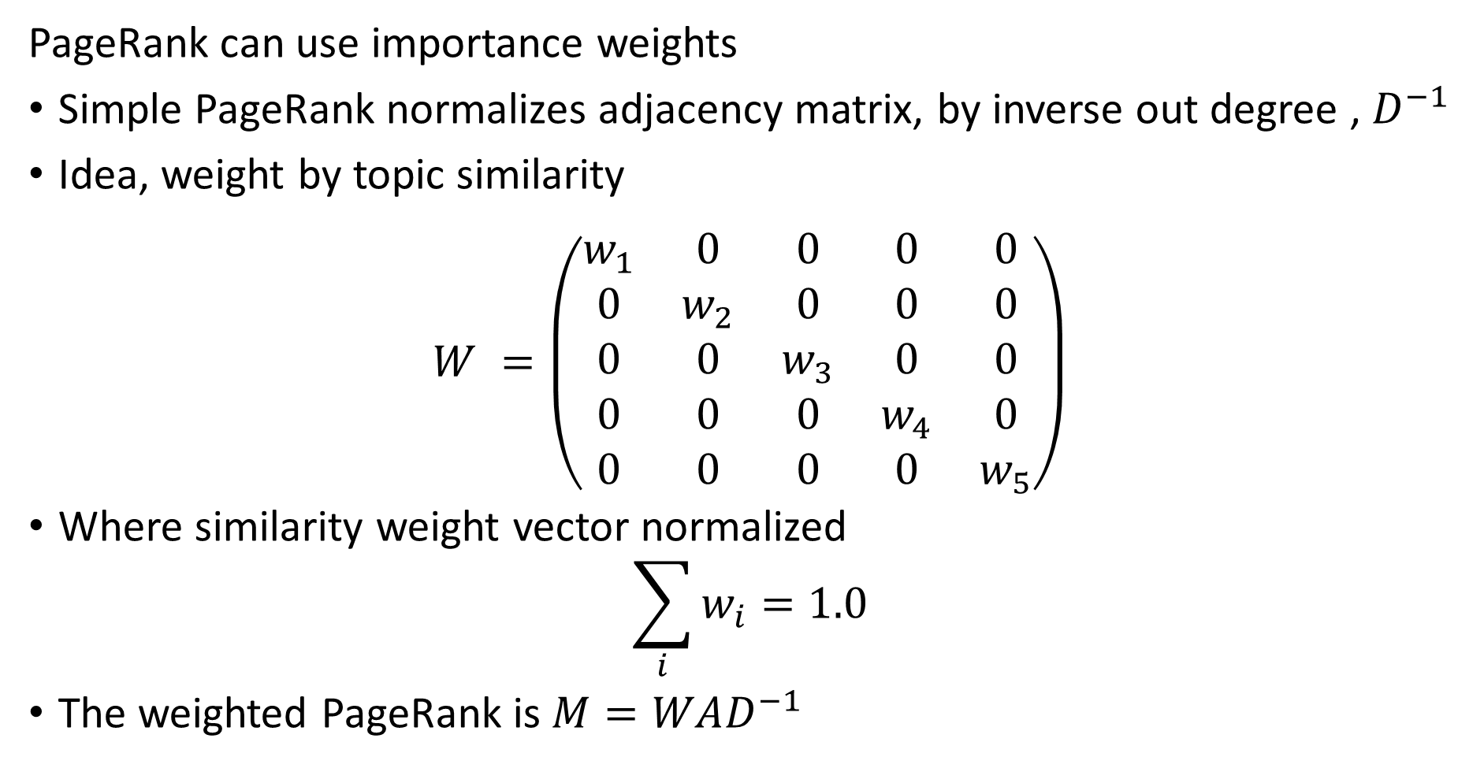
Weights for PageRank
PageRank can use importance weights
Simple PageRank normalizes adjacency matrix, by inverse out degree , $D^{−1}$
Idea, weight by topic similarity
$$W^{ }=\left(\begin{matrix}w_{1} & 0 & 0 & 0 & 0 \\ 0 & w_{2} & 0 & 0 & 0 \\ 0 & 0 & w_{3} & 0 & 0 \\ 0 & 0 & 0 & w_{4} & 0 \\ 0 & 0 & 0 & 0 & w_{5}\end{matrix}\right)$$
Where similarity weight vector normalized
$$\sum_{i}^{ }{w_{i}=1.0}$$
The weighted PageRank is $M=WAD^{−1}$

Slide 64
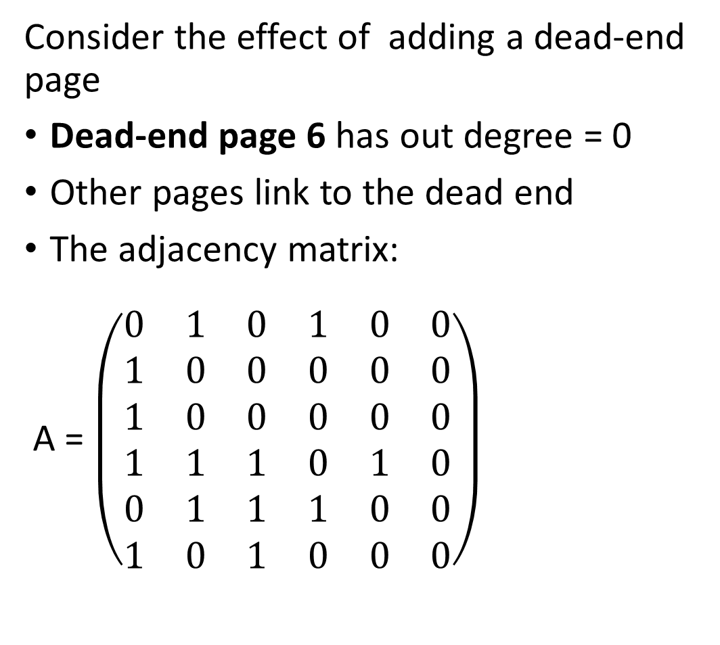
Damped PageRank
Page 6
Consider the effect of adding a dead-end page
Dead-end page 6 has out degree = 0
Other pages link to the dead end
The adjacency matrix:
A = $\left(\begin{matrix}0 & 1 & 0 & 1 & 0 & 0 \\ 1 & 0 & 0 & 0 & 0 & 0 \\ 1 & 0 & 0 & 0 & 0 & 0 \\ 1 & 1 & 1 & 0 & 1 & 0 \\ 0 & 1 & 1 & 1 & 0 & 0 \\ 1 & 0 & 1 & 0 & 0 & 0\end{matrix}\right)$
Page 1
Page 3
Page 2
Page 4
Page 5

Slide 65
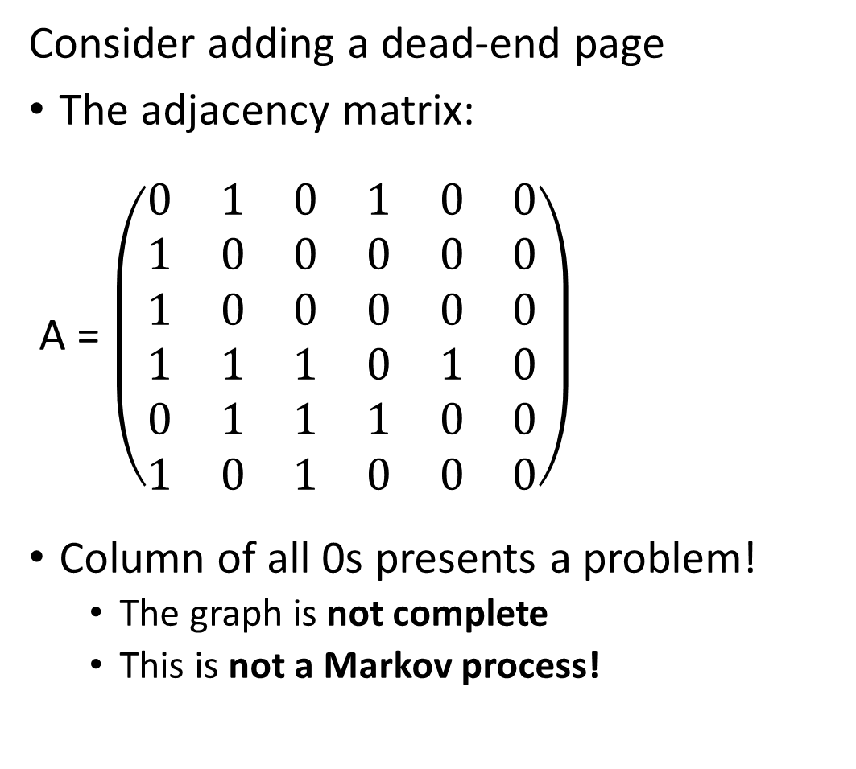
Damped PageRank
Page 6
Consider adding a dead-end page
The adjacency matrix:
A = $\left(\begin{matrix}0 & 1 & 0 & 1 & 0 & 0 \\ 1 & 0 & 0 & 0 & 0 & 0 \\ 1 & 0 & 0 & 0 & 0 & 0 \\ 1 & 1 & 1 & 0 & 1 & 0 \\ 0 & 1 & 1 & 1 & 0 & 0 \\ 1 & 0 & 1 & 0 & 0 & 0\end{matrix}\right)$
Column of all 0s presents a problem!
The graph is not complete
This is not a Markov process!
Page 1
Page 3
Page 2
Page 4
Page 5

Slide 66
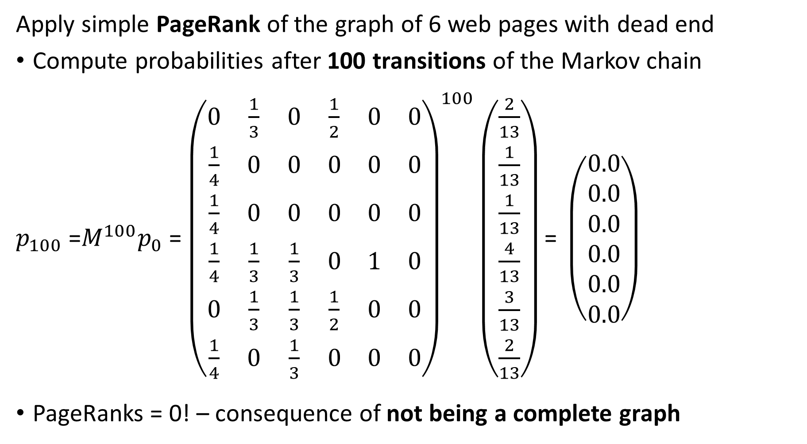
Damped PageRank
Apply simple PageRank of the graph of 6 web pages with dead end
Compute probabilities after 100 transitions of the Markov chain
$p_{100}$ =$M^{100}p_{0}$ = ${\left(\begin{matrix}0 & \frac{1}{3} & 0 & \frac{1}{2} & 0 & 0 \\ \frac{1}{4} & 0 & 0 & 0 & 0 & 0 \\ \frac{1}{4} & 0 & 0 & 0 & 0 & 0 \\ \frac{1}{4} & \frac{1}{3} & \frac{1}{3} & 0 & 1 & 0 \\ 0 & \frac{1}{3} & \frac{1}{3} & \frac{1}{2} & 0 & 0 \\ \frac{1}{4} & 0 & \frac{1}{3} & 0 & 0 & 0\end{matrix}\right)}^{100}\left(\begin{matrix}\frac{2}{13} \\ \frac{1}{13} \\ \frac{1}{13} \\ \frac{4}{13} \\ \frac{3}{13} \\ \frac{2}{13}\end{matrix}\right)\text{= }\left(\begin{matrix}0.0 \\ 0.0 \\ 0.0 \\ 0.0 \\ 0.0 \\ 0.0\end{matrix}\right)$
PageRanks = 0! – consequence of not being a complete graph

Slide 67
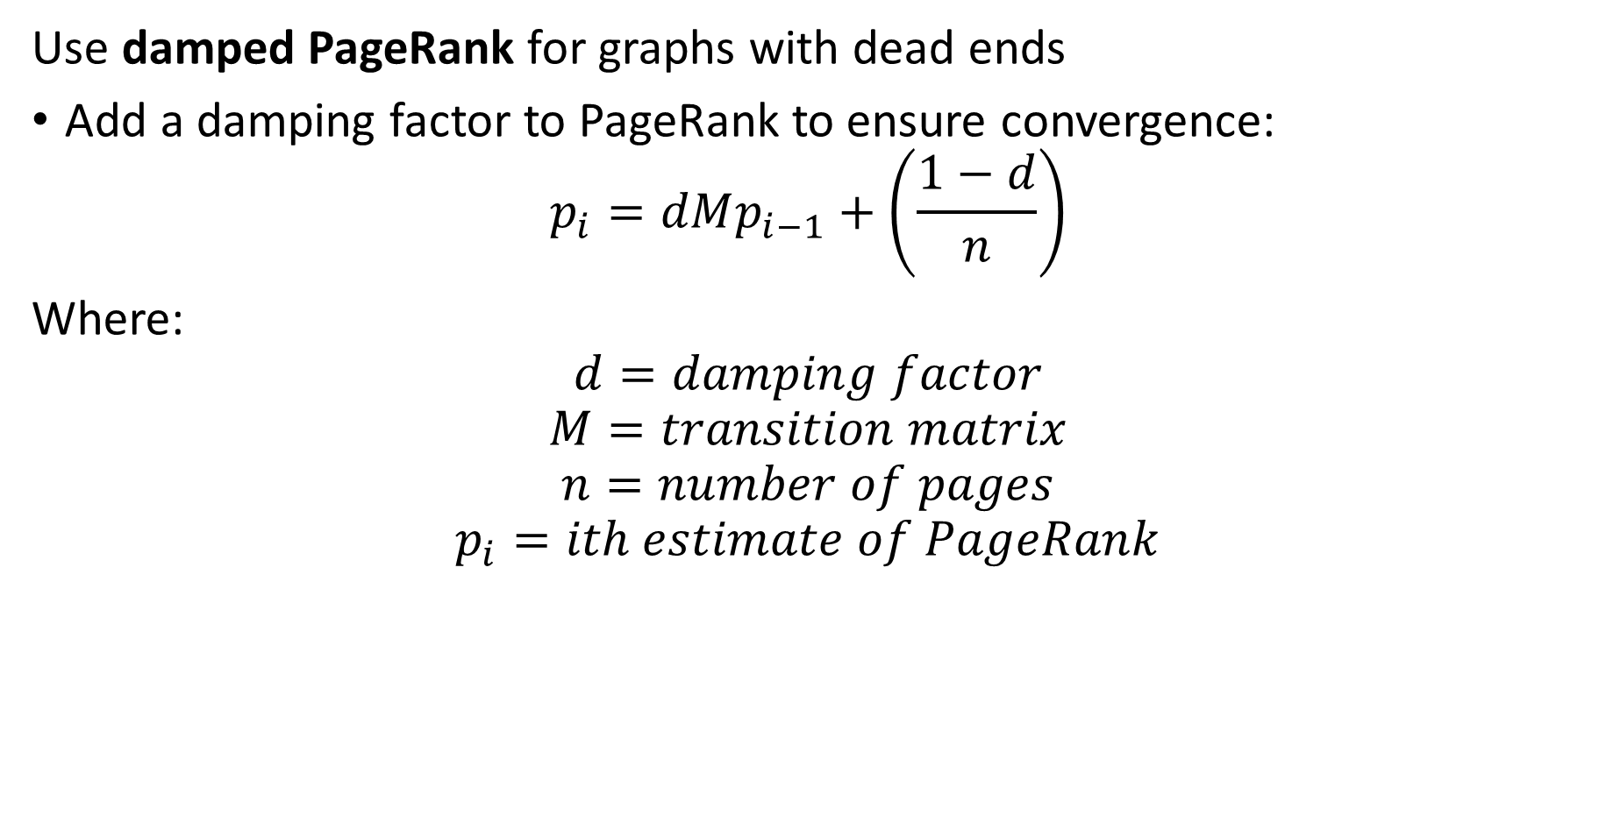
Damped PageRank
Use damped PageRank for graphs with dead ends
Add a damping factor to PageRank to ensure convergence:
$$p_{i}=dMp_{i−1}+\left(\frac{1−d}{n}\right)$$
Where:
$$d=damping factor$$
$$M=transition matrix$$
$$n=number of pages$$
$$p_{i}=ith estimate of PageRank$$

Slide 68
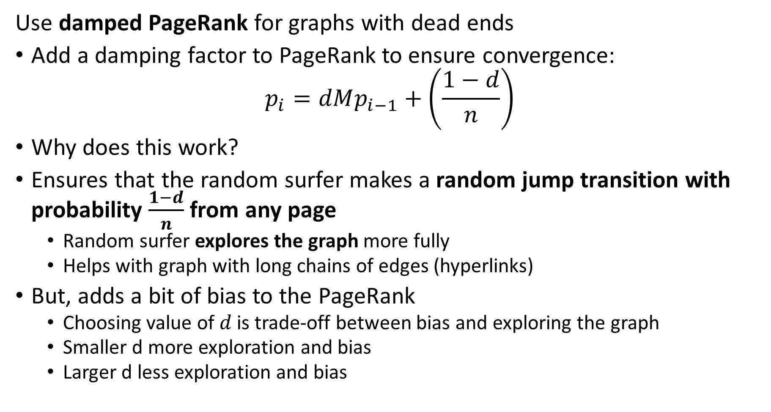
Damped PageRank
Use damped PageRank for graphs with dead ends
Add a damping factor to PageRank to ensure convergence:
$$p_{i}=dMp_{i−1}+\left(\frac{1−d}{n}\right)$$
Why does this work?
Ensures that the random surfer makes a random jump transition with probability $\frac{1−d}{n}$ from any page
Random surfer explores the graph more fully
Helps with graph with long chains of edges (hyperlinks)
But, adds a bit of bias to the PageRank
Choosing value of $d$ is trade-off between bias and exploring the graph
Smaller d more exploration and bias
Larger d less exploration and bias

Slide 69
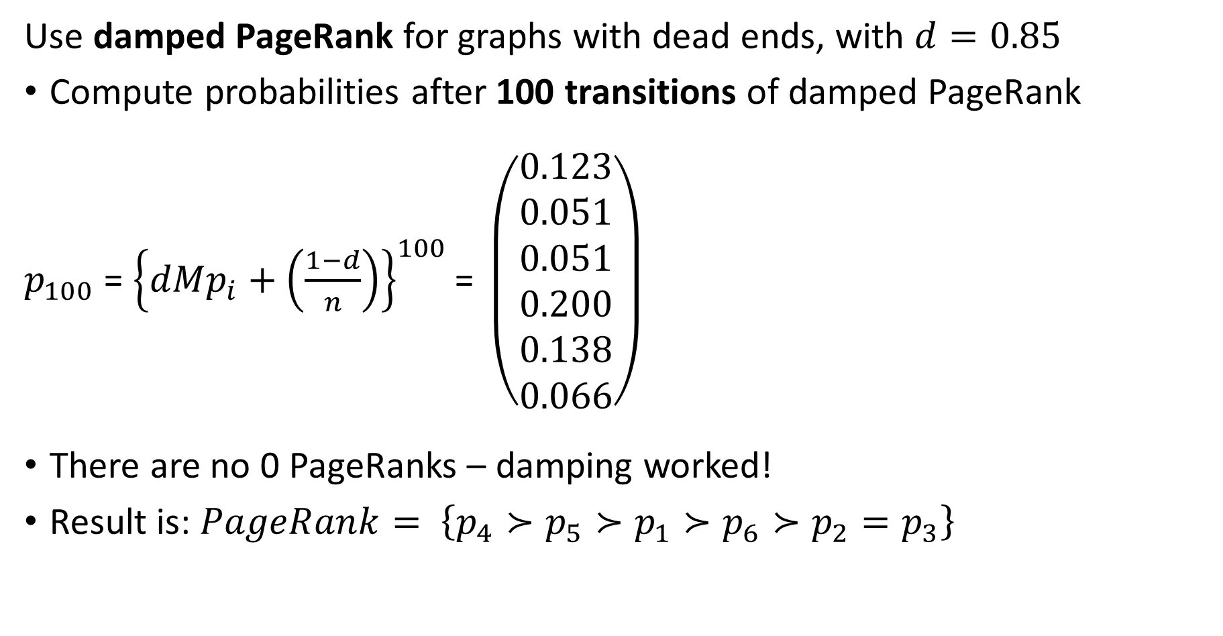
Damped PageRank
Use damped PageRank for graphs with dead ends, with $d=0.85$
Compute probabilities after 100 transitions of damped PageRank
$p_{100}$ = ${\left\{dMp_{i}+\left(\frac{1−d}{n}\right)\right\}}^{100}\text{= }\left(\begin{matrix}0.123 \\ 0.051 \\ 0.051 \\ 0.200 \\ 0.138 \\ 0.066\end{matrix}\right)$
There are no 0 PageRanks – damping worked!
Result is: $PageRank= \left\{p_{4}≻p_{5}≻p_{1}≻p_{6}≻p_{2}=p_{3}\right\}$

Slide 70
Damped Page Rank
Page 7
Consider the effect of adding a spider trap to the network
Nodes in the spider trap have no paths to other nodes.
Random surfer is trapped on these nodes
Effect is same as dead end
Use damped page rank to allow jumps out of trap
Page 8
Page 6
Page 3
Page 1
Page 4
Page 2
Page 5

Slide 71
TrustRank

Slide 72
Trust Rank
Are all pages of equal importance in a search?
No!
Some pages are more trusted
Pages known to have reliable content
Pages with higher topic relevance to query
We want to weight our search to account for trust of page
Leads to the trust rank algorithm
We can use the same algorithm for topic relevance weights
From autoencoder, LLM, etc

Slide 73
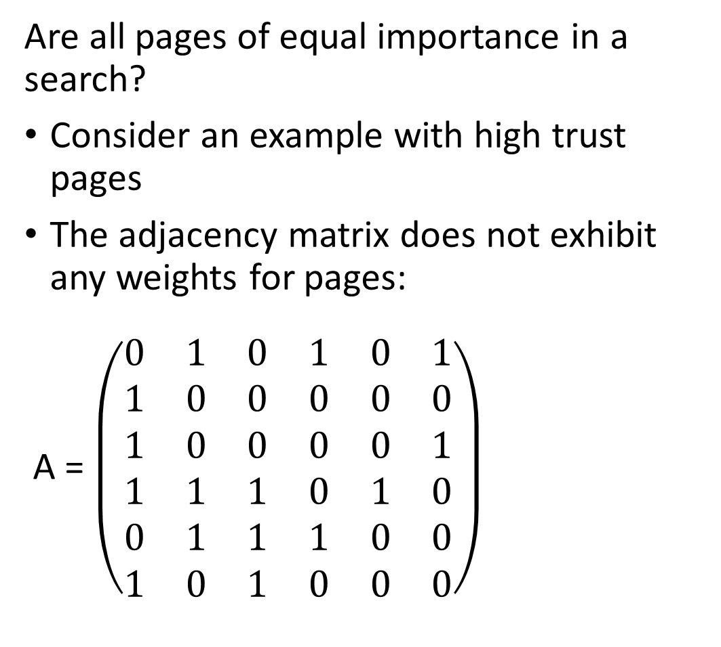
Trust Rank
Page 6
Are all pages of equal importance in a search?
Consider an example with high trust pages
The adjacency matrix does not exhibit any weights for pages:
A = $\left(\begin{matrix}0 & 1 & 0 & 1 & 0 & 1 \\ 1 & 0 & 0 & 0 & 0 & 0 \\ 1 & 0 & 0 & 0 & 0 & 1 \\ 1 & 1 & 1 & 0 & 1 & 0 \\ 0 & 1 & 1 & 1 & 0 & 0 \\ 1 & 0 & 1 & 0 & 0 & 0\end{matrix}\right)$
Page 1
Page 3
Page 2
Page 4
Page 5

Slide 74
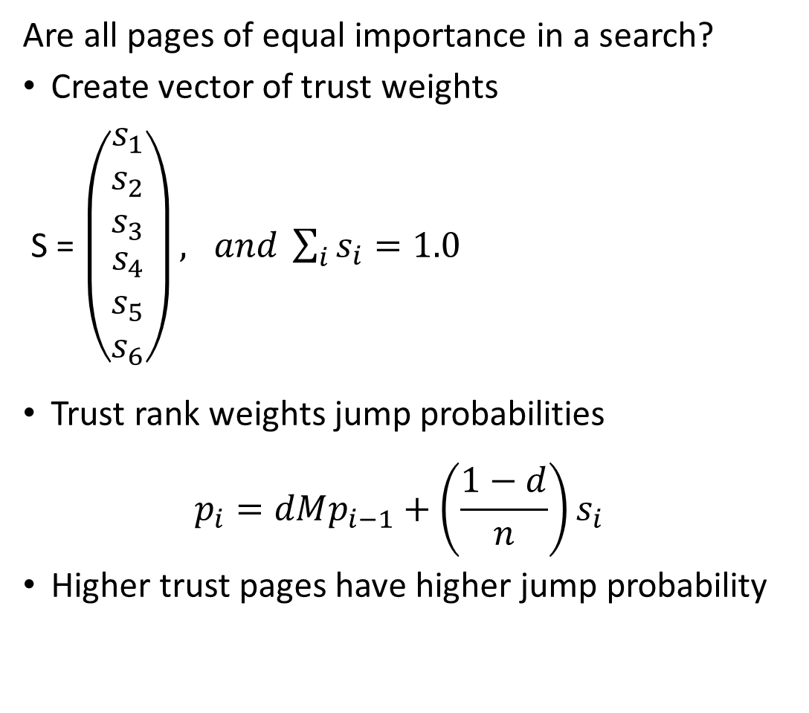
Trust Rank
Page 6
Are all pages of equal importance in a search?
Create vector of trust weights
S = $\left(\begin{matrix}\begin{matrix}s_{1} \\ s_{2} \\ s_{3}\end{matrix} \\ \begin{matrix}s_{4} \\ s_{5} \\ s_{6}\end{matrix}\end{matrix}\right), and \sum_{i}{s_{i}=1.0}$
Trust rank weights jump probabilities
$$p_{i}=dMp_{i−1}+\left(\frac{1−d}{n}\right)s_{i}$$
Higher trust pages have higher jump probability
Page 1
Page 3
Page 2
Page 4
Page 5

Slide 75
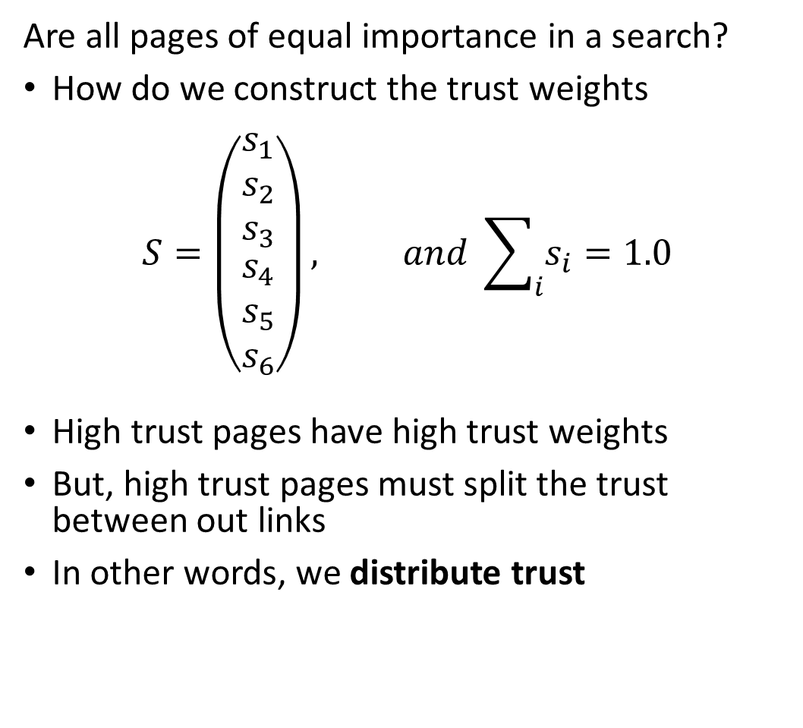
Trust Rank
Page 6
Are all pages of equal importance in a search?
How do we construct the trust weights
$$S=\left(\begin{matrix}\begin{matrix}s_{1} \\ s_{2} \\ s_{3}\end{matrix} \\ \begin{matrix}s_{4} \\ s_{5} \\ s_{6}\end{matrix}\end{matrix}\right), and \sum_{i}{s_{i}=1.0}$$
High trust pages have high trust weights
But, high trust pages must split the trust between out links
In other words, we distribute trust
Page 1
Page 3
Page 2
Page 4
Page 5

Slide 76
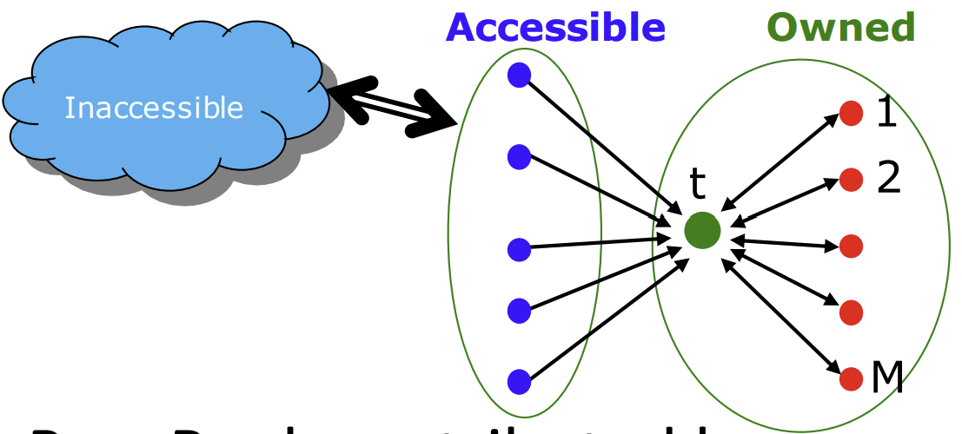
Trust Rank
Web SPAM is a significant problem for search engines
Owners of web pages want to artificially boost the importance
So called search engine optimization (SOE) is employed to boost page importance
This leads to web SPAM!
Owner of page creates other pages linked to page and uses accessible pages like social media to boost importance
Leskovec and Kanatsoulis, Standford CS 246, 2024

Slide 77
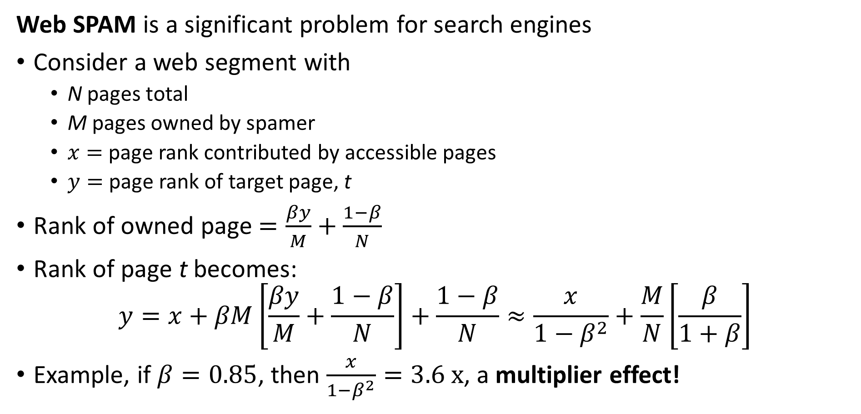
Trust Rank
Web SPAM is a significant problem for search engines
Consider a web segment with
N pages total
M pages owned by spamer
$x=$ page rank contributed by accessible pages
$y=$ page rank of target page, t
Rank of owned page $=\frac{βy}{M}+\frac{1−β}{N}$
Rank of page t becomes:
$$y=x+βM\left[\frac{βy}{M}+\frac{1−β}{N}\right]+\frac{1−β}{N}≈\frac{x}{1−β^{2}}+\frac{M}{N}\left[\frac{β}{1+β}\right]$$
Example, if $β=0.85$, then $\frac{x}{1−β^{2}}=3.6 x$, a multiplier effect!
Leskovec and Kanatsoulis, Standford CS 246, 2024

Slide 78
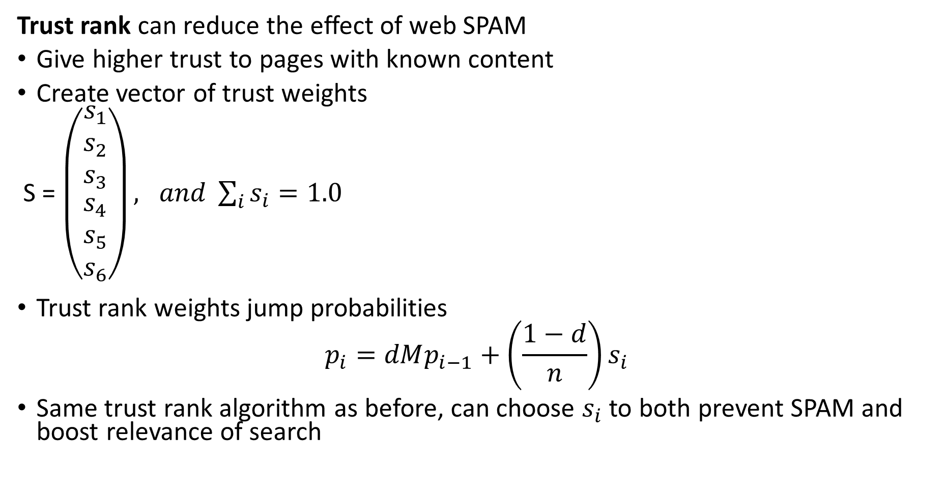
Trust Rank
Trust rank can reduce the effect of web SPAM
Give higher trust to pages with known content
Create vector of trust weights
S = $\left(\begin{matrix}\begin{matrix}s_{1} \\ s_{2} \\ s_{3}\end{matrix} \\ \begin{matrix}s_{4} \\ s_{5} \\ s_{6}\end{matrix}\end{matrix}\right), and \sum_{i}{s_{i}=1.0}$
Trust rank weights jump probabilities
$$p_{i}=dMp_{i−1}+\left(\frac{1−d}{n}\right)s_{i}$$
Same trust rank algorithm as before, can choose $s_{i}$ to both prevent SPAM and boost relevance of search
Leskovec and Kanatsoulis, Standford CS 246, 2024

Slide 79
Scaling PageRank

Slide 80
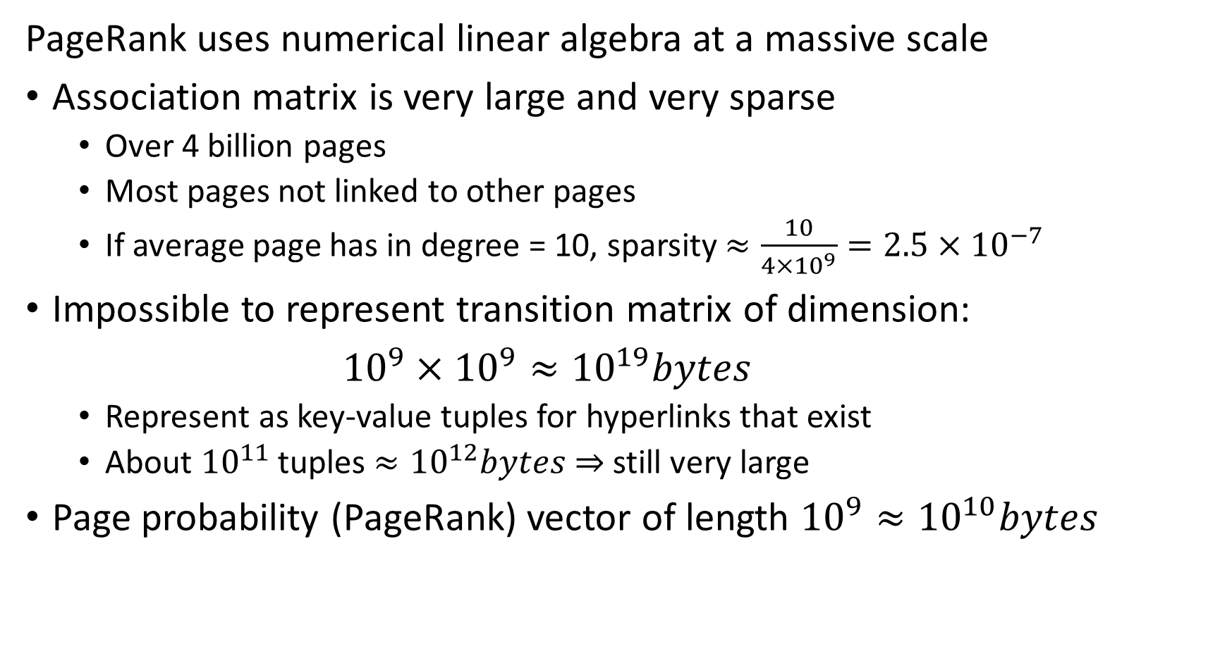
Scaling PageRank
PageRank uses numerical linear algebra at a massive scale
Association matrix is very large and very sparse
Over 4 billion pages
Most pages not linked to other pages
If average page has in degree = 10, sparsity $≈\frac{10}{4×{10}^{9}}=2.5×{10}^{−7}$
Impossible to represent transition matrix of dimension:
${10}^{9}×{10}^{9}≈{10}^{19}bytes$
Represent as key-value tuples for hyperlinks that exist
About ${10}^{11}$ tuples $≈{10}^{12}bytes$ $⇒$ still very large
Page probability (PageRank) vector of length ${10}^{9}≈{10}^{10}bytes$

Slide 81
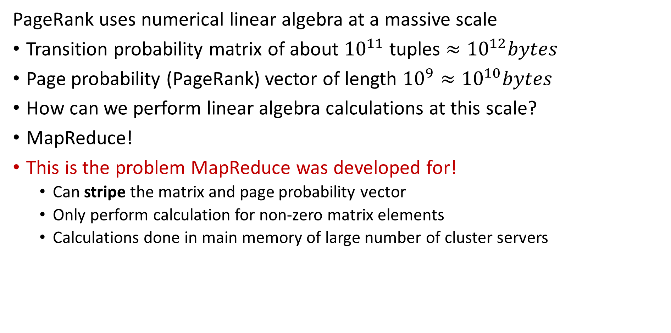
Scaling PageRank
PageRank uses numerical linear algebra at a massive scale
Transition probability matrix of about ${10}^{11}$ tuples $≈{10}^{12}bytes$
Page probability (PageRank) vector of length ${10}^{9}≈{10}^{10}bytes$
How can we perform linear algebra calculations at this scale?
MapReduce!
This is the problem MapReduce was developed for!
Can stripe the matrix and page probability vector
Only perform calculation for non-zero matrix elements
Calculations done in main memory of large number of cluster servers

Slide 82
Hubs and Authorities, the HITS Algorithm

Slide 83
HITS Algorithm
HITS algorithm is an alternative to PageRank
PageRank is a weighted measure of page centrality
Alternative is to compute hub and authority scores for each web page
Hub score represents how a page directs to other pages
Direct readers to informative pages
Hub pages have many outgoing links
Measure of trust
Authority score represents the value of information on a page
Considered authoritative source
Pages with high authority are linked from many pages
Measure of trust
HITS algorithm useful for other applications
e.g. citation networks

Slide 84
HITS Algorithm
Examples of hub and authority model:
Searching for a course to take
Department or program web site is hub with links to courses, but no information on courses
Course pages are the authorizes, containing specific information on courses
Searching research papers
Review articles are hubs with references to authorities
Original papers contain the authoritative information
But, the review paper, hub, can also act as an authority

Slide 85
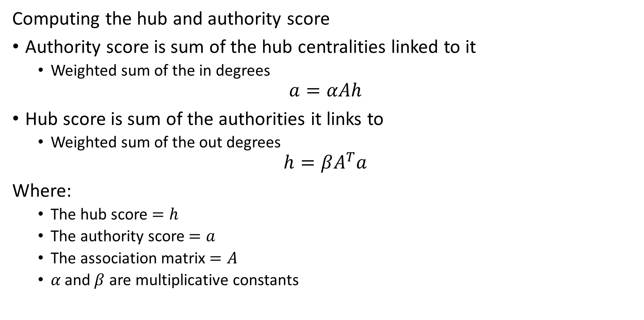
HITS Algorithm
Computing the hub and authority score
Authority score is sum of the hub centralities linked to it
Weighted sum of the in degrees
$$a=αAh$$
Hub score is sum of the authorities it links to
Weighted sum of the out degrees
$$h=βA^{T}a$$
Where:
The hub score $=h$
The authority score $=a$
The association matrix $=A$
$α \text{and} β$ are multiplicative constants

Slide 86
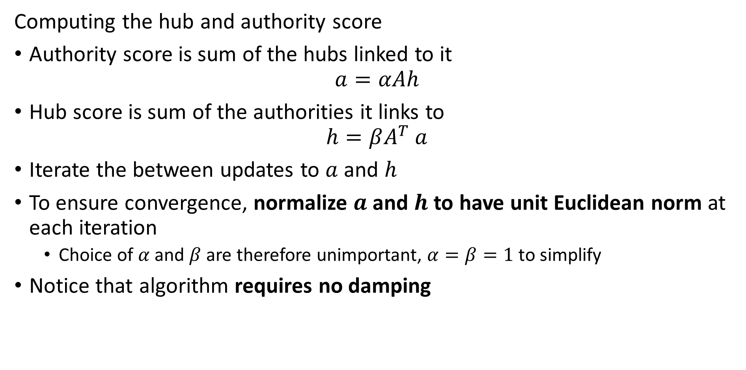
HITS Algorithm
Computing the hub and authority score
Authority score is sum of the hubs linked to it
$$a=αAh$$
Hub score is sum of the authorities it links to
$$h=βA^{T} a$$
Iterate the between updates to $a$ and $h$
To ensure convergence, normalize $a$ and $h$ to have unit Euclidean norm at each iteration
Choice of $α$ and $β$ are therefore unimportant, $α=β=1$ to simplify
Notice that algorithm requires no damping

Slide 87
Lesson Summary
Overview of graph theory and web search
Introduction to the web search problem
First overview of graph theory
Introduction to Markov processes and random walks
Structure of the web
The PageRank algorithm
Damped PageRank
TrustRank algorithm
HITS algorithm to rank hubs and authorities
Not just for web search

