Slide 1

CSCI E-108 Data Mining, Discovery and Exploration Big Data Analytic Algorithms
Steve Elston
Copyright 2021, 2022, 2023, 2004, Stephen F Elston. All rights reserved.

Slide 2
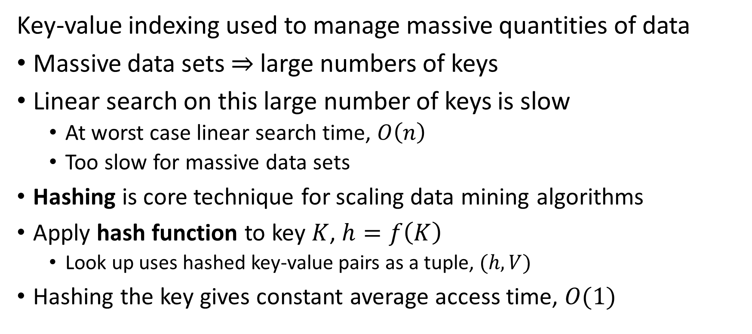
Review: K-V Pairs and Hashing
Key-value indexing used to manage massive quantities of data
Massive data sets $⇒$ large numbers of keys
Linear search on this large number of keys is slow
At worst case linear search time, $O\left(n\right)$
Too slow for massive data sets
Hashing is core technique for scaling data mining algorithms
Apply hash function to key $K$, $h=f\left(K\right)$
Look up uses hashed key-value pairs as a tuple, $(h,V)$
Hashing the key gives constant average access time, $O(1)$

Slide 3
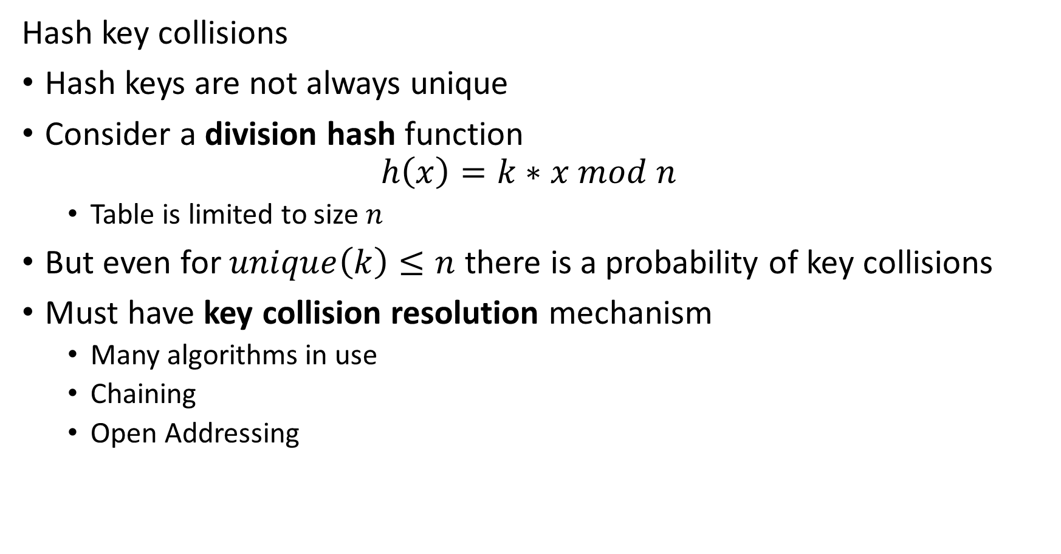
Review: Hash Collisions
Hash key collisions
Hash keys are not always unique
Consider a division hash function
$$h\left(x\right)=k∗x mod n$$
Table is limited to size $n$
But even for $unique\left(k\right)≤n$ there is a probability of key collisions
Must have key collision resolution mechanism
Many algorithms in use
Chaining
Open Addressing

Slide 4
Review: Hypothesis Testing
Steps in hypothesis testing
State you hypothesis; Example:
$H_{0}$, null hypothesis: there is no difference in the means of the population
$H_{a}$, alternative hypothesis: there is a significant difference in the means of the population
State a significance level, $α$
The probability of a false positive test we will accept – A Type I error
The lower the significance level the higher the probability of not rejecting the null – A Type II error
Select an appropriate test
Compute the test statistic and evaluate the result

Slide 5
Review: Large-Scale Comparison Methods
False discovery rate (FDR) control methods
FDR control methods limit the false positive rate (Type I errors)
Want to limit Type II errors – non-discovery
Statistical methods
Bonferroni correction
Holm’s method
Benjamini-Hochberg FDR control
Sampling based methods
Example: use mini-hashing sampling
We will discuss later
Notes:
The cu

Slide 6
Large Scale Analytic Computing
Scalable computing for mining massive datasets
Dataset size and complexity growing rapidly with time
Scalable computing required for analytics at massive scale
What are the limitations for scaling analytics?
Computing speed?
Main memory size?
File system size?
Network bandwidth?
Note: much of the subject discussed here falls under data engineering which is not the focal point of our course

Slide 7
Large Scale Analytics Computing
Computing speed
Historically, computing speed was a significant limitation
Computing capacity has increased massively
Parallel computing well established by 1980s
Cost of computing has dropped exponentially
1980 – about $100,000 per MFLOP
2020 – about $0.10 per MFLOP
Introduction of cluster and cloud computing in 2000’s
Massive on-demand capacity now available economically
1000s of CPU in cluster
For properly designed analytics algorithms computing speed is rarely a limitation now days

Slide 8
Large Scale Analytic Computing
Main memory size
Working (main) memory still a limitation on analytics algorithms
Memory costs and speeds have changed dramatically with time
1980s - $1000 per MB, 10 MHz bus speed
2020 - $0.01 per MB, 3 GHz bus speed
But, data set sizes have grown faster!
Main memory requirement remains a limitation of analytic algorithms

Slide 9
Large Scale Analytic Computing
File system size
File systems have grown to accommodate massive dataset size
Disk cost has changed dramatically, but seek time has not kept pace
1980s - $100 per MB, average 20 ms seek time
2020 - $0.0001 per MB, average 2 ms seek time
Disks in the file system are the mostly likely to component to fail in a cluster
Disk transfer rate is about 200 MB/sec
Slow compared to bus speed
Large scale analytic algorithms need to limit disk access

Slide 10
Large Scale Analytic Computing
Network bandwidth
Clusters of servers connected by networks
Network interconnected by switches
Network bandwidth is limited and has increased slowly
1980s – 10 Mbits/sec
2010 – 1,000 Mbits/sec
2023 – 100,000 Mbits/sec
Network bandwidth is shared across cluster
Scalable analytic algorithms must limit network communications

Slide 11
Large Scale Analytic Computing
What limits scalability of clusters?
Communications bandwidth between servers in cluster is greatest limitation
Disk access is next greatest limitation
Component | Capacity and Speed | Comment
CPU | Massively Scalable | Multiple cores per server Many servers in cluster
Main memory | Fast, but limited size | Shared with multiple cores
File system | Massive capacity, but slow | High failure rate
Network | Limited bandwidth | Shared across cluster

Slide 12
Large Scale Analytic Computing
Long history of large scale analytic computing
Parallel and cluster computing developed starting in 1980s
Around 1980 the Teradata platform became available
1983 Connection Machine employed up to 1024 CPUs
Algorithms resembled MapReduce of the 21st Century
In 21st Century massive clusters of identical servers become common
Google’s MapReduce algorithm (Dean and Ghemawat 2004) represented a significant step in employing massive clusters
Workflow architectures followed shortly thereafter
Theano platform (Bergstra et.al. 2010) first released 2006
Spark is a widely used and flexible workflow platform (Zaharia, et.al. 2010)
TensorFlow is a widely used workflow framework for linear algebra calculations (Abadi, et al. 2016)
And many others…

Slide 13
Cluster Computing
Simple model of cluster architecture distributes computing across many (thousands) of severs
Servers comprise
Central processors (CPUs)
Main memory (RAM)
Persistent memory (Disk)
Servers are interconnected by network (switches)
We need to distribute the computing load across the servers in the cluster
Algorithms must balance the load across servers

Slide 14
Cluster Computing
Cluster architecture distributes computing across many (thousands) of severs
Switch: 2-100 Gbps, rack interconnect backbone
Switch: 10 Gbps within rack
Switch: 10 Gbps within rack
CPU
CPU
CPU
CPU
Mem
…
Mem
Mem
…
Mem
Disk
Disk
Disk
Disk

Slide 15
Cluster Computing
Cluster architecture distributes computing across many (thousands) of severs
Reliability is significant problem in cluster computing
Disk (mechanical) is most likely to fail
Servers and entire racks fail
Switch failure leaves part of the cluster isolated
Jobs may run for hours or days
Must be able to recover from failures without restarting a job
Use redundant storage of intermediate results
Recomputing some results may be required for recovery

Slide 16
Distributed File Systems
Distributed file systems (DFS) are a widely used example of failure resistant persistent storage
A DFS maintains redundant copies of intermediate computed results
Redundant storage requires additional space
DFS incurs overhead – use only when needed
In the event of a partial failure of a cluster, the DFS provides a roll-back point to restart a calculation
Example: Hadoop Distributed File System (HDFS)
Widely used, not just with Hadoop
Several other DFS in common use
Cloud services all use a DFS; AWS, Azure, Google Cloud…

Slide 17
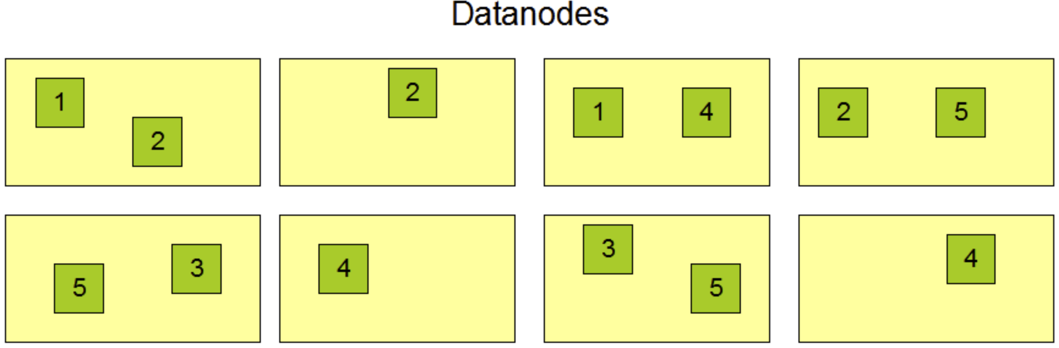
Distributed File Systems
Distributed file systems (DFS) are a widely used example of failure resistant persistent storage
Blocks of memory (64 or 128 MB) are randomly replicated across data nodes
Can restart calculations if partial failure of cluster
Credit: Apache Hadoop HDFS Architecture Guide

Slide 18
Map Reduce Algorithm
MapReduce is a basis for many large scale analytics algorithms
Cluster computing architectures require that we do the following:
Split the data into manageable chunks
Apply some transformation to the data
Combine or aggregate the results
A number of large scale analytic architectures use the split-apply-combine paradigm
MapReduce (Dean and Ghemawat, 2004) is a specific example of a split-apply-combine process operating on key-value pairs

Slide 19
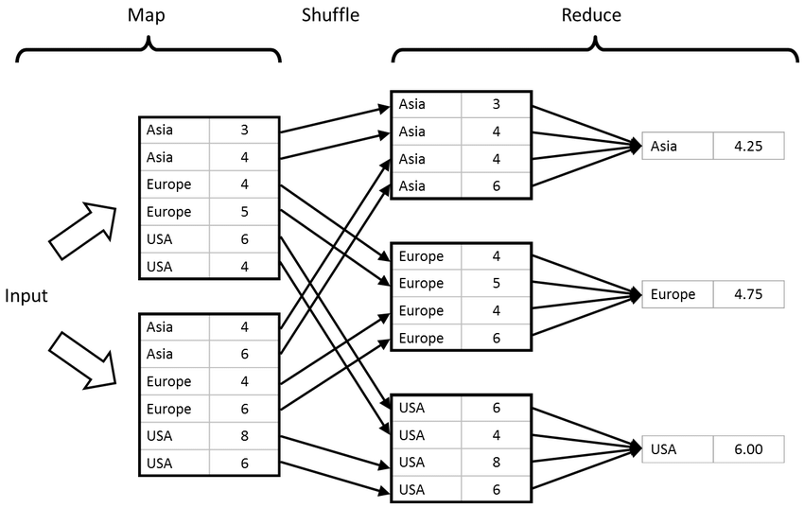
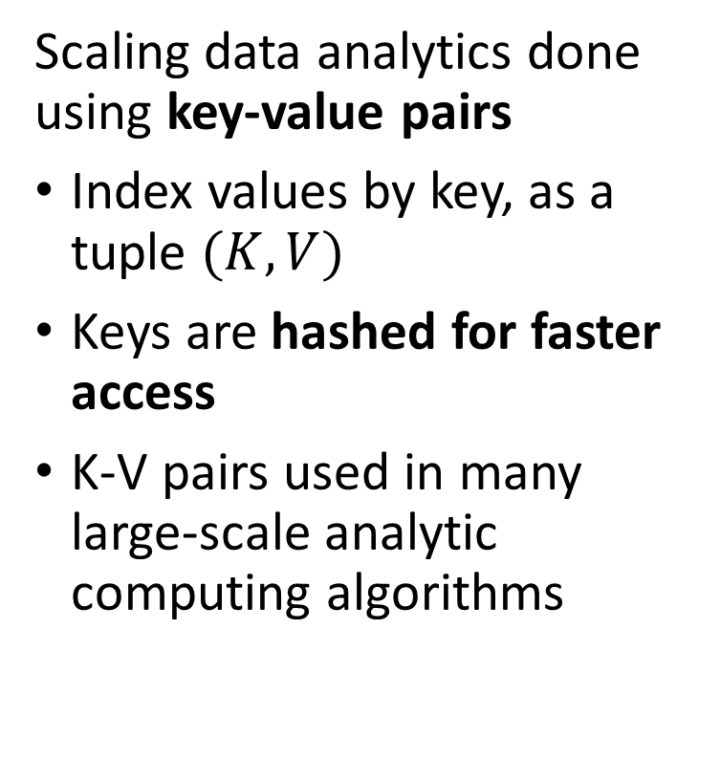
Map Reduce Algorithm
MapReduce is a basis for many large scale analytics algorithms
Scaling data analytics done using key-value pairs
Index values by key, as a tuple $(K,V)$
Keys are hashed for faster access
K-V pairs used in many large-scale analytic computing algorithms
Credit: Im, et. al., 2013

Slide 20
Map Reduce Algorithm
MapReduce is a basis for many large scale analytics algorithms
Basic steps for MapReduce
Input key-value pairs
Map process transforms and sorts (optionally) the key-value pairs
Shuffle groups by key
Reduce process aggregates by key
Find more details in the Apache MapReduce tutorial
Credit: Im, et. al., 2013

Slide 21
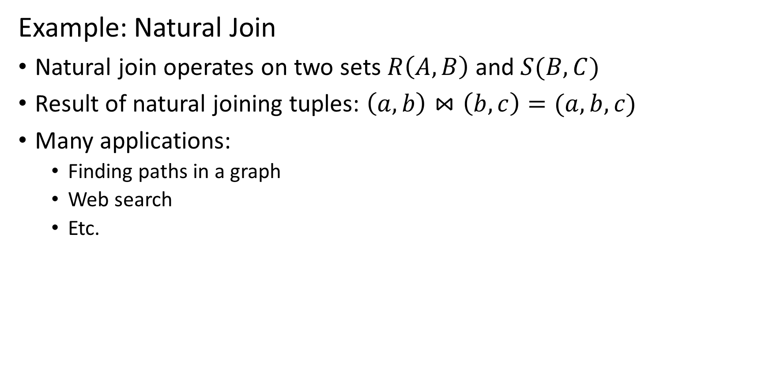
Map Reduce Algorithm
Example: Natural Join
Natural join operates on two sets $R\left(A,B\right)$ and $S(B,C)$
Result of natural joining tuples: $\left(a,b\right)⋈\left(b,c\right)=(a,b,c)$
Many applications:
Finding paths in a graph
Web search
Etc.

Slide 22
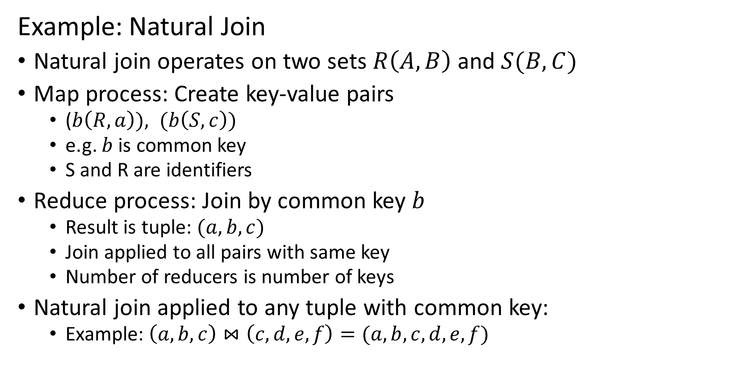
Map Reduce Algorithm
Example: Natural Join
Natural join operates on two sets $R\left(A,B\right)$ and $S(B,C)$
Map process: Create key-value pairs
($b\left(R,a\right)), (b\left(S,c\right))$
e.g. $b$ is common key
S and R are identifiers
Reduce process: Join by common key $b$
Result is tuple: $(a,b,c)$
Join applied to all pairs with same key
Number of reducers is number of keys
Natural join applied to any tuple with common key:
Example: $\left(a,b,c\right)⋈\left(c, d, e, f\right)=(a,b,c, d, e,f)$

Slide 23
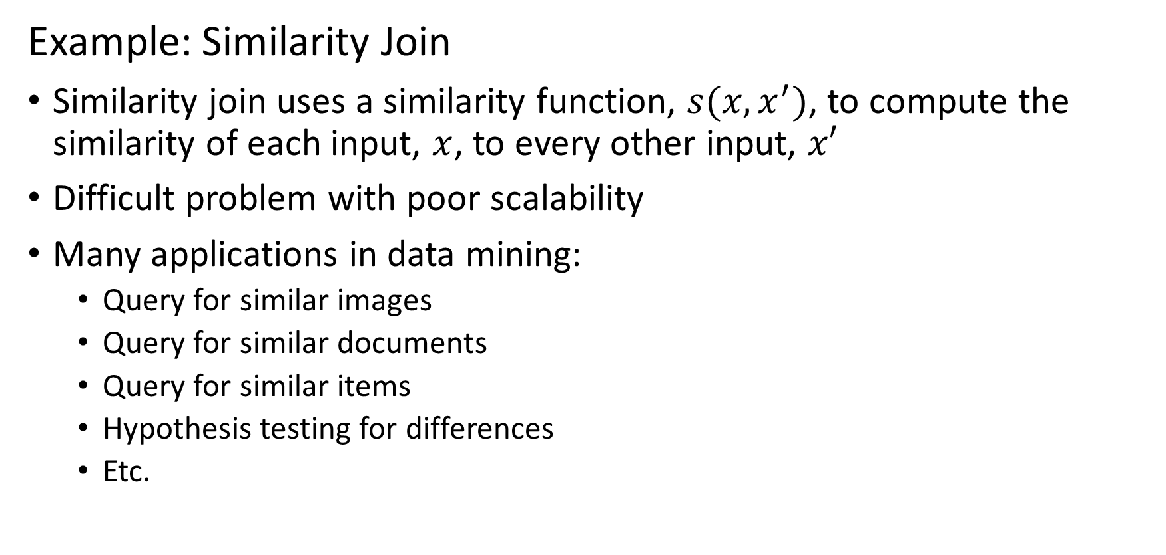
Map Reduce Algorithm
Example: Similarity Join
Similarity join uses a similarity function, $s(x,x^{′})$, to compute the similarity of each input, $x$, to every other input, $x′$
Difficult problem with poor scalability
Many applications in data mining:
Query for similar images
Query for similar documents
Query for similar items
Hypothesis testing for differences
Etc.

Slide 24




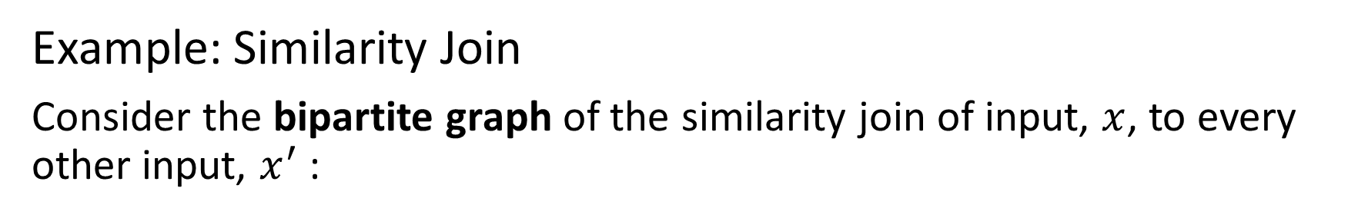






Map Reduce Algorithm
Example: Similarity Join
Consider the bipartite graph of the similarity join of input, $x$, to every other input, $x^{′}$:
${s(x}_{1},x_{2})$
$x_{1}$
${s(x}_{1},x_{3})$
Start with 4 inputs
Join inputs pairwise and compute similarity
All pairwise similarities are measured
$x_{2}$
${s(x}_{1},x_{4})$
$x_{3}$
${s(x}_{2},x_{3})$
${s(x}_{2},x_{4})$
$x_{4}$
${s(x}_{3},x_{4})$

Slide 25
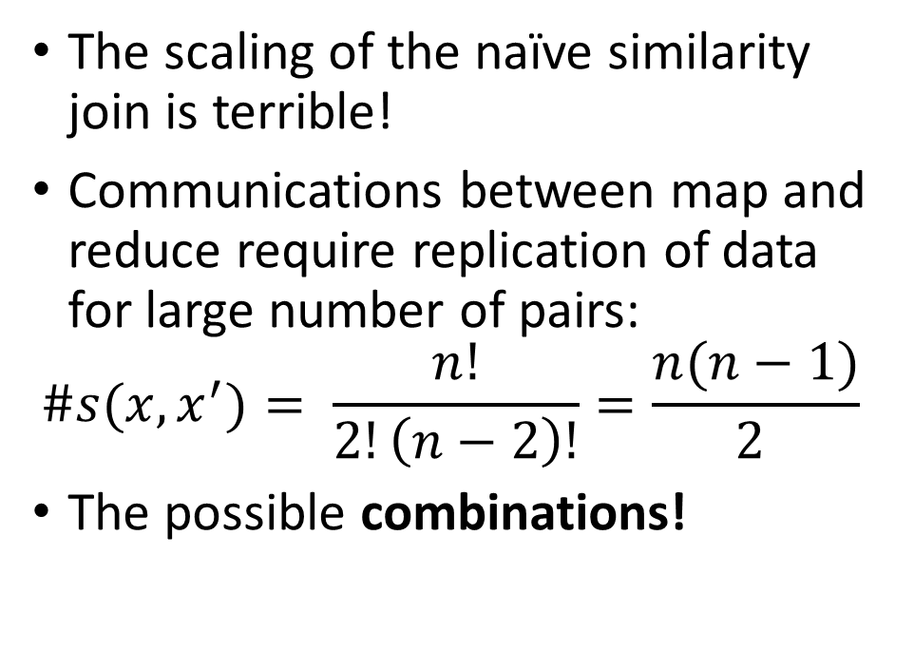
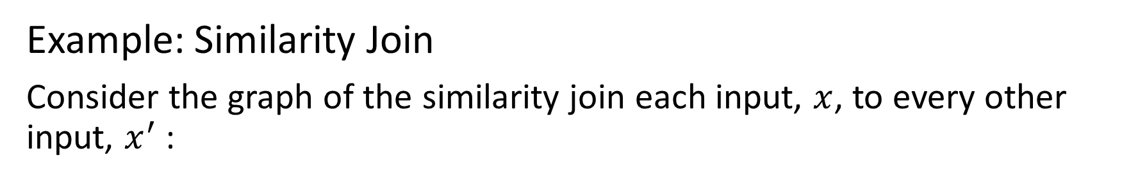
Map Reduce Algorithm
Example: Similarity Join
Consider the graph of the similarity join each input, $x$, to every other input, $x^{′}$:
The scaling of the naïve similarity join is terrible!
Communications between map and reduce require replication of data for large number of pairs:
$$\#s(x,x^{′})= \frac{n!}{2!\left(n−2\right)!}=\frac{n(n−1)}{2 }$$
The possible combinations!
${s(x}_{1},x_{2})$
$x_{1}$
${s(x}_{1},x_{3})$
$x_{2}$
${s(x}_{1},x_{4})$
$x_{3}$
${s(x}_{2},x_{3})$
${s(x}_{2},x_{4})$
$x_{4}$
${s(x}_{3},x_{4})$

Slide 26
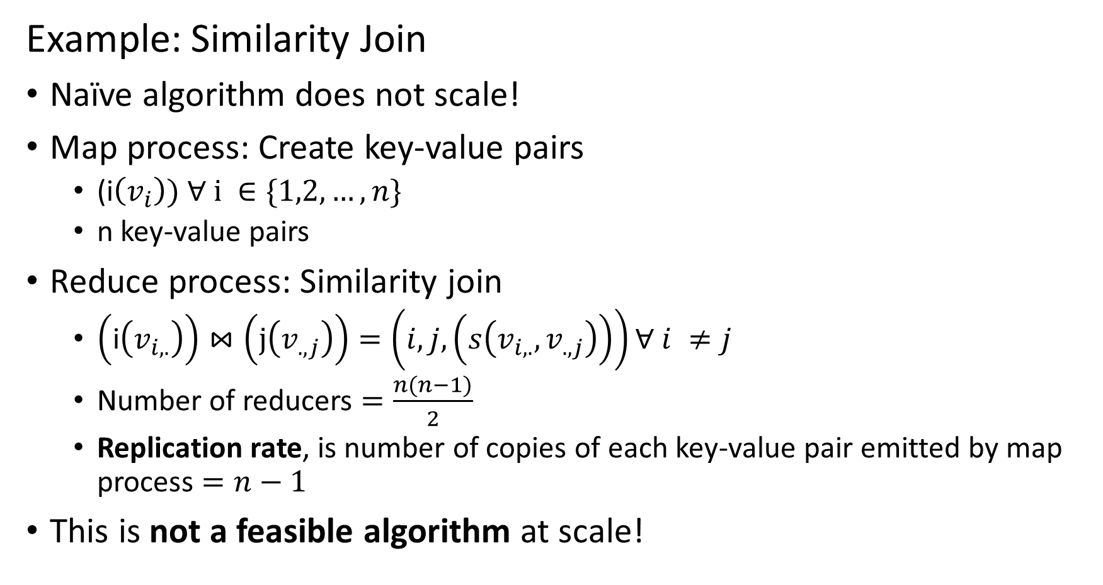
Map Reduce Algorithm
Example: Similarity Join
Naïve algorithm does not scale!
Map process: Create key-value pairs
(i$\left(v_{i}\right)) ∀ i ∈\{1,2,…,n\}$
n key-value pairs
Reduce process: Similarity join
$\left(\text{i}\left(v_{i,.}\right)\right)⋈\left(\text{j}\left(v_{.,j}\right)\right)=\left(i, j,\left(s\left(v_{i,.},v_{.,j}\right)\right)\right)∀ i ≠j$
Number of reducers $=\frac{n(n−1)}{2}$
Replication rate, is number of copies of each key-value pair emitted by map process $=n−1$
This is not a feasible algorithm at scale!

Slide 27
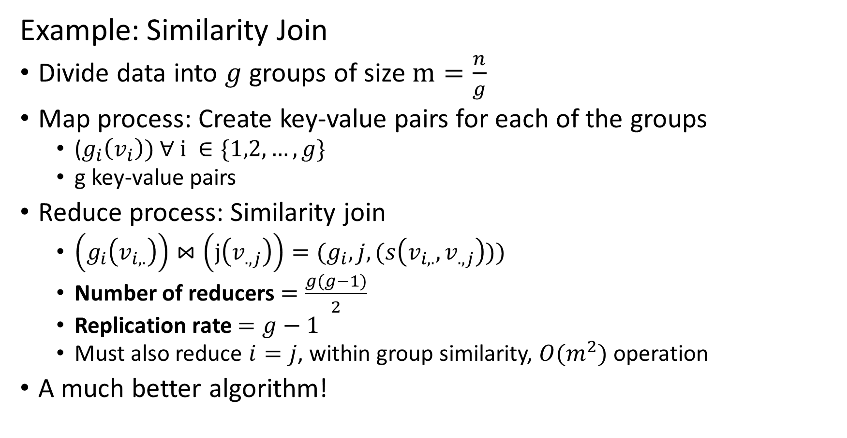
Map Reduce Algorithm
Example: Similarity Join
Divide data into $g$ groups of size $m=\frac{n}{g}$
Map process: Create key-value pairs for each of the groups
($g_{i}\left(v_{i}\right)) ∀ i ∈\{1,2,…,g\}$
g key-value pairs
Reduce process: Similarity join
$\left(g_{i}\left(v_{i,.}\right)\right)⋈\left(\text{j}\left(v_{.,j}\right)\right)=(g_{i}, j,(s\left(v_{i,.},v_{.,j}\right)))$
Number of reducers $=\frac{g(g−1)}{2}$
Replication rate $=g−1$
Must also reduce $i=j$, within group similarity, $O(m^{2})$ operation
A much better algorithm!

Slide 28
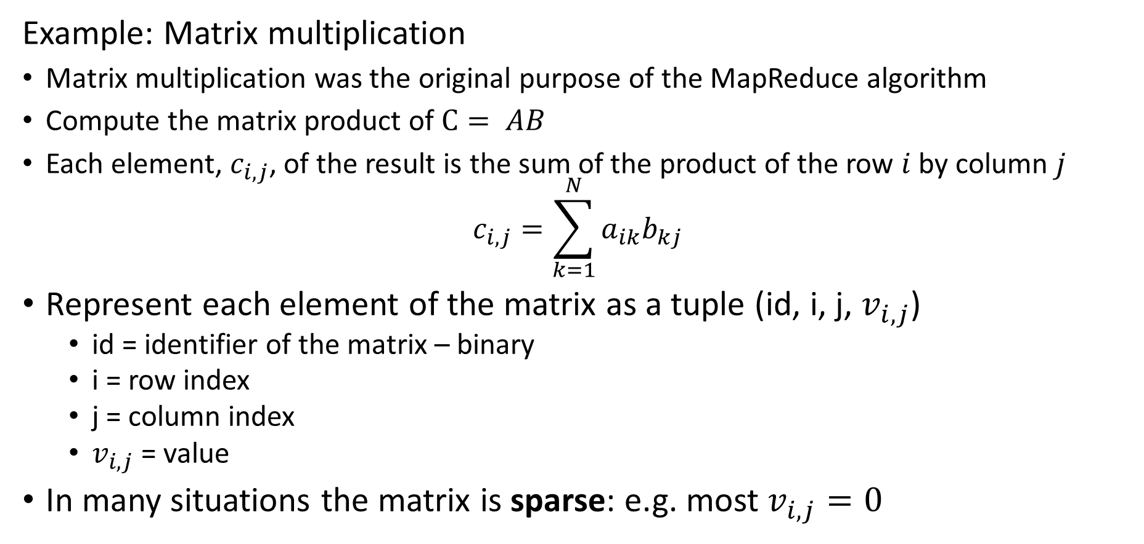
Map Reduce Algorithm
Example: Matrix multiplication
Matrix multiplication was the original purpose of the MapReduce algorithm
Compute the matrix product of $C= AB$
Each element, $c_{i,j}$, of the result is the sum of the product of the row $i$ by column $j$
$$c_{i,j}=\sum_{k=1}^{N}{a_{ik}b_{kj}}$$
Represent each element of the matrix as a tuple (id, i, j, $v_{i,j}$)
id = identifier of the matrix – binary
i = row index
j = column index
$v_{i,j}$= value
In many situations the matrix is sparse: e.g. most $v_{i,j}=0$

Slide 29
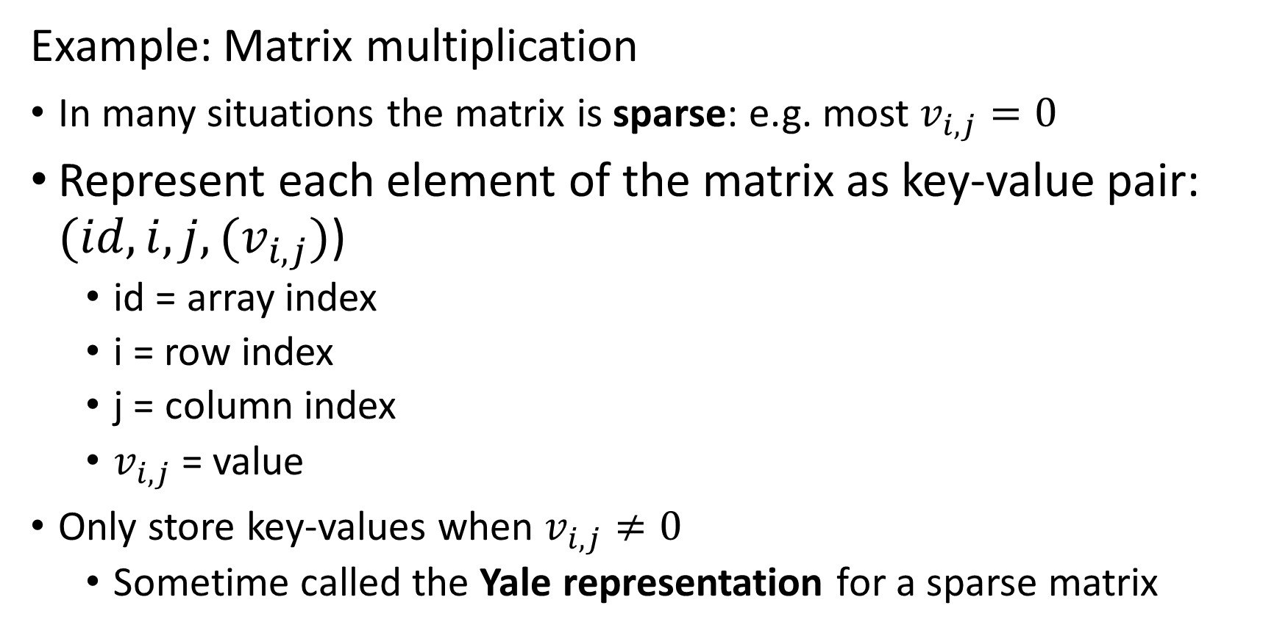
Map Reduce Algorithm
Example: Matrix multiplication
In many situations the matrix is sparse: e.g. most $v_{i,j}=0$
Represent each element of the matrix as key-value pair: ${(id,i, j, (v}_{i,j})$)
id = array index
i = row index
j = column index
$v_{i,j}$= value
Only store key-values when $v_{i,j}≠0$
Sometime called the Yale representation for a sparse matrix

Slide 30
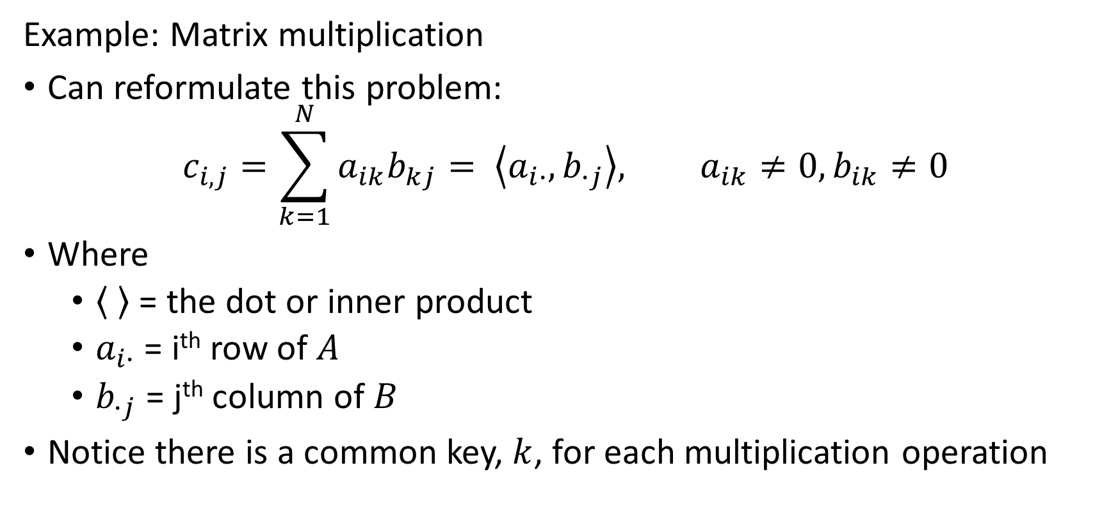
Map Reduce Algorithm
Example: Matrix multiplication
Can reformulate this problem:
$$c_{i,j}=\sum_{k=1}^{N}{a_{ik}b_{kj}= \left\langle a_{i∙},b_{∙j}\right\rangle , a_{ik}≠0,b_{ik}≠0}$$
Where
= the dot or inner product
$a_{i∙}$ = i^{th} row of $A$
$b_{∙j}$ = j^{th} column of $B$
Notice there is a common key, $k$, for each multiplication operation

Slide 31
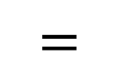
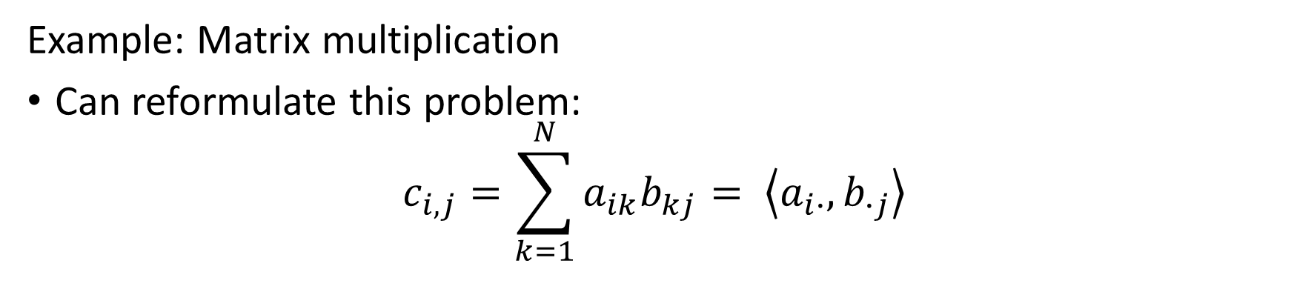



Map Reduce Algorithm
Example: Matrix multiplication
Can reformulate this problem:
$$c_{i,j}=\sum_{k=1}^{N}{a_{ik}b_{kj}= \left\langle a_{i∙},b_{∙j}\right\rangle }$$
$$a_{i∙}$$
$$b_{∙j}$$
$$=$$
$$c_{i,j}$$

Slide 32
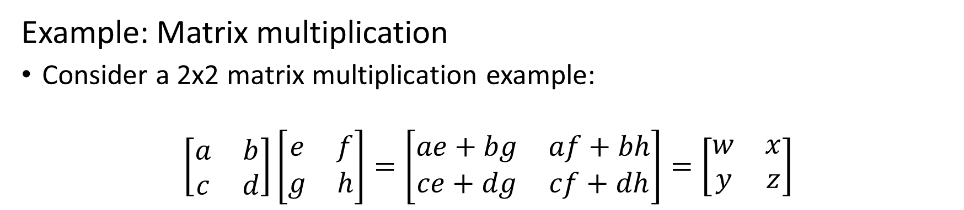
Map Reduce Algorithm
Example: Matrix multiplication
Consider a 2x2 matrix multiplication example:
$$\left[\begin{matrix}a & b \\ c & d\end{matrix}\right]\left[\begin{matrix}e & f \\ g & h\end{matrix}\right]=\left[\begin{matrix}ae+bg & af+bh \\ ce+dg & cf+dh\end{matrix}\right]=\left[\begin{matrix}w & x \\ y & z\end{matrix}\right]$$
a
b
c
d
e
f
g
h
Represent this algorithm by a bipartite graph
Start with the inputs and outputs
Each input contributes to two outputs
The complete graph shows the mapping from inputs to outputs
w
x
y
z

Slide 33
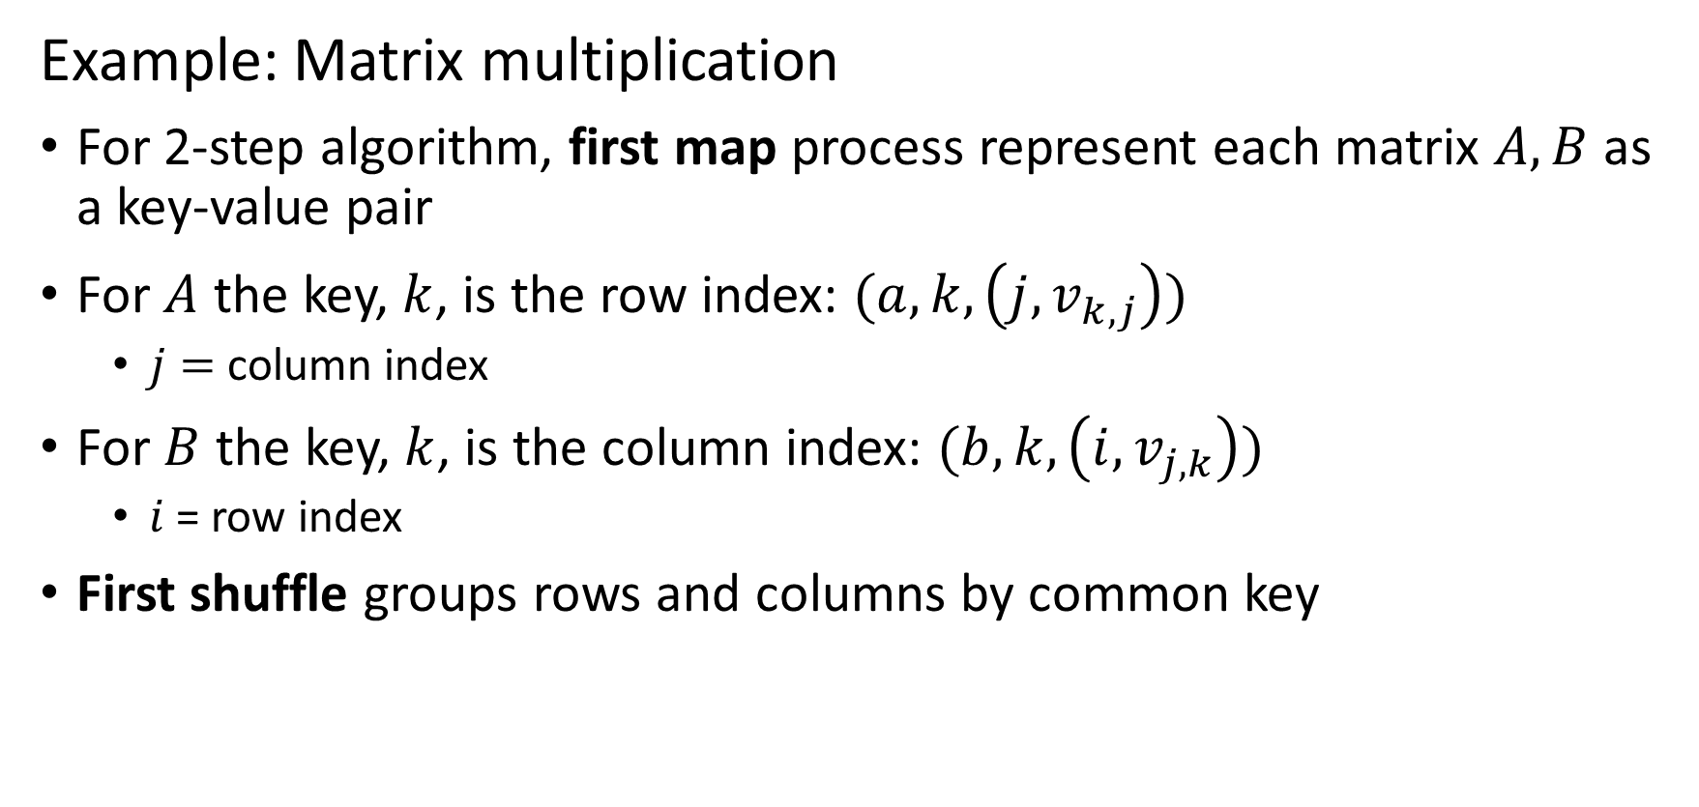
Map Reduce Algorithm
Example: Matrix multiplication
For 2-step algorithm, first map process represent each matrix $A, B$ as a key-value pair
For $A$ the key, $k$, is the row index: $(a,k, \left(j,v_{k,j}\right))$
$j=$ column index
For $B$ the key, $k$, is the column index: $(b,k, \left(i,v_{j,k}\right))$
$i$= row index
First shuffle groups rows and columns by common key

Slide 34
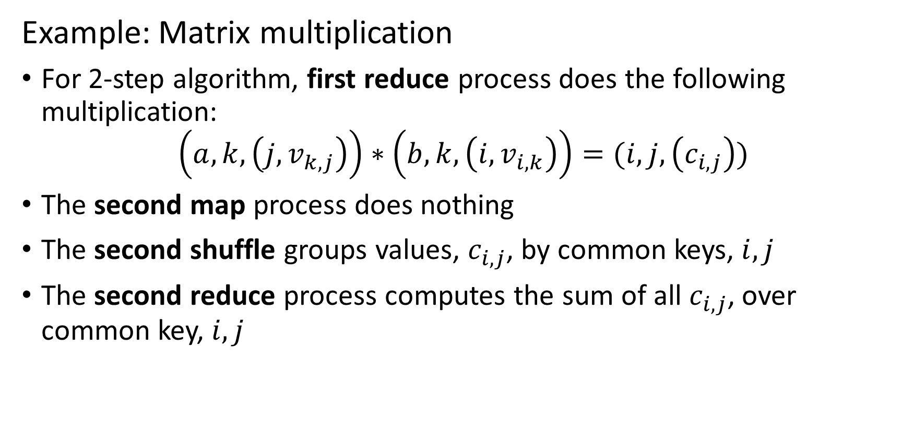
Map Reduce Algorithm
Example: Matrix multiplication
For 2-step algorithm, first reduce process does the following multiplication:
$$\left(a,k, \left(j,v_{k,j}\right)\right)∗\left(b,k, \left(i,v_{i,k}\right)\right)=(i, j,\left(c_{i,j}\right))$$
The second map process does nothing
The second shuffle groups values, $c_{i,j}$, by common keys, $i,j$
The second reduce process computes the sum of all $c_{i,j}$, over common key, $i,j$

Slide 35
Map Reduce Algorithm
Example: Matrix multiplication
What if a row or column of the matrices does not fit in main memory
We can chunk the matrices
Partition the rows and columns into strips
Compute the matrix products for each pair of stripes
Sum the products over the stripes

Slide 36
Workflow Architectures
MapReduce does not work for all analytic solutions
MapReduce only works for simple execution graphs
Single transformation per map and reduce process pair
Can chain map and reduce process pairs up to a point
Many analytic algorithms are iterative
ML algorithms
Optimization and dynamic programming
Stream processing
…
Iterative algorithms have complex execution graph
MapReduce does not accommodate these cases
Need a workflow platform to handle complex execution graphs

Slide 37
Workflow Architectures and Spark
Spark architecture supports large-scale complex execution graphs
Spark was introduced in 2010 (Zaharia, et. al., 2011) to overcome the limitations of the Hadoop MapReduce workflow
Spark is based on a lazy evaluation model
An execution graph is created for the specified workflow
The graph is executed only for values required for the output , an action in Spark terminology
Lazy evaluation eliminates unnecessary calculations
All calculations along the graph are performed in main memory
Look along entire graph to find values to keep in main memory
Limits disk I/O – can speed execution by orders of magnitude
One of many tutorials on the Spark lazy execution model can be found here

Slide 38
Lazy Evaluation
Example: Execution graph with several transformations and intermediate results
b²
σ_{ο}
Y
W²
+
U⁵
b¹
U⁴
W¹
dot
σ_{h}
U³
+
U²
Mat
Mult
U¹
X

Slide 39
Spark
Spark architecture supports large-scale complex execution graphs
Spark architecture is based on a fundamental data structure, the Resilient Distributed Dataset (RDD)
Execution of RDDs is distributed across the nodes of a cluster
Each RDD is immutable
Applying a transformation to an RDD creates a new RDD
One of many tutorials on Spark RDDs can be found here.
The Apache Spark project has created extensive documentation on programming Spark.
You can find the Apache Spark project documentation on cluster deployment here.

Slide 40
Spark
What are key properties of RDDs?
RDDs are resilient to failure
Use a distributed file system to recover from partial cluster failure
Immutable RDDs are persistent, so can restart calculation
RDDs partition data across a cluster
An RDD contains the execution graph
RDD has all the information required to compute an action (output)
RDDs use execution graph to distribute workload across a cluster
Two types of transformations
Fine grain or narrow only affect certain data values
Course grain or wide are global – use MapReduce

Slide 41
Graduate Independent project
Required if you are enrolled for Graduate Credit
Project proposal and final report comprise 30% of overall grade!
Your chance to pull the concepts of the course together and show what you can do
Good addition to your data science portfolio
Working independently, you will:
Select a data set and problem of interest to you
Explore and understand the data set in depth
Use data mining methods within the scope of the course to extract information and discover relationships
Write and submit a professional quality report
Please see assignments Canvas for specific grading criteria

Slide 42
Graduate Independent project
What constitutes a suitable project?
Must be focused on data mining methods and algorithms
Methods and algorithms within the scope of the course
Primary focus on unsupervised learning methods
This in not a supervised machine learning course: supervised machine learning is generally not appropriate!
Clustering project must go beyond k-means and apply several modern methods!
Sufficient publicly available data – ask instructor for exceptions
Appropriate scope
If you have sufficient background (e.g. course prerequisites) expect to spend about 80 hours on your project
If you are building key skills (e.g. programming, statistics) additional effort will be required

Slide 43
Graduate Independent project
Project proposal helps ensure your project has:
Clear and reasonable data mining objective
Must be understandable to non-technical audience
Appropriate scope
Sufficient depth – depth of data, depth of analysis
Not too ambitious!
Required data are available
Compete enough to execute project
Sufficient volume and complexity
But not too massive!
Use of appropriate data mining methods
Correctly selected for proposed objective
In scope of course

Slide 44
Graduate Independent project
Project report must:
Have introduction (summary) stating objectives and conclusions, understandable to the intended non-technical audience
Support conclusions based on evidence gathered in the data mining process
Demonstrate that data has been prepared correctly
Explain the data exploration and knowledge discovery process
Requires technical depth
Clear text and graphics
Use appropriate methods and algorithms
In depth analysis
Improve initial results by enhancing methods or using other algorithms
Show professional levels of code organization (e.g. use of function, commenting, good variable names,..) in an appendix

Slide 45
Graduate Independent project
Suitable projects – only ideas, pick a project that interests you:
Suitable methods include, but not limited to:
Unsupervised learning – many possible models
Large scale similarity measures
Recommenders and factorization
Graph models
Not supervised machine learning!
Suitable datasets and problems include, but not limited to:
Genetic data and gene expression
Text data, information retrieval, similarity search, etc.
Streaming and large scale time series data, event processing
Graph data, social networks, etc.

Slide 46
Summary
Scalable computing for mining massive datasets
Dataset size and complexity growing rapidly with time
Scalable computing required for scalable analytics
Limitations for scaling analytics
Computing speed
Main memory size
File system size
Network bandwidth
Use MapReduce algorithm for simple execution graph
Use workflow architecture for complex execution graph

