Slide 1

CSCI E-96 Data Mining, Exploration and Discovery Networks and Web Search Algorithms
Steve Elston
Copyright 2021, 2022, 2023, 2024, 2025, Stephen F Elston. All rights reserved.

Slide 2
Lesson Overview
Focus on introducing graph theory through web search
Introduction to the web search problem
First overview of graph theory
Introduction to Markov processes and random walks
Structure of the web
The PageRank algorithm
Damped PageRank
TrustRank algorithm
HITS algorithm for hubs and authorities
Not just for web search

Slide 3
Introduction to Web Searching
Web search is undoubtedly the most widely used data mining application
Major search engines, like Google, Bing, Yahoo!, Baidu are complex
Employ multiple algorithms
Typically use other information – e.g. user profiles and history, page content
Complexity arises from:
Massive data volumes
Unlimited number of queries - can’t really know user intent
Web spam
Enormous number of topics
Small number of large companies dominate search
Google’s global market share > 90%
Trade secrets make study of this subject difficult – cannot know details

Slide 4
Introduction to Web Searching
Some possible approaches to web search
Search for semantic match to query
Attractive in principle
Hard to implement on web at scale, ambiguous queries, inconsistent tags
Unclear how much semantic methods used by major search engines
We will not discuss semantic search further here
Semantic search on the semantic web
For a recent review paper on the state of the semantic web see Review of the Semantic Web Field, Pascal Hitzler, Communications of the ACM, February 2021.

Slide 5
Introduction to Web Searching
Some possible approaches to web search
Topic sensitive search
Goal is to restrict search to pages with topics relevant to the user’s query
Only want to search documents related to the intended topic
Used in document retrieval
Topic sensitive search is being revolutionized by LLMs
Create summary based on relevant pages
Or, use computed topic weights to find relevant pages

Slide 6
Introduction to Web Searching
Some possible approaches to web search
Many pitfalls in topic sensitive search
Natural language used for query is often ambiguous
Example: Query for ‘Jaguar numbers’ could refer to an endangered large cat, an automobile, a sports team, or maybe something else??
See Section of 5.3 of the MMDS book for a brief overview of topic sensitive search

Slide 7
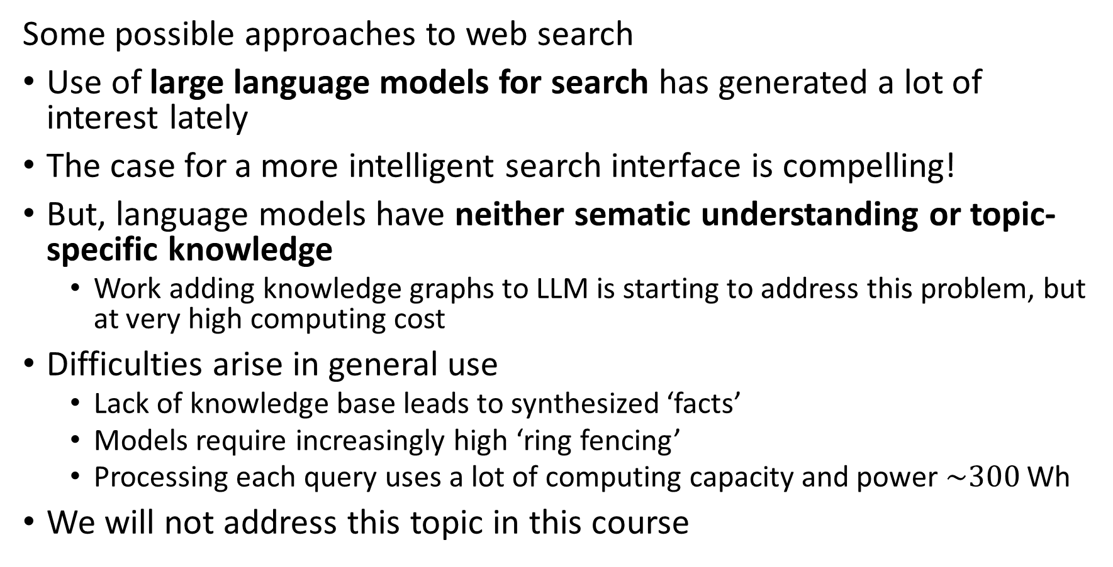
Introduction to Web Searching
Some possible approaches to web search
Use of large language models for search has generated a lot of interest lately
The case for a more intelligent search interface is compelling!
But, language models have neither sematic understanding or topic-specific knowledge
Work adding knowledge graphs to LLM is starting to address this problem, but at very high computing cost
Difficulties arise in general use
Lack of knowledge base leads to synthesized ‘facts’
Models require increasingly high ‘ring fencing’
Processing each query uses a lot of computing capacity and power $\sim 300$ Wh
We will not address this topic in this course

Slide 8
Introduction to Web Searching
Some possible approaches to web search
Mapping natural language to topic is ambiguous
Mini Hashing matches topics to filter pages for search
Topics represented by hash buckets
Number of possible buckets is very large
Embeddings to linear space
Embeddings computed with neural networks like autoencoders
Similar topics are ‘close’ in embedding space
Distance determined by similarity measure
Multiple methods used in practice

Slide 9
Introduction to Web Searching
Some possible approaches to web search
Centrality search
Model web as graph
Rank pages by how central they are on the graph
Assume more important pages are more central
We focus on centrality search algorithms
These methods are built on two areas of applied mathematics:
Graph theory
Stochastic processes, specifically Markov processes

Slide 10
Introduction to Graph Theory

Slide 11
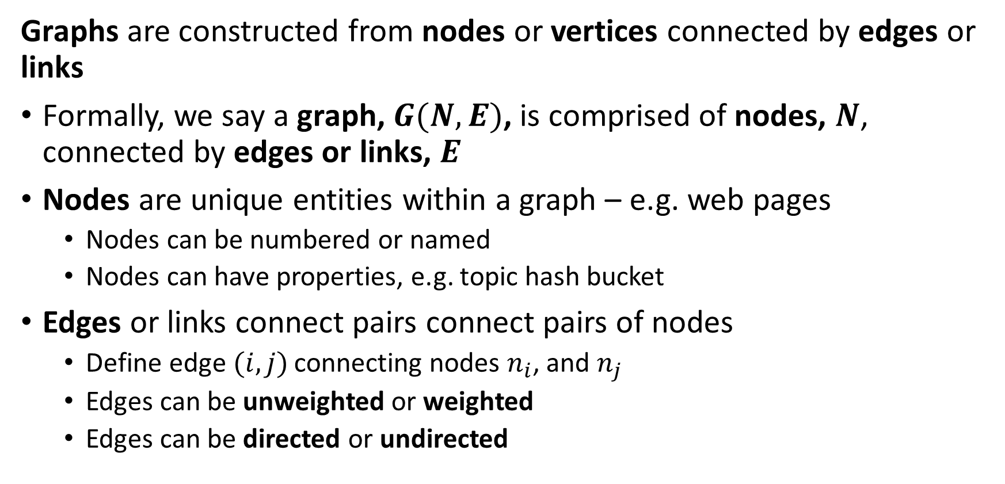
Introduction to Graph Theory Terminology
Graphs are constructed from nodes or vertices connected by edges or links
Formally, we say a graph, $G(N,E)$, is comprised of nodes, $N$, connected by edges or links, $E$
Nodes are unique entities within a graph – e.g. web pages
Nodes can be numbered or named
Nodes can have properties, e.g. topic hash bucket
Edges or links connect pairs connect pairs of nodes
Define edge$(i,j)$ connecting nodes $n_{i}$, and $n_{j}$
Edges can be unweighted or weighted
Edges can be directed or undirected

Slide 12

Introduction to Graph Theory Terminology
Undirected graphs are constructed from nodes or vertices connected by undirected edges
An undirected edge, $l\left(i,j\right)$, connects nodes $n_{i}$ and $n_{j}$ bidirectionally
Example: Facebook friends is a symmetric relationship
Example: A highway network allows travel in both directions

Slide 13
Introduction to Graph Theory Terminology
Undirected graphs are constructed from nodes or vertices connected by undirected edges
Example: Undirected graph between people in a social media network
Nodes are the people
Property is name
Edges are the connections between nodes
Weights can represent connection strength
Undirected edges are symmetric or bidirectional; e.g. Bob knows Gigi and Gigi knows Bob
Raj
Bob
Gigi
Asan
Mary

Slide 14
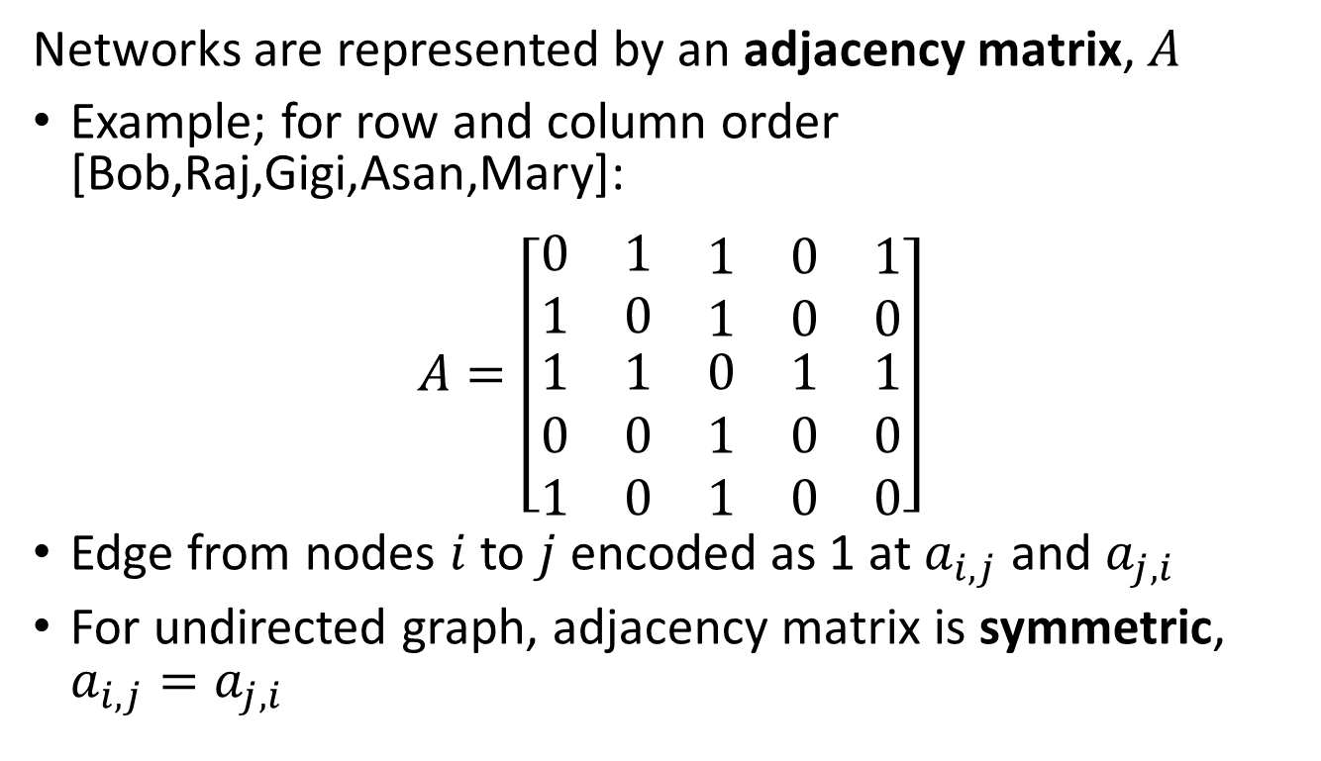
Introduction to Graph Theory
Undirected graphs are constructed from nodes or vertices connected by undirected edges
Networks are represented by an adjacency matrix, $A$
Example; for row and column order [Bob,Raj,Gigi,Asan,Mary]:
$$A=\left[\begin{matrix}0 & 1 & \begin{matrix}1 & 0 & 1\end{matrix} \\ 1 & 0 & \begin{matrix}1 & 0 & 0\end{matrix} \\ \begin{matrix}1 \\ 0 \\ 1\end{matrix} & \begin{matrix}1 \\ 0 \\ 0\end{matrix} & \begin{matrix}0 & 1 & 1 \\ 1 & 0 & 0 \\ 1 & 0 & 0\end{matrix}\end{matrix}\right]$$
Edge from nodes $i$ to $j$ encoded as 1 at $a_{i,j}$ and $a_{j,i}$
For undirected graph, adjacency matrix is symmetric, $a_{i,j}=a_{j,i}$
Raj
Bob
Gigi
Mary
Asan

Slide 15
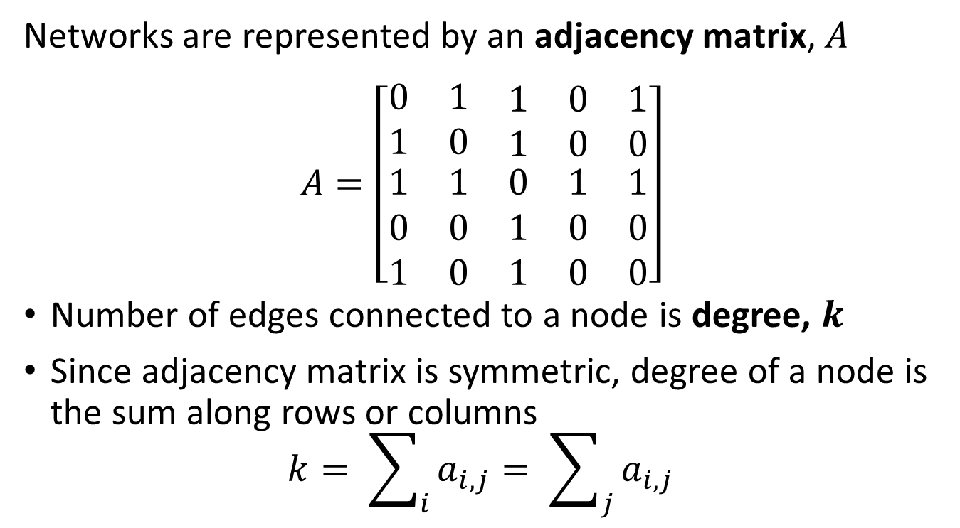
Introduction to Graph Theory
Undirected graphs are constructed from nodes or vertices connected by undirected edges
Networks are represented by an adjacency matrix, $A$
$$A=\left[\begin{matrix}0 & 1 & \begin{matrix}1 & 0 & 1\end{matrix} \\ 1 & 0 & \begin{matrix}1 & 0 & 0\end{matrix} \\ \begin{matrix}1 \\ 0 \\ 1\end{matrix} & \begin{matrix}1 \\ 0 \\ 0\end{matrix} & \begin{matrix}0 & 1 & 1 \\ 1 & 0 & 0 \\ 1 & 0 & 0\end{matrix}\end{matrix}\right]$$
Number of edges connected to a node is degree, $k$
Since adjacency matrix is symmetric, degree of a node is the sum along rows or columns
$$k= \sum_{i}{a_{i,j}}= \sum_{j}{a_{i,j}}$$
Raj
Bob
Gigi
Mary
Asan

Slide 16
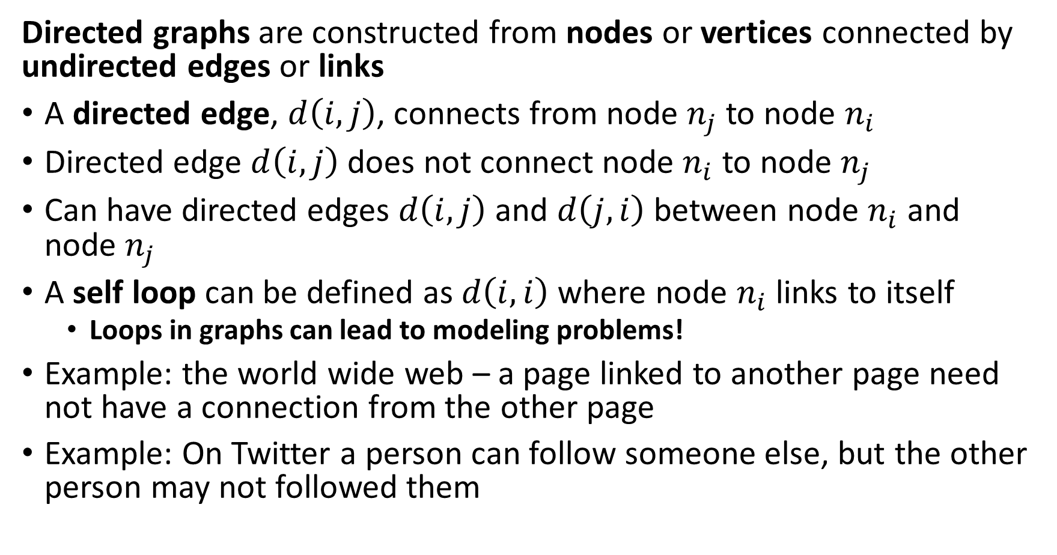
Introduction to Graph Theory Terminology
Directed graphs are constructed from nodes or vertices connected by undirected edges or links
A directed edge, $d\left(i,j\right)$, connects from node $n_{j}$ to node $n_{i}$
Directed edge $d\left(i,j\right)$ does not connect node $n_{i}$ to node $n_{j}$
Can have directed edges $d\left(i,j\right)$ and $d\left(j,i\right)$ between node $n_{i}$ and node $n_{j}$
A self loop can be defined as $d\left(i,i\right)$ where node $n_{i}$ links to itself
Loops in graphs can lead to modeling problems!
Example: the world wide web – a page linked to another page need not have a connection from the other page
Example: On Twitter a person can follow someone else, but the other person may not followed them

Slide 17
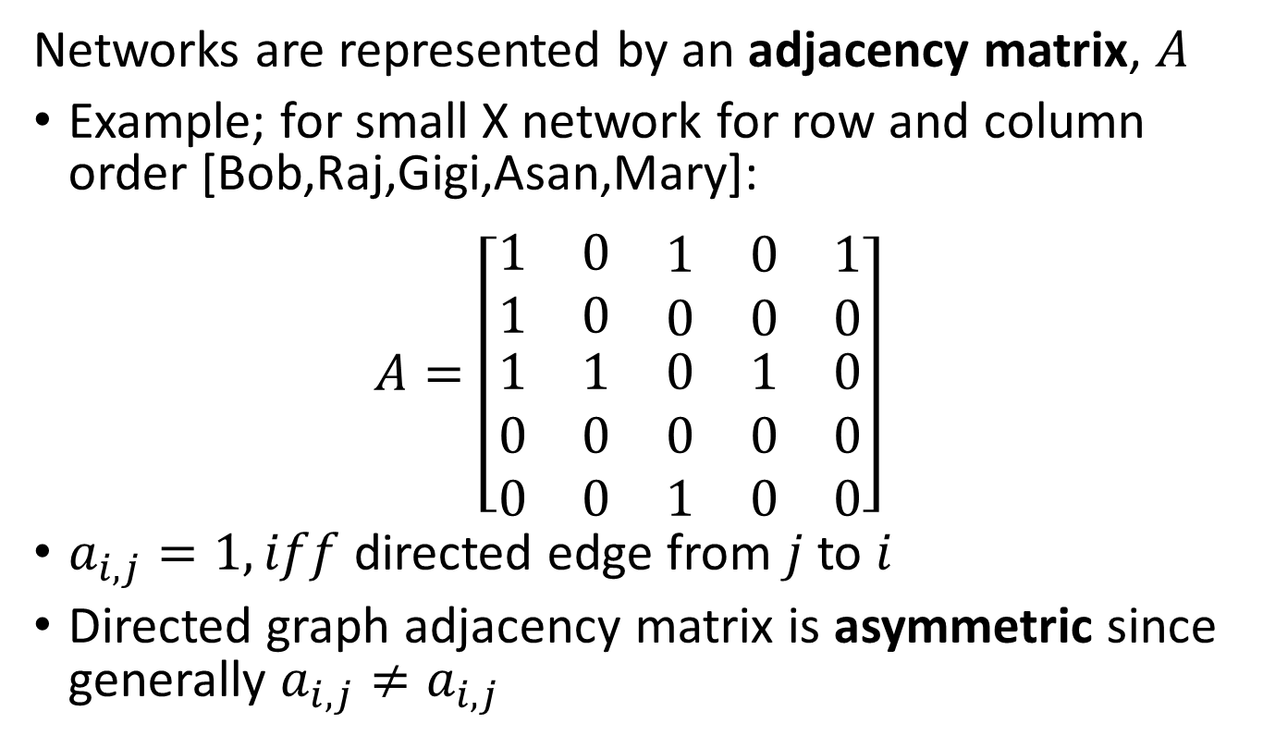
Introduction to Graph Theory
Directed graphs are constructed from nodes or vertices connected by directed edges
Networks are represented by an adjacency matrix, $A$
Example; for small X network for row and column order [Bob,Raj,Gigi,Asan,Mary]:
$$A=\left[\begin{matrix}1 & 0 & \begin{matrix}1 & 0 & 1\end{matrix} \\ 1 & 0 & \begin{matrix}0 & 0 & 0\end{matrix} \\ \begin{matrix}1 \\ 0 \\ 0\end{matrix} & \begin{matrix}1 \\ 0 \\ 0\end{matrix} & \begin{matrix}0 & 1 & 0 \\ 0 & 0 & 0 \\ 1 & 0 & 0\end{matrix}\end{matrix}\right]$$
$a_{i,j}=1, iff$ directed edge from $j$ to $i$
Directed graph adjacency matrix is asymmetric since generally $a_{i,j}≠a_{i,j}$
Raj
Bob
Gigi
Mary
Asan

Slide 18
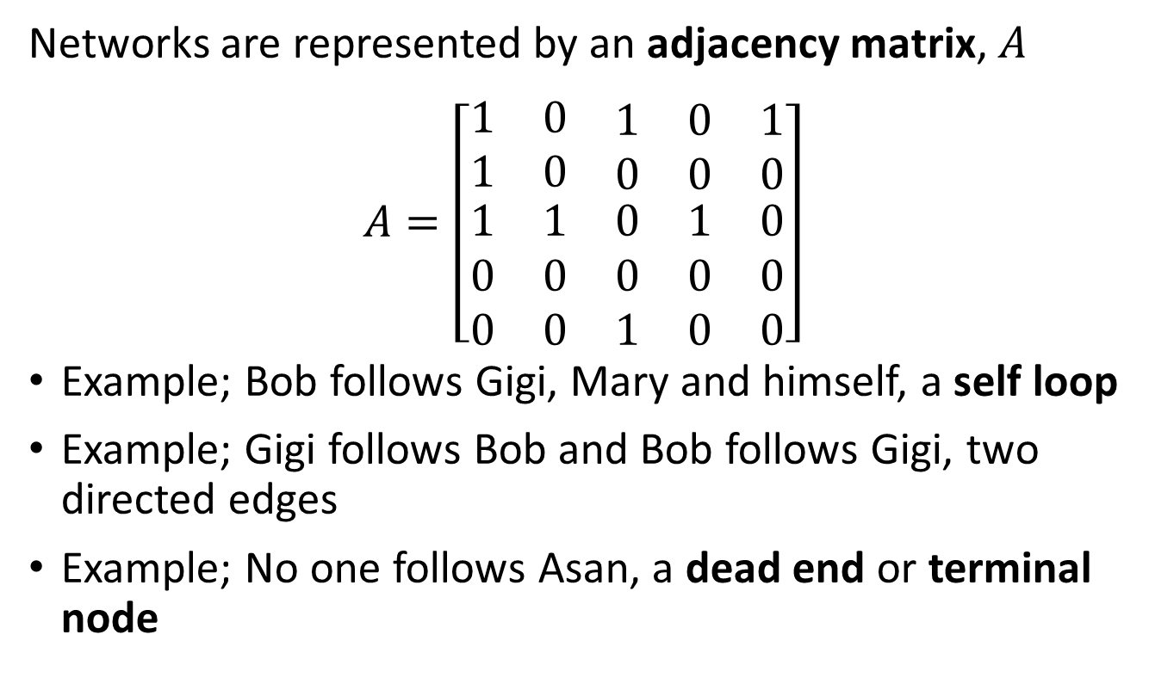
Introduction to Graph Theory
Directed graphs are constructed from nodes or vertices connected by directed edges
Networks are represented by an adjacency matrix, $A$
$$A=\left[\begin{matrix}1 & 0 & \begin{matrix}1 & 0 & 1\end{matrix} \\ 1 & 0 & \begin{matrix}0 & 0 & 0\end{matrix} \\ \begin{matrix}1 \\ 0 \\ 0\end{matrix} & \begin{matrix}1 \\ 0 \\ 0\end{matrix} & \begin{matrix}0 & 1 & 0 \\ 0 & 0 & 0 \\ 1 & 0 & 0\end{matrix}\end{matrix}\right]$$
Example; Bob follows Gigi, Mary and himself, a self loop
Example; Gigi follows Bob and Bob follows Gigi, two directed edges
Example; No one follows Asan, a dead end or terminal node
Raj
Bob
Gigi
Mary
Asan

Slide 19
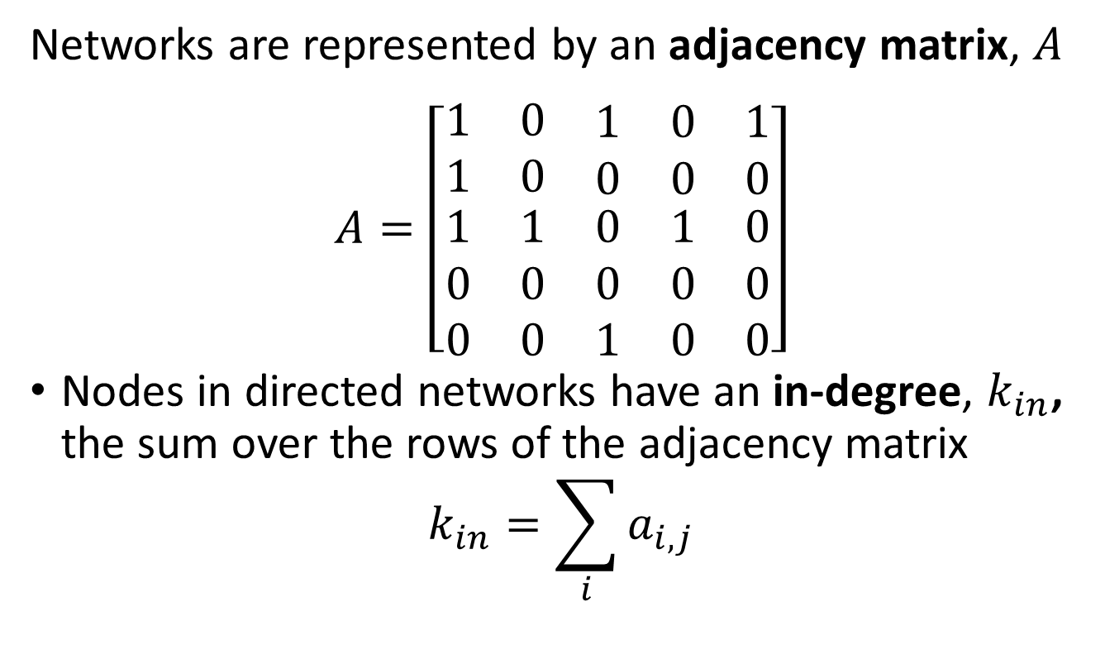
Introduction to Graph Theory
Directed graphs are constructed from nodes or vertices connected by directed edges
Networks are represented by an adjacency matrix, $A$
$$A=\left[\begin{matrix}1 & 0 & \begin{matrix}1 & 0 & 1\end{matrix} \\ 1 & 0 & \begin{matrix}0 & 0 & 0\end{matrix} \\ \begin{matrix}1 \\ 0 \\ 0\end{matrix} & \begin{matrix}1 \\ 0 \\ 0\end{matrix} & \begin{matrix}0 & 1 & 0 \\ 0 & 0 & 0 \\ 1 & 0 & 0\end{matrix}\end{matrix}\right]$$
Nodes in directed networks have an in-degree, $k_{in}$, the sum over the rows of the adjacency matrix
$$k_{in}=\sum_{i}{a_{i,j}}$$
Raj
Bob
Gigi
Mary
Asan

Slide 20
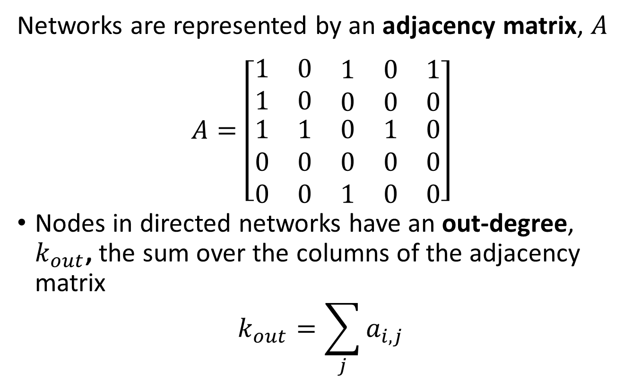
Introduction to Graph Theory
Directed graphs are constructed from nodes or vertices connected by directed edges
Networks are represented by an adjacency matrix, $A$
$$A=\left[\begin{matrix}1 & 0 & \begin{matrix}1 & 0 & 1\end{matrix} \\ 1 & 0 & \begin{matrix}0 & 0 & 0\end{matrix} \\ \begin{matrix}1 \\ 0 \\ 0\end{matrix} & \begin{matrix}1 \\ 0 \\ 0\end{matrix} & \begin{matrix}0 & 1 & 0 \\ 0 & 0 & 0 \\ 1 & 0 & 0\end{matrix}\end{matrix}\right]$$
Nodes in directed networks have an out-degree, $k_{out}$, the sum over the columns of the adjacency matrix
$$k_{out}=\sum_{j}{a_{i,j}}$$
Raj
Bob
Gigi
Mary
Asan

Slide 21

Introduction to Graph Theory
Directed graphs are constructed from nodes or vertices connected by directed edges
Nodes in directed networks have an in-degree, $k_{in}$, and out-degree, $k_{out}$,
Example; for Gigi $k_{in}=3$, $k_{out}=2$
Example; for Asan $k_{in}=0$, $k_{out}=1$
Raj
Bob
Gigi
Mary
Asan

Slide 22
Introduction to Markov Processes

Slide 23
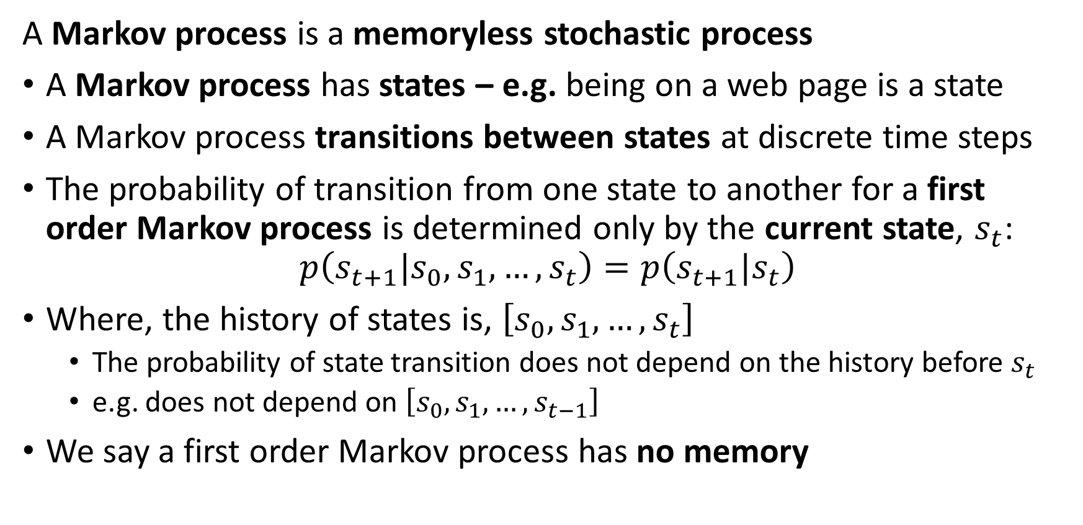
Introduction to Markov Processes
A Markov process is a memoryless stochastic process
A Markov process has states – e.g. being on a web page is a state
A Markov process transitions between states at discrete time steps
The probability of transition from one state to another for a first order Markov process is determined only by the current state, $s_{t}$:
$$p\left(s_{t+1}|s_{0},s_{1},…,s_{t}\right)=p\left(s_{t+1}|s_{t}\right)$$
Where, the history of states is, $\left[s_{0},s_{1},…,s_{t}\right]$
The probability of state transition does not depend on the history before $s_{t}$
e.g. does not depend on $\left[s_{0},s_{1},…,s_{t−1}\right]$
We say a first order Markov process has no memory

Slide 24
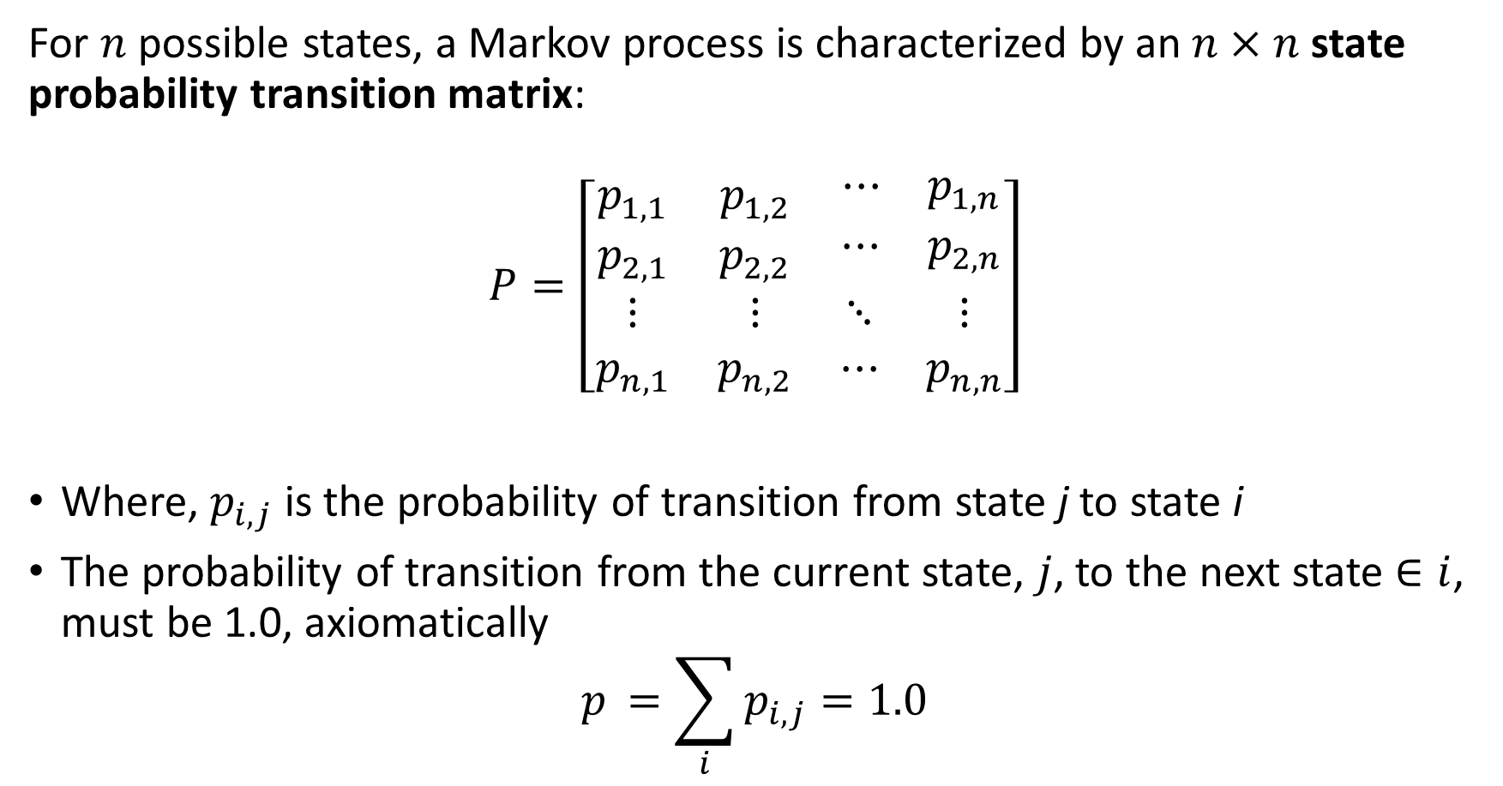
Introduction to Markov Processes
For $n$ possible states, a Markov process is characterized by an $n×n$ state probability transition matrix:
$$P=\left[\begin{matrix}p_{1,1} & p_{1,2} & \begin{matrix}⋯ & p_{1,n}\end{matrix} \\ p_{2,1} & p_{2,2} & \begin{matrix}⋯ & p_{2,n}\end{matrix} \\ \begin{matrix}⋮ \\ p_{n,1}\end{matrix} & \begin{matrix}⋮ \\ p_{n,2}\end{matrix} & \begin{matrix}⋱ & ⋮ \\ ⋯ & p_{n,n}\end{matrix}\end{matrix}\right]$$
Where, $p_{i,j}$ is the probability of transition from state j to state i
The probability of transition from the current state, $j$, to the next state $∈i$, must be 1.0, axiomatically
$$p_{ }=\sum_{i}^{ }{p_{i,j}=1.0}$$

Slide 25
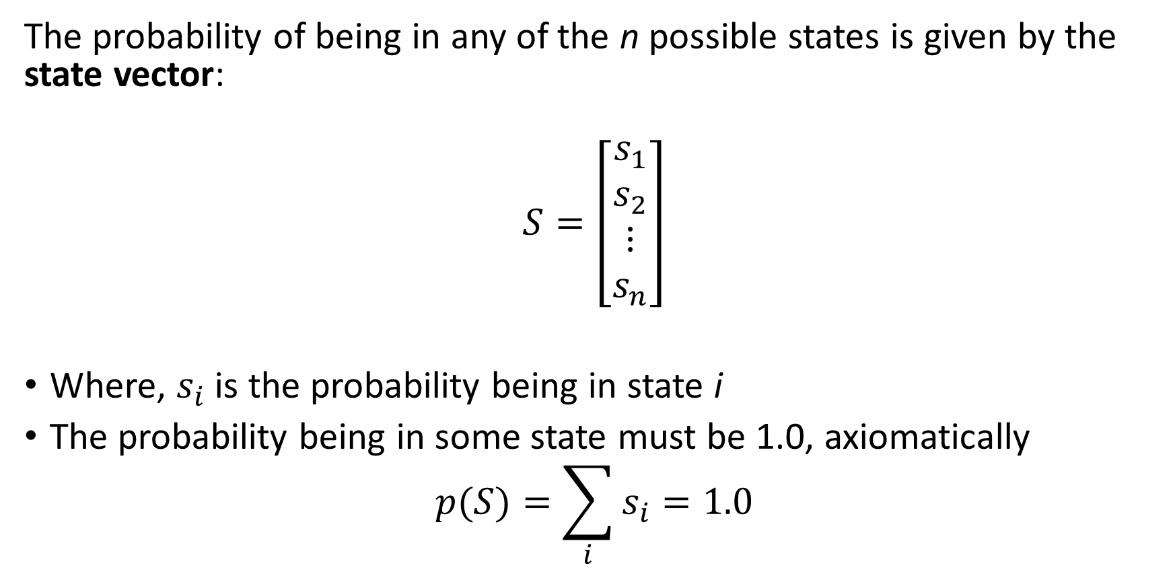
Introduction to Markov Processes
The probability of being in any of the n possible states is given by the state vector:
$$S=\left[\begin{matrix}s_{1} \\ s_{2} \\ \begin{matrix}⋮ \\ s_{n}\end{matrix}\end{matrix}\right]$$
Where, $s_{i}$ is the probability being in state i
The probability being in some state must be 1.0, axiomatically
$$p(S)=\sum_{i}^{ }{s_{i}=1.0}$$

Slide 26
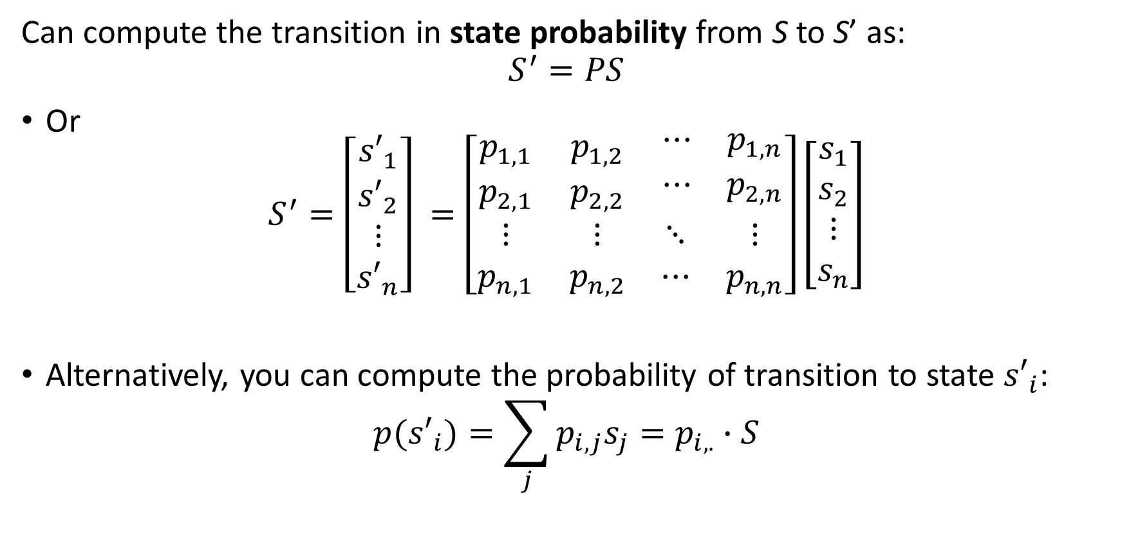
Introduction to Markov Processes
Can compute the transition in state probability from S to S’ as:
$$S^{′}=PS$$
Or
$$S^{′}=\left[\begin{matrix}{s′}_{1} \\ {s′}_{2} \\ \begin{matrix}⋮ \\ {s′}_{n}\end{matrix}\end{matrix}\right] =\left[\begin{matrix}p_{1,1} & p_{1,2} & \begin{matrix}⋯ & p_{1,n}\end{matrix} \\ p_{2,1} & p_{2,2} & \begin{matrix}⋯ & p_{2,n}\end{matrix} \\ \begin{matrix}⋮ \\ p_{n,1}\end{matrix} & \begin{matrix}⋮ \\ p_{n,2}\end{matrix} & \begin{matrix}⋱ & ⋮ \\ ⋯ & p_{n,n}\end{matrix}\end{matrix}\right]\left[\begin{matrix}s_{1} \\ s_{2} \\ \begin{matrix}⋮ \\ s_{n}\end{matrix}\end{matrix}\right]$$
Alternatively, you can compute the probability of transition to state ${s′}_{i}$:
$${p(s′}_{i})=\sum_{j}{p_{i,j}s_{j}}=p_{i,.}∙S$$

Slide 27
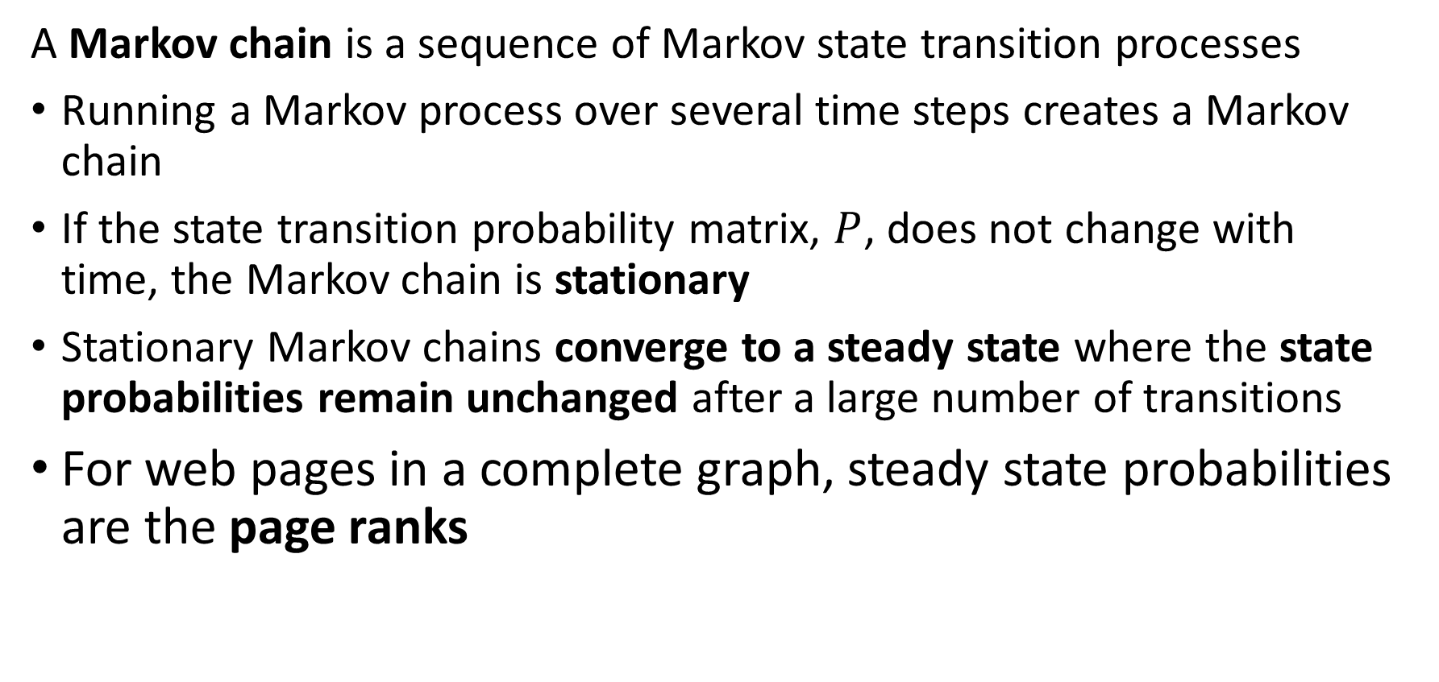
Introduction to Markov Processes
A Markov chain is a sequence of Markov state transition processes
Running a Markov process over several time steps creates a Markov chain
If the state transition probability matrix, $P$, does not change with time, the Markov chain is stationary
Stationary Markov chains converge to a steady state where the state probabilities remain unchanged after a large number of transitions
For web pages in a complete graph, steady state probabilities are the page ranks

Slide 28
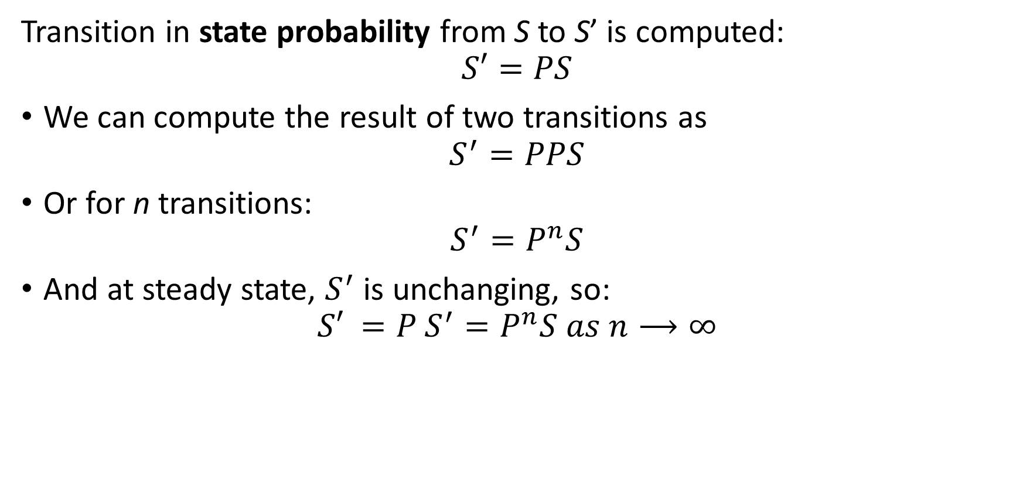
Introduction to Markov Processes
Transition in state probability from S to S’ is computed:
$$S′=PS$$
We can compute the result of two transitions as
$$S^{′}=PPS$$
Or for n transitions:
$$S^{′}=P^{n}S$$
And at steady state, $S^{′}$ is unchanging, so:
$${S′}^{ }=P^{ }S^{′}=P^{n}S as n⟶∞$$

Slide 29
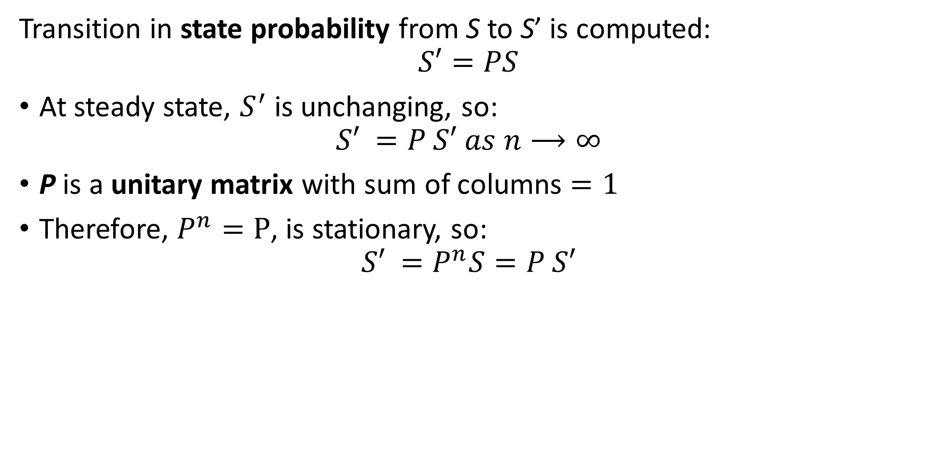
Introduction to Markov Processes
Transition in state probability from S to S’ is computed:
$$S′=PS$$
At steady state, $S^{′}$ is unchanging, so:
$${S′}^{ }=P^{ }S′ as n⟶∞$$
P is a unitary matrix with sum of columns $=1$
Therefore, $P^{n}=P$, is stationary, so:
$${S′}^{ }=P^{n}S=P^{ }S′$$

Slide 30
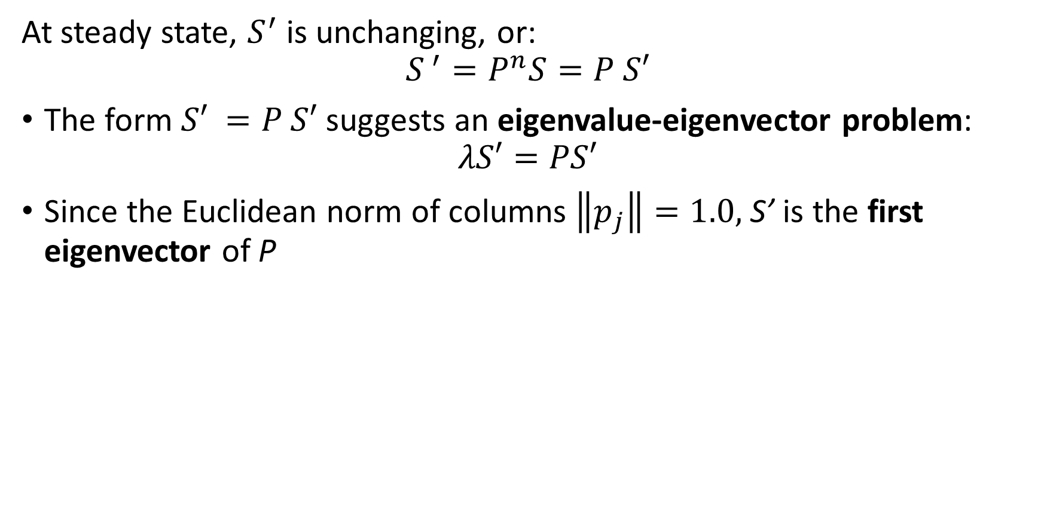
Introduction to Markov Processes
At steady state, $S^{′}$ is unchanging, or:
$$S^{ ′}=P^{n}S=P^{ }S′$$
The form ${S′}^{ }=P^{ }S′$ suggests an eigenvalue-eigenvector problem:
$$λS′=PS′$$
Since the Euclidean norm of columns $\left\|p_{j}\right\|=1.0,$ S’ is the first eigenvector of P

Slide 31
Overview of Web Search

Slide 32
Searching on the Web
Web search is an application of graph theory
The web is a very large directed graph
Nodes are pages
Pages contain content in most any form – text, video, audio, documents,…
Search results are presented as pages that best fit a user’s query
Directed edges are hyperlinks
Edges are directed from one page to another - outgoing
Pages can have multiple directed links
A page with a link to another page need not be linked by the other page – no symmetry!

Slide 33
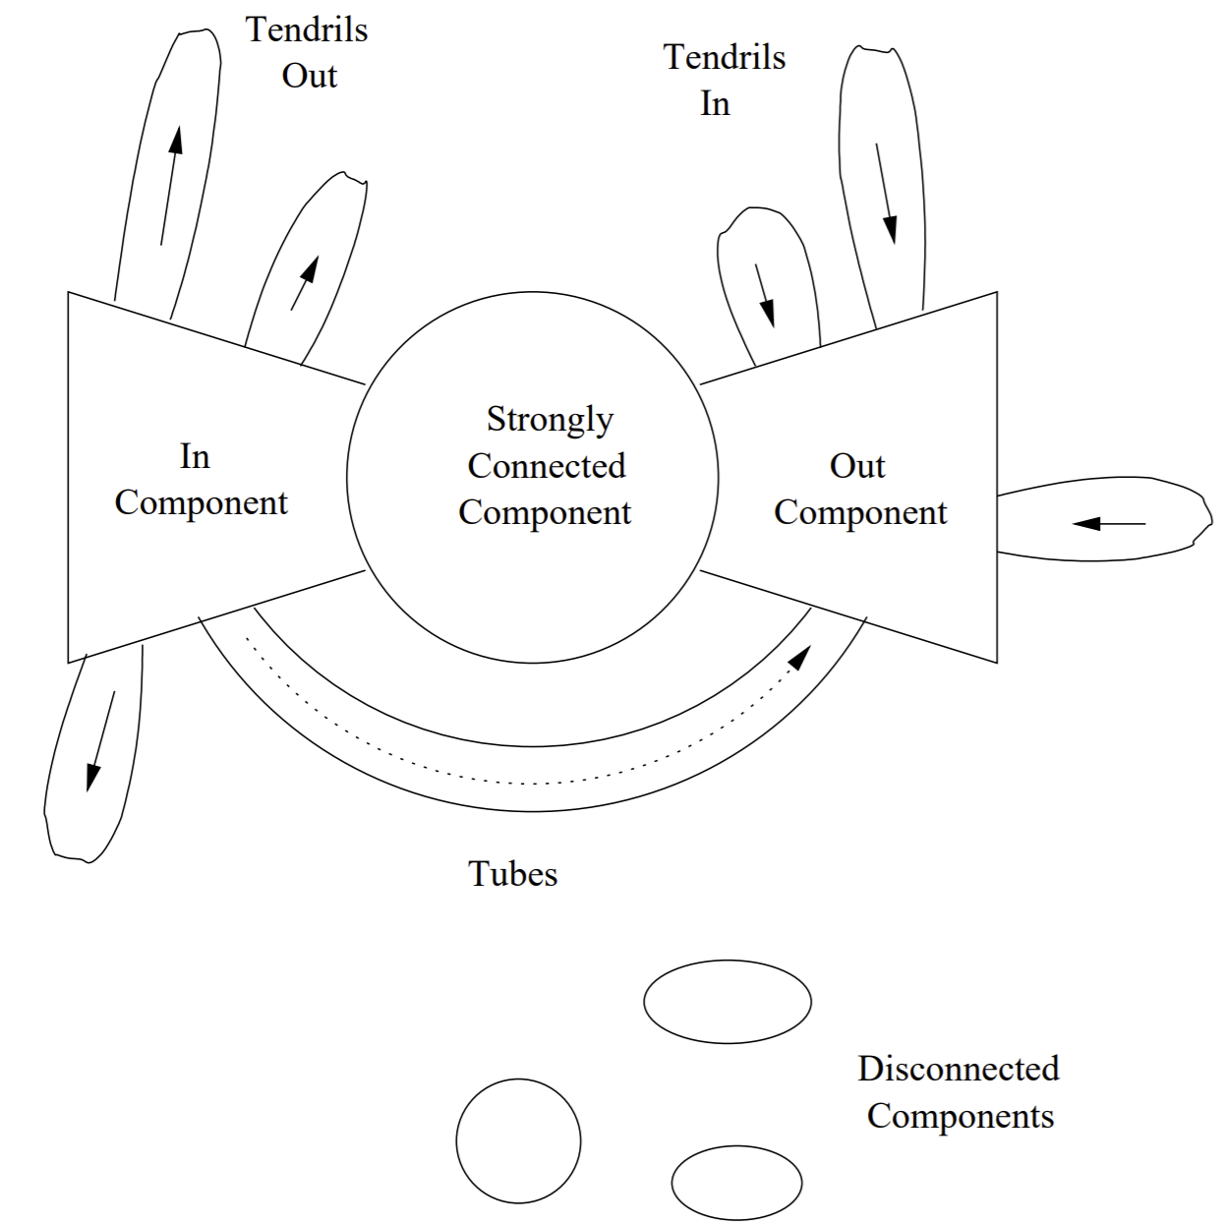
Searching on the Web
Structure of the web can be described by the bowtie model
Strongly connected core
Widely referenced pages
Both in and out links
In component comprises pages that link to the strongly connected core
Mostly links to strongly connected core
Few in-links
Out component are pages referenced by other pages
Few out-links

Slide 34
Searching on the Web
Structure of the web can be described by the bowtie model
Tendrils Out are links to pages with no out-links, called dead ends
Tendrils In are in-links to the Out Components from relatively isolated pages
Tubes connect directly from the In Component to the Out Component
Disconnected Components are groups of isolated pages which do not connect to the rest of the web – typically private networks

Slide 35
Learning the Structure of the Web

Slide 36
Learning the Structure of the Web
How can we learn the structure of the web?
The importance of a web page for a search can be measured by its centrality
Centrality is a measure of how important a graph node is with respect to the other nodes
Web pages
Social networks
We assume the more central a web page is the more important it is as a search result
Centrality in networks is an old idea
Developed by Kratz, 1953, for scocialogical analysis of networks of people

Slide 37
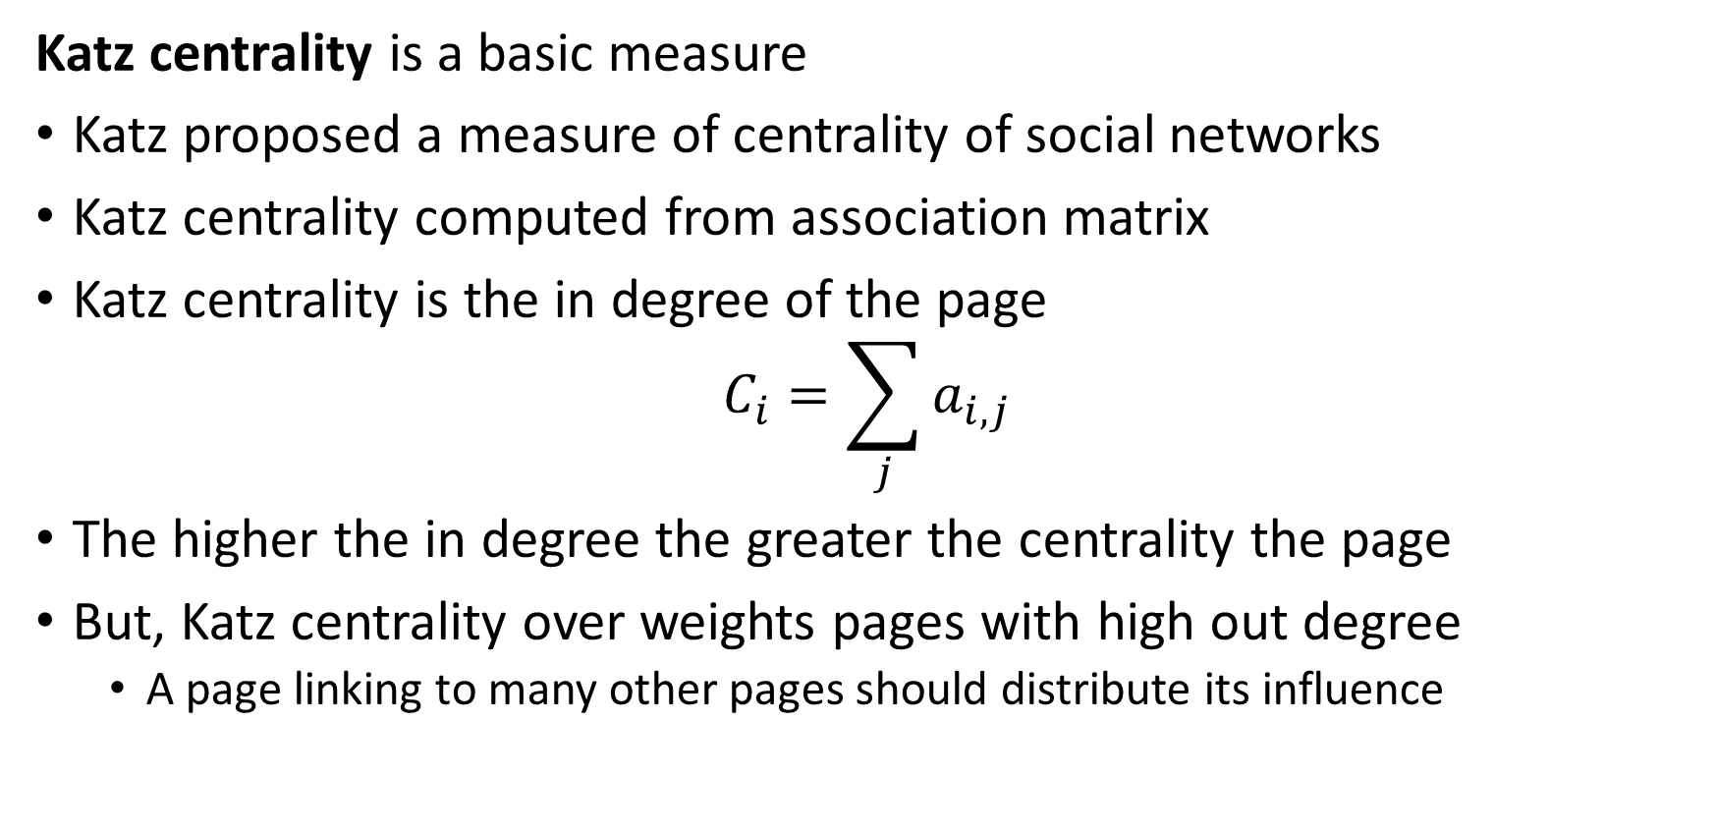
Measures of Centrality
Katz centrality is a basic measure
Katz proposed a measure of centrality of social networks
Katz centrality computed from association matrix
Katz centrality is the in degree of the page
$$C_{i}=\sum_{j}{a_{i,j}}$$
The higher the in degree the greater the centrality the page
But, Katz centrality over weights pages with high out degree
A page linking to many other pages should distribute its influence

Slide 38
Learning the Structure of the Web?
How can we learn the structure of the web?
Idea: randomly surf the web to discover links between pages
The surfer starts at a random page
Follows randomly chosen link out of page
Continues to follow random links from page to page
The probabilities of transitions into a page ranks the page’s importance
Assume high probability of landing on pages with many in-links
This is the basis of the PageRank algorithm
Is a steady state Markov processes!
PageRank is an unsupervised learning algorithm
Learns page importance without marked cases – no ground truth

Slide 39
Learning the Structure of the Web
Consider a small scale example
Pages are nodes of a directed graph
The directed edges represent hyperlinks from one page to another
The graph is complete - each page can be accessed by one or more steps from any other page
No self loops
No terminal nodes – dead ends
Transitions from one page to another on this graph represent a Markov process
Page 1
Page 3
Page 2
Page 4
Page 5

Slide 40
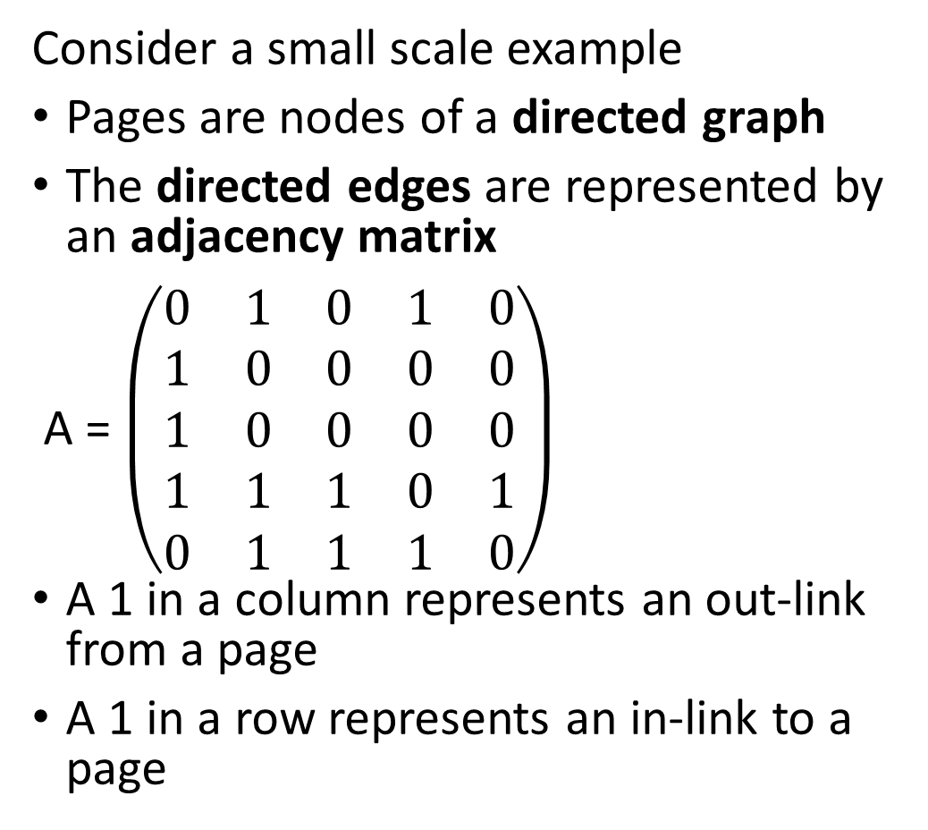
Learning the Structure of the Web
Consider a small scale example
Pages are nodes of a directed graph
The directed edges are represented by an adjacency matrix
A = $\left(\begin{matrix}0 & 1 & 0 & 1 & 0 \\ 1 & 0 & 0 & 0 & 0 \\ 1 & 0 & 0 & 0 & 0 \\ 1 & 1 & 1 & 0 & 1 \\ 0 & 1 & 1 & 1 & 0\end{matrix}\right)$
A 1 in a column represents an out-link from a page
A 1 in a row represents an in-link to a page
Page 1
Page 3
Page 2
Page 4
Page 5

Slide 41

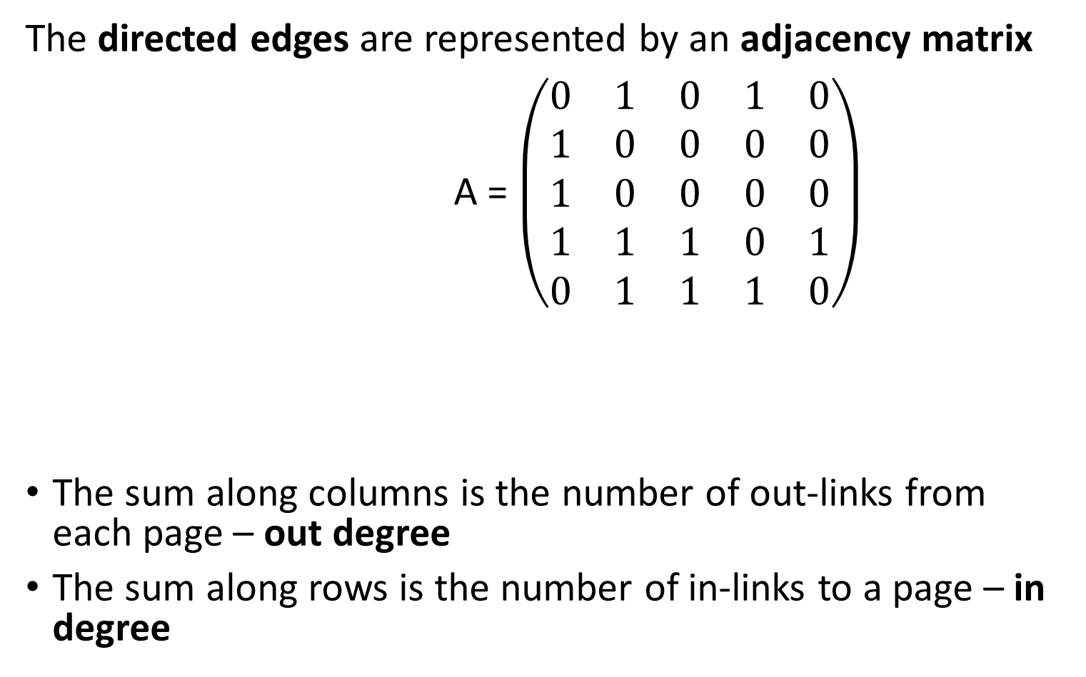

Learning the Structure of the Web
The directed edges are represented by an adjacency matrix
A = $\left(\begin{matrix}0 & 1 & 0 & 1 & 0 \\ 1 & 0 & 0 & 0 & 0 \\ 1 & 0 & 0 & 0 & 0 \\ 1 & 1 & 1 & 0 & 1 \\ 0 & 1 & 1 & 1 & 0\end{matrix}\right)$
The sum along columns is the number of out-links from each page – out degree
The sum along rows is the number of in-links to a page – in degree
$$\sum_{ rows}{=in degree}=\left(\begin{matrix}2 \\ 1 \\ 1 \\ 4 \\ 3\end{matrix}\right)$$
$$\sum_{columns}{=out degree}=\left(\begin{matrix}3 & 3 & 2 & 2 & 1\end{matrix}\right)$$

Slide 42
Simple PageRank Algorithm

Slide 43
Simple PageRank
Compute the PageRank of the complete graph of 5 web pages
Complete graph defines a stochastic Markov process
PageRank normalizes influence of out degree of page
Inverse out degree weight of page reduces influence of pages with large out degree
Distributes influence equally between pages linked
At convergence the probabilities of being on a page is its PageRank
Compute PageRank probabilities with a Markov chain
Known as the iterative PageRank algorithm
An efficient algorithm to find a first eigenvector

Slide 44
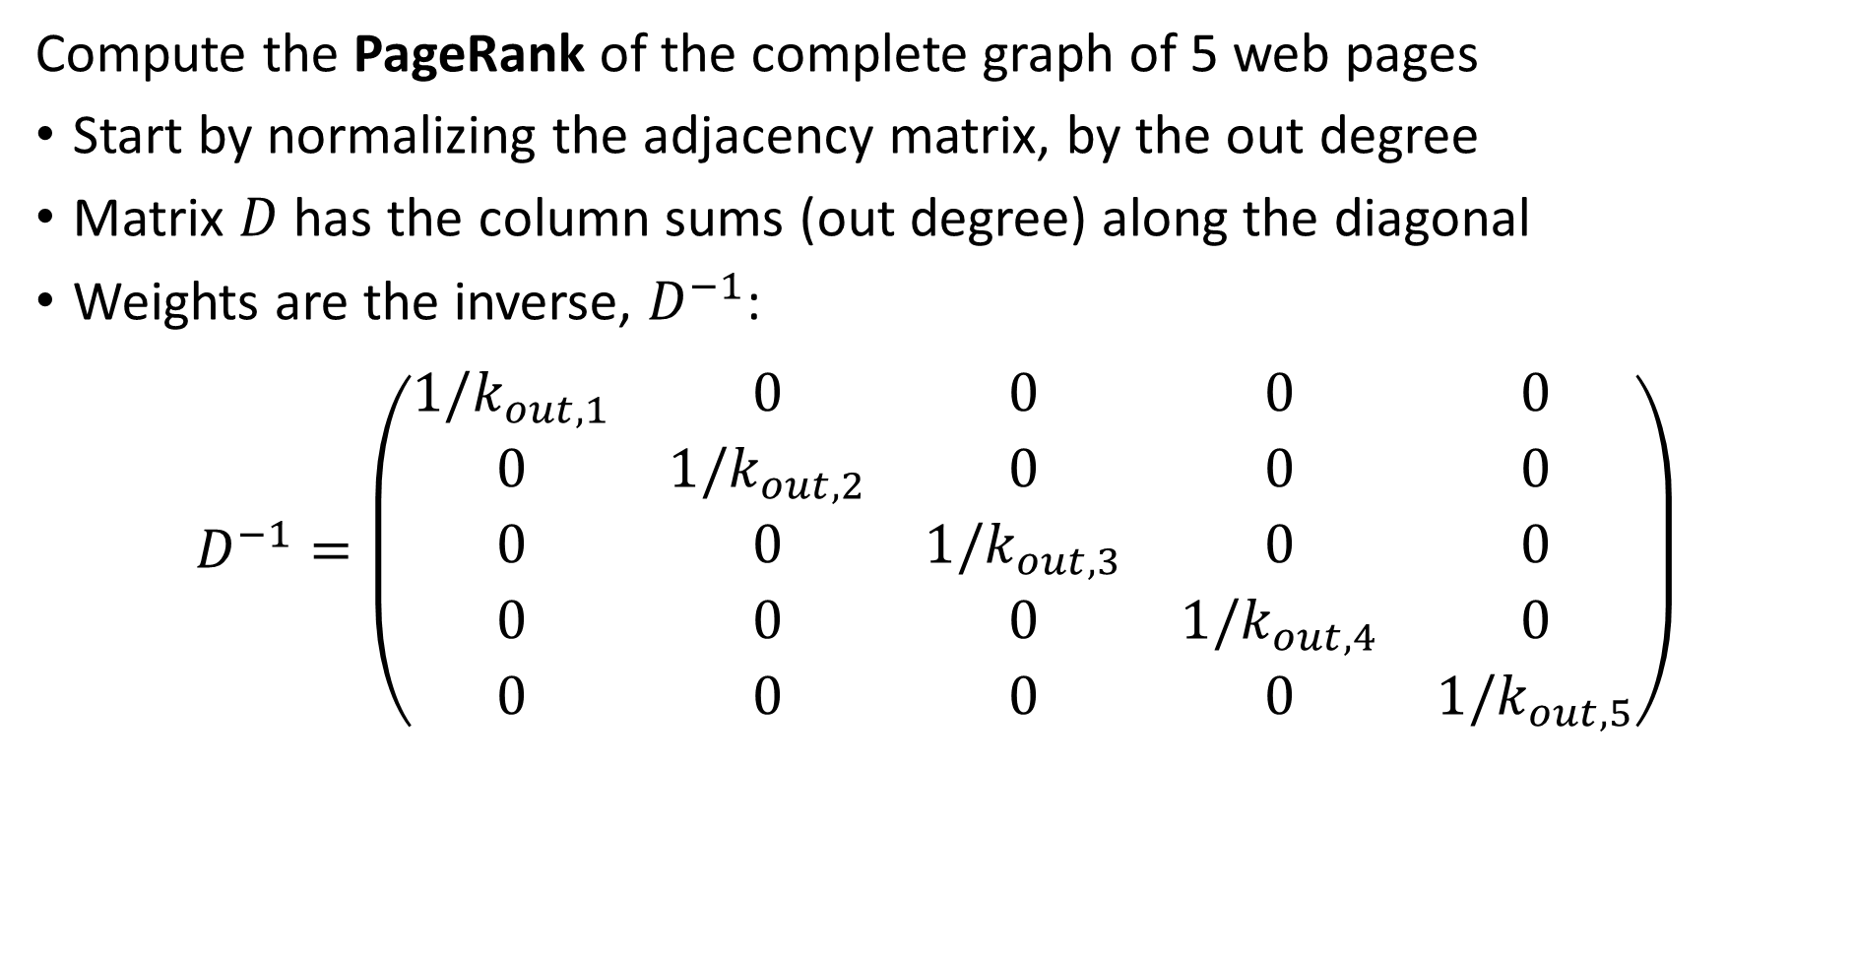
Simple PageRank
Compute the PageRank of the complete graph of 5 web pages
Start by normalizing the adjacency matrix, by the out degree
Matrix $D$ has the column sums (out degree) along the diagonal
Weights are the inverse, $D^{−1}$:
$$D^{−1}=\left(\begin{matrix}1/k_{out,1} & 0 & 0 & 0 & 0 \\ 0 & 1/k_{out,2} & 0 & 0 & 0 \\ 0 & 0 & 1/k_{out,3} & 0 & 0 \\ 0 & 0 & 0 & 1/k_{out,4} & 0 \\ 0 & 0 & 0 & 0 & 1/k_{out,5}\end{matrix}\right)$$

Slide 45
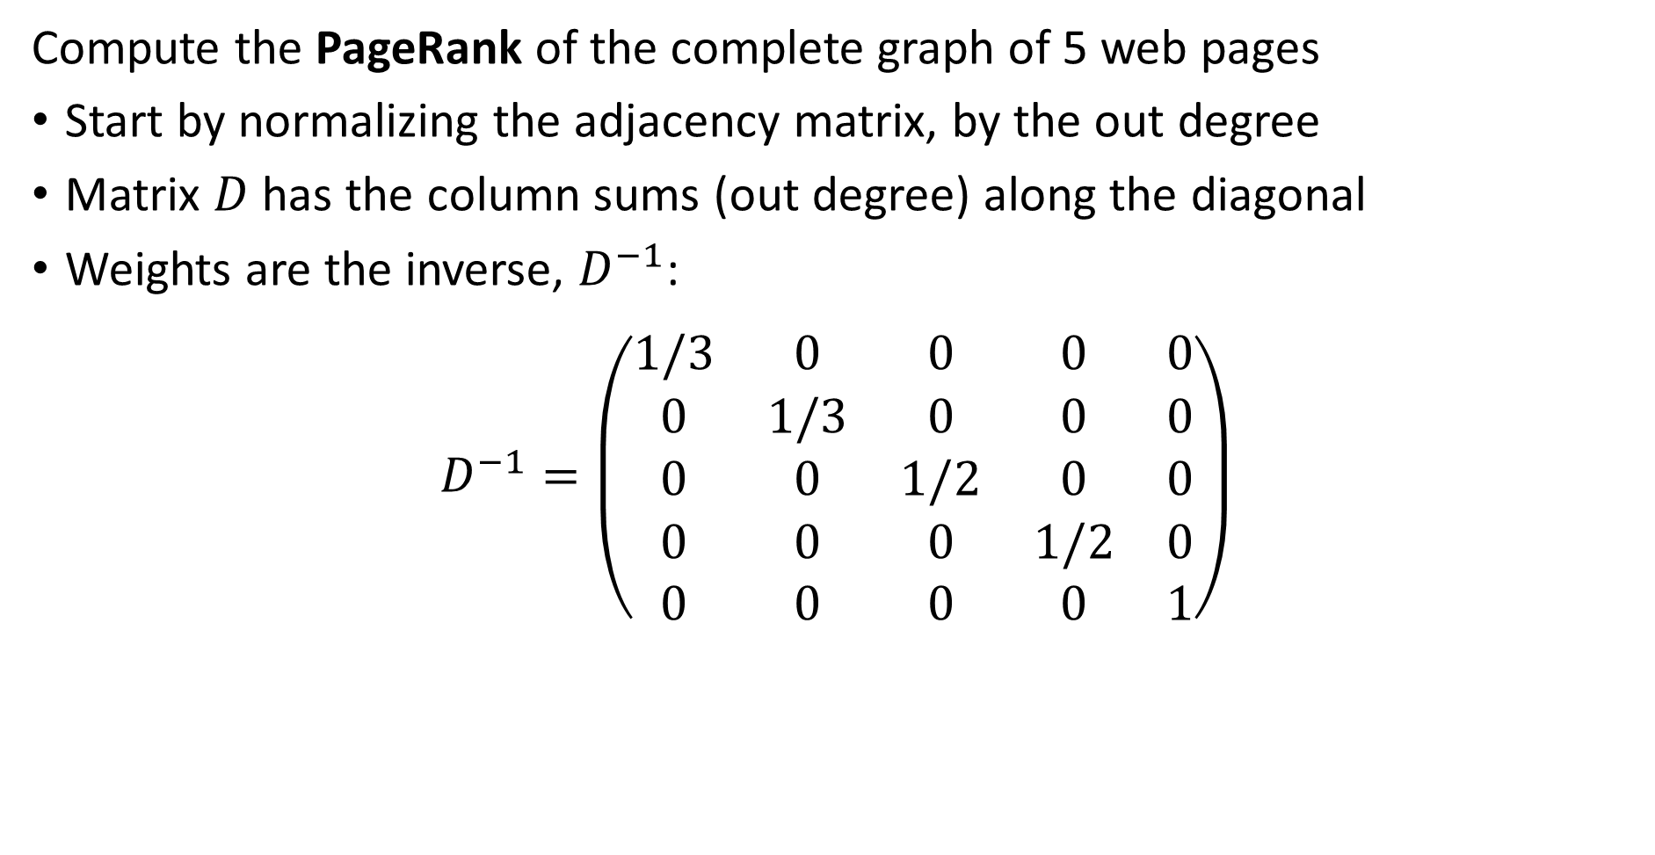
Simple PageRank
Compute the PageRank of the complete graph of 5 web pages
Start by normalizing the adjacency matrix, by the out degree
Matrix $D$ has the column sums (out degree) along the diagonal
Weights are the inverse, $D^{−1}$:
$$D^{−1}=\left(\begin{matrix}1/3 & 0 & 0 & 0 & 0 \\ 0 & 1/3 & 0 & 0 & 0 \\ 0 & 0 & 1/2 & 0 & 0 \\ 0 & 0 & 0 & 1/2 & 0 \\ 0 & 0 & 0 & 0 & 1\end{matrix}\right)$$

Slide 46
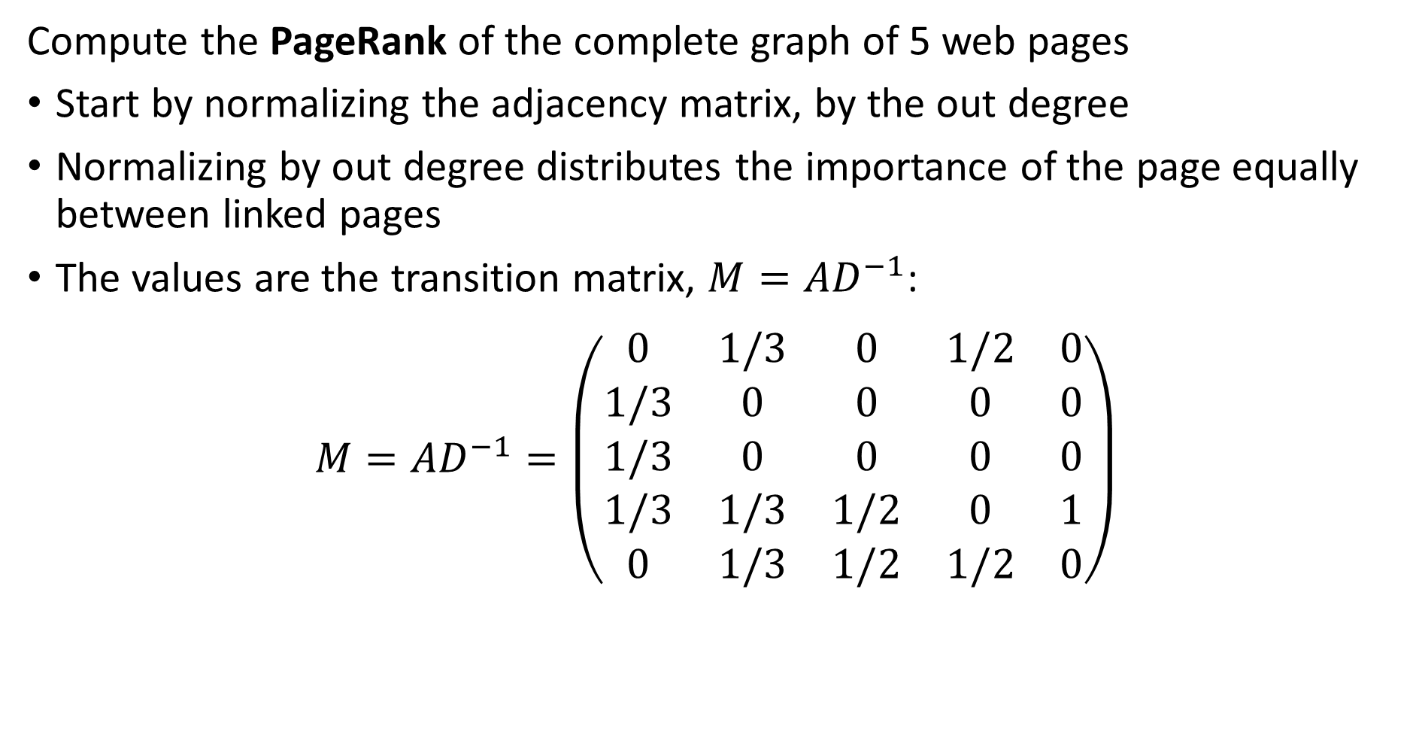
Simple PageRank
Compute the PageRank of the complete graph of 5 web pages
Start by normalizing the adjacency matrix, by the out degree
Normalizing by out degree distributes the importance of the page equally between linked pages
The values are the transition matrix, $M=AD^{−1}$:
$${M=AD}^{−1}=\left(\begin{matrix}0 & 1/3 & 0 & 1/2 & 0 \\ 1/3 & 0 & 0 & 0 & 0 \\ 1/3 & 0 & 0 & 0 & 0 \\ 1/3 & 1/3 & 1/2 & 0 & 1 \\ 0 & 1/3 & 1/2 & 1/2 & 0\end{matrix}\right)$$

Slide 47
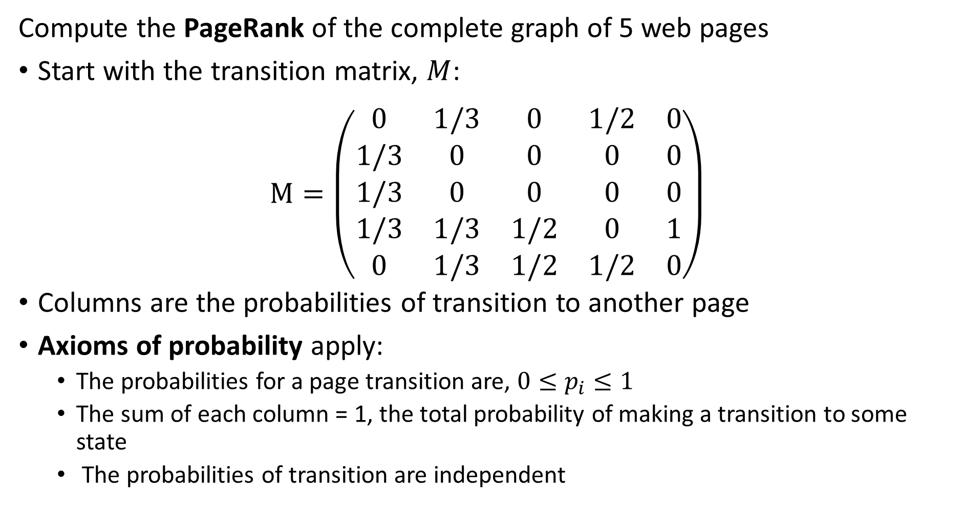
Simple PageRank
Compute the PageRank of the complete graph of 5 web pages
Start with the transition matrix, $M$:
$$M=\left(\begin{matrix}0 & 1/3 & 0 & 1/2 & 0 \\ 1/3 & 0 & 0 & 0 & 0 \\ 1/3 & 0 & 0 & 0 & 0 \\ 1/3 & 1/3 & 1/2 & 0 & 1 \\ 0 & 1/3 & 1/2 & 1/2 & 0\end{matrix}\right)$$
Columns are the probabilities of transition to another page
Axioms of probability apply:
The probabilities for a page transition are, $0≤p_{i}≤1$
The sum of each column = 1, the total probability of making a transition to some state
The probabilities of transition are independent

Slide 48
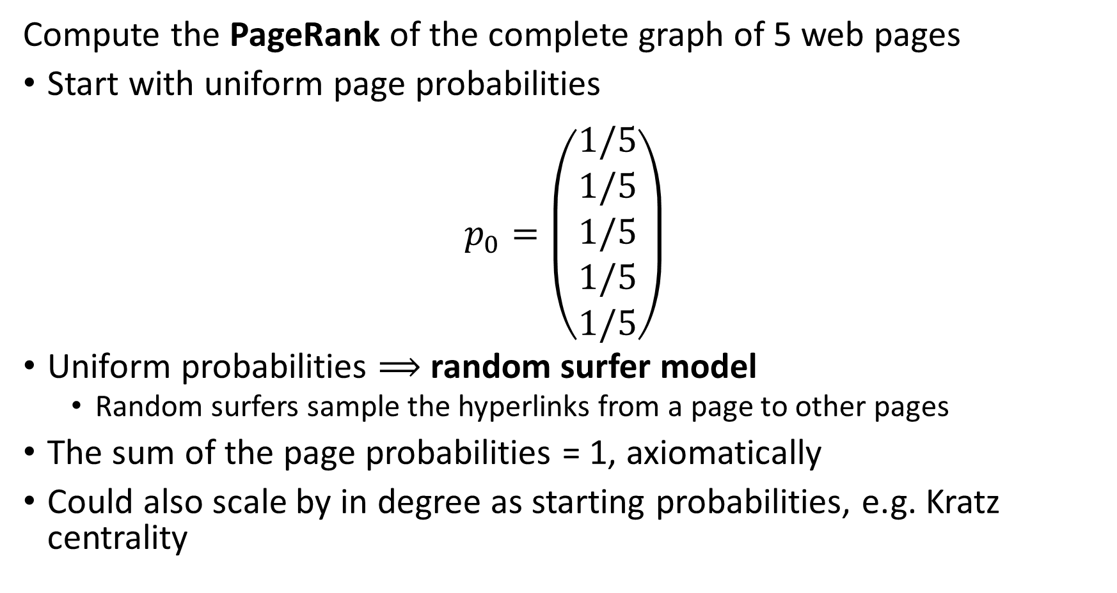
Simple PageRank
Compute the PageRank of the complete graph of 5 web pages
Start with uniform page probabilities
$$p_{0}=\left(\begin{matrix}1/5 \\ 1/5 \\ 1/5 \\ 1/5 \\ 1/5\end{matrix}\right)$$
Uniform probabilities $⟹$ random surfer model
Random surfers sample the hyperlinks from a page to other pages
The sum of the page probabilities = 1, axiomatically
Could also scale by in degree as starting probabilities, e.g. Kratz centrality

Slide 49
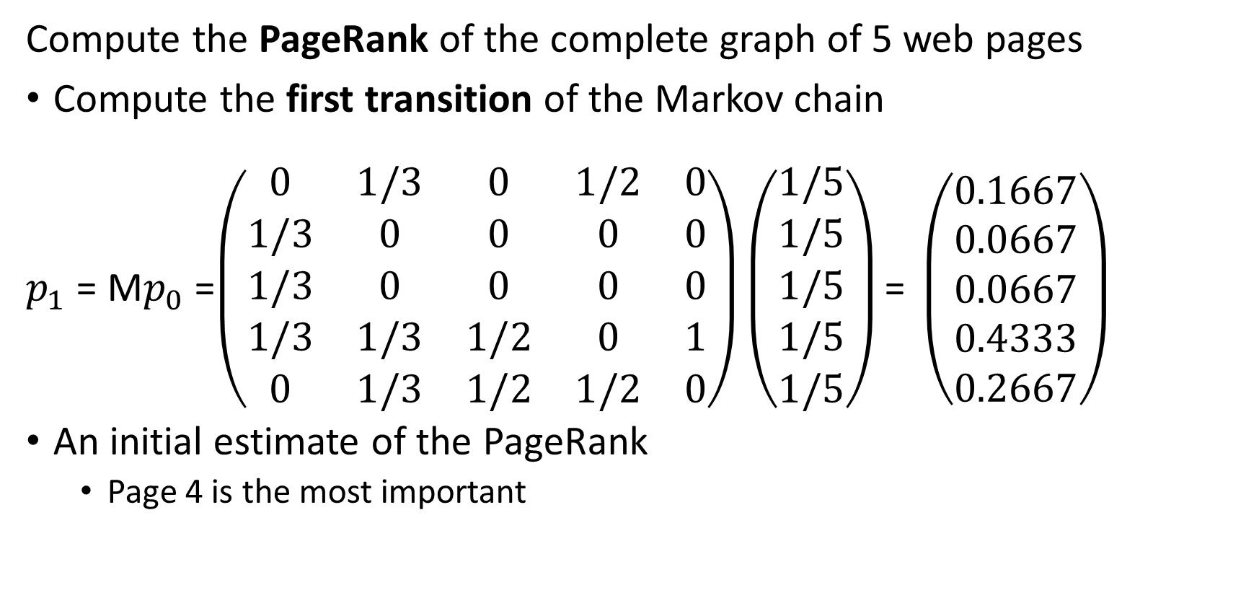
Simple PageRank
Compute the PageRank of the complete graph of 5 web pages
Compute the first transition of the Markov chain
$p_{1}$ = M$p_{0}$ =$\left(\begin{matrix}0 & 1/3 & 0 & 1/2 & 0 \\ 1/3 & 0 & 0 & 0 & 0 \\ 1/3 & 0 & 0 & 0 & 0 \\ 1/3 & 1/3 & 1/2 & 0 & 1 \\ 0 & 1/3 & 1/2 & 1/2 & 0\end{matrix}\right)\left(\begin{matrix}1/5 \\ 1/5 \\ 1/5 \\ 1/5 \\ 1/5\end{matrix}\right)\text{= }\left(\begin{matrix}0.1667 \\ 0.0667 \\ 0.0667 \\ 0.4333 \\ 0.2667\end{matrix}\right)$
An initial estimate of the PageRank
Page 4 is the most important

Slide 50
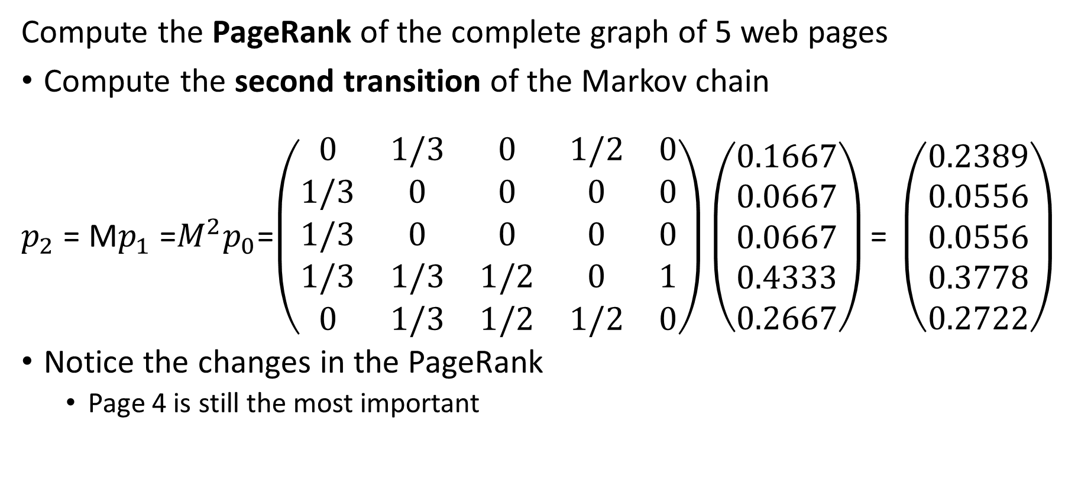
Simple PageRank
Compute the PageRank of the complete graph of 5 web pages
Compute the second transition of the Markov chain
$p_{2}$ = M$p_{1}$ =$M^{2}p_{0}$=$\left(\begin{matrix}0 & 1/3 & 0 & 1/2 & 0 \\ 1/3 & 0 & 0 & 0 & 0 \\ 1/3 & 0 & 0 & 0 & 0 \\ 1/3 & 1/3 & 1/2 & 0 & 1 \\ 0 & 1/3 & 1/2 & 1/2 & 0\end{matrix}\right)\left(\begin{matrix}0.1667 \\ 0.0667 \\ 0.0667 \\ 0.4333 \\ 0.2667\end{matrix}\right)\text{= }\left(\begin{matrix}0.2389 \\ 0.0556 \\ 0.0556 \\ 0.3778 \\ 0.2722\end{matrix}\right)$
Notice the changes in the PageRank
Page 4 is still the most important

Slide 51
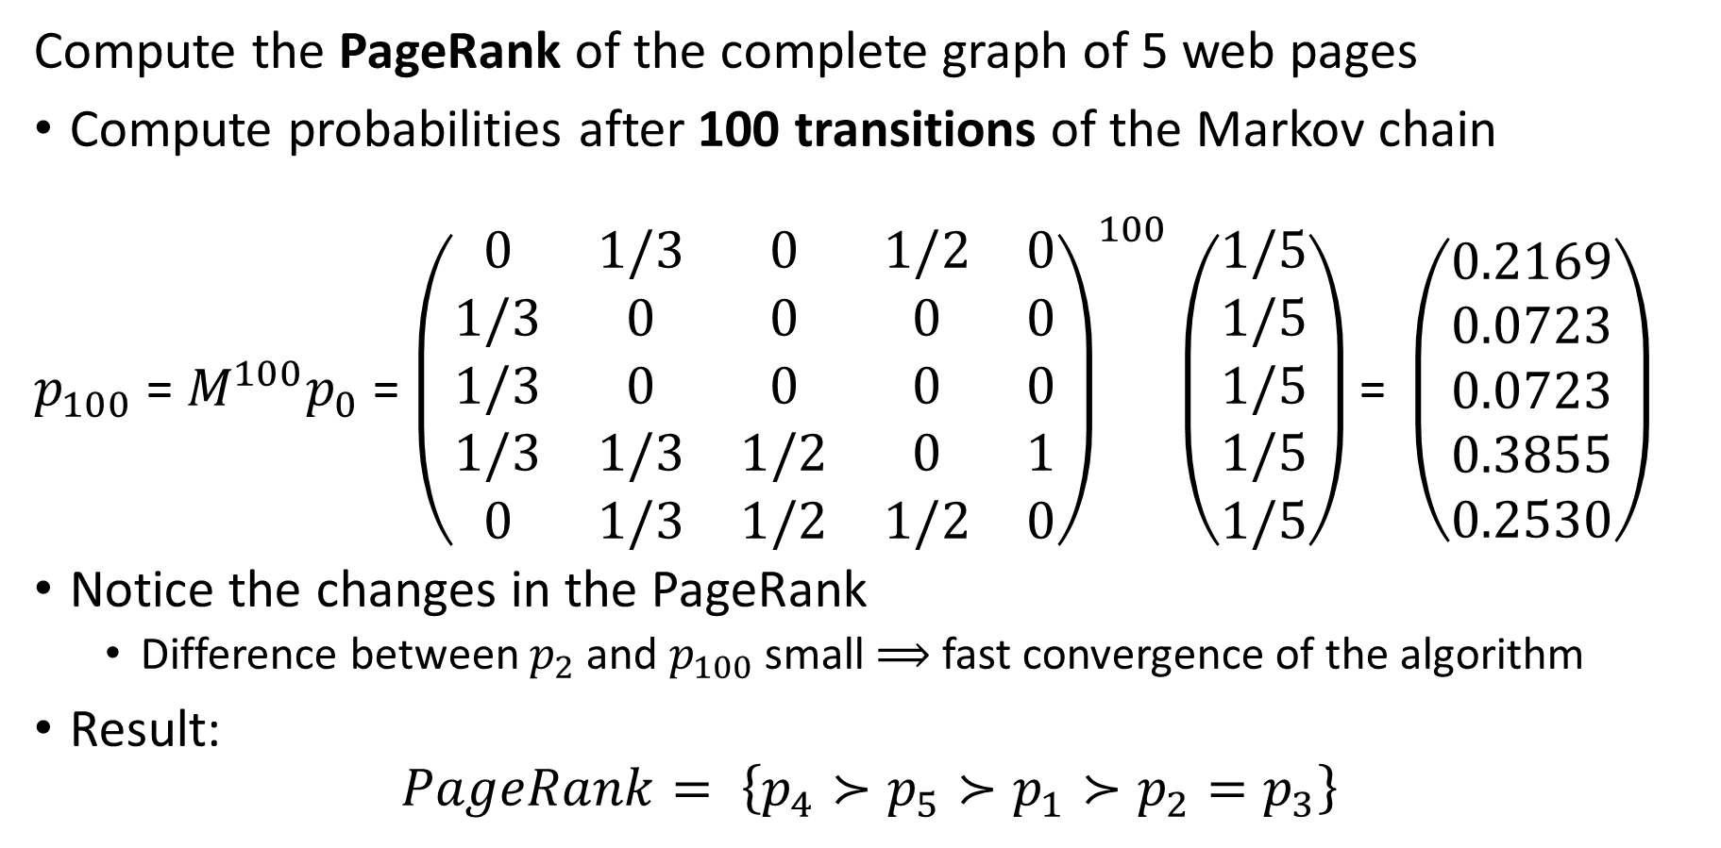
Simple PageRank
Compute the PageRank of the complete graph of 5 web pages
Compute probabilities after 100 transitions of the Markov chain
$p_{100}$ = $M^{100}p_{0}$ = ${\left(\begin{matrix}0 & 1/3 & 0 & 1/2 & 0 \\ 1/3 & 0 & 0 & 0 & 0 \\ 1/3 & 0 & 0 & 0 & 0 \\ 1/3 & 1/3 & 1/2 & 0 & 1 \\ 0 & 1/3 & 1/2 & 1/2 & 0\end{matrix}\right)}^{100}\left(\begin{matrix}1/5 \\ 1/5 \\ 1/5 \\ 1/5 \\ 1/5\end{matrix}\right)\text{= }\left(\begin{matrix}0.2169 \\ 0.0723 \\ 0.0723 \\ 0.3855 \\ 0.2530\end{matrix}\right)$
Notice the changes in the PageRank
Difference between $p_{2}$ and $p_{100}$ small $⟹$ fast convergence of the algorithm
Result:
$$PageRank= \left\{p_{4}≻p_{5}≻p_{1}≻p_{2}=p_{3}\right\}$$

Slide 52
Damped PageRank

Slide 53
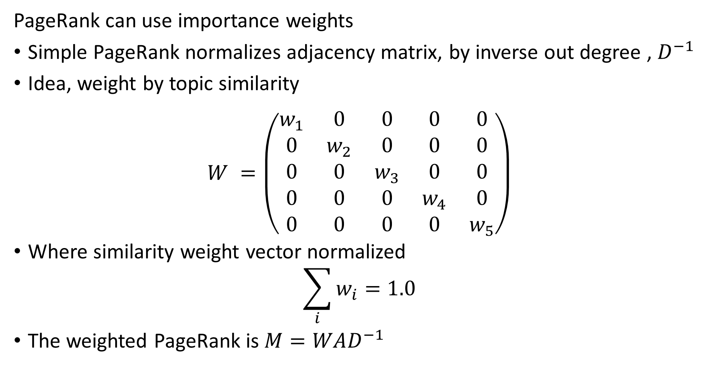
Weights for PageRank
PageRank can use importance weights
Simple PageRank normalizes adjacency matrix, by inverse out degree , $D^{−1}$
Idea, weight by topic similarity
$$W^{ }=\left(\begin{matrix}w_{1} & 0 & 0 & 0 & 0 \\ 0 & w_{2} & 0 & 0 & 0 \\ 0 & 0 & w_{3} & 0 & 0 \\ 0 & 0 & 0 & w_{4} & 0 \\ 0 & 0 & 0 & 0 & w_{5}\end{matrix}\right)$$
Where similarity weight vector normalized
$$\sum_{i}^{ }{w_{i}=1.0}$$
The weighted PageRank is $M=WAD^{−1}$

Slide 54
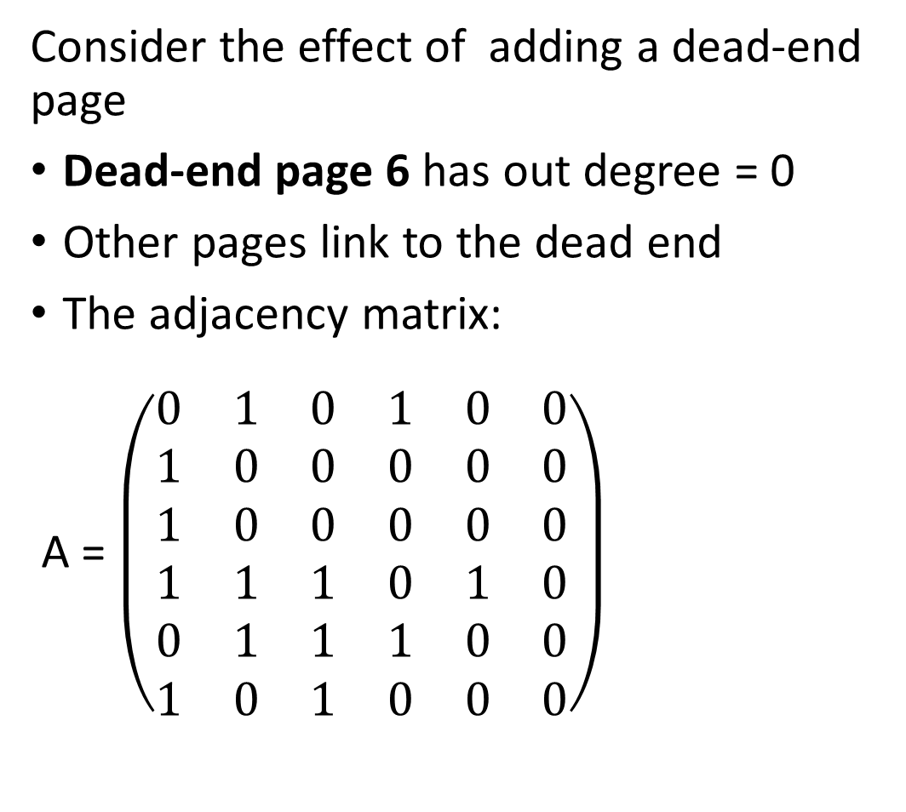
Damped PageRank
Page 6
Consider the effect of adding a dead-end page
Dead-end page 6 has out degree = 0
Other pages link to the dead end
The adjacency matrix:
A = $\left(\begin{matrix}0 & 1 & 0 & 1 & 0 & 0 \\ 1 & 0 & 0 & 0 & 0 & 0 \\ 1 & 0 & 0 & 0 & 0 & 0 \\ 1 & 1 & 1 & 0 & 1 & 0 \\ 0 & 1 & 1 & 1 & 0 & 0 \\ 1 & 0 & 1 & 0 & 0 & 0\end{matrix}\right)$
Page 1
Page 3
Page 2
Page 4
Page 5

Slide 55
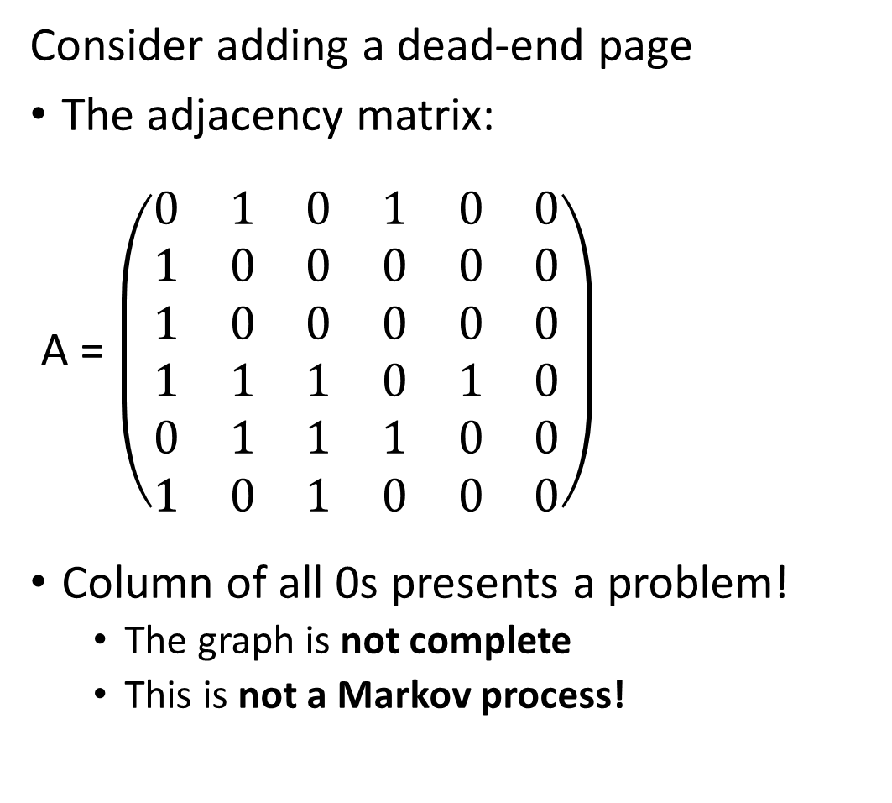
Damped PageRank
Page 6
Consider adding a dead-end page
The adjacency matrix:
A = $\left(\begin{matrix}0 & 1 & 0 & 1 & 0 & 0 \\ 1 & 0 & 0 & 0 & 0 & 0 \\ 1 & 0 & 0 & 0 & 0 & 0 \\ 1 & 1 & 1 & 0 & 1 & 0 \\ 0 & 1 & 1 & 1 & 0 & 0 \\ 1 & 0 & 1 & 0 & 0 & 0\end{matrix}\right)$
Column of all 0s presents a problem!
The graph is not complete
This is not a Markov process!
Page 1
Page 3
Page 2
Page 4
Page 5

Slide 56
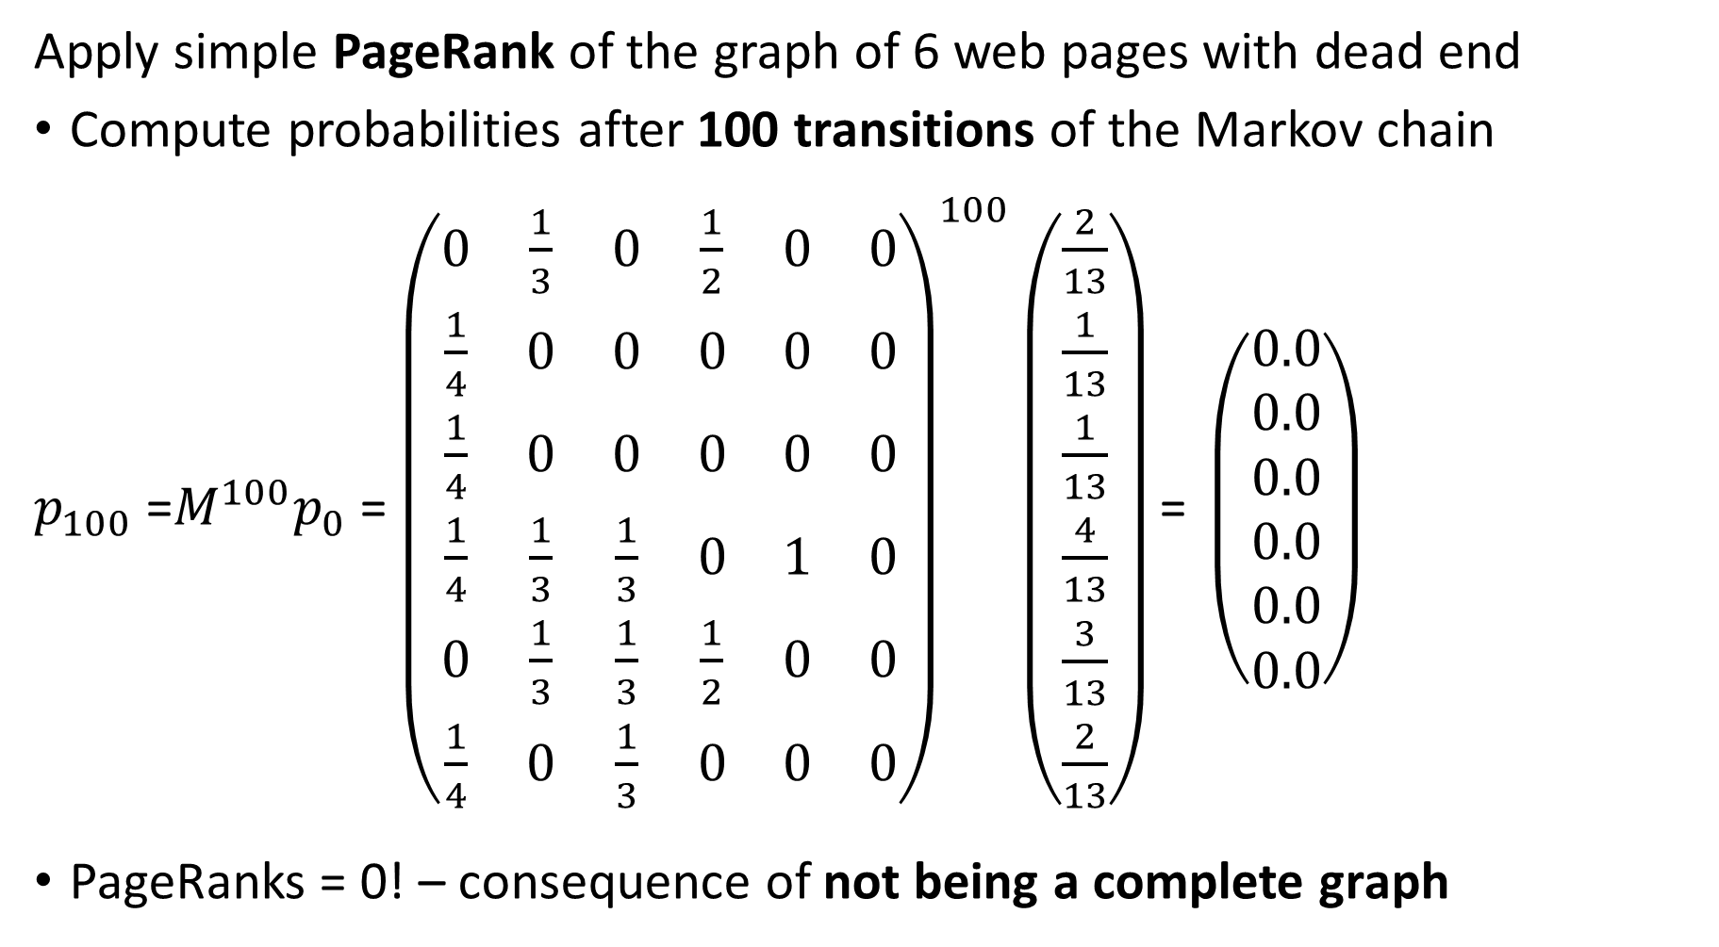
Damped PageRank
Apply simple PageRank of the graph of 6 web pages with dead end
Compute probabilities after 100 transitions of the Markov chain
$p_{100}$ =$M^{100}p_{0}$ = ${\left(\begin{matrix}0 & \frac{1}{3} & 0 & \frac{1}{2} & 0 & 0 \\ \frac{1}{4} & 0 & 0 & 0 & 0 & 0 \\ \frac{1}{4} & 0 & 0 & 0 & 0 & 0 \\ \frac{1}{4} & \frac{1}{3} & \frac{1}{3} & 0 & 1 & 0 \\ 0 & \frac{1}{3} & \frac{1}{3} & \frac{1}{2} & 0 & 0 \\ \frac{1}{4} & 0 & \frac{1}{3} & 0 & 0 & 0\end{matrix}\right)}^{100}\left(\begin{matrix}\frac{2}{13} \\ \frac{1}{13} \\ \frac{1}{13} \\ \frac{4}{13} \\ \frac{3}{13} \\ \frac{2}{13}\end{matrix}\right)\text{= }\left(\begin{matrix}0.0 \\ 0.0 \\ 0.0 \\ 0.0 \\ 0.0 \\ 0.0\end{matrix}\right)$
PageRanks = 0! – consequence of not being a complete graph

Slide 57
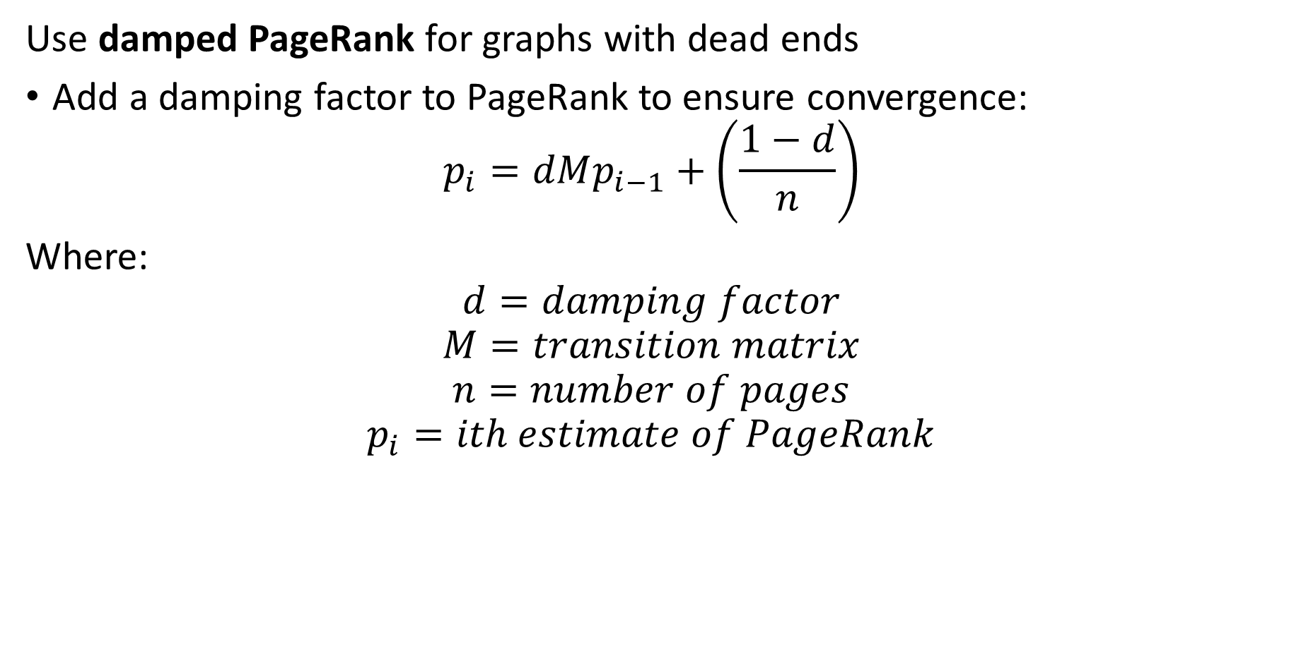
Damped PageRank
Use damped PageRank for graphs with dead ends
Add a damping factor to PageRank to ensure convergence:
$$p_{i}=dMp_{i−1}+\left(\frac{1−d}{n}\right)$$
Where:
$$d=damping factor$$
$$M=transition matrix$$
$$n=number of pages$$
$$p_{i}=ith estimate of PageRank$$

Slide 58
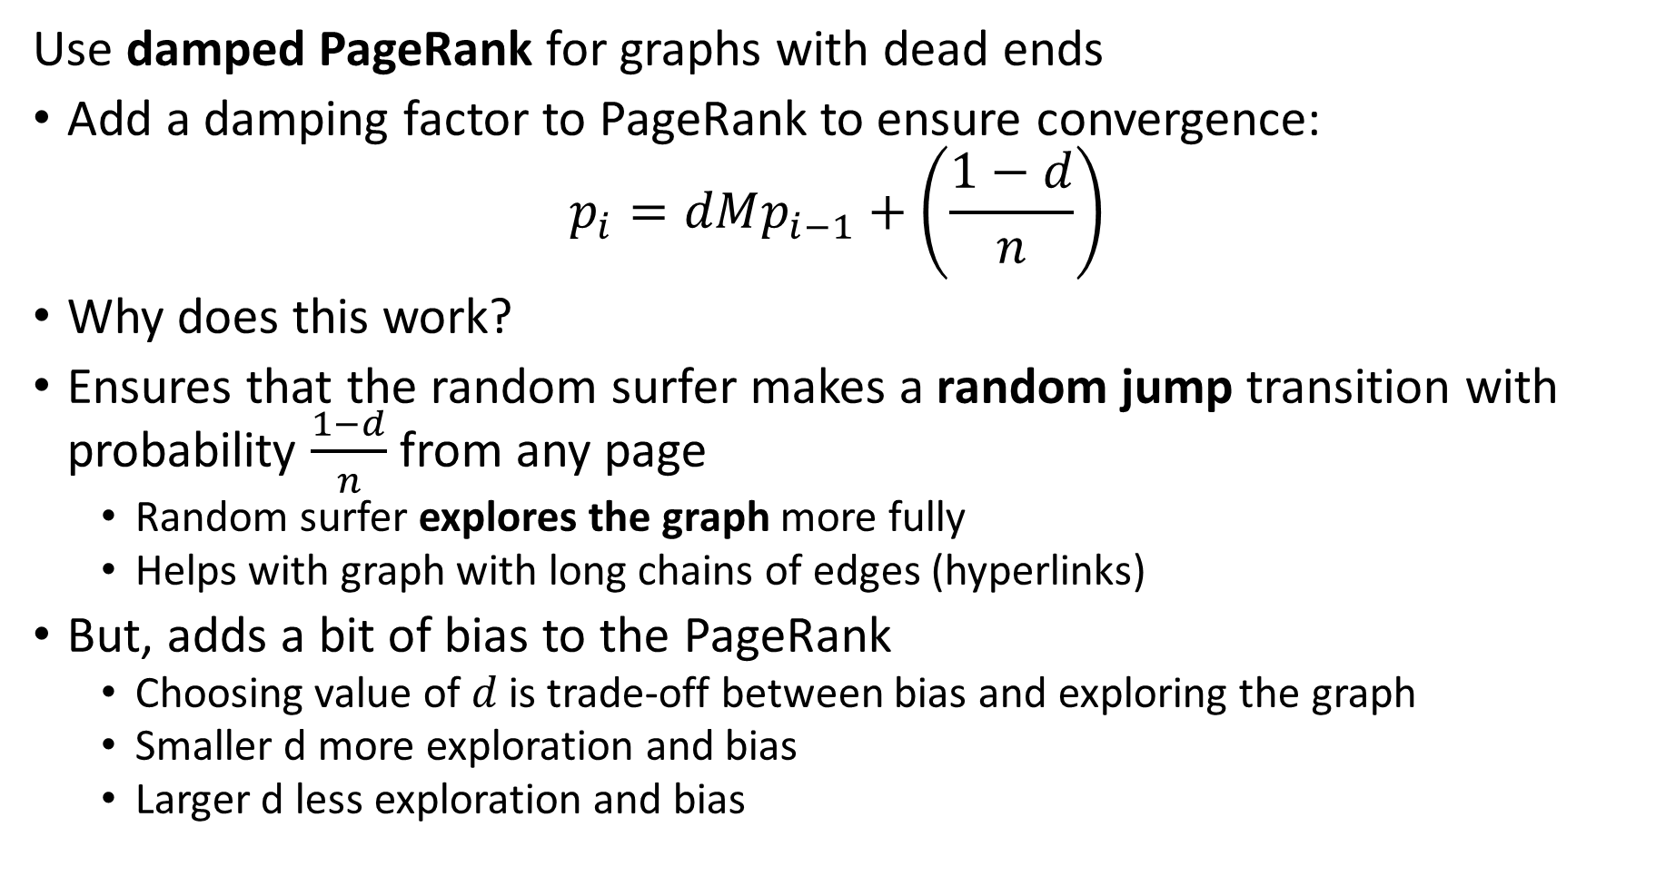
Damped PageRank
Use damped PageRank for graphs with dead ends
Add a damping factor to PageRank to ensure convergence:
$$p_{i}=dMp_{i−1}+\left(\frac{1−d}{n}\right)$$
Why does this work?
Ensures that the random surfer makes a random jump transition with probability $\frac{1−d}{n}$ from any page
Random surfer explores the graph more fully
Helps with graph with long chains of edges (hyperlinks)
But, adds a bit of bias to the PageRank
Choosing value of $d$ is trade-off between bias and exploring the graph
Smaller d more exploration and bias
Larger d less exploration and bias

Slide 59
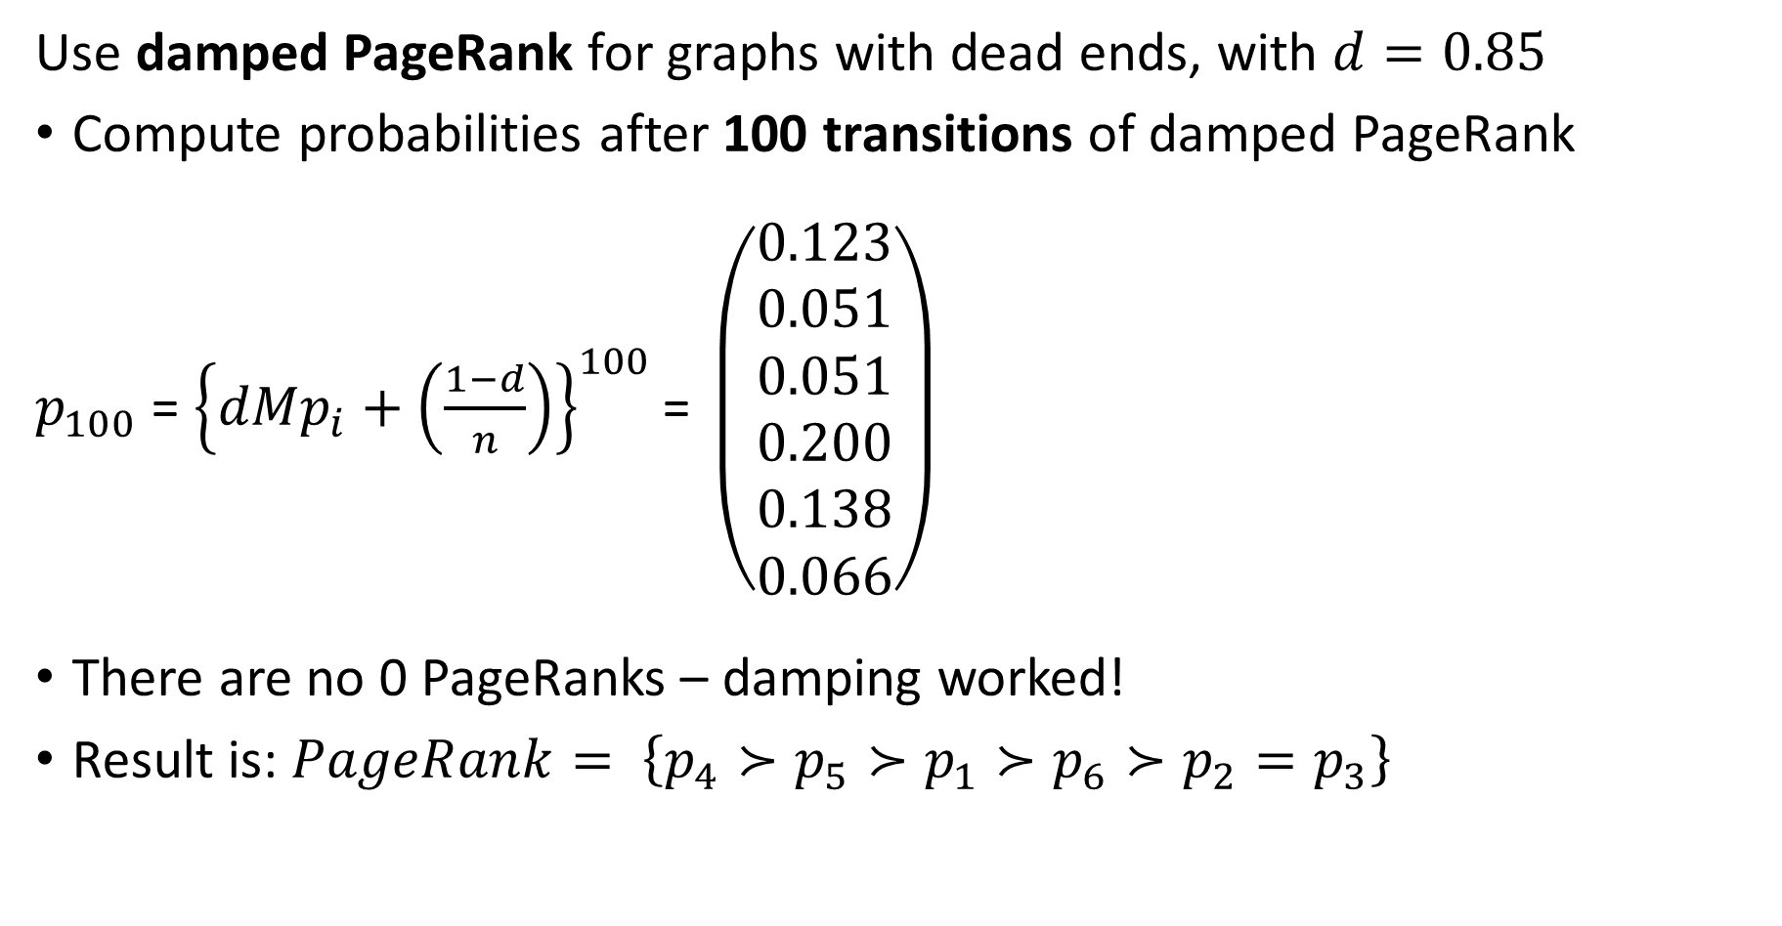
Damped PageRank
Use damped PageRank for graphs with dead ends, with $d=0.85$
Compute probabilities after 100 transitions of damped PageRank
$p_{100}$ = ${\left\{dMp_{i}+\left(\frac{1−d}{n}\right)\right\}}^{100}\text{= }\left(\begin{matrix}0.123 \\ 0.051 \\ 0.051 \\ 0.200 \\ 0.138 \\ 0.066\end{matrix}\right)$
There are no 0 PageRanks – damping worked!
Result is: $PageRank= \left\{p_{4}≻p_{5}≻p_{1}≻p_{6}≻p_{2}=p_{3}\right\}$

Slide 60
Damped Page Rank
Page 7
Consider the effect of adding a spider trap to the network
Nodes in the spider trap have no paths to other nodes.
Random surfer is trapped on these nodes
Effect is same as dead end
Use damped page rank to allow jumps out of trap
Page 8
Page 6
Page 3
Page 1
Page 4
Page 2
Page 5

Slide 61
TrustRank

Slide 62
Trust Rank
Are all pages of equal importance in a search?
No!
Some pages are more trusted
Pages known to have reliable content
Pages with higher semantic similarity to query
We want to weight our search to account for trust of page
Leads to the trust rank algorithm
We can use the same algorithm for topic relevance weights
From autoencoder, LLM, etc

Slide 63
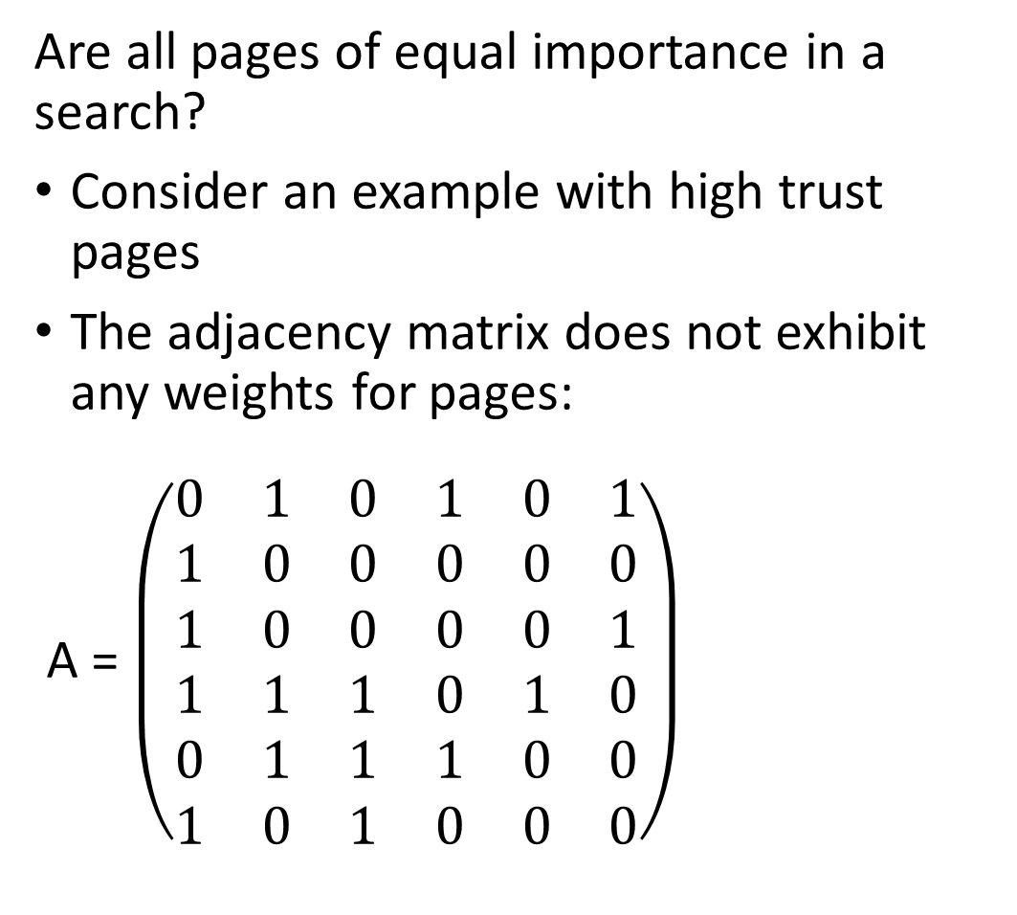
Trust Rank
Page 6
Are all pages of equal importance in a search?
Consider an example with high trust pages
The adjacency matrix does not exhibit any weights for pages:
A = $\left(\begin{matrix}0 & 1 & 0 & 1 & 0 & 1 \\ 1 & 0 & 0 & 0 & 0 & 0 \\ 1 & 0 & 0 & 0 & 0 & 1 \\ 1 & 1 & 1 & 0 & 1 & 0 \\ 0 & 1 & 1 & 1 & 0 & 0 \\ 1 & 0 & 1 & 0 & 0 & 0\end{matrix}\right)$
Page 1
Page 3
Page 2
Page 4
Page 5

Slide 64
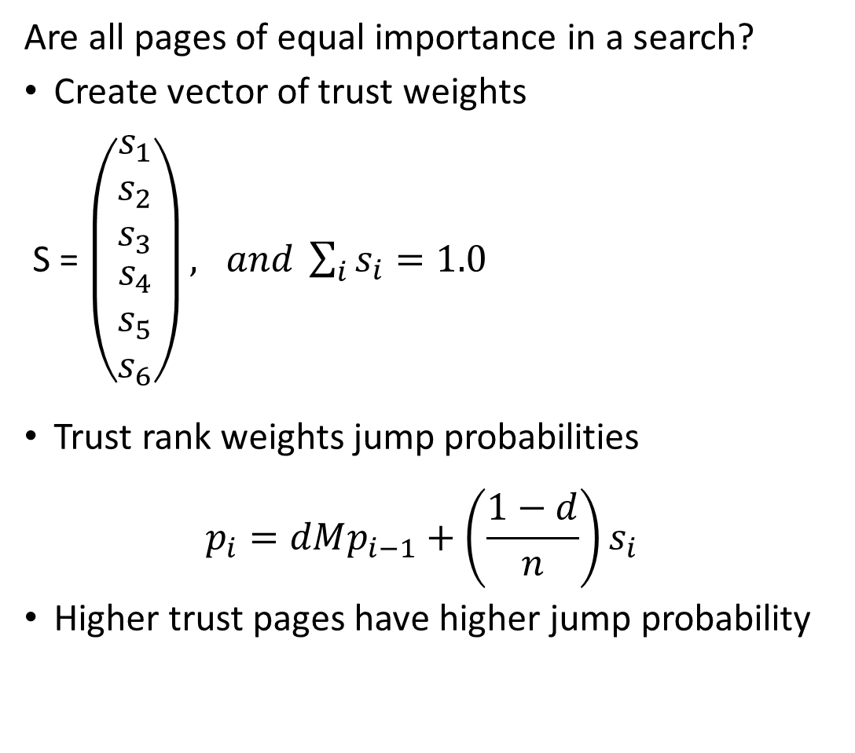
Trust Rank
Page 6
Are all pages of equal importance in a search?
Create vector of trust weights
S = $\left(\begin{matrix}\begin{matrix}s_{1} \\ s_{2} \\ s_{3}\end{matrix} \\ \begin{matrix}s_{4} \\ s_{5} \\ s_{6}\end{matrix}\end{matrix}\right), and \sum_{i}{s_{i}=1.0}$
Trust rank weights jump probabilities
$$p_{i}=dMp_{i−1}+\left(\frac{1−d}{n}\right)s_{i}$$
Higher trust pages have higher jump probability
Page 1
Page 3
Page 2
Page 4
Page 5

Slide 65
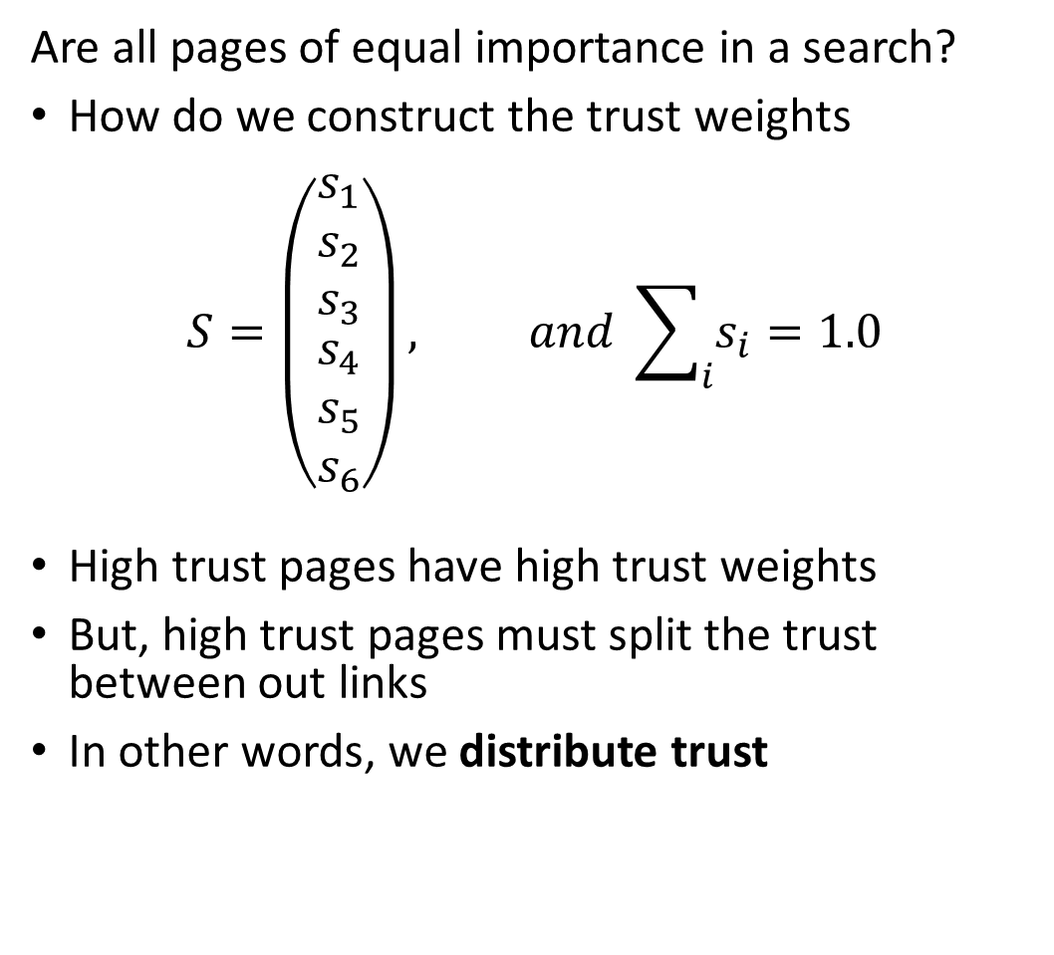
Trust Rank
Page 6
Are all pages of equal importance in a search?
How do we construct the trust weights
$$S=\left(\begin{matrix}\begin{matrix}s_{1} \\ s_{2} \\ s_{3}\end{matrix} \\ \begin{matrix}s_{4} \\ s_{5} \\ s_{6}\end{matrix}\end{matrix}\right), and \sum_{i}{s_{i}=1.0}$$
High trust pages have high trust weights
But, high trust pages must split the trust between out links
In other words, we distribute trust
Page 1
Page 3
Page 2
Page 4
Page 5

Slide 66
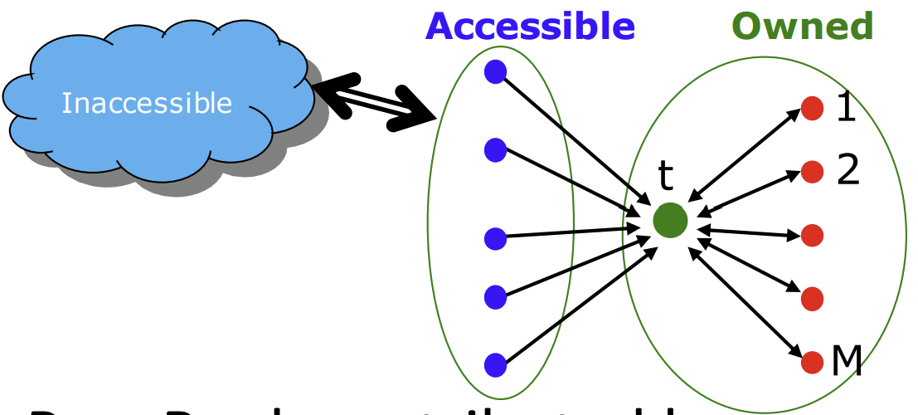
Trust Rank
Web SPAM is a significant problem for search engines
Owners of web pages want to artificially boost the importance
So called search engine optimization (SOE) is employed to boost page importance
This leads to web SPAM!
Owner of page creates other pages linked to page and uses accessible pages like social media to boost importance
Leskovec and Kanatsoulis, Standford CS 246, 2024

Slide 67
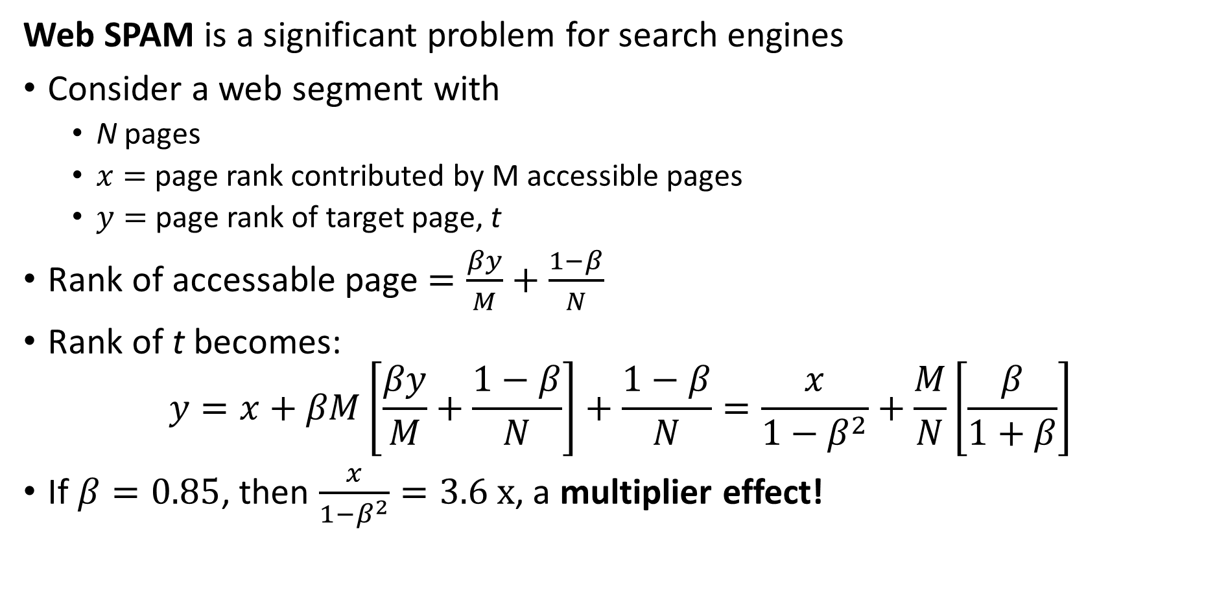
Trust Rank
Web SPAM is a significant problem for search engines
Consider a web segment with
N pages
$x=$ page rank contributed by M accessible pages
$y=$ page rank of target page, t
Rank of accessable page $=\frac{βy}{M}+\frac{1−β}{N}$
Rank of t becomes:
$$y=x+βM\left[\frac{βy}{M}+\frac{1−β}{N}\right]+\frac{1−β}{N}=\frac{x}{1−β^{2}}+\frac{M}{N}\left[\frac{β}{1+β}\right]$$
If $β=0.85$, then $\frac{x}{1−β^{2}}=3.6 x$, a multiplier effect!
Leskovec and Kanatsoulis, Standford CS 246, 2024

Slide 68
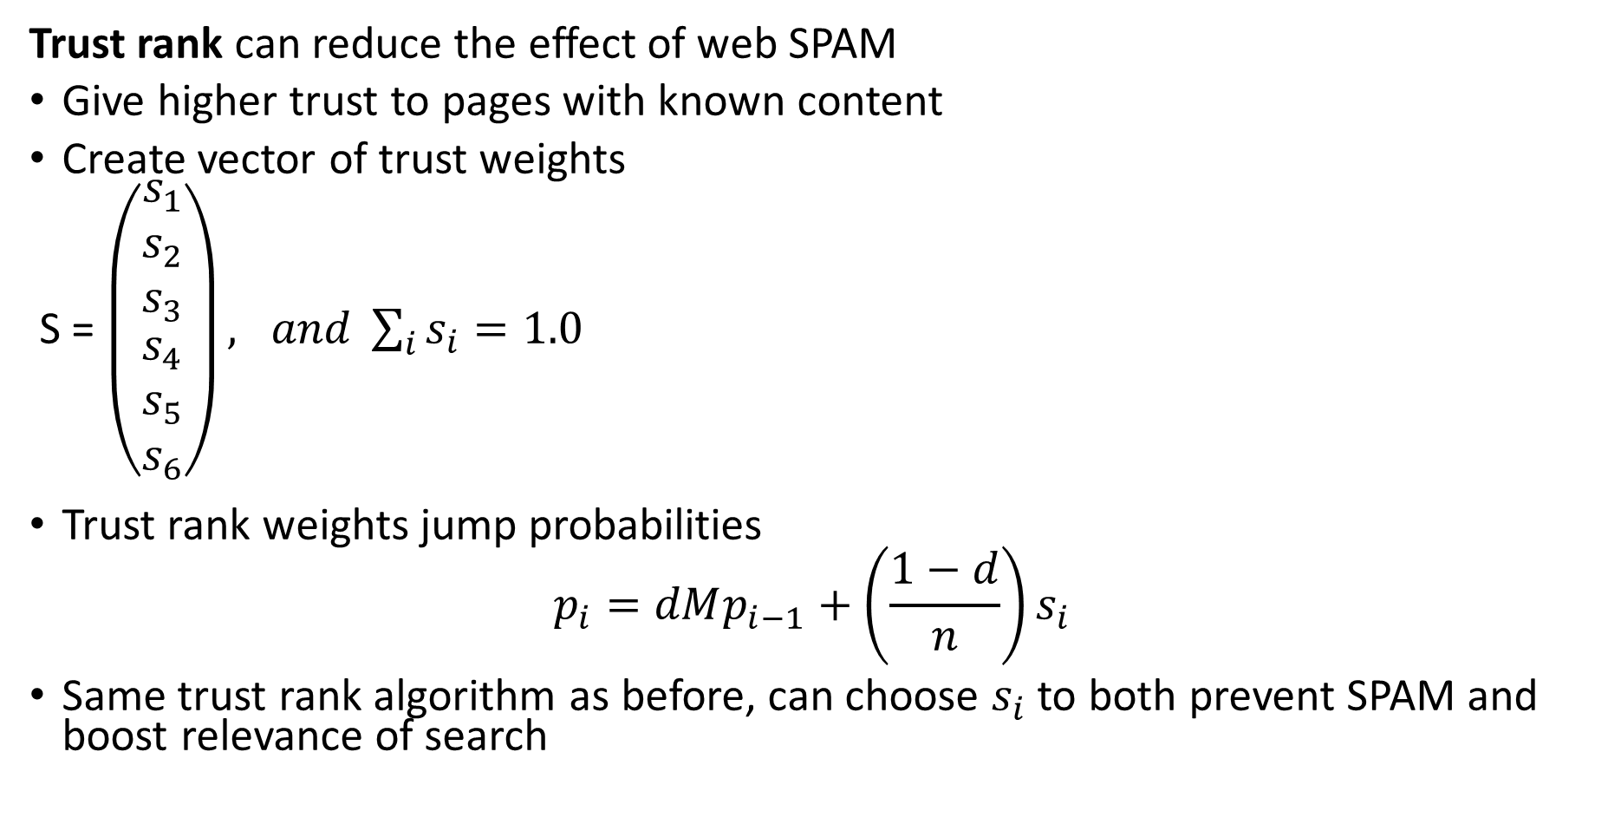
Trust Rank
Trust rank can reduce the effect of web SPAM
Give higher trust to pages with known content
Create vector of trust weights
S = $\left(\begin{matrix}\begin{matrix}s_{1} \\ s_{2} \\ s_{3}\end{matrix} \\ \begin{matrix}s_{4} \\ s_{5} \\ s_{6}\end{matrix}\end{matrix}\right), and \sum_{i}{s_{i}=1.0}$
Trust rank weights jump probabilities
$$p_{i}=dMp_{i−1}+\left(\frac{1−d}{n}\right)s_{i}$$
Same trust rank algorithm as before, can choose $s_{i}$ to both prevent SPAM and boost relevance of search
Leskovec and Kanatsoulis, Standford CS 246, 2024

Slide 69
Scaling PageRank

Slide 70
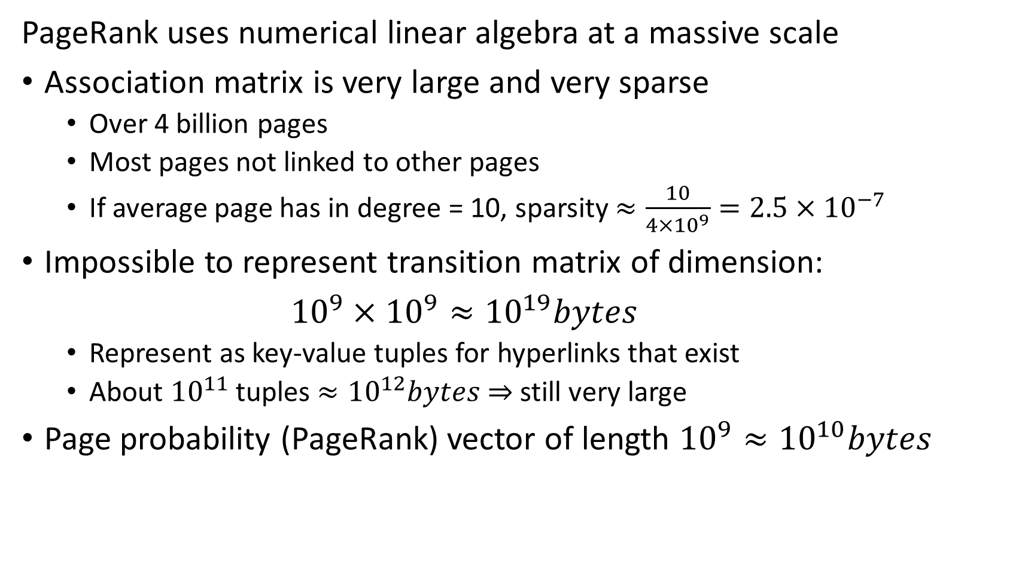
Scaling PageRank
PageRank uses numerical linear algebra at a massive scale
Association matrix is very large and very sparse
Over 4 billion pages
Most pages not linked to other pages
If average page has in degree = 10, sparsity $≈\frac{10}{4×{10}^{9}}=2.5×{10}^{−7}$
Impossible to represent transition matrix of dimension:
${10}^{9}×{10}^{9}≈{10}^{19}bytes$
Represent as key-value tuples for hyperlinks that exist
About ${10}^{11}$ tuples $≈{10}^{12}bytes$ $⇒$ still very large
Page probability (PageRank) vector of length ${10}^{9}≈{10}^{10}bytes$

Slide 71
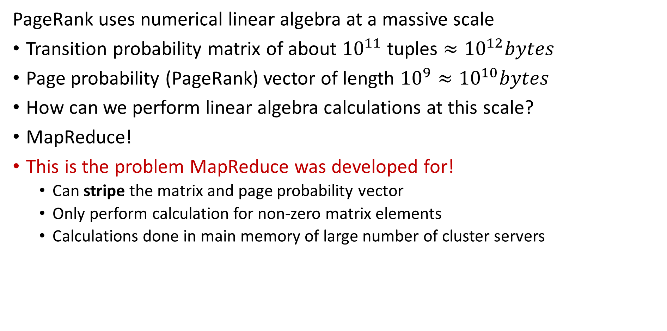
Scaling PageRank
PageRank uses numerical linear algebra at a massive scale
Transition probability matrix of about ${10}^{11}$ tuples $≈{10}^{12}bytes$
Page probability (PageRank) vector of length ${10}^{9}≈{10}^{10}bytes$
How can we perform linear algebra calculations at this scale?
MapReduce!
This is the problem MapReduce was developed for!
Can stripe the matrix and page probability vector
Only perform calculation for non-zero matrix elements
Calculations done in main memory of large number of cluster servers

Slide 72
Hubs and Authorities, the HITS Algorithm

Slide 73
HITS Algorithm
HITS algorithm is an alternative to PageRank
PageRank is a weighted measure of page centrality
Alternative is to compute hub and authority scores for each web page
Hub score represents how a page directs to other pages
Direct readers to informative pages
Hub pages have many outgoing links
Measure of trust
Authority score represents the value of information on a page
Considered authoritative source
Pages with high authority are linked from many pages
Measure of trust
HITS algorithm useful for other applications
e.g. citation networks

Slide 74
HITS Algorithm
Examples of hub and authority model:
Searching for a course to take
Department or program web site is hub with links to courses, but no information on courses
Course pages are the authorizes, containing specific information on courses
Searching research papers
Review articles are hubs with references to authorities
Original papers contain the authoritative information
But, the review paper, hub, can also act as an authority

Slide 75
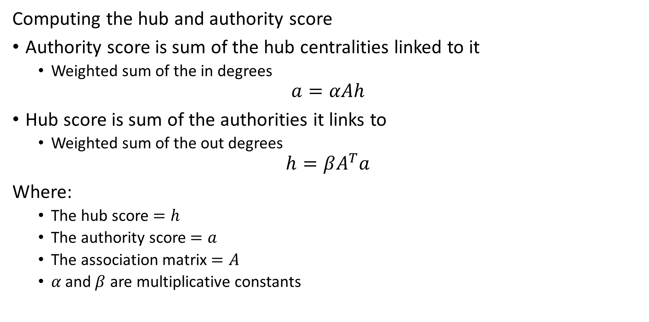
HITS Algorithm
Computing the hub and authority score
Authority score is sum of the hub centralities linked to it
Weighted sum of the in degrees
$$a=αAh$$
Hub score is sum of the authorities it links to
Weighted sum of the out degrees
$$h=βA^{T}a$$
Where:
The hub score $=h$
The authority score $=a$
The association matrix $=A$
$α \text{and} β$ are multiplicative constants

Slide 76
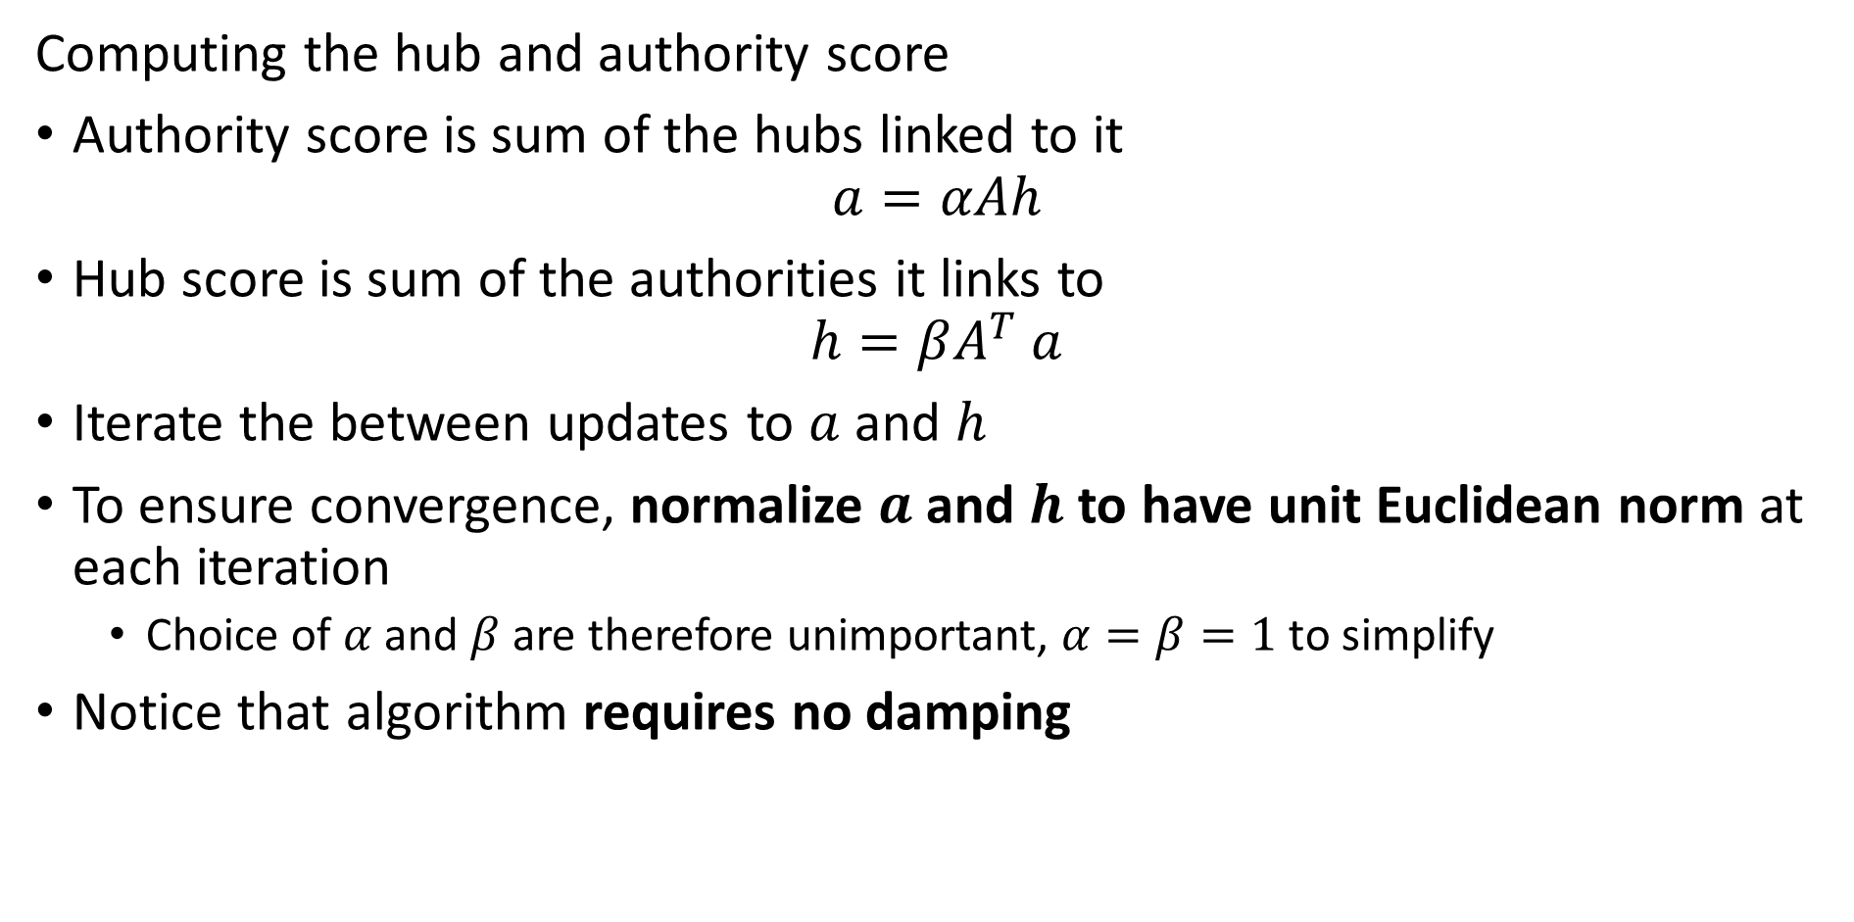
HITS Algorithm
Computing the hub and authority score
Authority score is sum of the hubs linked to it
$$a=αAh$$
Hub score is sum of the authorities it links to
$$h=βA^{T} a$$
Iterate the between updates to $a$ and $h$
To ensure convergence, normalize $a$ and $h$ to have unit Euclidean norm at each iteration
Choice of $α$ and $β$ are therefore unimportant, $α=β=1$ to simplify
Notice that algorithm requires no damping

Slide 77
Lesson Summary
Overview of graph theory and web search
Introduction to the web search problem
First overview of graph theory
Introduction to Markov processes and random walks
Structure of the web
The PageRank algorithm
Damped PageRank
TrustRank algorithm
HITS algorithm to rank hubs and authorities
Not just for web search

