Slide 1

CSCI E-108 Data Mining, Exploration and Discovery Association Rules and Frequent Item Sets
Steve Elston
Copyright 2021, 2022, 2023, 2024, Stephen F Elston. All rights reserved.

Slide 2
Association Rules and Frequent Item Sets
Association rules are used to find sets of items that occur frequently
Originally, association rules applied to market basket analysis
Retailers search database of transaction to find items commonly purchased together
Many applications of association rules
Identify sets of items customers are likely to buy in the same transaction
Find unusual commonality in text documents; e.g. plagiarism
Identify symptoms from drug interactions
Identify transaction patterns that imply fraud
Match IP addresses to DoS messages
Identify patterns of environmental pollutants and disease
And many more….

Slide 3
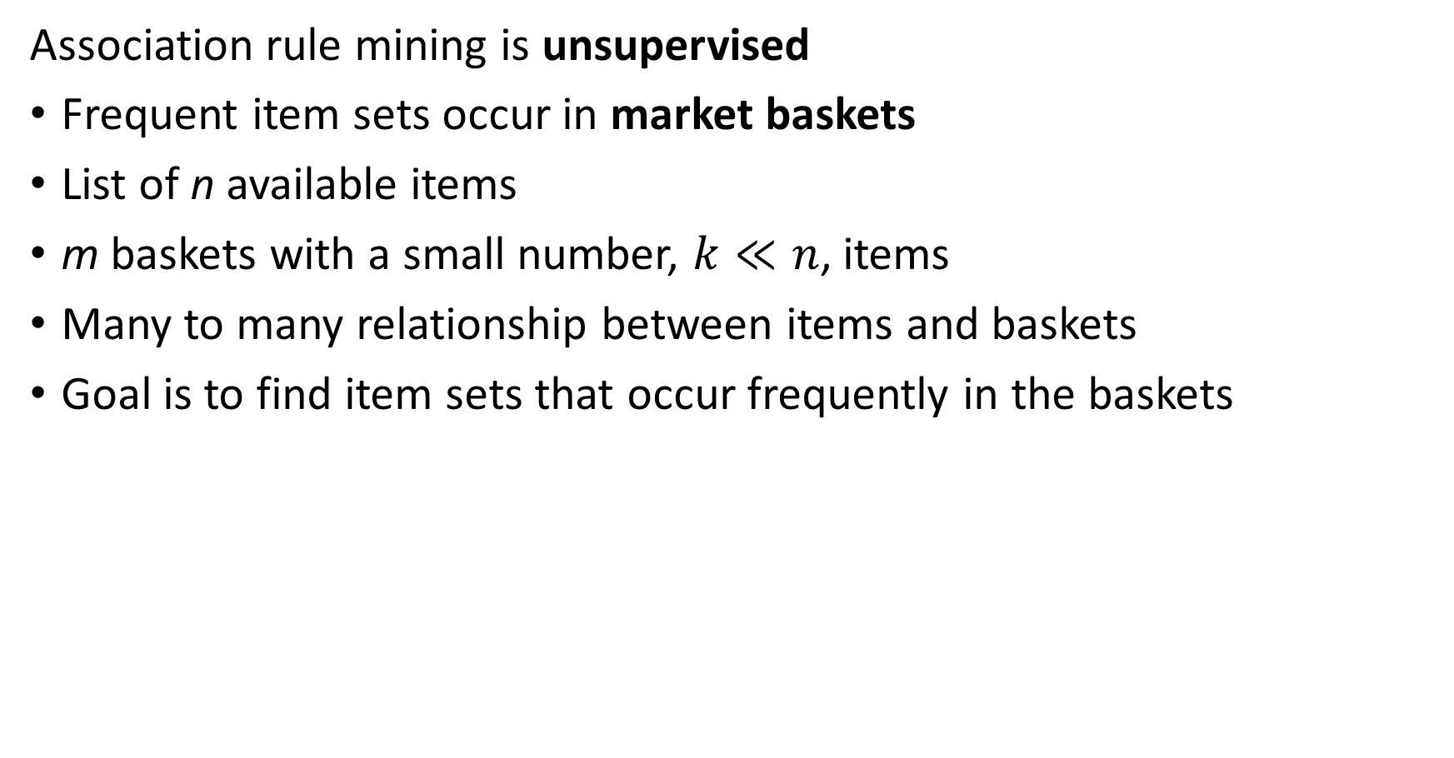
The Market Basket Model
Association rule mining is unsupervised
Frequent item sets occur in market baskets
List of n available items
m baskets with a small number, $k≪n$, items
Many to many relationship between items and baskets
Goal is to find item sets that occur frequently in the baskets

Slide 4
Association Rules vs Similarity
How are association rules different from similarity search
Similarity search seeks baskets with large fraction of common items
Generally large number of items
Seek high, but not absolute, similarity between baskets
Association rules seek the absolute number of baskets containing specific item sets
Large number of baskets
Small average number of items in baskets
Seek exact match of sets

Slide 5

The Market Basket Model
Start with item set, $I=\left\{bread, butter, eggs, milk, bacon\right\}$
Database of baskets
Identify frequent item sets
Notice the growth in data structure size!
Memory is a major limitation!
Item Set | Frequency
{bread, butter} | 2
{bread, eggs} | 1
{bread, milk} | 2
{bread, bacon} | 1
{butter, eggs} | 1
{butter, milk} | 2
{butter, bacon} | 2
{eggs, milk} | 1
{eggs, bacon} | 4
{milk, bacon} | 1
Basket ID | Item Set
1 | {bread, butter, milk}
2 | {butter, eggs, bacon}
3 | {bread, butter, milk}
4 | {butter, eggs, bacon}
5 | {bread, eggs, bacon}
6 | {eggs, milk, bacon}

Slide 6
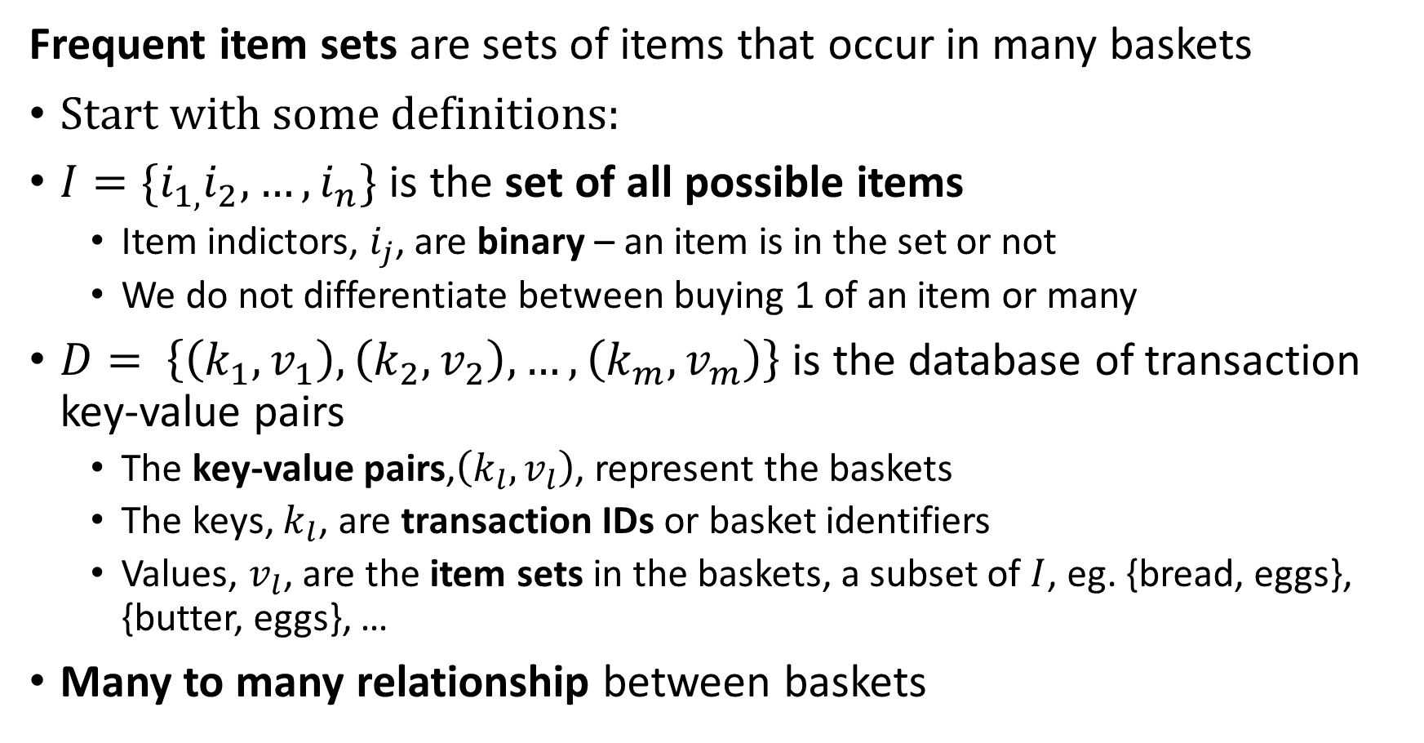
Frequent Item Sets and Association Rules
Frequent item sets are sets of items that occur in many baskets
Start with some definitions:
$I=\{i_{1,}i_{2},…,i_{n}\}$ is the set of all possible items
Item indictors, $i_{j}$, are binary – an item is in the set or not
We do not differentiate between buying 1 of an item or many
$D= \left\{\left(k_{1},v_{1}\right),\left(k_{2},v_{2}\right),…,\left(k_{m},v_{m}\right)\right\}$ is the database of transaction key-value pairs
The key-value pairs,$\left(k_{l},v_{l}\right)$, represent the baskets
The keys, $k_{l}$, are transaction IDs or basket identifiers
Values, $v_{l}$, are the item sets in the baskets, a subset of $I$, eg. {bread, eggs}, {butter, eggs}, …
Many to many relationship between baskets

Slide 7
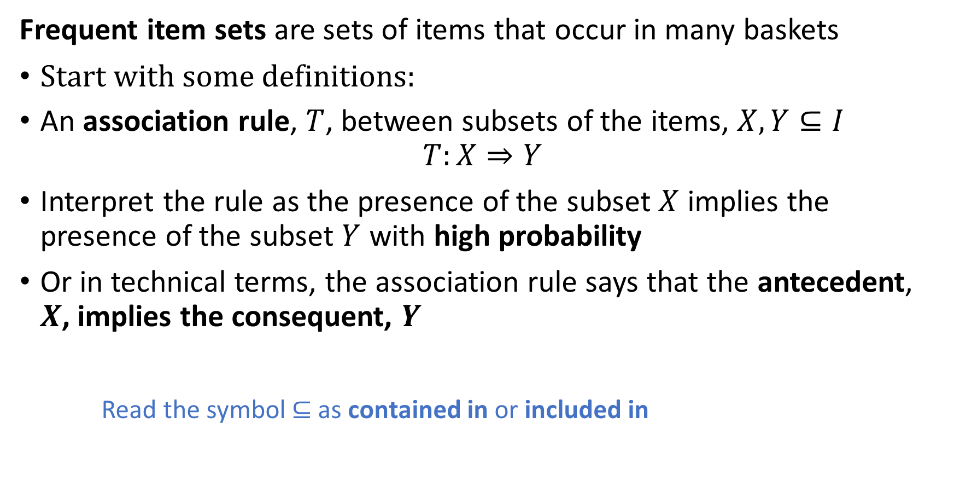
Frequent Item Sets and Association Rules
Frequent item sets are sets of items that occur in many baskets
Start with some definitions:
An association rule, $T$, between subsets of the items, $X,Y⊆I$
$$T:X⇒Y$$
Interpret the rule as the presence of the subset $X$ implies the presence of the subset $Y$ with high probability
Or in technical terms, the association rule says that the antecedent, $X$, implies the consequent, $Y$
Read the symbol $⊆$ as contained in or included in

Slide 8
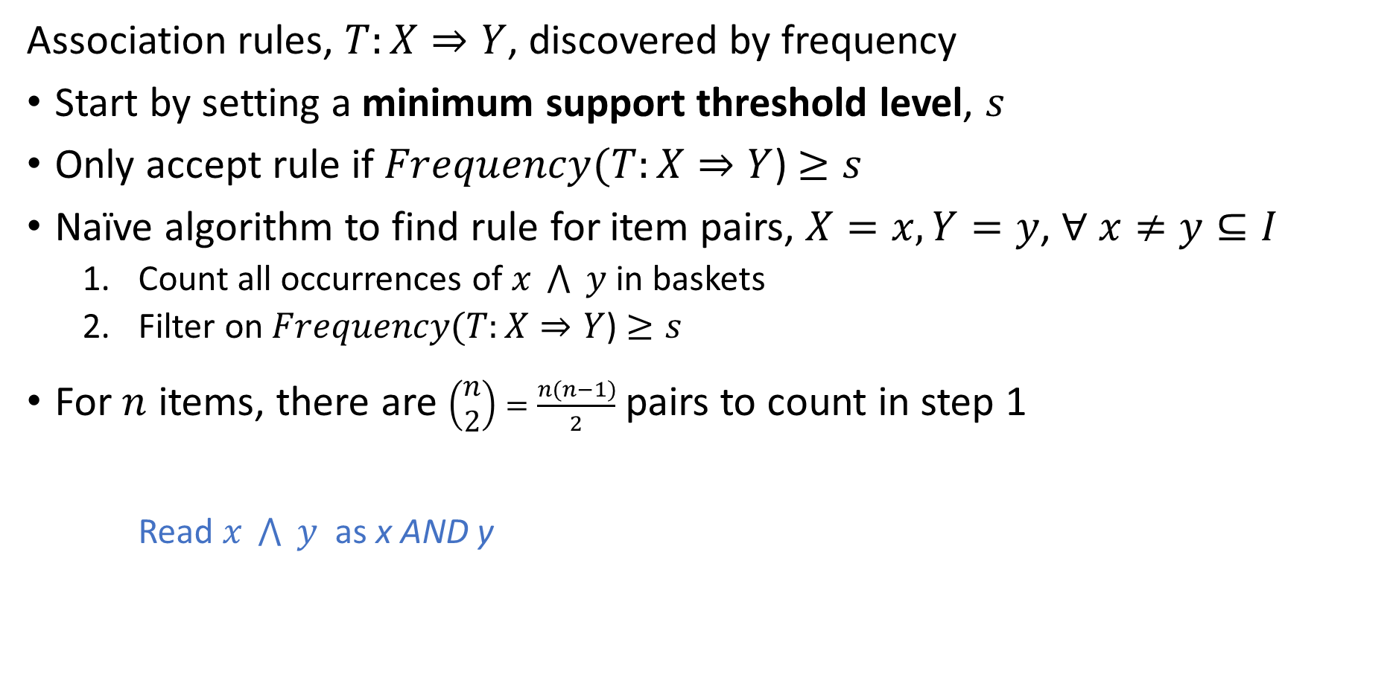
Computing Association Frequency
Association rules, $T:X⇒Y$, discovered by frequency
Start by setting a minimum support threshold level, $s$
Only accept rule if $Frequency(T:X⇒Y$) $≥s$
Naïve algorithm to find rule for item pairs, $X=x, Y=y$, $∀ x≠y⊆I$
Count all occurrences of $x \bigwedge{ }y$ in baskets
Filter on $Frequency(T:X⇒Y$) $≥s$
For $n$ items, there are $\left(\begin{matrix}n \\ 2\end{matrix}\right)=\frac{n(n−1)}{2}$ pairs to count in step 1
Read $x \bigwedge{ }y$ as x AND y

Slide 9
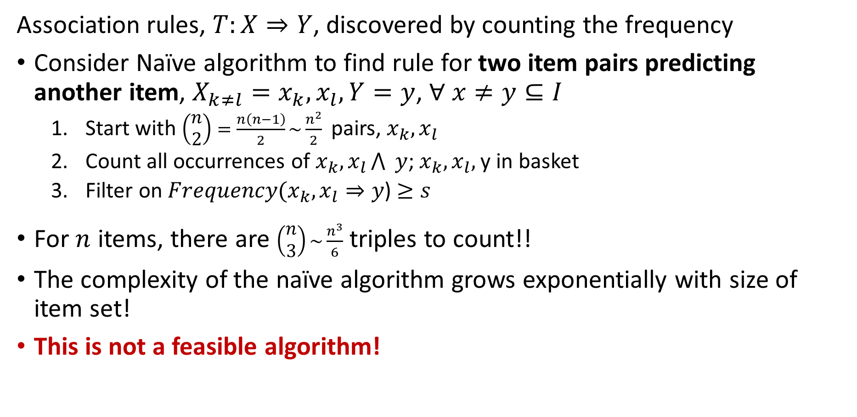
Computing Association Frequency
Association rules, $T:X⇒Y$, discovered by counting the frequency
Consider Naïve algorithm to find rule for two item pairs predicting another item, $X_{k≠l}=x_{k},x_{l}, Y=y$, $∀ x≠y⊆I$
Start with ${\left(\begin{matrix}n \\ 2\end{matrix}\right)=\frac{n\left(n−1\right)}{2}\sim \frac{n^{2}}{2}}^{ }$ pairs, $x_{k},x_{l}$
Count all occurrences of $x_{k},x_{l}\bigwedge{ }y$; $x_{k},x_{l},$y in basket
Filter on $Frequency(x_{k},x_{l}⇒y$) $≥s$
For $n$ items, there are $\left(\begin{matrix}n \\ 3\end{matrix}\right)\sim \frac{n^{3}}{6}$ triples to count!!
The complexity of the naïve algorithm grows exponentially with size of item set!
This is not a feasible algorithm!

Slide 10
Apriori Algorithm

Slide 11
Apriori Algorithm
Apriori algorithm is based on the properties of sets
Apriori algorithm proposed by Agrawal and Srikant (1994)
Algorithm relies on the downward closure lemma of sets:
All subsets of a frequent set must also be at least as frequent
Downward closure property also know as the monotonicity property
In other words, all subsets must be at least as frequent as the set
The downward closure lemma ensures that we only need only consider frequent subsets when searching for frequent item sets

Slide 12
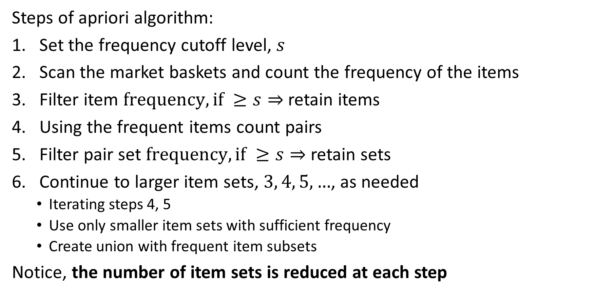
Apriori Algorithm
Steps of apriori algorithm:
Set the frequency cutoff level, $s$
Scan the market baskets and count the frequency of the items
Filter item $frequency, if ≥s⇒$ retain items
Using the frequent items count pairs
Filter pair set $frequency, if ≥s⇒$ retain sets
Continue to larger item sets, $3, 4, 5,…$, as needed
Iterating steps 4, 5
Use only smaller item sets with sufficient frequency
Create union with frequent item subsets
Notice, the number of item sets is reduced at each step

Slide 13
Apriori Algorithm
Apriori algorithm example; s = 3
Start with small database
First pass find frequent items
TID | Item Set
1 | {a,b}
2 | {b,c,d}
3 | {a,c,d,e}
4 | {a,d,e}
5 | {a,c,d}
6 | {a,b,c}
7 | {a,b,c,d}
item | Frequency
a | 6
b | 3
c | 5
d | 5
e | 2
item | Frequency
a | 6
b | 3
c | 5
d | 5
Compute Frequency
Filter on Frequency

Slide 14
Apriori Algorithm
Apriori algorithm example; s = 3
Second pass find frequent item pairs for frequent items; don’t consider sets containing e
Filter on frequency
TID | Item Set
1 | {a,b}
2 | {b,c,d}
3 | {a,c,d,e}
4 | {a,d,e}
5 | {a,c,d}
6 | {a,b,c}
7 | {a,b,c,d}
Item Set | Frequency
{a,b} | 3
{a,c} | 4
{a,d} | 4
{b,c} | 3
{b,d} | 2
{c,d} | 4
Item Set | Frequency
{a,b} | 3
{a,c} | 4
{a,d} | 4
{b,c} | 3
{c,d} | 4
Compute Pair Frequency
Filter on Frequency
item | Frequency
a | 6
b | 3
c | 5
d | 5

Slide 15
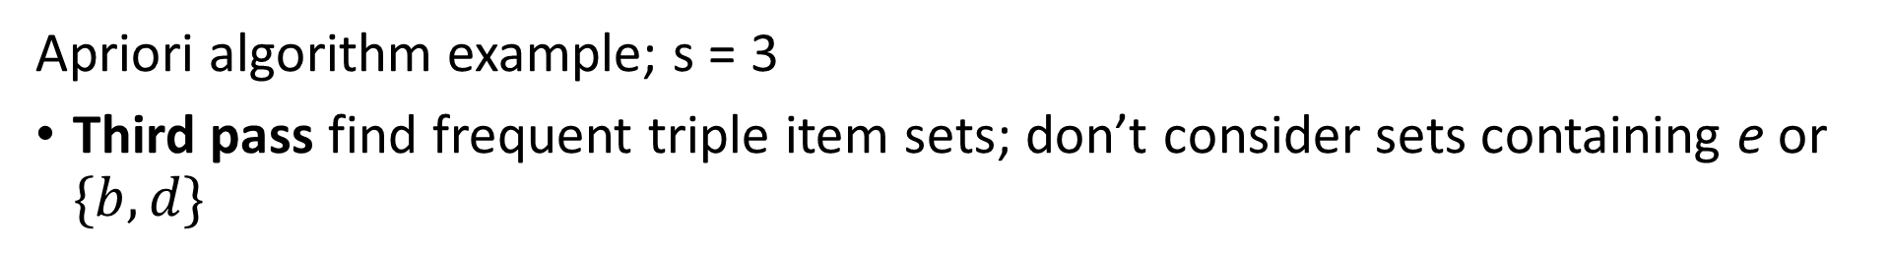
Apriori Algorithm
Apriori algorithm example; s = 3
Third pass find frequent triple item sets; don’t consider sets containing e or $\{b,d\}$
Item Set | Frequency
{a,b} | 3
{a,c} | 4
{a,d} | 4
{b,c} | 3
{c,d} | 4
TID | Item Set
1 | {a,b}
2 | {b,c,d}
3 | {a,c,d,e}
4 | {a,d,e}
5 | {a,c,d}
6 | {a,b,c}
7 | {a,b,c,d}
Item Set | Frequency
{a,b,c} | 2
{a,b,d} | 1
{a,c,d} | 3
{b,c,d} | 2
Compute Item Set Frequncy
Item Set | Frequency
{a,c,d} | 3
item | Frequncy
a | 6
b | 3
c | 5
d | 5
Filter on Frequncy

Slide 16
Apriori Algorithm
Antecedent | Consequent | Frequency
{a} | {b} | 3
{a} | {c} | 4
{a} | {d} | 4
{b} | {c} | 3
{c} | {d} | 4
{b} | {a} | 3
{c} | {a} | 4
{d} | {a} | 4
{c} | {b} | 3
{c} | {d} | 4
{a,c} | {d} | 3
{a,d} | {c} | 3
{c,d} | {a} | 3
{a} | {c,d} | 3
{c} | {a,d} | 3
{d} | {a,c} | 3
Apriori algorithm example; s = 3
Start with all frequent item sets
Find all possible rule combinations from frequent item sets
Rule maps antecedent to its consequent
Item Set | Frequency
{a,b} | 3
{a,c} | 4
{a,d} | 4
{b,c} | 3
{c,d} | 4
{a,c,d} | 3
Derive rules

Slide 17
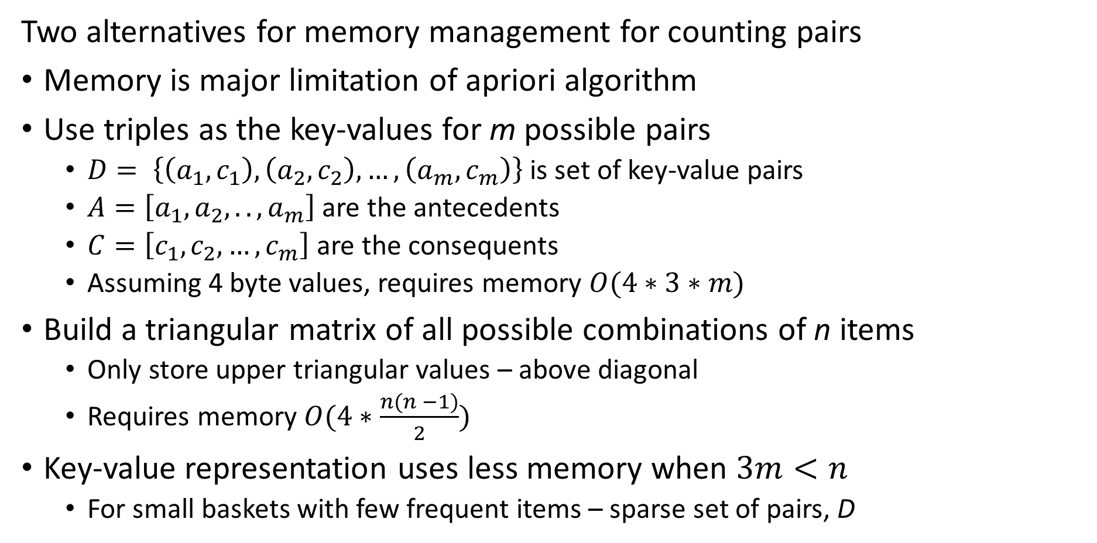
Memory Management for Apriori Algorithm
Two alternatives for memory management for counting pairs
Memory is major limitation of apriori algorithm
Use triples as the key-values for m possible pairs
$D= \left\{\left(a_{1},c_{1}\right),\left(a_{2},c_{2}\right),…,\left(a_{m},c_{m}\right)\right\}$ is set of key-value pairs
$A=\left[a_{1},a_{2},..,a_{m}\right]$ are the antecedents
$C=\left[c_{1},c_{2},…,c_{m}\right]$ are the consequents
Assuming 4 byte values, requires memory $O(4∗3∗m)$
Build a triangular matrix of all possible combinations of n items
Only store upper triangular values – above diagonal
Requires memory $O(4∗\frac{{n(n}^{ }−1)}{2})$
Key-value representation uses less memory when $3m<n$
For small baskets with few frequent items – sparse set of pairs, D

Slide 18
Summary of Apriori Algorithm
Advantages and disadvantages of apriori algorithm
Advantages
Reduces the set size for unions at each step
Simple table-oriented implementation
Easy to parallelize; e.g. MapReduce
Disadvantages
Computationally intensive since all unions of subsets must be counted – potentially massive candidate sets
Count for all pairs must fit in main memory
Multiple passes of data required

Slide 19
Evaluation of Association Rules

Slide 20
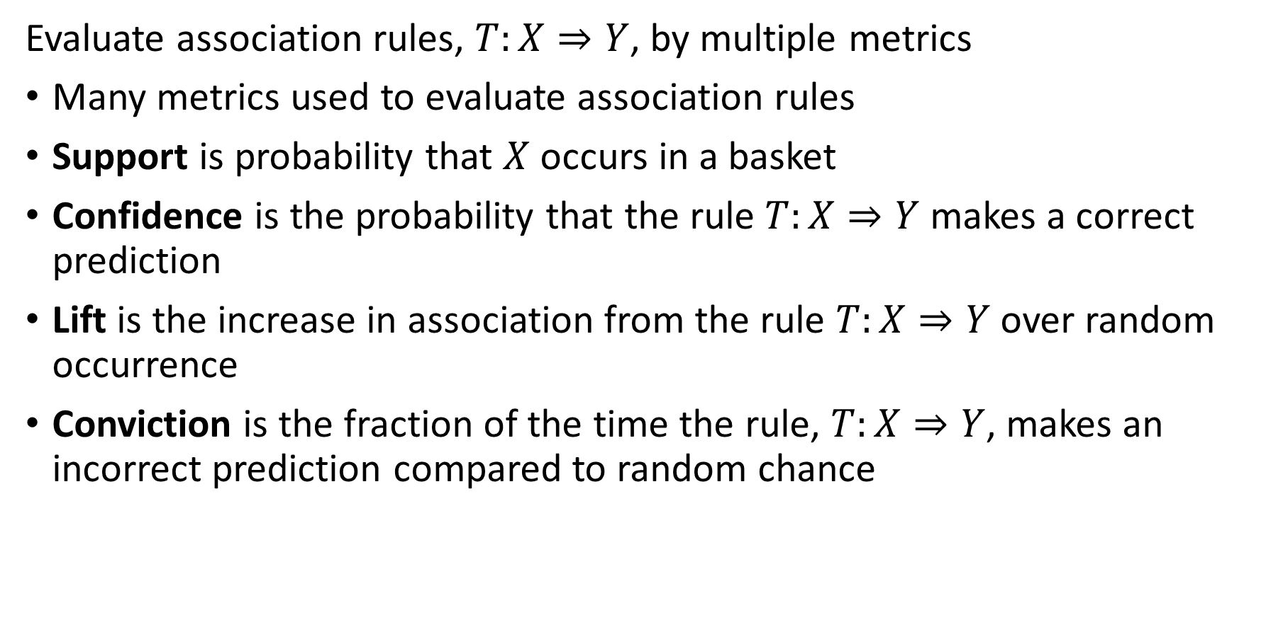
Evaluation of Association Rules
Evaluate association rules, $T:X⇒Y$, by multiple metrics
Many metrics used to evaluate association rules
Support is probability that $X$ occurs in a basket
Confidence is the probability that the rule $T:X⇒Y$ makes a correct prediction
Lift is the increase in association from the rule $T:X⇒Y$ over random occurrence
Conviction is the fraction of the time the rule, $T:X⇒Y$, makes an incorrect prediction compared to random chance

Slide 21
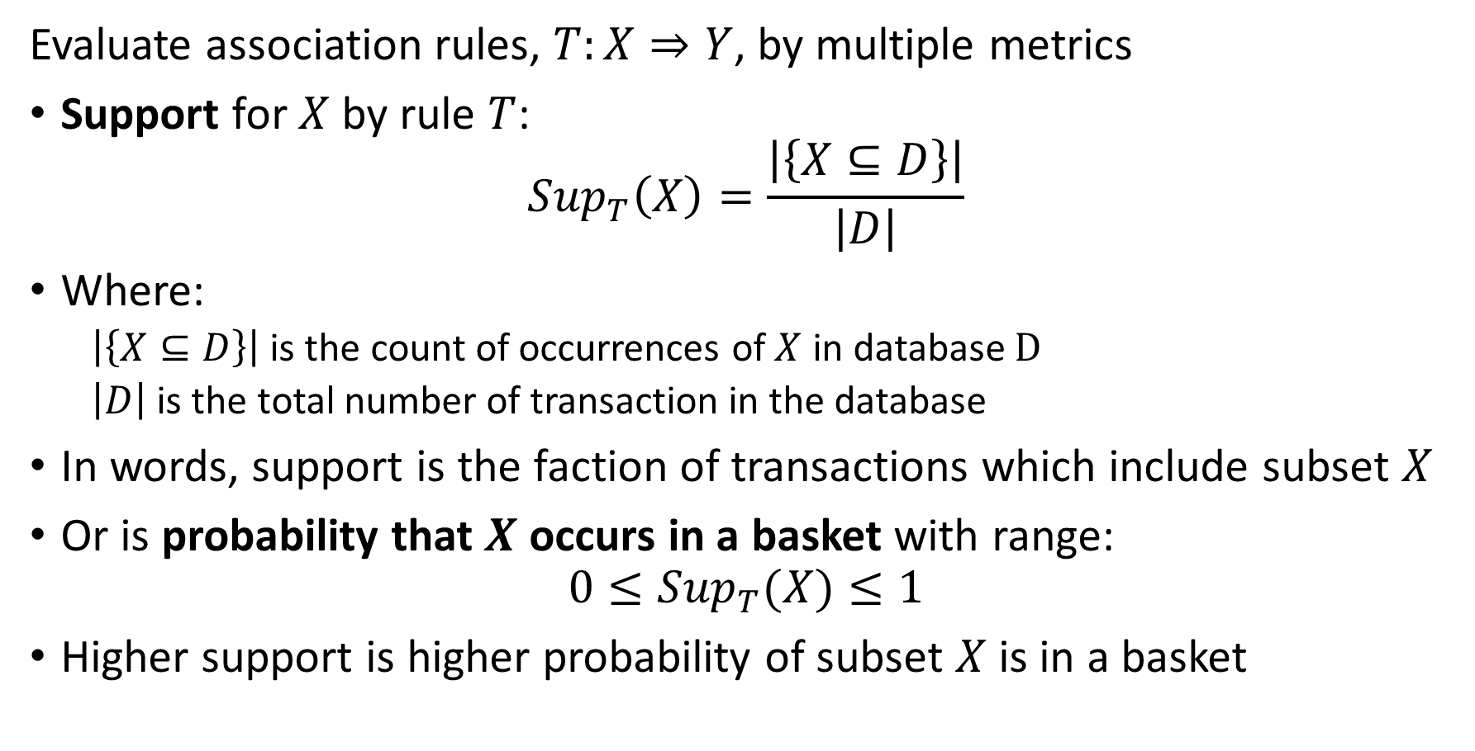
Evaluation of Association Rules
Evaluate association rules, $T:X⇒Y$, by multiple metrics
Support for $X$ by rule $T$:
$${Sup}_{T}\left(X\right)=\frac{\left|\left\{X⊆D\right\}\right|}{\left|D\right|}$$
Where:
$\left|\left\{X⊆D\right\}\right|$ is the count of occurrences of $X$ in database $D$
$\left|D\right|$ is the total number of transaction in the database
In words, support is the faction of transactions which include subset $X$
Or is probability that $X$ occurs in a basket with range:
$$0≤{Sup}_{T}(X)≤1$$
Higher support is higher probability of subset $X$ is in a basket

Slide 22
Evaluation of Association Rules
Example: Compute Support for association rules
item | Frequency
a | 6
b | 3
c | 5
d | 5
Item Set | Support
{a} | 6/7=0.86
{b} | 3/7=0.43
{c} | 5/7=0.71
{d} | 5/7=0.71
{a,b} | 3/7=0.43
{a,c} | 4/7=0.57
{a,d} | 4/7=0.57
{b,c} | 3/7=0.43
{c,d} | 4/7=0.57
{a,c,d} | 3/7=0.43
Item Set | Frequency
{a,b} | 3
{a,c} | 4
{a,d} | 4
{b,c} | 3
{c,d} | 4
{a,c,d} | 3

Slide 23
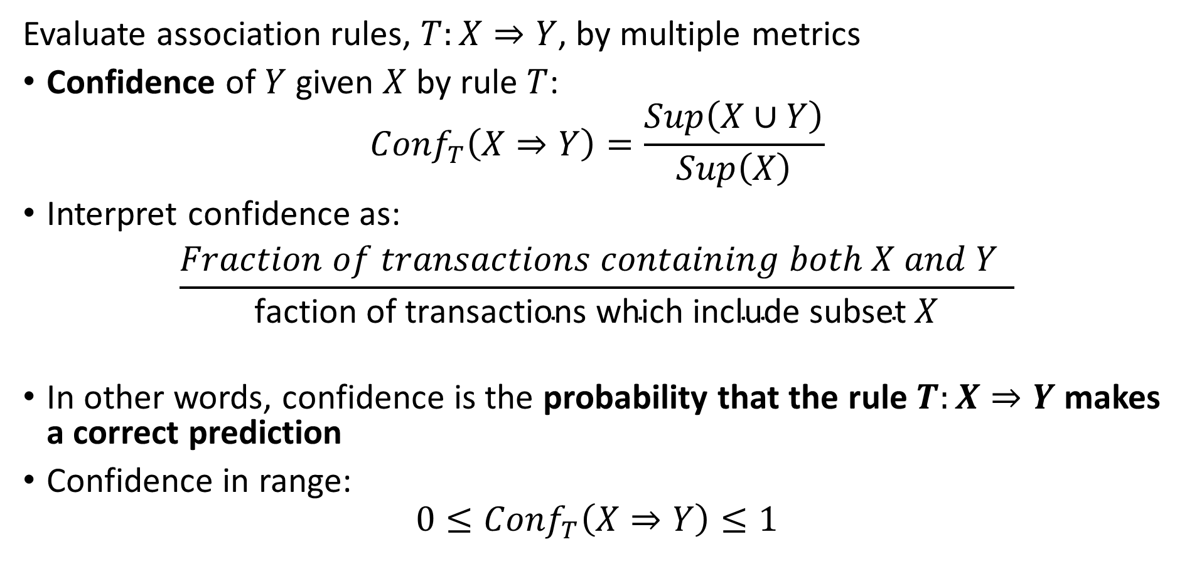
Evaluation of Association Rules
Evaluate association rules, $T:X⇒Y$, by multiple metrics
Confidence of $Y$ given $X$ by rule $T$:
$${Conf}_{T}\left(X⇒Y\right)=\frac{Sup\left(X∪Y\right)}{Sup\left(X\right)}$$
Interpret confidence as:
$$\frac{Fraction of transactions containing both X and Y }{\text{faction} \text{of} \text{transactions} \text{which} \text{include} \text{subset} X}$$
In other words, confidence is the probability that the rule $T:X⇒Y$ makes a correct prediction
Confidence in range:
$$0≤{Conf}_{T}\left(X⇒Y\right)≤1$$

Slide 24
Evaluation of Association Rules
Example: Compute Confidence for association rules
Partial list not showing all rule permutations
Antecedent | Consequent | Confidence
{a} | {b} | 0.43/0.86=0.5
{b} | {a} | 0.43/.43=1.0
{a} | {c} | 0.57/.86=0.66
{c} | {a} | 0.57/.71=0.80
{a} | {d} | 0.57/0.86=0.66
{d} | {a} | 0.57/.71=0.80
{b} | {c} | 0.43/0.43=1.0
{c} | {b} | 0.43/0.71=0.61
{c} | {d} | 0.57/0.71=0.80
{d} | {c} | 0.57/0.71=0.80
{a,c} | {d} | 0.43/0.57=0.76
{a,d} | {c} | 0.43/0.57=0.76
{c,d} | {a} | 0.43/0.57=0.76
Item Set | Support
{a} | 6/7=0.86
{b} | 3/7=0.43
{c} | 5/7=0.71
{d} | 5/7=0.71
{a,b} | 3/7=0.43
{a,c} | 4/7=0.57
{a,d} | 4/7=0.57
{b,c} | 3/7=0.43
{c,d} | 4/7=0.57
{a,c,d} | 3/7=0.43

Slide 25
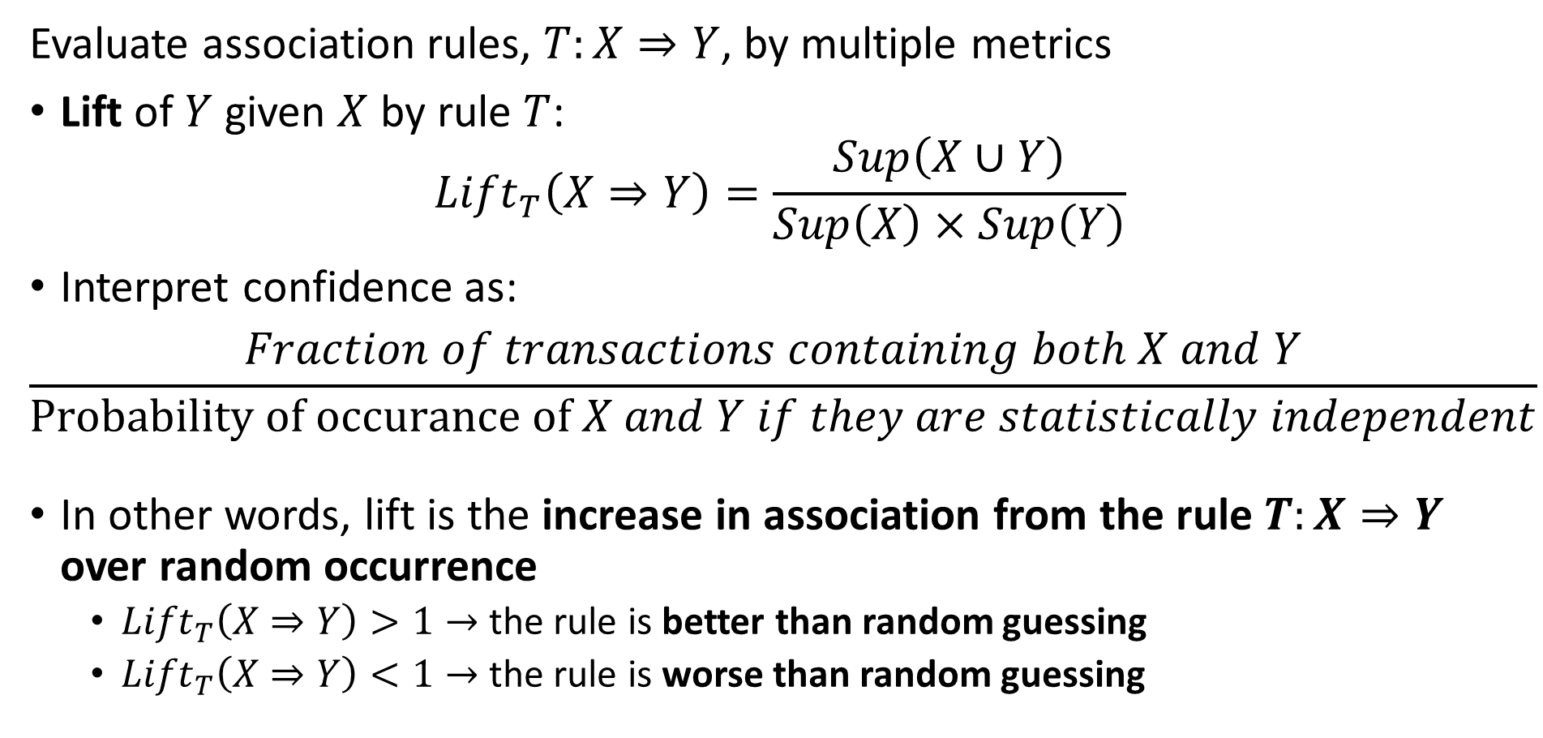
Evaluation of Association Rules
Evaluate association rules, $T:X⇒Y$, by multiple metrics
Lift of $Y$ given $X$ by rule $T$:
$${Lift}_{T}\left(X⇒Y\right)=\frac{Sup\left(X∪Y\right)}{Sup\left(X\right)×Sup\left(Y\right)}$$
Interpret confidence as:
$$\frac{Fraction of transactions containing both X and Y }{\text{Probability} \text{of} \text{occurance} \text{of} X and Y if they are statistically independent}$$
In other words, lift is the increase in association from the rule $T:X⇒Y$ over random occurrence
${Lift}_{T}\left(X⇒Y\right)>1→$ the rule is better than random guessing
${Lift}_{T}\left(X⇒Y\right)<1→$ the rule is worse than random guessing

Slide 26
Evaluation of Association Rules
Example: Compute Lift for association rules
Item Set | Support | Lift
{a} | 6/7=0.86 | NA
{b} | 3/7=0.43 | NA
{c} | 5/7=0.71 | NA
{d} | 5/7=0.71 | NA
{a,b} | 3/7=0.43 | 0.43/(0.86*0.43)=1.16
{a,c} | 4/7=0.57 | 0.57/(0.86*0.71)=0.93
{a,d} | 4/7=0.57 | 0.57/(0.86*0.71)=0.93
{b,c} | 3/7=0.43 | 0.43/(0.43*0.71)=1.41
{c,d} | 4/7=0.57 | 0.57/(0.71*0.71)=1.13
{a,c,d} | 3/7=0.43 | 0.43/(0.86*0.71*0.71)=0.99

Slide 27
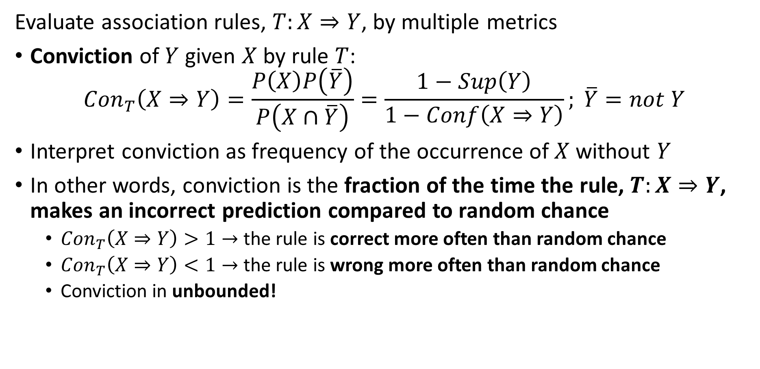
Evaluation of Association Rules
Evaluate association rules, $T:X⇒Y$, by multiple metrics
Conviction of $Y$ given $X$ by rule $T$:
$${Con}_{T}\left(X⇒Y\right)=\frac{P\left(X\right)P\left(\overline{Y}\right)}{P\left(X∩\overline{Y}\right)}=\frac{1−Sup\left(Y\right)}{1−Conf\left(X⇒Y\right)}; \overline{Y}=not Y$$
Interpret conviction as frequency of the occurrence of $X$ without $Y$
In other words, conviction is the fraction of the time the rule, $T:X⇒Y$, makes an incorrect prediction compared to random chance
${Con}_{T}\left(X⇒Y\right)>1→$ the rule is correct more often than random chance
${Con}_{T}\left(X⇒Y\right)<1→$ the rule is wrong more often than random chance
Conviction in unbounded!

Slide 28
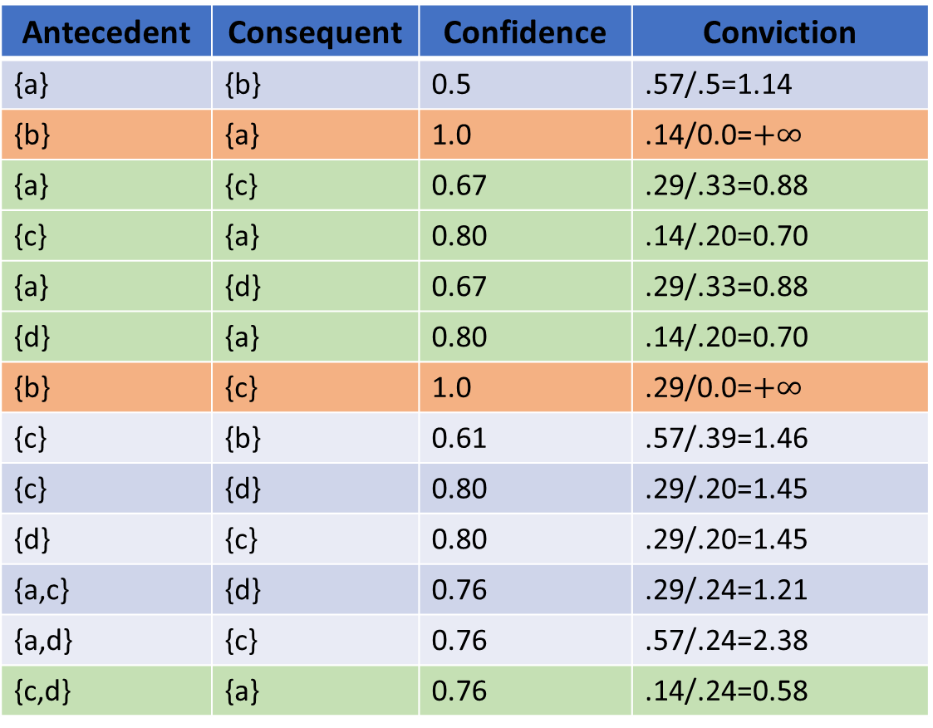
Evaluation of Association Rules
Example: Compute Conviction for association rules
Antecedent | Consequent | Confidence | Conviction
{a} | {b} | 0.5 | .57/.5=1.14
{b} | {a} | 1.0 | .14/0.0=$+∞$
{a} | {c} | 0.67 | .29/.33=0.88
{c} | {a} | 0.80 | .14/.20=0.70
{a} | {d} | 0.67 | .29/.33=0.88
{d} | {a} | 0.80 | .14/.20=0.70
{b} | {c} | 1.0 | .29/0.0=$+∞$
{c} | {b} | 0.61 | .57/.39=1.46
{c} | {d} | 0.80 | .29/.20=1.45
{d} | {c} | 0.80 | .29/.20=1.45
{a,c} | {d} | 0.76 | .29/.24=1.21
{a,d} | {c} | 0.76 | .57/.24=2.38
{c,d} | {a} | 0.76 | .14/.24=0.58
Item Set | Support
{a} | 6/7=0.86
{b} | 3/7=0.43
{c} | 5/7=0.71
{d} | 5/7=0.71
{a,b} | 3/7=0.43
{a,c} | 4/7=0.57
{a,d} | 4/7=0.57
{b,c} | 3/7=0.43
{c,d} | 4/7=0.57
{a,c,d} | 3/7=0.43

Slide 29
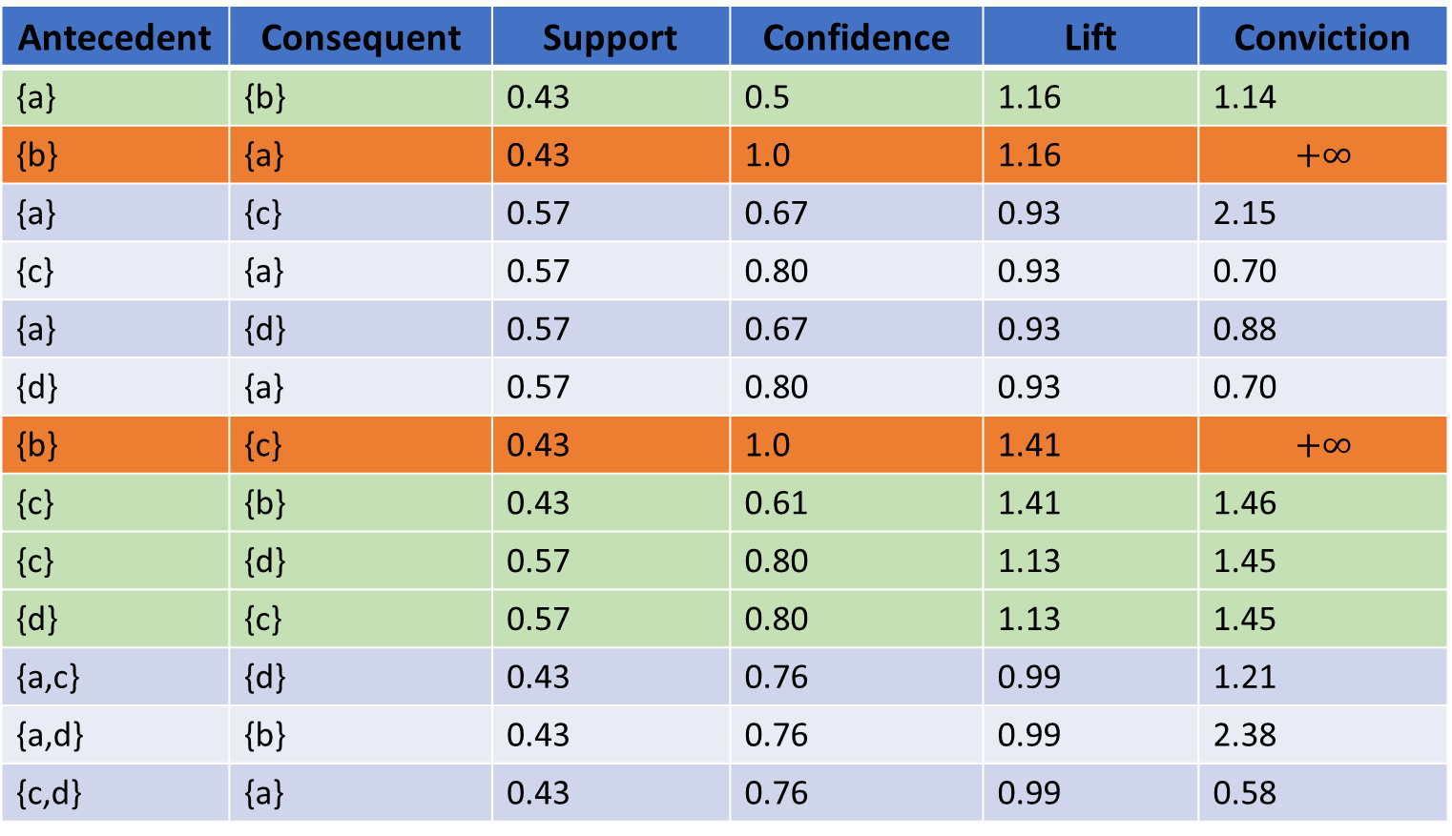
Evaluation of Association Rules
Antecedent | Consequent | Support | Confidence | Lift | Conviction
{a} | {b} | 0.43 | 0.5 | 1.16 | 1.14
{b} | {a} | 0.43 | 1.0 | 1.16 | $$+∞$$
{a} | {c} | 0.57 | 0.67 | 0.93 | 2.15
{c} | {a} | 0.57 | 0.80 | 0.93 | 0.70
{a} | {d} | 0.57 | 0.67 | 0.93 | 0.88
{d} | {a} | 0.57 | 0.80 | 0.93 | 0.70
{b} | {c} | 0.43 | 1.0 | 1.41 | $$+∞$$
{c} | {b} | 0.43 | 0.61 | 1.41 | 1.46
{c} | {d} | 0.57 | 0.80 | 1.13 | 1.45
{d} | {c} | 0.57 | 0.80 | 1.13 | 1.45
{a,c} | {d} | 0.43 | 0.76 | 0.99 | 1.21
{a,d} | {b} | 0.43 | 0.76 | 0.99 | 2.38
{c,d} | {a} | 0.43 | 0.76 | 0.99 | 0.58
Example: Summary for association rules
Note 4 rules with lift>1 and conviction> 1
But, 2 rules have high confidence and lift

Slide 30
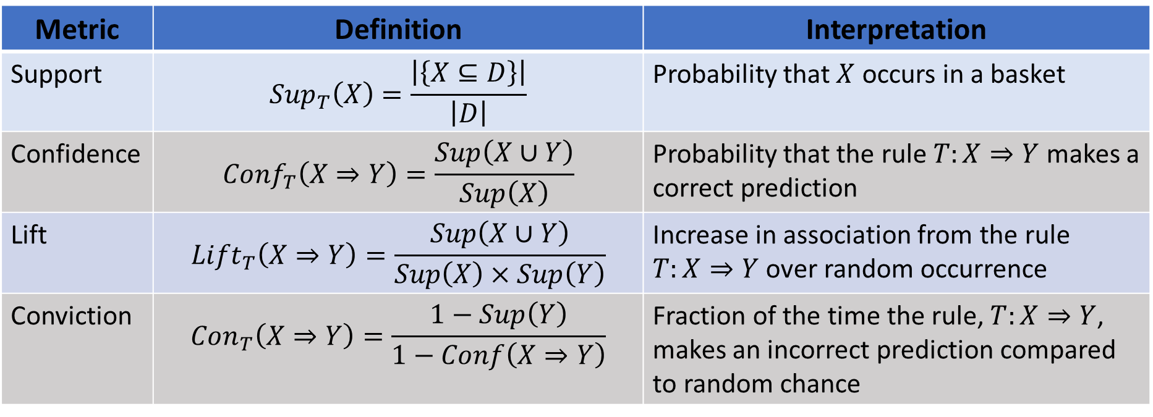
Evaluation of Association Rules
Metric | Definition | Interpretation
Support | $${Sup}_{T}\left(X\right)=\frac{\left|\left\{X⊆D\right\}\right|}{\left|D\right|}$$ | Probability that $X$ occurs in a basket
Confidence | $${Conf}_{T}\left(X⇒Y\right)=\frac{Sup\left(X∪Y\right)}{Sup\left(X\right)}$$ | Probability that the rule $T:X⇒Y$ makes a correct prediction
Lift | $${Lift}_{T}\left(X⇒Y\right)=\frac{Sup\left(X∪Y\right)}{Sup\left(X\right)×Sup\left(Y\right)}$$ | Increase in association from the rule $T:X⇒Y$ over random occurrence
Conviction | $${Con}_{T}\left(X⇒Y\right)=\frac{1−Sup\left(Y\right)}{1−Conf\left(X⇒Y\right)}$$ | Fraction of the time the rule, $T:X⇒Y$, makes an incorrect prediction compared to random chance

Slide 31
Improving the Apriori Algorithm

Slide 32
Improving on Apriori Algorithm
How can we improve the apriori algorithm?
Many proposals
Make clever use of hash tables
Exploit aspects of the downward closure property of sets and subsets
Success depends on frequency of item sets
For example, the Park, Chen, Yu (PCY) algorithm proposed in 1995
Modification to basic apriori algorithm
Uses hash table lookup to filter frequent item sets
Similar to a Bloom filter

Slide 33

The PCY Algorithm
Start with item set, $I=\left\{bread, butter, eggs, milk, bacon\right\}$
Database of baskets
Example; on first pass use simple hash of first letter of identifier
Hash first basket and add counts to buckets
Notice hash collisions
Basket ID | Item Set
1 | {bread, butter, milk}
2 | {butter, eggs, bacon}
3 | {bread, butter, milk}
4 | {butter, eggs, bacon}
5 | {bread, eggs, bacon}
6 | {eggs, milk, bacon}
Hash | Frequency
bb | 1
bm | 2

Slide 34

The PCY Algorithm
Start with item set, $I=\left\{bread, butter, eggs, milk, bacon\right\}$
Continue first pass
Hash second basket and add counts to buckets
More has collisions
Basket ID | Item Set
1 | {bread, butter, milk}
2 | {butter, eggs, bacon}
3 | {bread, butter, milk}
4 | {butter, eggs, bacon}
5 | {bread, eggs, bacon}
6 | {eggs, milk, bacon}
Hash | Frequency
bb | 2
bm | 2
be | 2

Slide 35

The PCY Algorithm
Start with item set, $I=\left\{bread, butter, eggs, milk, bacon\right\}$
Hash all other baskets in order and add counts to buckets
Basket ID | Item Set
1 | {bread, butter, milk}
2 | {butter, eggs, bacon}
3 | {bread, butter, milk}
4 | {butter, eggs, bacon}
5 | {bread, eggs, bacon}
6 | {eggs, milk, bacon}
Hash | Frequency
bb | 5
bm | 5
be | 6
em | 1

Slide 36

The PCY Algorithm
Start with item set, $I=\left\{bread, butter, eggs, milk, bacon\right\}$
Filter after first pass
For count $>s=5$, only one hash bucket remains
Only pairs with hash in table need to be considered
$$\left\{butter,eggs\right\},\left\{bread, eggs\right\}, \{bacon, eggs\}$$
Basket ID | Item Set
1 | {bread, butter, milk}
2 | {butter, eggs, bacon}
3 | {bread, butter, milk}
4 | {butter, eggs, bacon}
5 | {bread, eggs, bacon}
6 | {eggs, milk, bacon}
Hash | Frequency
bb | 5
bm | 5
be | 6
em | 1

Slide 37
The PYC Algorithm
Hash filters reduce memory use
Like a Bloom filter, the are no false negatives, only false positives
For sparse item sets, PYC algorithm significantly reduces memory use compared to aprioir
Only count pairs with positive hash in table
Reduce pairs considered by downward closure property of sets
Can create new hash tables with triples for other passes
More sophisticated implementations use multiple hash tables
Reduce false positive rate – like LSH
Trade-off between memory use and computational complexity

Slide 38
FP-Growth Algorithm

Slide 39
FP Growth Algorithm
Frequent pattern (FP) growth algorithm
The FP growth algorithm proposed by Han et.al. (2004) as a possible improvement over apriori
Advantages of FP growth
Computationally efficient
Potentially significant reduction in memory use
Compression in representation from downward closure property of sets
FP growth grows a tree (graph) of item sets
Counts of occurrence are maintained in the tree
Pointers across branches used to sum frequency of items

Slide 40
FP Growth Algorithm
FP growth algorithm example – grow tree case by case
Start with small database
Sort sets by item frequency
TID | Item Set
1 | {a,b}
2 | {b,c,d}
3 | {a,c,d,e}
4 | {a,d,e}
5 | {a,c,d}
6 | {a,b,c}
7 | {a,b,c,d}
item | Frequency
a | 6
c | 5
d | 5
b | 4
e | 2
Sort

Slide 41
FP Growth Algorithm
FP growth algorithm example – grow tree case by case
Build tree branch for 1st item set
Start with set containing most frequent item, a, ordered by fequency
Null
a:1
TID | Item Set
1 | {a,b}
2 | {b,c,d}
3 | {a,c,d,e}
4 | {a,d,e}
5 | {a,c,d}
6 | {a,b,c}
7 | {a,b,c,d}
c:1
d:1
Items and counts in sets
e:1

Slide 42
FP Growth Algorithm
FP growth algorithm example – grow tree case by case
Increment count of items in next set containing first set
Null
a:2
TID | Item Set
1 | {a,b}
2 | {b,c,d}
3 | {a,c,d,e}
4 | {a,d,e}
5 | {a,c,d}
6 | {a,b,c}
7 | {a,b,c,d}
c:2
d:2
Increment counts for members of set
e:1

Slide 43
FP Growth Algorithm
FP growth algorithm example – grow tree case by case
Create branch for next item set containing most frequent item, a
Increment counts
Null
a:3
TID | Item Set
1 | {a,b}
2 | {b,c,d}
3 | {a,c,d,e}
4 | {a,d,e}
5 | {a,c,d}
6 | {a,b,c}
7 | {a,b,c,d}
c:2
d:2
d:1
e:1
e:1

Slide 44
FP Growth Algorithm
FP growth algorithm example – grow tree case by case
Add pointers between common items in branches
Null
a:3
TID | Item Set
1 | {a,b}
2 | {b,c,d}
3 | {a,c,d,e}
4 | {a,d,e}
5 | {a,c,d}
6 | {a,b,c}
7 | {a,b,c,d}
c:2
d:2
d:1
e:1
e:1

Slide 45
FP Growth Algorithm
FP growth algorithm example – grow tree case by case
Add branch for next set in sort order
Null
a:4
TID | Item Set
1 | {a,b}
2 | {b,c,d}
3 | {a,c,d,e}
4 | {a,d,e}
5 | {a,c,d}
6 | {a,b,c}
7 | {a,b,c,d}
c:2
d:1
b:1
d:2
e:1
e:1

Slide 46
FP Growth Algorithm
FP growth algorithm example – grow tree case by case
Add branch for next set in sort order
Increment counts
Pointers between common items
Null
a:5
TID | Item Set
1 | {a,b}
2 | {b,c,d}
3 | {a,c,d,e}
4 | {a,d,e}
5 | {a,c,d}
6 | {a,b,c}
7 | {a,b,c,d}
c:2
b:2
d:2
d:1
e:1
c:1
e:1

Slide 47
FP Growth Algorithm
FP growth algorithm example – grow tree case by case
Add branch for next set in sort order
Increment counts
Pointers between common items
Null
a:6
TID | Item Set
1 | {a,b}
2 | {b,c,d}
3 | {a,c,d,e}
4 | {a,d,e}
5 | {a,c,d}
6 | {a,b,c}
7 | {a,b,c,d}
c:2
d:1
b:3
d:2
e:1
c:2
e:1
d:1

Slide 48
FP Growth Algorithm
FP growth algorithm example – grow tree case by case
Finally, add the last branch!
Pointers between common items
Null
a:6
c:1
TID | Item Set
1 | {a,b}
2 | {b,c,d}
3 | {a,c,d,e}
4 | {a,d,e}
5 | {a,c,d}
6 | {a,b,c}
7 | {a,b,c,d}
c:2
d:1
d:1
b:3
d:2
b:1
e:1
c:2
e:1
d:1

Slide 49
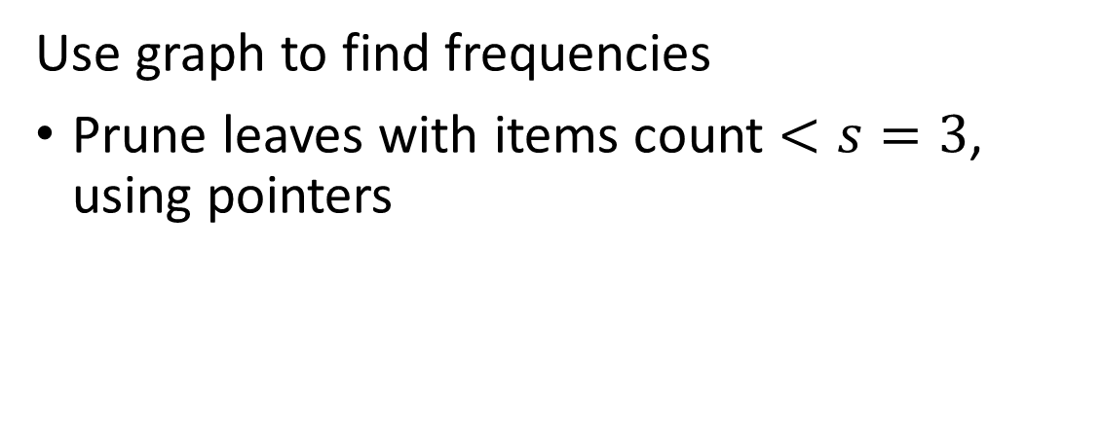
FP Growth Algorithm
Use graph to find frequencies
Prune leaves with items count $<s=3$, using pointers
Null
a:6
c:1
c:2
d:1
d:1
b:3
d:2
b:1
e:1
c:2
e:1
d:1

Slide 50
FP Growth Algorithm
Use graph to find frequencies
Sum from leaves to root to find item set frequency
Item Set | Frequency
{d,c} | 4
{d,a} | 4
{c,a} | 4
{c,b} | 3
{b,a} | 3
{d,c,a} | 3
{d,c,b} | 2
{c,b,a} | 2
{d,c,b,a} | 1
Null
a:6
c:1
c:2
d:1
d:1
b:3
d:2
b:1
c:2
d:1

Slide 51
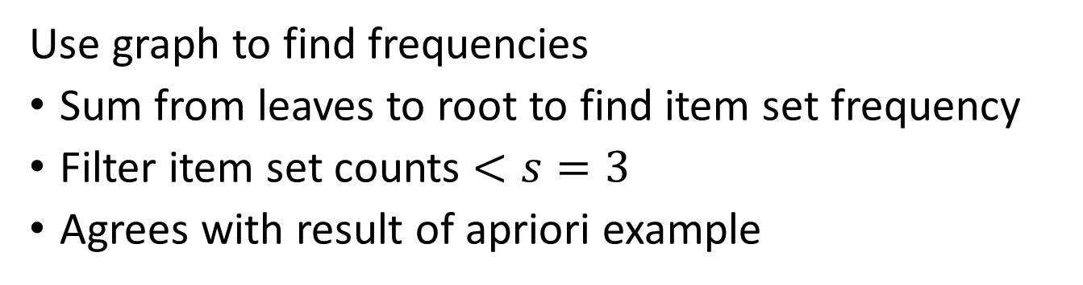
FP Growth Algorithm
Use graph to find frequencies
Sum from leaves to root to find item set frequency
Filter item set counts $<s=3$
Agrees with result of apriori example
Item Set | Frequency
{d,c} | 4
{d,a} | 3
{c,a} | 4
{c,b} | 3
{b,a} | 3
{d,c,a} | 3
{d,c,b} | 2
{c,b,a} | 2
{d,c,b,a} | 1
Null
a:6
c:1
c:2
d:1
d:1
b:3
d:2
b:1
c:2
d:1
d:1

Slide 52
FP Growth Algorithm
Compression with FP growth algorithm
Compression arises from monotonicity property of sets
Example: Sets {a,c}, {a,c,d} require no additional memory given set {a,c,d,e}
Example: Set {b,c} requires no additional memory given set {b,c,d)
Notice that this representation places the most frequent item sets near root of tree
Sets {a,c,d,e}, {a,c,d} and {a,c}
Null
Sets {b,c,d} and {c,d}
a:6
c:1
c:2
d:1
d:1
b:3
d:2
b:1
c:2
e:1
e:1
d:1

Slide 53
FP Growth Algorithm
Why build the tree in inverse sort order?
Graph built in inverse sort order
- Uses less memory by downward closure property
Graph built in random order - More complex graph, uses more memory
Null
Null
a:6
c:1
a:6
b:1
c:2
b:3
c:1
c:1
d:1
b:3
d:1
d:1
d:1
d:2
d:1
c:2
d:1
b:1
e:1
e:1
c:2
e:1
d:1
e:1
d:1

Slide 54
FP Growth Algorithm
Frequent pattern (FP) growth algorithm
Recall that computing the pair frequencies is the memory consuming step of the apriori algorithm
FP growth algorithm can provide considerable compression
The downward closure says that frequent large item sets are comprised of smaller frequent item sets
Smaller item sets are highly likely to occur on the same branch
If this pattern is consistent there is considerable compression over tables
But, FP growth is still relatively slow
Building tree is computationally intensive
May use excessive memory if there is little redundancy on the branches

Slide 55
Summary of Association Rules
Association rules are used to find sets of items that occur frequently
Originally, association rules applied to market basket analysis
Systematic search algorithm is computationally infeasible
Memory is the major limitation
Many algorithms have been developed to limit memory use
Practical algorithms rely on downward closure property of sets
Apriori algorithm was first practical method
Search limited by filtering
PCY improves on apriori using hashing methods
FP growth algorithm is a tree (graph) based method
Memory efficient by downward closure property of sets
Find Python implementation of some association algorithms in the MLxtend package

