Slide 1

CSCI E-96 Data Mining, Exploration and Discovery Introduction to Dimensionality Reduction
Steve Elston
Copyright 2020,2021, 2022, 2023, Stephen F Elston. All rights reserved.

Slide 2
Lesson Overview
Reduction of high-dimensional spaces to lower-dimensions is widely used in data mining
We have already explored reduction of high dimensional spaces with LSH
Projection methods for high dimensions
Highly efficient alternative to PCA
Bounds on distance error
Manifold learning and visualization in high dimensions
Project to low dimensional manifold
Not distance preserving
Association models – next week

Slide 3
Introduction to Dimensionality Reduction
Why is dimensionality reduction possible?
Consider the information content of each feature
Information of a feature is only unique if it is independent of all other features
Dependent features have redundant information
Dimensionality can be reduced if features are dependent
Almost always the case in real-world data
Linear dependency
Nonlinear dependency
Dependency implies effective dimensionality less than number of features

Slide 4
Introduction to Dimensionality Reduction
Dimensionality reduction is widely used in data mining
Human understanding of high dimensional spaces is difficult at best
For most people, perception of data relationships starts to dimension beyond 4 or dimensions
Exploration of complex spaces can be aided by projection into lower dimensional space
Most algorithms converge better in lower dimensional spaces
High dimensional spaces can lead to over-fitting of data mining algorithms
For example, clustering in high dimensional spaces can lead fragmentation of the data
Dimensionality reduction can improve results

Slide 5
Clustering in High Dimensions and The Curse of Dimensionality!

Slide 6
What Could Possibly Go Wrong? Curse of Dimensionality!
Cluster models scale poorly with dimensionality
Consider sampling required to maintain the same uniformly distributed density in a hypercube:
An example of the Curse of Dimensionality!
Dimensions | Samples
1 | 10
2 | 100
3 | 1,000
5 | 10⁵
10 | 10¹⁰

Slide 7
What Could Possibly Go Wrong? Curse of Dimensionality
The curse of dimensionality means that all clusters are the same in high dimensions
Sampling density decreases exponentially
Distances converge to the same size in a high dimensional space
The choice of metric does not help
All distances are the same in high dimensions!
Implication is that high-dimensional cluster models are easy to overfit!!

Slide 8
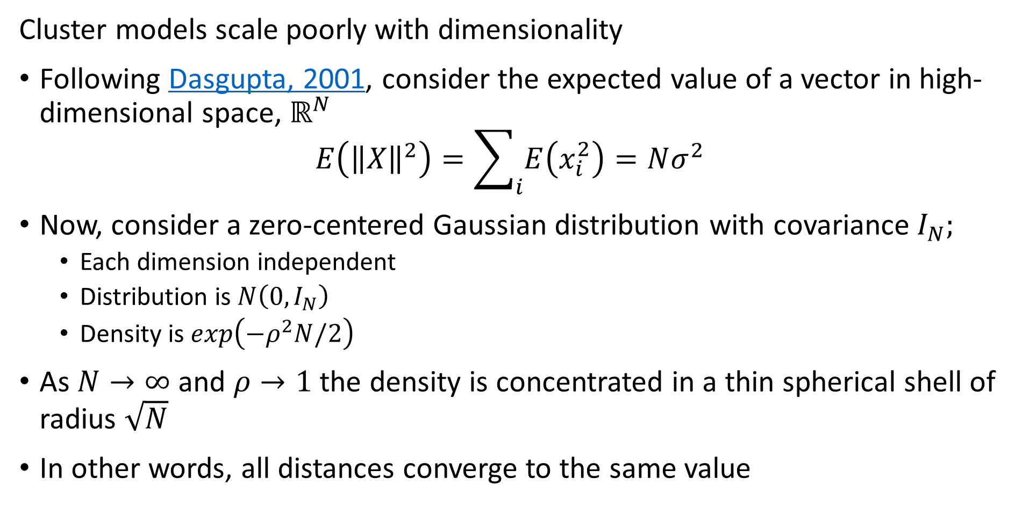
What Could Possibly Go Wrong? Curse of Dimensionality
Cluster models scale poorly with dimensionality
Following Dasgupta, 2001, consider the expected value of a vector in high-dimensional space, $ℝ^{N}$
$$E\left({\left\|X\right\|}^{2}\right)=\sum_{i}{E\left(x_{i}^{2}\right)=Nσ^{2}}$$
Now, consider a zero-centered Gaussian distribution with covariance $I_{N};$
Each dimension independent
Distribution is$N\left(0,I_{N}\right)$
Density is $exp\left(−ρ^{2}N/2\right)$
As $N→∞$ and $ρ→1$ the density is concentrated in a thin spherical shell of radius $\sqrt{N}$
In other words, all distances converge to the same value

Slide 9
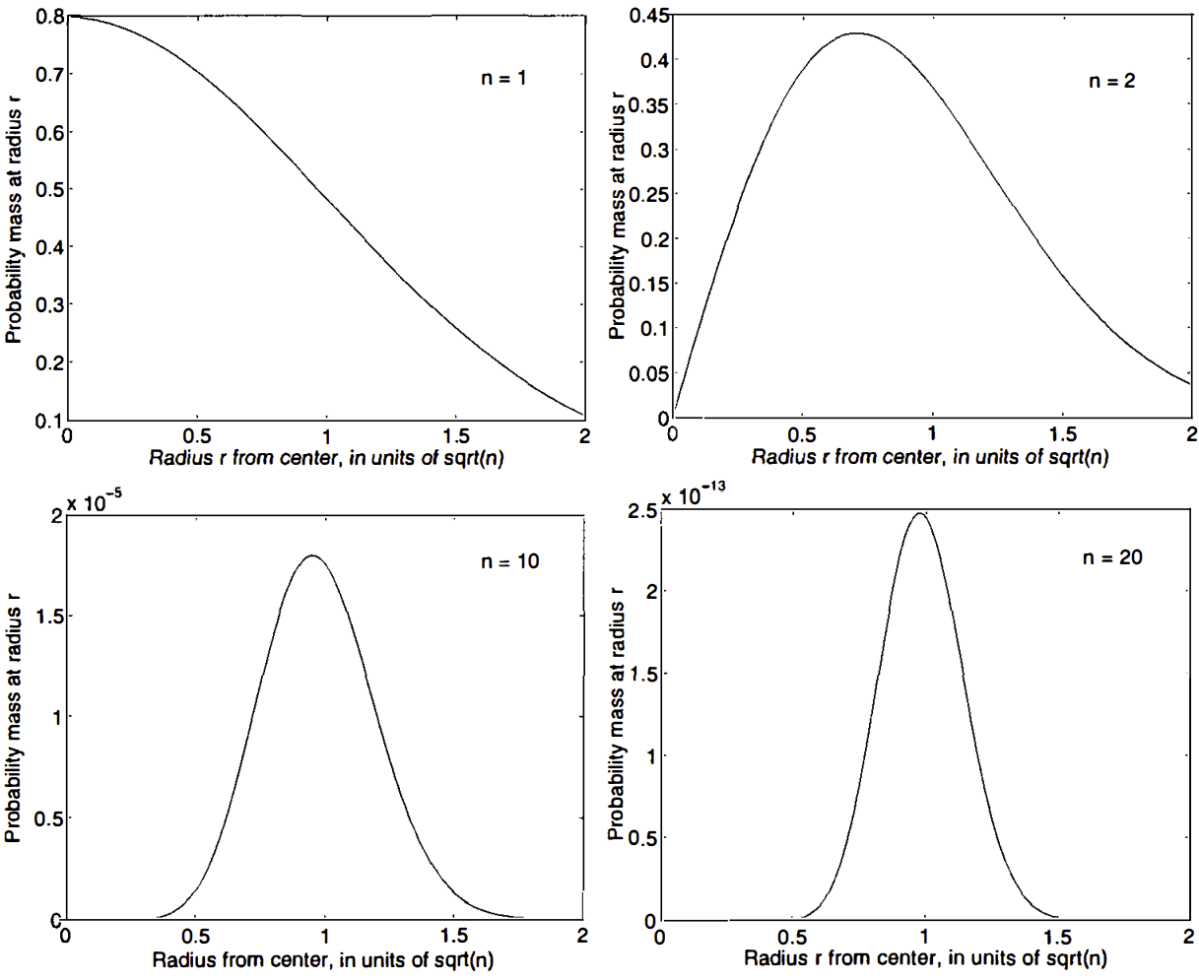
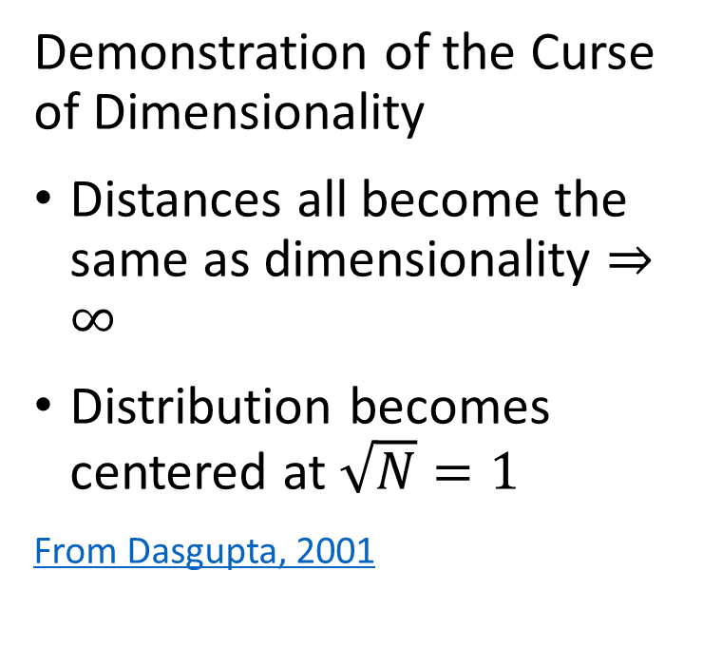
What Could Possibly Go Wrong? Curse of Dimensionality
Demonstration of the Curse of Dimensionality
Distances all become the same as dimensionality $⇒∞$
Distribution becomes centered at $\sqrt{N}=1$
From Dasgupta, 2001

Slide 10
What Could Possibly Go Wrong? Curse of Dimensionality
How can we extend clustering to higher dimensions?
Reducing dimensionality can help
Need to create a lower dimensional embedding
But how?
PCA is a linear projection
Several families of alternatives
Subspace clustering
Random projection
Manifold learning

Slide 11
Projection Methods

Slide 12
Random Projection Methods
How can we overcome the curse of dimensionality?
Random projection methods samples random directions
Introduced in several contexts, including by Bingham and Mannila, 2001 and Achliptas, 2001
Alternative to PCA
Error of the random projection to lower dimensional space is bounded
Distance is therefore preserved
Random projections in Euclidean space tend to create spherical clusters
Spherical clusters are easier for many algorithms to deal with

Slide 13
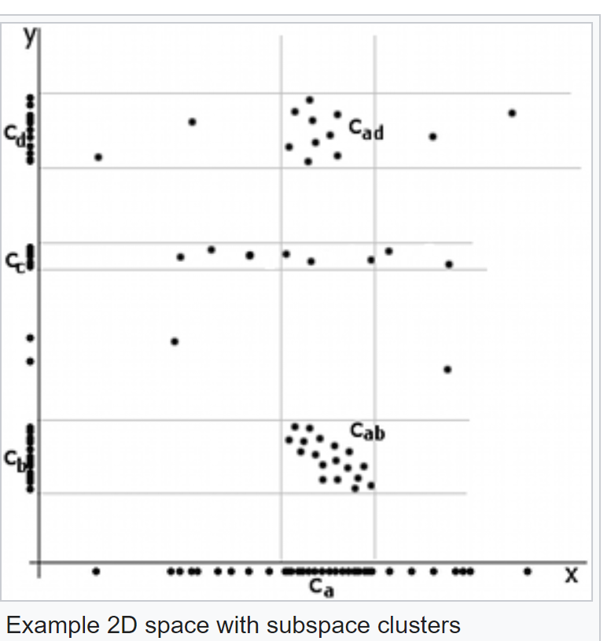
Random Projection Methods
Example of difficult dimensionality reduction
Cluster centers aligned along x axis
Apparent cluster along axis
No apparent cluster along axis
Credit Wikipedia commons

Slide 14
Random Projection Methods
Example of difficult dimensionality reduction
Highest variance direction aligned with axis
Largest eigenvector for largest eigenvalue along axes
Principal components same as axes
No dimensionality reduction
First Principal Component
Credit Wikipedia commons
Second Principle Component

Slide 15
Random Projection Methods
Example of difficult dimensionality reduction
Cluster models will struggle
2 well defined clusters on both components
Cluster with low variance on first component, dispersed along second component
- Not a spherical cluster!
First Principal Component
Credit Wikipedia commons
Second Principle Component

Slide 16
Subspace Projection Methods
How can we extend clustering to higher dimensions?
Subspace clustering samples many subspaces to find embedding
Limited scalability since there are infinite possible subspaces
Heuristic, downward closure property, improves scalability - addressed in a subsequent lesson
Python subspace clustering package in Chong You’s GitHub repository
We will not pursue this method further here
Random projection methods are a better alternative in many cases

Slide 17
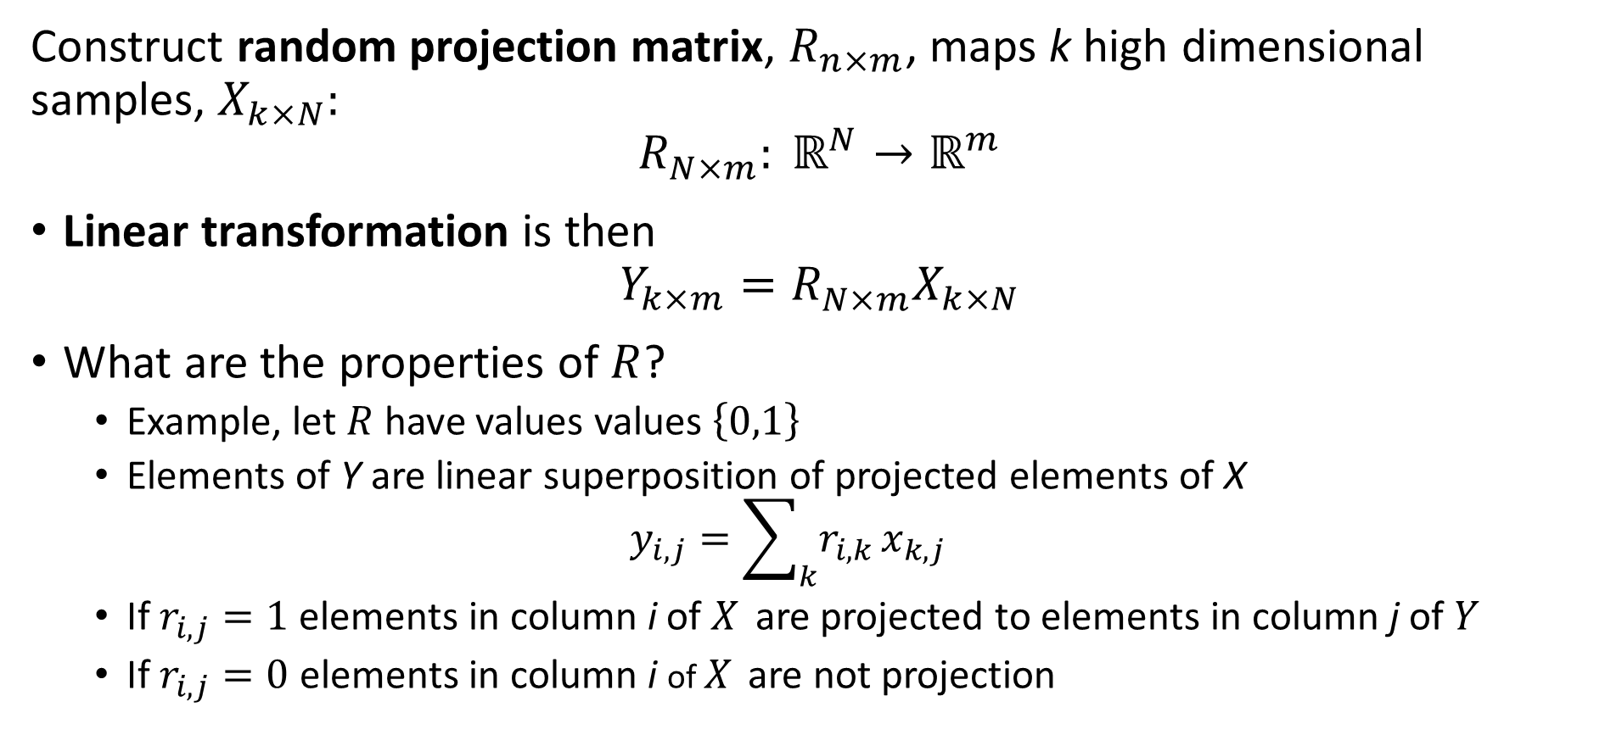
Random Projection Methods
Construct random projection matrix, $R_{n×m}^{ }$, maps k high dimensional samples, $X_{k×N}:$
$${R_{N×m}^{ }: ℝ}^{N}→ℝ^{m}$$
Linear transformation is then
$$Y_{k×m}=R_{N×m}^{ }X_{k×N}$$
What are the properties of $R$?
Example, let $R$ have values values $\left\{0,1\right\}$
Elements of Y are linear superposition of projected elements of X
$$y_{i,j}=\sum_{k}{r_{i,k}}x_{k,j}$$
If $r_{i,j}=1$ elements in column i of $X_{ }$ are projected to elements in column j of $Y$
If $r_{i,j}=0$ elements in column i of $X_{ }$ are not projection

Slide 18
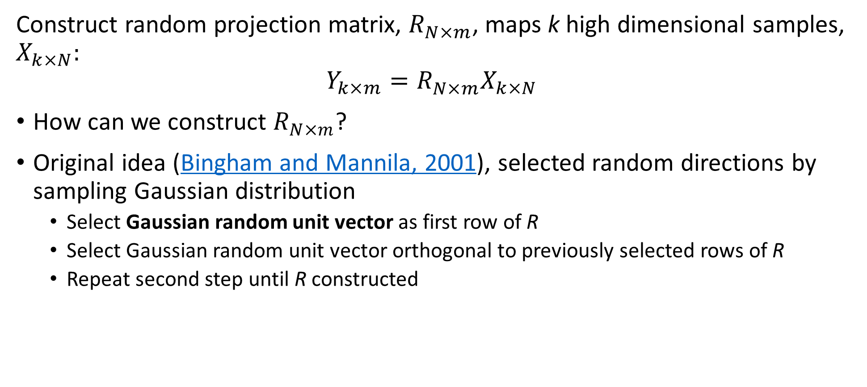
Random Projection Methods
Construct random projection matrix, $R_{N×m}^{ }$, maps k high dimensional samples, $X_{k×N}:$
$$Y_{k×m}=R_{N×m}^{ }X_{k×N}$$
How can we construct $R_{N×m}^{ }$?
Original idea (Bingham and Mannila, 2001), selected random directions by sampling Gaussian distribution
Select Gaussian random unit vector as first row of R
Select Gaussian random unit vector orthogonal to previously selected rows of R
Repeat second step until R constructed

Slide 19
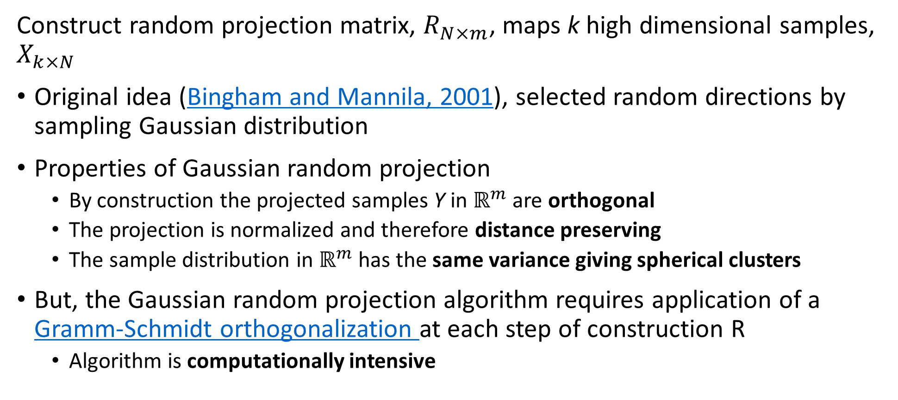
Random Projection Methods
Construct random projection matrix, $R_{N×m}^{ }$, maps k high dimensional samples, $X_{k×N}$
Original idea (Bingham and Mannila, 2001), selected random directions by sampling Gaussian distribution
Properties of Gaussian random projection
By construction the projected samples Y in $ℝ^{m}$ are orthogonal
The projection is normalized and therefore distance preserving
The sample distribution in $ℝ^{m}$ has the same variance giving spherical clusters
But, the Gaussian random projection algorithm requires application of a Gramm-Schmidt orthogonalization at each step of construction R
Algorithm is computationally intensive

Slide 20
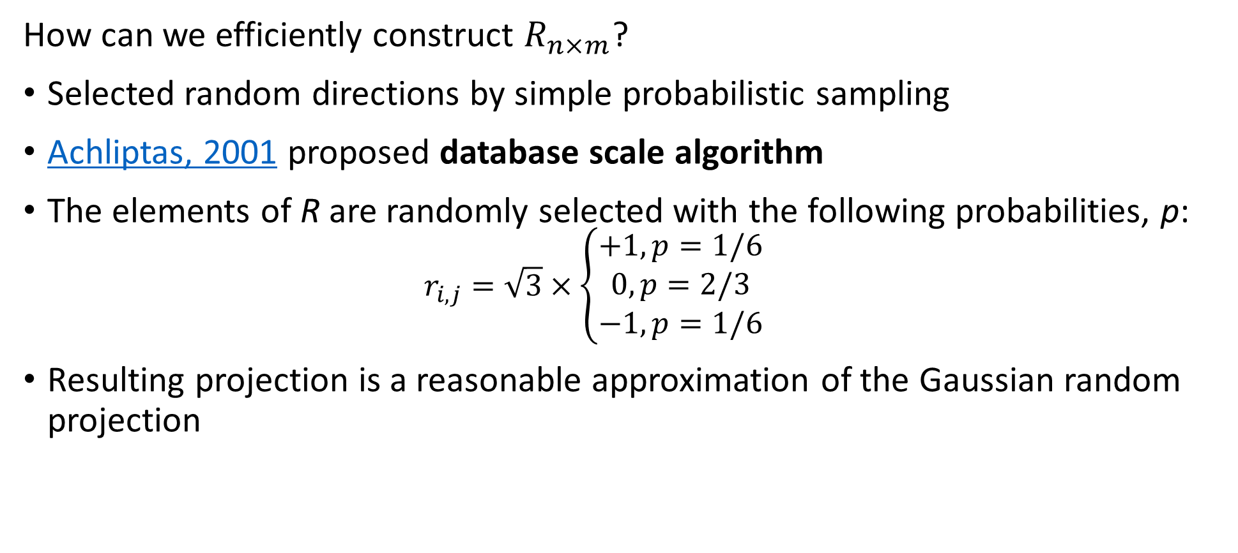
Random Projection Methods
How can we efficiently construct $R_{n×m}^{ }$?
Selected random directions by simple probabilistic sampling
Achliptas, 2001 proposed database scale algorithm
The elements of R are randomly selected with the following probabilities, p:
$$r_{i,j}=\sqrt{3}×\left\{\begin{aligned}+1, p=1/6 \\ 0, p=2/3 \\ −1, p=1/6\end{aligned}\right.$$
Resulting projection is a reasonable approximation of the Gaussian random projection

Slide 21
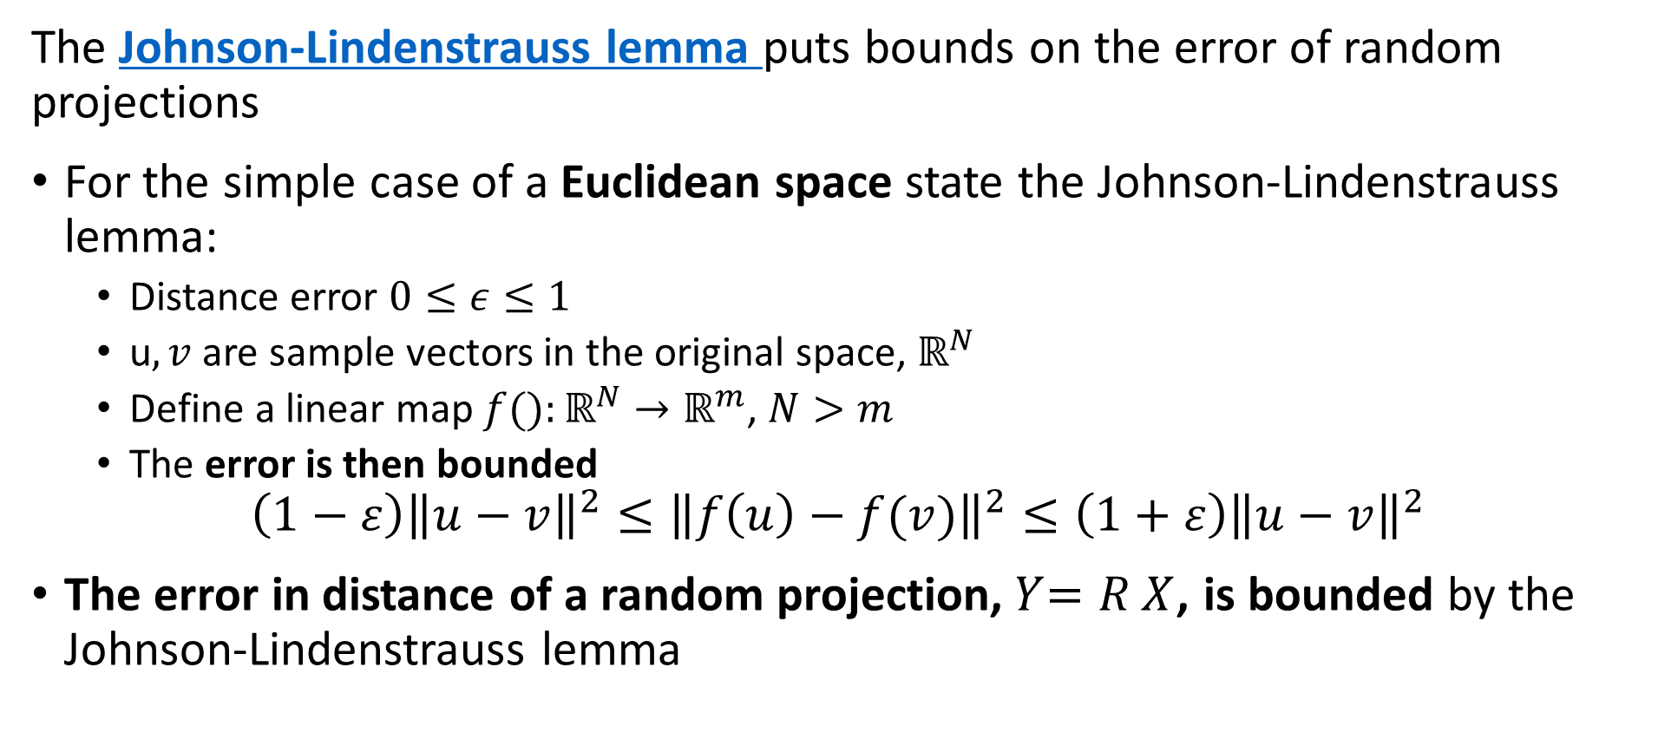
Random Projection Methods
The Johnson-Lindenstrauss lemma puts bounds on the error of random projections
For the simple case of a Euclidean space state the Johnson-Lindenstrauss lemma:
Distance error $0≤ε≤1$
u$,v$ are sample vectors in the original space, $ℝ^{N}$
Define a linear map $f():ℝ^{N}→ℝ^{m}$, $N>m$
The error is then bounded
$$\left(1−ε\right){\left\|u−v\right\|}^{2}≤{\left\|f\left(u\right)−f(v)\right\|}^{2}≤\left(1+ε\right){\left\|u−v\right\|}^{2}$$
The error in distance of a random projection,${ Y}_{ }=R_{ }^{ }X$, is bounded by the Johnson-Lindenstrauss lemma

Slide 22
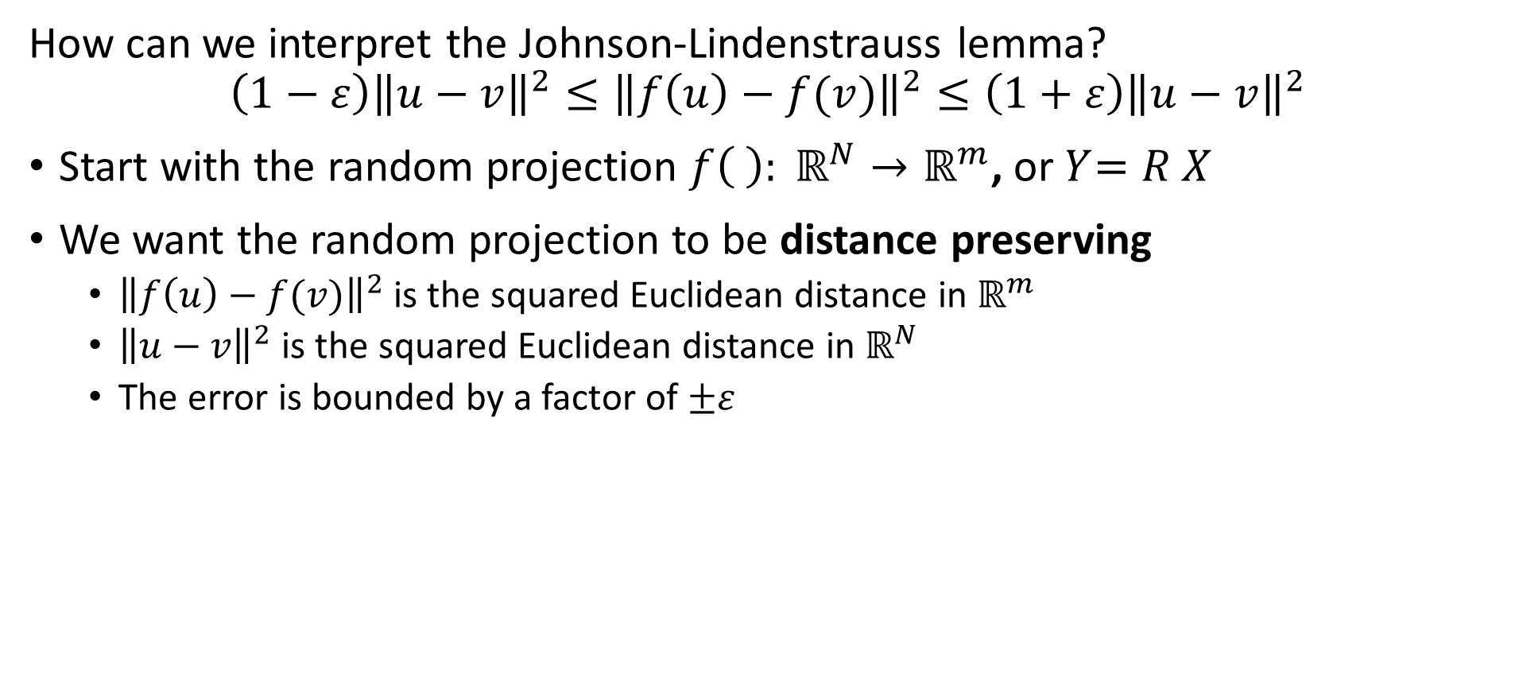
Random Projection Methods
How can we interpret the Johnson-Lindenstrauss lemma?
$$\left(1−ε\right){\left\|u−v\right\|}^{2}≤{\left\|f\left(u\right)−f(v)\right\|}^{2}≤\left(1+ε\right){\left\|u−v\right\|}^{2}$$
Start with the random projection ${f\left( \right): ℝ}^{N}→ℝ^{m}$, or${ Y}_{ }=R_{ }^{ }X$
We want the random projection to be distance preserving
${\left\|f\left(u\right)−f(v)\right\|}^{2}$ is the squared Euclidean distance in $ℝ^{m}$
${\left\|u−v\right\|}^{2}$ is the squared Euclidean distance in $ℝ^{N}$
The error is bounded by a factor of $±ε$

Slide 23
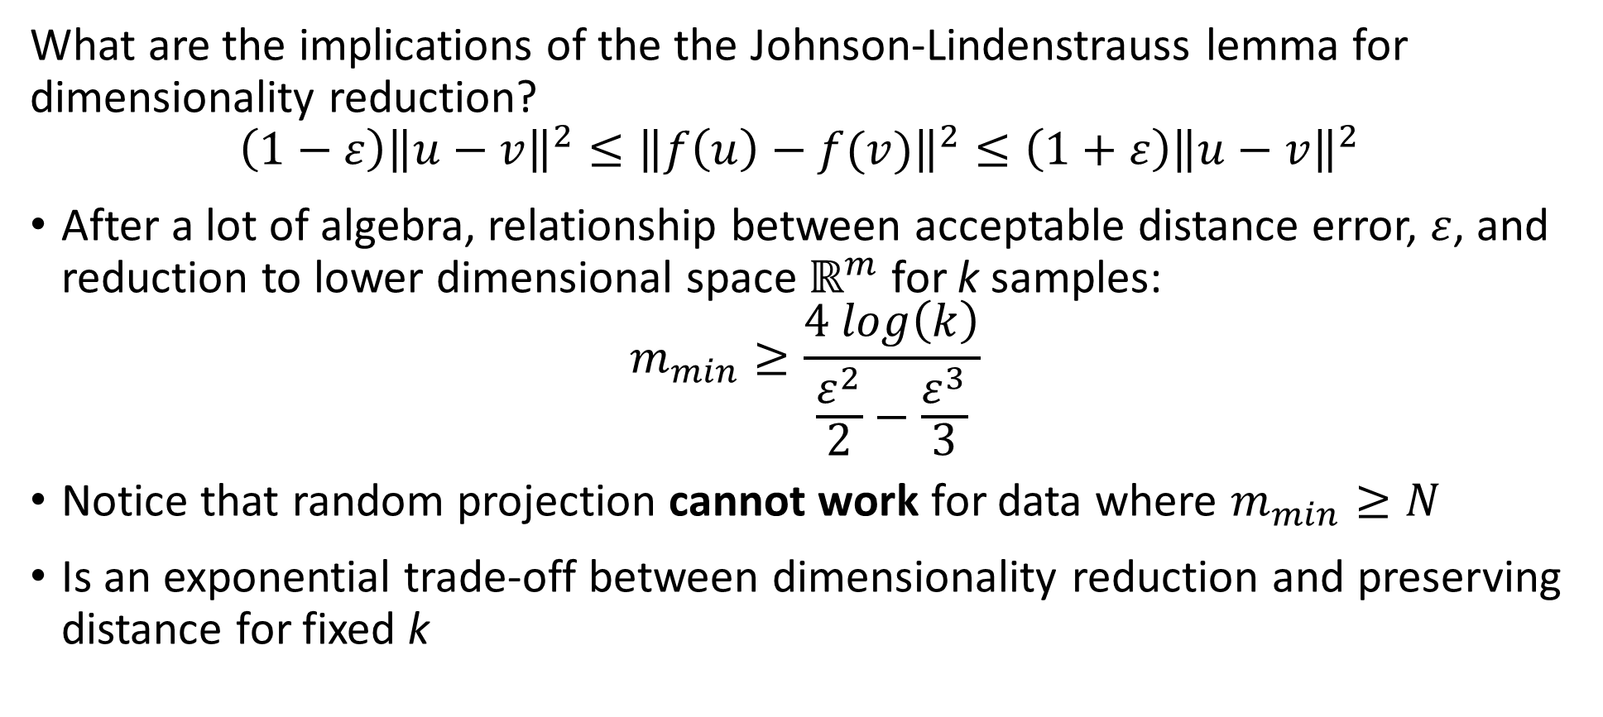
Random Projection Methods
What are the implications of the the Johnson-Lindenstrauss lemma for dimensionality reduction?
$$\left(1−ε\right){\left\|u−v\right\|}^{2}≤{\left\|f\left(u\right)−f(v)\right\|}^{2}≤\left(1+ε\right){\left\|u−v\right\|}^{2}$$
After a lot of algebra, relationship between acceptable distance error, $ε$, and reduction to lower dimensional space $ℝ^{m}$ for k samples:
$$m_{min}≥\frac{4 log\left(k\right)}{\frac{ε^{2}}{2}−\frac{ε^{3}}{3}}$$
Notice that random projection cannot work for data where $m_{min}≥N$
Is an exponential trade-off between dimensionality reduction and preserving distance for fixed k

Slide 24
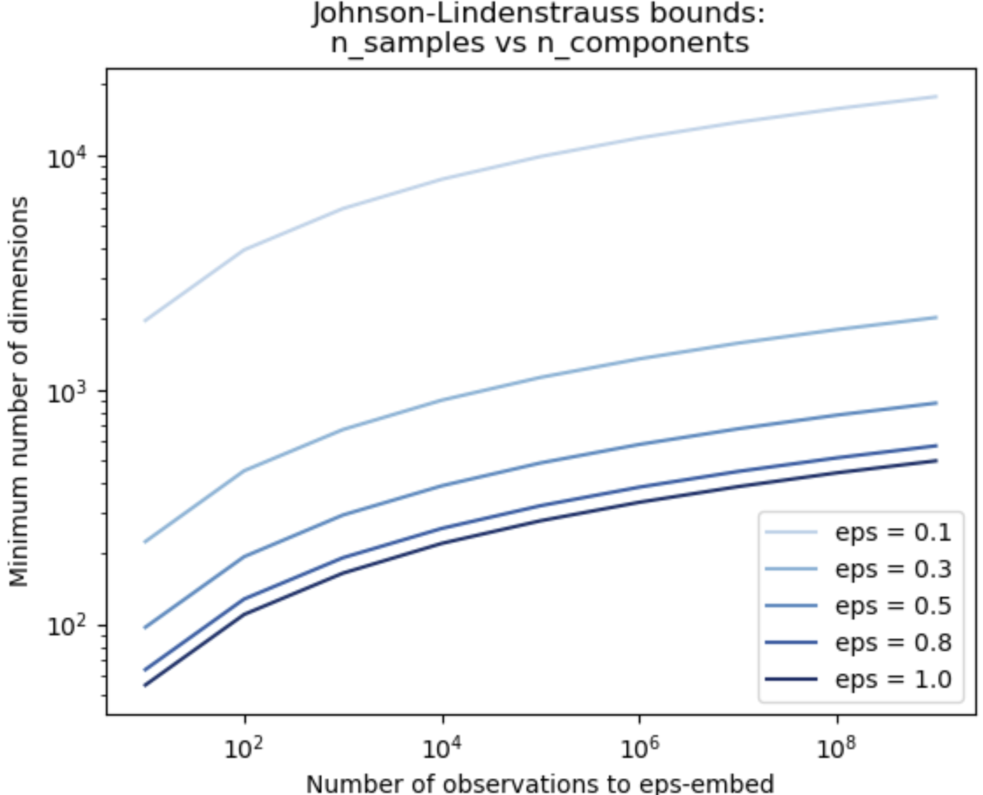
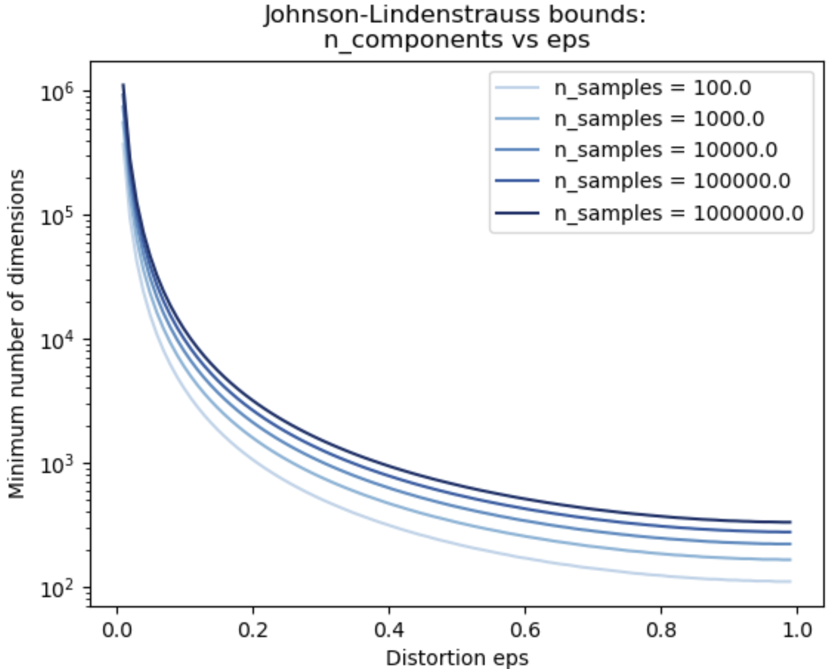
Random Projection Methods
Exponential trade-off between dimensionality reduction and preserving distance
Credit: Scikit-Learn team

Slide 25
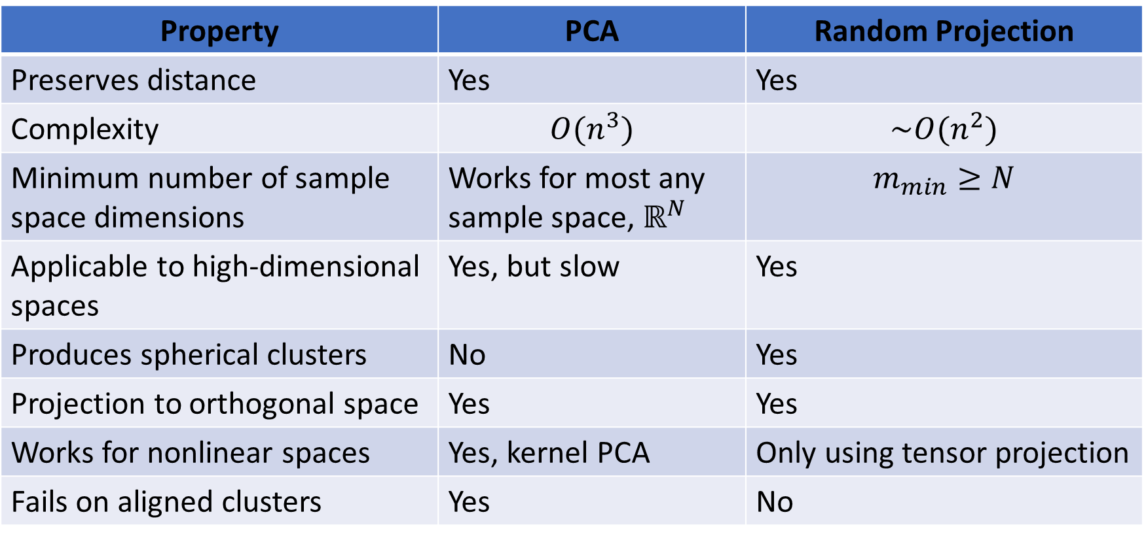
Random Projection Methods
How does random projection compare to PCA?
Property | PCA | Random Projection
Preserves distance | Yes | Yes
Complexity | $$O(n^{3})$$ | $$\sim O(n^{2})$$
Minimum number of sample space dimensions | Works for most any sample space, $ℝ^{N}$ | $$m_{min}≥N$$
Applicable to high-dimensional spaces | Yes, but slow | Yes
Produces spherical clusters | No | Yes
Projection to orthogonal space | Yes | Yes
Works for nonlinear spaces | Yes, kernel PCA | Only using tensor projection
Fails on aligned clusters | Yes | No

Slide 26
Manifold Learning

Slide 27
Manifold Learning
How can we visualize data from higher dimensions?
Reducing dimensionality can help
Need to create a lower dimensional embedding
But how?
Manifold Learning finds projection of high-dimensional space onto a low-dimensional manifold – lesson on dimensionality reduction
Many commonly used unsupervised methods
Spectral embedding
t-distributed Stochastic Neighbor Embedding (t-SNE)
…..
Well supported in Scikit-Learn

Slide 28
Manifold Learning
Map high-dimensional space to a low dimensional manifold
A manifold is a low dimensional surface in a high-dimensional space
Linear manifold is a hyperplane
Nonlinear manifolds for more complex embeddings
Often used as a visualization technique
Human perception generally fails beyond a few dimensions
Mapping to a manifold creates low-dimensional projection of complex data relationships

Slide 29
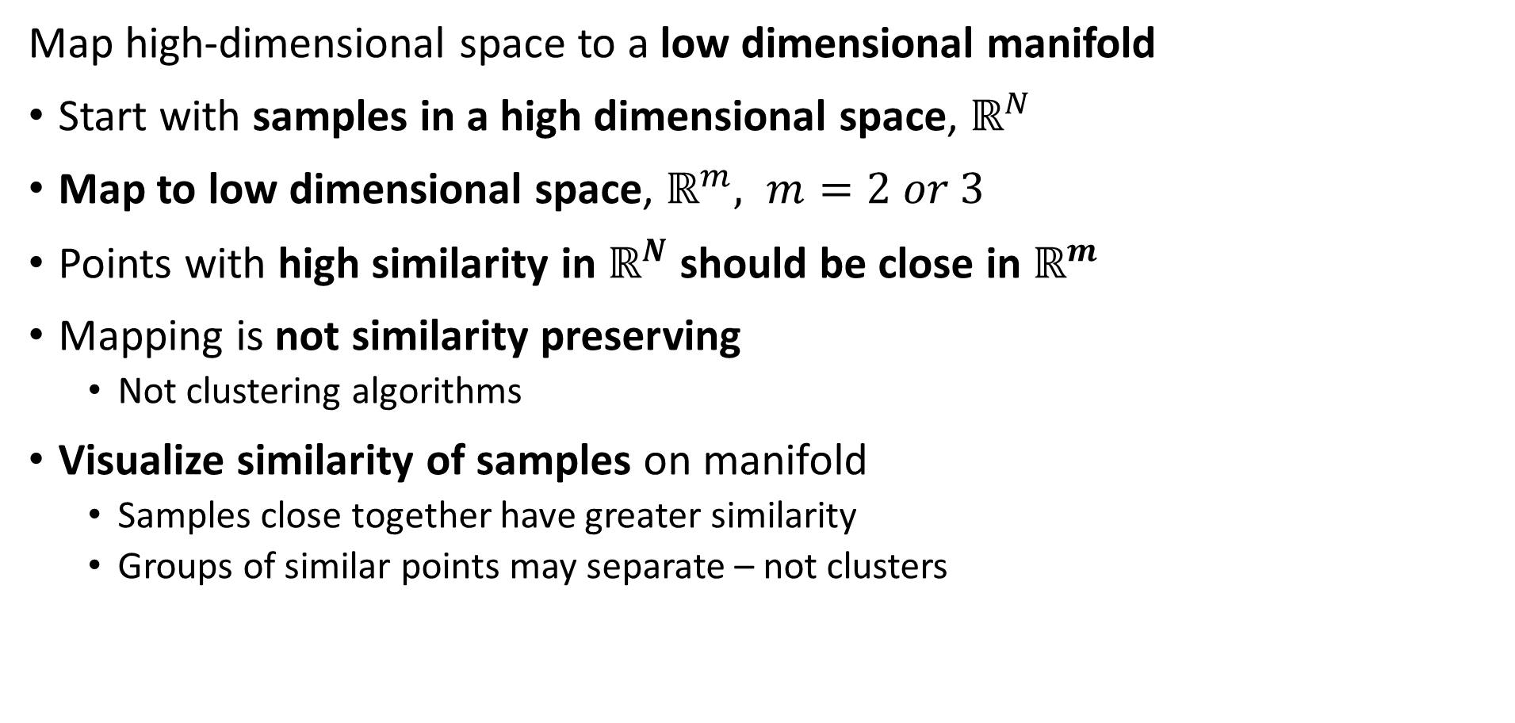
Manifold Learning
Map high-dimensional space to a low dimensional manifold
Start with samples in a high dimensional space, $ℝ^{N}$
Map to low dimensional space, $ℝ^{m}, m=2 or 3$
Points with high similarity in $ℝ^{N}$ should be close in $ℝ^{m}$
Mapping is not similarity preserving
Not clustering algorithms
Visualize similarity of samples on manifold
Samples close together have greater similarity
Groups of similar points may separate – not clusters

Slide 30
Manifold Learning
Map high-dimensional space to a low dimensional manifold
Many algorithms have been developed
Scikit-Learn supports 8 algorithms + PCA
Projection of first 2 or 3 PCs is on a linear manifold or hyperplane
We will look at two unsupervised algorithms in detail:
Spectral embedding
t-distributed Stochastic Neighbor Embedding, t-SNE
Also some supervised algorithms like UMAP
We will not discuss in this course

Slide 31
Spectral Embedding
Spectral embedding uses graph-based construction
Creates a low-dimensional map of high dimensional space
Closely related to spectral clustering algorithm
Uses eigendecomposition of graph Laplacian
Maps to nonlinear manifold from high-dimensional space
Supported in Scikit-Learn

Slide 32
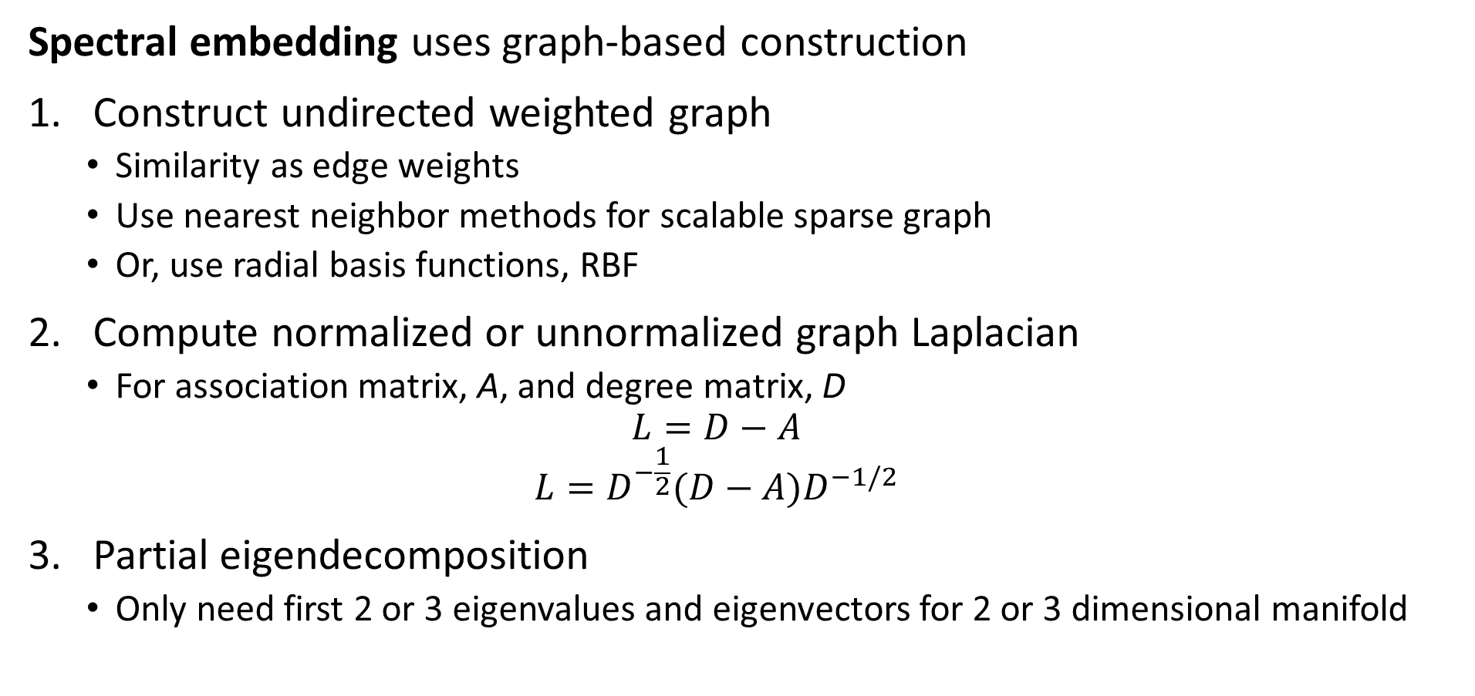
Spectral Embedding
Spectral embedding uses graph-based construction
Construct undirected weighted graph
Similarity as edge weights
Use nearest neighbor methods for scalable sparse graph
Or, use radial basis functions, RBF
Compute normalized or unnormalized graph Laplacian
For association matrix, A, and degree matrix, D
$$L=D−A$$
$$L=D^{−\frac{1}{2}}(D−A)D^{−1/2}$$
Partial eigendecomposition
Only need first 2 or 3 eigenvalues and eigenvectors for 2 or 3 dimensional manifold

Slide 33
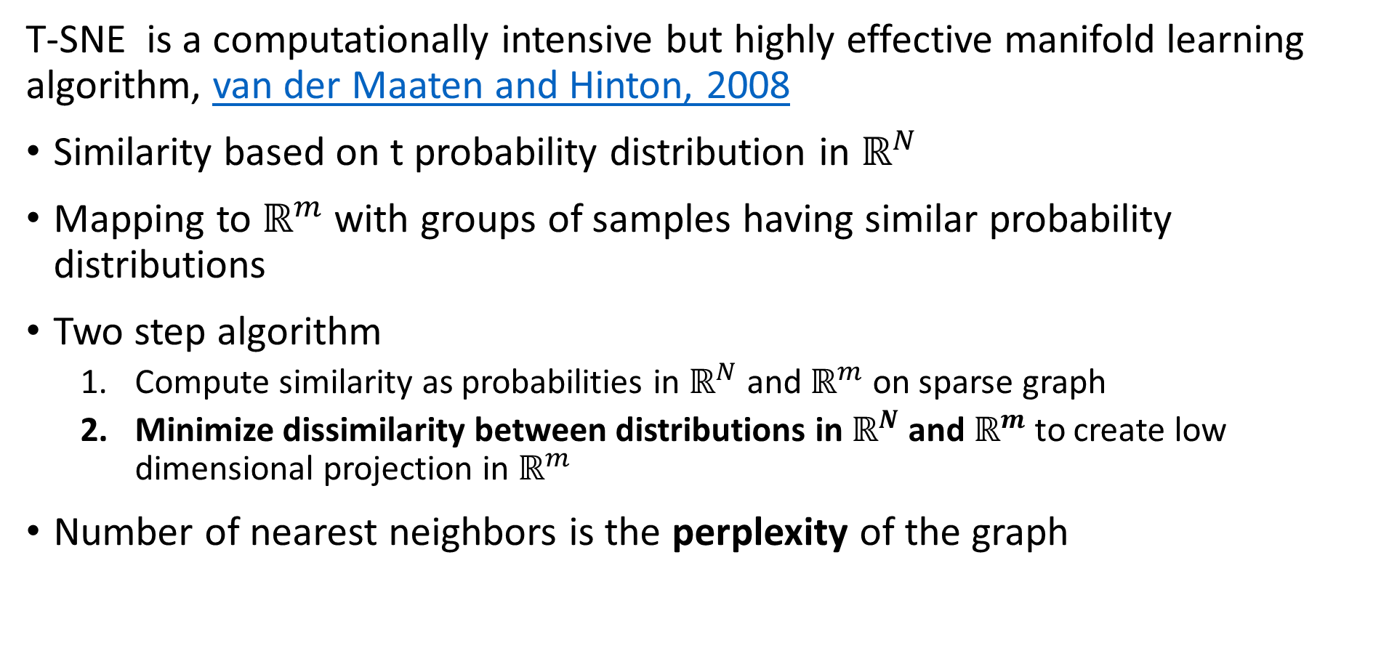
t-SNE
T-SNE is a computationally intensive but highly effective manifold learning algorithm, van der Maaten and Hinton, 2008
Similarity based on t probability distribution in $ℝ^{N}$
Mapping to $ℝ^{m}$ with groups of samples having similar probability distributions
Two step algorithm
Compute similarity as probabilities in $ℝ^{N}$ and $ℝ^{m}$ on sparse graph
Minimize dissimilarity between distributions in $ℝ^{N}$ and $ℝ^{m}$ to create low dimensional projection in $ℝ^{m}$
Number of nearest neighbors is the perplexity of the graph

Slide 34
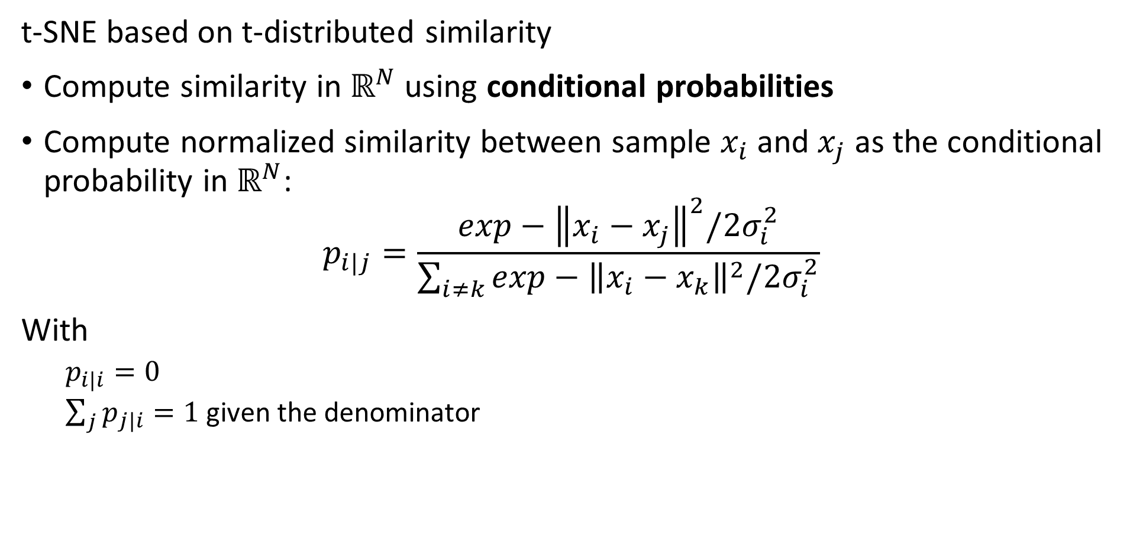
t-SNE
t-SNE based on t-distributed similarity
Compute similarity in $ℝ^{N}$ using conditional probabilities
Compute normalized similarity between sample $x_{i}$ and $x_{j}$ as the conditional probability in $ℝ^{N}$:
$$p_{i|j}=\frac{exp−{\left\|x_{i}−x_{j}\right\|}^{2}/2σ_{i}^{2}}{\sum_{i≠k}^{ }{exp−{\left\|x_{i}−x_{k}\right\|}^{2}/2σ_{i}^{2}}}$$
With
$p_{i|i}=0$
$\sum_{j}{p_{j|i}}=1$ given the denominator

Slide 35
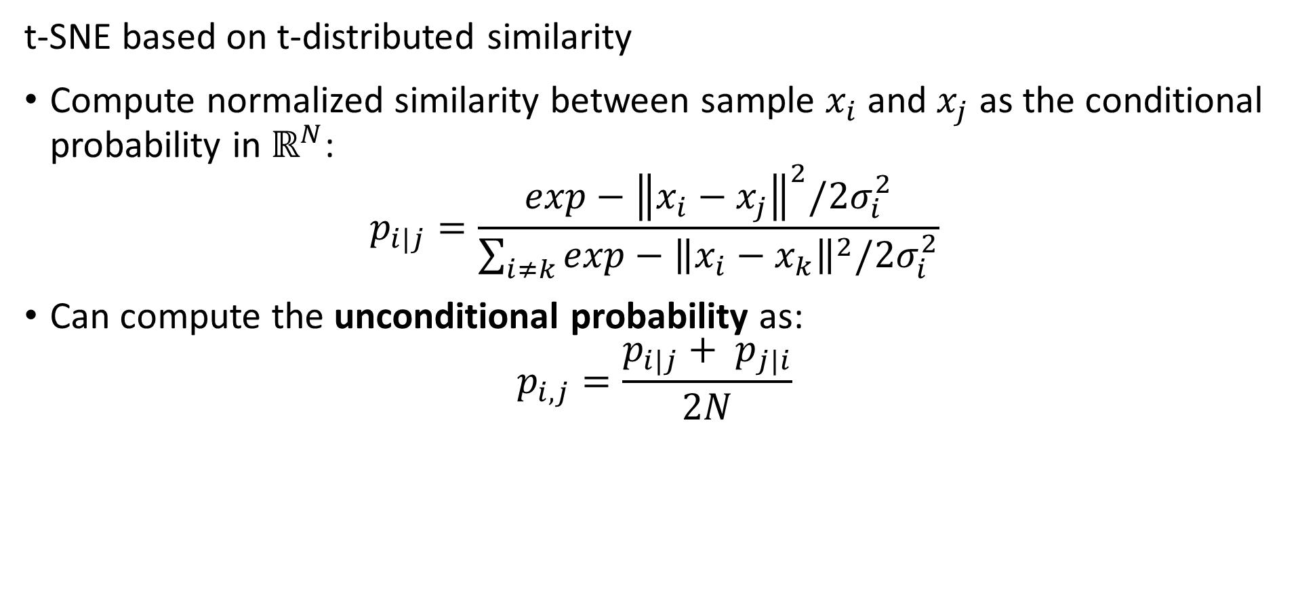
t-SNE
t-SNE based on t-distributed similarity
Compute normalized similarity between sample $x_{i}$ and $x_{j}$ as the conditional probability in $ℝ^{N}$:
$$p_{i|j}=\frac{exp−{\left\|x_{i}−x_{j}\right\|}^{2}/2σ_{i}^{2}}{\sum_{i≠k}^{ }{exp−{\left\|x_{i}−x_{k}\right\|}^{2}/2σ_{i}^{2}}}$$
Can compute the unconditional probability as:
$$p_{i,j}=\frac{p_{i|j}+ p_{j|i}}{2N}$$

Slide 36
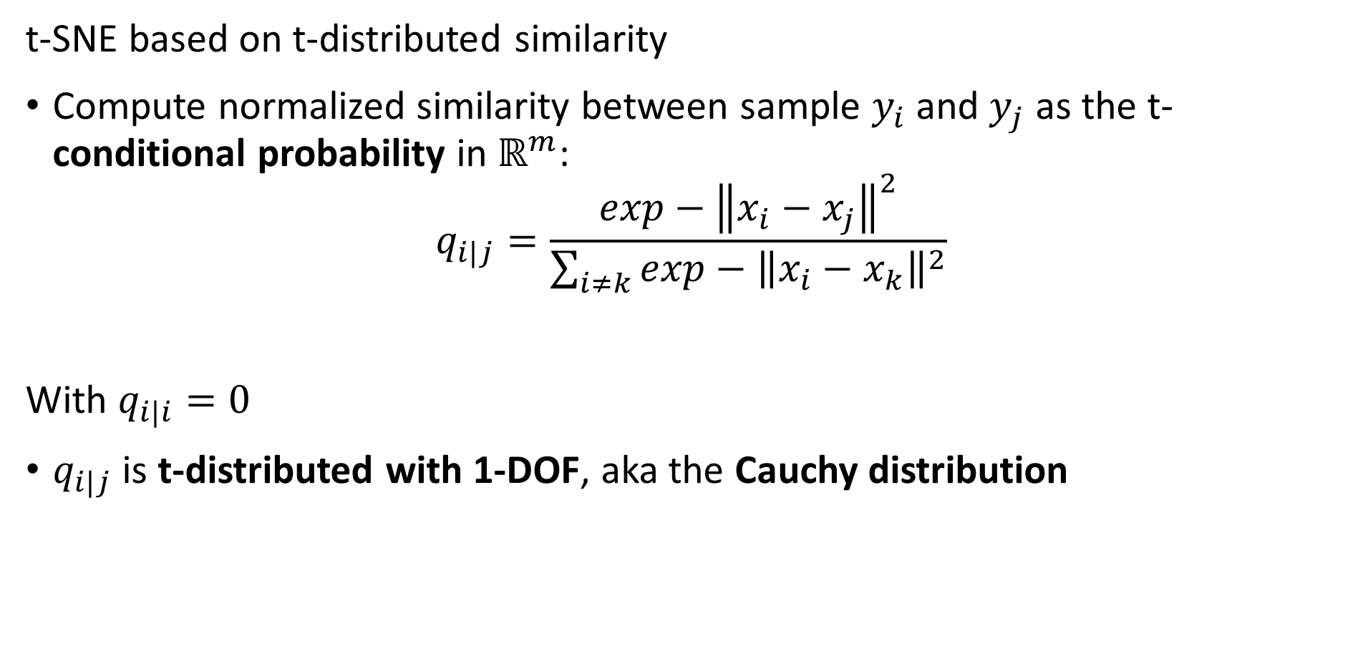
t-SNE
t-SNE based on t-distributed similarity
Compute normalized similarity between sample $y_{i}$ and $y_{j}$ as the t-conditional probability in $ℝ^{m}$:
$$q_{i|j}=\frac{exp−{\left\|x_{i}−x_{j}\right\|}^{2}}{\sum_{i≠k}^{ }{exp−{\left\|x_{i}−x_{k}\right\|}^{2}}}$$
With $q_{i|i}=0$
$q_{i|j}$ is t-distributed with 1-DOF, aka the Cauchy distribution

Slide 37
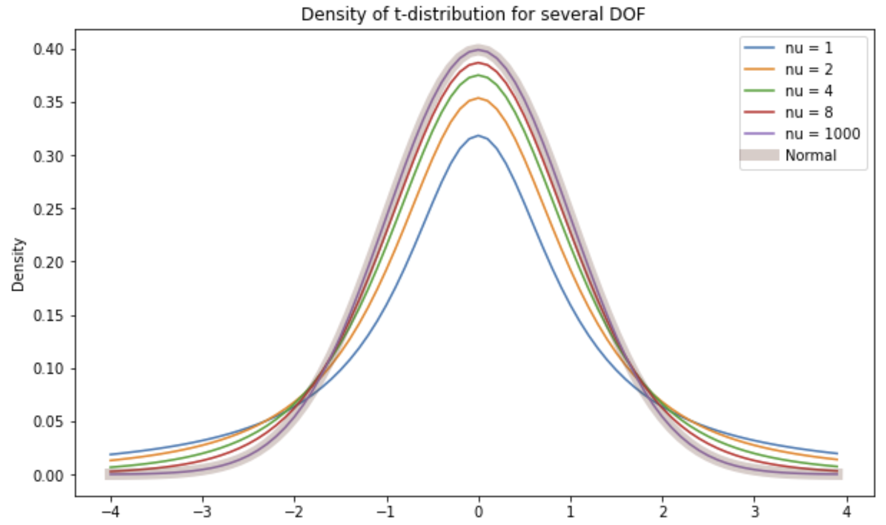
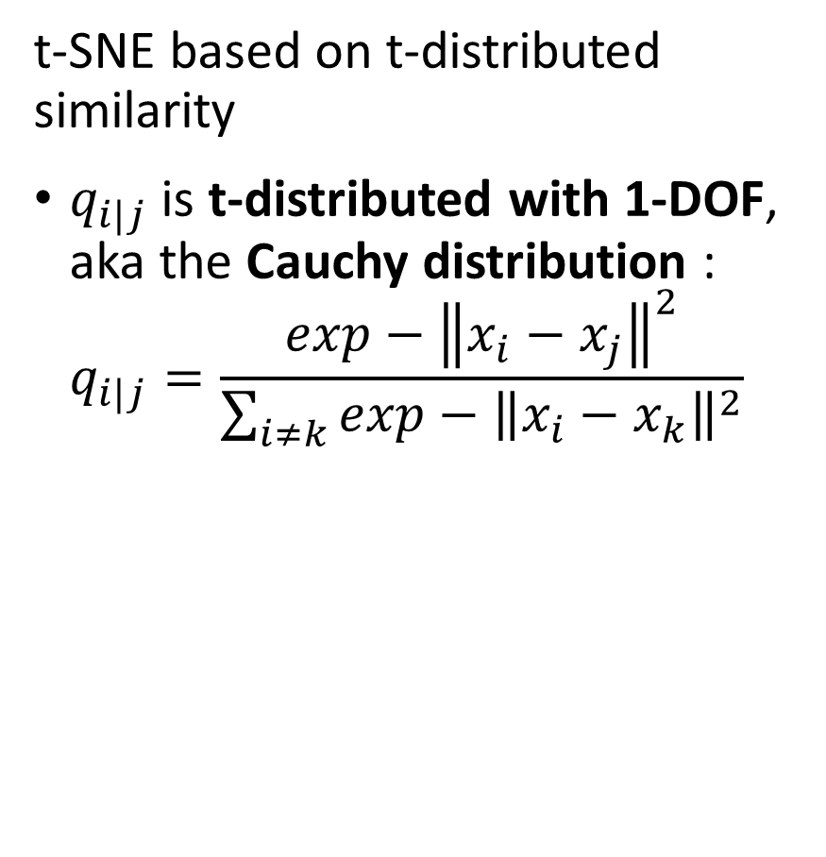
t-SNE
t-SNE based on t-distributed similarity
$q_{i|j}$ is t-distributed with 1-DOF, aka the Cauchy distribution :
$$q_{i|j}=\frac{exp−{\left\|x_{i}−x_{j}\right\|}^{2}}{\sum_{i≠k}^{ }{exp−{\left\|x_{i}−x_{k}\right\|}^{2}}}$$

Slide 38
t-SNE
t-SNE based on t-distributed similarity
Why is the t-distribution a good choice
Notice that for the Normal distribution probability low for samples far from the center
t-distribution has reasonable probability further from center
t-distribution with 1 DOF has heaviest tail

Slide 39
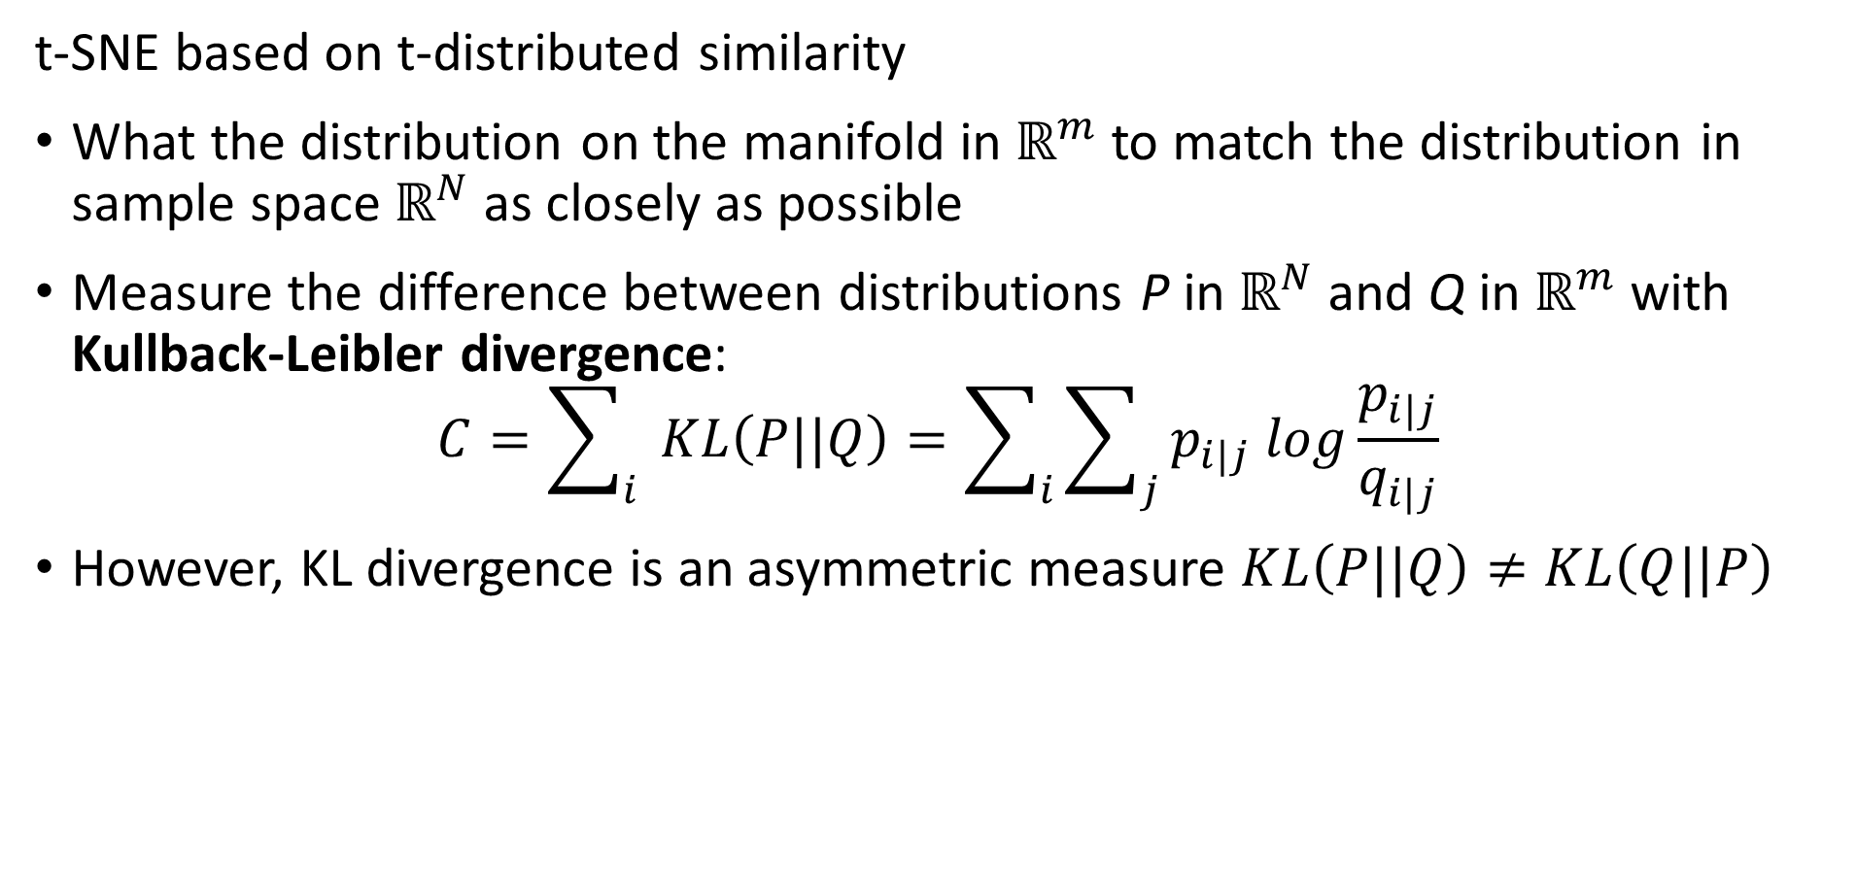
t-SNE
t-SNE based on t-distributed similarity
What the distribution on the manifold in $ℝ^{m}$ to match the distribution in sample space $ℝ^{N}$ as closely as possible
Measure the difference between distributions P in $ℝ^{N}$ and Q in $ℝ^{m}$ with Kullback-Leibler divergence:
$$C=\sum_{i}{ }KL\left(P||Q\right)=\sum_{i}{\sum_{j}{p_{i|j} log\frac{p_{i|j}}{q_{i|j}}}}$$
However, KL divergence is an asymmetric measure $KL\left(P||Q\right)≠KL\left(Q||P\right)$

Slide 40
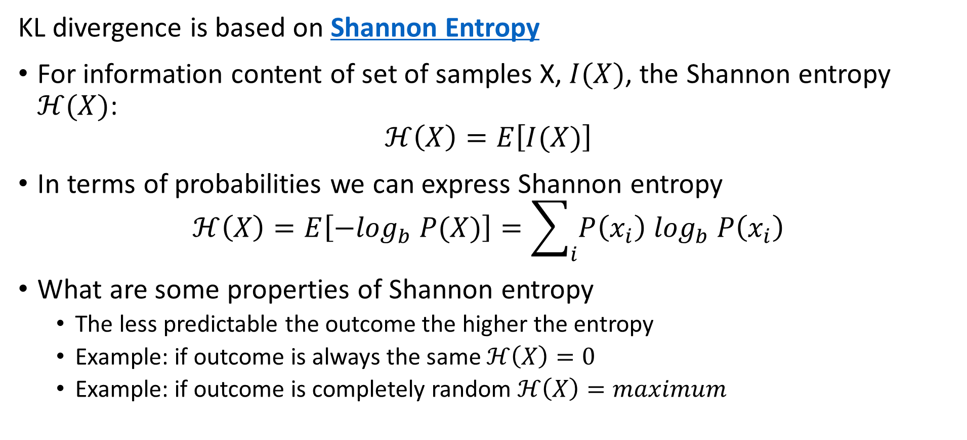
KL Divergence
KL divergence is based on Shannon Entropy
For information content of set of samples X, $I(X)$, the Shannon entropy $ℋ(X)$:
$$ℋ\left(X\right)=E\left[I(X)\right]$$
In terms of probabilities we can express Shannon entropy
$$ℋ\left(X\right)=E\left[{−log}_{b} P(X)\right]=\sum_{i}{P\left(x_{i}\right) \log_{b} P\left(x_{i}\right)}$$
What are some properties of Shannon entropy
The less predictable the outcome the higher the entropy
Example: if outcome is always the same $ℋ\left(X\right)=0$
Example: if outcome is completely random $ℋ\left(X\right)=maximum$

Slide 41
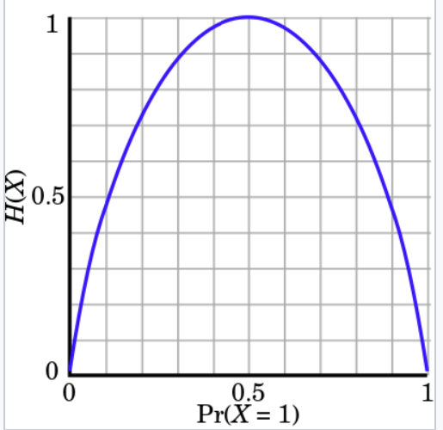
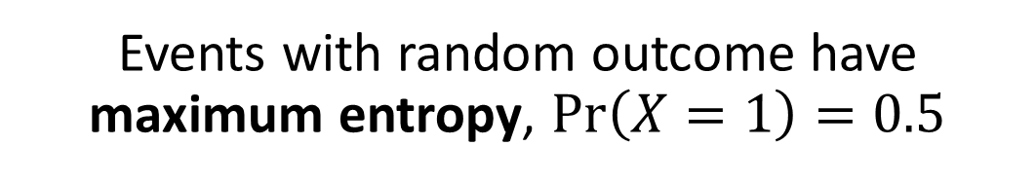
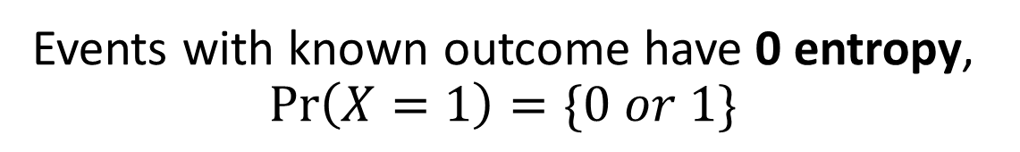
KL Divergence
Events with random outcome have maximum entropy, $\operatorname{Pr}\left(X=1\right)=0.5$
Understanding Shannon Entropy
Example: binomially distributed events
Events with known outcome have 0 entropy, $\operatorname{Pr}\left(X=1\right)=\{0 or 1\}$
Credit: Wikipedia commons

Slide 42
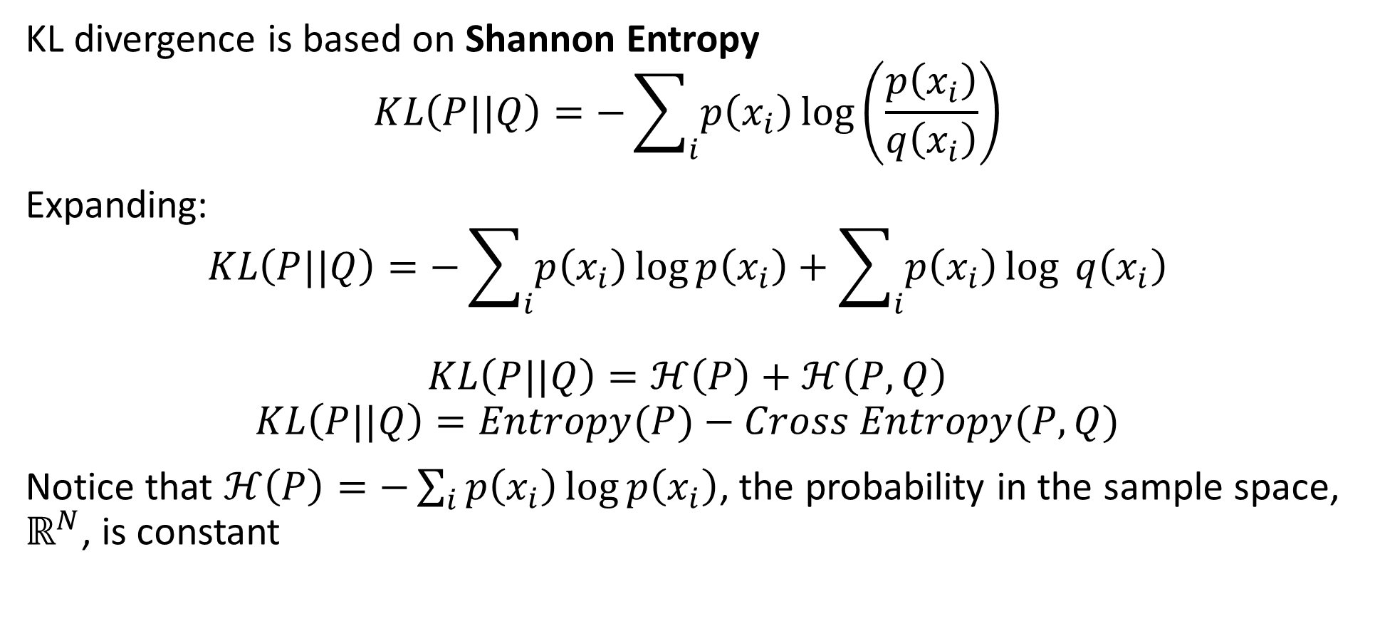
KL Divergence
KL divergence is based on Shannon Entropy
$$KL\left(P||Q\right)=−\sum_{i}{p\left(x_{i}\right)}\log\left(\frac{p\left(x_{i}\right)}{q\left(x_{i}\right)}\right)$$
Expanding:
$$KL\left(P||Q\right)=−\sum_{i}{p\left(x_{i}\right)}\log{p\left(x_{i}\right)}+\sum_{i}{p\left(x_{i}\right)}\log{q\left(x_{i}\right)}$$
$$KL\left(P||Q\right)=ℋ\left(P\right)+ℋ\left(P,Q\right)$$
$$KL\left(P||Q\right)=Entropy(P)−Cross Entropy(P,Q)$$
Notice that $ℋ\left(P\right)=−\sum_{i}{p\left(x_{i}\right)}\log{p\left(x_{i}\right)}$, the probability in the sample space, $ℝ^{N}$, is constant

Slide 43
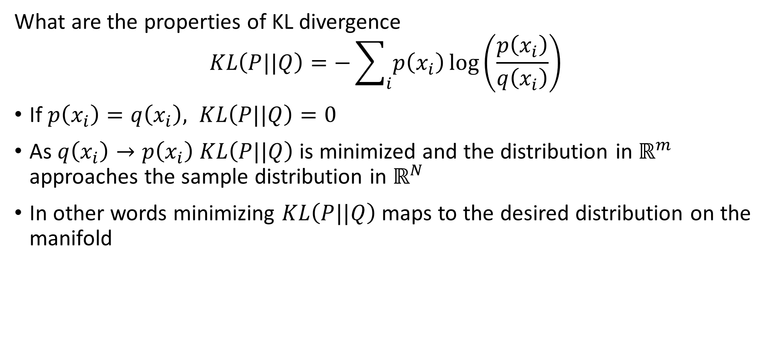
KL Divergence
What are the properties of KL divergence
$$KL\left(P||Q\right)=−\sum_{i}{p\left(x_{i}\right)}\log\left(\frac{p\left(x_{i}\right)}{q\left(x_{i}\right)}\right)$$
If $p\left(x_{i}\right)=q\left(x_{i}\right), KL\left(P||Q\right)=0$
As $q\left(x_{i}\right)→p\left(x_{i}\right)$ $KL\left(P||Q\right)$is minimized and the distribution in $ℝ^{m}$ approaches the sample distribution in $ℝ^{N}$
In other words minimizing $KL\left(P||Q\right)$ maps to the desired distribution on the manifold

Slide 44
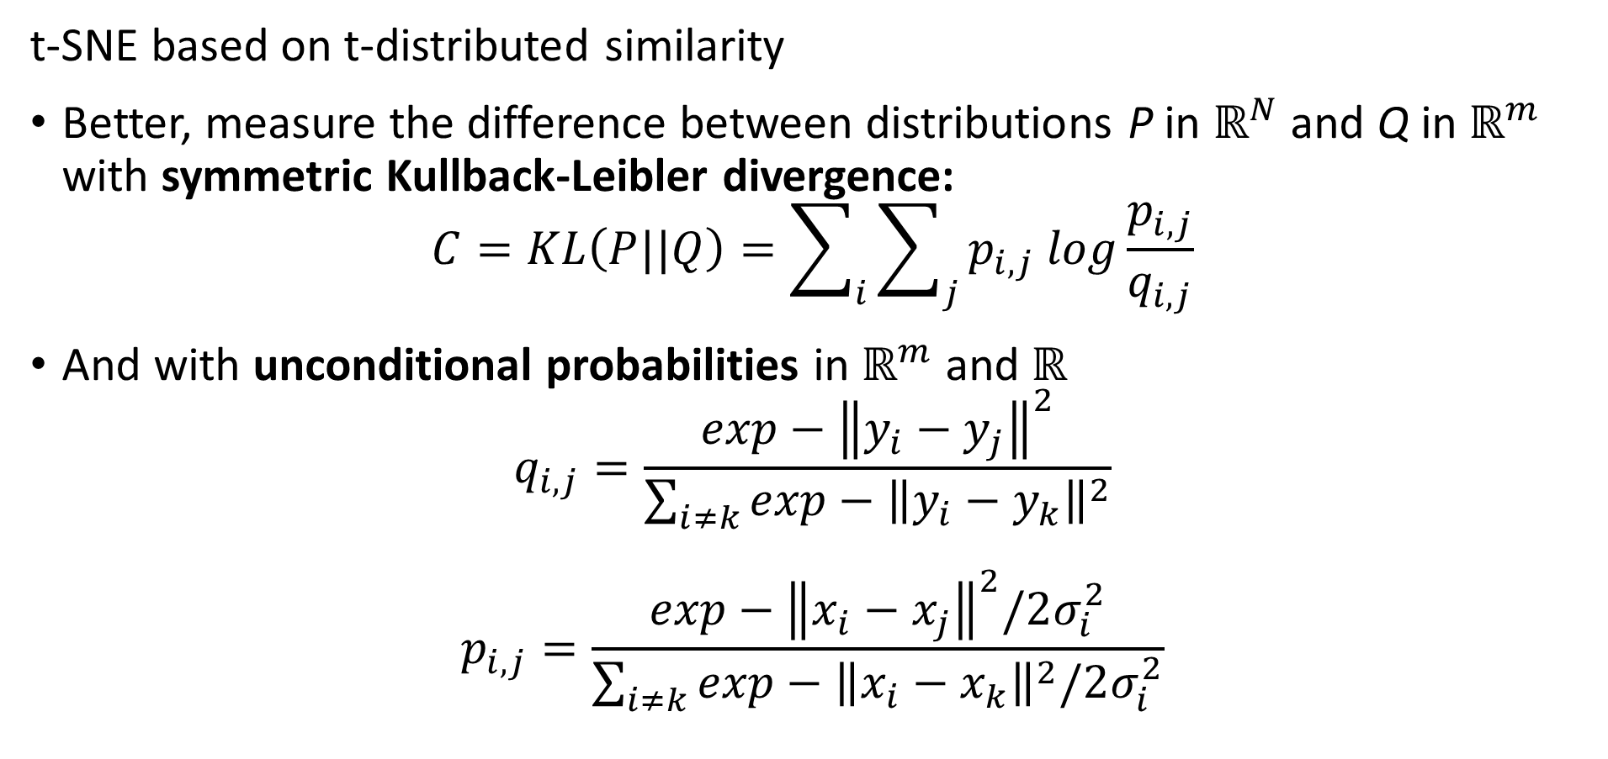
t-SNE
t-SNE based on t-distributed similarity
Better, measure the difference between distributions P in $ℝ^{N}$ and Q in $ℝ^{m}$ with symmetric Kullback-Leibler divergence:
$$C=KL\left(P||Q\right)=\sum_{i}{\sum_{j}{p_{i,j} log\frac{p_{i,j}}{q_{i,j}}}}$$
And with unconditional probabilities in $ℝ^{m}$ and $ℝ^{}$
$$q_{i,j}=\frac{exp−{\left\|y_{i}−y_{j}\right\|}^{2}}{\sum_{i≠k}^{ }{exp−{\left\|y_{i}−y_{k}\right\|}^{2}}}$$
$$p_{i,j}=\frac{exp−{\left\|x_{i}−x_{j}\right\|}^{2}/2σ_{i}^{2}}{\sum_{i≠k}^{ }{exp−{\left\|x_{i}−x_{k}\right\|}^{2}/2σ_{i}^{2}}}$$

Slide 45
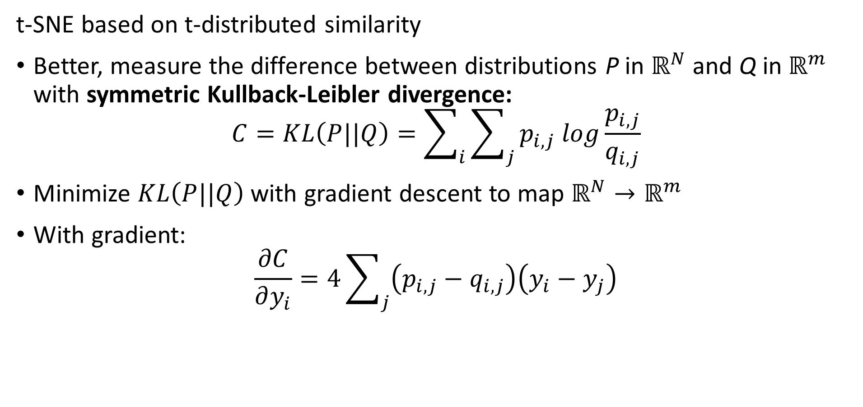
t-SNE
t-SNE based on t-distributed similarity
Better, measure the difference between distributions P in $ℝ^{N}$ and Q in $ℝ^{m}$ with symmetric Kullback-Leibler divergence:
$$C=KL\left(P||Q\right)=\sum_{i}{\sum_{j}{p_{i,j} log\frac{p_{i,j}}{q_{i,j}}}}$$
Minimize $KL\left(P||Q\right)$ with gradient descent to map $ℝ^{N}→ℝ^{m}$
With gradient:
$$\frac{∂C}{∂y_{i}}=4\sum_{j}{\left(p_{i,j}−q_{i,j}\right)\left(y_{i}−y_{j}\right)}$$

Slide 46
t-SNE
t-SNE based on t-distributed similarity
Better, measure the difference between distributions P in $ℝ^{N}$ and Q in $ℝ^{m}$ with symmetric Kullback-Leibler divergence:
$$C=KL\left(P||Q\right)=\sum_{i}{\sum_{j}{p_{i,j} log\frac{p_{i,j}}{q_{i,j}}}}$$
Minimize $KL\left(P||Q\right)$ with gradient descent to map $ℝ^{N}→ℝ^{m}$
With gradient:
$$\frac{∂C}{∂y_{i}}=4\sum_{j}{\left(p_{i,j}−q_{i,j}\right)\left(y_{i}−y_{j}\right)}$$

Slide 47
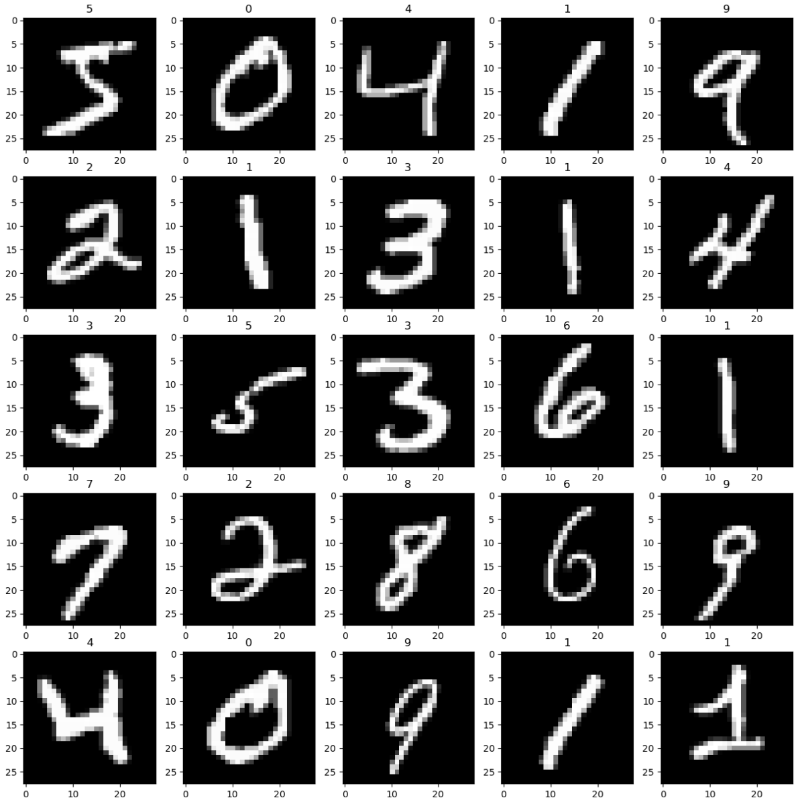
Example t-SNE vs. PCA
Use the pixel values of handwritten MNIST digits dataset

Slide 48
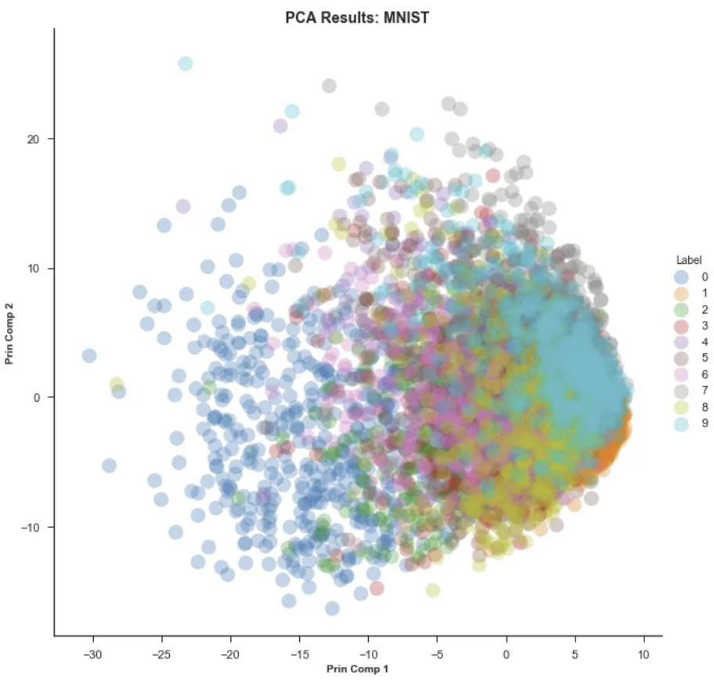
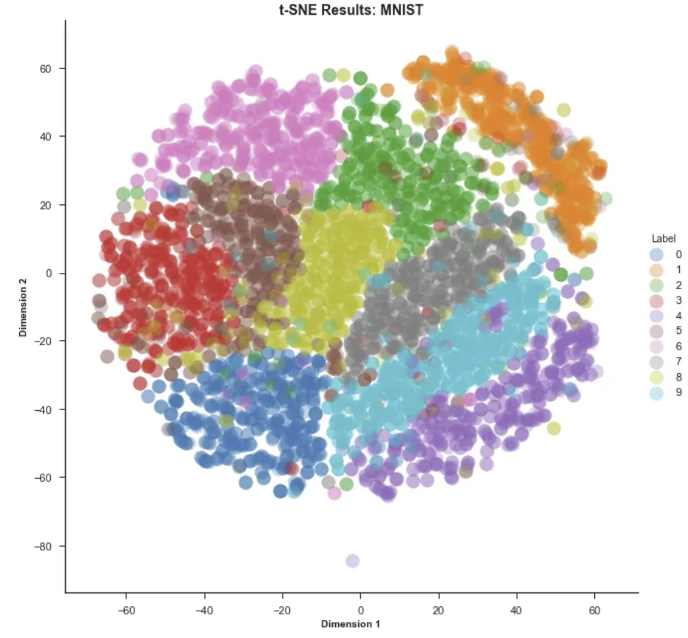
Example t-SNE vs. PCA
First 2 PCs, linear manifold
t-SNE
From blog post by Andrey Violante

Slide 49
Summary
Dimensionality reduction is widely used in data mining
Review of high-dimensional spaces and the Curse of Dimensionality
Projection methods for high dimensions
Highly efficient alternative to PCA
Bounds on distance error
Manifold learning and visualization in high dimensions
Project to low dimensional manifold
Not distance preserving

