Slide 1



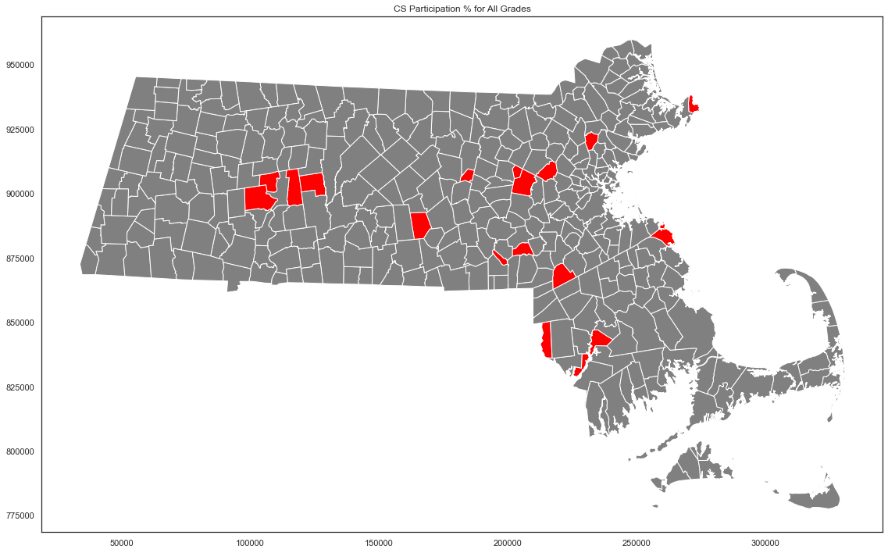
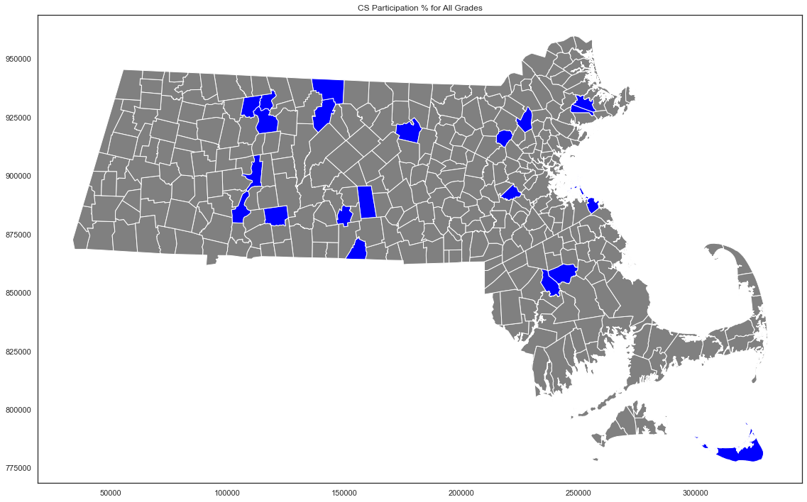
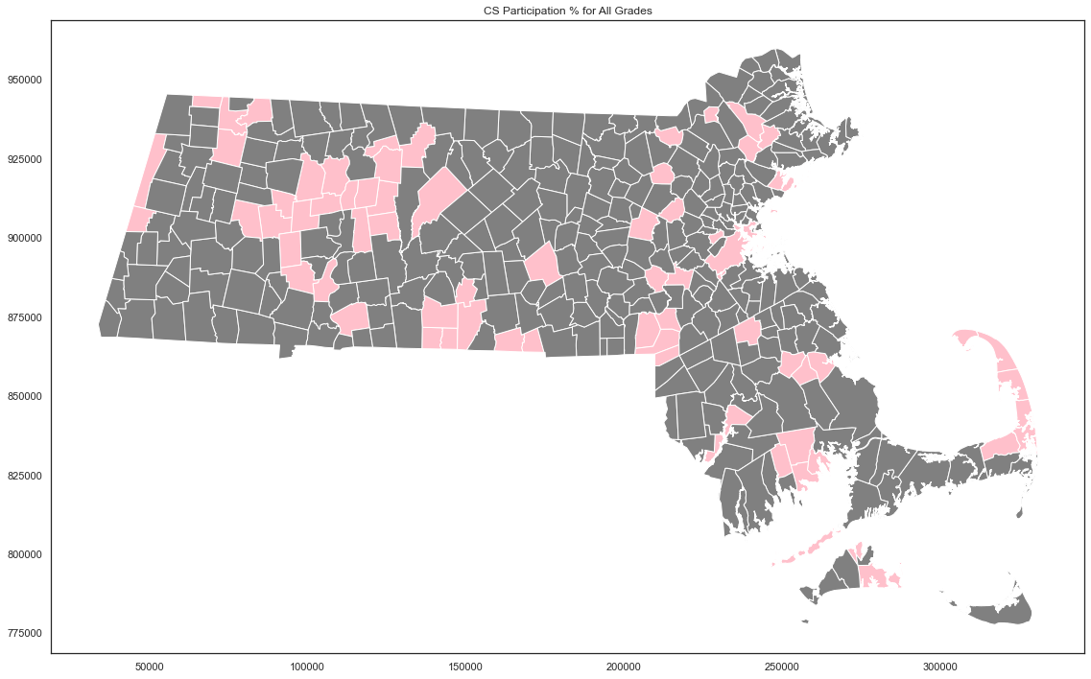
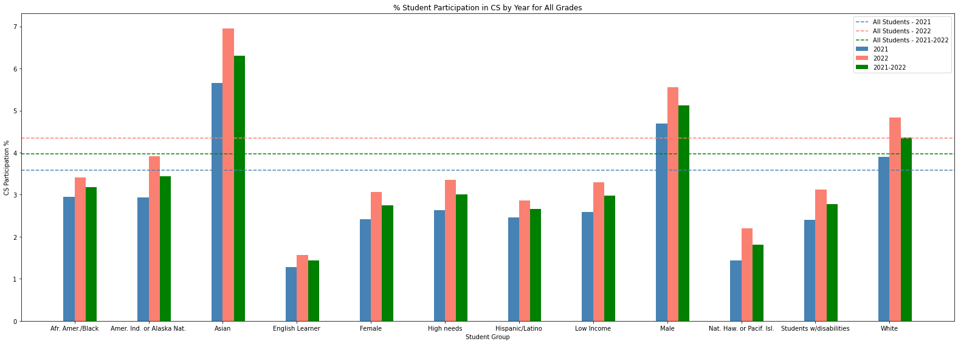
Funding a Better Computer Science Education in Massachusetts
Team A: Kelvin Lin, Changxuan Fan, Sai Tejaswini Junnuri, Kenise Neal, Pratham Schroff
CS506: Data Science Tools and Applications
Abstract:
In an era marked by rapid technological advancements and digital integration, computer science education stands as a pillar for economic opportunity and social equity. Our goal as a team is to identify the gaps and barriers faced by these communities in the realm of computer science education and AP test-taking and remediate these issues.
Goals and Deliverables
Extension Project
Geographic Analysis
What are the student groups that need the most assistance?
Is there a geographic correlation with CS participation/performance?
How can we use limited resources to achieve the best educational results?
How do we understand demographic disparities across the Commonwealth?
Identify towns that have been emphasizing CS education in recent years
Determine towns lacking funding that require increased financial support for education
Develop strategies to address disparities in race and gender within education
Most Participation
Least Participation
Most Participation
15k school size
Least Participation
26k school size
No Participation
4k school size
Clients and Mentors
Clients: New Commonwealth Fund
TPM:
Partners: BU SPARK!
Analysis of Various Student Groups and Conclusions
No Participation
Strategies For Remediation
Tech Stack and Processes
Studies have also shown that there exists less financial gap in education and schools than decades ago
The focus should be on programs that fund on CS initiatives
Creation of teaching positions
CS AP/IB test waivers
Providing computers and necessary tools to eliminate financial barrier
Data Analysis Tools Used
Python, SciKit, Pandas, Matplotlib, Geopandas, Selenium
Sectors Targeted
Technology, Data Analysis, Education

